Slide 1
Smart Shoe for Visually Impaired People
Innovative Assistive Technology | IoT + AI + Mobile Integration

Slide 2
Problem Statement
Visually impaired individuals face significant mobility challenges.
Traditional aids like canes have limitations in obstacle detection, safety, and independence.
There is a need for a smart, real-time assistive device.

Slide 3
Proposed Solution
A Smart Shoe integrated with:
- Obstacle Detection using Ultrasonic Sensors
- Bluetooth Connectivity for Real-Time Alerts
- Mobile App (Android & Flutter Web Dashboard)
- Firebase Cloud Storage for Logs
- Optional GPS, Voice Assistance, and Fall Detection

Slide 4
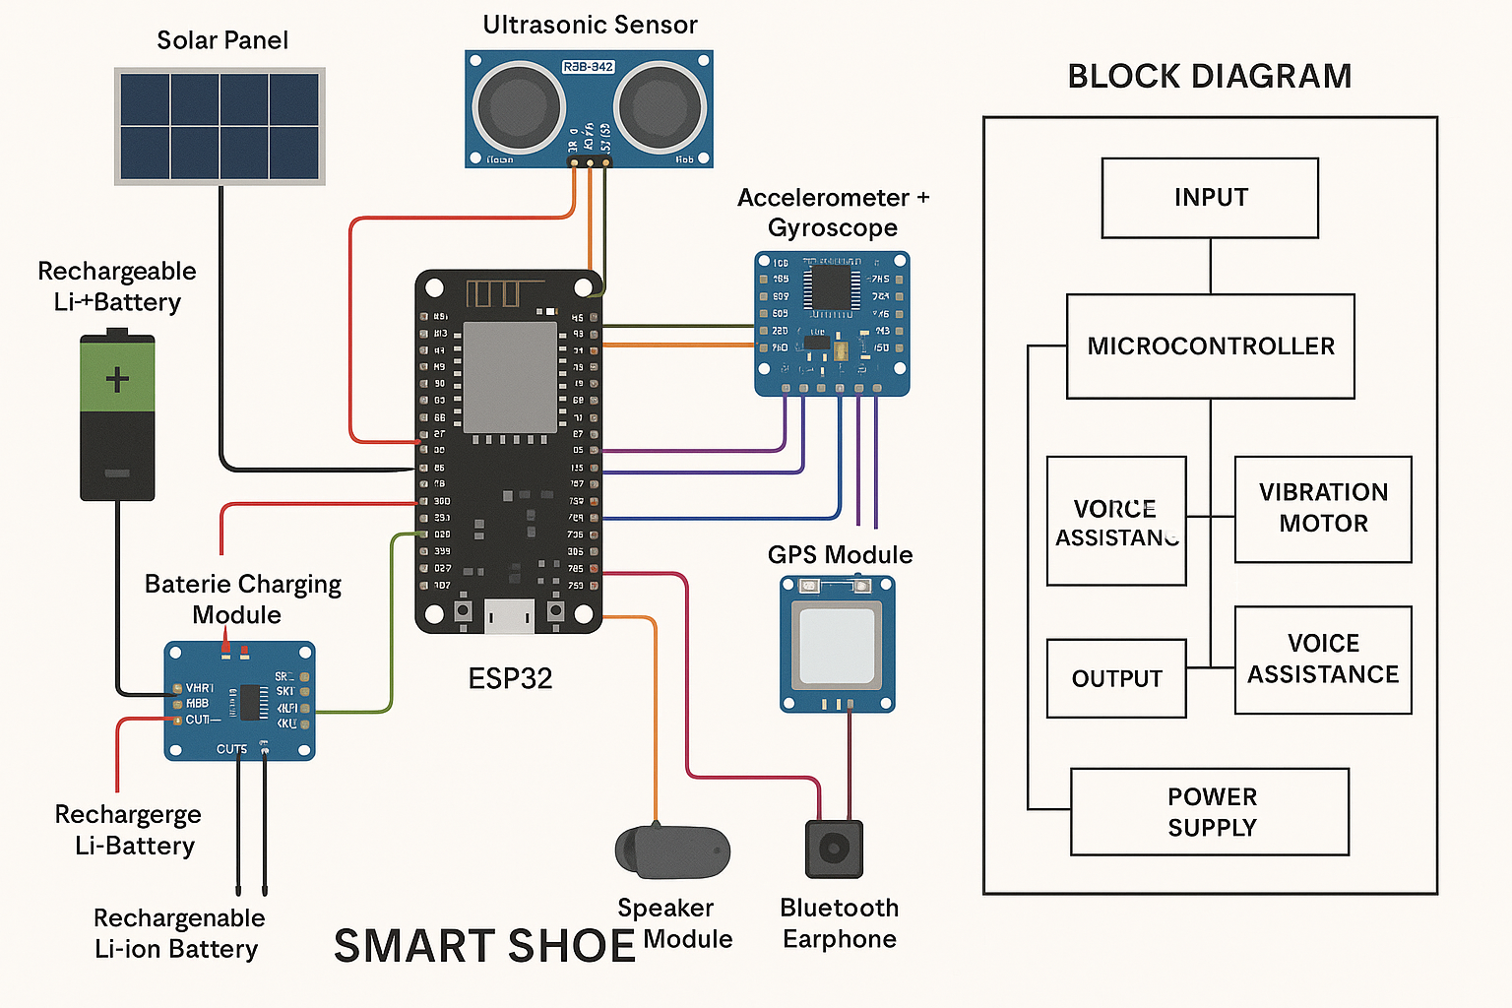
System Architecture

Slide 5
Technologies Used
- ESP32 / Arduino UNO
- Ultrasonic Sensor, Buzzer, Vibration Motor
- Bluetooth (HC-05)
- Android Studio (Java/Kotlin), Flutter (Dart)
- Firebase Realtime Database
- Streamlit / Flutter Web for Dashboard
- Python (optional AI/ML features)

Slide 6
Screenshots and Features

Slide 7
Impact and Benefits
- Empowers visually impaired users with smart mobility
- Real-time obstacle alerts enhance safety
- Easy to use, affordable, and scalable
- Cloud connectivity enables remote monitoring by caretakers
- Potential for deployment in smart cities and rehabilitation centers

Slide 8
Demo & Source Code
- Full working prototype available
- All code hosted in ZIP bundle:
Arduino, Android, Flutter App, Firebase setup
- IEEE-style report and project documentation included

Slide 9
Thank You!
Questions? Feedback?
We welcome your support and ideas to take this innovation forward.

