Slide 1
Datalist machine learning project
By omer faruk, kadir, Serkan,Muhammed
Mentor : Ibrahim

Slide 2
Cleaning the data feature engineering filling NaN values OUTLIERS PROCESS ENCODING MODELLING Default dataset

Slide 3
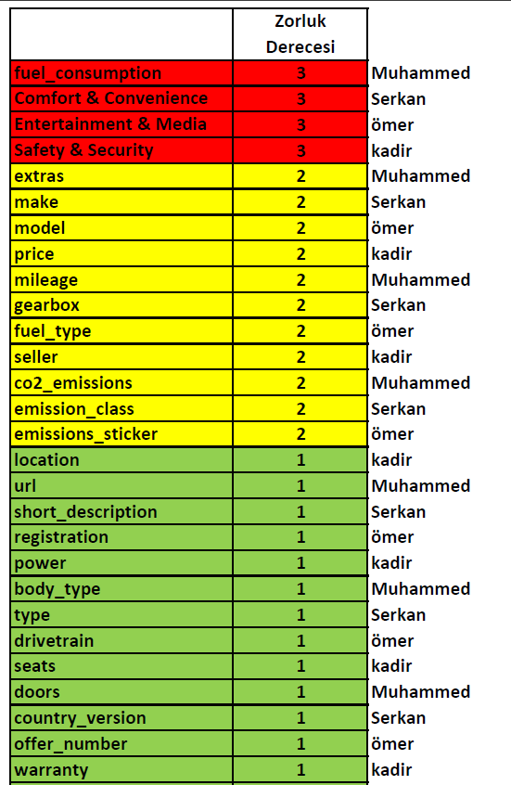
Divide features for collobration
Scrum methodology

Slide 4
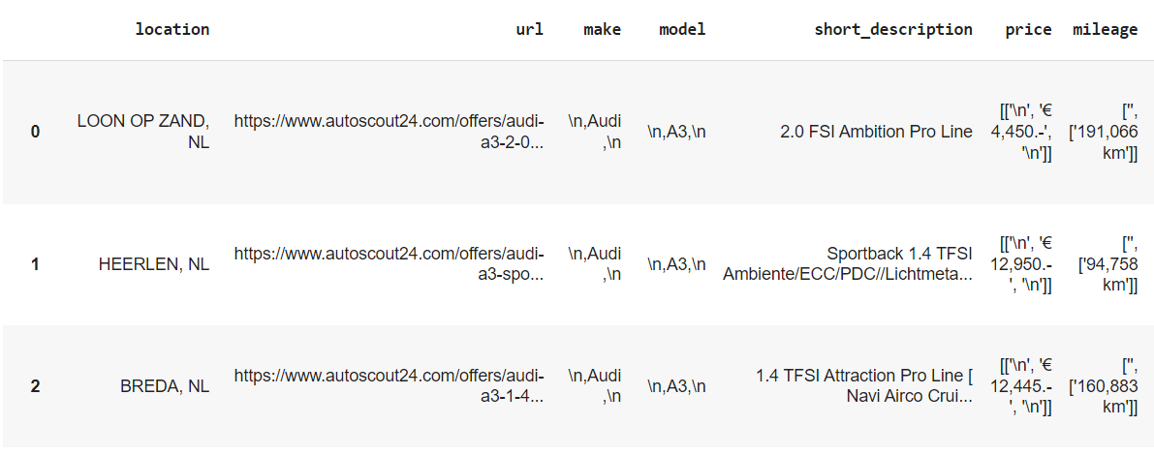
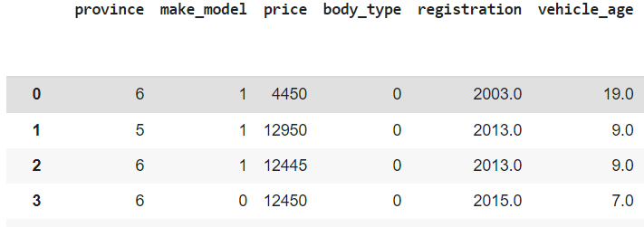
AUTOSCOUT24
Raw Data
71104 Rows, 49 Columns
110 MB DATA
2020 AutoScout24
69510 Rows, 160 Columns
85 MB
Ready to model

Slide 5
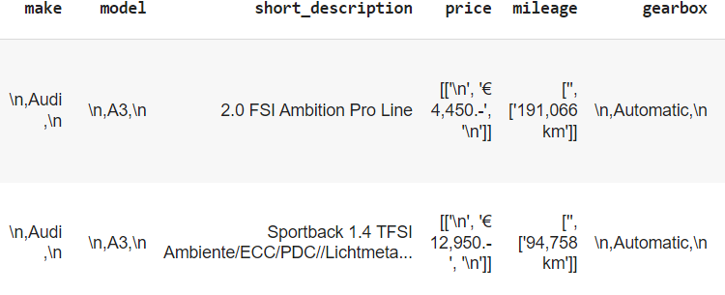
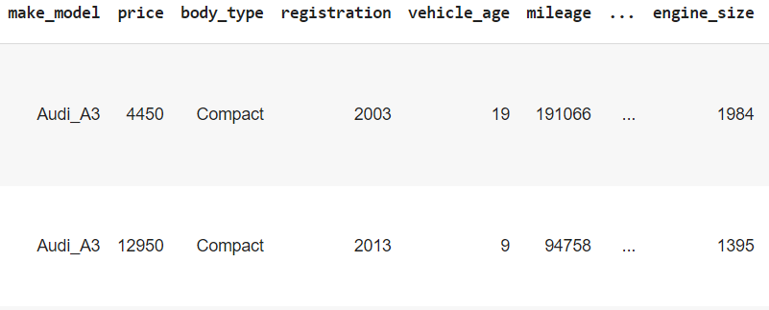
Cleaning the data
BEFORE CLEANING
REGEX
example
df['engine_size']=df['engine_size'].str.replace(r'[^0-9]+', ‘’)
USE .PICKLE FORMAT
DETECT ANOMALY
-empty_weight<500
-price>10000000
-engine_power<50
Convert anomalies to nan
AFTER CLEANING

Slide 6
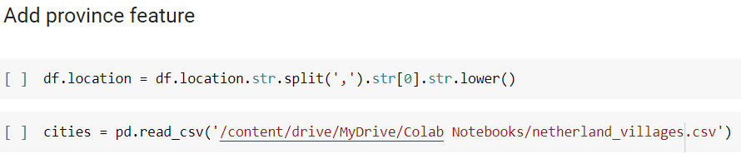

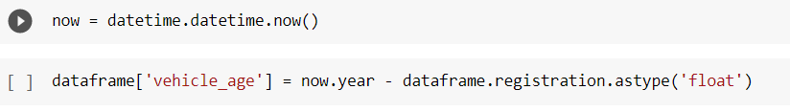
Feature engineering
Province
Location to Province
make and model to make_model
Registration to age
make_model
age

Slide 7
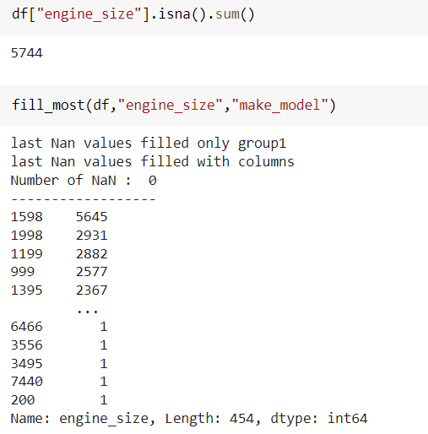
FILLING NAN VALUE
FILLING PROCESS
Fill NaN with the most proper function
fill() , fill_prop() , fill_most()
Mostly use ‘make_model’ (merge ‘make’ and ‘model’ features)

Slide 8
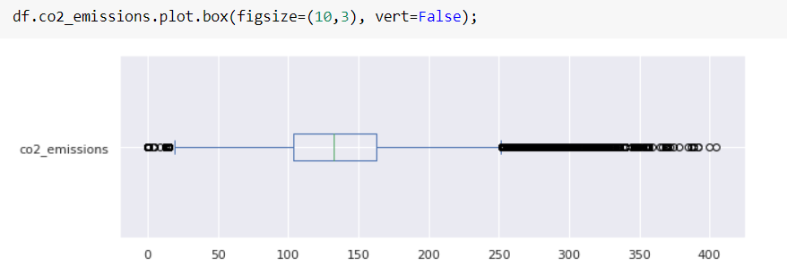
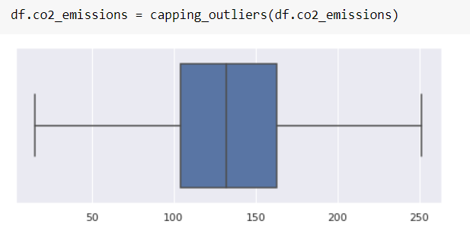
OUTLIERS PROCESS
Before
VISUALIZE OUTLIERS
mathplotlib, seaborn, Func: col_plot()
REPLACE OUTLIERS
Functions: replace_outliers(), outliers(), capping_outliers()
After

Slide 9
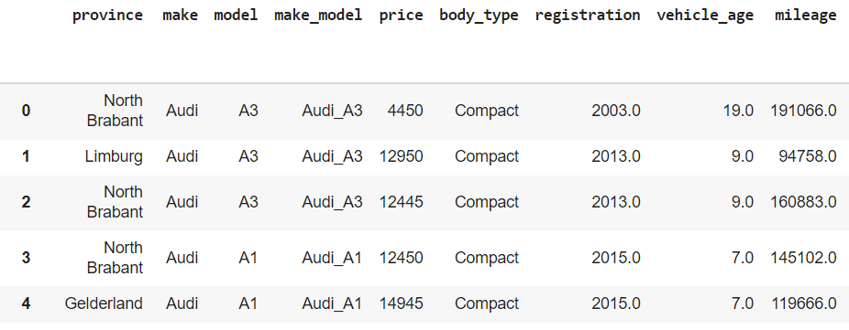
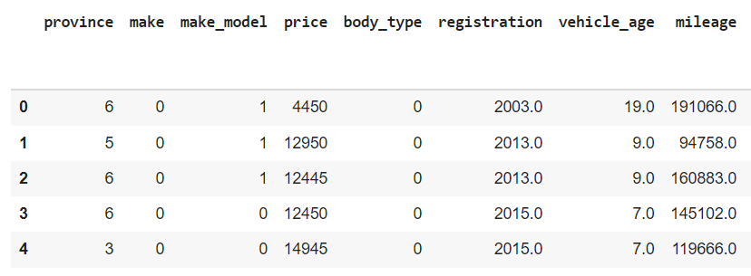
ENCODING
Before
Transform all data into numerics
Now dataframe is ready to modelling
After

Slide 10
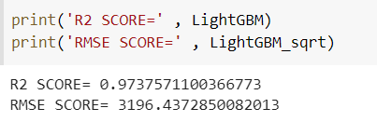
MODELLING
Test
Use Scikit-learn library
Lasso(), KNeighborsRegressor() LightGBM()*
find which is the best ml model for our dataset,compare R2 and RMSE values

Slide 11
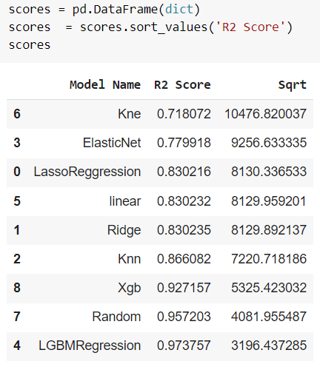
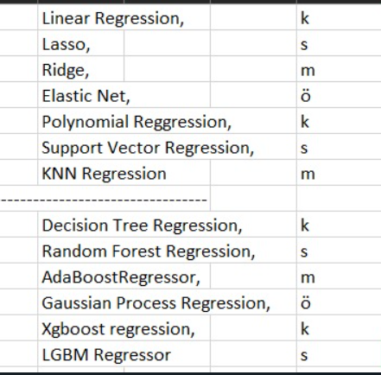
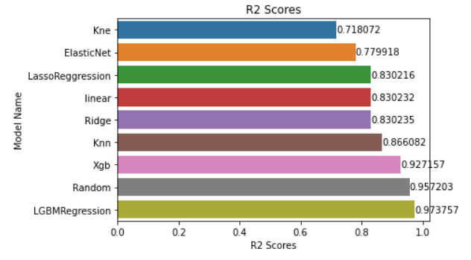
BEST MODEL
Compare the models
Best result : LGBMResgression

Slide 12
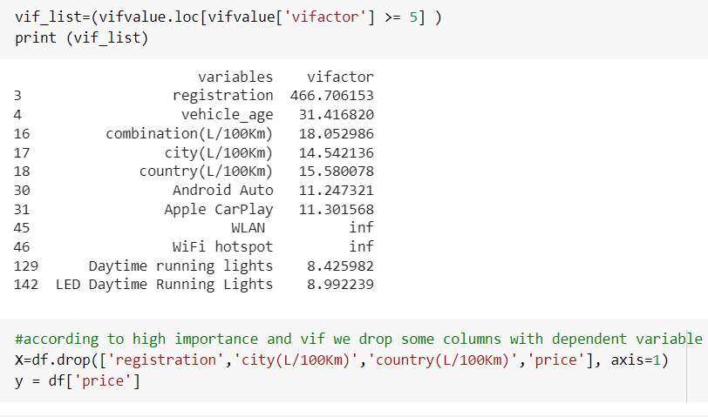
Variance Inflation Factor
To avoid multicollinearity
Does not affect predictions and goodness-of-fit test
Drop according to inflation factor
Must keep at least one of them

Slide 13
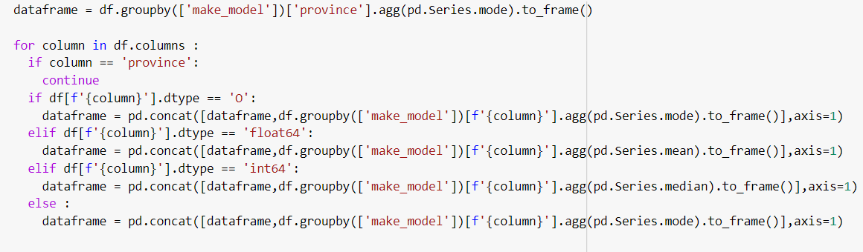
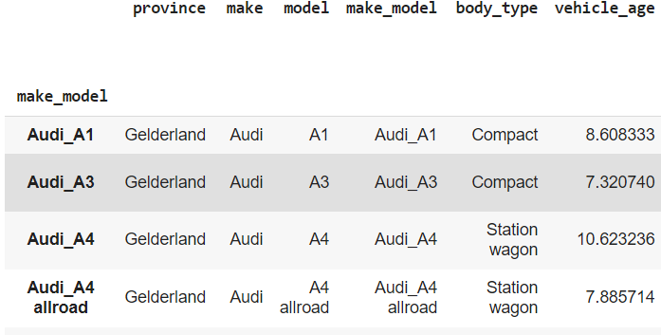
Default dataset
Make defaut data according to ‘make_model’
Totally 378 default data
Default data

Slide 14
conclusion
url=Demo

