Slide 1


PowerSoft
K
Integrantes:
Cristian Camilo Julio Mejía
Johan Daniel Zuluaga Gómez
Kadyha Paz Gutierrez
Sebastian Londoño Tobón

Slide 2
Diagrama de componentes

Slide 3
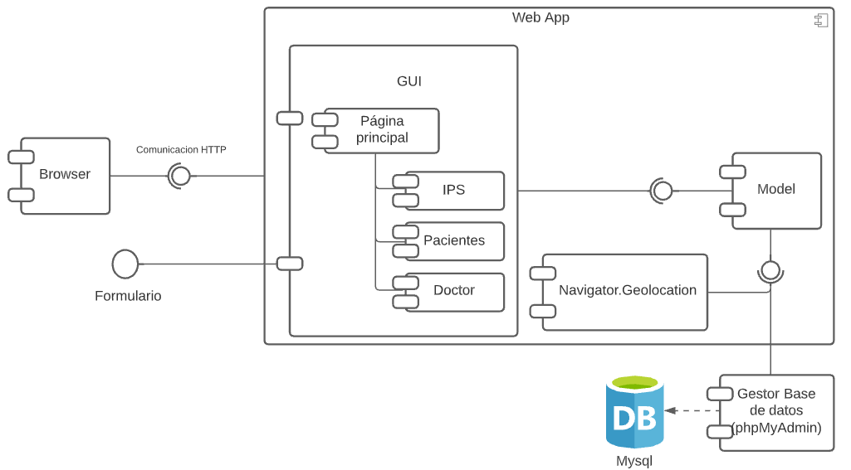
Diagrama de componentes: https://lucid.app/lucidchart/invitations/accept/inv_6080d876-d6a2-4450-9939-2a51f86fc9d8?viewport_loc=-11%2C-11%2C1612%2C1093%2C0_0

Slide 4
Diagrama de despliegue

Slide 5
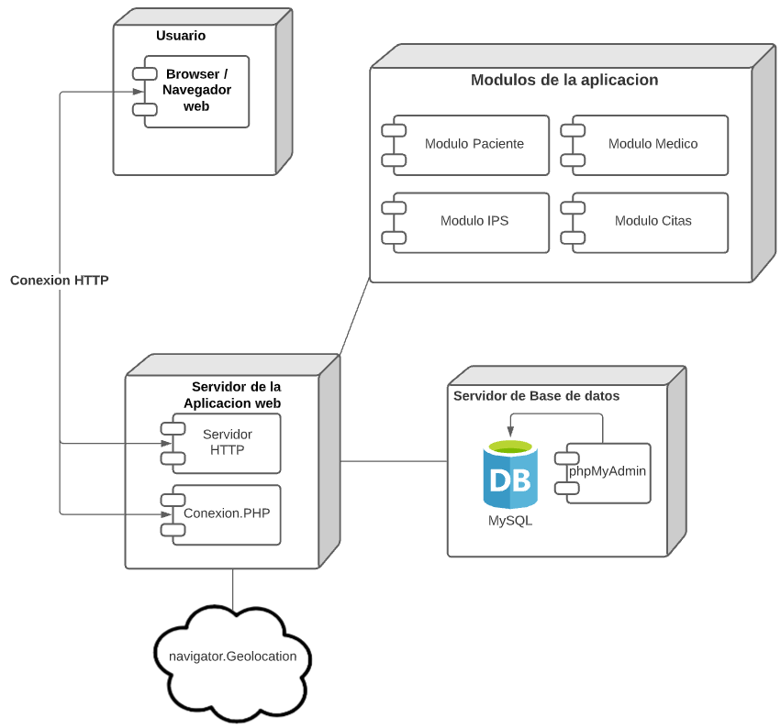
Diagrama de despliegue: https://lucid.app/lucidchart/invitations/accept/inv_0fc426e2-02c9-4dec-b392-348f73adeb06?viewport_loc=-11%2C-11%2C1612%2C1093%2C0_0

