Slide 1


PowerSoft
K
Integrantes:
Cristian Camilo Julio Mejía
Johan Daniel Zuluaga Gómez
Kadyha Paz Gutierrez
Sebastian Londoño Tobón

Slide 2
Página web
K

Slide 3
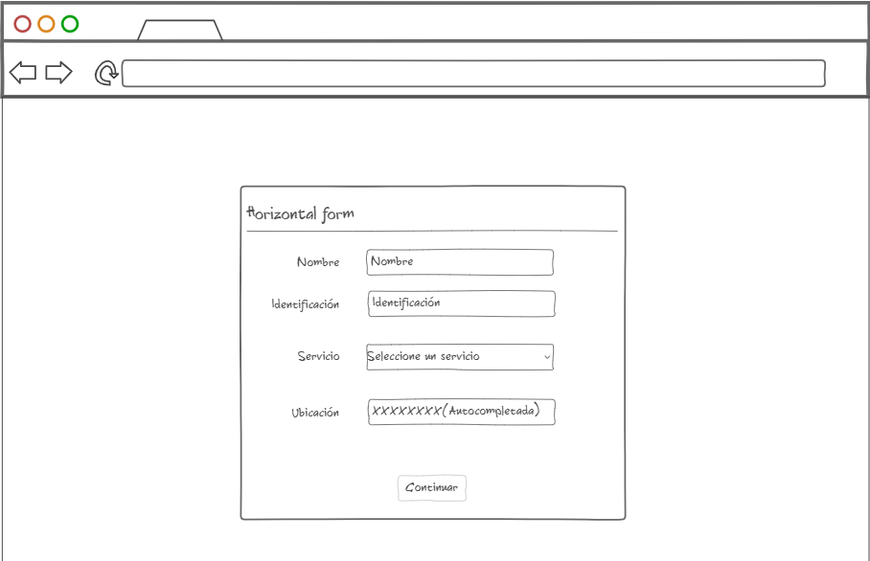

Slide 4
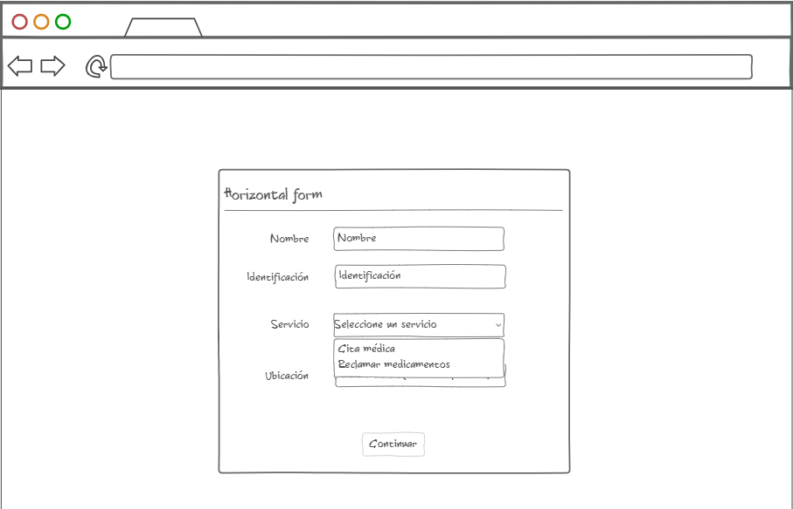

Slide 5
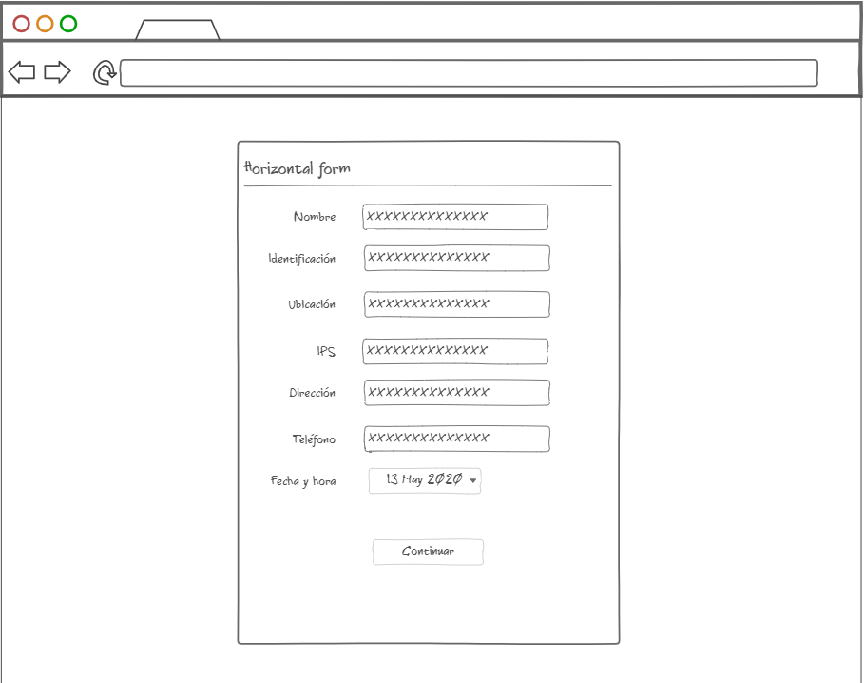

Slide 6
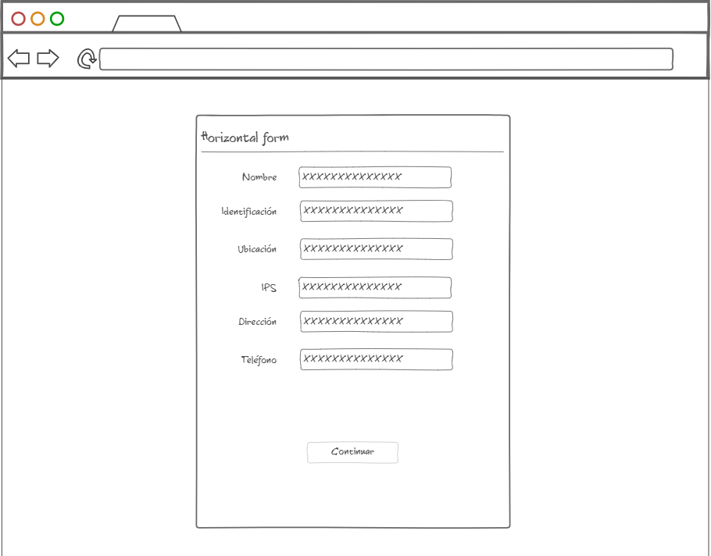

Slide 7
Diagrama de clases

Slide 8
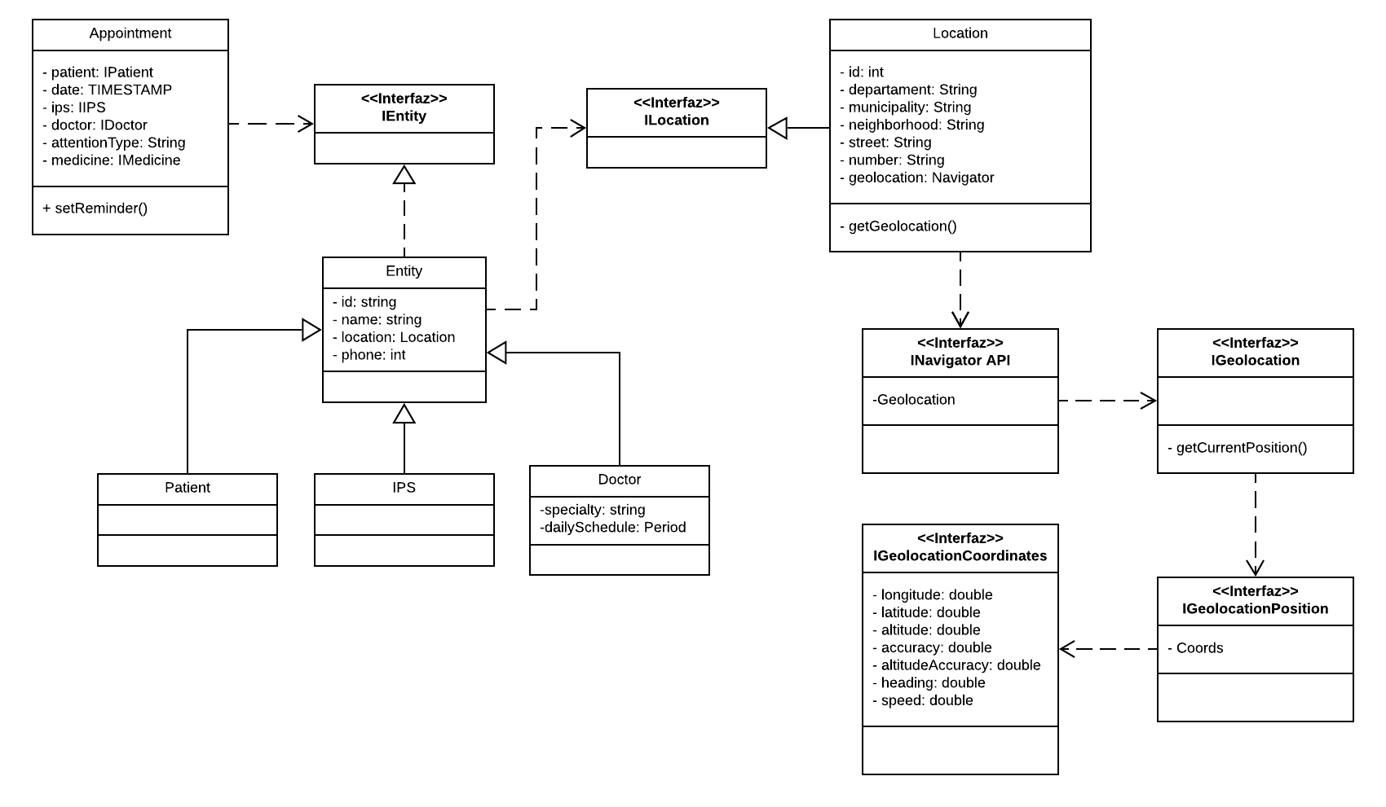
diagrama de clases: https://lucid.app/lucidchart/invitations/accept/inv_4811ab19-a946-48f3-a242-85598225ddf2?viewport_loc=-168%2C2724%2C2761%2C1067%2C6WhqSi9izUu3

Slide 9
Diagrama de paquetes

Slide 10
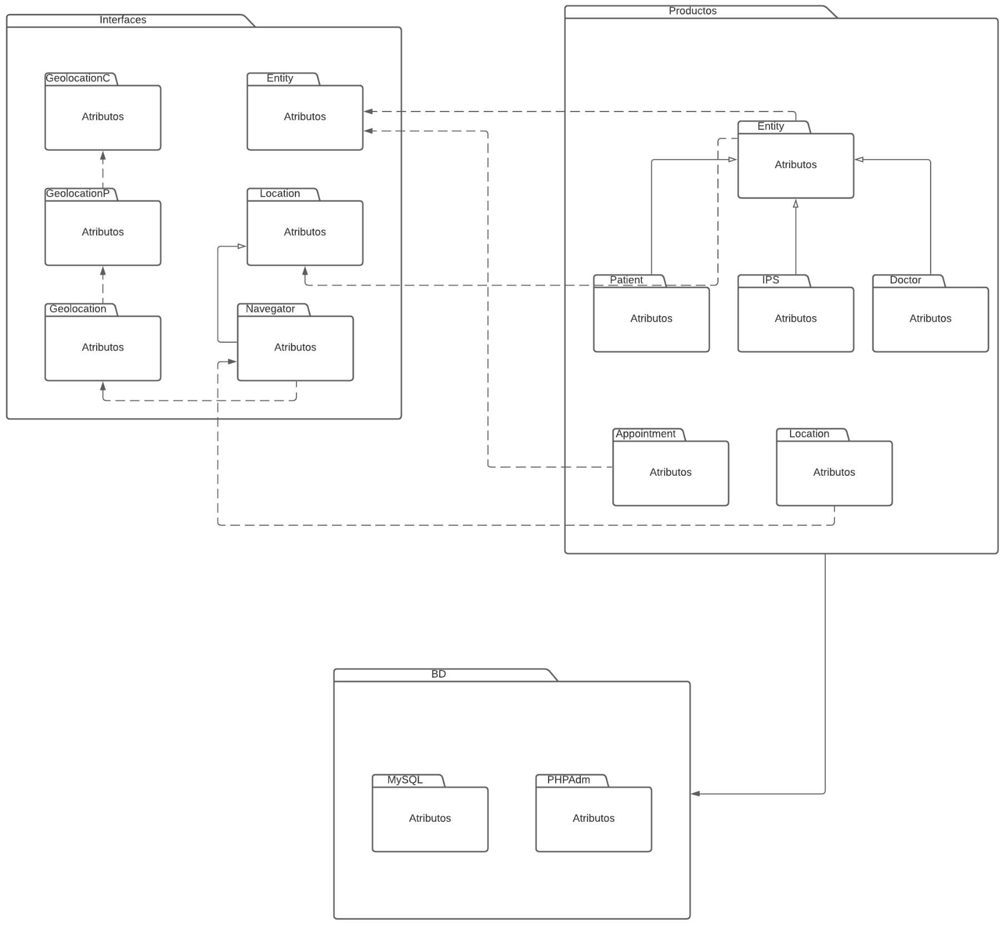
Diagrama de paquetes: https://lucid.app/lucidchart/invitations/accept/inv_1cc56c02-52c9-4c22-b474-a2278bdaa119

Slide 11
Diagrama de componentes

Slide 12
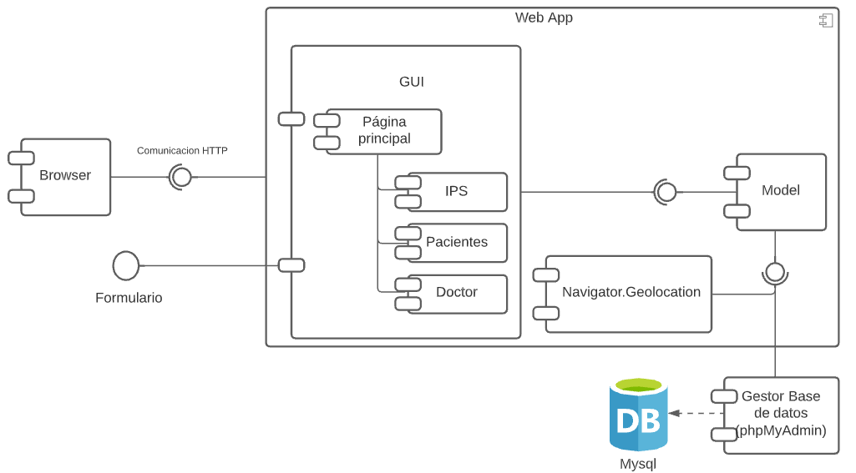
Diagrama de componentes: https://lucid.app/lucidchart/invitations/accept/inv_6080d876-d6a2-4450-9939-2a51f86fc9d8?viewport_loc=-11%2C-11%2C1612%2C1093%2C0_0

Slide 13
Diagrama de despliegue

Slide 14
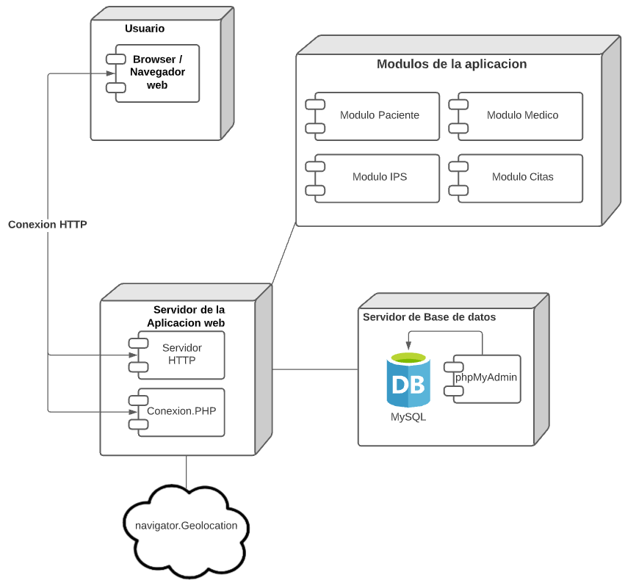
Diagrama de despliegue: https://lucid.app/lucidchart/invitations/accept/inv_0fc426e2-02c9-4dec-b392-348f73adeb06?viewport_loc=-11%2C-11%2C1612%2C1093%2C0_0

