Slide 1
Reproduction of Research
Reproducible Survival Prediction with SEER Cancer Data
By: Elizabeth Amundsen (ecreigh2)
Notes:
Welcome to the presentation on Reproduction of Reproducible Survival Prediction with SEER Cancer data

Slide 2
General Problem
Reproducibility is crucial in scientific research
3rd party verification, otherwise results are suspect
Validation of new approaches
Research Focus: breast and lung cancer survivability prediction
Literature Review to discover current repeatable research
Replicable Experiment designed
Data cohort documentation
Source code repository
Goal: Set New Methodology Standards for Future Research
Notes:
Reproducibility is a crucial aspect of all scientific research.
- Without objective verification from an alternative, non-related source, results of the research can be suspect.
- Also, future research cannot by validated as an improvement without comparison to past results
The study investigated reproducibility by focusing on cancer survival prediction at the 1-year and 5-year marks using cancer data from the Surveillance, Epidemiology, and End Results (SEER) database provided by the National Cancer Institute.
They did this in two ways:
- First with a literature review to discover any current research that may be repeatable.
- Second, they created their own experiment that was designed to be highly replicable through data cohort selection documentation and publication of source code in a code repository.
They strived to set new methodology standards for future research
And, therefore showing research reproducibility is not an impossible goal.

Slide 3
Specific Approach
Literature Review
Experiment
Study Selection
PubMed, Google Scholar query
Exclusion Criteria
Reviewed Relevancy
Study Review
Extracted Information
Analyzed Reproducibility
Result: 0 Repeatable Studies
Experimental Steps
Cohort selection & Data preprocessing
Feature choice & Target label generation
Modeling with hyperparameter tuning
Analysis Steps
Testing results metrics: AUC, F1, ACC
Input attribute importance
Result: Repeatable experiment design with cohort file & source code publication
Notes:
LITERATURE REVIEW:
------------------
First, they performed a literature review utilizing PubMed and Google Scholar to discover published research studies that may be replicable.
- Queries included "SEER", "machine learning", "Surveillance, Epidemiology, and End Results"
- Exclusions:
patents, citations, theses, duplicates
headlines & abstracts without
SEER, machine learning, or survival prediction
- Reviewed text for relevancy
- Extracted 7 types of information: cancer type, data time range, survival duration, applied machine learning models, number of cases and attributes used as input, and the best reported result.
- Analyzed text for aspects of reproducibility:
keyword searching of ‘code’, ‘program’, ‘repro-’ and ‘repeat-’
tried to identify if the study published its source code
They found no repeatable research studies in their query.
EXPERIMENT:
-----------
Second, the researchers designed a replicable experiment.
- Data access through SEER*Stat program from the National Cancer Institute
- Exported 133 features including survival duration for cancer types (‘Breast’, ‘Lung and Bronchus’) and year of diagnosis (‘2004’, ‘2005’, ‘2006’, ‘2007’, ‘2008’, ‘2009’)
- Irrelevant, combined, post-diagnostic, and treatment attributes were removed to prevent leaking of future information
- Features were utilized as continuous, normalized values or 1-N encoded values depending on the model tested
- Boolean target labels were created from the attribute survival months for 1 and 5 years.
- Training, validation, and testing datasets were created randomly with the ratios 80%, 10%, and 10%.
- 6 models were trained & tested for the 2 cancer types: a dummy classifier, logistical regression w/ & w/o 1-n encoding, multilayer perceptron (MLP) models w/ & w/o 1-n encoding, and an embedded multilayer perceptron w/ 1-n encoding.
- Analysis of model performance was done using 3 metrics: Area Under the Receiver Operating Characteristic Curve (AUC), F1 score (F1), and Accuracy (ACC).
- The top ten attributes were selected and discussed for each cancer type using a comparison of weights for logistic regression and ablation analysis for MLPs to determine the importance of these attributes in cancer survival prediction

Slide 4
Reproduction Steps (1 of 2)
Data Selection & Pre-processing
Feature map: 2016 vs 2023 database data sources, variables
New data formatting script to extract data directly from SEER*Stat (extension)
Source code updates required
Model Training
Toolset upgrades
Hyperparameter tuning through new batch script
Best hyperparameters selection used AUC + F1
Notes:
A majority of the experimentation steps were approximately reproduced but could not be exactly replicated due to data availability.
The litature reveiw was removed from this replication.
The SEER cancer data is a live database and only keeps the last 3 years of datasets so the exact data used by the paper was unavailable.
Between the 2016 database that the paper used & the 2023 database used for this reproduction, several things changed
- 2 data sites Detriot & Louisiana were dropped & modified, respectively
- 28 variables were removed, modified, or added in the database.
- A feature map was created to track the changes.
- Data formatting has been revised so an new script for data extraction was written.
- Modifications to the original source code were required to implement these changes.
- All models were implemented using scikit-learn and Keras python libraries obtained from the original study's source code. Updates were required due to library upgrades.
- Since the originally selected hyperparameters were not published, a tuning batch script was written to perform model training on the validation dataset. The 20 batches required 5 days, running 3 - 5 batches at a time.
- The best hyperparameters were selected for each cancer type, survival duration, and model combination using the sum of AUC and F1 scores.

Slide 5
Reproduction Steps (2 of 2)
Model Testing
New run final models script including best hyperparameters
Output metrics: AUC, F1, ACC
Model Performance & Attribute Importance Analysis
Updated experiment output script
Metrics documented in tables
New attribute importance script
Notes:
The best hyperparameters were input into the new final models script, which tested all models for each cancer type and survival duration combination on the test dataset. 24 models were tested.
Each run output 3 metrics: Area Under the Receiver Operating Characteristic Curve (AUC), F1 score (F1), and Accuracy (ACC)
Model performance and attribute importance analysis was done to compare this replication's results to the original paper's results. Modifications were made to the author's experiment output script so that it will write to CSV file. And, a new graphing script was written to parse and plot the attribute importance results.

Slide 6
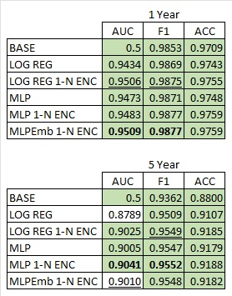
Model Performance Breast Cancer
Nearly all models performed better
Very similar values, so marginal improvements
None of the Best Models matched
Original Study Best Models
Replication Best Models
Differences due to changes in data cohorts, features selected, hyperparameters
Notes:
Nearly all models predicting survival from breast cancer at the 1-year and 5 year marks performed better than the original study.
All values are very similar to each other making these improvements marginal.
Interestingly, none of the best models matched.
The difference in scores and model selection are most likely due to the different data cohorts, features selected, and hyperparameter values used in model training and testing.

Slide 7
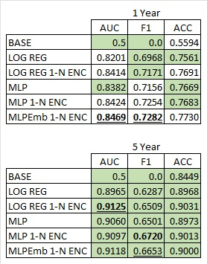
Model Performance Lung Cancer
< 50% of models performed better at 1 year
All models performed better at 5 years
5 year values show significant improvement
3 out of 4 of the Best Models matched
Original Study Best Models
Replication Best Models
Differences due to changes in data cohorts, features selected, hyperparameters
Notes:
8 of the 18 models predicting survival from lung and bronchus cancer at the 1-year mark performed better than the original study.
But, all models predicting survival from lung and bronchus cancer at the 5-year mark performed better than the original study.
While all values are similar, the 5-year survival prediction values are different enough to indicate significance in these improvements.
Three of the best models matched.
Again, the difference in scores and model selection are most likely due to the different data cohorts, features selected, and hyperparameter values used in model training and testing.

Slide 8
Attribute Importance Breast Cancer
Top 10 Attributes, 1 Year Survival
Median household income inflation adj to 2022
Rural-Urban Continuum Code
Breast - Adjusted AJCC 6th Stage (1988-2015)
Breast - Adjusted AJCC 6th M (1988-2015)
Breast - Adjusted AJCC 6th T (1988-2015)
Breast - Adjusted AJCC 6th N (1988-2015)
SEER Combined Summary Stage 2000 (2004-2017)
ER Status Recode Breast Cancer (1990+)
CS version input original (2004-2015) *
PR Status Recode Breast Cancer (1990+)
Top 10 Attributes, 5 Year Survival
Breast - Adjusted AJCC 6th Stage (1988-2015)
Breast - Adjusted AJCC 6th M (1988-2015)
Breast - Adjusted AJCC 6th T (1988-2015)
Breast - Adjusted AJCC 6th N (1988-2015)
Median household income inflation adj to 2022
SEER Combined Summary Stage 2000 (2004-2017)
Rural-Urban Continuum Code
Histologic Type ICD-O-3 *
ER Status Recode Breast Cancer (1990+)
Histology recode - broad groupings *
Same features as original study Similar features to original study *New feature to replication
Notes:
Attribute importance was calculated as the summed importance across all models.
For breast cancer survival prediction at the 1-year and 5-year marks, many of the top 10 attributes were the same as the original study, including AJCC codes and ER/PR statuses.
Median Household Income and Rural-Urban Code were replacements for the unavailable State-Country Recode feature that ranked very high in the original study.
And, SEER Combined Summary Stage is similar to the Historic SSG 2000 Stage feature from the original study.
In the 1-year prediction, Insurance Recode is not listed since that feature was dropped from the 2023 database. In the 5-year prediction, 2 Histologic features gained importance over the original study.
80% - 90% of the attributes matching the original study shows that AJCC codes, staging, and specific breast cancer attributes are very important to breast cancer survival predictions.

Slide 9
Attribute Importance Lung Cancer
Top 10 Attributes, 1 Year Survival
CS mets at dx (2004-2015)
Derived AJCC M, 6th ed (2004-2015)
CS version input original (2004-2015) *
Histologic Type ICD-O-3
ICCC site recode 3rd edition/IARC 2017
CS extension (2004-2015) *
SEER Combined Summary Stage 2000 (2004-2017) *
ICCC site recode extended 3rd edition/IARC 2017
Derived AJCC Stage Group, 6th ed (2004-2015) *
AYA site recode 2020 Revision
Top 10 Attributes, 5 Year Survival
CS mets at dx (2004-2015)
Histologic Type ICD-O-3 *
Derived AJCC M, 6th ed (2004-2015)
SEER Combined Summary Stage 2000 (2004-2017)
ICCC site recode extended 3rd edition/IARC 2017
CS version input current (2004-2015)
CS extension (2004-2015) *
ICCC site recode 3rd edition/IARC 2017
CS version input original (2004-2015) *
AYA site recode 2020 Revision
Same features as original study Similar features to original study *New feature to replication
Notes:
For lung and bronchus cancer survival prediction at the 1-year and 5-year marks, 3 of the 10 features (CS Mets at Diagnosis, Derived AJCC M, AYA site recode) were the same between this replication and the original study.
Histologic Type ICD-O-3 matched for 1-year predictions
CS Version Input Current matched 5-year prediction
2 of the 10 features were very similar, the ICCC site codes. Despite replacing WHO 2008 codes with IARC 2017 codes, it did not affect their importance.
One major difference is that Median Household Income and Rural-Urban Code (replacements for the unavailable State-Country Recode feature) were not ranked as important attributes despite State-Country being ranked very high in the original study.
The nearly 20\% of the attributes being different had a greater affect on lung and bronchus cancer survival predictions with only 60% - 70% match.
This shows that while metastases, staging, and histology attributes are very important to lung and bronchus cancer survival predictions, some staging and extension aspects had a higher impact in this replication study than in the original study.

Slide 10
Extension – SEER*Stat Data Format
Expands research’s data access to include SEER*Stat exports
Configure data selection directly in SEER*Stat, more user-friendly UI
SAS Matrix Formatter script creates a custom specifications file based on SEER*Stat export
Script outputs files usable by research study source code
SEER*Stat Direct Data Access
Database (data source) configuration
SAS Matrix Formatter Script
Calculates data position & length
File Format
Data case filtering in Selection Tab
Data feature selection in Table Tab
Generates custom specification file
Converts CSV data to ASCII format
CASES.txt for case list
INCIDENCES.txt for feature data
matrix.sas for specifications
Notes:
The SEER*Stat Data Format Extension expands the research’s data access to include SEER*Stat exports.
Data selection can be configured directly in SEER*Stat, which has a more user-friendly UI.
The SAS Matrix Formatter script creates a custom specifications file based on SEER*Stat export and outputs files usable by research study's source code

Slide 11
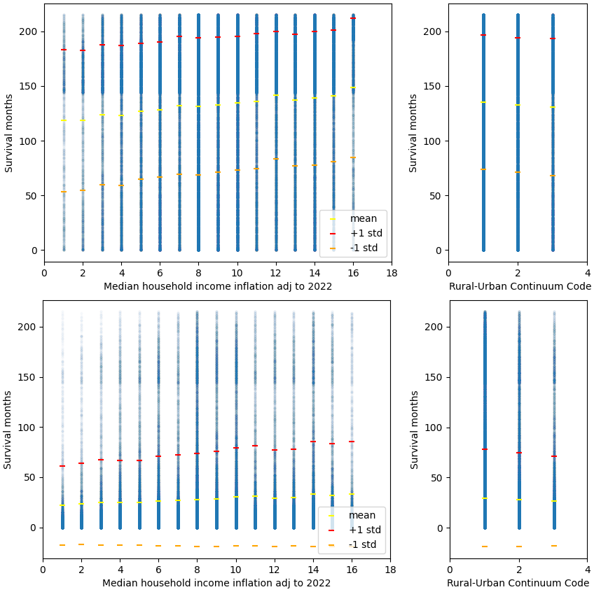
Extension – Socioeconomic Impact
Authors Hypothesis: 1-N encoding contributed to high impact of socioeconomic features
Analyzed socioeconomic impact through correlation
New feature analysis script to calculate R-value and plot results
Result: < 0.1 correlation
Notes:
The authors hypothesized that high number of values in the 1-N encoding of the State-Country feature from the original study was the reason for its top ranking in attribute importance.
Socioeconomic feature impact was analyzed through correlation calculations on Median Household Income and Rural-Urban Code. Both features have typical 1-N encodings.
A new feature analysis script was written to calculate the R-value of these features vs. Survival Months and plot the data, mean, and standard deviations.

