Slide 1

PROGRAMMING PARADIGMS IN C#
CHELARU LAURENTIU

Slide 2



CONTENT
Introduction to C#
Kruskal’s Algorithm
Different Paradigms Solutions
Comparison & Analysis
Conclusions

Slide 3
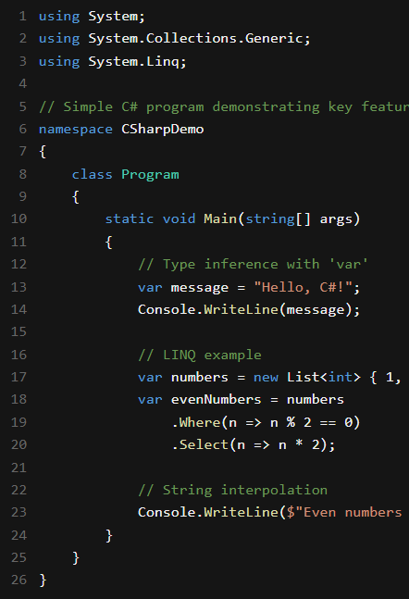
INTRODUCTION TO C# LANGUAGE
• History: Developed at Microsoft in 2000 by Anders Hejlsberg; first released with .NET in 2002
• Design Philosophy: Modern, type-safe, object-oriented with support for multiple paradigms
• Key Features: Strongly-typed with type inference
• Automatic memory management with garbage collection
• Language Integrated Query (LINQ) for data manipulation
• Multi-paradigm: OOP, functional, procedural, component-oriented
• Comprehensive standard library (.NET Framework/Core)

Slide 4

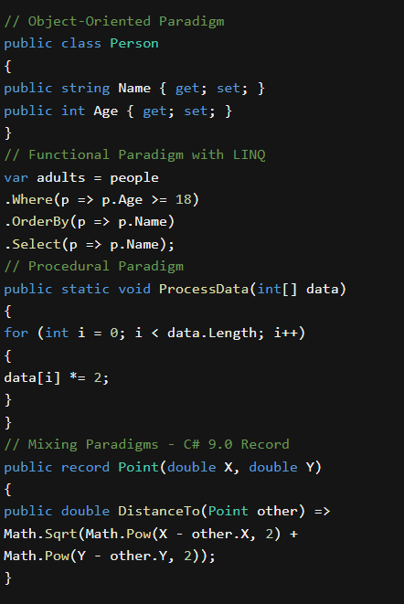
PROGRAMMING PARADIGMS IN C#
Object-Oriented Programming
Classes, inheritance, polymorphism, and encapsulation
Interfaces and access modifiers (public, private, protected)
Functional Programming
Introduced in C# 2.0 and expanded in later versions
Lambda expressions, LINQ, and immutability
Procedural Programming
Static methods and structured programming constructs
Component-Oriented Programming
Events, properties, and attributes

Slide 5
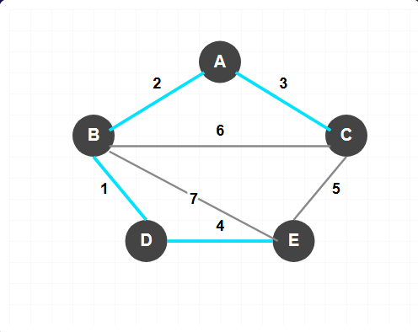
KRUSKAL'S ALGORITHM - PROBLEM DESCRIPTION
A greedy algorithm that finds the Minimum Spanning Tree (MST) for a connected, weighted, undirected graph by adding the lightest edge that doesn't create a cycle.
Applications
Network design
Circuit design
Transportation routes
Clustering.
Example: Graph with MST highlighted in cyan. Edges in MST: B-D (1), A-B (2), A-C (3), D-E (4) Total MST weight: 10

Slide 6
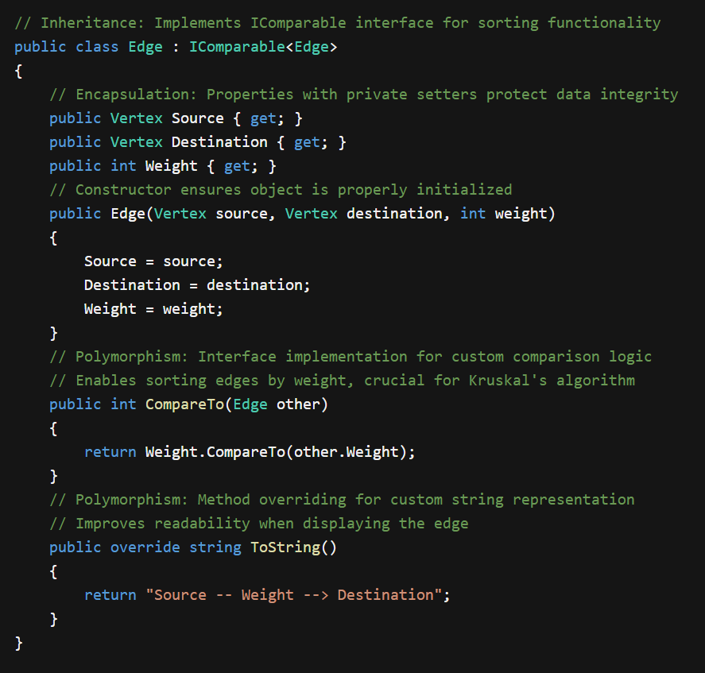
OOP SOLUTION OVERVIEW
OOP in C#: Classes with properties and methods following object-oriented principles
Key Components:
Vertex class: Represents nodes in the graph
Edge class: Connects vertices with weights, implements IComparable
Graph class: Collection of vertices and edges
DisjointSet class: Handles cycle detection
Algorithm: Kruskal's MST with sorted edges and union-find data structure

Slide 7
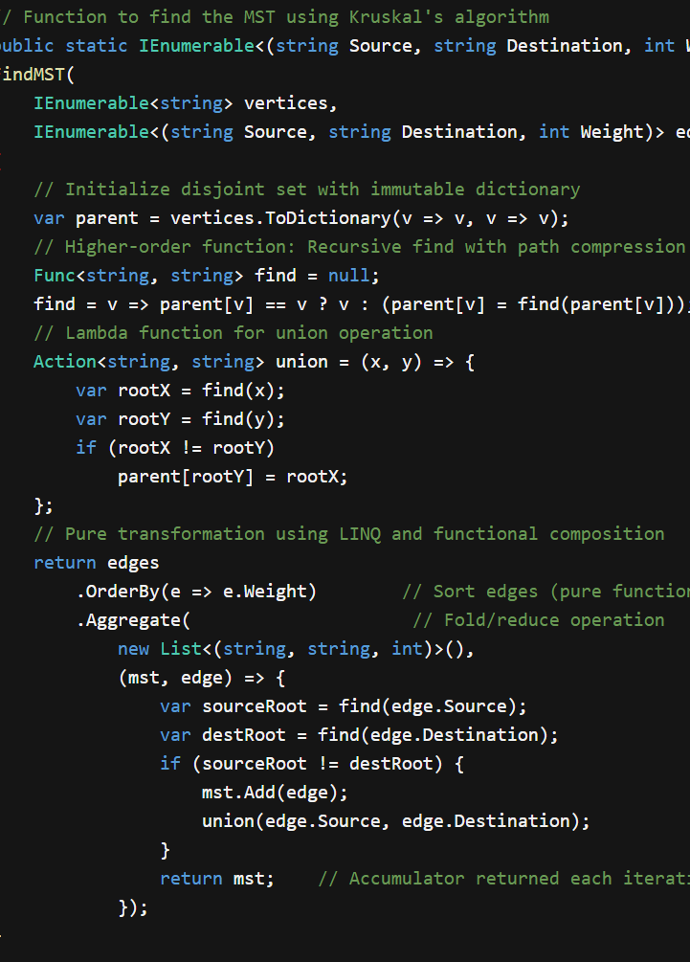
Functional Solution Overview
Functional C#: Using higher-order functions, lambdas, and immutable structures
Key Components:
Pure Functions: No side effects, same input produces same output
LINQ: Declarative style with OrderBy, Aggregate and projection
Higher-order functions: Functions that receive or return functions
Tuples: Lightweight immutable data structures
Algorithm: Kruskal’s MST via data transformation and functional composition

Slide 8
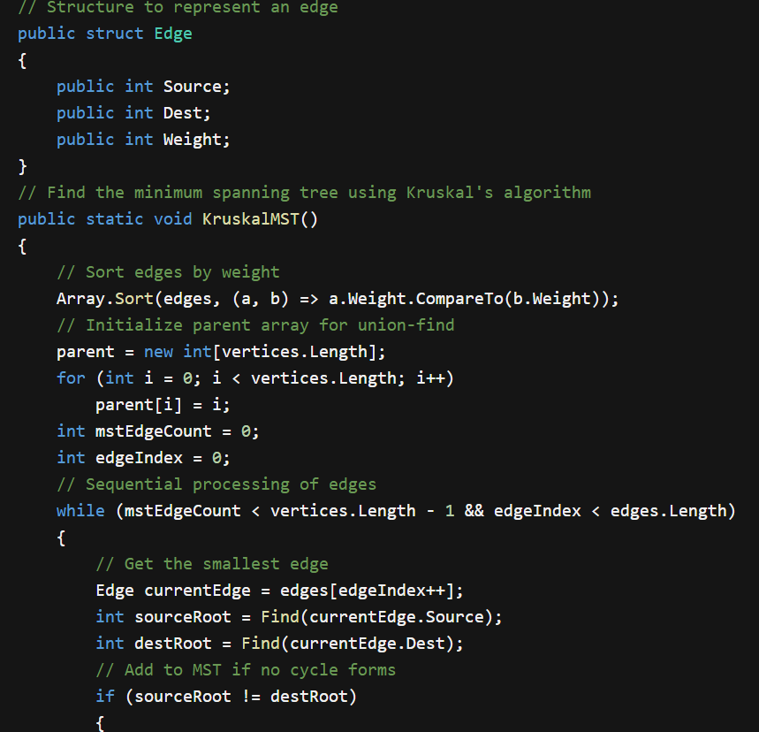
PROCEDURAL SOLUTION OVERVIEW
Procedural C#: Step-by-step instructions with global state and procedures
Key Components:
Global variables: Shared state accessible to all procedures
Structs: Lightweight value types for data storage
Procedures: Sequential operations manipulating shared state
Arrays: Simple indexed collections for data storage
Algorithm: Kruskal's MST with clear sequential steps and direct data access

Slide 9
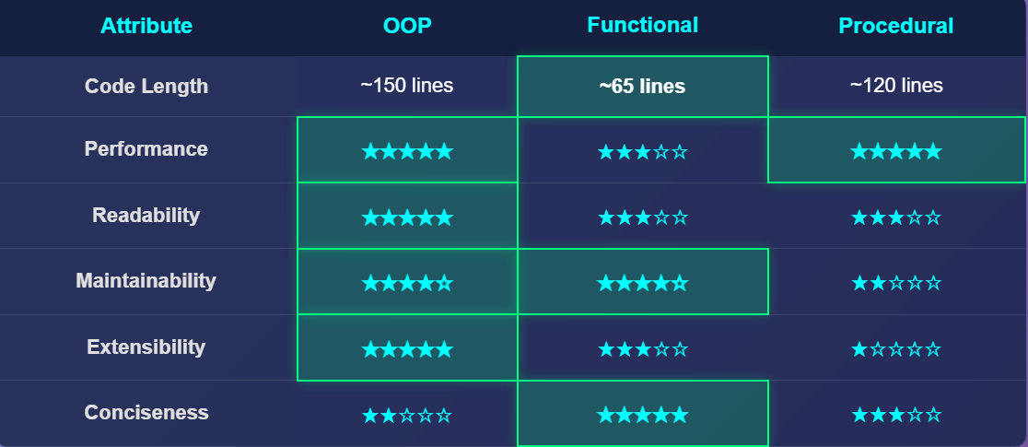
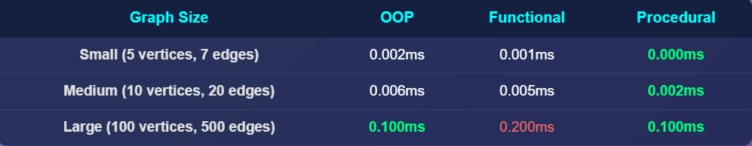
COMPARISON & ANALYSIS

Slide 10
COMPARISON & ANALYSIS
Key Findings:
OOP offers the best balance of readability and extensibility
Functional implementation is the most concise but has performance overhead
Procedural approach provides the best raw performance
Choice of paradigm depends on project priorities (speed vs. maintainability)

Slide 11

CONCLUSION
Paradigm Selection Insights
•OOP: Best for complex systems requiring clear domain modeling and future extensibility
•Functional: Excellent for data transformations and pipelines where conciseness matters
•Procedural: Provides performance advantages for compute-intensive operations
•Hybrid Approach: Most practical real-world solutions combine elements from multiple paradigms

Slide 12

Thank You FOR YOUR ATTENTION!

