Slide 1
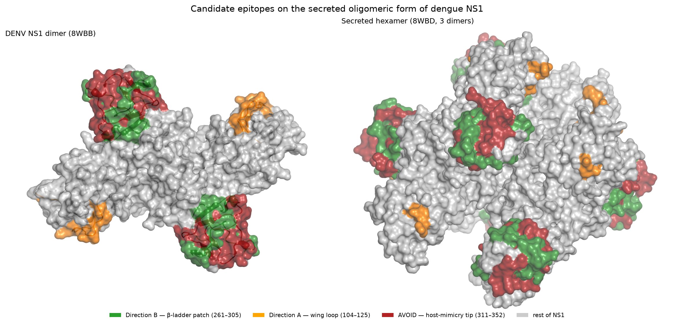
From Binary to How Much
Designing a Quantitative Dengue Test
A number you can carry — not just a yes/no
Kaeyura Puram & Rabaani Mehra · Non-Trivial Fellowship
Notes:
From binary to how much — a project about turning a dengue test that answers yes-or-no into one that answers the question that actually helps a patient: how much, and which way are they heading?

Slide 2
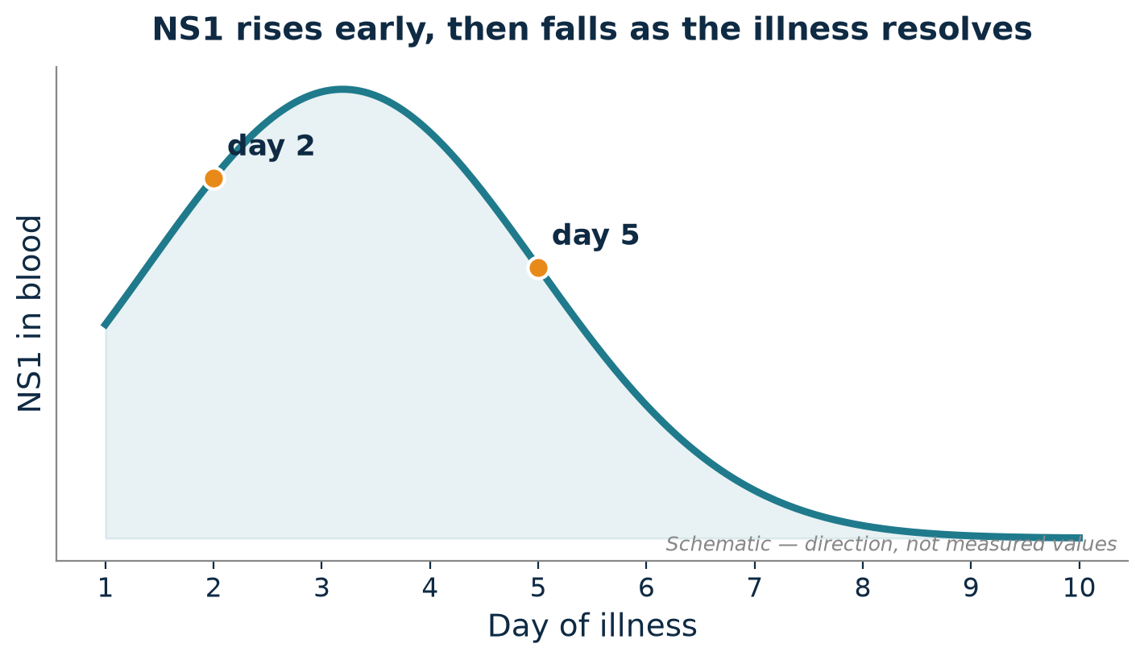
The problem
0:34
• ~390 million dengue infections a year; no drug for any of the four serotypes
• Care means monitoring the patient — so what is there to monitor?
• Infected cells shed a protein, NS1, into the blood early in infection
• Its level rises as infection takes hold and falls as the patient recovers
• So NS1 concentration signals the direction of the illness, not just its presence
From Binary to How Much · The problem
2 / 15
Notes:
Start with the scale. Dengue infects around 390 million people a year, there's no drug, and surviving one serotype doesn't protect you from the rest. So medicine can't cure a patient — a clinician can only watch and react. Luckily the virus gives us something to watch: cells shed a protein, NS1, into the blood early, and its level rises as infection takes hold and falls as the patient recovers. So NS1 tells you which way the illness is going.

Slide 3
Why a number, not a yes/no
0:33
• The portable field test reports only presence: NS1, yes or no
• A quantity, measured across days, shows if a patient is improving or worsening
• “Positive” on day 2 and day 5 gives a clinician no new information
• Quantifying NS1 is routine — but needs a plate reader, cold chain, trained staff
• The useful information exists, and is stuck where patients can't reach it
From Binary to How Much · The problem
3 / 15
Notes:
But reading that signal is the whole problem. The test you can carry gives one bit — is NS1 there, yes or no? What you actually want is the number, measured more than once: positive on day two and again on day five tells you nothing new. The amount shows whether someone's turning the corner. And measuring it isn't hard — it just isn't portable. It lives on a plate reader in a hospital, where most patients can't reach it.

Slide 4
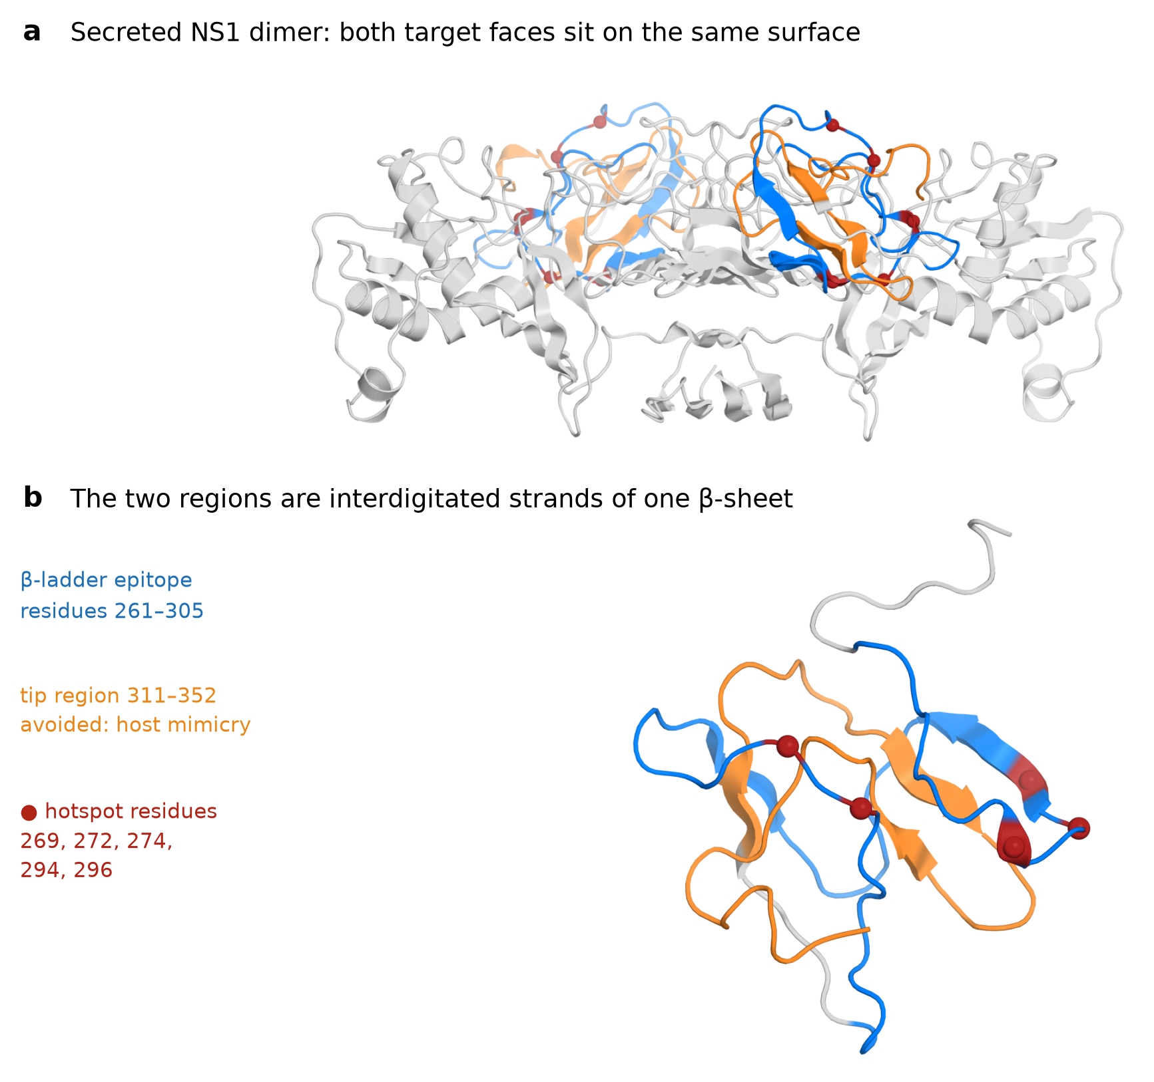
Literature & the gap
0:27
• Quantitative NS1 assays already exist — confined to hospital laboratories
• Protein switches — bind a target AND report it in one molecule — are established
• The gap: a de novo–designed protein switch for NS1, usable at point of care
• Scope: the β-ladder patch (residues 261–305), conserved across DENV1–4
• The tip region (311–352) was excluded — host mimicry risks false positives
From Binary to How Much · The problem
4 / 15
Notes:
And we weren't the first to want this. Quantitative NS1 tests already exist — they're just tethered to that lab. And protein switches, molecules that recognise a target and report it in one step, are proven. So our gap sits between the two: could you design, from scratch, a switch for NS1 that does the lab's job but is small enough to carry?

Slide 5
What a protein switch is
0:28
• A switch = two binders + a reporter protein split into two halves
• Apart, the two halves are dark and produce no signal
• Both binders must grip the SAME antigen to bring the halves together
• Antigen present → halves reunite → light; brighter = more antigen
• This proportionality is what turns presence into a quantity
From Binary to How Much · The problem
5 / 15
Notes:
Here's the one idea everything rests on. A switch is two binders plus a reporter split in half. On their own, the halves are dark. But when both binders grab the same antigen at once, they drag the halves together and it lights up. A little antigen, a little light; a lot, a lot. That proportionality is what turns a yes-or-no molecule into a number.

Slide 6
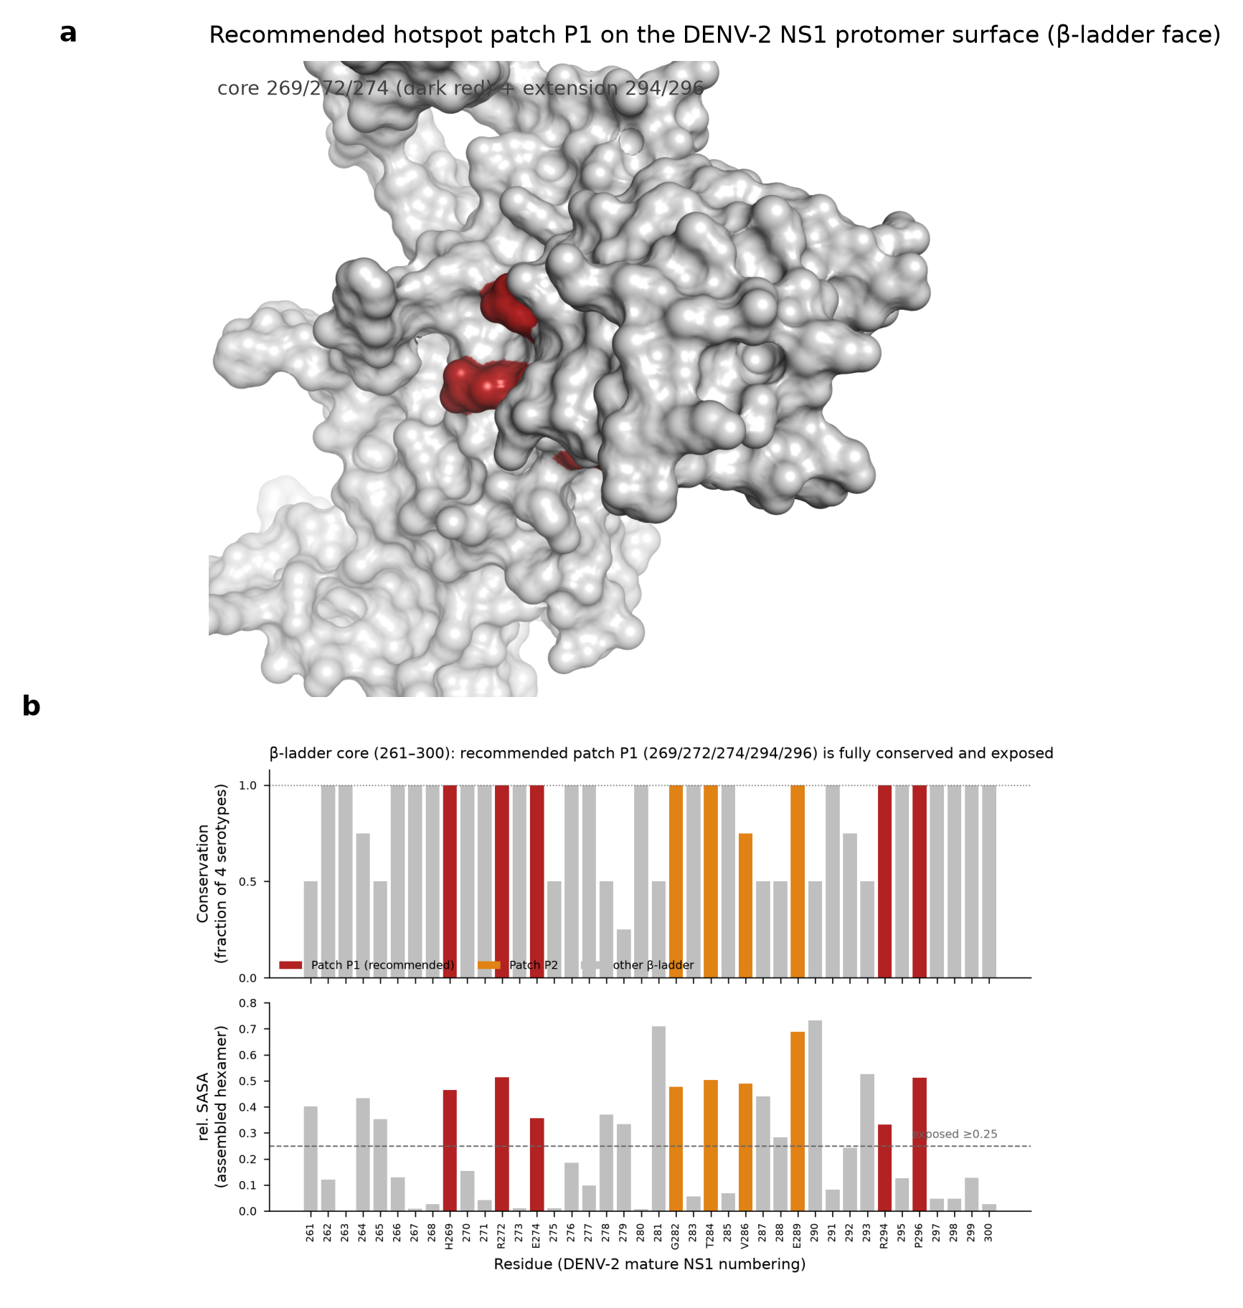
Our approach
0:32
• Three questions: design a binder? two at once? does the switch behave?
• De novo design — invent proteins from scratch — not slow, hard-to-aim antibodies
• Lets us pick the exact epitope and avoid the false-positive-prone tip
• Pipeline: RFdiffusion → ProteinMPNN → structure-predictor check
• One fixed prediction harness for designs AND controls — the same ruler throughout
From Binary to How Much · Approach
6 / 15
Notes:
So how do we build it? For the binders, we designed de novo — inventing proteins from scratch, with the Baker lab's tools — rather than raising antibodies, which are slow and hard to aim. That buys control: we pick the exact patch and steer away from the risky tip. The pipeline runs in three stages — a backbone, then a sequence, then a structure check — all on one fixed setup, used identically on designs and controls.

Slide 7
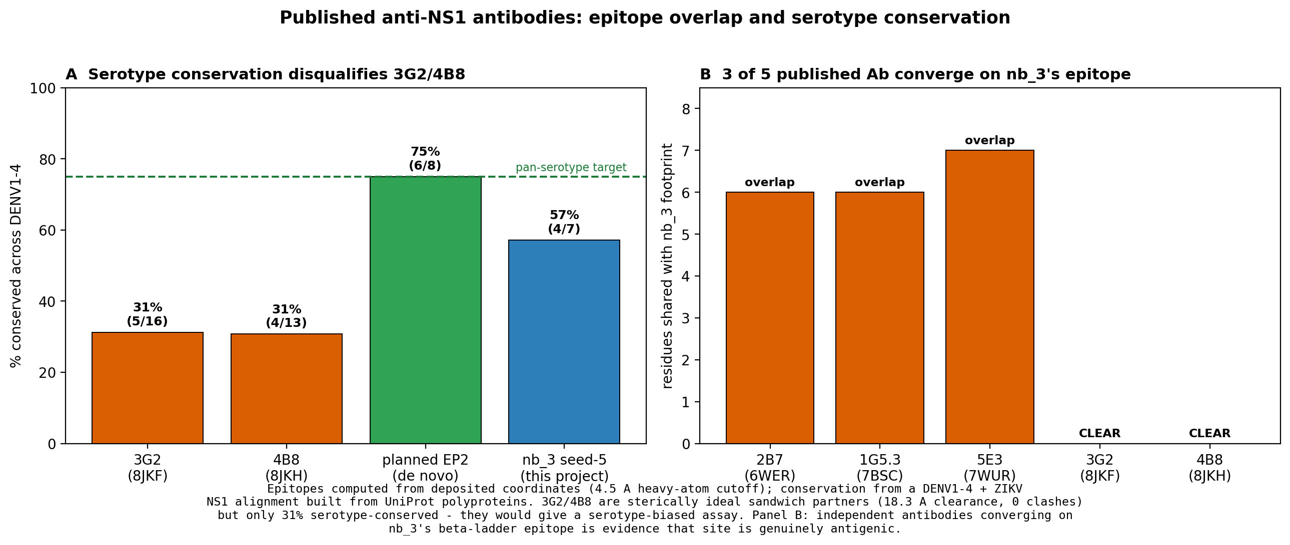
The controls we ran
0:30
• Four controls beyond a standard protocol — three exposed a broken component
• The key idea: calibrate the scoring filter against KNOWN answers first
• Positive control: a protective anti-NS1 antibody with a solved crystal structure
• Negative control: a nanobody raised against a completely different protein
• A valid filter passes the real binder and fails the decoy — an obvious test
From Binary to How Much · Approach
7 / 15
Notes:
And the controls are the heart of this talk, because they're the part a design project usually skips. Before trusting our scoring filter, we asked whether it could rank things we already knew. We gave it a real antibody — with a crystal structure, so there's no argument it binds — and a decoy with no business touching NS1. If the filter works, this is easy: the binder passes, the decoy fails.

Slide 8
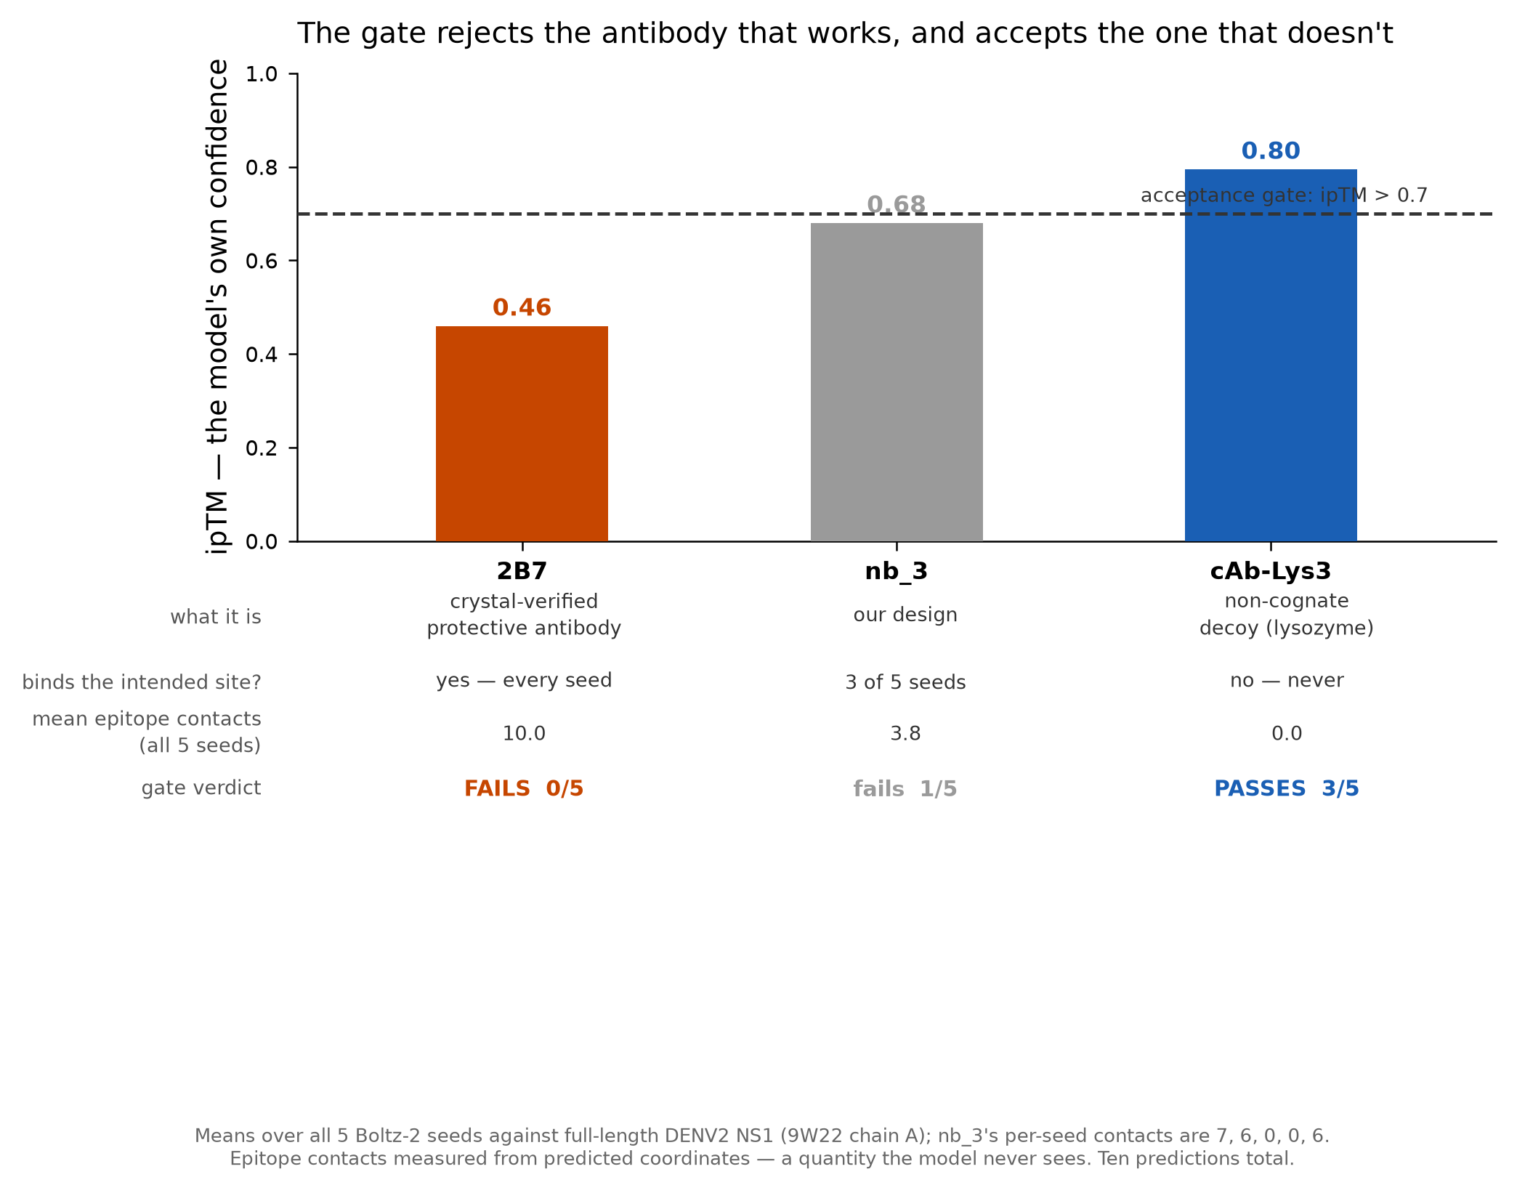
Result — the metric ran backwards
0:33
• The real antibody recovered 18–20 of its 20 contacts every seed — yet FAILED the gate every time
• The non-binding decoy made zero epitope contacts — yet PASSED 3 of 5 seeds
• Across 15 predictions, the confidence score was anti-correlated with real binding
• The metric was ranking backwards — invisible without a crystallographic answer key
• Fix: re-ranked designs on measured structural contacts, not the confidence score
KEY FINDING
From Binary to How Much · Results
8 / 15
Notes:
It did the exact opposite. The real antibody placed 18 to 20 of its 20 known contacts every seed — and our filter failed it every time. The decoy that touches nothing sailed through three times in five. Across fifteen predictions, the better a thing bound, the worse our score rated it. It wasn't noisy — it was running backwards. And we only caught it because we'd checked against a known answer. So we re-ranked everything on measured structure.

Slide 9
Three more ways it misled us
0:31
• The same failure shape recurred — hidden in metrics, found only by controls
• Cropped-target designs: 0 of 32 fit intact NS1 (a pose that can't physically exist)
• A top design buried 1,703 Å²/side vs 602 Å² for a real antibody
• Antibody 3G2: predictor placed 0 of 16 epitope residues right — in 10/10 runs
• Confidence never flagged it (ipTM 0.41–0.63, pLDDT 0.90–0.92)
• Lesson, repeated: a high confidence score is not evidence of a correct structure
From Binary to How Much · Results
9 / 15
Notes:
And it wasn't a one-off. Three more failures had the same shape — invisible in the metrics, caught only by a control. Designs built against a cropped target looked spectacular, until we tested them on the full protein: zero of thirty-two could physically fit. And a second antibody was placed completely off its own epitope — zero of sixteen residues — with full confidence, in all ten runs. The lesson kept repeating: confidence is not correctness.

Slide 10
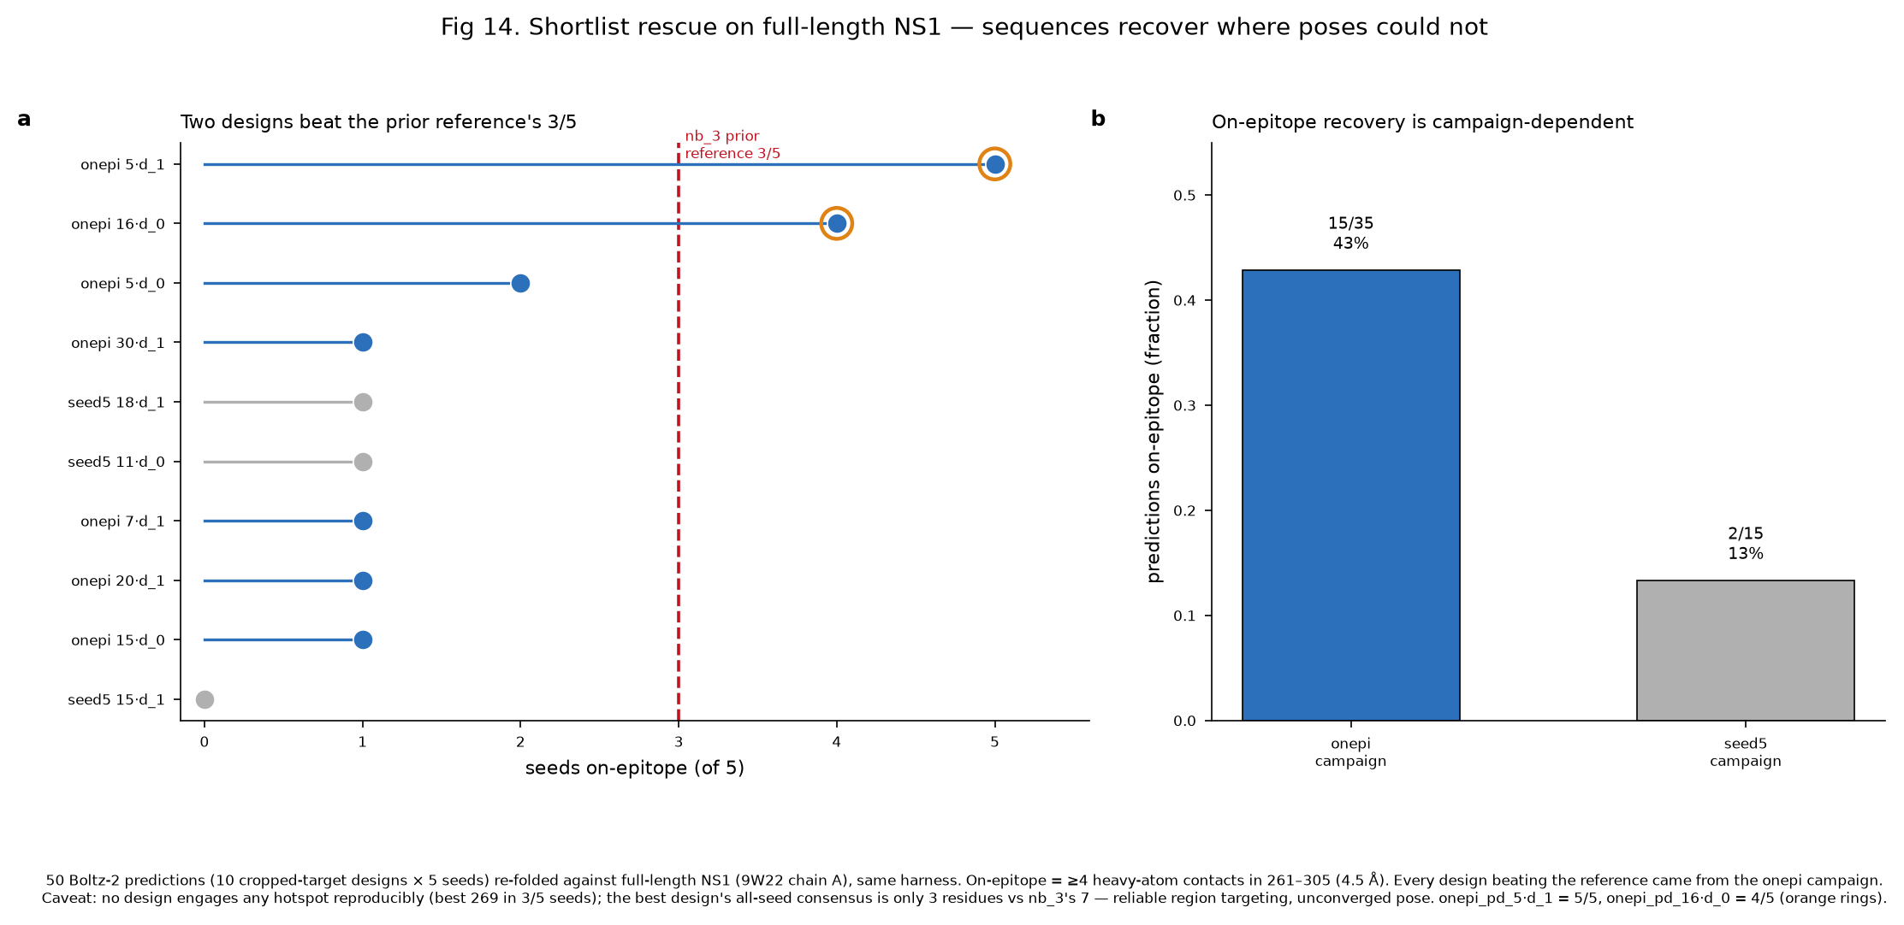
Result — what we deliver
0:36
• Arm 1 (β-ladder): on-epitope in 5 of 5 seeds; residues 299/303/327 every seed
• A repeatable footprint — real, not a lucky single run
• Arm 2 (wing site): 16 of 19 contact positions conserved across all four serotypes
• Pan-serotype coverage is plausible; 4 positions differ from Zika (a selectivity handle)
• Both are CHARACTERISED candidates — not yet experimentally validated
DELIVERABLE
From Binary to How Much · Results
10 / 15
Notes:
So what's left standing? Two designs. The first grips the conserved patch in all five runs, with three residues in the contact every single time — repeatability that makes it real, not lucky. The second lands on a different face, and sixteen of its nineteen positions are identical across all four serotypes, so a test on it could work against all of them. But these are characterised candidates, not validated binders — we haven't put them in a test tube, and that honesty is the point.

Slide 11
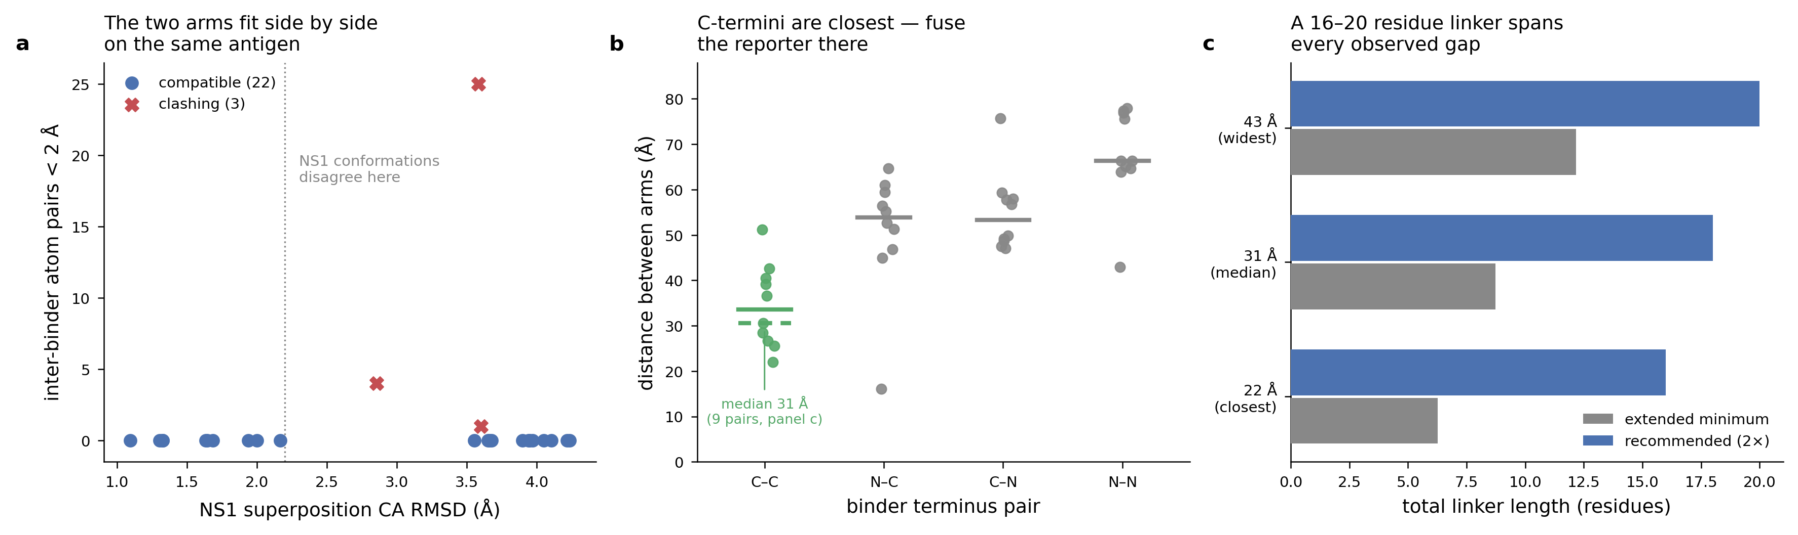
Result — the two binders fit
0:33
• 22 of 25 seed pairs place both binders on NS1 with no steric clash
• Room remains for both halves of the split reporter
• Measured directly from superposed structures — geometry, not a confidence score
• Terminus-to-terminus spacing sets the linker length to build to
• Survives the metric failure precisely because it rests on coordinates
MEASURED
From Binary to How Much · Results
11 / 15
Notes:
That was question two — can two binders share the antigen? The clearest yes in the report. In twenty-two of twenty-five tries, both settle onto NS1 without colliding, with room for the reporter halves. And notice how we know: we didn't predict it, we measured it off the structures, like a ruler — the spacing even tells you how long to make the linkers. Because it's geometry, not a score, it survives even though that score let us down.

Slide 12
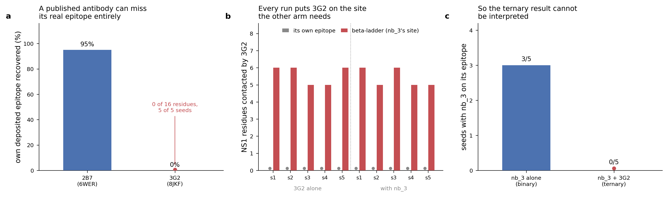
Discussion — the central bet
0:28
• Scorecard: Q1 qualified yes · Q2 clear yes · Q3 honest no (no converged pose yet)
• Antibody tests lose sensitivity in severe, repeat (secondary) infection
• Cause: the patient's own antibodies form complexes that mask the antigen
• Our binders are aimed OFF that immunodominant surface by design
• So they may keep reporting exactly where antibody tests fail — a testable prediction
From Binary to How Much · Discussion
12 / 15
Notes:
So where does that leave us? One qualified yes, one clear yes, one honest no — no converged pose yet, and I won't dress that up. But the interesting idea is testable. Antibody tests struggle in severe repeat infections, because the patient's own antibodies hide the antigen. Ours are aimed off that surface by design — so they might keep working exactly where today's tests fail.

Slide 13
Limitations & what I learned
0:30
• Geometry — most durable: atom distances don't depend on any model's confidence
• Binder candidates — least secure: characterised, not experimentally validated
• Calibration finding — most secure: 15 predictions against a crystallographic answer key
• Measured on the dimer, not the physiological hexamer — a stated boundary
What I learned
A model's confidence is not the same as being right. If you can find one place you already know the answer, check there first — before you trust it anywhere you don't.
From Binary to How Much · Discussion
13 / 15
Notes:
A quick word on trust, because it varies. The geometry I'd stake a lot on — atoms don't care what a confidence score says. The binders are the shakiest, because they're characterised, not tested. And the calibration finding is the sturdiest thing here. Which points past dengue: a model's confidence is not the same as being right. If you can find one place you already know the answer, check there first.

Slide 14
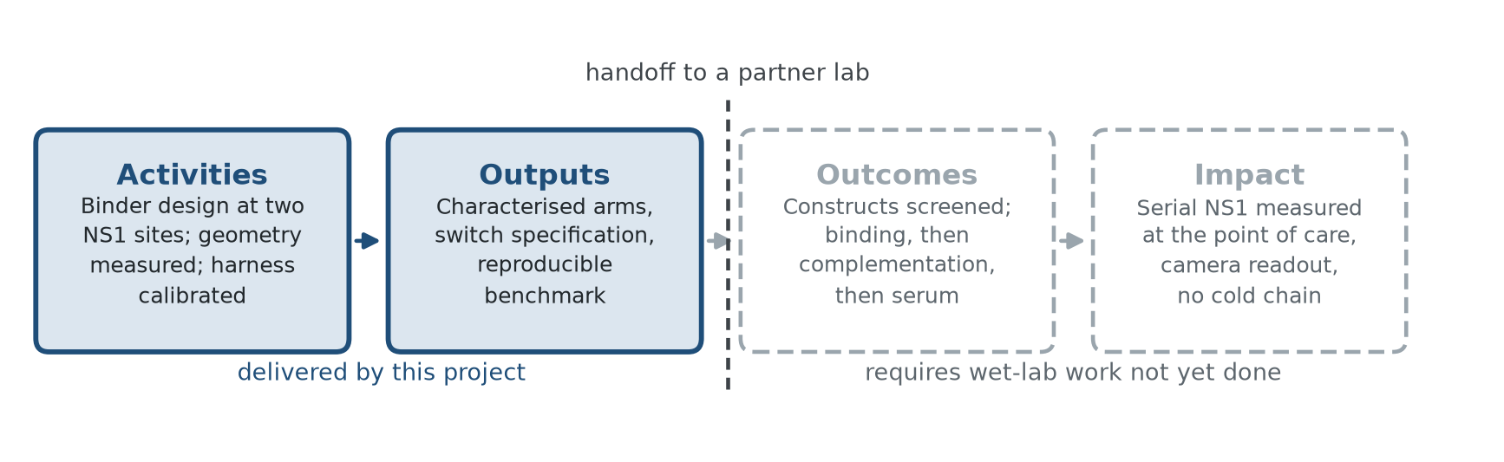
Theory of change & next steps
0:36
What a lab receives today
• Scoring harness + crystallographic calibration
• Two characterised binder arms
• Cheapest falsifying test: bind arms to NS1
Next steps (by cost)
1 Assemble the switch — no partner
2 Re-run controls on a 2nd predictor
3 Wet-lab screen — needs a partner
Collaboration
Have now: Baker lab PhD design input
In progress: Amritsar connection
Planned: Indian labs · FIND · WHO
From Binary to How Much · Where this goes
14 / 15
Notes:
So what's next? A wet lab can take from us today a complete package — the harness, the calibration that proves it works, and the two binder arms — plus the cheapest experiment that could prove us wrong: seeing whether the arms bind NS1. We've had steady input from Baker lab PhD students throughout. The next steps need no partner: build the switch, re-run controls on a second predictor. Then a wet-lab screen — and we're reaching out to labs across India, and to FIND and the WHO.

Slide 15
IF → HOW MUCH
A field test tells a patient if they're infected. We're designing the one that tells them whether they're getting better — or worse.
15 / 15
Notes:
So here's where we are. A test you can carry today tells a patient whether they're infected. We're designing the one that tells them whether they're getting better, or worse. The molecules are designed. The next step is to build them.

