Slide 1
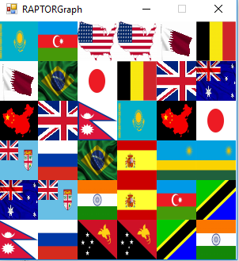
Mira-mira
Topic: Game
ICS
BY: Dikshya Kafle, Elyse Isimbi and Christine Giwar

Slide 2
Mira-mira
Introduce game
What message we aim to convey
List main features ( Home screen, Procedure Screen, Game screen, exit screen)
Objective: eliminate all matching flags

Slide 3
demo
Mira-mira

Slide 4
Solutions
Design and Implementation:
Dimensions (300x300)
Images (50x50)
Title
Main problems & solutions:
Determining logic behind the game – number of conditions 18/36?
The elimination process behind the images

Slide 5
Division of labour
Group effort:
Brainstorming the idea of a game
Dimensions
Images
Logic
Project Report and User Manual
Background Music
Subcharts

Slide 6
Project analysis
Advantages
It is an executable program
Background Music
Conveys message of openness
Contains a straightforward procedure and user manual
Uses familiar flags
Disadvantages:
Final Project was time consuming

Slide 7
Overall experience
Gained deeper knowledge of Raptor
Enhanced our algorithmic thinking capabilities
Content with the effort
Passion allows one to do a job well
There are countless ways to approach a problem and hence reach the solution
Think more outside the box.
Patience is key to everything

Slide 8


