Slide 1
Computer Operating System Experiment

Slide 2
Threads
Lab 4

Slide 3
Roadmap
What is the thread?
How to use pthread in Linux?
Q&A

Slide 4
Objective:
Practice working with multi-threaded
Data sharing mechanism
Thread Parallelism

Slide 5
What are Threads? Threads vs Processes
A Process is an instance of a computer program that is being executed.
A Thread is an instance of a sequential computer program that is being executed.
  Threads are the basic unit for scheduling in modern OS
  A process contains at least one thread
  A process may contain multiple threads for parallel execution
Threads of the same processes share memory space; i.e., they accesses the same chunk of memory with the same address
  Threading represents the OS support for shared-memory programming

Slide 6

What are threads?
A basic unit of CPU utilization
  Private: Thread ID, program counter, register set, stack
  Shared: code section, data section, OS resources (IO & file)

Slide 7
What is Pthreads?
POSIX Threads
Defines standard threads API supported on almost all platforms
Concepts behind Pthreads interface are broadly applicable
Pthreads standard interfaces for users to use the OS threads of any vendors (as long as the vendor follows the standard)
  Improved portability
  Also helps OS vendors to properly implement their threads

Slide 8
Compiling Pthreads
On Linux, Pthreads are provided with library libpthreads. GCC also has additional supports for Pthreads compilation.
Always include <pthread.h>
To compile a C/C++ Pthread program, use command line option “-lpthread”
  – Example: gcc -lpthread pthreads_code.c -o pthread_exec
To execute a Pthread program, just run the executable normally.
  But it is the Pthread program’s responsibility to create threads, determine thread count, and map tasks to the threads

Slide 9
Pthread APIs
Thread execution management APIs
  – functions start with “pthread_”
Thread property (attributes) management APIs
  – Functions start with “pthread_attr”
Synchronization APIs
  – Mutex: “pthread_mutex_” and “pthread_mutexattr_”
  – Conditional variables: “pthread_cond_” and “pthread_condattr_”
Thead specific data
  Functions start with “pthread_key_”

Slide 10
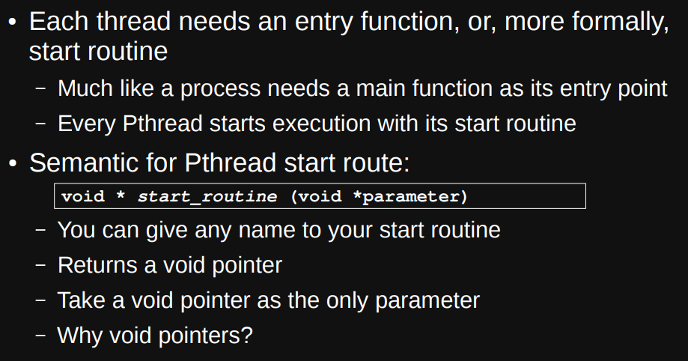
Creating A New Thread

Slide 11
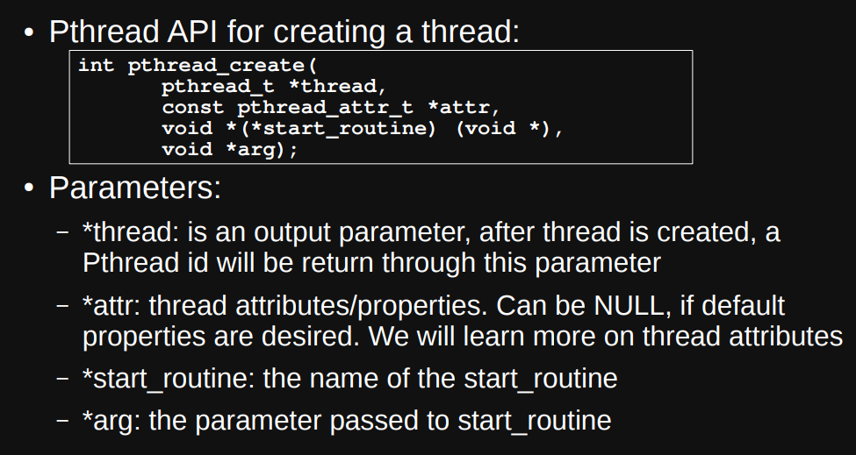
Creating A New Thread cont’d

Slide 12
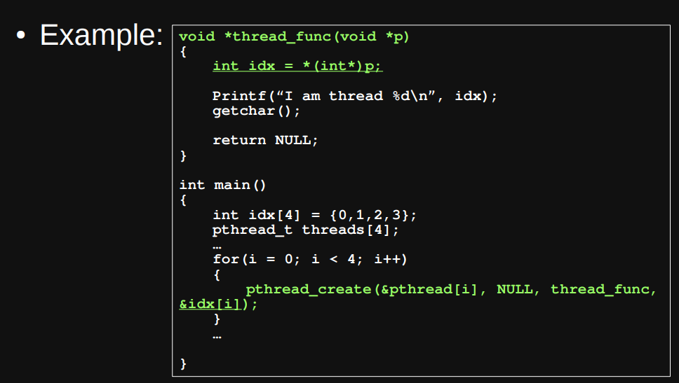
Creating A New Thread cont’d

Slide 13
Waiting for A Thread to Finish
Most of the time, the main thread of a process should only quit if all other threads have finished execution
  – What happens if the main thread does not wait?
Pthread provides a function pthread_join to allow a program to determine whether a thread has finished
pthread_join also allows the retrieval of thread return values.

Slide 14
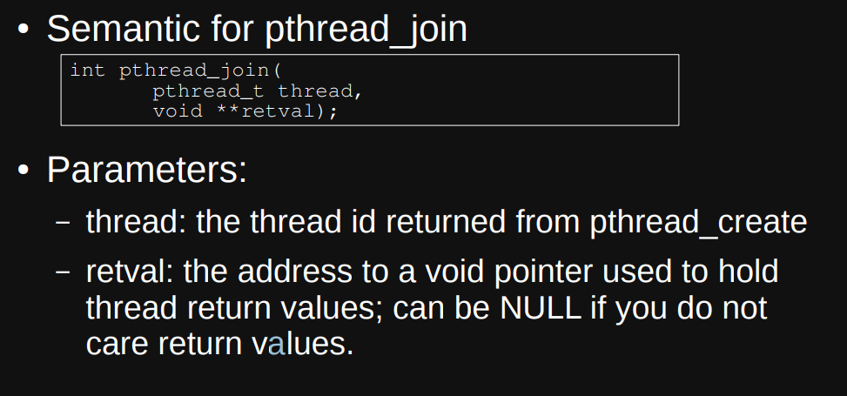
Waiting for A Thread to Finish cont’d

Slide 15
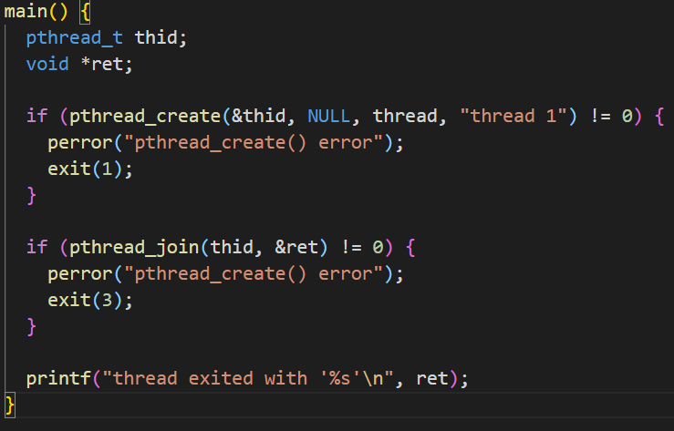
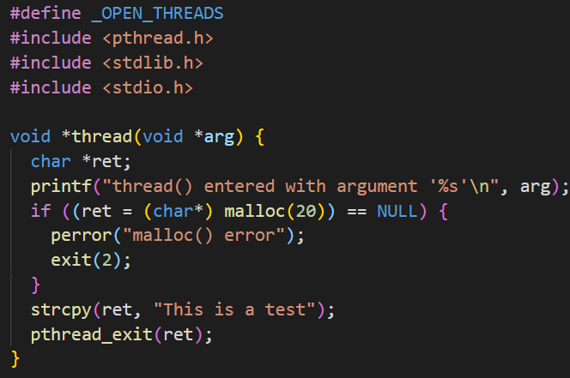
Waiting for A Thread to Finish cont’d
Example：

Slide 16
Experiments
Experiment 1:
  data sharing
Experiment 2:
  calculates various statistical values using pthread
Experiment 3:
  calculate the sum of number of squares
  Implement a serial program first , then modify it to pthread version

Slide 17


