Slide 1
Computer Operating System Experiment

Slide 2
Synchronization
Lab 5

Slide 3
Roadmap
What is the critical-section problem?
How to work with Linux and Pthread synchronization mechanisms?
Q&A

Slide 4
Objective:
Practice working with multi-threaded
Practice the critical-section problem
To examine several classical synchronization problems
  The Bounded-Buffer Problem
  Dining Philosophers

Slide 5
Definition
Race condition
  Several process access and manipulate the same data concurrently
  Outcomes of the execution depends on the order in which the access take place
How to remove Race Condition?
  Serial execution

Slide 6
Critical section problem
Consider system of n processes {p₀, p₁, … p_{n-1}}
Each process has critical section segment of code
  Process may be changing common variables, updating table, writing file, etc
  When one process in critical section, no other may be in its critical section
Critical section problem is to design protocol to solve this
Each process must ask permission to enter critical section in entry section, may follow critical section with exit section, then remainder section

Slide 7
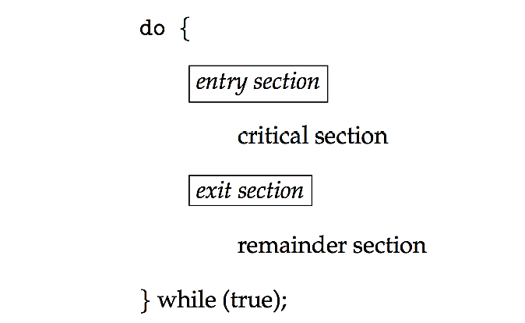
Critical section
General structure of process P_{i}

Slide 8
Requirements to solutions
Mutual exclusion
  If process P_{i} is executing in its critical section, then no other processes can be executing in their critical sections
Progress
  If no process is executing in its critical section and there exist some processes that wish to enter their critical section, then the selection of the processes that will enter the critical section next cannot be postponed indefinitely
Bounded waiting
  A bound must exist on the number of times that other processes are allowed to enter their critical sections after a process has made a request to enter its critical section and before that request is granted
    Assume that each process executes at a nonzero speed
    No assumption concerning relative speed of the n processes

Slide 9
Where are we going with synchronization?
Programs
Shared Programs
Higher-level
API
Locks Semaphores Monitors
Hardware
Load/Store Disable Ints Test&Set Compare&Swap
We are going to implement various higher-level synchronization primitives using atomic operations
  Everything is pretty painful if only atomic primitives are load and store
  Need to provide primitives useful at user-level

Slide 10
Semaphore
Synchronization tool that provides more sophisticated ways (than Mutex locks) for process to synchronize their activities
  Semaphore S – integer variable
  Can only be accessed via two indivisible (atomic) operations
  P()(wait())and V()(signal())
S. P()
S. V()
  signal(S)
  {
  S++;
  }
  wait(S)
  {
  while (S < 0)
  ; // busy wait
  S--;
  }

Slide 11
The implementation of semaphore
Class Semaphore {
int sem;
WaitQueue q;
}
Semaphore::P() {
sem--;
if (sem < 0) {
Add this thread t to q;
block(p);
}
}
Semaphore::V() {
sem++;
if (sem<=0) {
Remove a thread t from q;
wakeup(t);
}
}
Note that in this implementation, semaphore values may be negative, whereas semaphore values are never negative under the classical definition of semaphores with busy waiting.

Slide 12
Types of semaphore
Types
  Binary semaphore (same as mutex lock)
  Counting semaphore (suitable for managing number of resources)
Can solve various synchronization problems
Example:
  Consider P₁ and P₂ that require S₁ to happen before S₂
Create a semaphore “synch” initialized to zero
  P1:
  S₁;
  signal(synch);
  P2:
  wait(synch);
  S₂;

Slide 13
Semaphores in C
the POSIX system in Linux presents its own built-in semaphore library. To use it, we have to :
  Include semaphore.h
  Compile the code by linking with -lpthread -lrt
To declare a semaphores
sem_t sem;
To lock a semaphore or wait we can use the sem_wait function:
int sem_wait(sem_t *sem);
To release or signal a semaphore, we use the sem_post function:
int sem_post(sem_t *sem);
A semaphore is initialised by using sem_init(for processes or threads) or sem_open (for IPC).
sem_init(sem_t *sem, int pshared, unsigned int value);
To destroy a semaphore
sem_destoy(sem_t *mutex);

Slide 14
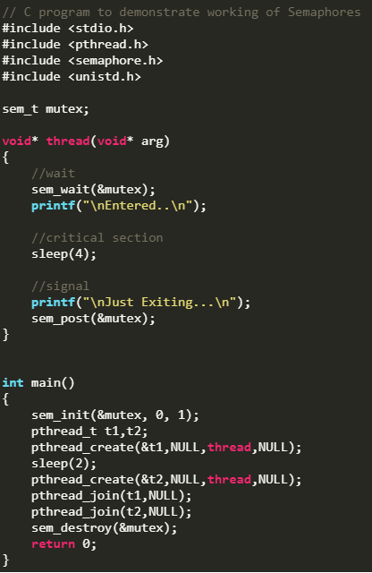
EX:1
gcc a.c -lpthread -lrt

Slide 15
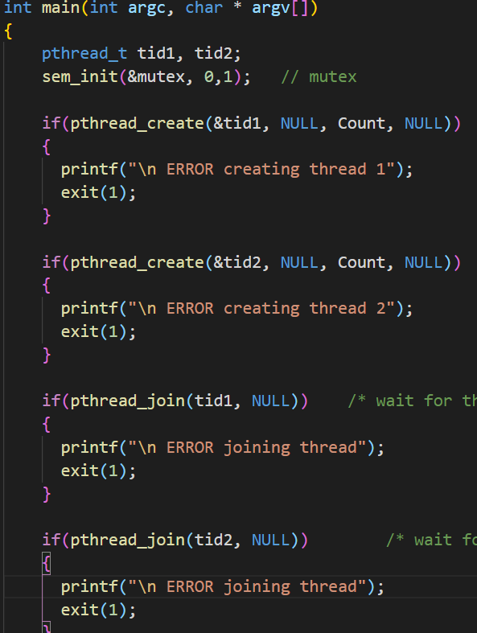
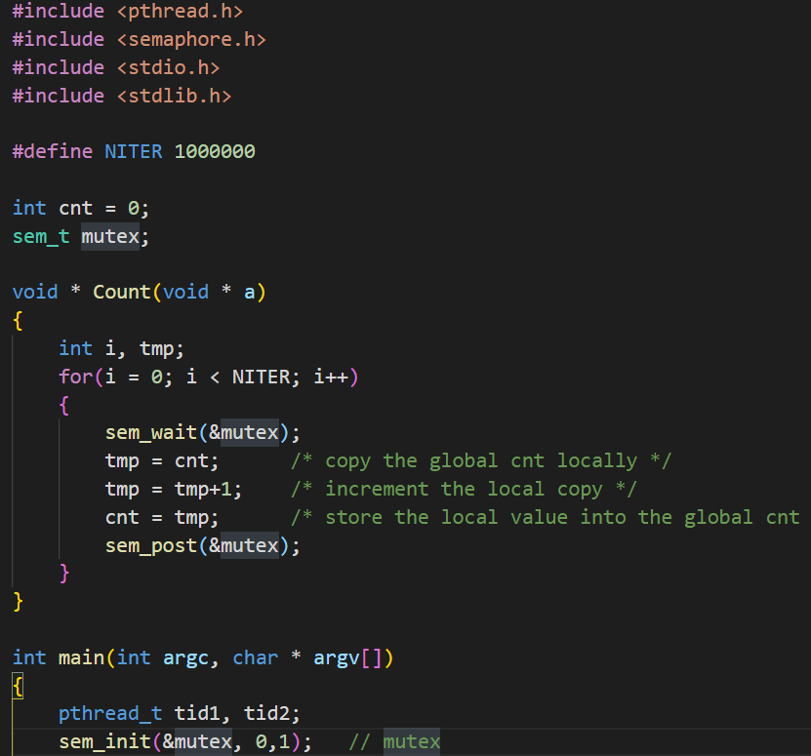
Ex 2:

Slide 16
Experiment 1: Thread Synchronization Problems
Experiment 2: The Bounded-Buffer Problem
Experiment 3: Dining Philosophers(optional if you are still available )

Slide 17


