Slide 1
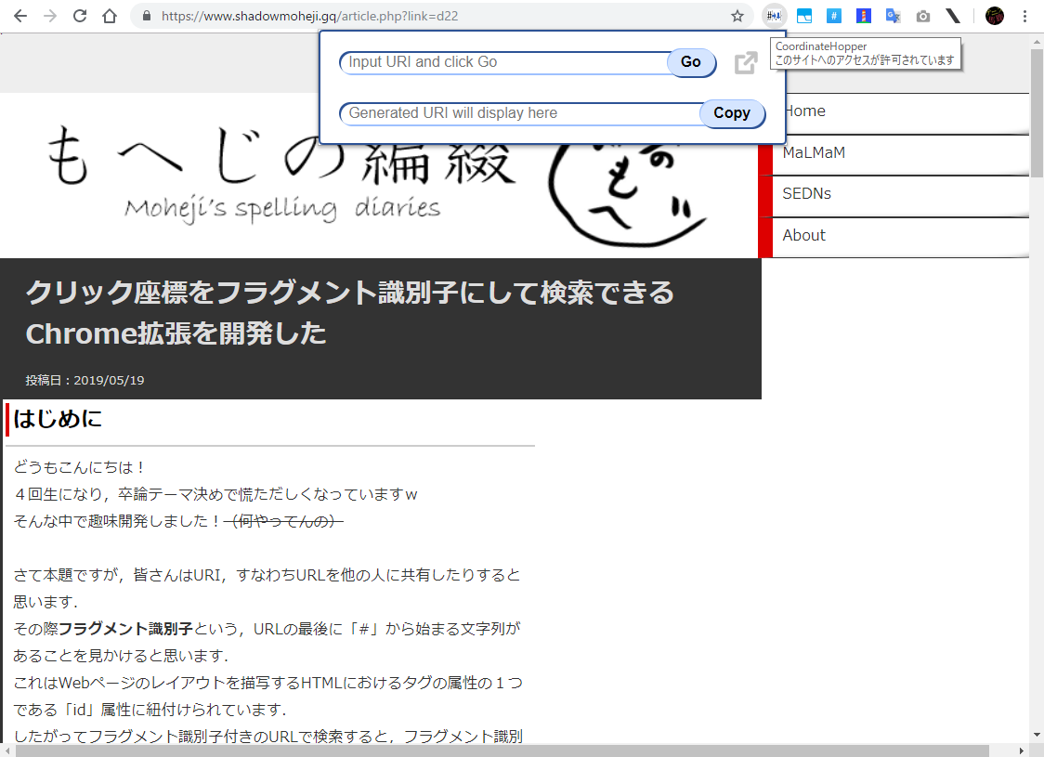

Slide 2
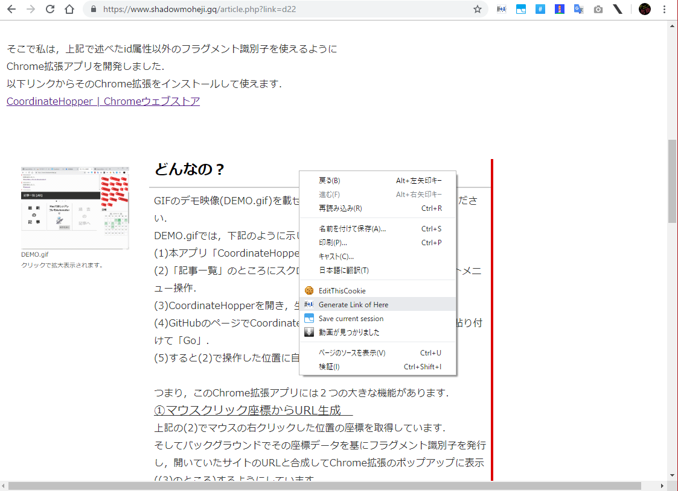
Open context menu
and select this!

Slide 3
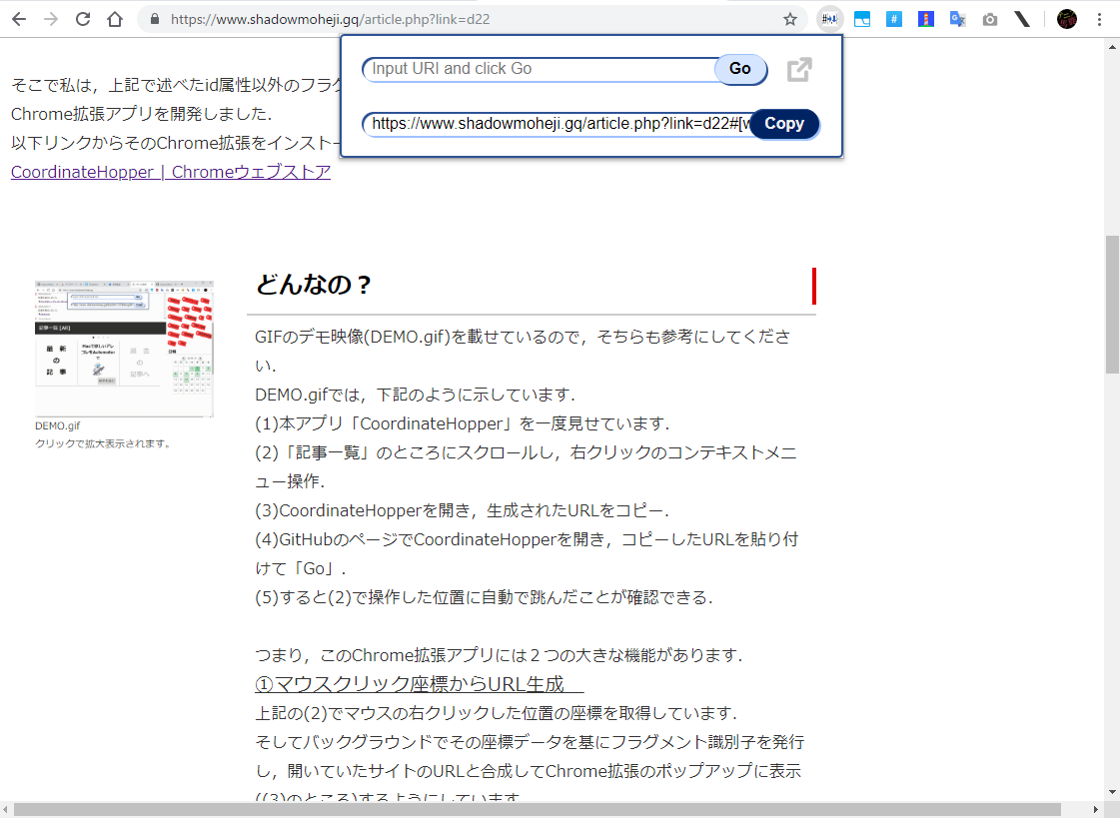
Copy
the generated URL!

Slide 4
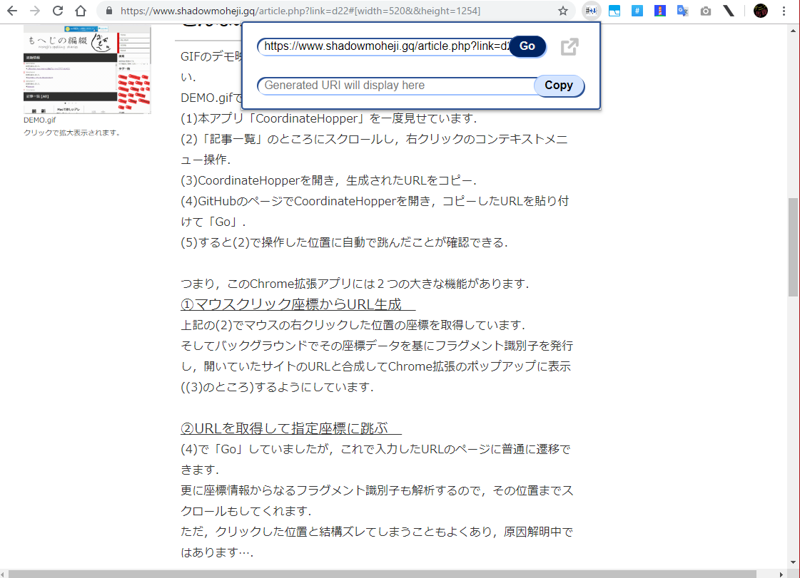
Mode
“you open this link
in a current tab”

Slide 5
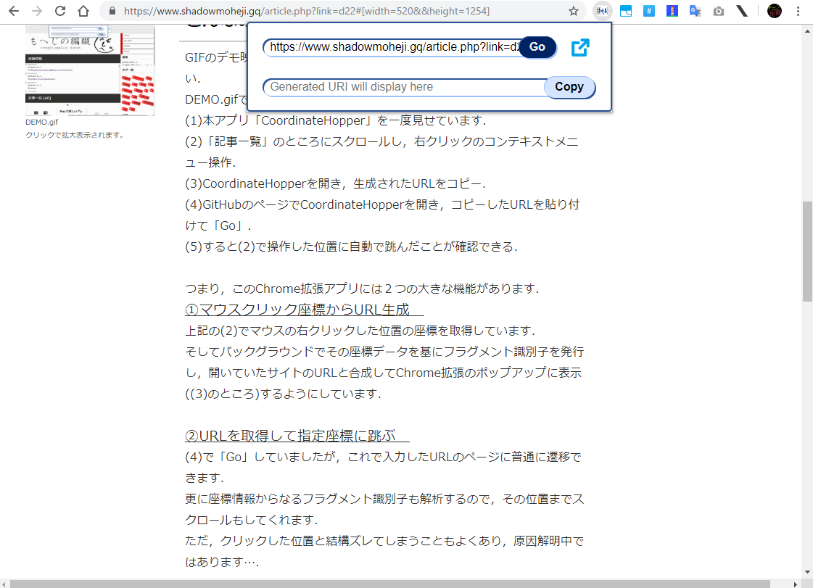
Mode
“you open this link
in a new tab”

