Slide 1
R Basics
8. Workflow: projects
9. Exploratory Data Analysis
10. Tibbles
2017.05.17 김승욱

Slide 2
8. Workflow: projects

Slide 3
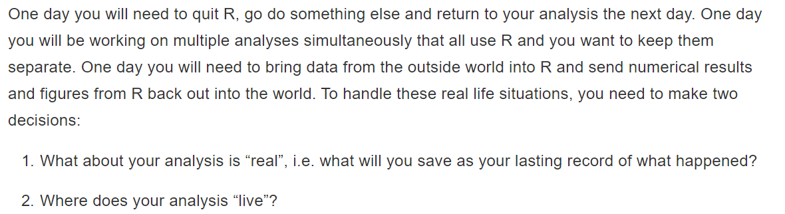

Slide 4
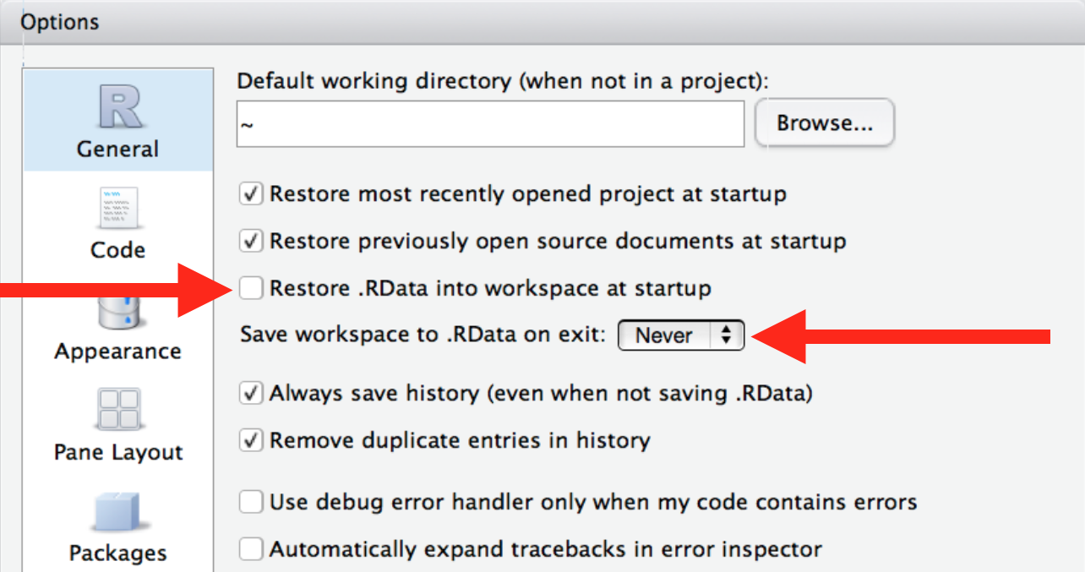
8.1 What is real?

Slide 5
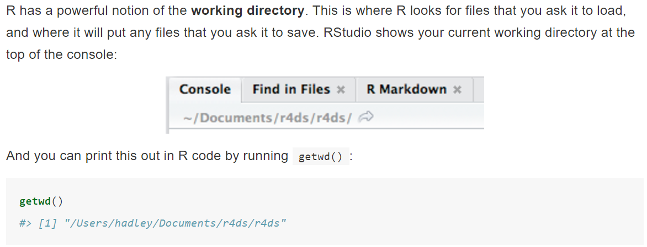
8.2 Where does your analysis live?

Slide 6



8.3 Paths and directories
plots/diamonds.pdf
plots\diamonds.pdf
/users/hadley
C:
\\servername
~
~

Slide 7
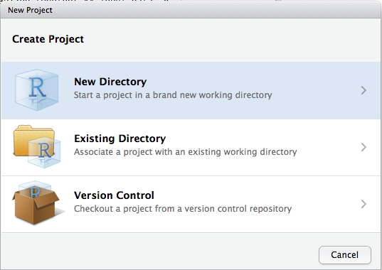
8.4 RStudio projects
별도 Working Directory 지정
코드 분리 보관 가능

Slide 8
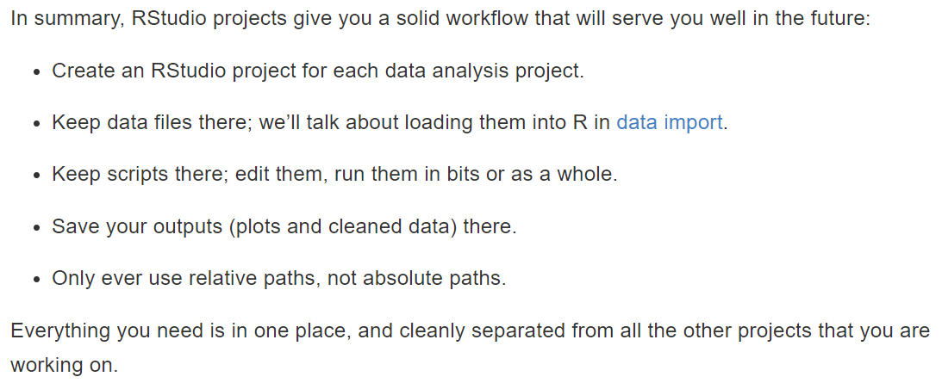
8.5 Summary

Slide 9
9. Introduction

Slide 10
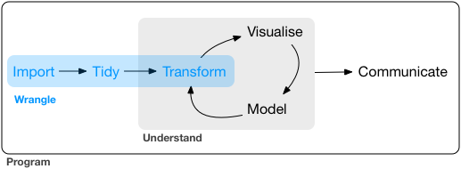
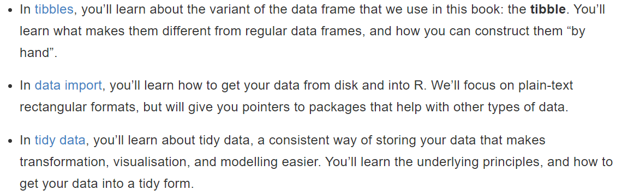

Slide 11
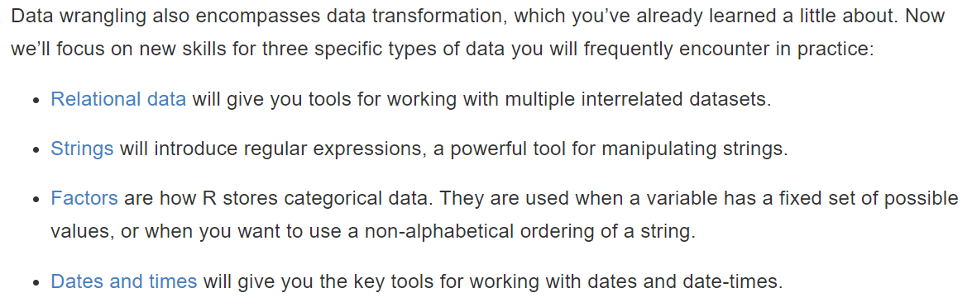

Slide 12
10. Tibbles

Slide 13
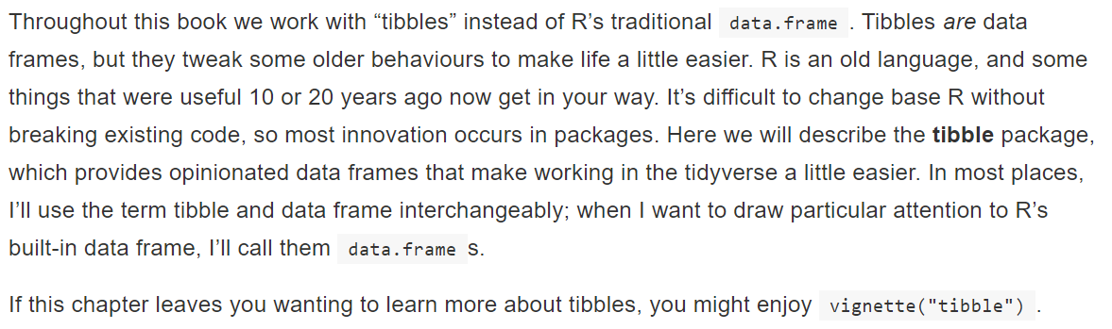
10.1 Introduction

Slide 14
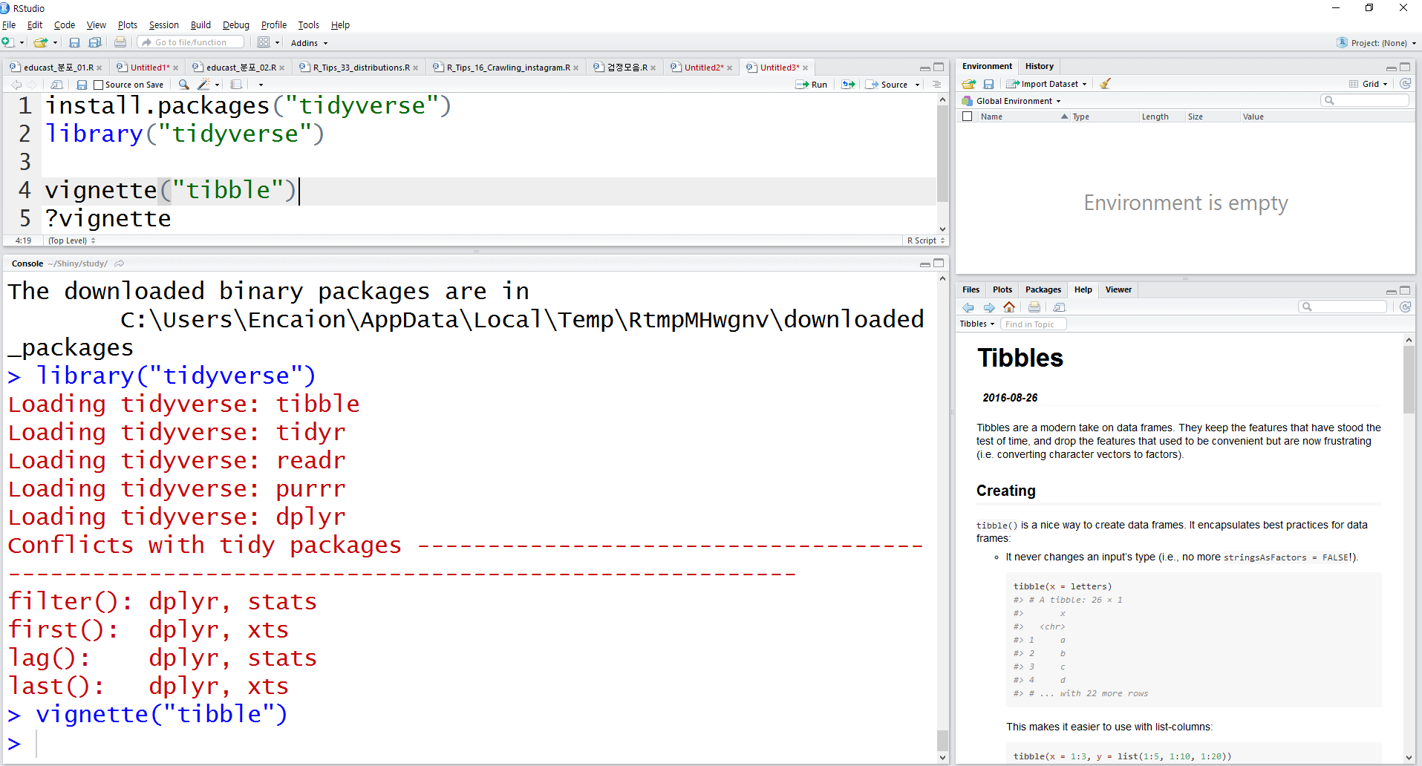
10.1 Introduction

Slide 15
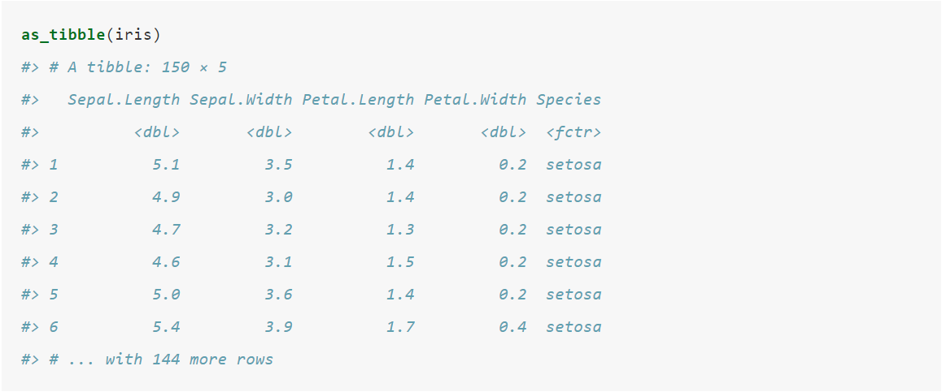
10.2 Creating tibbles

Slide 16
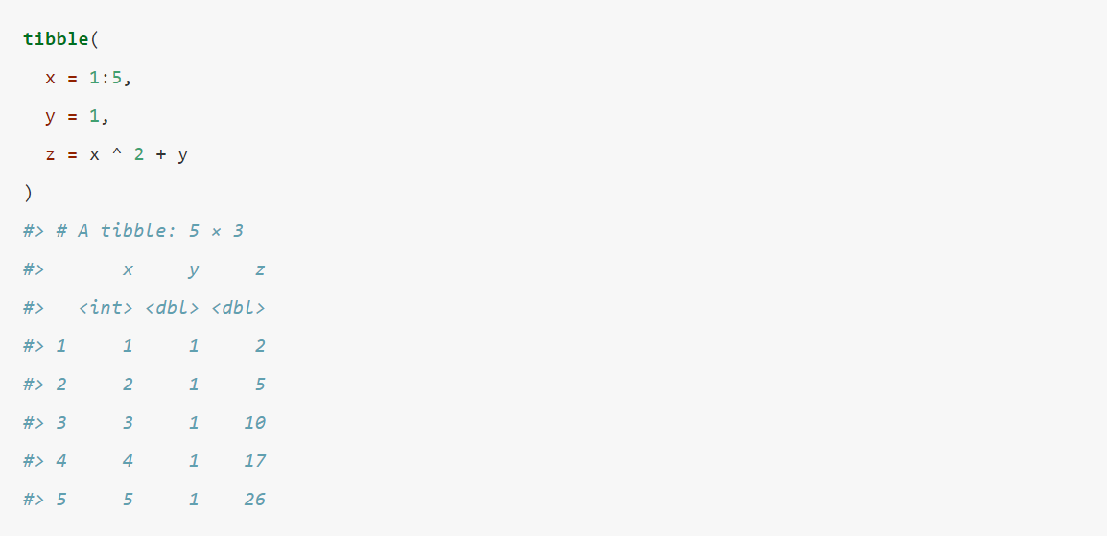
10.2 Creating tibbles

Slide 17
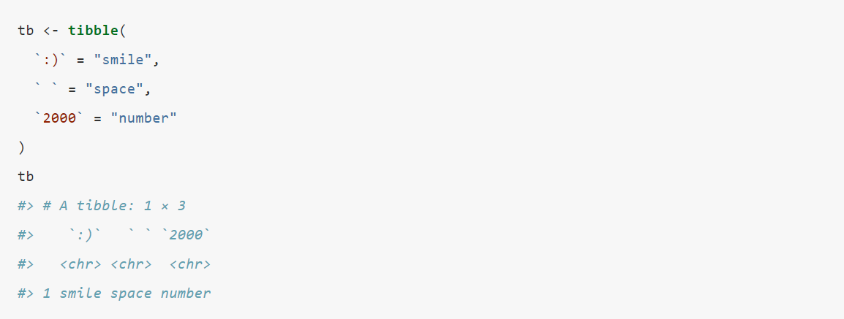
10.2 Creating tibbles

Slide 18
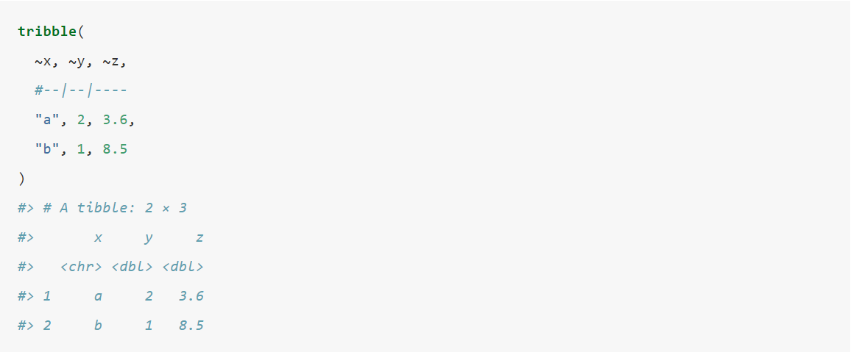
10.2 Creating tibbles

Slide 19
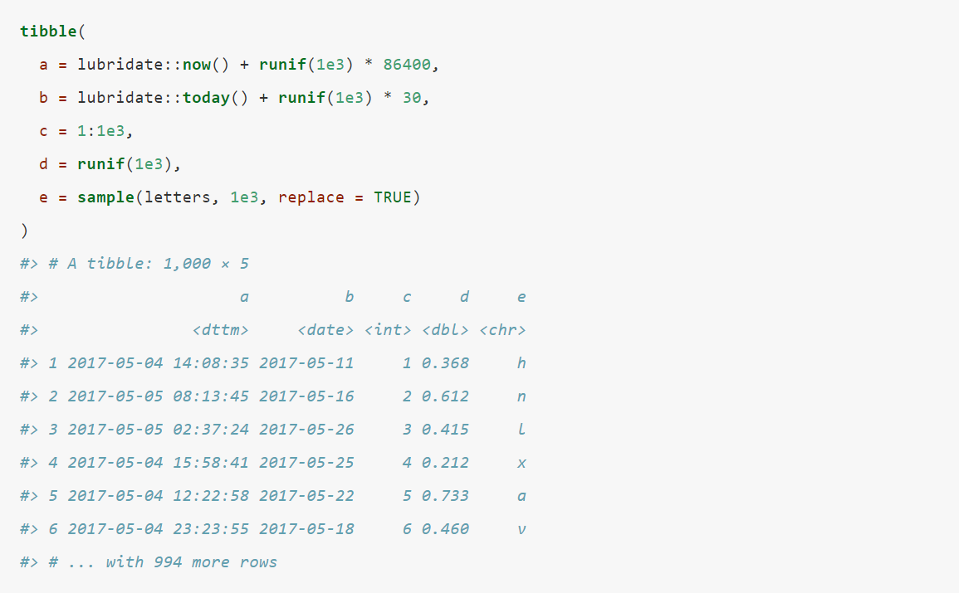
10.3 Tibbles vs. data.frame

Slide 20
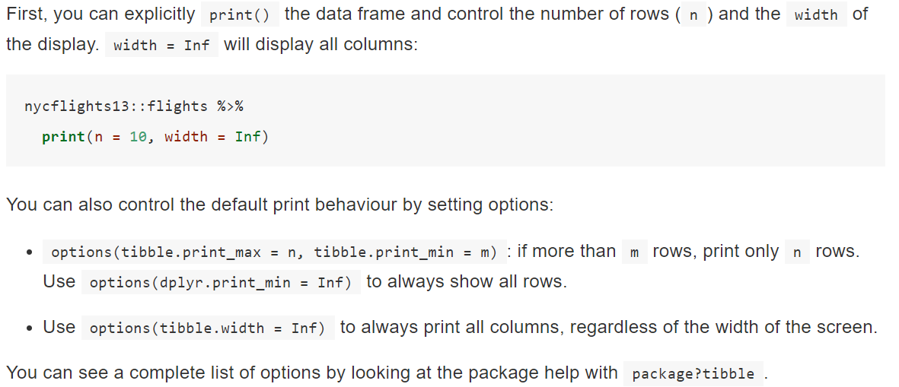
10.3 Tibbles vs. data.frame

Slide 21
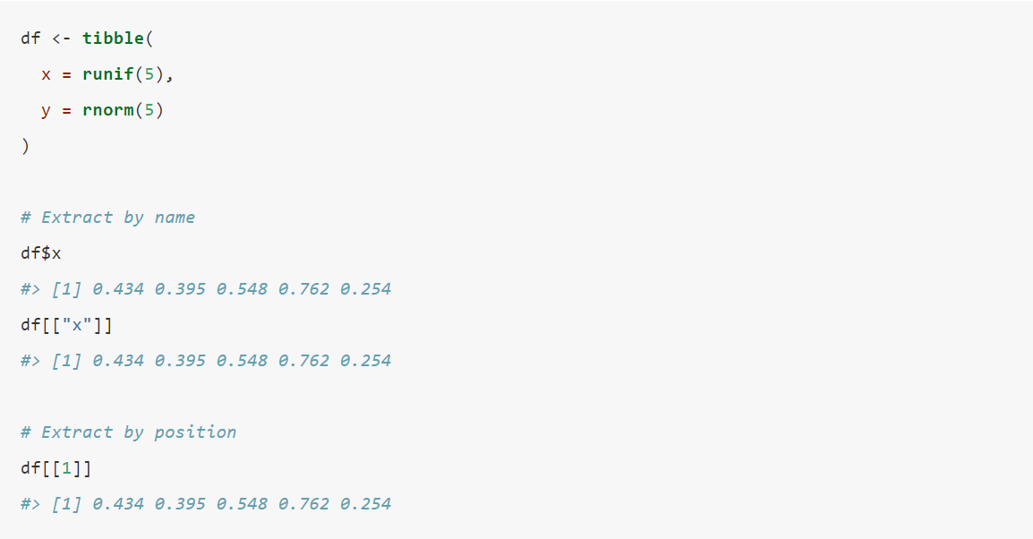
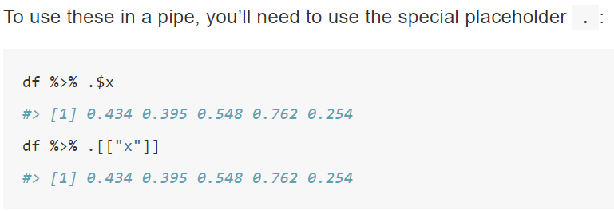
10.3 Tibbles vs. data.frame

Slide 22
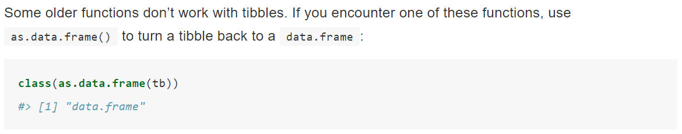
10.4 Interacting with older code

Slide 23
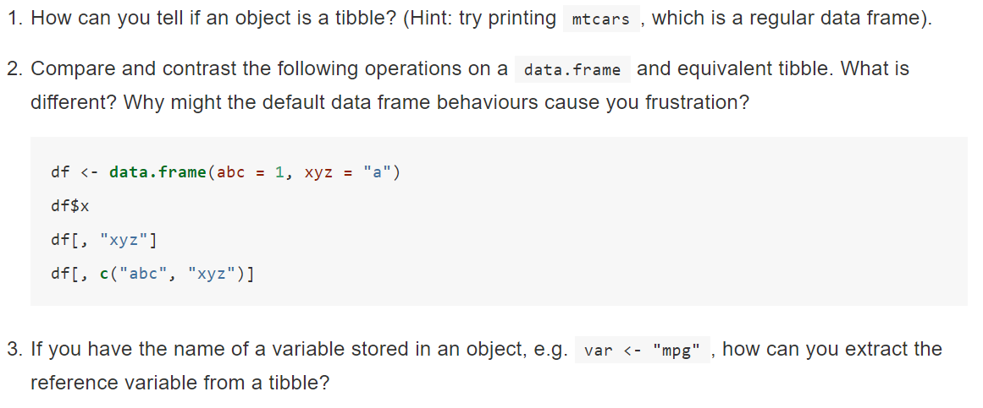
10.5 Exercises

Slide 24
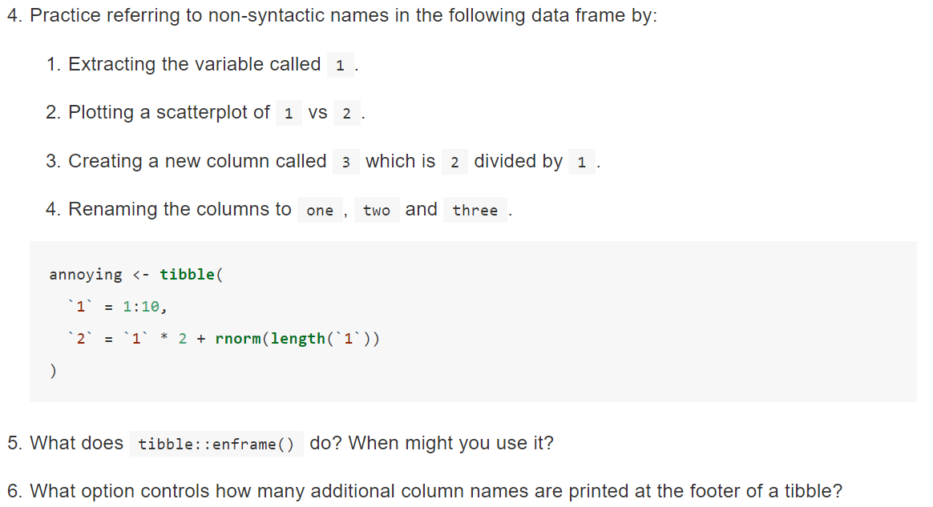
10.5 Exercises

