Slide 1
Vectors/Iterators(I)

Slide 2
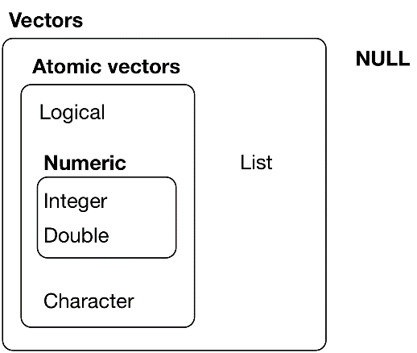
Two types of vectors
Atomic vectors, of which there are six types: logical, integer, double, character, complex, and raw. Integer and double vectors are collectively known as numeric vectors.
Lists, which are sometimes called recursive vectors because lists can contain other lists.

Slide 3
Two key properties of vectors
typeof()
typeof(letters) #> [1] “character” typeof(1:10) #> [1] “integer”
length()
x <- list(“a”, “b”, 1:10) length(x) #> [1] 3

Slide 4
Augmented Vectors
Factors are built on top of integer vectors.
Dates and date-times are built on top of numeric vectors.
Data frames and tibbles are built on top of lists.

Slide 5
Logical
Logical vectors are the simplest type of atomic vector because they can take only three possible values: FALSE, TRUE, and NA.
1:10 %% 3 == 0 #> [1] FALSE FALSE TRUE FALSE FALSE TRUE FALSE FALSE TRUE FALSE c(TRUE, TRUE, FALSE, NA) #> [1] TRUE TRUE FALSE NA

Slide 6
Numeric
Integer and double vectors are known collectively as numeric vectors. In R, numbers are doubles by default. To make an integer, place an L after the number:
typeof(1) #> [1] "double" typeof(1L) #> [1] "integer“ 1.5L #> [1] 1.5
x <- sqrt(2) ^ 2 x #> [1] 2 x - 2 #> [1] 4.44e-16
c(-1, 0, 1) / 0 #> [1] -Inf NaN Inf
Avoid using == to check for these other special values. Instead use the helper functions is.finite(), is.infinite(), and is.nan():
Doubles are approximations. Doubles represent floating point numbers that can not always be precisely represented with a fixed amount of memory. This means that you should consider all doubles to be approximations. : dplyr::near() instead of ‘==‘

Slide 7
Character
Character vectors are the most complex type of atomic vector, because each element of a character vector is a string, and a string can contain an arbitrary amount of data.
R uses a global string pool. This means that each unique string is only stored in memory once, and every use of the string points to that representation.
‘y’ doesn’t take up 1,000x as much memory as x, because each element of y is just a pointer to that same string. A pointer is 8 bytes, so 1000 pointers to a 136 B string is 8 * 1000 + 136 = 8.13 kB.
x <- "This is a reasonably long string." pryr::object_size(x) #> 136 B y <- rep(x, 1000) pryr::object_size(y) #> 8.13 kB

Slide 8
Missing Values
NA # logical #> [1] NA NA_integer_ # integer #> [1] NA NA_real_ # double #> [1] NA NA_character_ # character #> [1] NA
Normally you don’t need to know about these different types because you can always use NA and it will be converted to the correct type using the implicit coercion rules described next. However, there are some functions that are strict about their inputs, so it’s useful to have this knowledge sitting in your back pocket so you can be specific when needed.

Slide 9
Using atomic vectors
How to convert from one type to another, and when that happens automatically.
How to tell if an object is a specific type of vector.
What happens when you work with vectors of different lengths.
How to name the elements of a vector.
How to pull out elements of interest.

Slide 10
Coercion
There are two ways to convert, or coerce, one type of vector to another:
Explicit coercion happens when you call a function like as.logical(), as.integer(), as.double(), or as.character(). Whenever you find yourself using explicit coercion, you should always check whether you can make the fix upstream, so that the vector never had the wrong type in the first place. For example, you may need to tweak your readr col_types specification.
Implicit coercion happens when you use a vector in a specific context that expects a certain type of vector. For example, when you use a logical vector with a numeric summary function, or when you use a double vector where an integer vector is expected.
Because explicit coercion is used relatively rarely, and is largely easy to understand, I’ll focus on implicit coercion here.

Slide 11
You’ve already seen the most important type of implicit coercion: using a logical vector in a numeric context. In this case TRUE is converted to 1 and FALSE converted to 0. That means the sum of a logical vector is the number of trues, and the mean of a logical vector is the proportion of trues:
x <- sample(20, 100, replace = TRUE) y <- x > 10 sum(y) # how many are greater than 10? #> [1] 44 mean(y) # what proportion are greater than 10? #> [1] 0.44
if (length(x)) { # do something }
typeof(c(TRUE, 1L)) #> [1] "integer" typeof(c(1L, 1.5)) #> [1] "double" typeof(c(1.5, "a")) #> [1] "character"
An atomic vector can not have a mix of different types because the type is a property of the complete vector, not the individual elements. If you need to mix multiple types in the same vector, you should use a list, which you’ll learn about shortly.

Slide 12
Test Functions
 | lgl | int | dbl | chr | list
is_logical() | x
is_integer() |  | x
is_double() |  |  | x
is_numeric() |  | x | x
is_character() |  |  |  | x
is_atomic() | x | x | x | x
is_list() |  |  |  |  | x
is_vector() | x | x | x | x | x
Each predicate also comes with a “scalar” version, like is_scalar_atomic(), which checks that the length is 1. This is useful, for example, if you want to check that an argument to your function is a single logical value.

Slide 13
Scalars and recycling rules
As well as implicitly coercing the types of vectors to be compatible, R will also implicitly coerce the length of vectors. This is called vector recycling, because the shorter vector is repeated, or recycled, to the same length as the longer vector.
This is generally most useful when you are mixing vectors and “scalars”. I put scalars in quotes because R doesn’t actually have scalars: instead, a single number is a vector of length 1. Because there are no scalars, most built-in functions are vectorised, meaning that they will operate on a vector of numbers. That’s why, for example, this code works:

Slide 14
sample(10) + 100 #> [1] 109 108 104 102 103 110 106 107 105 101 runif(10) > 0.5 #> [1] TRUE TRUE FALSE TRUE TRUE TRUE FALSE TRUE TRUE TRUE
1:10 + 1:2 #> [1] 2 4 4 6 6 8 8 10 10 12
1:10 + 1:3 #> Warning in 1:10 + 1:3: longer object length is not a multiple of shorter #> object length #> [1] 2 4 6 5 7 9 8 10 12 11

Slide 15
tibble(x = 1:4, y = 1:2) #> Error: Variables must be length 1 or 4. #> Problem variables: 'y' tibble(x = 1:4, y = rep(1:2, 2)) #> # A tibble: 4 × 2 #> x y #> <int> <int> #> 1 1 1 #> 2 2 2 #> 3 3 1 #> 4 4 2 tibble(x = 1:4, y = rep(1:2, each = 2)) #> # A tibble: 4 × 2 #> x y #> <int> <int> #> 1 1 1 #> 2 2 1 #> 3 3 2 #> 4 4 2
While vector recycling can be used to create very succinct, clever code, it can also silently conceal problems. For this reason, the vectorised functions in tidyverse will throw errors when you recycle anything other than a scalar. If you do want to recycle, you’ll need to do it yourself with rep():

Slide 16
Naming vectors
c(x = 1, y = 2, z = 4) #> x y z #> 1 2 4
set_names(1:3, c("a", "b", "c")) #> a b c #> 1 2 3

Slide 17
Subsetting
So far we’ve used dplyr::filter() to filter the rows in a tibble. filter() only works with tibble, so we’ll need new tool for vectors: [. [ is the subsetting function, and is called like x[a]. There are four types of things that you can subset a vector with:
A numeric vector containing only integers. The integers must either be all positive, all negative, or zero.
Subsetting with a logical vector keeps all values corresponding to a TRUE value. This is most often useful in conjunction with the comparison functions.
If you have a named vector, you can subset it with a character vector:
The simplest type of subsetting is nothing, x[], which returns the complete x. This is not useful for subsetting vectors, but it is useful when subsetting matrices (and other high dimensional structures) because it lets you select all the rows or all the columns, by leaving that index blank. For example, if x is 2d, x[1, ] selects the first row and all the columns, and x[, -1] selects all rows and all columns except the first.
Reference : http://adv-r.had.co.nz/Subsetting.html#applications

Slide 18
Subsetting with positive integers keeps the elements at those positions:
x <- c("one", "two", "three", "four", "five") x[c(3, 2, 5)] #> [1] "three" "two" "five"
By repeating a position, you can actually make a longer output than input:
x[c(1, 1, 5, 5, 5, 2)] #> [1] "one" "one" "five" "five" "five" "two"
Negative values drop the elements at the specified positions:
x[c(-1, -3, -5)] #> [1] "two" "four"
It’s an error to mix positive and negative values:
x[c(1, -1)] #> Error in x[c(1, -1)]: only 0's may be mixed with negative subscripts
The error message mentions subsetting with zero, which returns no values:
x[0] #> character(0)

Slide 19
x <- c(10, 3, NA, 5, 8, 1, NA)
# All non-missing values of x x[!is.na(x)] #> [1] 10 3 5 8 1 # All even (or missing!) values of x x[x %% 2 == 0] #> [1] 10 NA 8 NA
x <- c(abc = 1, def = 2, xyz = 5) x[c("xyz", "def")] #> xyz def #> 5 2

Slide 20
Recursive vectors (lists)
str(x) #> List of 3 #> $ : num 1 #> $ : num 2 #> $ : num 3 x_named <- list(a = 1, b = 2, c = 3) str(x_named) #> List of 3 #> $ a: num 1 #> $ b: num 2 #> $ c: num 3
x <- list(1, 2, 3) x #> [[1]] #> [1] 1 #> #> [[2]] #> [1] 2 #> #> [[3]] #> [1] 3
A very useful tool for working with lists is str() because it focusses on the structure, not the contents.

Slide 21
z <- list(list(1, 2), list(3, 4)) str(z) #> List of 2 #> $ :List of 2 #> ..$ : num 1 #> ..$ : num 2 #> $ :List of 2 #> ..$ : num 3 #> ..$ : num 4
y <- list("a", 1L, 1.5, TRUE) str(y) #> List of 4 #> $ : chr "a" #> $ : int 1 #> $ : num 1.5 #> $ : logi TRUE

Slide 22
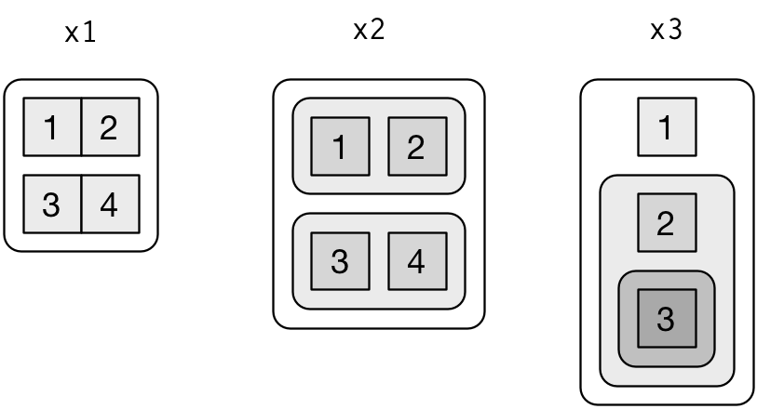
Visualizing lists
x1 <- list(c(1, 2), c(3, 4)) x2 <- list(list(1, 2), list(3, 4)) x3 <- list(1, list(2, list(3)))

Slide 23
a <- list(a = 1:3, b = "a string", c = pi, d = list(-1, -5))
str(a[1:2]) #> List of 2 #> $ a: int [1:3] 1 2 3 #> $ b: chr "a string" str(a[4]) #> List of 1 #> $ d:List of 2 #> ..$ : num -1 #> ..$ : num -5
[ extracts a sub-list. The result will always be a list.
str(a[[1]]) #> int [1:3] 1 2 3 str(a[[4]]) #> List of 2 #> $ : num -1 #> $ : num -5
[[ extracts a single component from a list. It removes a level of hierarchy from the list.
a$a #> [1] 1 2 3 a[["a"]] #> [1] 1 2 3
$ is a shorthand for extracting named elements of a list. It works similarly to [[ except that you don’t need to use quotes.

Slide 24
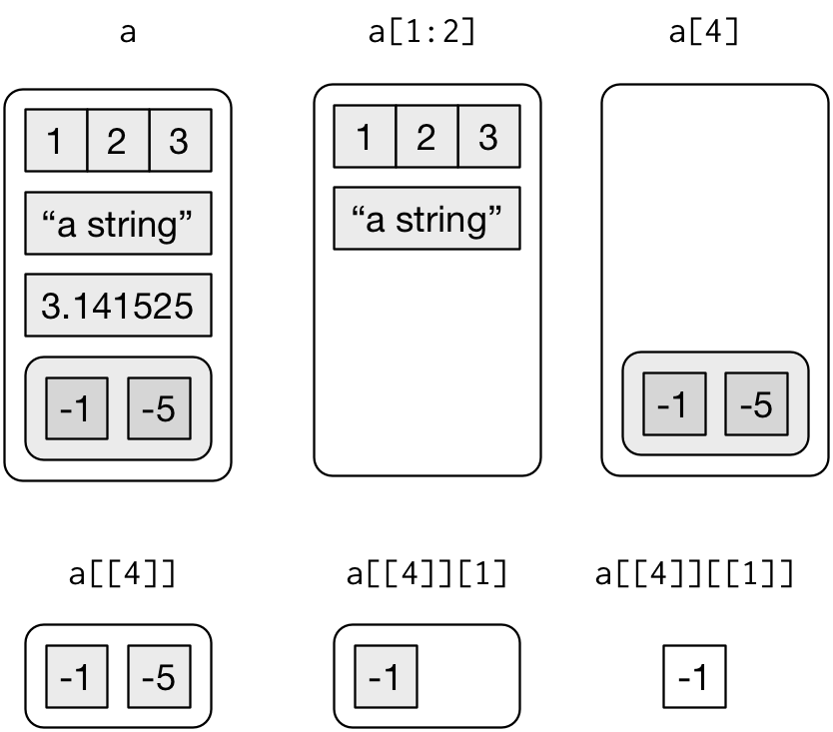

Slide 25
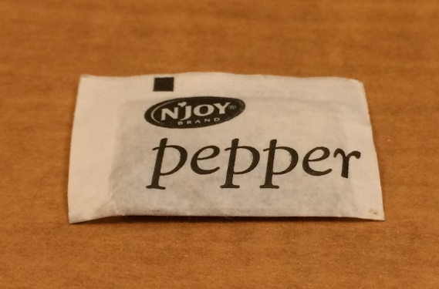

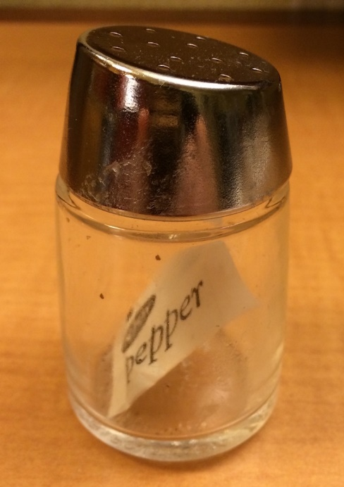

Lists of condiments
The difference between [ and [[ is very important, but it’s easy to get confused. To help you remember, let me show you an unusual pepper shaker.
x[[1]]
x[[1]][[1]]
x
x[1]

Slide 26
Attributes
Any vector can contain arbitrary additional metadata through its attributes. You can think of attributes as named list of vectors that can be attached to any object. You can get and set individual attribute values with attr() or see them all at once with attributes().
x <- 1:10 attr(x, "greeting") #> NULL attr(x, "greeting") <- "Hi!" attr(x, "farewell") <- "Bye!" attributes(x) #> $greeting #> [1] "Hi!" #> #> $farewell #> [1] "Bye!"

Slide 27
Three import attributes
There are three very important attributes that are used to implement fundamental parts of R:
Names are used to name the elements of a vector.
Dimensions (dims, for short) make a vector behave like a matrix or array.
Class is used to implement the S3 object oriented system.

Slide 28
Generic Functions?
It remains to describe the class, which controls how generic functions work. Generic functions are key to object oriented programming in R, because they make functions behave differently for different classes of input. A detailed discussion of object oriented programming is beyond the scope of this book, but you can read more about it in Advanced R at http://adv-r.had.co.nz/OO-essentials.html#s3.

Slide 29
as.Date #> function (x, ...) #> UseMethod("as.Date") #> <bytecode: 0x6b42288> #> <environment: namespace:base>
The call to “UseMethod” means that this is a generic function, and it will call a specific method, a function, based on the class of the first argument. (All methods are functions; not all functions are methods). You can list all the methods for a generic with methods():
methods("as.Date") #> [1] as.Date.character as.Date.date as.Date.dates as.Date.default #> [5] as.Date.factor as.Date.numeric as.Date.POSIXct as.Date.POSIXlt #> see '?methods' for accessing help and source code

Slide 30
getS3method("as.Date", "default") #> function (x, ...) #> { #> if (inherits(x, "Date")) #> return(x) #> if (is.logical(x) && all(is.na(x))) #> return(structure(as.numeric(x), class = "Date")) #> stop(gettextf("do not know how to convert '%s' to class %s", #> deparse(substitute(x)), dQuote("Date")), domain = NA) #> } #> <bytecode: 0x573a678> #> <environment: namespace:base> getS3method("as.Date", "numeric") #> function (x, origin, ...) #> { #> if (missing(origin)) #> stop("'origin' must be supplied") #> as.Date(origin, ...) + x #> } #> <bytecode: 0x573d6b8> #> <environment: namespace:base>
The most important S3 generic is print(): it controls how the object is printed when you type its name at the console. Other important generics are the subsetting functions [, [[, and $.

Slide 31
Augmented Vectors
Atomic vectors and lists are the building blocks for other important vector types like factors and dates. I call these augmented vectors, because they are vectors with additional attributes, including class. Because augmented vectors have a class, they behave differently to the atomic vector on which they are built. In this book, we make use of four important augmented vectors:
Factors
Dates
Date-times
Tibbles
These are described below.

Slide 32
Factors
Factors are designed to represent categorical data that can take a fixed set of possible values. Factors are built on top of integers, and have a levels attribute:
x <- factor(c("ab", "cd", "ab"), levels = c("ab", "cd", "ef")) typeof(x) #> [1] "integer" attributes(x) #> $levels #> [1] "ab" "cd" "ef" #> #> $class #> [1] "factor"

Slide 33
Dates and date-times
Date-times are numeric vectors with class POSIXct that represent the number of seconds since 1 January 1970. (In case you were wondering, “POSIXct” stands for “Portable Operating System Interface”, calendar time.)
x <- as.Date("1971-01-01") unclass(x) #> [1] 365 typeof(x) #> [1] "double" attributes(x) #> $class #> [1] "Date"

Slide 34
x <- lubridate::ymd_hm("1970-01-01 01:00") unclass(x) #> [1] 3600 #> attr(,"tzone") #> [1] "UTC" typeof(x) #> [1] "double" attributes(x) #> $tzone #> [1] "UTC" #> #> $class #> [1] "POSIXct" "POSIXt"
attr(x, "tzone") <- "US/Pacific" x #> [1] "1969-12-31 17:00:00 PST" attr(x, "tzone") <- "US/Eastern" x #> [1] "1969-12-31 20:00:00 EST"
y <- as.POSIXlt(x) typeof(y) #> [1] "list" attributes(y) #> $names #> [1] "sec" "min" "hour" "mday" "mon" "year" "wday" #> [8] "yday" "isdst" "zone" "gmtoff" #> #> $class #> [1] "POSIXlt" "POSIXt" #> #> $tzone #> [1] "US/Eastern" "EST" "EDT"

Slide 35
Tibbles
Tibbles are augmented lists: they have class “tbl_df” + “tbl” + “data.frame”, and names (column) and row.names attributes:
tb <- tibble::tibble(x = 1:5, y = 5:1) typeof(tb) #> [1] "list" attributes(tb) #> $names #> [1] "x" "y" #> #> $class #> [1] "tbl_df" "tbl" "data.frame" #> #> $row.names #> [1] 1 2 3 4 5
df <- data.frame(x = 1:5, y = 5:1) typeof(df) #> [1] "list" attributes(df) #> $names #> [1] "x" "y" #> #> $row.names #> [1] 1 2 3 4 5 #> #> $class #> [1] "data.frame"
The difference between a tibble and a list is that all the elements of a data frame must be vectors with the same length. All functions that work with tibbles enforce this constraint.
The main difference is the class. The class of tibble includes “data.frame” which means tibbles inherit the regular data frame behaviour by default.

