Slide 1
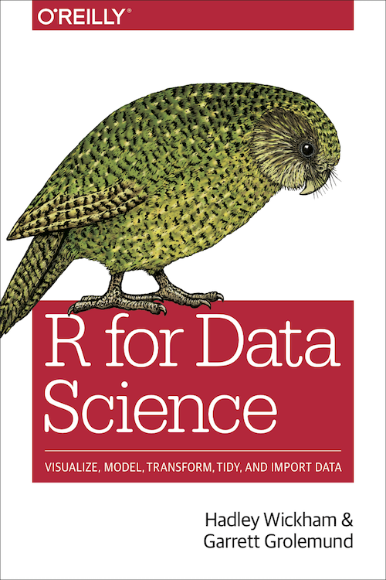
#23 Model Basics

Slide 2
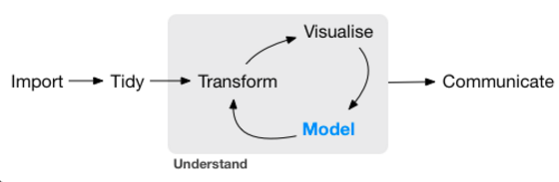
Introduction
The focus of this chapter is on exploration, not confirmation or formal inference. But you’ll learn a few basic tools that help you understand the variation within your models.

Slide 3
2 Category
Supervised(지도학습) : 훈련 데이터(Training Data)로부터 하나의 함수를 유추해내기 위한 기계 학습(Machine Learning)
Unsupervised(비지도학습) : 데이터가 어떻게 구성되었는지를 알아내는 문제의 범주, 입력값에 대한 목표치가 주어지지 않음

Slide 4
In model basics, you’ll learn how models work mechanistically, focussing on the important family of linear models. You’ll learn general tools for gaining insight into what a predictive model tells you about your data, focussing on simple simulated datasets.
In model building, you’ll learn how to use models to pull out known patterns in real data.
In many models, you’ll learn how to use many simple models to help understand complex datasets. This is a powerful technique, but to access it you’ll need to combine modelling and programming tools.

Slide 5
Hypothesis generation vs. hypothesis confirmation
Doing this correctly is not complicated, but it is hard. There is a pair of ideas that you must understand in order to do inference correctly:
Each observation can either be used for exploration or confirmation, not both.
You can use an observation as many times as you like for exploration, but you can only use it once for confirmation. As soon as you use an observation twice, you’ve switched from confirmation to exploration.

Slide 6
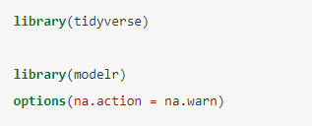

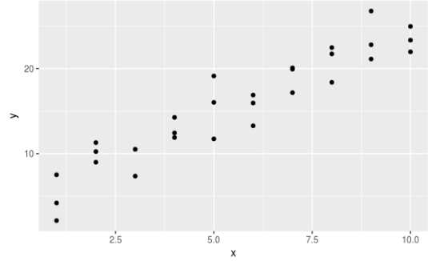
Model Basics
Prerequisites
Simple Model
modelr 패키지를 사용하여 파이프에서 자연스럽게 작동하도록 하기 위함
Modelr 패키지에 sim1 이라는 DataSet포함. Sim1의 패턴 확인

Slide 7
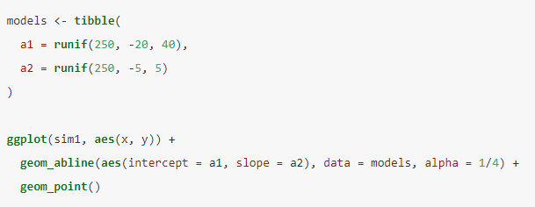
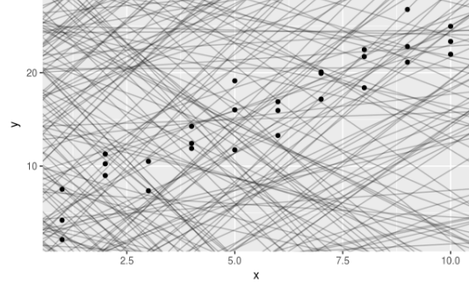
Model Basics
There are 250 models on this plot, but a lot are really bad! We need to find the good models by making precise our intuition that a good model is “close” to the data. We need a way to quantify the distance between the data and a model.

Slide 8
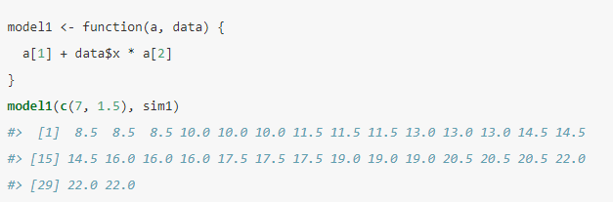
Model Basics
The plot shows 30 distances: how do we collapse that into a single number?

Slide 9
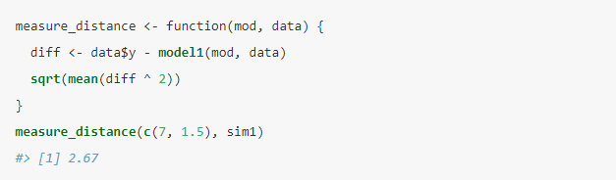
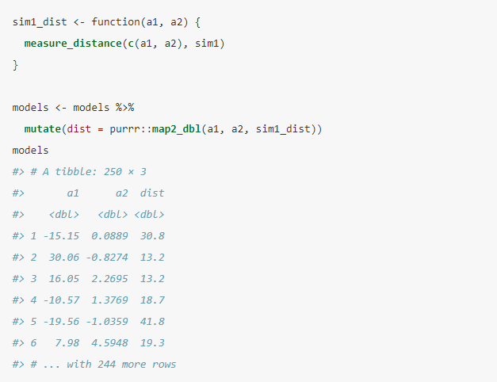
Model Basics
we can use purrr to compute the distance for all the models defined above. We need a helper function because our distance function expects the model as a numeric vector of length 2.

Slide 10
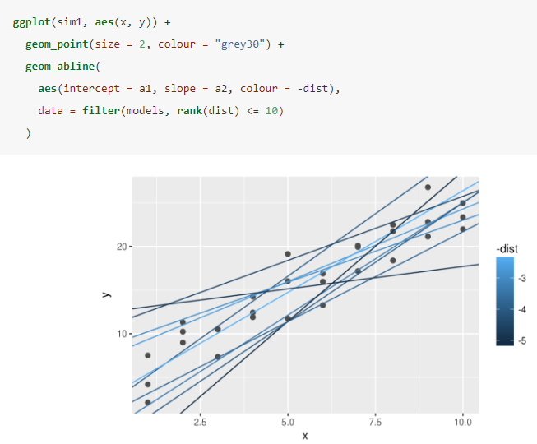
Model Basics
let’s overlay the 10 best models on to the data. I’ve coloured the models by –dist : this is an easy way to make sure that the best models (i.e. the ones with the smallest distance) get the brighest colours.

Slide 11
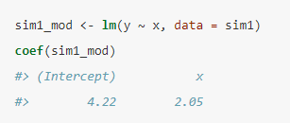
Model Basics
Using some connections between geometry, calculus, and linear algebra, lm() actually finds the closest model in a single step, using a sophisticated algorithm. This approach is both faster, and guarantees that there is a global minimum.

Slide 12
Visualising models
It’s also useful to see what the model doesn’t capture, the so-called residuals which are left after subtracting the predictions from the data. Residuals are powerful because they allow us to use models to remove striking patterns so we can study the subtler trends that remain.

Slide 13
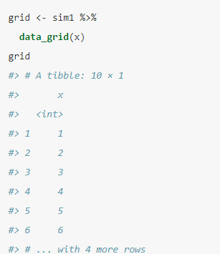
Visualising models - Prediction
To visualise the predictions from a model, we start by generating an evenly spaced grid of values that covers the region where our data lies.
균일한 값을 생성하기 위해 사용한 modelr :: data_grid()

Slide 14
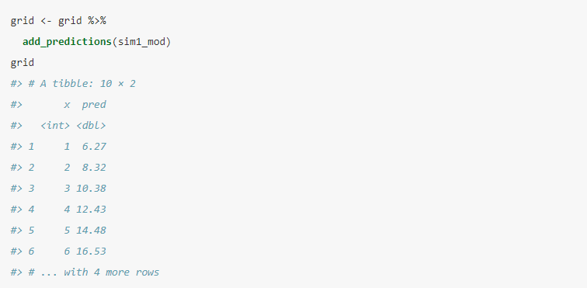
Visualising models – Prediction_Add
Modelr :: add_prediction() 을 사용하면 예측 열을 추가 할 수 있다.

Slide 15
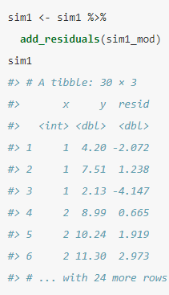
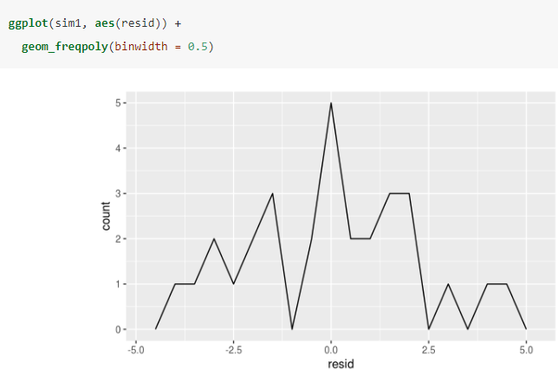
Visualising models – Residual
We add residuals to the data with add_residual( ), which works much like add_prediction( )

Slide 16
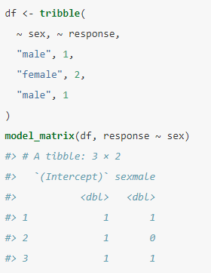
Categorical variables
범주형 일 때는 상황이 조금 복잡해짐 범주형 변수이기 때문에 0 or 1로 표현을 해야함

Slide 17
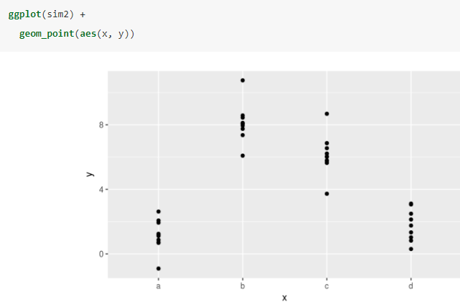
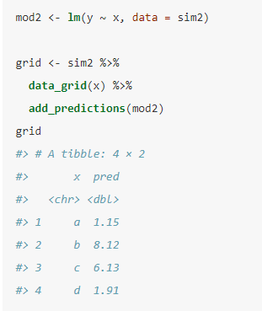
Look at some data and models to make that concrete. Here’s the sim2 dataset from modelr
We can fit a model to it, and generate predictions:

Slide 18
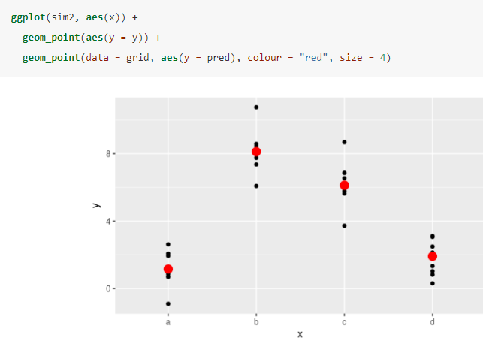
That’s easy to see if we overlay the predictions on top of the original data:

Slide 19
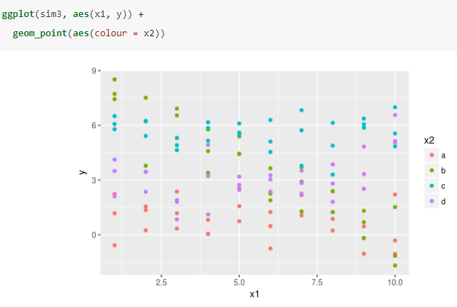
Interactions (continuous and categorical)
What happens when you combine a continuous and a categorical variable?

Slide 20

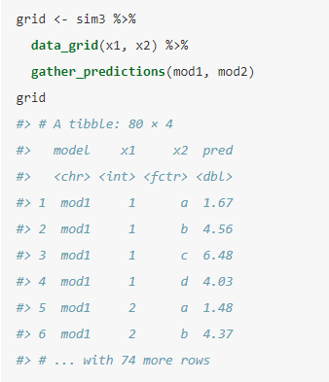
There are two possible models you could fit to this data:
When you add variables with +, the model will estimate each effect independent of all the others. It’s possible to fit the so-called interaction by using * .
To visualise these models we need two new tricks: We have two predictors, so we need to give data_grid( ) both variable. To generate predictions from both models simultaneously, we can use gather_prediction( ) which adds each prediction as a row.

Slide 21
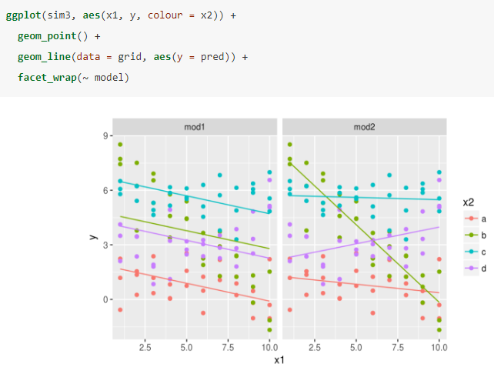
Interactions (continuous and categorical)
Note that the model that uses + has the same slope for each line, but different intercepts. The model that uses * has a different slope and intercept for each line.
Which model is better for this data? We can take look at the residuals. Here I’ve facetted by both model and x2 because it makes it easier to see the pattern within each group.

Slide 22
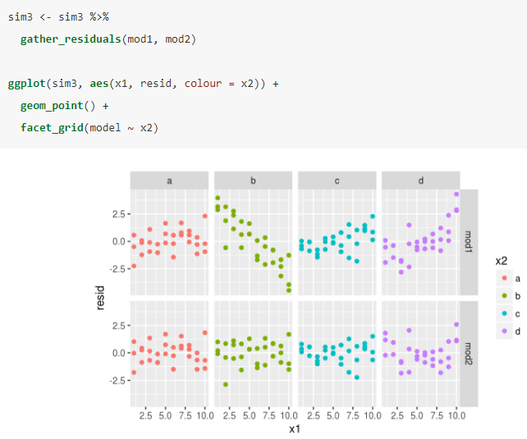
Interactions (continuous and categorical)
There is little obvious pattern in the residuals for mod2. The residuals for mod1 show that the model has clearly missed some pattern in b, and less so, but still present is pattern in c, and d.

Slide 23
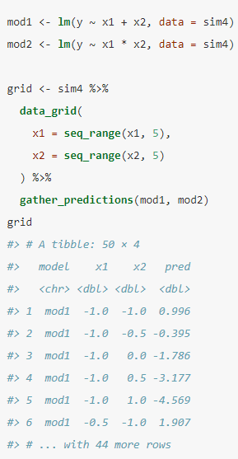
Interactions (two continuous)
연속형 변수가 2개 일 때

Slide 24
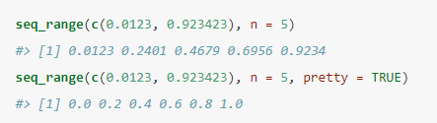
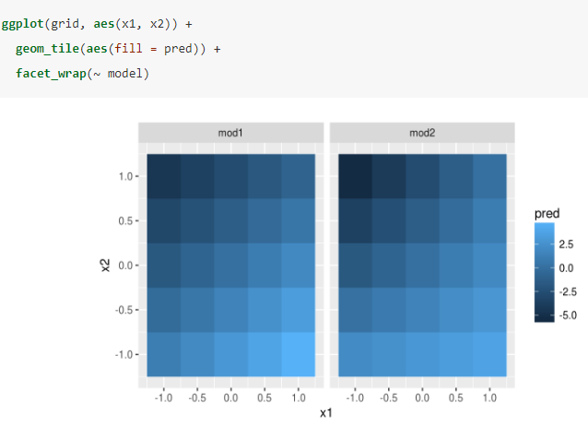
Interactions (two continuous)
Pretty = TRUE will generate a “pretty” sequence, i.e. something that looks nice to the human eye. This is useful if you want to produce tables of output:
Next let’s try and visualise that model. We have two continuous predictors, so you can imagine the model like a 3d surface. We could display that using geom_tile( ) :

Slide 25
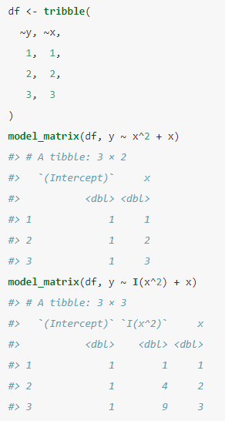
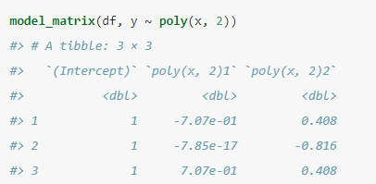
Transformations
Transformations are useful because you can use them to approximate non-linear functions. Typing that sequence by hand is tedious, so R provides a helper function: : poly ( )
Use a fumction Poly( )

Slide 26
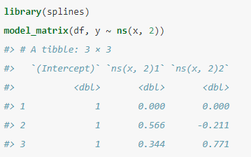
Transformations
However there's one major problem with using : poly( ) outside the range of the data, polynomials rapidly shoot off to positive or negative infinity. One safer alternative is to use the natural spline, . : spline :: ns( )
Poly( ) 는 데이터의 범위를 벗어날 때 음 또는 양의 무한대로 떨어져 나간다. 이것에 대한 대안 중 하나는 spline :: ns를 사용 하는 것

Slide 27
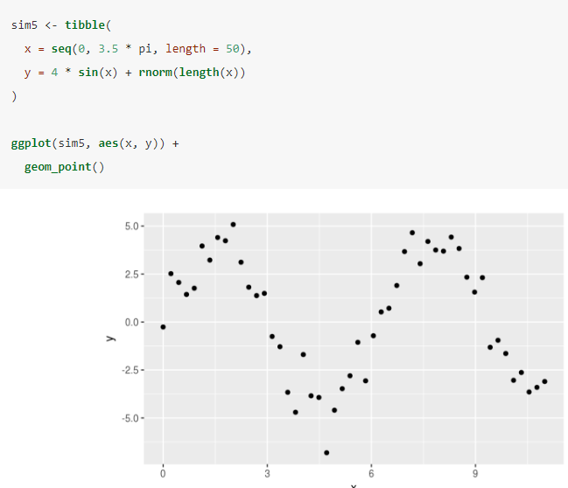
Transformations
Let’s see what that looks like when we try and approximate a non-linear function:
비선형 함수를 근사 할 때 어떤 모양인지에 대한 부분

Slide 28
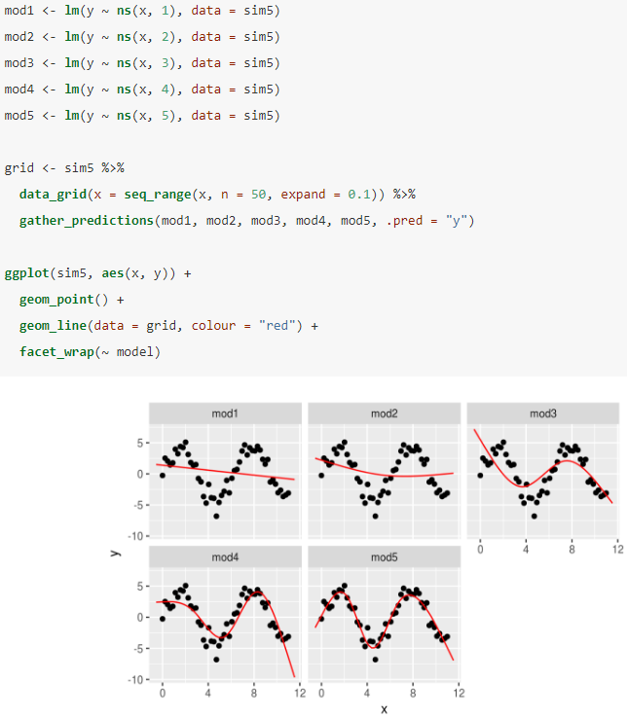
Transformations
5가지 모델을 적용 하면

Slide 29
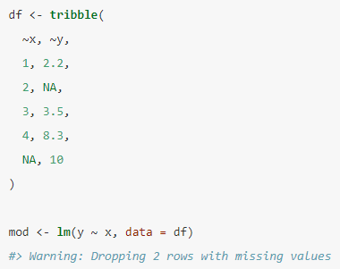
Missing values
Missing values obviously can not convey any information about the relationship between the variables, so modelling functions will drop any rows that contain missing values. R’s default behaviour is to silently drop them, but options(na.action = na.warn) (run in the prerequisites), makes sure you get a warning.

