Slide 1
RNN
이규영

Slide 2
https://hunkim.github.io/ml/
https://github.com/hunkim/DeepLearningZeroToAll
https://hunkim.github.io/ml/lec12.pdf
https://github.com/hunkim/DeepLearningZeroToAll/blob/master/lab-12-0-rnn_basics.ipynb

Slide 3
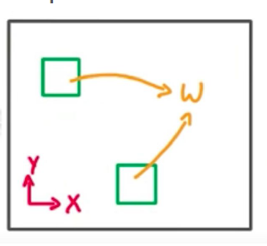
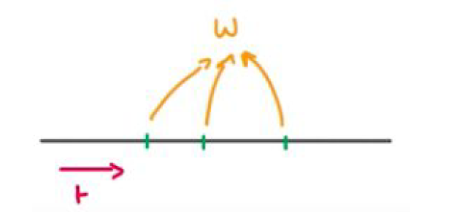
Sequential Data Modeling
Speech/Language Translation
Action in video summarization
Music recognition
Time-series forecasting → 효과는 미약
CNN model shares parameter over spatial
RNN model shares parameters over sequence (or time)

Slide 4
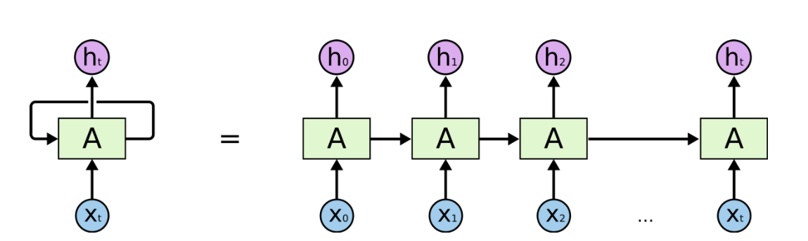
RNN

Slide 5
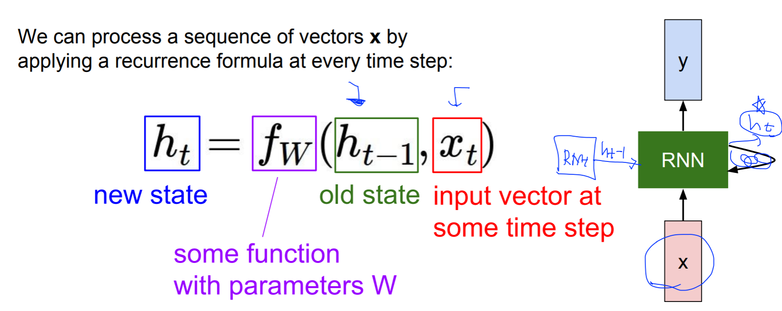
RNN
Notice: the same function and the same set of parameters are used at every time step.

Slide 6
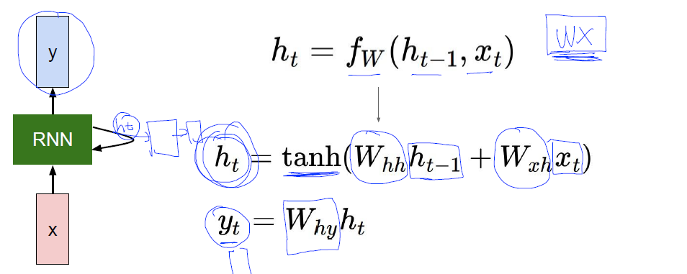
Vanilla RNN

Slide 7
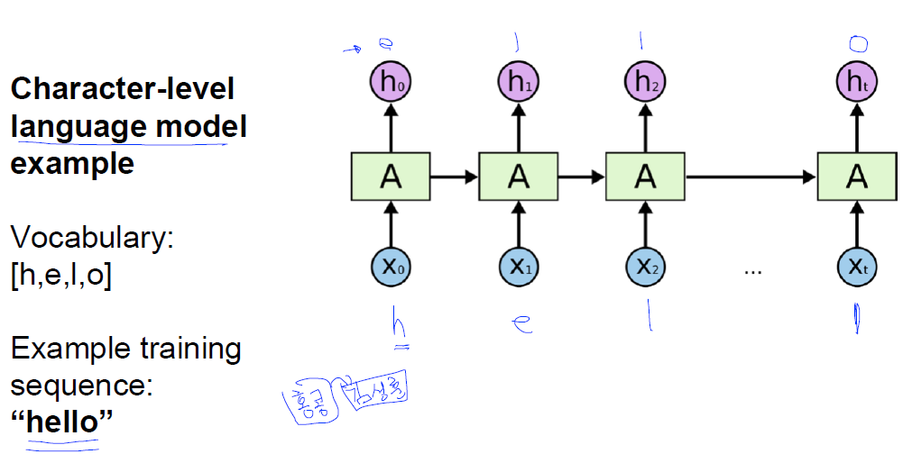
Example RNN

Slide 8
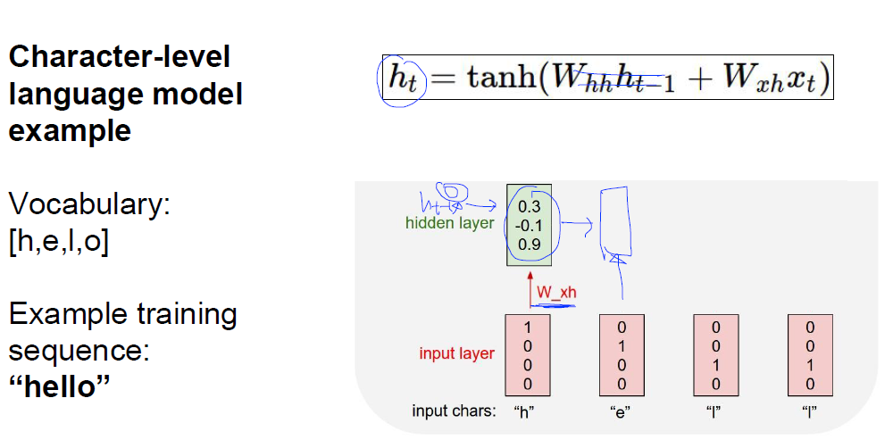
Example RNN

Slide 9
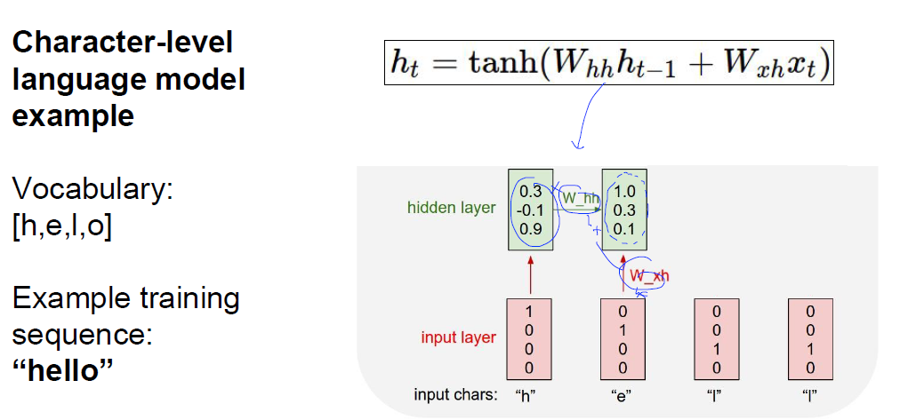
Example RNN

Slide 10
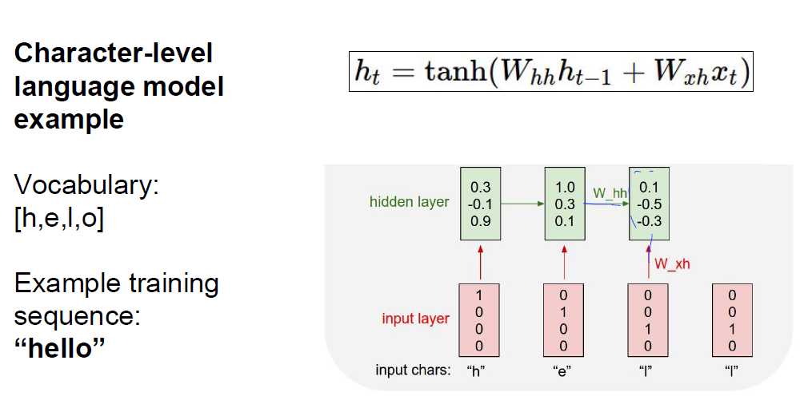
Example RNN

Slide 11
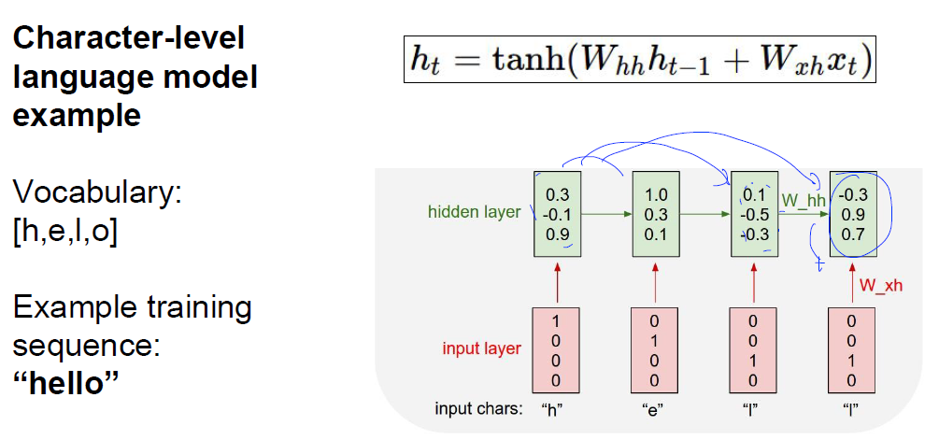
Example RNN

Slide 12
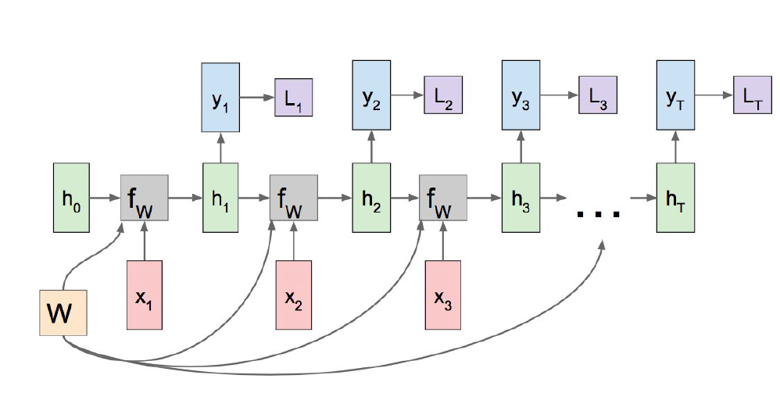
RNN : many to many

Slide 13
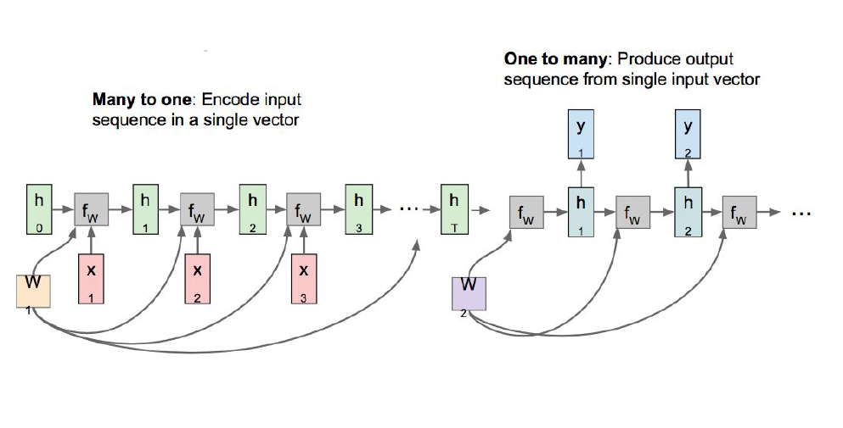
RNN : many to one + one to many

Slide 14
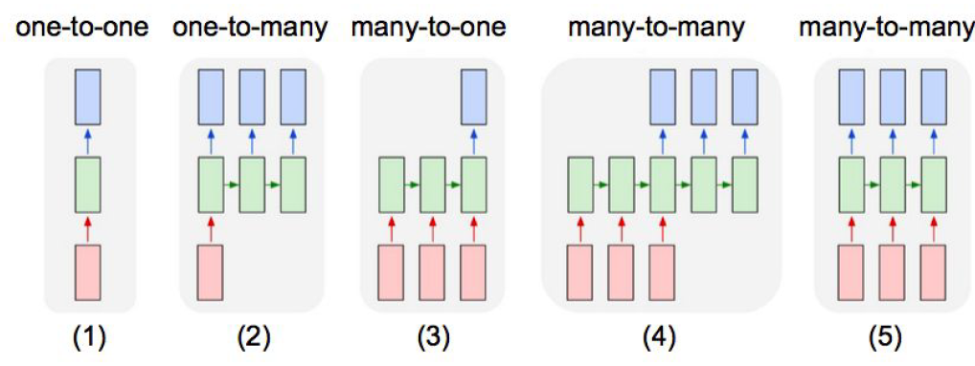
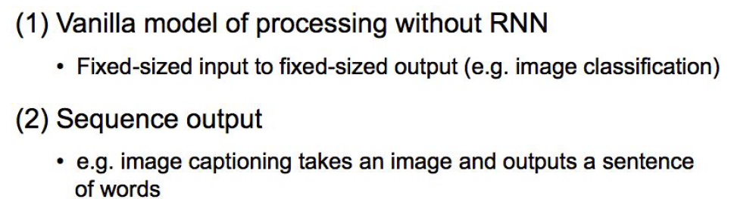
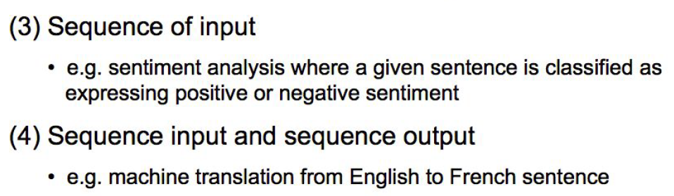
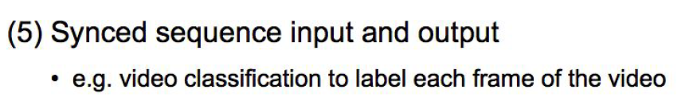
RNN Model Type

Slide 15
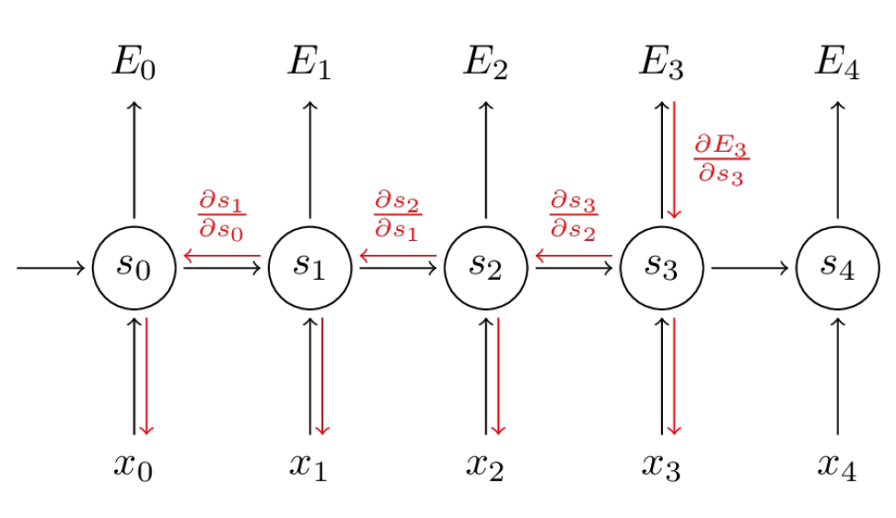
Vanishing Gradients Problem
Backpropagation Through Time

Slide 16
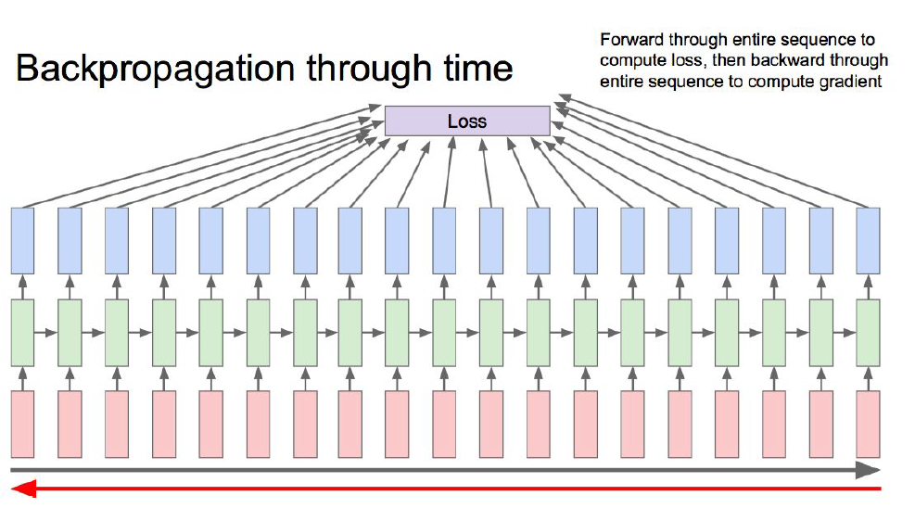
Vanishing Gradients Problem

Slide 17
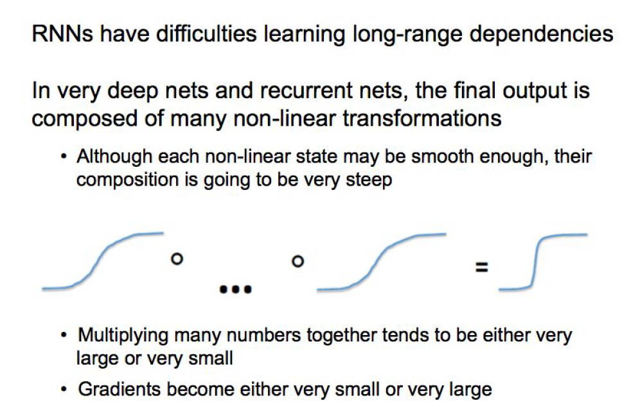
Vanishing Gradients Problem

Slide 18
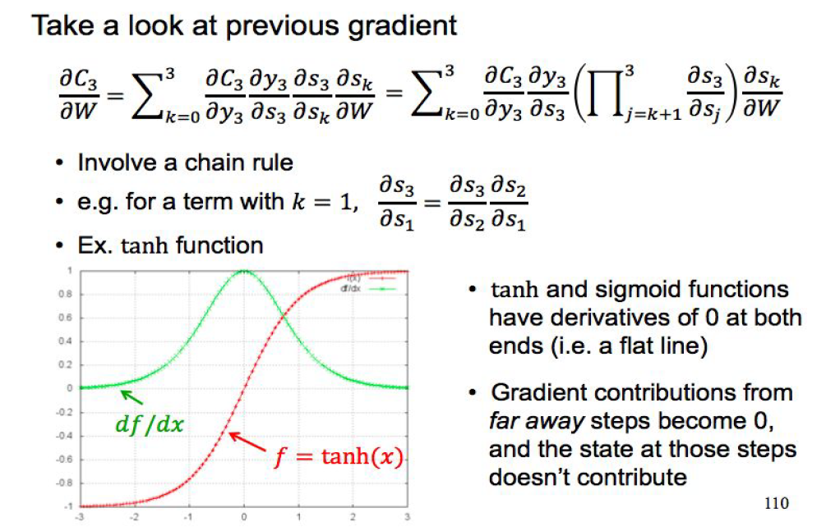
Vanishing Gradients Problem

Slide 19
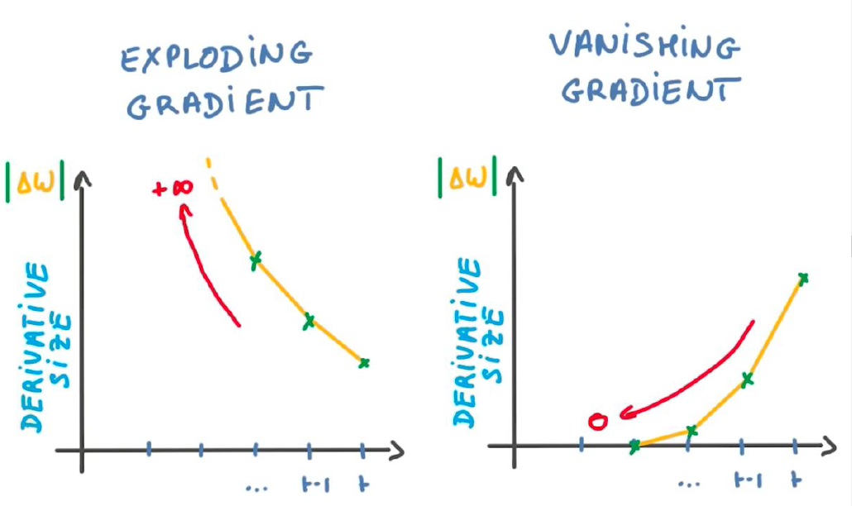
Vanishing Gradients Problem
-> Gradient Clipping
-> LSTM/GRU

