Slide 1

Kagglizer
A Data Science Tool with AI Assistant
ICW with Microsoft Global AI Hack 15 FEB – 4 MAR 2024

Slide 2
AGENDA
Intro
What We Want to Build
Frontend CaseSteps
Frontend AI Assistant
Architecture
Next Steps

Slide 3
Problem Statement
CONTEXT = Random software engineering types coming together for MS Global AI Hackathon 15 FEB – 4 MAR 2024. Most are time constrainted part-time contributors with mostly junior full-stack developer skills. Only one developer has taken an Machine Learning college class.
PROBLEM = How do we produce a competitive product given constraints?
OBJECTIVES =
1) Create a solution that utilizes AI in combination with Microsoft Fabric Features (as defined by MS) that is not dismissed for non-compliance with submission rules.
2) Have a positive learning experience for all contributors
3) Early identification of contributors most like to contribute the most and have them as registered competitors and benefit by official recognition. These will be noted on project pages as ‘lead developer’ or similar.
4) Allow other interested contributors to perform project support development tasks and gain hackathon experience. These will be noted on project pages as ‘project advisors’ or something similiar.
SCOPE & CONSTRAINTS =
1) Must use Microsoft Fabric and AI (either Co-pilot or Azure OpenAI), sub by 4 MAR and other factors in rules
2) Proviso for asynchronous work and communication
ASSUMPTIONS & DEPENDENCIES =
1) It will be very beneficial to pick a Kaggle Problem with datasets and starter code provided.
2) It is not necessary that we solve the Kaggle Problem for the MS Hack.
3) The Kaggle problem makes this hackathon a twofer of sorts… the Kaggle problem is competition of itself with similar outputs, $25k in 1st prize and a deadline of 6 MAY 2024. Taking indications of interest for that registrated team.

Slide 4
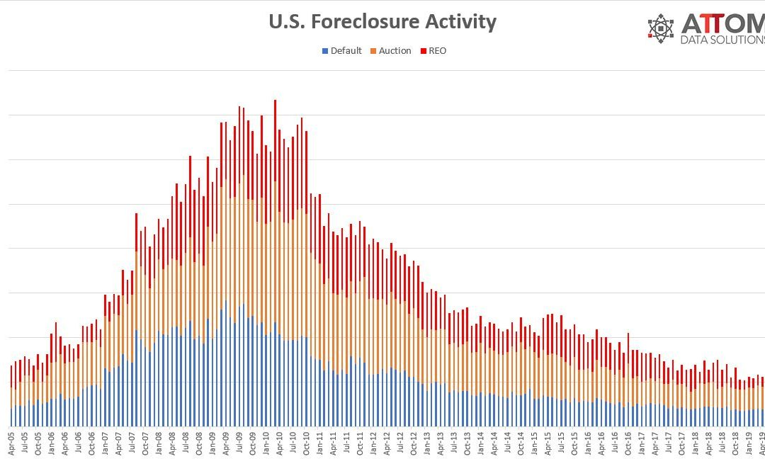





Casebook – Credit Risk Model Stability
Hard $25k
Your model will be evaluated using a gini stability metric.
QUESTION: What is the gini metric and what are the component factors?
CHOOSE ONE:
Gini is a formula that measures the greater risk index (gi) * number of failures index (ni)
The Gini coefficient is a metric that indicates the model’s discriminatory power
The Gini metric coefficient is a metric that indicates the model’s discriminatory power
Ask ChatGPT
Explain Gini metric
The Gini metric, often used in the context of machine learning, particularly in decision tree algorithms, is a measure of purity or impurity of a set of elements. It is used to evaluate splits in the dataset: the lower the Gini metric, the better the split. The Gini metric for a node is defined as the probability of a randomly chosen sample being incorrectly labeled if it was randomly labeled according to the distribution of labels in the node.
The absence of a credit history might mean a lot of things, including young age or a preference for cash. Without traditional data, someone with little to no credit history is likely to be denied. Consumer finance providers must accurately determine which clients can repay a loan and which cannot and data is key. If data science could help better predict one’s repayment capabilities, loans might become more accessible to those who may benefit from them the most. Currently, consumer finance providers use various statistical and machine learning methods to predict loan risk. These models are generally called scorecards. In the real world, clients' behaviors change constantly, so every scorecard must be updated regularly, which takes time. The scorecard's stability in the future is critical, as a sudden drop in performance means that loans will be issued to worse clients on average. The core of the issue is that loan providers aren't able to spot potential problems any sooner than the first due dates of those loans are observable. Given the time it takes to redevelop, validate, and implement the scorecard, stability is highly desirable. There is a trade-off between the stability of the model and its performance, and a balance must be reached before deployment. Founded in 1997, competition host Home Credit is an international consumer finance provider focusing on responsible lending primarily to people with little or no credit history. Home Credit broadens financial inclusion for the unbanked population by creating a positive and safe borrowing experience. Your work in helping to assess potential clients' default risks will enable consumer finance providers to accept more loan applications. This may improve the lives of people who have historically been denied due to lack of credit history. Use the gini stability metric to create a model.

Slide 5
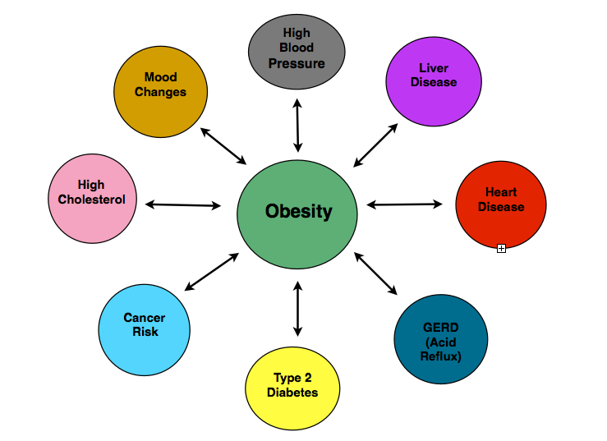
Casebook – Multi Class Prediction of Obesity Risk
Beginner $0k
Your goal is to use various factors to predict obesity risk in individuals, which is related to cardiovascular disease.
QUESTION: What are the steps to predict obesity risk in individuals using data science techniques and using this data?
train.csv - the training dataset; NObeyesdad is the categorical target
test.csv - the test dataset; your objective is to predict the class of NObeyesdad for each row
sample_submission.csv - a sample submission file in the correct format
Data collection, data exploration, data preprocessing, data splitting, model selection, model training, model evaluation, model optimization, final model training, prediction on test data, preparation for submission, submission, interpretation, deployment
CHOOSE ONE:
True
False
The Gini coefficient is a metric that indicates the model’s discriminatory power
The Gini metric coefficient is a metric that indicates the model’s discriminatory power
Ask ChatGPT
What are the steps to predict obesity risk in individuals using data science techniques and using this data?
The typical steps you would follow to predict obesity risk in individuals using data science techniques:
Data Collection
Data exploration
Data preprocessing
Data splitting
Model selection
Model training
Model evaluation
Model optimization
Final model training
Prediction on test data
Preparation for submission
Submission
Interpretation
Deployment
.
Predicting obesity risk in individuals is a complex task that involves an interplay of multiple factors. These factors can be broadly categorized into genetic, behavioral, environmental, physiological, and psychological factors. Here is an overview of each:
Genetic Factors
Behavioral Factors
Environmental Factors.
Physiological Factors
Psychological Factors
Other Factors
The dataset provided (for both train and test) was generated from a deep learning model trained on the Obesity or CVD risk dataset. Feature distributions are close to, but not exactly the same, as the original. Feel free to use the original dataset as part of this competition, both to explore differences as well as to see whether incorporating the original in training improves model performance.
Provided dataset are particularly well suited for visualizations, clustering, and general EDA. Show off your skills!

Slide 6
Work Breakdown
Product Submission
Fabric Solution with AI Assist
Kaggle Problem Stepthru
Problem Solving
Kaggle Solution
Sub File
Submission & ‘IO’
Demo Pages
Front End
Midtier
Backend
AI Assistant
C# / .NET APIs to db & Chatbot
Kaggle Problem Steps
Research
Confirm Approach
Python vs C#
Fabric
Confirm Approach
Chatbot
Chatbot
Confirm Approach
Concept
Stepthru
Kaggle Content
PS
Chatbot
Python Notebook
Fabric
Confirm Approach
DS Process
DevOps – Github / Teams
Plan & Mockup
Github Repos & Template
Project Organize
DevOps - Azure Cloud
Static & Dynamic Pages
Python Container
C#/ NETContainer
Fabric?
Fabric?
Fabric vs Azure?
Entra IDs

Slide 7
STATUS AND HAT SORTING
INITIAL INVITE LIST
william@storybook.network / woldwi74@gmail.com
orrinohanian13@gmail.com
naseanh@gmail.com
aeruelas@gmail.com
fullstackjonathon@gmail.com
jordincamp23@gmail.com
julian.118@proton.me
saevangsandy1@gmail.com
phdinh12@gmail.com
luca@chitayat.dev / lucachitayat@gmail.com
qristopherdavis@gmail.com
d.miranda@me.com
thane@storybook.network
sandavrancomputerscience@gmail.com / davrans@oregonstate.edu
Mdwilliams0521@gmail.com
RESPONDED WITH INTEREST
orrinohanian13@gmail.com
naseanh@gmail.com
fullstackjonathon@gmail.com
jordincamp23@gmail.com
phdinh12@gmail.com
luca@chitayat.dev / lucachitayat@gmail.com
qristopherdavis@gmail.com
d.miranda@me.com
thane.@storybook.network
sandavrancomputerscience@gmail.com / davrans@oregonstate.edu
Mdwilliams0521@gmail.com
IN FOR INFO
orrinohanian13@gmail.com
naseanh@gmail.com
fullstackjonathon@gmail.com
jordincamp23@gmail.com
phdinh12@gmail.com
luca@chitayat.dev / lucachitayat@gmail.com
qristopherdavis@gmail.com
d.miranda@me.com
thane.@storybook.network
sandavrancomputerscience@gmail.com / davrans@oregonstate.edu
Mdwilliams0521@gmail.com
IN FOR WORK
orrinohanian13@gmail.com
naseanh@gmail.com
fullstackjonathon@gmail.com
jordincamp23@gmail.com
phdinh12@gmail.com
luca@chitayat.dev / lucachitayat@gmail.com
qristopherdavis@gmail.com
d.miranda@me.com
thane.@storybook.network
sandavrancomputerscience@gmail.com / davrans@oregonstate.edu
IN FOR PRIMARY WORK
orrinohanian13@gmail.com
fullstackjonathon@gmail.com
jordincamp23@gmail.com
phdinh12@gmail.com
d.miranda@me.com
thane.@storybook.network
sandavrancomputerscience@gmail.com / davrans@oregonstate.edu

Slide 8
SWIMLANES
FEATURE | Backend | API / Model / Interface / SVC | Frontend | Primary / Alternates
Github | SQL template SQL Scripts Fabric Scripts??? Work integration | .NET / C# Template Work integration | JS / HTML / CSS Template Work integration | Thane Thompson Luca
Problem panel -Steps – Step by Step rendering of db data | Select by ApproachById and ApproachIdis the key stored procedure for demo | Test Postman API test using (1) Entity Framework OR (2) Sabio exemplar Template complete and on github | Separate dynamic page that is login secured on Azure to demo the step-by-step rendering of Approach StepThru, problem art, and data Separate static for ‘IO’ ‘Case”Template on github on 03b-fe-react-dynamic | Orrin
Data analysis panel | Done for US by Fabric | Test Postman API test using (1) Entity Framework OR (2) Sabio exemplar Rough template on github | Test Postman API test using (1) Entity Framework OR (2) Sabio exemplar Rough template on github | David
AI panel – custom prompted OpenAi chatbot | Done for US by OpenAi | API controller & services Complete on github, needs local connection configuration | Need separate webpage to demo a popout of Chat with AI | Patricia Luca
MS Teams / Work synchronization |  |  |  | Thane Thompson Luca

Slide 9
Checklist for Kaggle Problem Solving (according to ChatGPT) - To Be Loaded to SQL db as a “ApproachStep” in an “Approaches” Table
To create a Python notebook that addresses the problem of predicting which clients are more likely to default on their loans, you can follow these steps:
Understanding the Problem:
Read and thoroughly understand the problem statement provided.
Understand the importance of stability in the model's predictions over time.
Exploratory Data Analysis (EDA):
Load the dataset provided for the competition.
Explore the dataset to understand its structure, features, and target variable.
Check for missing values, outliers, and anomalies in the data.
Analyze the distribution of the target variable (default or non-default).
Explore relationships between features and the target variable through visualizations and statistical analysis.
Data Preprocessing:
Handle missing values by imputation or removal, depending on the nature of the data.
Encode categorical variables if necessary using techniques such as one-hot encoding or label encoding.
Scale numerical features if needed to ensure all features are on a similar scale.
Feature Engineering:
Create new features that may improve the predictive power of the model.
Consider domain knowledge and insights gained during EDA to engineer relevant features.
Select relevant features and drop irrelevant or redundant ones.
Model Selection:
Choose appropriate machine learning models for classification, considering the problem statement and the characteristics of the dataset.
Experiment with different algorithms such as Logistic Regression, Random Forest, Gradient Boosting, etc.
Tune hyperparameters using techniques like grid search or random search to optimize model performance.
Model Training:
Split the dataset into training and testing sets to evaluate the model's performance.
Train the selected models on the training data.
Model Evaluation:
Evaluate model performance using appropriate evaluation metrics such as accuracy, precision, recall, F1-score, and ROC-AUC.
Consider the trade-off between model stability and performance.
Explore techniques to enhance model stability over time, such as feature selection, regularization, or ensemble methods.
Model Interpretation:
Interpret the trained models to understand which features are most influential in predicting loan default.
Communicate insights gained from the model to stakeholders in a clear and understandable manner.
Conclusion and Recommendations:
Summarize findings and key insights from the analysis.
Provide recommendations for consumer finance providers based on the model's predictions and stability.
Discuss potential future improvements or directions for further research.
Documentation and Reporting:
Document the entire process including data exploration, preprocessing steps, model selection, training, evaluation, and interpretation.
Create a final report or presentation summarizing the methodology, results, and recommendations.

Slide 10
Primary Team
Hackathon Rules
TEAM SIZE
Max 3. Team comprised of one (1) Team Leader and two (2) additional Team Members.
There is a maximum of three (3) people per team – one (1) Team Leader and two (2) Team Members.
ENTRY PERIOD
The Contest starts at 12:00 a.m. Pacific Time (PT) on February 15, 2024, and ends at 11:59 p.m. PT on March 3, 2024 (“Entry Period”).
SUBMISSION / ENTRY
NAMES = Visit the contest repo at https://aka.ms/fabricaihack and register yourself or your team to participate in the Microsoft Fabric Global AI HackTogether event by completing this registration form: https://aka.ms/hacktogether/fabric-ai/register
SOLUTION = Create a solution that utilizes AI in combination with Microsoft Fabric Features
STEPS OF SOLUTION = Document the solution by posting steps to reproduce along with an explanation of the solution in an open-source repository on GitHub
VIDEO = Record a video demonstration of your solution
POSTED VIDEO & GITHUB = Complete the project submission process which will require a web link to your project's GitHub repo and a web link to the recorded video demonstration of your project by using the provided content submission template located at https://aka.ms/fabric-ai/submit
SUBMIT = To submit an entry, visit the Contest website at https://ideas.fabric.microsoft.com/ and follow the instructions to register and submit your entry.
The entry limit is one (1) per person/Team overall. Any attempt by you to obtain more than the stated number of entries by using multiple/different accounts, email addresses, identities, registrations, logins, or any other methods will void your entries and you may be disqualified. Use of any automated system to participate is prohibited. Team Leaders may only provide individual Team Member’s personal data to Microsoft in accordance with Section 13 (Privacy) below.

Slide 11
Primary Team
Hackathon Rules
ELIGIBLE ENTRY
To be eligible, an entry must meet the following content/technical requirements: · Your entry must be your own original work; and o Please note the video portion of your entry must be solely the work of you or your Team, including but not limited to, the actual filming, editing, graphic design, etc. of the video. · Your entry cannot have been selected as a winner in any other contest; and · You must have obtained all consents, approvals, or licenses required for you to submit your entry; and · To the extent that entry requires the submission of user-generated content such as software, photos, videos, music, artwork, essays, etc., entrants warrant that their entry is their original work, has not been copied from others without permission or apparent rights, and does not violate the privacy, intellectual property rights, or other rights of any other person or entity. You may include Microsoft trademarks, logos, and designs, for which Microsoft grants you a limited license to use for the sole purposes of submitting an entry into this Contest; and · Your entry may NOT contain, as determined by us in our sole and absolute discretion, any content that is obscene or offensive, violent, defamatory, disparaging, or illegal, or that promotes alcohol, illegal drugs, tobacco or a particular political agenda, or that communicates messages that may reflect negatively on the goodwill of Microsoft; and · The video portion of your entry must be no more than five (5) minutes in length; and · The video portion of your entry must include the following content: o A demonstration of your entry; o A description of your experience using AI to build your entry; o An explanation of why you choose to create the entry that you did; and o An answer to the question: “How did AI help you build this solution?

Slide 12
DEVELOPMENT ENVIRONMENT - GET IT RUNNING ON YOUR LOCAL COMPUTER
Built using React.js/HTML/CSS, C#/.NET, Python, SQL
use OpenAI APIs
use Azure Fabric APIs
Dynamic webpage interaction with .NET and Python APIs
Static webpage links to Dynamic page on Azure
Local Computer
VS Code on local
VS on local
SSMS to Azure /
Fabric
Cloudflare
Static Front
1A
MS SQL Server
2A
Github
1B
API Layer
(future App Svc)
Azure
Dynamic Front
Mid-Tier
.NET/C#
2B
API Layer
(future App Svc)
Mid-Tier Python
FUTURE ENVIRONMENT - AZURE
Azure App Service APIs
OpenAI

Slide 13
Templates & TBD Initial Files
Interface
OpenAI
Approach Feature
Iapproaches.cs
AI Assistant Feature
Ichat.cs
PyNote Feature
IPyNote.cs
Client
Controller
Services
Python
Midtier
StoryLine Feature
ApproachesAPIController.cs
AI Assistant Feature
ChatAPIController.cs
PyNote Function
PyNote.cs
pyNoteService.cs
Approaches Feature
approachersService.cs
AI Assistant Feature
chatService.cs
PyNote Feacture
PyNoteService.cs
.NET
Midtier
Database
Approach Feature
Approaches.jsx
ApproachesService.js
AI Assistant Feature
Chat.jsx
chatService.js
PyNote Function
PyNote.jsx
pyNoteService.js
Dependency Injection
Approaches Feature
approaches TABLE
AI Assistant Feature
chatExchange TABLE
QAPairs TABLE
PyNote Feature
PyNotes TABLE
StoryLine Feature
Approaches.cs
AI Assistant Feature
ChatQues.cs
ChatAnscs
PyNote Function
PyNotes.cs
Model
Domain
Requests
Notes:
# Connectiong to DB with .Net
You should use the Console application in this project (Open Sabio.Db.ConsoleApp.sln)
and write code using the included projects to call all the procs in the `/SqlInit/Sabio_Address.sql` file.
The instructors will help you with the first couple of procs and then you finish the rest on your own using the resources available to you.
> :star: Be sure to get instructor help to run the `/SqlInit/Sabio_Address.sql` file.
Use the following Page to help you.
- [Working .Net Services Classes](https://github.com/sabiocode/wiki/blob/master/dotnet/data-access/service-class.md)
- [Data Service CRUD Operations Videos](https://training.sabio.la/courses/516025/lectures/10839166) to go with Data Access via Service Classes
- [How to Use DataProvider (ExecuteCmd)](https://github.com/sabiocode/wiki/blob/master/dotnet/data-access/DataProvider/DataProvider-ExecuteCmd.md)
- [How to Use DataProvider (ExecuteNonQuery)](https://github.com/sabiocode/wiki/blob/master/dotnet/data-access/DataProvider/DataProvider-ExecuteNonQuery.md)
---
# Background on Models
## Models
Models serve to carry data from one place to an other.
In many applications, Models are used in a variety of ways including partial updates, inserts and deletes.
In our application we will create a more refined architecture and create 4 different types of Models.
These four types will be named according to their utility or purpose
### Request Models
- These models will be used to pass data into a Controller or Service method
- These models will participate in Model Binding where data from an incoming request will be mapped to the properties of the given Model.
- They will be used to perform updates, inserts or deletes. More often than not, they will contain partial list of all the properties of the entities that they represent.
> Located in `Sabio.Models.Requests`
> :key: They are **PASSED* into Service Method calls or Controller Methods
### Response Models
- These Models will be the objects passed **out** of Api Controllers.
- Often times these Models will be used to wrap Domain models as they are passed out of the web application.
- All Response Models must inherit from BaseResponse.
> Located in `Sabio.Models.Responses`
> :key: They are returned from Controllers
### Domain Models
- These models will be used to most accurately represent the entities we store in our database.
- When returned, they should be fully hydrated with the data in the database.
- These files are located here at the following path. You should inspect the files there for more information.
> Located in `Sabio.Models.Domain`
> :key: They are returned from Service Method calls

Slide 14
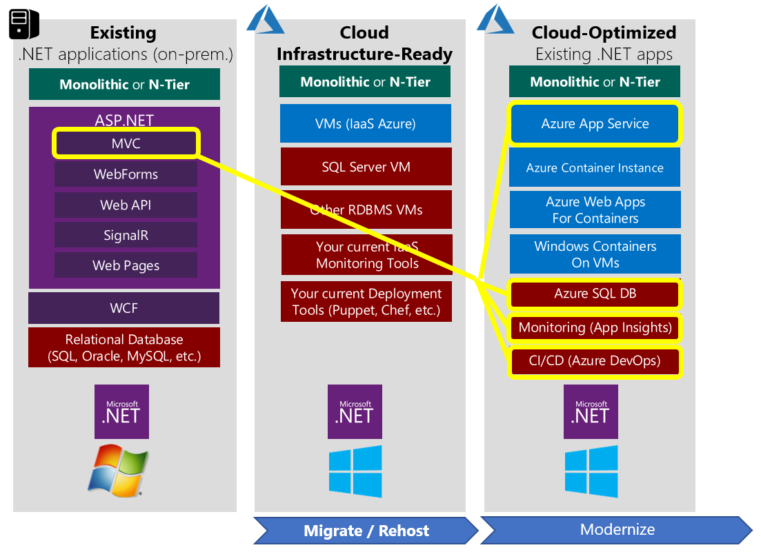
LOCAL
DEVELOPMENT
FUTURE
DEPLOYMENT

Slide 15
Questions

Slide 16
PRIORITY | MEANS | System Design / Architecture | Backend |  | Midtier |  | Frontend
1 | CONCEPT/ PURPOSE | Problem Content, Education App Architecture & Reference documents | AI Tutor | Storyline and App data | Models & Controllers for db & python | Controllers for Gemini | Simple public pages | Storyline-Student interactive page
2 | Github (TJT Account) | 00-devops | 01A-Gemini | 01B-SQL Server | 02A-dotnet | 02B-python | 03A-react static | 03B-react-dynamic
3 | Cloudflare (TJT Account) | DNS routing of static & dynamic URL. https://www.firefly-adventures.com | Research CF AI API management |  |  |  | https://fireflyadventures.github.io/static/ | Need demo routing for sub-domain: Demo.Firefly-Adventures.com
4 | Github.io (TJT Account) | Marketing copy |  |  |  |  | https://fireflyadventures.github.io/03A-fe-react-static/
5 | Local Test (Individual Level | Instructions needs | Julian demo’d | 1/22 Abe test | Stub on github | Stub on github | Runs on local, code on github | Sandy’s piece pending
6 | GCP (TJT Account) | Three tier using Cloud Run, VPC and Cloud SQL | GCP APIs?? | Private cloud IP: 34.123.144.175 Local VPC tunnel via Cloud CLI & MS SSMS: 127.0.0.1 | Cloud Run Container Need CD setup with github | Cloud Run Container Need CD setup with github | Firebase? | https://firefly-react-dpcb4fn6na-uc.a.run.app/
7 | Gemini (Julian / Abe Accts) | Architecture explainer | Firefly Account? |  |  | Need to run on Cloud Run |  | Chat section on dynamic site
8 | Blockchain (Jon Accts) | Ecosystem / Architecture explainer |  | Backend Architecture? | Mid-Tier architecture? |  | Front architecture? | Front architecture?

Slide 17
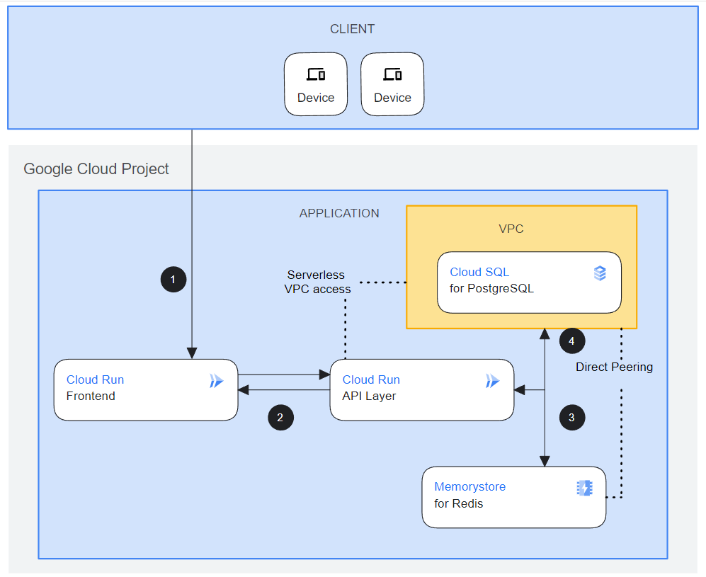
SYSTEM ARCHITECTURE
Built using React, .NET, Python, SQL
Designed to use Google Gemini
Designed for Google Cloud
Dynamic React webpage interaction with .NET and Python APIs
Cloudflare
Static Front
1A
MS SQL Server
Local Development
1B
Github
2A
Mid-Tier
.NET/C#
NEXT
Extend multimodal interaction with Gemini
Build out administrative aspects of the App, Google Identity, etc
2B
Cloud Run
API Layer
Mid-Tier Python
Cloud Storage
Gemini

Slide 18
SYSTEM ARCHITECTURE REFERENCES
(Github Organization and Repo Guide)
https://github.com/FireflyAdventures
PLAN, CODE TALKS
(1) 00-devops-documents = Concept and working documents
FRONTEND
(1A) 03C-fe-minimalist-static-CF = Website for home & static code
(1B) 03B-fe-react-dynamic = Website for database & AI dependent code
MIDTIER
(2A) 02B-mid-dotnet-julian = .NET/C# Midtier
(2B) 02B-mid-python = Python Midtier
BACKEND
(4) 01A-be-sqlserver = SQL database scripts
STATIC WEBPAGE
www.firefly-adventures.com
Cloudflare
Static Front
1A
MS SQL Server
1B
2A
Local Development
Github
Mid-Tier
.NET/C#
2B
Cloud Run
API Layer
Mid-Tier Python
GOOGLE CLOUD PLATFORM THREE TIER PROJECT:
https://console.cloud.google.com/home/dashboard?project=sincere-pen-411305
Cloud Storage
Gemini

Slide 19
Straight
3 nodes (steps)
2 edges
CYOA
9 nodes
20 edges
Start
Finish

Slide 20
Straight
3 nodes (steps)
2 edges
CYOA
9 nodes
16 edges
Start
Finish

