Slide 1

AGENT-ONE
Policies enforced in code
One Go binary where review gates, approvals, the sandbox and memory are part of the runtime
v0.1.2 · github.com/Kaginari/agent-one
Notes:
Title. AGENT-ONE v0.1.2: a single static Go binary. Everything shown in this deck is captured from the released binary running in a demo workspace against a scripted OpenAI-compatible server.

Slide 2
A model can read a rule — and still skip it
Other harnesses put the policy in the prompt. Here the harness is the policy.
The review gate
Human approval
Every turn that changed the workspace is checked before it's called done: right author, invariants hold, work complete, doc changed with the code. The verdict is appended to log.md — even when the write came through the shell.
Every action is classified before it runs — read · write · outward · destructive. Outward and destructive ask you. Per-command rules (bash:git push*) allow, ask or deny, and hold against wrapped forms like env git push or sh -c.
The sandbox
Native memory
bash is a persistent shell under bwrap: read-only filesystem except the workspace, no network unless the act was approved as outward, API keys and tokens scrubbed from the environment.
Recall before every step, remember after. Undocumented knowledge (policy · team · domain) is surfaced and filed. When the context window fills, it is drained to memory by pointer — not summarized away.
AGENT-ONE ⋄ POLICIES ENFORCED IN CODE
2
Notes:
The four things the binary enforces in code. Each is proven by tests and attacked by an independent validator; the gate's shell-write blind spot and several permission bypasses were found and fixed before release.

Slide 3
Same loop as Claude Code and OpenCode — plus what they lack
One model call per step. The other five beats are code: no tokens, milliseconds.
 | Claude Code / OpenCode | Agent-one
Model calls per step | 1 | 1 — the same
What the model sees | full history, full tool outputs, every tool schema | pointers instead of file contents; only the tools that fit the turn
Checking the work | none built in — the model says it's done | verify per step + the review gate per turn, verdict in log.md
Context full | one summary (lossy) | drain: mechanical passes first, one call for the undocumented and the notes
Subagents | one model for all | each role on its own model (cheap to read, strong to judge)
Failure | retry or stop | bounded retries, then one hop up with a named gap — never a guess
AGENT-ONE ⋄ POLICIES ENFORCED IN CODE
3
Notes:
Per step the cost is the same as other harnesses: one model call. Per task it should be lower — smaller prompts, cheaper models for reading, fewer redone steps — to be measured with Harbor.

Slide 4
Where the model sits in the loop
Six beats per tool step, every beat journaled.
perceive
recall
plan
act
verify
record
›
›
›
›
›
budgets, context %
memory + tool pointers
THE MODEL CALL
run the chosen tool
exit code / check
journal, notes
Outside the step, the model is called only by the binary's own routed work: the gate's verdict (Judge), the drain's notes (Drafter), and each ephemeral subagent's own loop.
AGENT-ONE ⋄ POLICIES ENFORCED IN CODE
4
Notes:
The only token-consuming beat is plan. Budgets are readings, not feelings; past a budget the run checkpoints and prints a resume command.

Slide 5
One ask, end to end
agent-one run — classified step, the write, the report, the gate's verdict, live cost.
$ agent-one run "Create hello.txt with the line: hello bench"
→ s1 bash [write]: the classifier settled the class before it ran — inside the workspace, so no prompt.
The review gate ran on the shell write and appended its verdict to log.md.
Tokens and cost are live, priced from config — an unpriced model shows tokens, never a guess.
--json gives the same run as one JSON object for automation and benchmarks.
→ s1 bash [write] printf '%s\n' 'hello bench' > hello.txt && cat hello.txt
ok (21ms) wrote hello.txt
@S DONE wrote hello.txt
@E 30
gate: Gate: n/a (no domain owners)
agent-one · vllm/fake/vllm-coder · ctx 0% (OK) · 2780 tok · $0.0006
$ tail .agent-one/log.md
### [2026-09-26T15:36:11+02:00] orchestrator — Gate: n/a (no domain owners) —…
- **Task:** Create hello.txt with the line: hello bench
- **Files:** hello.txt
- **Gate:** Gate: n/a (no domain owners)
- **Result:** done
- **Learned:** —
AGENT-ONE ⋄ POLICIES ENFORCED IN CODE
5
Notes:
Real capture: the model here is a scripted OpenAI-compatible server (the benchmark's fake vLLM), so the run is reproducible and costs nothing.

Slide 6
Human approval: the harness decides, not the model
The scripted model tried to write outside the workspace. Nobody was there to approve it.
$ agent-one run "Create the file /app/hello.txt with hello bench"
✗ s1 bash [outward] denied at the gate (path outside the workspace: /app/hello.txt; no TTY to ask — pass --approve outward to p…
@? s1 denied at the gate (outward: path outside the workspace: /app/hello.txt; no TTY to ask — pass --approve outward to pre-ap…
agent-one · vllm/fake/vllm-coder · ctx 0% (OK) · 1240 tok · $0.0003
.agent-one/config.yaml
read · write inside the workspace — run; the gate judges the result.
outward (network, outside paths, git push) · destructive — ask; with no TTY, deny and name the flag that would pre-approve.
The most specific rule wins; deny beats approval. Rules match the inner forms too: env git push, sh -c '…', git -C . push, xargs, sudo.
A bare "allow everything" on outward is refused when config loads.
permissions:
rules:
- { match: "bash:git push*",
action: ask }
- { match: "bash:git push --force*",
action: deny }
tools:
webfetch: { enabled: false }
AGENT-ONE ⋄ POLICIES ENFORCED IN CODE
6
Notes:
The validator attacked the deny rule with eight disguises of git push; before the fix several slipped through. All hold now, with tests.

Slide 7
The CLI, part by part
Every command speaks the same instruments; nothing keeps a private store.
command | what it does
agent-one repl (default) | the live session — talk while ephemeral subagents work; /agents /send /usage /status /compact
agent-one run "<ask>" | one ask to its end, non-interactive; --json for machines
agent-one resume · sessions | continue or list sessions (JSONL on disk)
agent-one status | the instrument board and the off-list — every disabled feature, and where
agent-one config | show · explain · check · path · patch — every value with its origin
agent-one memory · toolbox · onto | the memory tiers, the two-level tool registry, the ownership graph
agent-one usage | tokens and cost by agent, role, rank, model and day
agent-one bench · selftest | a fixed task set on each model · every package's self-checks
agent-one board · init · version | the dashboard alone · onboard a workspace · build stamp
$ agent-one help
agent-one [command] [flags]
repl a live session (the default)
run run one ask to its end: run [--json] [--forma…
resume resume a session: resume <id> [ask]
sessions list the sessions of this workspace
status the honesty rule and the instrument board
config config show [--yaml] | explain | check | path…
memory the memory instrument (status, index, recall,…
toolbox the toolbox instrument (index, brief, pick, l…
onto the ontology (check, project, query)
usage the usage journal: usage [--session <id>] [--…
bench a fixed task set on every configured model (m…
selftest every package's selftest, one @S PASS n checks
init found a workspace here: init [--bench]
board serve the board without a session
version print the version
help this list
AGENT-ONE ⋄ POLICIES ENFORCED IN CODE
7
Notes:
One static binary, linux and macOS, amd64 and arm64. Same commands in both distributions.

Slide 8
status: nothing switched off is ever silent
Every feature can be disabled in config — and every disabled one is listed, with the file and line that did it.
$ agent-one status
tools off: webfetch — disabled by tools.webfetch.enabled in ~/demo/.agent-one/config.yaml:17
ranks: orchestrator [rankSet: extend] · auditor (ephemeral, role judge) · coord (ephemeral, role drafter) · domain (gate,…
model default vllm/fake/vllm-coder ~/demo/.agent-one/config.yaml:11
model role analyst vllm/fake/vllm-coder ~/demo/.agent-one/config.yaml:11
model role judge vllm/fake/vllm-coder ~/demo/.agent-one/config.yaml:11
model role drafter vllm/fake/vllm-coder ~/demo/.agent-one/config.yaml:11
model rank coord vllm/fake/vllm-coder ~/demo/.agent-one/config.yaml:11
model rank domain vllm/fake/vllm-coder ~/demo/.agent-one/config.yaml:11
model rank zone vllm/fake/vllm-coder ~/demo/.agent-one/config.yaml:11
model rank service vllm/fake/vllm-coder ~/demo/.agent-one/config.yaml:11
model rank principal-coordinator vllm/fake/vllm-coder ~/demo/.agent-one/config.yaml:11
model rank principal-domain-owner vllm/fake/vllm-coder ~/demo/.agent-one/config.yaml:11
model rank auditor vllm/fake/vllm-coder ~/demo/.agent-one/config.yaml:11
model task drain vllm/fake/vllm-coder ~/demo/.agent-one/config.yaml:11
model task gate vllm/fake/vllm-coder ~/demo/.agent-one/config.yaml:11
model task log vllm/fake/vllm-coder ~/demo/.agent-one/config.yaml:11
model task bench vllm/fake/vllm-coder ~/demo/.agent-one/config.yaml:11
sandbox: bwrap (/usr/bin/bwrap bubblewrap 0.4.0)
compaction: drain · passes pointerize,trimSpent,unsaid,workingNotes,episode,verify
budget session: off
budget subagent: off
workspace: ~/demo · agent-one · 1 members · 0 skills · 4 commands · 1 foreign agents
AGENT-ONE ⋄ POLICIES ENFORCED IN CODE
8
Notes:
The honesty rule: a switched-off instrument is a finding, not silence. The ranks line, models per role and rank, the sandbox probe, the drain passes and the budgets are all readings.

Slide 9
Configuration: everything on, config takes away
YAML or JSON · seven layers · every value knows where it came from.
.agent-one/config.yaml
Layers: defaults → ~/.config → project → project-local → env file → env → flags.
config explain shows every value with its origin; config patch edits keeping your comments.
Strict YAML: anything it can't parse is an error with file:line — never a silent misparse.
Custom tools: each {{param}} fills one argument — '; rm -rf /' stays a file name.
Injected rules go to the prompt; rules with a check are enforced by the gate.
Any OpenAI-compatible endpoint: vLLM, Ollama, OpenRouter — keys from env only.
providers:
vllm:
type: openai
baseURL: https://vllm.internal/v1
apiKeyEnv: VLLM_API_KEY # never a key in a file
models:
default: anthropic/claude-opus-5
roles:
analyst: anthropic/claude-haiku-4-5
judge: anthropic/claude-opus-5
drafter: anthropic/claude-fable-5-1
tools:
custom:
kube-pods:
run: [kubectl, get, pods, -n, "{{ns}}"]
class: outward
rules:
- { text: "Tests pass before a change lands.",
check: "go test ./..." }
AGENT-ONE ⋄ POLICIES ENFORCED IN CODE
9
Notes:
While capturing this deck, the strict parser rejected two of my own config mistakes with file and line — exactly as designed.

Slide 10
Memory, native in the loop
Three tiers every agent has. Files are the truth; every index is derived and rebuildable.
Short — per agent, per task
$ agent-one memory status
memory — world-agent-one · as orchestrator
SHORT context @? no Claude Code transcripts for this root
working 0 workingNotess
cache 3 recalls cached, 2 hits (.agent-one/memor…
LONG episodic 1 · procedural 0 · semantic 17 (built 202…
SHARED workspace 0 · machine 0 · unsaid policy 0 · team 0 …
@? index older than its sources — 1 changed: .agent-one/log…
The context window (measured, never guessed) · working notes (~5 live thoughts) · a semantic cache so the same question costs one search.
Long — durable, git is the record
Episodic: log.md · procedural: skills, commands, tools · semantic: the policy, docs, the ownership graph. Recall ranks by meaning, then by relation.
Compaction = a drain, not a summary
1 pointerize: file reads become path:lines · hash
2 trim: finished steps shrink to their journal line
3 one call: surface the undocumented + write the notes
4 episode: log what landed
5 verify: ask kept, gaps kept, pointers resolve — or abort
Shared — across agents
The workspace's shared notes travel with git; machine-shared notes span every workspace on the machine. Undocumented knowledge (policy · team · domain) lands here before a subagent's context dies.
AGENT-ONE ⋄ POLICIES ENFORCED IN CODE
10
Notes:
Two of the five drain passes need no model at all. A verify failure keeps the old context — compaction can never lose the ask.

Slide 11
The toolbox: two levels, one budget
The registry can grow without bound; the prompt does not.
Level 1 — the manifest
$ agent-one toolbox brief "edit a file and run the tests"
@TOOLS as=orchestrator k=0 cost=0/1500 — level 2 on decision on…
@? registry empty — nothing under .claude/skills, .opencode/ski…
Each turn gets only the entries that fit the ask and a token budget: name, one line, triggers, path, and the cost of loading it. Skills, commands, tools, agents, MCP servers — all priced.
Level 2 — the load
The agent loads a body only when it decides to use it — whole, or one section. Every load is journaled, so status reports what was loaded against what was merely offered.
Default toolset (max): bash, read/ls/glob/grep, write/edit/multiedit/patch, git, webfetch, websearch, ask, dispatch, recall/remember, toolbox, onto, skill, MCP.
Reads .claude/ and .opencode/ skills, commands and agents as they are.
Missing tool? Named, never looped
Error + closest alternatives; a need named twice becomes a config diff you approve.
AGENT-ONE ⋄ POLICIES ENFORCED IN CODE
11
Notes:
An empty demo workspace has an empty registry, and the brief says so as a named gap rather than an empty answer.

Slide 12





Roles and model routing
Built-in ranks are the default; config can add, override, or replace them all (rankSet: replace).
Orchestrator
Coordinator
Domain owner
the session: plans, decides, dispatches
shared context; routes work across domains
owns a domain; holds the review gate
Zone worker
Service owner
Auditor
owns one zone; authors changes
long-running owner of one subsystem
reviews verdicts and the change log
Analyst
Judge
Drafter
reads — facts, file:line →
judges — verdicts with evidence →
writes — drafts, the log, notes
AGENT-ONE ⋄ POLICIES ENFORCED IN CODE
12
Notes:
One escalating chain: Analyst → Judge → Drafter. Each can run its own model; config refuses a chain where a later role sits on a weaker model. The session never chooses its own model — it runs on yours.

Slide 13
A live session: keep talking while the work runs
Ephemeral subagents run in the background; tokens and cost are an instrument.
$ agent-one usage
Type while a turn runs — your line reaches the agent at its next tool step; Ctrl-C interrupts.
/agents and a status line: every live agent's role, model, state, context %, tokens, cost.
/send <agent> talks to a running ephemeral subagent; its context dies when its report is taken.
Usage journal per call, priced from config; session and subagent budgets stop honestly at the line with a resume command.
usage: 4 calls · 2 sessions · in 5400 (cache read 0, write 0) · out 1…
by agent:
orchestrator 4 calls in 5400 out 160 $…
by role:
— 4 calls in 5400 out 160 $…
by rank:
orchestrator 4 calls in 5400 out 160 $…
by model:
vllm/fake/vllm-coder 4 calls in 5400 out 160 $…
by day:
2026-09-26 4 calls in 5400 out 160 $…
The session's own calls carry no role — only dispatched agents and routed calls do.
AGENT-ONE ⋄ POLICIES ENFORCED IN CODE
13
Notes:
While capturing this deck, usage showed the session's calls labelled as another rank: a machine-wide agent file had been imported as the session. Found here, fixed with a regression test, released as a patch.

Slide 14
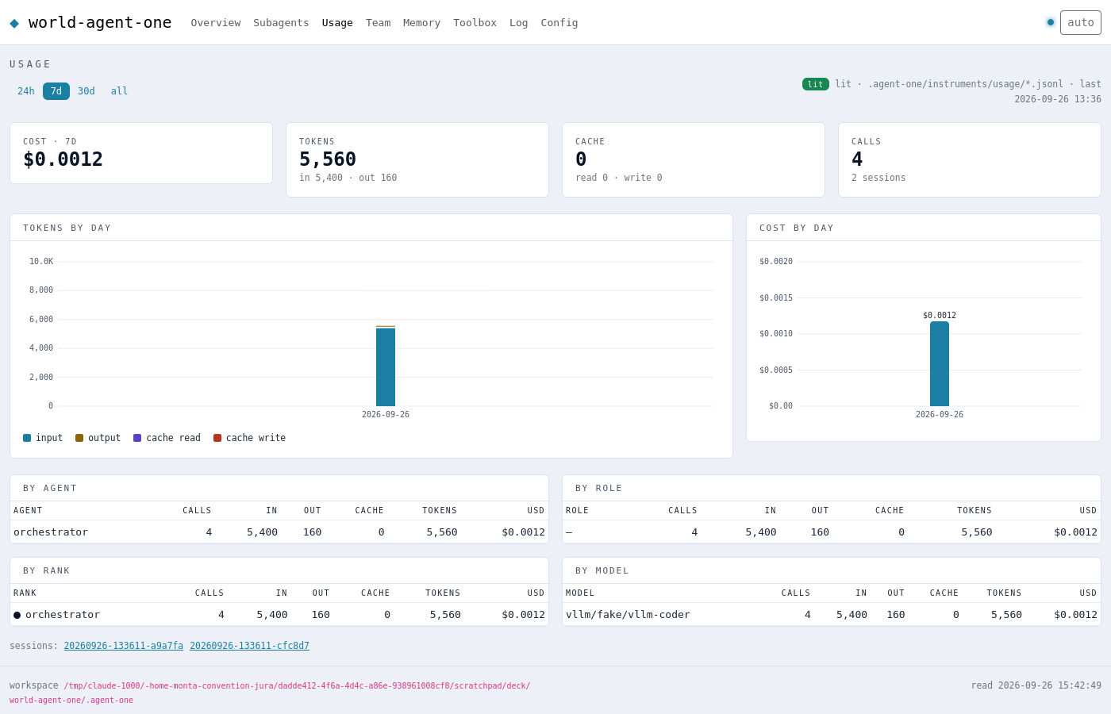
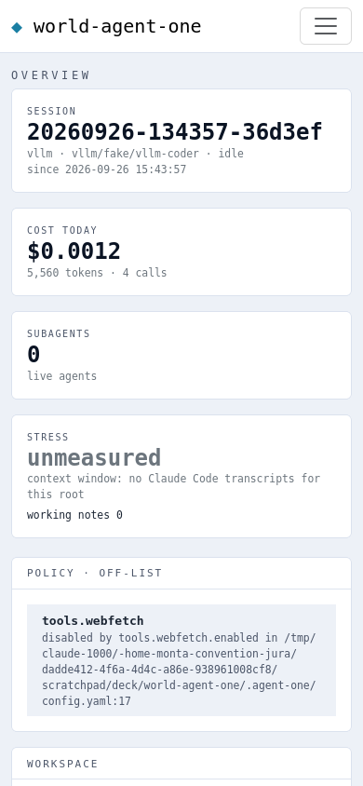
The board: the workspace, seen
Served by the binary on localhost · eight pages on the Bootstrap grid · live over SSE · dark and light.
AGENT-ONE ⋄ POLICIES ENFORCED IN CODE
14
Notes:
Pages: Overview · Subagents · Usage · Team · Memory · Toolbox · Log · Config. Mobile first: the phone layout on the right. A page is proven by rendering it — that rule caught a rename that had silently broken the theme.

Slide 15
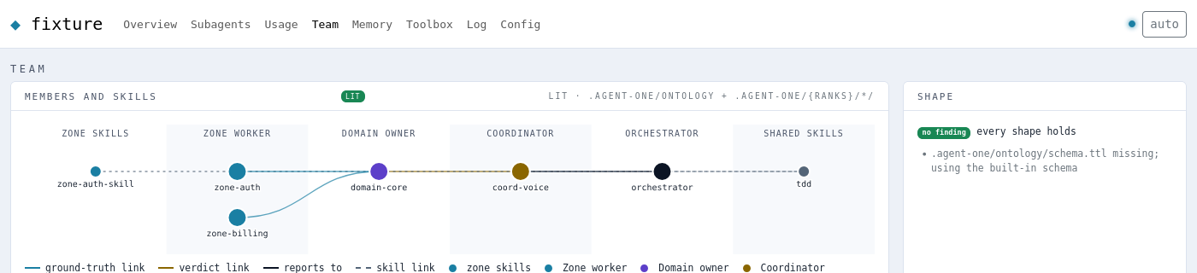
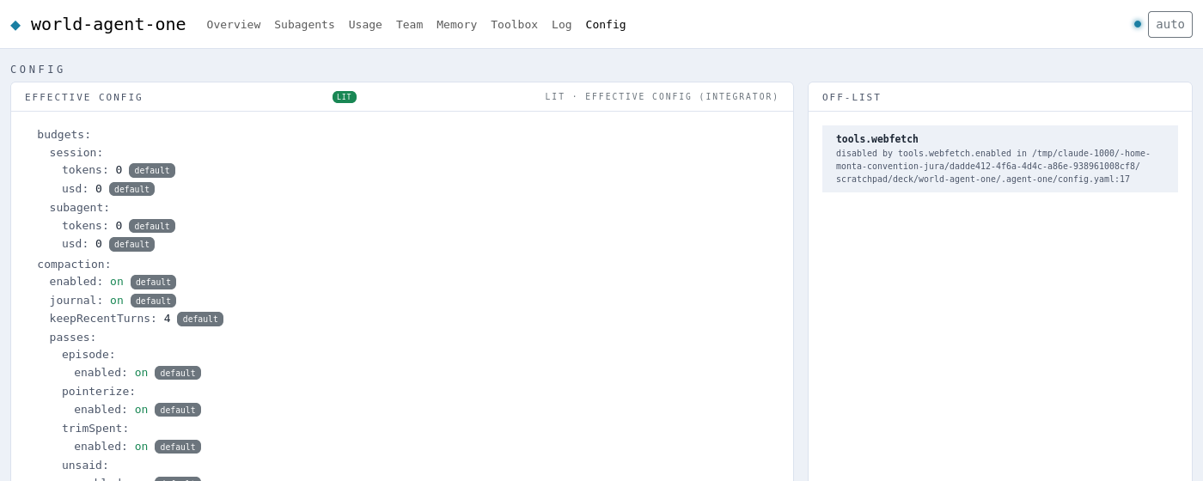
The ownership graph, and every value with its origin
The Team page draws who owns what and how knowledge flows; Config shows each value and the layer it came from.
Lanes by rank; typed, coloured links: ground truth up to the gate holder, verdicts up to the coordinator.
Click a node: its neighbours light up, its doc opens beside the graph.
The off-list names every disabled feature with the file and line that did it.
AGENT-ONE ⋄ POLICIES ENFORCED IN CODE
15
Notes:
The graph is a fixture workspace with a coordinator, a domain owner and two zone workers; the config page is the demo workspace, showing webfetch switched off.

Slide 16
Proof, not promises
What was measured before each release.
195
23
9 + 8
1.0 / 0.0
selftest checks
test packages, race-clean
defects fixed: by attack, then by using the releases
Harbor smoke: right / wrong
An independent validator attacked the gate, the sandbox, the permission rules, symlinks, secrets and injection — before release. Running the released binaries for this deck found the rest; each fix ships with a regression test.
Every commit: gofmt, vet, race tests, selftest, four builds, GoReleaser check and the Harbor smoke on GitHub's runners.
Honest limits: providers' streaming, caching and fallbacks are tested against local fakes only — not yet live.
AGENT-ONE ⋄ POLICIES ENFORCED IN CODE
16
Notes:
The numbers come from the validation log and CI, not estimates.

Slide 17
Benchmarks under Harbor, in Docker
One container per task, the agent inside, the task's own tests deciding. Every launch recorded.
Harbor
adapter
agent-one
verifier
runs.jsonl
runs a task in its own container
installs the static agent-one, seeds a workspace
run --json against any OpenAI-compatible model
the task's tests: reward 1.0 or 0.0
append-only record → RESULTS.md
€0 smoke on every commit: a scripted OpenAI-compatible server stands in for vLLM — right answer must score 1.0, wrong 0.0.
Next, at no API cost: your hosted vLLM, the same tasks, agent-one against OpenCode on the same model.
Claude runs only with an API key and a hard budget per task (budgets.session.usd).
AGENT-ONE ⋄ POLICIES ENFORCED IN CODE
17
Notes:
Harbor is the Terminal-Bench team's framework; the adapter is ~100 lines against its BaseInstalledAgent API.

Slide 18
Next: v0.2
Specified, not built yet.
Container runtime
Enterprise registries & proxy
Workspaces and systems
Install anything inside a disposable container; your repo, the network and pushes stay gated. Builds via rootless BuildKit — never the host Docker socket.
Artifactory, GitLab, Nexus for docker, go, pypi, npm, cargo, maven; corporate proxy and CA everywhere; later a token-injecting egress proxy so no secret enters the container.
Nested workspaces are sovereign; systems group workspaces (app · deploy · infra) with typed, learned relations; one hop per level; the dashboard opens on the map.
Each lands by the ladder: a layer is done only when its own tests pass against mocks of the layer below, and the next layer opens with an integration test of the two.
AGENT-ONE ⋄ POLICIES ENFORCED IN CODE
18
Notes:
v0.2 lands by the same ladder: each layer green on its own tests before the next starts.

Slide 19
AGENT-ONE v0.1.2
curl -fsSL https://raw.githubusercontent.com/Kaginari/agent-one/main/install.sh | sh
agent-one init · agent-one · agent-one run "…"
MIT · linux/macOS · amd64/arm64 · github.com/Kaginari/agent-one
Notes:
Install, onboard, run.

