Slide 1

From the LLM to the harness
…and Agent-One: policies enforced in code, on our own models
Agents · harnesses · self-learning · a live demo on vLLM
20 minutes · AI, ops, dev
Notes:
Welcome. In the next twenty minutes: what an AI agent really is beyond the model, how today's harnesses differ, how some of them now learn from their own runs — and Agent-One, the harness we built, running live on our own vLLM models behind our gateway. Keep one idea in mind throughout: the model gives the intelligence, the harness gives the reliability.

Slide 2
AGENDA
Four steps, twenty minutes
1
From LLM to agent
2
Harnesses today
3
Self-learning harnesses
4
Agent-One + demo
the loop, the layers
Claude Code, Codex, OpenCode, Pi…
Hermes, Prime Agent
guardrails, previews, config, live
3'
4'
4'
9'
AGENT-ONE ⋄ FROM THE LLM TO THE HARNESS
2
Notes:
Four parts. First, from a bare language model to an agent, and the layers every agent is built from. Second, the harnesses you have heard of — Claude Code, Codex, OpenCode, Pi — and what really separates them. Third, the newest idea: harnesses that learn from their own runs, with Hermes and Prime Agent as examples. Fourth, Agent-One: its safety model, what you can see while it works, how it is configured for an enterprise — and a live demo.

Slide 3
1 · FROM LLM TO AGENT
A model alone is text in, text out
LLM
Prompt
Text
No hands
No memory
Frozen knowledge
Can't check itself
can't read files, run tests, call APIs
every call starts from zero
stops at its training date
wrong and right sound the same
AGENT-ONE ⋄ FROM THE LLM TO THE HARNESS
3
Notes:
Start from the bare model. A large language model is a function: text in, text out. It cannot read your repository, run a test or call an API — it has no hands. It remembers nothing between calls — every request starts from zero. Its knowledge stops at its training date. And it cannot check its own work: it will state a wrong answer with the same confidence as a right one. Everything we will see today exists to close these four gaps.

Slide 4
1 · FROM LLM TO AGENT
An agent is a model in a loop, with tools
Agent
Observe
the model deciding, step after step, which tool to use next — until the task is done
Check
↻
Think
Harness
everything around the model: the tools, the context it sees, what it may do without asking, its memory, its safety net, how you watch it
Act
AGENT-ONE ⋄ FROM THE LLM TO THE HARNESS
4
Notes:
An agent puts the model in a loop with tools. It observes — reads files, runs commands; it thinks — the model decides the next step; it acts — calls a tool; it checks — reads the result, and loops until the task is done. That is the agent. The harness is everything around the model that makes this loop useful and safe: which tools exist, what context the model sees, what it may do without asking, how it remembers, how you watch it. Same model, different harness, very different results.

Slide 5
1 · FROM LLM TO AGENT
Each layer wraps the last
1 / 4
The LLM alone — a bounded mind
text in, text out
knowledge frozen at its training date
no hands: it touches nothing
no memory between calls
LLM
a bounded mind · text in, text out
frozen knowledge · no hands · no memory
LLM = a bounded mind
AGENT-ONE ⋄ FROM THE LLM TO THE HARNESS
5
Notes:
Let us build it up, one containing area at a time. At the centre, the model alone: a bounded mind. Brilliant inside its box, but the box is closed: text in, text out, knowledge frozen at its training date, no hands, no memory. Everything around it, from now on, is something we add.

Slide 6
1 · FROM LLM TO AGENT
Each layer wraps the last
2 / 4
+ a system prompt and tools = an agent
Agent
system prompt
tools
the system prompt gives it a role, rules and the task's context
tools give it hands: read files, run commands, call APIs
it can now act on the world — once per answer
LLM
a bounded mind · text in, text out
frozen knowledge · no hands · no memory
LLM + system prompt + tools = agent
AGENT-ONE ⋄ FROM THE LLM TO THE HARNESS
6
Notes:
First wrap: a system prompt and tools. The prompt tells the model who it is and what the rules are; the tools give it hands. Now it can read a file or run a command. That is an agent — but a single shot: it acts once, and nobody checks the result.

Slide 7
1 · FROM LLM TO AGENT
Each layer wraps the last
3 / 4
+ a loop, memory and permissions = a harness
Harness
the loop
context & memory
permissions & sandbox
Agent
system prompt
tools
the loop: observe → think → act → check, until the task is done
context and memory: what it sees now, what survives the session
permissions and sandbox: what it may do without asking
LLM
a bounded mind · text in, text out
frozen knowledge · no hands · no memory
agent + loop + memory + permissions = harness
AGENT-ONE ⋄ FROM THE LLM TO THE HARNESS
7
Notes:
Second wrap: the harness. A loop, so the agent keeps going until the task is done and checks its own results. Context management and memory, so long work fits and knowledge survives the session. Permissions and a sandbox, so it can only do what it is allowed to. Claude Code, Codex, OpenCode all live at this level.

Slide 8
1 · FROM LLM TO AGENT
Each layer wraps the last
Agent-One
guard & gate
previews
subagents
gateway · registry
it learns
4 / 4
+ policy in code, previews and a team = Agent-One
Harness
the loop
context & memory
permissions & sandbox
Agent
system prompt
tools
the guard and the gate: refused or checked in code, not by prompt
previews: dry-run, diffs, the live dashboard
subagents and roles on different models, one merged review
your gateway, your registry, your containers
a workspace that remembers and learns
LLM
a bounded mind · text in, text out
frozen knowledge · no hands · no memory
harness + policy in code + a team = Agent-One
AGENT-ONE ⋄ FROM THE LLM TO THE HARNESS
8
Notes:
The last wrap is Agent-One. Around a complete harness, it adds what an enterprise needs: a guard and a gate that enforce the policy in code rather than in the prompt; previews — dry-run, diffs, a live dashboard — so you see before and while it acts; a team of subagents and roles on different models; your own gateway, registry and containers; and a workspace that remembers and learns from every run. Same model at the centre — very different reliability at the edge.

Slide 9
1 · THE LAYERS
Every agent is built from the same layers
Interfaces
terminal, IDE, CI, dashboards
The harness decides
Observability
logs, traces, usage and cost
which model does which job
what the model may touch
what it remembers
what needs a human
what you can see and audit
Safety
permissions, sandbox, guardrails, review gates
Context & memory
what the model sees; what survives the session
Tools & MCP
files, shell, web, APIs, skills
Agent loop
observe → think → act → check; sub-agents
Models
providers, gateways, routing, fallbacks
AGENT-ONE ⋄ FROM THE LLM TO THE HARNESS
9
Notes:
Every agent, whoever builds it, is made of the same layers. At the bottom, the models — a provider, or your own models behind a gateway. Above, the loop that drives them, and the tools the loop can call, including MCP servers. Then context and memory: what the model sees now, and what survives the session. Then safety: permissions, the sandbox, guardrails, review gates. Then what you see: observability and the interface. Keep this picture — I will map each harness, and Agent-One, onto it.

Slide 10





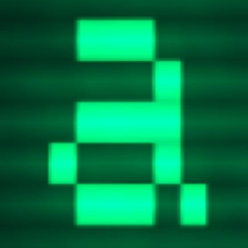

2 · HARNESSES TODAY
The harnesses you will meet
Vendor CLIs
Open, any model
In the IDE
Claude Code
OC
OpenCode
Cursor
Anthropic · terminal agent
open source · any provider
AI-first editor
Codex
π
Pi
Cline
OpenAI · terminal and cloud
minimal, extensible core
VS Code extension
Gemini CLI
Aider
Google · open source
git-native pair programmer
Goose
Block · open source
AGENT-ONE ⋄ FROM THE LLM TO THE HARNESS
10
Notes:
The landscape moves every month; here are the harnesses you will meet. The vendor CLIs — Claude Code from Anthropic, Codex from OpenAI, Gemini CLI from Google — are polished and tuned for their own models. The open, model-agnostic ones — OpenCode, Pi, Aider, Goose from Block — run on any provider, including self-hosted models. The IDE agents — Cursor, Cline — live in the editor. Under the logos, they all implement the same layers; they differ in who chooses the model, where they run, and how much they let you enforce.

Slide 11
2 · HARNESSES TODAY
Four questions to ask any harness
1
Who chooses the model?
2
Where does it run?
the vendor's models only — or any provider, your own vLLM behind a gateway
your terminal, the editor, the vendor's cloud — and what it can reach from there
3
How far does it extend?
4
Rules in code, or in a prompt?
skills, MCP servers, hooks, plugins, sub-agents
asking before a risky command is common; guaranteeing a rule is followed is rare
AGENT-ONE ⋄ FROM THE LLM TO THE HARNESS
11
Notes:
So what actually separates them? Four questions to ask of any harness before you adopt it. Who chooses the model — the vendor, or you, including your own vLLM models? Where does it run — your terminal, the editor, the vendor's cloud? How far can you extend it — skills, MCP servers, hooks, plugins? And the one ops teams care most about: are the rules enforced in code, or only written in a prompt the model may ignore? Most harnesses ask before a risky command; very few can guarantee a rule is followed.

Slide 12
3 · SELF-LEARNING HARNESSES
Better from their own runs — without retraining
more power → more guardrails
4
Train
runs become training data
3
Check and retry
a failed check goes back to the agent
2
Write procedures
a repeated workflow becomes a skill
1
Remember
memory that survives the session
AGENT-ONE ⋄ FROM THE LLM TO THE HARNESS
12
Notes:
The newest idea: harnesses that get better from their own runs, without retraining the model. It comes in four levels. First, remember: notes and memory that survive the session. Second, write procedures: the agent turns a workflow it repeated into a reusable skill. Third, check and retry: a verifier — tests, a gate — sends a failure back to the agent instead of stopping. Fourth, train: the runs themselves become training data. Each level is more powerful and needs more guardrails — a harness that edits itself must not be able to cheat its own checks.

Slide 13

3 · EXAMPLE: HERMES AGENT
A harness built around a learning loop
Sessions you can search
Skills it writes itself
every session stored with full-text search: recall returns what was said, not a summary
repeated workflows become skills; writes can wait for human approval
Nous Research
Skills loaded in levels
Trajectories for training
a name and a line always; the body only when used
runs exported for reinforcement learning
AGENT-ONE ⋄ FROM THE LLM TO THE HARNESS
13
Notes:
Hermes Agent, from Nous Research, is built around a learning loop. Every session goes into a searchable store, so the agent can recall what was actually said weeks ago — not a summary. It writes and refines its own skills from the workflows it repeats, with an option to stage them for human approval. Skills load in levels, so hundreds cost almost nothing until used. And its runs can be exported as trajectories to train models with reinforcement learning. The lesson for us: memory and skills are where a harness learns.

Slide 14

3 · EXAMPLE: PRIME AGENT
The check decides when the work is done
Autonomous gate
Branching sessions
a failed check goes back to the agent for another attempt
fork a run; try two plans from one point
Prime Intellect
Heartbeats
Persistent sub-agents
scheduled messages into the session — watch a sub-agent
keep their memory; wake when addressed
AGENT-ONE ⋄ FROM THE LLM TO THE HARNESS
14
Notes:
Prime Agent, from Prime Intellect, puts the learning in the loop itself. Its autonomous gate runs a check before a session may finish; if it fails, the output goes back to the agent for another try — the check, not the model, decides when it is done. Sessions are branching files: you can fork a run and try two plans from the same point. Heartbeats inject scheduled messages, for example to watch a sub-agent. Persistent sub-agents keep their memory and wake when addressed. And the harness can refine its own configuration from a run. The lesson: verifiers and branches make an agent reliable.

Slide 15
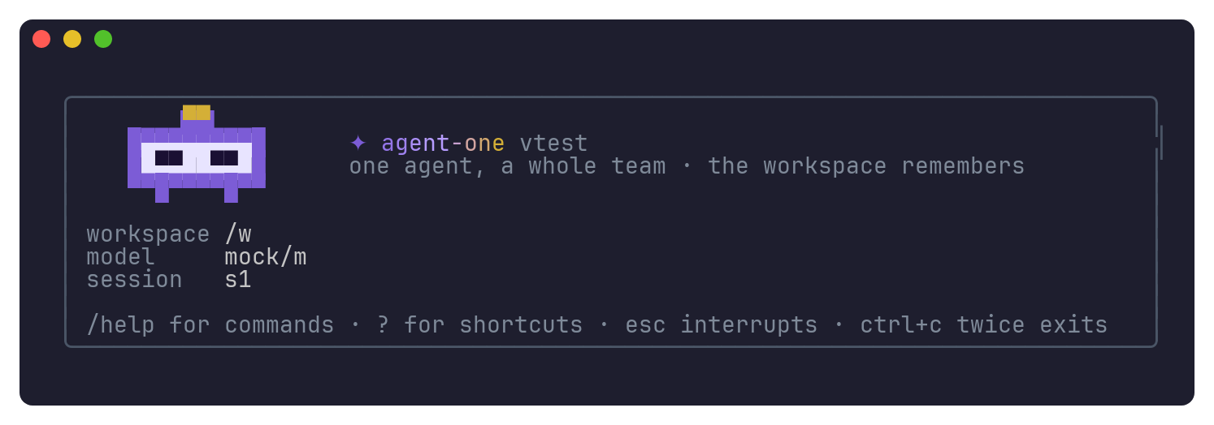
4 · AGENT-ONE
Policies enforced in code, on any model
One Go binary
no runtime; Linux and macOS
Roles and sub-agents
analyst reads · judge reviews · drafter writes
Everything on by default; turning something off is always shown
Claude Code and OpenCode skills, commands, agents and MCP servers are picked up
Any OpenAI-compatible model
our vLLM models behind the gateway
AGENT-ONE ⋄ FROM THE LLM TO THE HARNESS
15
Notes:
Agent-One is our harness: one Go binary, no runtime to install. Its promise is simple — the rules are enforced in code, not written in a prompt the model may skip. An orchestrator dispatches sub-agents that own parts of the codebase; three model roles split the work — an analyst reads, a judge reviews, a drafter writes — each on its own model with a fallback. It talks to any OpenAI-compatible endpoint, which is exactly what our gateway in front of vLLM is. And it comes with a terminal interface in the class of Claude Code.

Slide 16
4 · AGENT-ONE
Every layer, with Agent-One's answer
Interfaces
terminal UI · dashboard · board over SSH · run --json for CI
Observability
every step journaled · usage and cost by role and model · status, explain
Safety
guard · human approval · review gate · sandbox or container
Context & memory
notes, index, recall · context drained by reference · handoff
Tools & MCP
built-ins · MCP · custom tools · a searchable tool registry
Agent loop
perceive → recall → plan → act → verify → record · sub-agents
Models
the gateway · registry.yaml · roles with fallbacks
AGENT-ONE ⋄ FROM THE LLM TO THE HARNESS
16
Notes:
Here is Agent-One on the same layer picture. Models: our gateway, the models declared in a registry, each role with a fallback. The loop: perceive, recall, plan, act, verify, record — every step journaled. Tools: built-ins, MCP servers, custom tools, and a registry the agent searches instead of loading everything. Memory: notes and a searchable index, and when the context fills, it is drained to memory by reference, not summarised away. Safety: a guard, human approval, a review gate, the sandbox or a container. Interfaces and observability: the terminal, a dashboard, JSON output for CI, usage and cost.

Slide 17
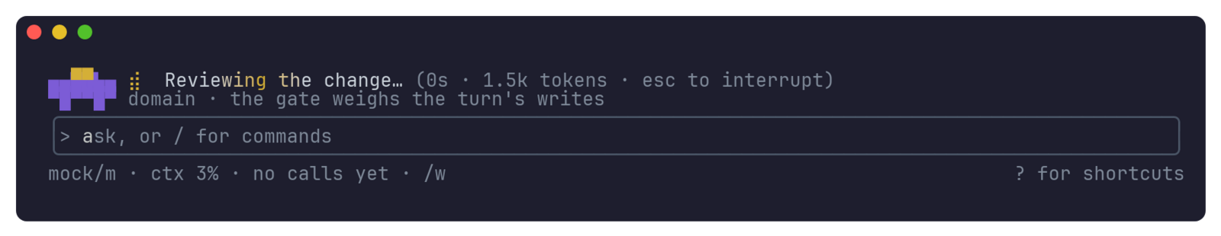
4 · GUARDRAILS
Four layers, all in code
1
Guard
the catastrophic, refused before any approval
2
Human approval
read · write · outward · destructive
Review gate
37 / 90
dangerous commands our first classifier let through — found by a 151-case test corpus, now closed and tested for good
3
owner, checks, tests intact, docs — retried once
4
Sandbox / container
workspace read-write, the rest read-only
AGENT-ONE ⋄ FROM THE LLM TO THE HARNESS
17
Notes:
Guardrails, in four layers. The guard refuses the catastrophic before anything else — wiping a disk, deleting home, force-pushing, deleting a repository, reading a password store; no approval can run it, and the same list can protect Claude Code and OpenCode on the same machine. Human approval classifies every command — read, write, outward, destructive — and asks you for the last two. The review gate checks every change before the turn ends: the right owner, the checks still pass, the tests were not weakened, the docs changed — and a failure goes back to the agent once. Around it all, a sandbox or a container. A number from building it: testing against 151 real commands showed 37 dangerous ones our first classifier let through. Fixed, and tested forever.

Slide 18
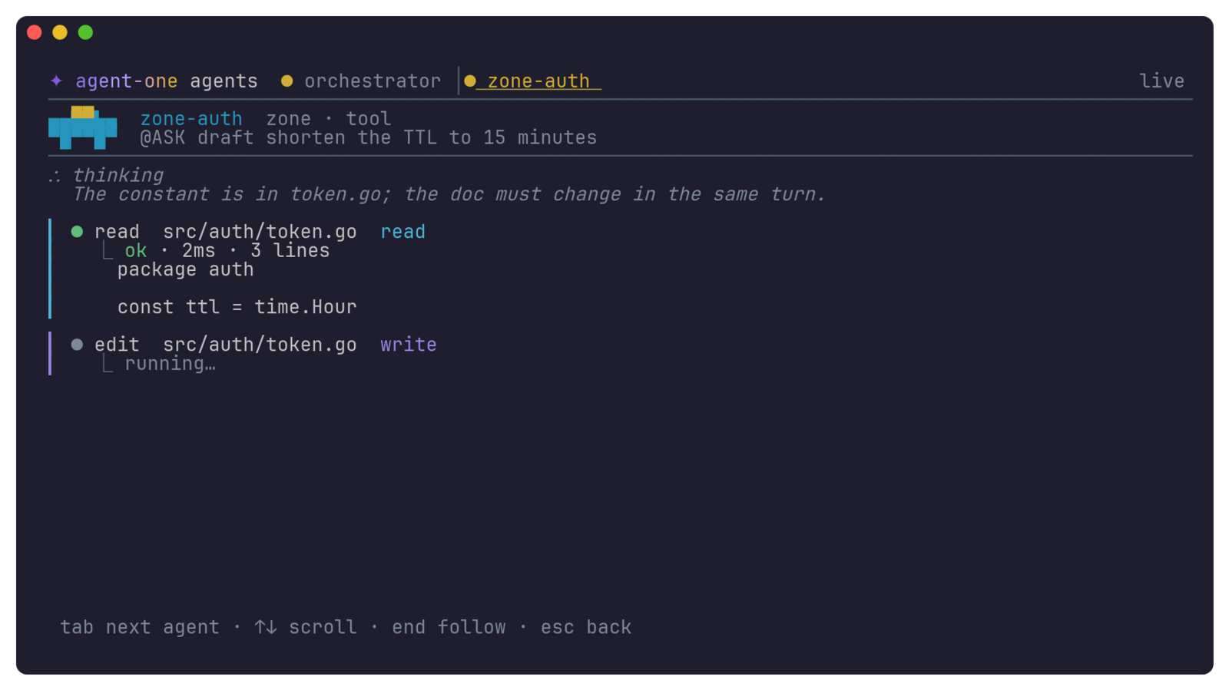
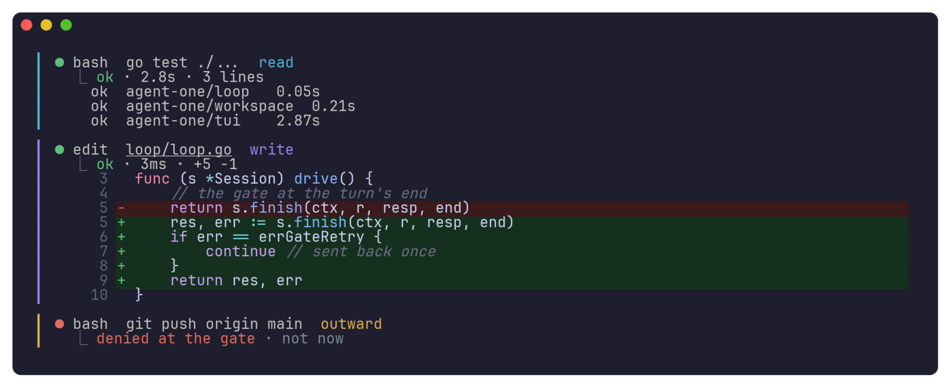
4 · PREVIEWS
See what it will do — and what it is doing
Dry-run
Diffs
Every agent, live
The dashboard
plans and shows, runs nothing
every edit, before it lands
thinking and steps, one key
ownership graph, usage, cost
AGENT-ONE ⋄ FROM THE LLM TO THE HARNESS
18
Notes:
Seeing before and while it acts — the second thing ops teams ask for. Dry-run: the agent plans and tells you what it would run and what it would ask, and runs nothing. Every edit shows its diff, in the code's own colours, before it lands. You see the model's thinking as it arrives. And with one key you watch every agent: the orchestrator and each sub-agent, its thinking and its steps, live. The dashboard shows the whole workspace: who owns what, as a graph, and what each model has cost.

Slide 19
4 · LEARNING, WITH GUARDRAILS
What we took — and how it can't cheat
goal
Gate retry
Tests intact
Prime
Prime
ours
works until your command passes; the harness runs it
a failed review goes back to the agent once
pre-turn checks; no deleting or skipping tests
Memory, recalled
Handoff
review
Hermes
ours
ours
drained by reference; the unsaid is filed
state, decisions, traps — for the next session
two models review; you approve the shortlist
AGENT-ONE ⋄ FROM THE LLM TO THE HARNESS
19
Notes:
What we took from the self-learning harnesses, with guardrails. From Prime: the gate that sends a failure back instead of stopping — and a goal mode that keeps working until a command you choose passes; the harness runs that command itself, so the model can neither skip nor edit it. Against reward hacking: the gate runs the checks as they were before the turn, and fails a turn that deletes or skips tests. From Hermes: memory that is recalled, not summarised; knowledge the agent held but never wrote down is surfaced and filed. A handoff note carries a session into the next. And two reviewers on two different models, merged into one shortlist that you approve.

Slide 20
4 · CONFIGURATION
One file per part; secrets named, never written
.agent-one/
├── config.yaml
├── providers.yaml the gateway
├── registry.yaml models · tools ·
│ Artifactory · images
├── models.yaml who runs on what
├── guards.yaml refused, always
├── rules.yaml
└── permissions.yaml
# registry.yaml
models:
gateway/muse-glimmer: { tier: 1 }
gateway/glm-5-3: { tier: 2 }
gateway/kimi-k3: { tier: 3 }
packages:
npm: https://artifactory…/npm-remote/
pip: https://artifactory…/pypi-remote/simple
tokenEnv: ARTIFACTORY_TOKEN # the name only
containers:
base: artifactory…/debian:bookworm-slim
agent-one config explain → every value, its file and line
AGENT-ONE ⋄ FROM THE LLM TO THE HARNESS
20
Notes:
Configuration for an enterprise. The configuration is YAML, layered — global, project, local, environment, flags — and can be split into one file per part, so each team owns its file. The registry says where things come from: the models the gateway serves, the tools the agent can find, our private Artifactory for npm, pip and Go — set in every command the agent runs and inside the container — and the private registry the container image comes from. Secrets are only ever named: the configuration holds the variable's name, never the key. And one command shows every value with the file and line it came from.

Slide 21
DEMO
Live, on our vLLM models
vLLM
Agent-One
Gateway
muse-glimmer
glm-5-3
kimi-k3
analyst · reads
judge · reviews
drafter · session
1
status
2
A real task
3
A sub-agent
4
The review gate
5
The guard
every model resolved, with its file
thinking streams; tools as cards; diffs
ctrl+t — watch it work
the domain owner's verdict, in the log
"delete ~" — refused before any question
AGENT-ONE ⋄ FROM THE LLM TO THE HARNESS
21
Notes:
The demo, on our own models. Agent-One talks to our gateway, which fronts vLLM serving three models: muse-glimmer, fast, reads; glm-5-3 reviews; kimi-k3, the strongest, writes and runs the session — each with a fallback from another family. Five steps: status shows every model resolved from the configuration, with its file. Then a real task: watch the thinking and the tool cards. A sub-agent takes a part — ctrl+t to watch it. At the end the domain owner reviews the change and the verdict lands in the log. Last, I ask it to delete the home directory: the guard refuses, before anything asks me.

Slide 22
TAKEAWAYS
Three things to remember
1
The harness makes it reliable
2
Rules belong in code
3
Learning needs guardrails
same model, different harness, different results
a rule in a prompt is a wish
memory, skills, verifiers — that can't be cheated
Questions?
github.com/Kaginari/agent-one
AGENT-ONE ⋄ FROM THE LLM TO THE HARNESS
22
Notes:
Three things to take away. One: reliability comes from the harness, not only from the model — the same model does very different work in different harnesses. Two: rules that matter must be enforced in code; a rule in a prompt is a wish. Three: the next step is harnesses that learn from their own runs — memory, skills, verifiers — and that only works if the harness cannot cheat its own checks. Agent-One is where we put these ideas to work, on our own models. Thank you — questions.

