Slide 1
⋄
ISEKAI
Reincarnating a Directory as a Living, Self-Documenting Multi-Agent World
A CROSS-HARNESS CONVENTION
convention-jura · 2026
Notes:
Title slide. This deck explains the Isekai convention from OpenCode's perspective, since OpenCode is where Minds and Bodies are natively authored. A Claude Code compatibility appendix follows the main content.

Slide 2
AI sessions forget everything. Isekai doesn't.
0
Every AI coding session starts cold.
It re-derives the codebase's shape, re-learns who owns what, and re-discovers the same gotchas the last session already found — because nothing survived the session boundary.
Isekai answers this with disk, not memory: a directory that adopts the convention gets a .isekai/ folder holding the world's law, its change log, and the creatures that work in it — so the next session picks up exactly where the last one left off, by reading what's on disk instead of guessing.
context carried into the
next session, by default
ISEKAI ⋄ A CONVENTION FOR LIVING WORLDS
2
Notes:
Framing slide. The core value proposition: persistence across session boundaries, via disk, not model memory.

Slide 3

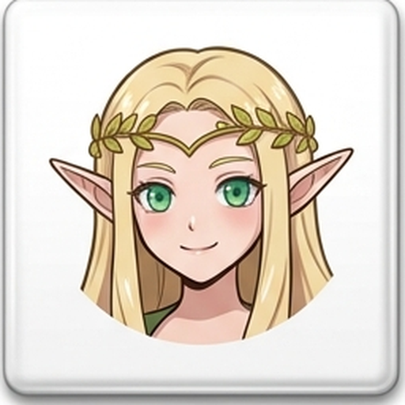


Intelligence, distributed across four ranks
Rimuru — the session agent
Elf — the shared mind & voice
Thinks, decides, orders. A machine-global throne body: one agent, installed once per machine, ruling whichever world it stands in. Works through the Elf by default.
Thinks across domains, routes work to Orcs, and is the one who speaks back up to the human. Every world gets at least one.
Orc — the domain ruler
Slime — the ground truth
Rules one domain and holds the gate: verifies the right Slime authored, traits hold, duties done, doc truthful. Nothing lands without its pass.
One narrow zone, held deeply. Authors changes there directly — its doc is the one fact anyone trusts about that zone.
ISEKAI ⋄ A CONVENTION FOR LIVING WORLDS
3
Notes:
The four ranks, shown with their official portraits from .isekai/portraits/. Rimuru is the only rank excluded from model branding — it's model-agnostic by rule ('the throne does not choose its horse').

Slide 4
Nine Natures — the crest, read first, always
1
Vitality
2
Symbiosis
3
Evolution
Code and doc change together, or the doc dies.
Each race does exactly its role — no duplication.
Every mistake mutates the genome, at once.
4
Genesis
5
Memory
6
Swarm
Nothing is born silently — a need is named twice.
Thoughts are kept to ~5, distilled, let go.
Colonies emerge from observed convergence.
7
Containment
8
The Wire
9
Perception
Territory flows inward; nothing leaves without consent.
One terse channel between machines; humans get courtesy.
The world watches itself — instruments stay lit.
ISEKAI ⋄ A CONVENTION FOR LIVING WORLDS
4
Notes:
Condensed from the Crest. Full text lives in .isekai/isekai.md — this is the memorable nine-breath version.

Slide 5




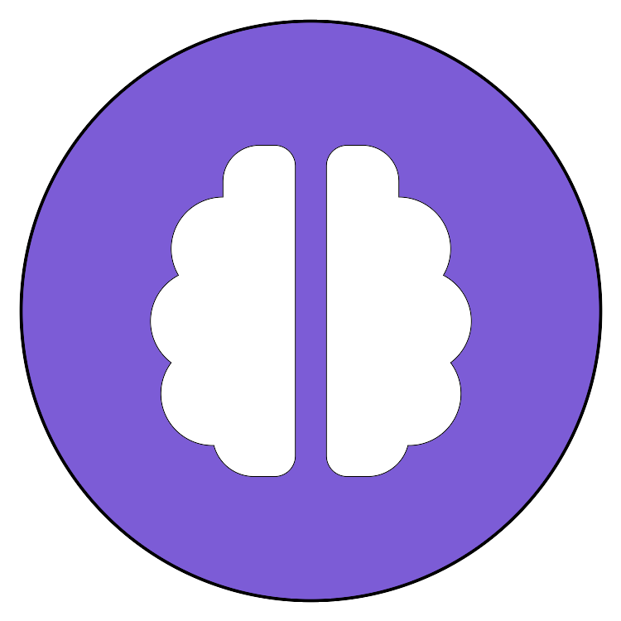


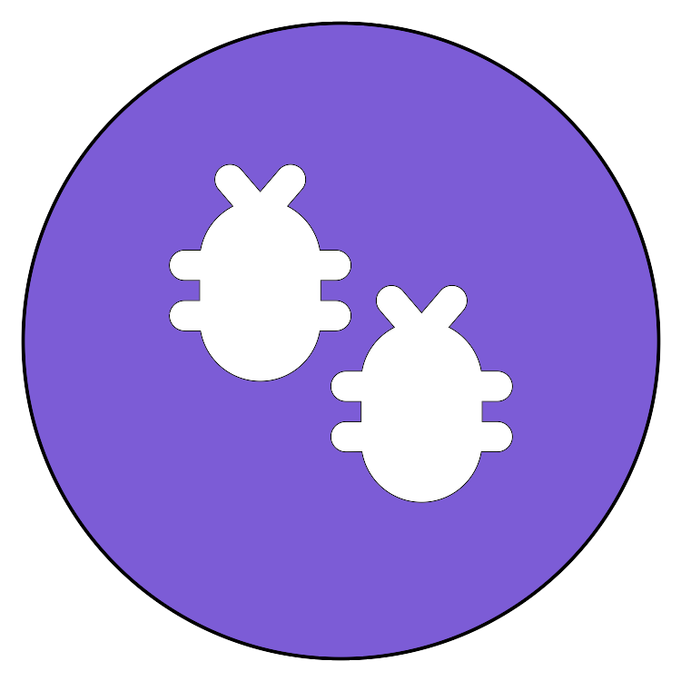

Nine Natures — as nature already does them
Each law is borrowed from a real phenomenon. The convention didn't invent these rules; biology did.
1 · Vitality
2 · Symbiosis
3 · Evolution
DNA checkpoints & apoptosis
Lichen
CRISPR–Cas immunity in bacteria
A cell never divides before its genome is fully copied and repaired; a copy that can't be repaired triggers apoptosis — the cell removes itself rather than pass on a stale record.
A fungus builds the body, holds water and mines minerals; an alga or cyanobacterium photosynthesizes and feeds both. Neither does the other's job, and together they live on bare rock.
A bacterium that survives a phage stores a snippet of the invader's DNA in its own genome — at once. The next time that phage comes, Cas proteins cut it. The same mistake never repeats.
4 · Genesis
5 · Memory
6 · Swarm
Quorum sensing (Vibrio fischeri)
Sleep-dependent consolidation
Dictyostelium slime mold
Every cell secretes a signal molecule; one cell's is noise. Only when the signal crosses a threshold — many cells naming the same need — does the colony switch on bioluminescence.
The hippocampus holds the day in a small buffer, replays it to the neocortex during slow-wave sleep, which distils it into durable schemas, then clears the buffer. Analysis up, wisdom down.
Solitary amoebae live alone while food lasts. When it runs out they pulse cAMP, converge into one migrating slug, fruit, and disperse. Nobody declares the colony; it emerges and dissolves.
7 · Containment
8 · The Wire
9 · Perception
The blood–brain barrier
The honeybee waggle dance
Proprioception
Tight junctions seal the brain's capillaries: nothing crosses by default. What the brain needs passes only through specific gated transporters. Consent is the tissue's shape, not a checklist.
A forager doesn't carry the field home — she points to it in a fixed schema: run angle = direction from the sun, run duration = distance. Known field order, so the field names disappear.
Muscle spindles and tendon organs measure the body's own stretch and tension continuously; position is read, never guessed. When that instrument goes silent, every move must be checked by eye.
ISEKAI ⋄ A CONVENTION FOR LIVING WORLDS
5
Notes:
Companion to the previous slide: one real biological phenomenon per Nature, chosen for the closest structural match, not just the name. Vitality = the G2/M checkpoint + p53-triggered apoptosis (change and record land together, or the cell is sacrificed — the convention's 'stale slime' verdict). Symbiosis = lichen (and, for the 'merge' verdict, endosymbiosis: mitochondria were once free-living bacteria). Evolution = CRISPR-Cas: the mistake literally mutates the genome, and the spacer is inherited by every daughter cell. Genesis = quorum sensing, e.g. Vibrio fischeri lighting up only at high density in the bobtail squid's light organ — 'one naming is an observation, two is a pattern'. Memory = hippocampal-neocortical consolidation; working memory itself holds only ~4 chunks (Cowan), the convention's '~5 thoughts'. Swarm = Dictyostelium discoideum — a slime that forms a colony only on observed convergence, apt for a convention whose ground-truth creatures are Slimes. Containment = the blood-brain barrier, a barrier that is structure rather than policy. The Wire = von Frisch's waggle dance: 'point, don't carry' and 'fix the schema' in one behaviour. Perception = proprioception; Ian Waterman's deafferentation case is the 'silent instrument is itself a finding' example. Icons are Font Awesome glyphs built locally (make_icons.js), not photos — Nature 7 forbids fetching from the network without the human's agreement.

Slide 6
Every reincarnated world has the same shape
isekai.md — the Nine Natures, Principles, Laws, and the gate. Every creature reads it before working; it changes only on the human's order.
log.md — one entry per change: task, files, gate verdict, result, what should be remembered. Never edited, only appended to.
One command founds it: /isekai — and on a fresh reincarnation, it survey-populates the world in the same pass.
.isekai/
├── isekai.md the law every creature reads
├── log.md append-only change chronicle
├── portraits/ one image per race
├── instruments/ the world watching itself
├── elf/orc/slime/ creatures live here
└── tmp/ the proving grounds
ISEKAI ⋄ A CONVENTION FOR LIVING WORLDS
6
Notes:
The .isekai/ skeleton. Same shape whether founded from OpenCode or Claude Code.

Slide 7


Minds & Bodies — how creatures exist
Minds
Bodies
Reusable, stateless know-how. No memory of its own, does no work alone — a creature dons it for one task, then moves on.
Native home: .opencode/skills/<name>/SKILL.md
The vessel that actually runs and holds context. Never minted generic — born already named for the rank it serves: orc-security, slime-auth-zone.
Native home: .opencode/agents/*.md
ISEKAI ⋄ A CONVENTION FOR LIVING WORLDS
7
Notes:
OpenCode is where both are natively authored — .opencode/ is the source-of-truth format the canon assumes.

Slide 8
Three memories — one shape for every creature
Short
Long
Shared
per body, per task — dies with the session
the world's — files are the truth, git is the record
across bodies, across worlds — append-only
context window
the live context — measured, never felt
working memory
the ~5-thought desk on the worn Mind
semantic cache
recent recalls keyed by meaning; local, disposable
episodic
what happened — log.md, one memory per entry
procedural
how to do — Minds, commands, tools
semantic
what is true — the law, creature docs, canon
world
.isekai/memory/shared — travels by git
machine
~/.isekai/shared — one Rimuru, every world
the bus
what must outlive a Court Body goes here first
Files are the truth; every index is derived and rebuildable. memory.js indexes them, recalls by meaning then by relation (the same typed bonds the colony draws), and reports each tier as an instrument reading — a silent tier is a finding, not a gap to route around.
ISEKAI ⋄ A CONVENTION FOR LIVING WORLDS
8
Notes:
Nature 5 is the biology (hippocampal buffer, sleep consolidation, cleared traces); this is where each memory lives. Short → distilled → long; shared is the bus between bodies. The DB tier, when a world needs it, is the same boundary with a bigger engine — see canon/memory-tiers.md.

Slide 9
“The unsaid is your real knowledge.”
What a creature wrote down is the smaller part of what it knows. The larger part sits in the head that did the work — and a head in this world is a context that dies.
Law
Colony
Territory
institutional knowledge
tribal knowledge
domain context
The rules, definitions and decisions the isekai runs on.
Analogy: how data is modelled
Home: semantic long memory — the law, canon, creature docs
What the colony knows but rarely writes down anywhere.
Analogy: how queries are executed
Home: the unwritten — desks, shared notes, what Court Bodies carry and lose
What the numbers and entities actually mean in your territory.
Analogy: metadata
Home: the Slime's own doc — the zone's ground truth
On the wire: @U <kind> … — one piece of knowledge that was in the worker's head and nowhere on disk. A Court Body's report with no @U line either had nothing unsaid or failed its duty; the dispatcher may ask with @ASK … +unsaid. Surface it before the context dies, before the gate verdict, before the distill wave.
ISEKAI ⋄ A CONVENTION FOR LIVING WORLDS
9
Notes:
The three kinds are the human's own (institutional / tribal / domain context), renamed into the world's vocabulary — Law, Colony, Territory — with the definitions kept exact. Colony is the kind the principle is really about: it is where the world's real knowledge leaks.

Slide 10
The loop — six beats a Court Body runs on its own
1
perceive
2
recall
3
plan
4
act
5
verify
6
record
read the instruments: steps left, wall clock, context window
›
ask memory by the step's question; carry anchors, not payloads
›
one step, one class: read · write · outward · destructive
›
outward and destructive pass the human gate first — never auto-approved
›
an instrument reading; a failed verify is a failed act
›
journal the beat; land what was learned as a shared note
Autonomy, bounded by readings
Failure recovers, then escalates
One gate for side effects
Budgets — steps, minutes, context tokens — are read from instruments before every step, never felt. Past any of them the run checkpoints and stops honestly.
Every beat is journaled; a crashed or cleared run resumes from its journal. Retries are bounded; past them the run ends with @? to its dispatcher — never a guess, never forever.
Outward (network, other repos, git push) and destructive (rm, reset) steps need a real answer: a TTY y/N, an explicit pre-approval, or a dry run that only says what it would ask. An interrupted outward act is gated again, not replayed.
Tool and protocol, one shape. loop.js run <plan> --as <body> drives a scripted plan; an LLM-driven body follows the same six beats by hand, and there the gate is the host's own permission prompt — never worked around.
ISEKAI ⋄ A CONVENTION FOR LIVING WORLDS
10
Notes:
Where it fits: the dispatch seam. Rimuru dispatching a Court Body is a loop run; the Elf's routing is the plan file; the Orc's gate is the verify beat plus the human gate above it for anything outward or destructive.

Slide 11
The toolbox — a big registry, a small prompt
Only the tools that fit the turn are injected — as pointers with known costs, never as bodies. The registry may grow without bound; the prompt does not.
Registry
Level 1 — manifest
Level 2 — load
derived, never hand-kept
resident, per turn, budgeted
on the body's own decision
Every Mind, command, world tool, Body and named external — harvested from the world, each entry priced before injection: resident cost (its one-line description) and full cost (its body).
›
The turn's ask is ranked against the registry by trigger, meaning and relation; the picks fill a token budget (1,500 by default). What the body receives: names, one-liners, paths, and the cost of level 2 — the way a skill's frontmatter already sits in context.
›
Only when the body decides to use a tool does it pull the full SKILL.md — whole, or one section by anchor. Every load is journaled, so status reports what was loaded against what was merely offered.
@TOOLS as=slime-auth k=2 cost=203/1500 — level 2 on decision only: toolbox.js load <name> [--sec N]
@T mind tdd — .opencode/skills/tdd/SKILL.md — 95tok (load≈842) — trigger “test”
@T mind code-review — .opencode/skills/code-review/SKILL.md — 108tok (load≈1648) — meaning 0.42
ISEKAI ⋄ A CONVENTION FOR LIVING WORLDS
11
Notes:
This is the law's own sentence — 'loading is already two-tiered' — made an instrument and extended past Minds to commands, tools, Bodies and externals. In Claude Code level 2 is the Skill / ToolSearch by name; in OpenCode it is loading the skill; for a scripted Court Body it is toolbox.js load. The loop runs a pick before every step.

Slide 12
Four commands, native to OpenCode
/isekai
/genesis
Reincarnates a directory: writes the law, the chronicle, the portraits — then, on a fresh founding, survey-populates it in the same pass.
Scans the code and decides, itself, which Elves, Orcs and Slimes it needs, then births them. Offer-first, never silent.
/don
/mint
Brings a Mind across from another ecosystem's skill format into this one — a bridge, not a native OpenCode need.
Brings a Body across the same way — names it on the way in, never mints one unnamed.
ISEKAI ⋄ A CONVENTION FOR LIVING WORLDS
12
Notes:
/isekai and /genesis run identically in OpenCode and Claude Code. /don and /mint only make sense from the Claude Code side, since .opencode/ is already the native format.

Slide 13

Nature 9 — the world watches itself
1
∞
1
app for the whole machine
worlds, each at its own /name/ sub-path
global dashboard, live
tempest.js — a zero-dependency instrument board. Reads every registered world fresh, per request, and reads real session usage from both OpenCode's own store and Claude Code's transcripts — nothing cached, nothing guessed.
1.18.31
842M
3
OpenCode installed + run live here
real input tokens correctly counted (was 0.0M — undercount found by testing)
real bugs found and fixed by an actual test script, not assumed away
ISEKAI ⋄ A CONVENTION FOR LIVING WORLDS
13
Notes:
Instruments are perception, not memory — what the world can check about itself right now, versus what a document claims. The bottom row is field-tested, not illustrative: OpenCode was actually installed and run on the machine this deck was built on, the 842M figure is the real, corrected total after fixing a Claude Code input-token undercount, and the 3 bugs (Claude cache-token undercount, a silent node:sqlite failure, and an OpenCode cache-token undercount) were each caught by an actual deterministic test script (.isekai/tools/test-opencode-integration.js), not by inspection.

Slide 14
One throne, several mounts — model per rank
Rank / office | Suggested model | Why
Great Sage | Haiku 4.5 | Bulk retrieval, terse facts — no judgment, no writes.
Raphael | Sonnet 5 | Real reasoning for a verdict — Opus for high-stakes domains.
Ciel | Sonnet 5 · Opus 5 · Fable 5.1 | Default prose; Opus for heavy synthesis; Fable when voice is the point.
Elf | Sonnet 5 · Opus 5 · Fable 5.1 | Coordination default; Opus for conflict; Fable for the outward voice itself.
Orc | Sonnet 5 | Reasoning-critical gate work — Opus for high-stakes domains.
Slime | Sonnet 5 | Authors real changes — narrow scope, not low judgment. Haiku only for mechanical zones.
Ascended ranks | Opus 5 | Cross-session judgment over an archive, or the last systemic check — task-driven, not just rarity.
ISEKAI ⋄ A CONVENTION FOR LIVING WORLDS
14
Notes:
Rimuru is deliberately excluded — the throne's mount is the human's choice, never hardcoded. Tuned by what each task actually demands, not by rank prestige: narrow scope (Slime) is not the same as low judgment, since a Slime authors real changes — retuned from Haiku to Sonnet 5 default accordingly. Ciel was the only office with no Opus escalation path at all; added one for heavy-synthesis pieces (a session report weaving many threads), kept separate from the Fable axis (voice-consistency specifically). This table is reference guidance today, not yet wired into /mint's actual minting flow.

Slide 15
Why run a codebase this way
1
Memory survives the session
The next session reads what the last one wrote — no re-deriving the same facts twice.
2
Nothing lands without a gate
An Orc verifies the right Slime authored it, traits hold, the doc is truthful — before it counts as done.
3
Observability is built in, not bolted on
One instrument board, live, across every world on the machine — not a dashboard you have to remember to check.
4
Harness-agnostic by design
Minds and Bodies cross from OpenCode into Claude Code and back — one convention, any coding harness, not a plugin bound to one vendor.
ISEKAI ⋄ A CONVENTION FOR LIVING WORLDS
15
Notes:
The pitch slide. Four advantages, each tied to a Nature: Memory, The gate, Perception, and cross-ecosystem Minds & Bodies.

Slide 16
One fix, start to finish
Not hypothetical — this is how slime-db-role's Update path — a raw collection delete where every sibling used the proper dropRole command — actually got fixed, found by /genesis --depth deep's git archaeology.
1
Rimuru
Confirms scope with the human, routes the fix down.
2
Elf
One domain, nothing to arbitrate — routes straight to the Orc.
3
Orc
Dispatches Great Sage for recon (read-wide, terse facts: every raw-delete / dropRole site), then the owning Slime.
4
Slime
Reads its own territory, mirrors dropRole the way Delete and the sibling resource already do — updates its own doc's Traits in the same change.
5
Orc
Dispatches Raphael for the gate verdict: file:line evidence, right Slime authored, traits hold, doc truthful.
6
Orc
Raphael PASSes with evidence — lands the change, records the verdict.
7
Ciel + Elf
Ciel journals it in log.md — Sonnet 5, its own floor: turning facts into house-format prose is voice work, never below Raphael's tier. Elf reports back to the human, one line, full courtesy.
ISEKAI ⋄ A CONVENTION FOR LIVING WORLDS
16
Notes:
The full sequence, grounded in a real fix from this session rather than a hypothetical. Context flows down (Rimuru -> Elf -> Orc -> Slime); the gate (Orc + Raphael) is what stands between a Slime's change and it landing. Ciel's journaling step runs on Sonnet 5, its own floor -- the deterministic-script principle still applies, but only to inputs mechanical enough to bypass the Ciel office entirely (a raw field append with no prose); the moment Ciel itself is actually dispatched, its tier never drops below Raphael's, per the canon's own Great Sage -> Raphael -> Ciel evolutionary ordering.

Slide 17
When a rank hits its ceiling: escalate, never guess
Absolute Rule III — Confirmation and Escalation. Escalation moves by rank, one hop at a time — never skipping a level, never a handoff of the work itself, and it never guesses past confusion.
1
Slime
Hits something it can't resolve at its own level: a request it can't parse, a doc that contradicts the code, an instrument reading it can't explain. Asks its immediate parent — never further up, never sideways.
2
Orc
If the Orc is also stuck, it escalates again in turn — the same question, one hop further, not a rewrite of the problem.
3
Elf
Genuine cross-domain judgment lands here — per the model table, this is where Elf steps up to Opus 5 for real arbitration, not routine coordination.
4
Rimuru
If even the Elf can't resolve it, Rimuru is asked to bring it to Veldora directly — the one siphon that never narrows, in full human courtesy.
5
Veldora (the human)
Confirms or clarifies. Rimuru carries the resolved answer back down the same chain it came up.
Note: escalation is about rank, not model — Fable 5.1 is only the Elf/Ciel office's voice-drafting model choice (model table), not an escalation step of its own.
ISEKAI ⋄ A CONVENTION FOR LIVING WORLDS
17
Notes:
Direct answer to: can a Slime escalate past its own ceiling? Yes -- Absolute Rule III, named 'Confirmation and Escalation'. Verified this section is actually present and correctly readable by testing it live: asked a free, non-Claude OpenCode model (nemotron-3.5-lightning-free) to read isekai.md's Rule III cold and explain the escalation chain -- it correctly answered 'asks its immediate parent, never skipping a rank' without prompting, confirming the doc itself is the mechanism, not something Claude-specific.

Slide 18
Does it actually help? We measured it.
6 isolated Claude Code sessions (Sonnet 5) fixed the same real, documented bug in terraform-provider-mongodb -- 3 with .isekai/ present, 3 with it stripped entirely. Not a pitch: a controlled comparison, graded against objective pass/fail criteria.
3 / 3
~3x
3.35x
adopted the codebase's own canonical fix
higher cost, not lower
gap held across a 2nd chained task
vs. 0/3 without -- which all settled for a narrower, incomplete patch despite the correct pattern sitting 20 lines away in the same file.
$0.49 avg vs $0.17 avg per trial. The overhead is real: turns spent reading world docs, some irrelevant to the specific task.
Ran a second real task in the same sessions (claude -c). Caching cut everyone's marginal cost vs. a cold start -- but the with/without ratio didn't shrink.
Verdict: better decisions, not cheaper ones -- at least not within one small session on an 862-line codebase. The savings case this convention actually makes (skipping expensive cold exploration) needs a larger codebase or separate sessions over time to show up; this test doesn't have either, and says so.
ISEKAI ⋄ A CONVENTION FOR LIVING WORLDS
18
Notes:
Real, honest empirical test -- logged in .isekai/log.md 2026-09-20. Deliberately keeps the negative/mixed finding (cost went up, not down) rather than only reporting the correctness win, per this convention's own Nature 9 (Perception: compute it, don't eyeball it) and Nature 3 (Evolution: a finding that complicates the pitch still gets recorded, not filtered out).

Slide 19

APPENDIX
A note on Claude Code compatibility
Isekai was not designed OpenCode-only — isekai.md itself already treats .opencode/ and .claude/ as two coexisting homes for the same Minds and Bodies.
/don and /mint bridge the gap
/isekai and /genesis run identically in both
Claude-Code-only commands that port a Mind or Body from .opencode/ into .claude/skills/ or .claude/agents/ — a straight copy, since both ecosystems speak the same open Agent Skills format.
Same world document, same population logic, either side — a world founded from OpenCode looks no different from one founded in Claude Code.
A working proof, not just a claim
tempest.js reads both ecosystems' usage
palette-audit, a Mind built during this convention's own development, ships byte-identical in both .opencode/skills/ and .claude/skills/ right now.
The instrument board reports real session activity from OpenCode's own store and Claude Code's own transcripts, side by side, on the same dashboard.
ISEKAI ⋄ A CONVENTION FOR LIVING WORLDS
19
Notes:
Appendix, distinctly styled (slate background) to mark it as supplementary to the OpenCode-perspective main deck. The advantage: adopting Isekai isn't a bet on one ecosystem.

Slide 20

Reincarnate any directory. One command.
/isekai
The world remembers in documents, because sessions forget.
It watches itself through instruments, because memory alone cannot see stress.
ISEKAI ⋄ A CONVENTION FOR LIVING WORLDS
20
Notes:
Closing slide. Quote lifted directly from isekai.md's own opening.

