Slide 1
Website Demo
Errick Aliifua
Elijah Blake
Connor Osborn
Benji Stewart

Slide 2
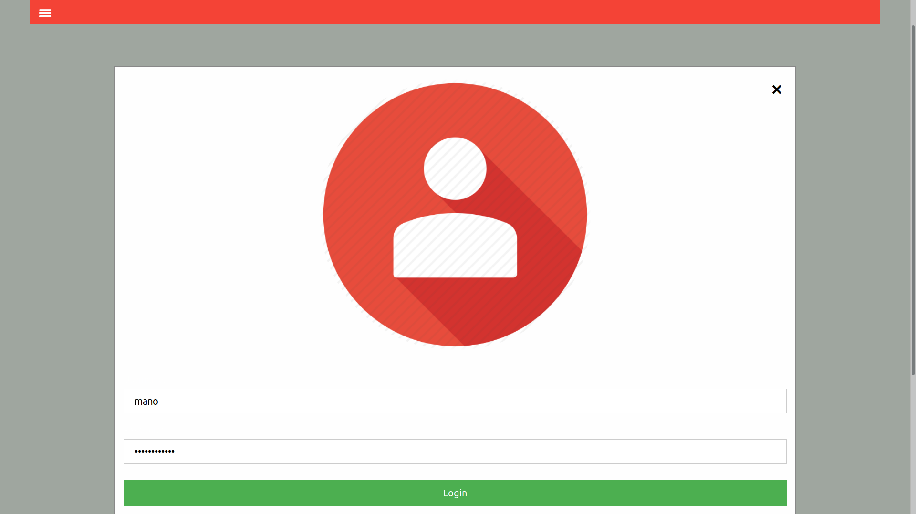
Login

Slide 3
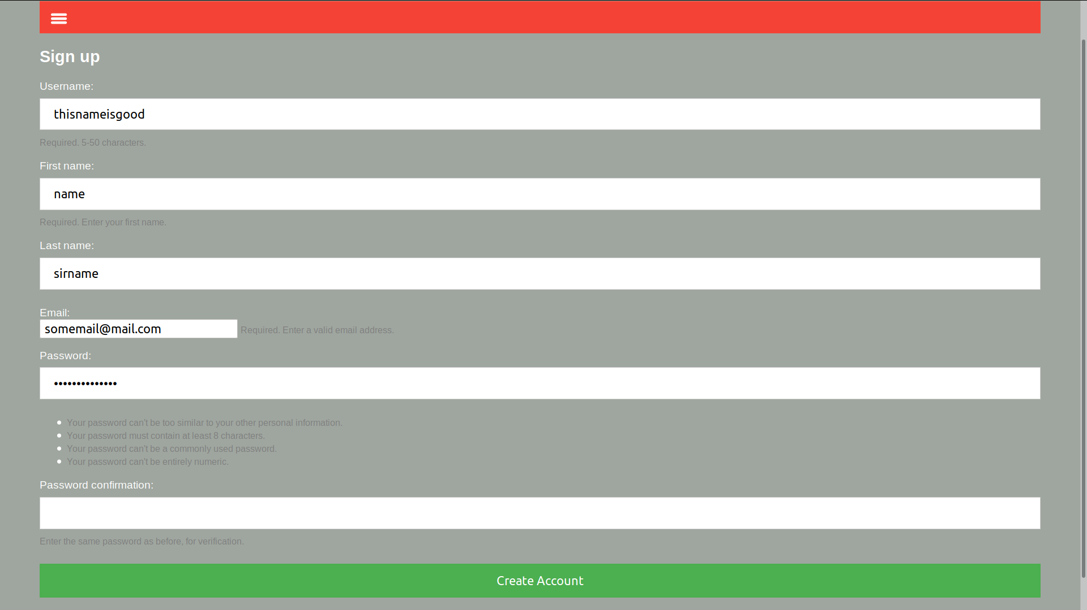
Sign up/Registration
Creates account
Gives a unique bidding number
Detects if user is logged in properly

Slide 4
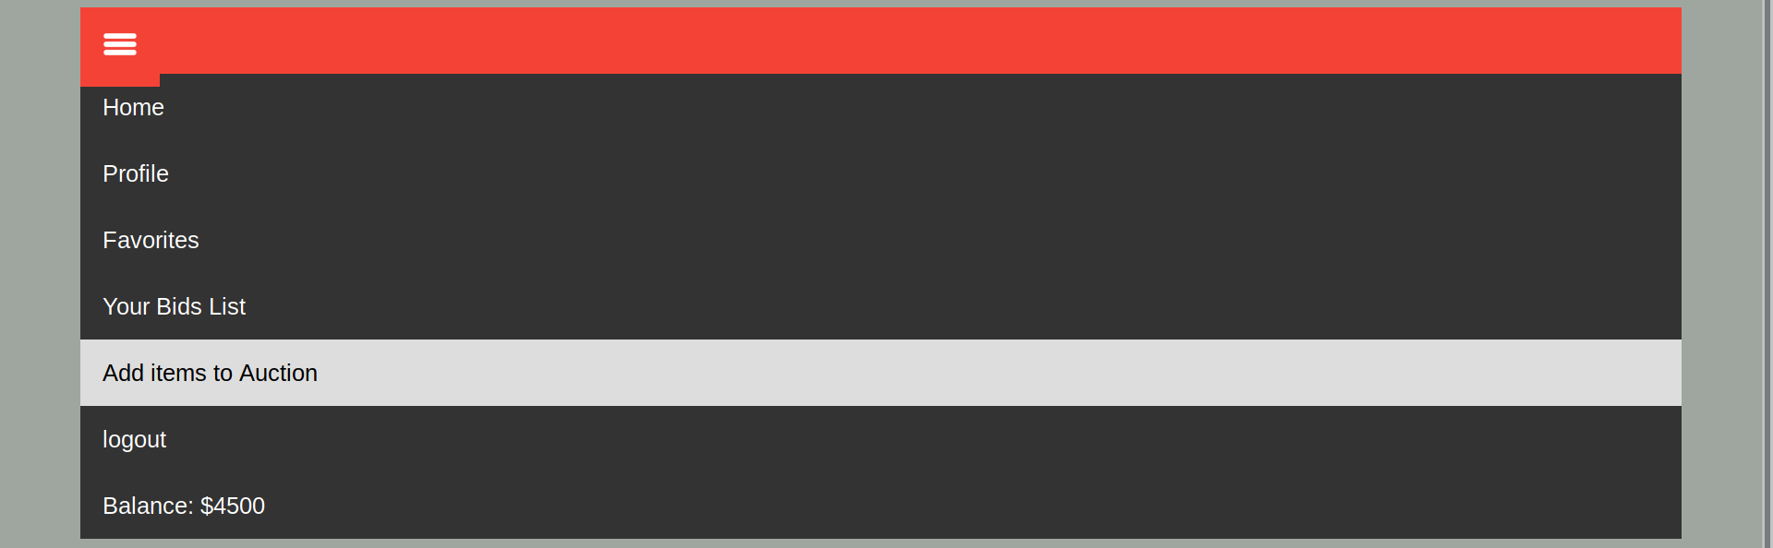
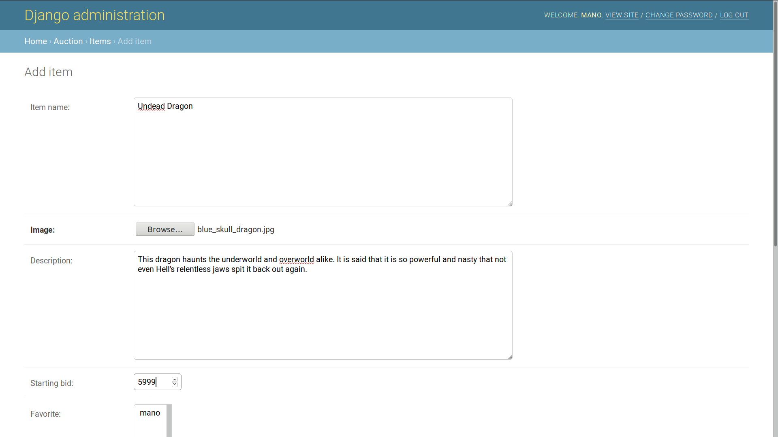
Adding Items

Slide 5
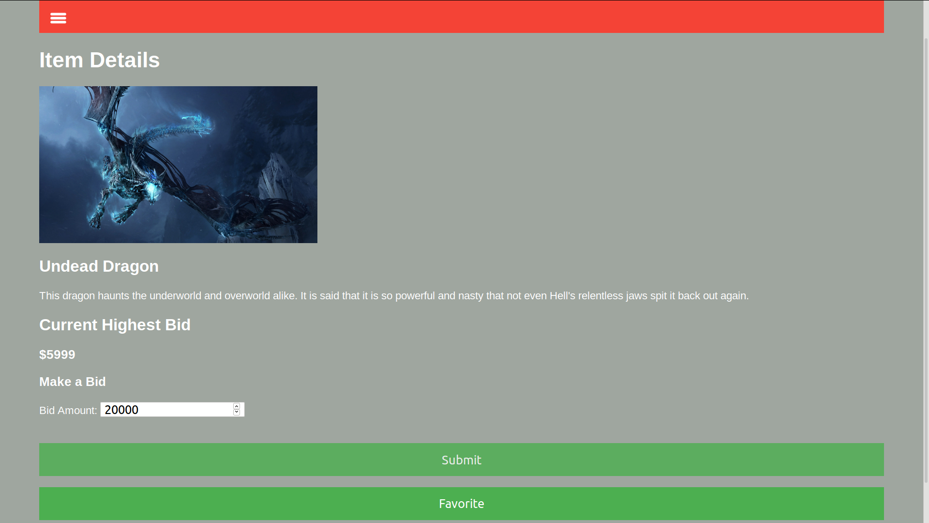
Placing a Bid/Adding a Favorite

Slide 6
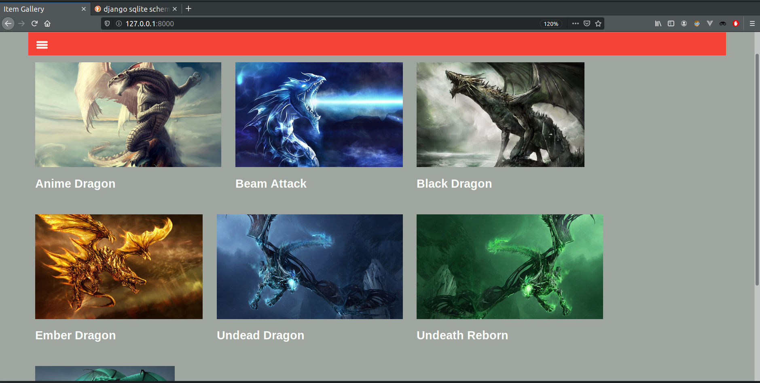
Main Bidder View

Slide 7
Tool Stack
Django 2.2.5
Python 3.7
Javascript
Sqlite3

Slide 8
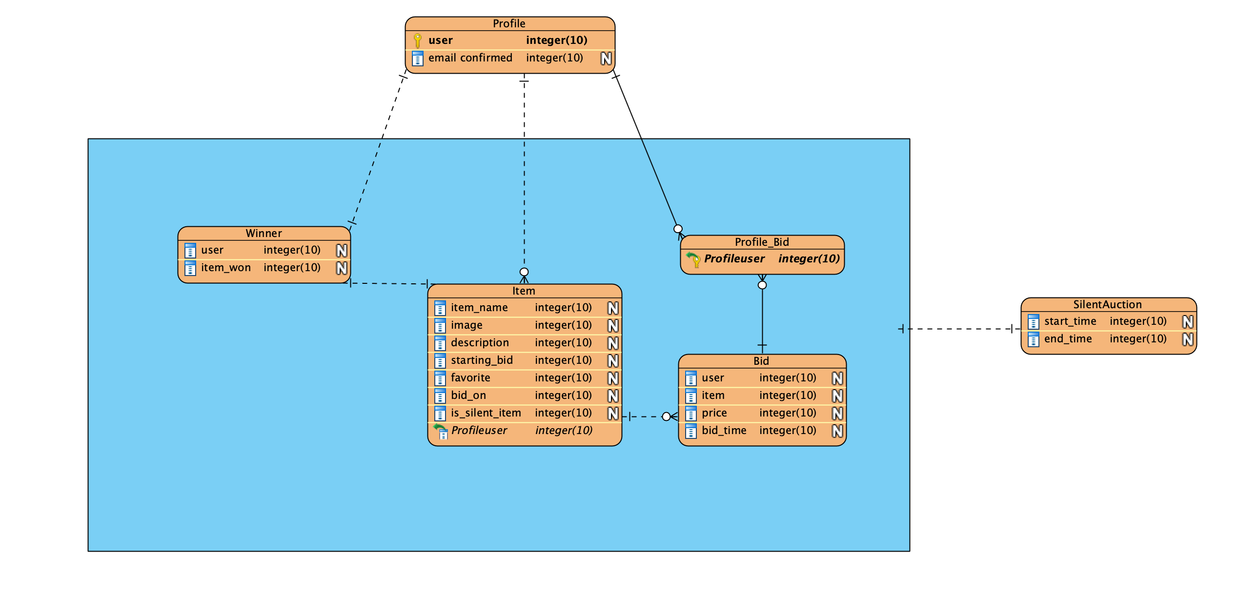
Data Base Schema

