Slide 1
Credit Data Analysis – Mophones Assessment
Sharon Kagwiria | Credit Data Analyst
January 2025

Slide 2
Assessment Objective
Clean the data set
Join the data set together
Assess portfolio health through balances, arrears, and repayment trends
Analyze customer quality and experience and their relationship to repayment and return behavior
Measure collections effectiveness by comparing expected versus actual payments and identifying collection gaps

Slide 3
Data Structure and Tables
Credit Data– Contains loan pricing, cash and loan values, loan terms, premiums, and
credit-related attributes. Used to assess affordability, pricing strategy, and credit risk.
NSP data – Contains loan repayment and facilities data, including expected and actual payments,
balances, arrears, days past due, and account status
Customer & Sales Dataset– Contains customer demographics, sales information, product details,
seller data, and return behavior. Used to analyze customer quality, sales performance,
and behavioral risk.
DATA RELATIONSHIP
Loan_id provided a link to all the tables

Slide 4
Data Preparation $ Cleaning
Standardized column names
Cleaned and formatted date fields
Removed duplicates and irrelevant columns
Merged sales, loan, and gender datasets
Categorized NPS responses (Promoters, Passives, Detractors).
Prepared final dataset for analysis and visualization

Slide 5
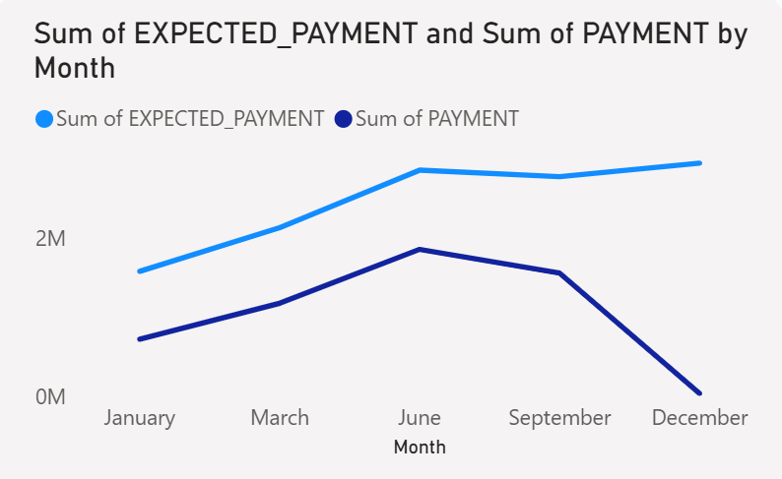
Expected vs Actual Payments Trend
This chart shows the monthly trend of expected payments versus actual payments received. While expected payments steadily increase over time, actual payments rise initially but drop sharply toward the end of the year.
-The growing gap between expected and actual payments indicates deteriorating repayment performance.
-The sharp decline in actual payments in the final month suggests higher arrears or defaults, increasing portfolio risk.
-This trend highlights the need for earlier intervention and stronger collections to prevent payment shortfalls as the portfolio grows.

Slide 6
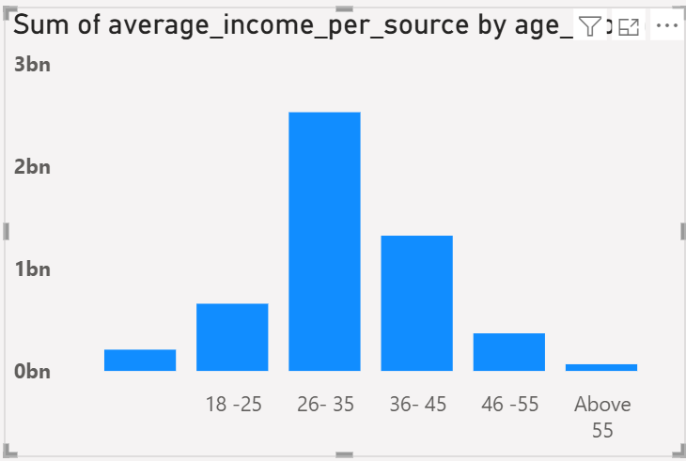
Average income per Age Group
This chart shows the total average income by age group. Income contribution rises from younger customers, peaks strongly in the 26–35 age group.
Customers aged 26–35 contribute the largest share of income, making them the most economically active and valuable segment.
Income levels are lower among younger (18–25) and older (46+) age groups, indicating potentially lower repayment capacity
Income levels are lower among younger (18–25) and older (46+) age groups, indicating potentially lower repayment capacity

Slide 7
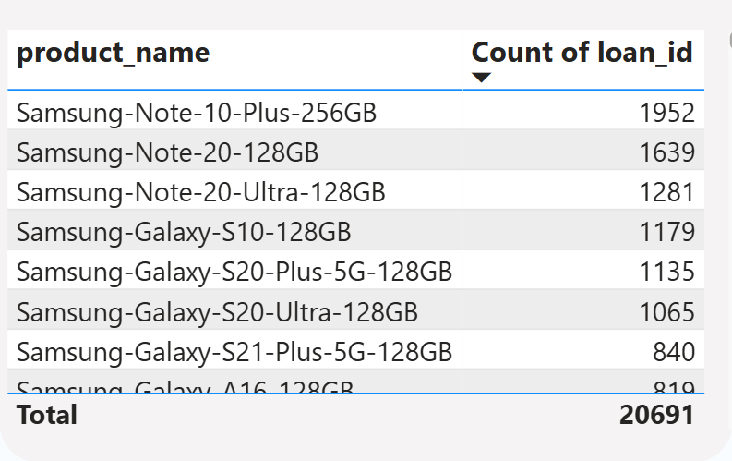
Product Performances
This table shows the number of loans issued by product (phone model). It highlights which device models are most frequently financed within the credit portfolio.
  High-end Samsung models (Note and Galaxy S series) account for the largest share of loans, indicating strong demand for premium devices on credit.
  A small number of products contribute a disproportionate share of total loans, suggesting portfolio concentration risk.
  Credit performance and default rates should be closely monitored for these top-financed models, as issues in these products would have the largest impact on portfolio health.

Slide 8
Key Findings
Material collection gap: With ~2bn total balance and ~1bn in arrears, the 7M collection gap indicates a significant shortfall between expected and actual payments, confirming growing repayment risk.
Worsening late-year performance: Expected payments continue rising, but actual payments decline sharply toward year-end, driving arrears and increasing the collection gap.
Delinquency concentration: A small number of loans account for extremely high Days Past Due, suggesting concentration risk and the need for targeted recovery actions.
Core risk segments identified: Customers aged 26–45 dominate income and loan uptake, meaning deterioration in this would materially impact the portfolio.
Credit check coverage is high: Most customers underwent credit checks, indicating that post-disbursement behavior, not underwriting coverage, is the primary driver of arrears.
Rising outstanding balances: Closing balances grow steadily over time, increasing exposure if collection effectiveness does not improve.

Slide 9
Actionable Recommendations
- Collections underperform expectations
- Arrears and balances increasing
- Strengthen collections and credit policies
- Improve customer experience

