Slide 1
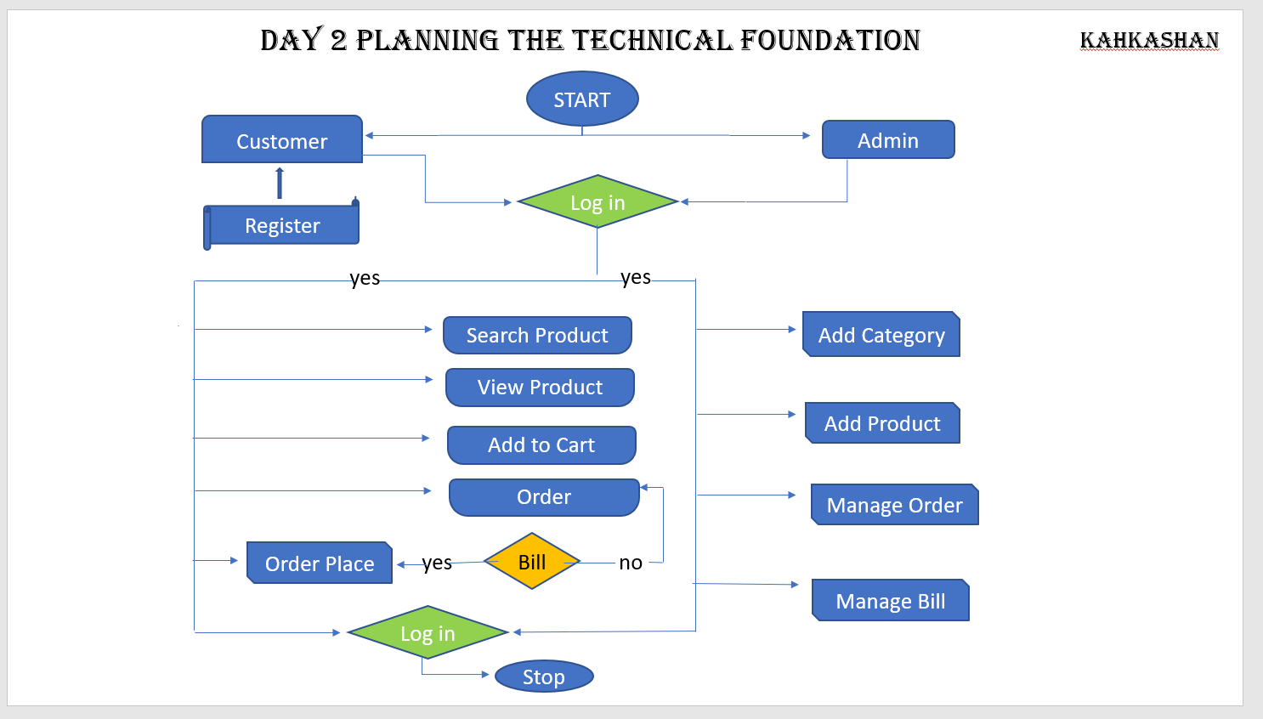

Slide 2
DAY 2 PLANNING THE TECHNICAL FOUNDATION
Kahakshan
381830
System Architecture Over View
Diagram:
[Frontend (Next.js)]
[Sanity CMS]
[Product Data API]
[Third-Party API]
[Shipment Tracking API]
[Payment Gateway]

Slide 3
System Architecture
Customer service
Admin
Admin
Gateway
API
Admin Data Admin Data SyncSync
Admin Data Sync
Browser
Catalog service
Browser
API
Admin
Query API
Storefron
Aggregation
Storefront
Gateway
Checkout service
Storefront
API
Order service
API
Catalog
Customers
Checkout
Order management

Slide 4
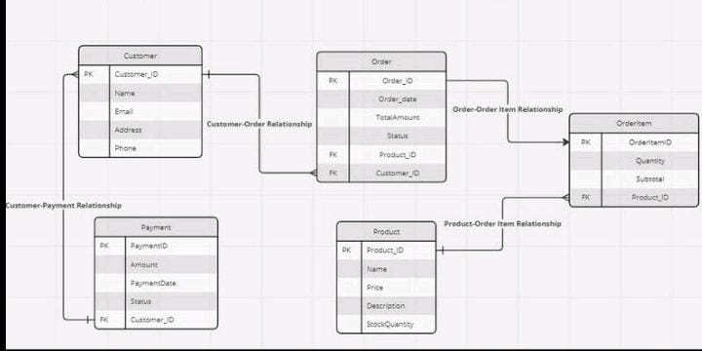
EDR Diagram

Slide 5
Workflow Diagram
Kahkashan
[Visit Home Page] [Browser Products] [Views Product Details Page]
[Add Product to Cart] [ Proceed to Checkout] [ Complete Profile and Payment Details]
[Order Confirmation] [Tracks shipment]
[Receive Delivery at Home]

Slide 6
