Slide 1
AWARE
Adaptive Weighted Architecture for Reflective Essays
A Multi-Label Classification Framework for Detecting Community Cultural Wealth in Student Narratives
San Francisco State University
Advisor: Dr. Anagha Kulkarni
Master of Science in Computer Science
ALMA Project | 2025

Slide 2
Community Cultural Wealth (CCW)
Yosso (2005): 6 forms of capital marginalized students bring to education
ALMA Project at SFSU: Extended to 11 themes for STEM student essays
7 years of collection: 2,636 annotated essays across Physics, Astronomy, Science
Bottleneck: Manual annotation requires months per few hundred essays
Our goal: Automate multi-label CCW detection at sentence level
Example: A single sentence expressing 4 themes simultaneously
"My parents always pushed me to be the first in our family to graduate, and that drive kept me going even when I felt like I didn't belong."
Aspirational (goal of graduating) Familial (parents as motivation) Attainment (first-gen milestone) Resistance (persisting despite not belonging)

Slide 3
Final 8 Themes After Consolidation (from 11 original)
Theme | Prevalence | Multi-Label % | d-prime | Single-Label N | Key Observation
Navigational | 24.1% | 42.3% | 1.07 | 2,449 | Most common; distinctive context patterns
Aspirational | 15.6% | 59.3% | 0.66 | 1,009 | Goal-oriented language; detectable by keywords
Familial Capital | 12.7% | 37.8% | 1.62 | 634 | Highest d-prime; family vocabulary is unambiguous
Social | 8.1% | 48.2% | 0.53 | 410 | Peer networks; multi-modal sub-structure
Perseverance | 7.8% | 43.2% | 0.73 | 730 | Overlaps with Resistance in overcoming difficulty
Resistance | 6.3% | 60.9% | 0.39 | 278 | Lowest d-prime; requires narrative context
Spiritual | 3.4% | 22.3% | 0.54 | 418 | Values-driven; appears across all prompts
Attainment | 2.3% | 77.3% | 1.55 | 92 | Almost never alone; absorbed by Nav+Asp
Consolidation decisions: Merged Familial + Filial Piety (cosine = 0.987) | Dropped First Generation (33 sentences, 88% multi-label) | Dropped Community Consciousness (119 sentences, 84% multi-label)
Each decision justified by: centroid similarity, LOO error rates, and multi-label contamination

Slide 4
5 Attributes That Make CCW Classification Hard
Noisy & Fragmented Data
7 years, multiple annotators, inconsistent formats. Different annotation tools per semester.
Deep Semantic Overlap
ALL theme-pair cosine similarities > 0.93. K-means finds only K=2 (themed vs unthemed), NOT 8.
Context Determines Meaning
"They helped me figure it out" = Familial or Social depending on essay context.
Severe Class Imbalance
21.8:1 ratio. Majority baseline = F1=0.000 (no theme exceeds 50%). Oracle baseline = F1=0.151.
Small Data, Large Model
17,622 sentences for 438M parameters. Model can memorize entire training set.
Each attribute maps to a specific design response in our pipeline and model.

Slide 5
The Data
2,636 Annotated Essays | 17,622 Sentences | 8 Themes | 5 Prompts

Slide 6
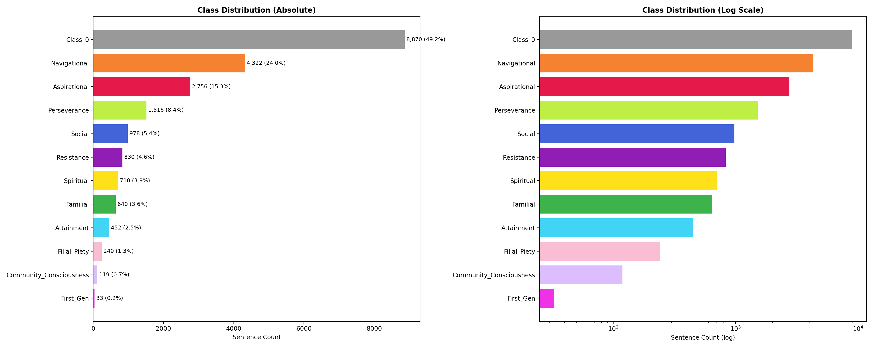
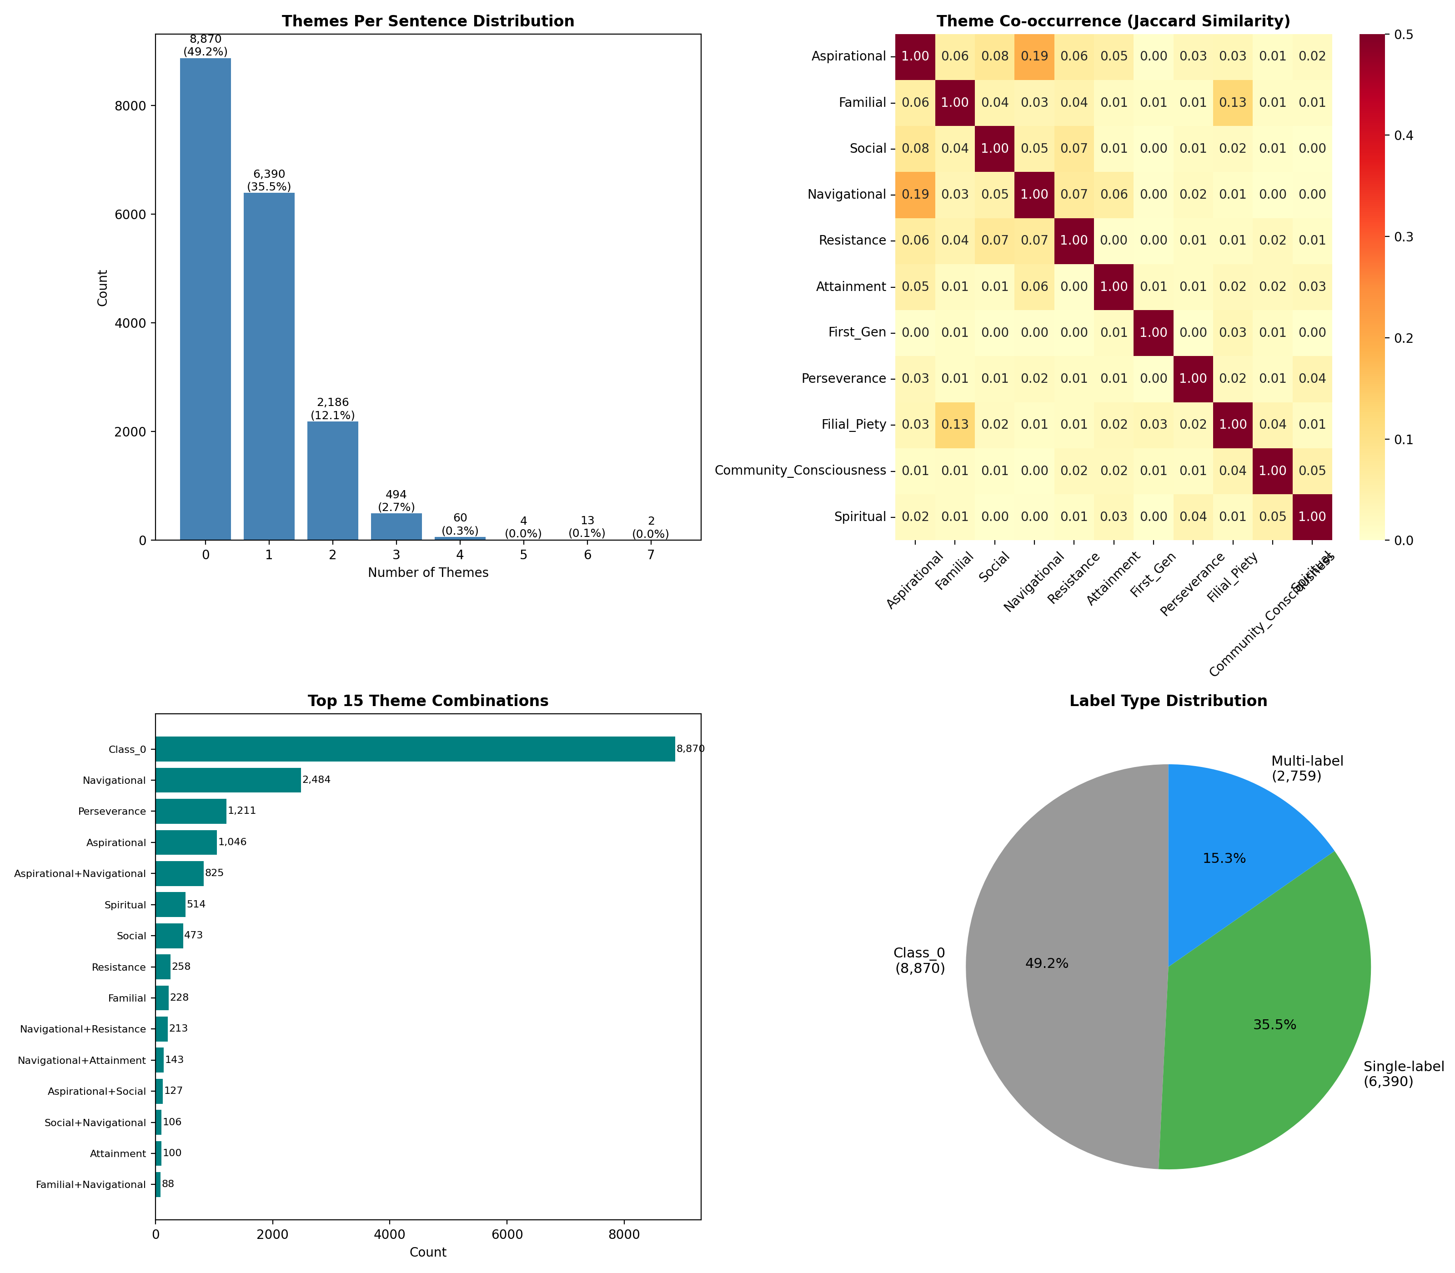
Observation 1: Severe Class Imbalance + Pervasive Multi-Label Co-occurrence

Slide 7
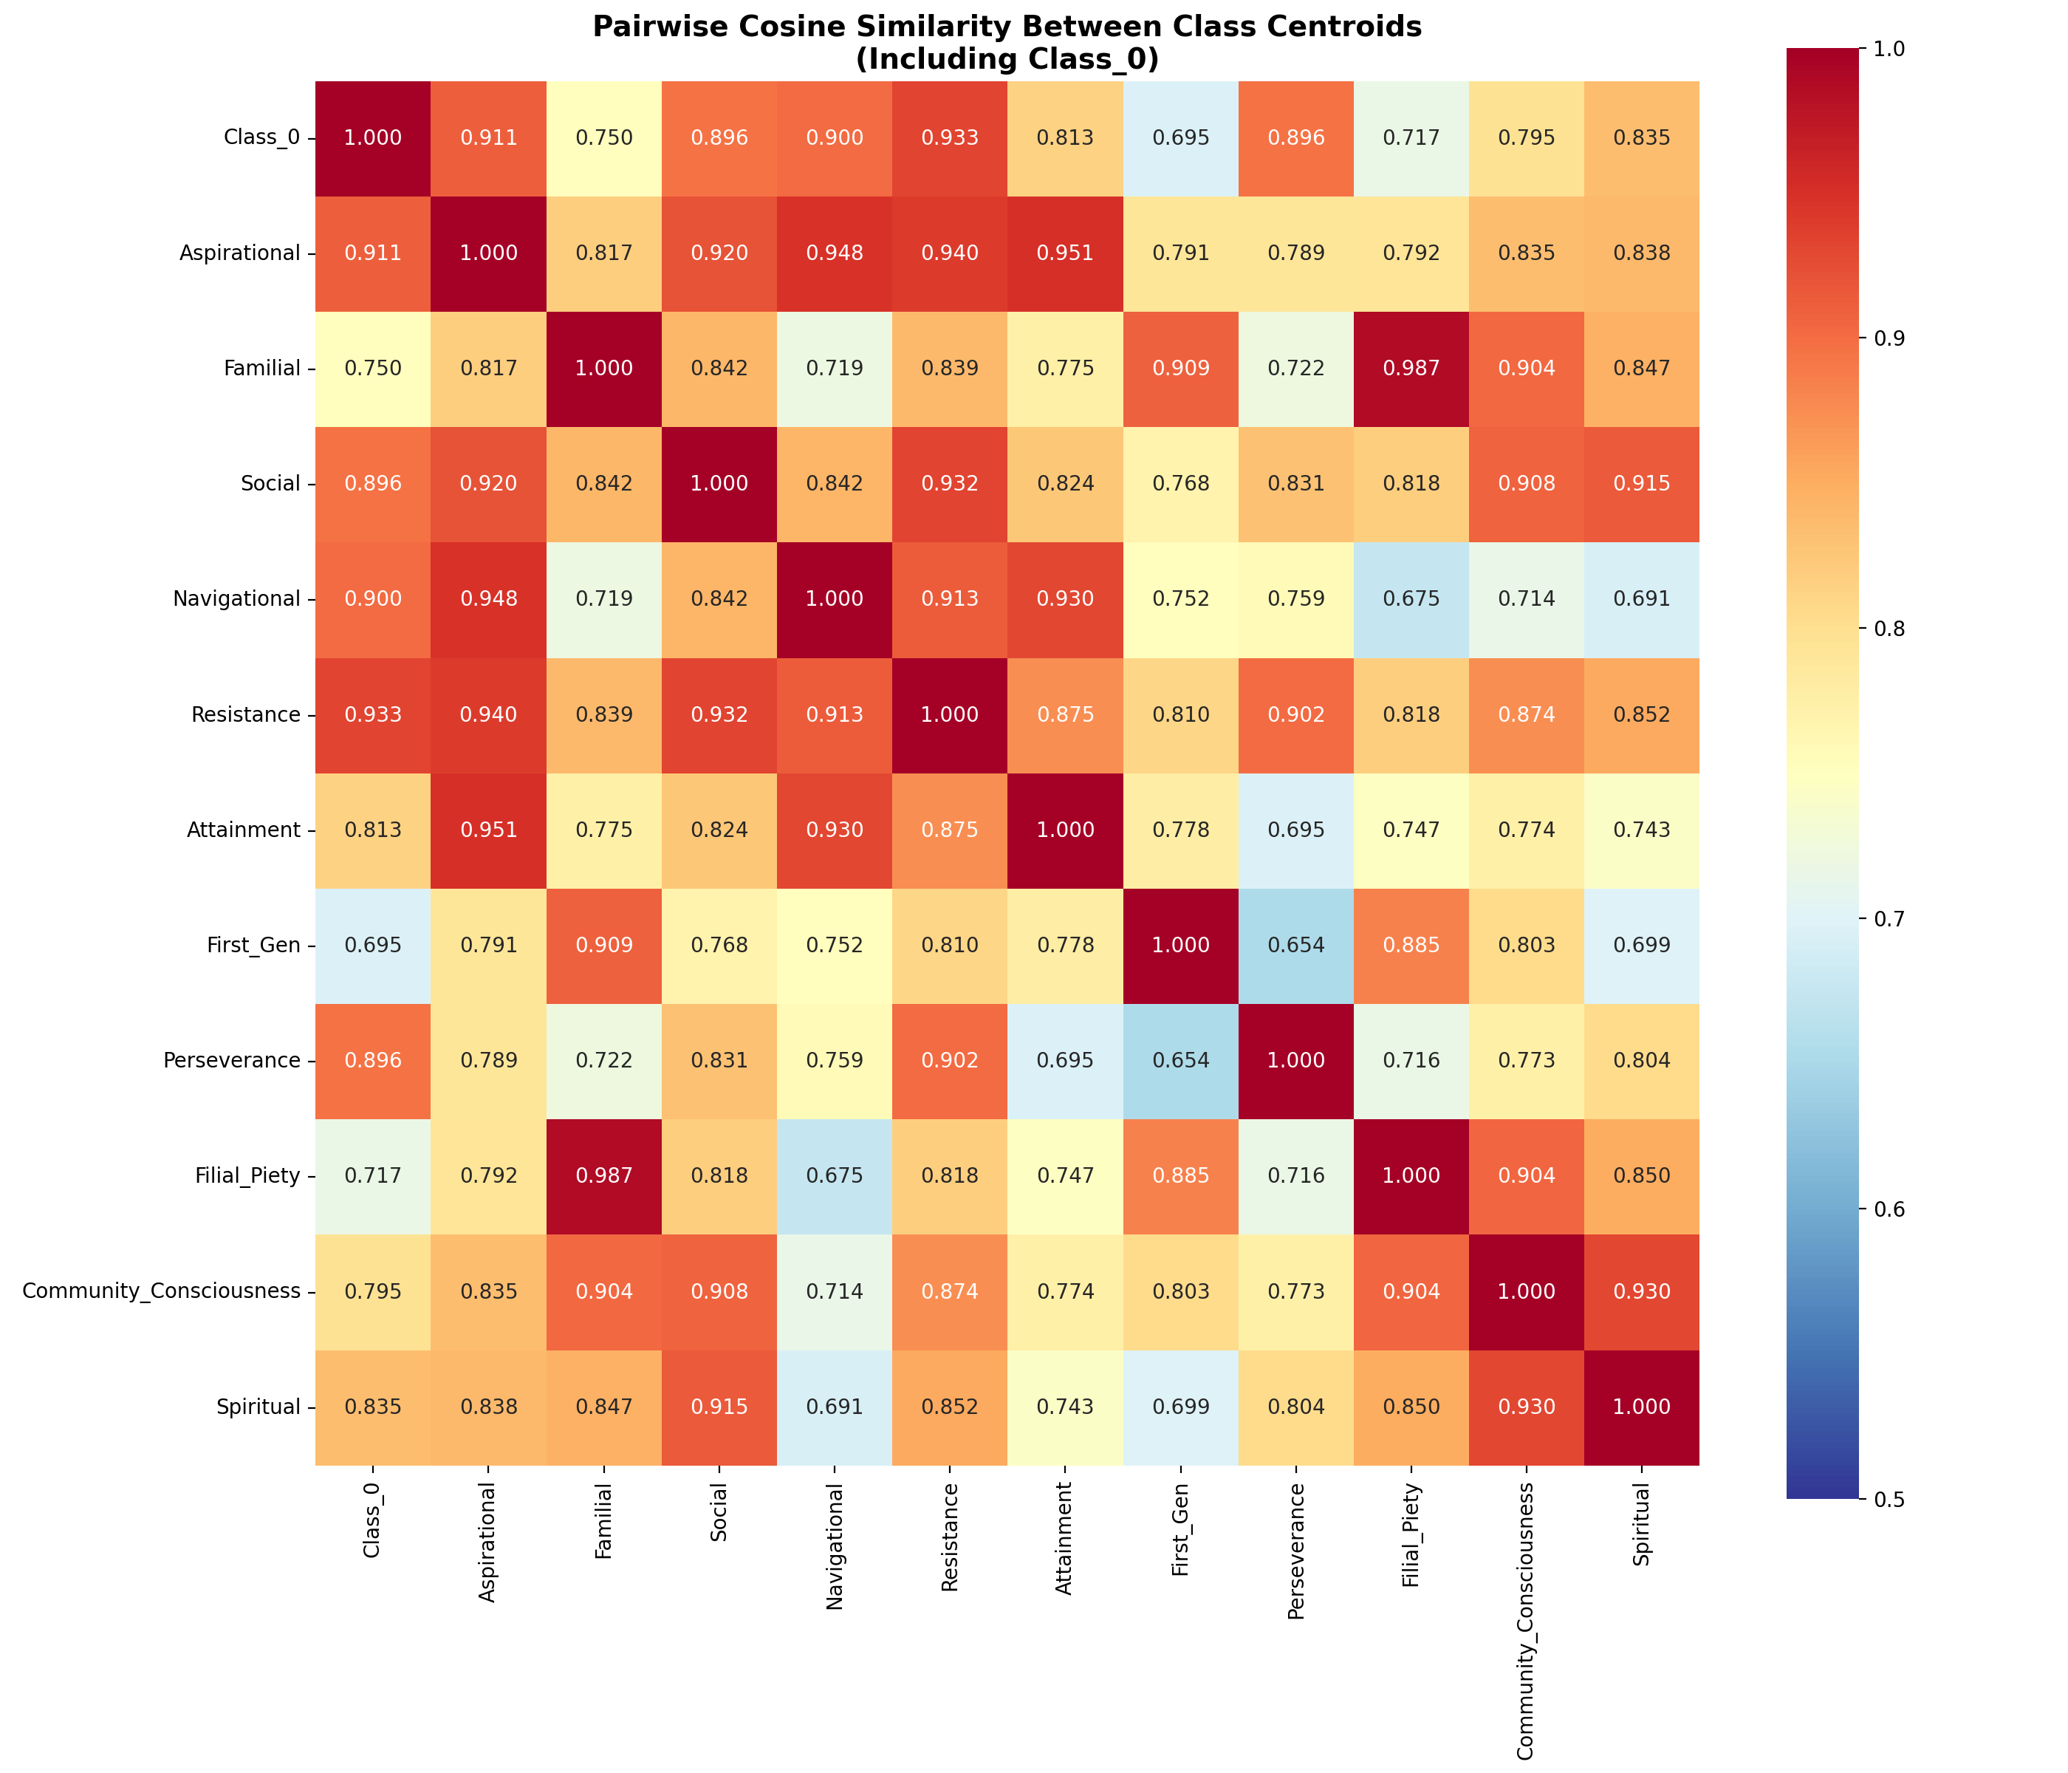
Observation 2: Themes Overlap Deeply in Embedding Space
What this means:
Cosine > 0.93 everywhere — no pair is well-separated
Familial-Filial = 0.987 — virtually identical, so we MERGED them
K-means optimal K = 2 — algorithm sees only themed vs unthemed
LOO KNN error = 38.7% — 4 in 10 sentences are closer to wrong theme
Implication for classification:
No linear boundary can separate these themes
The model must learn non-trivial decision surfaces
Data cleaning must be semantic, not syntactic

Slide 8
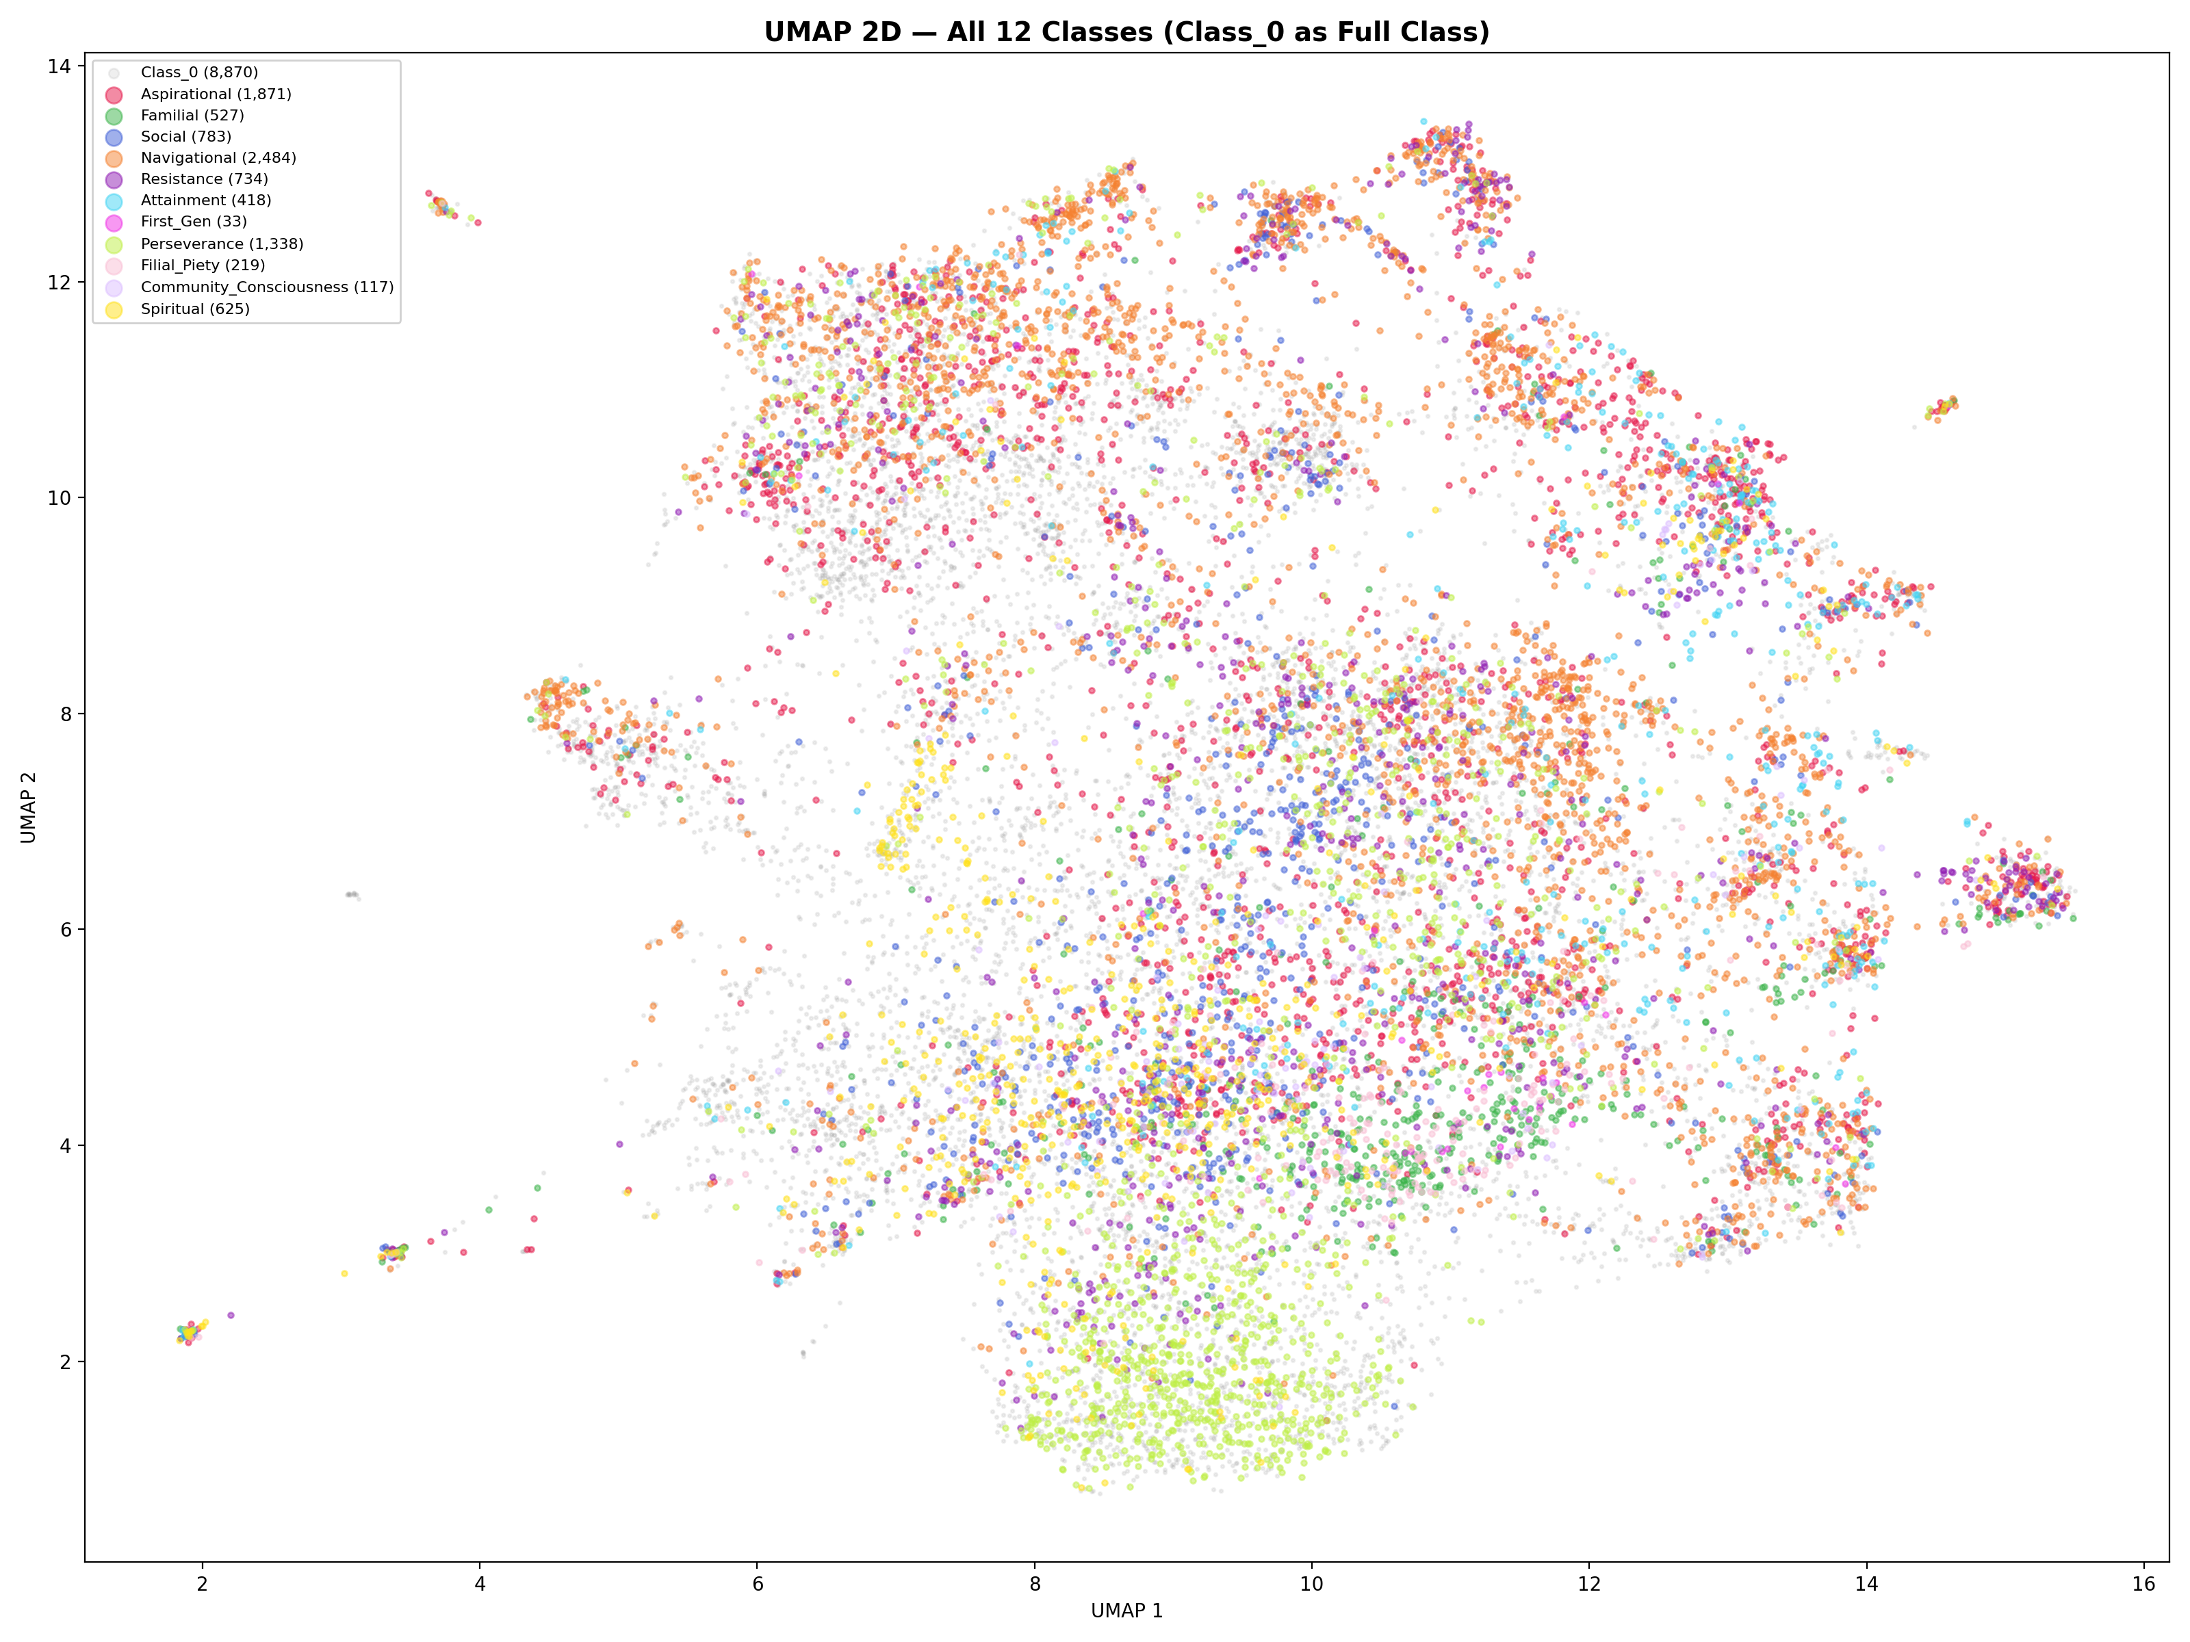
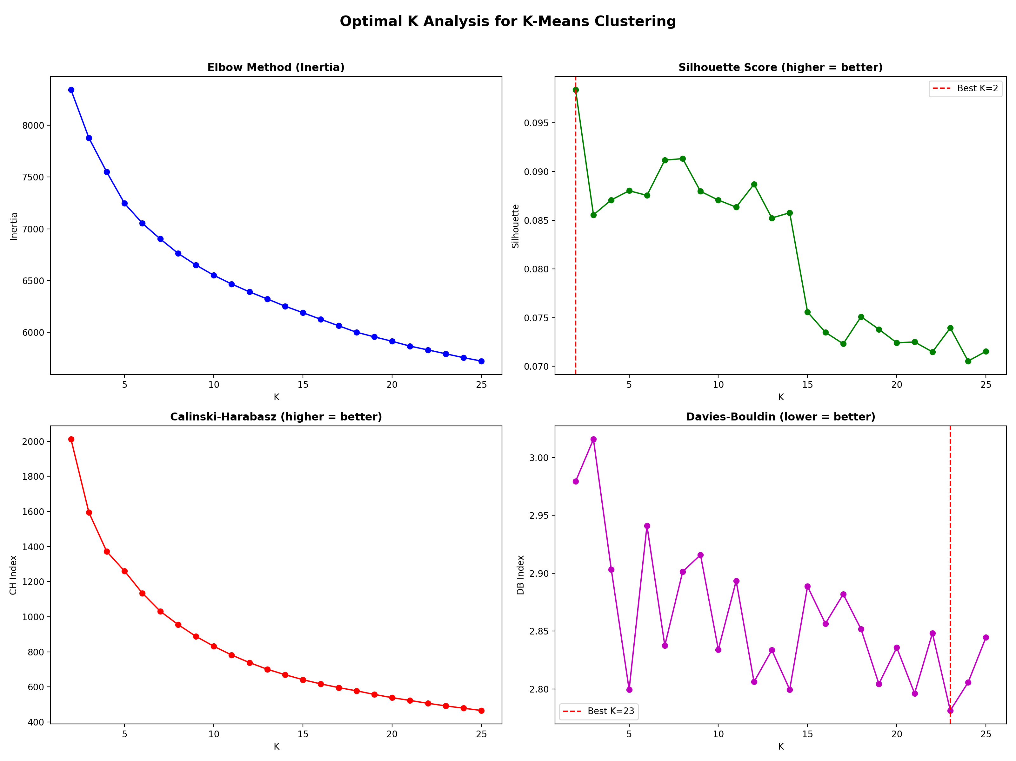
Observation 3: Pre-trained Embeddings Show No Theme Structure

Slide 9
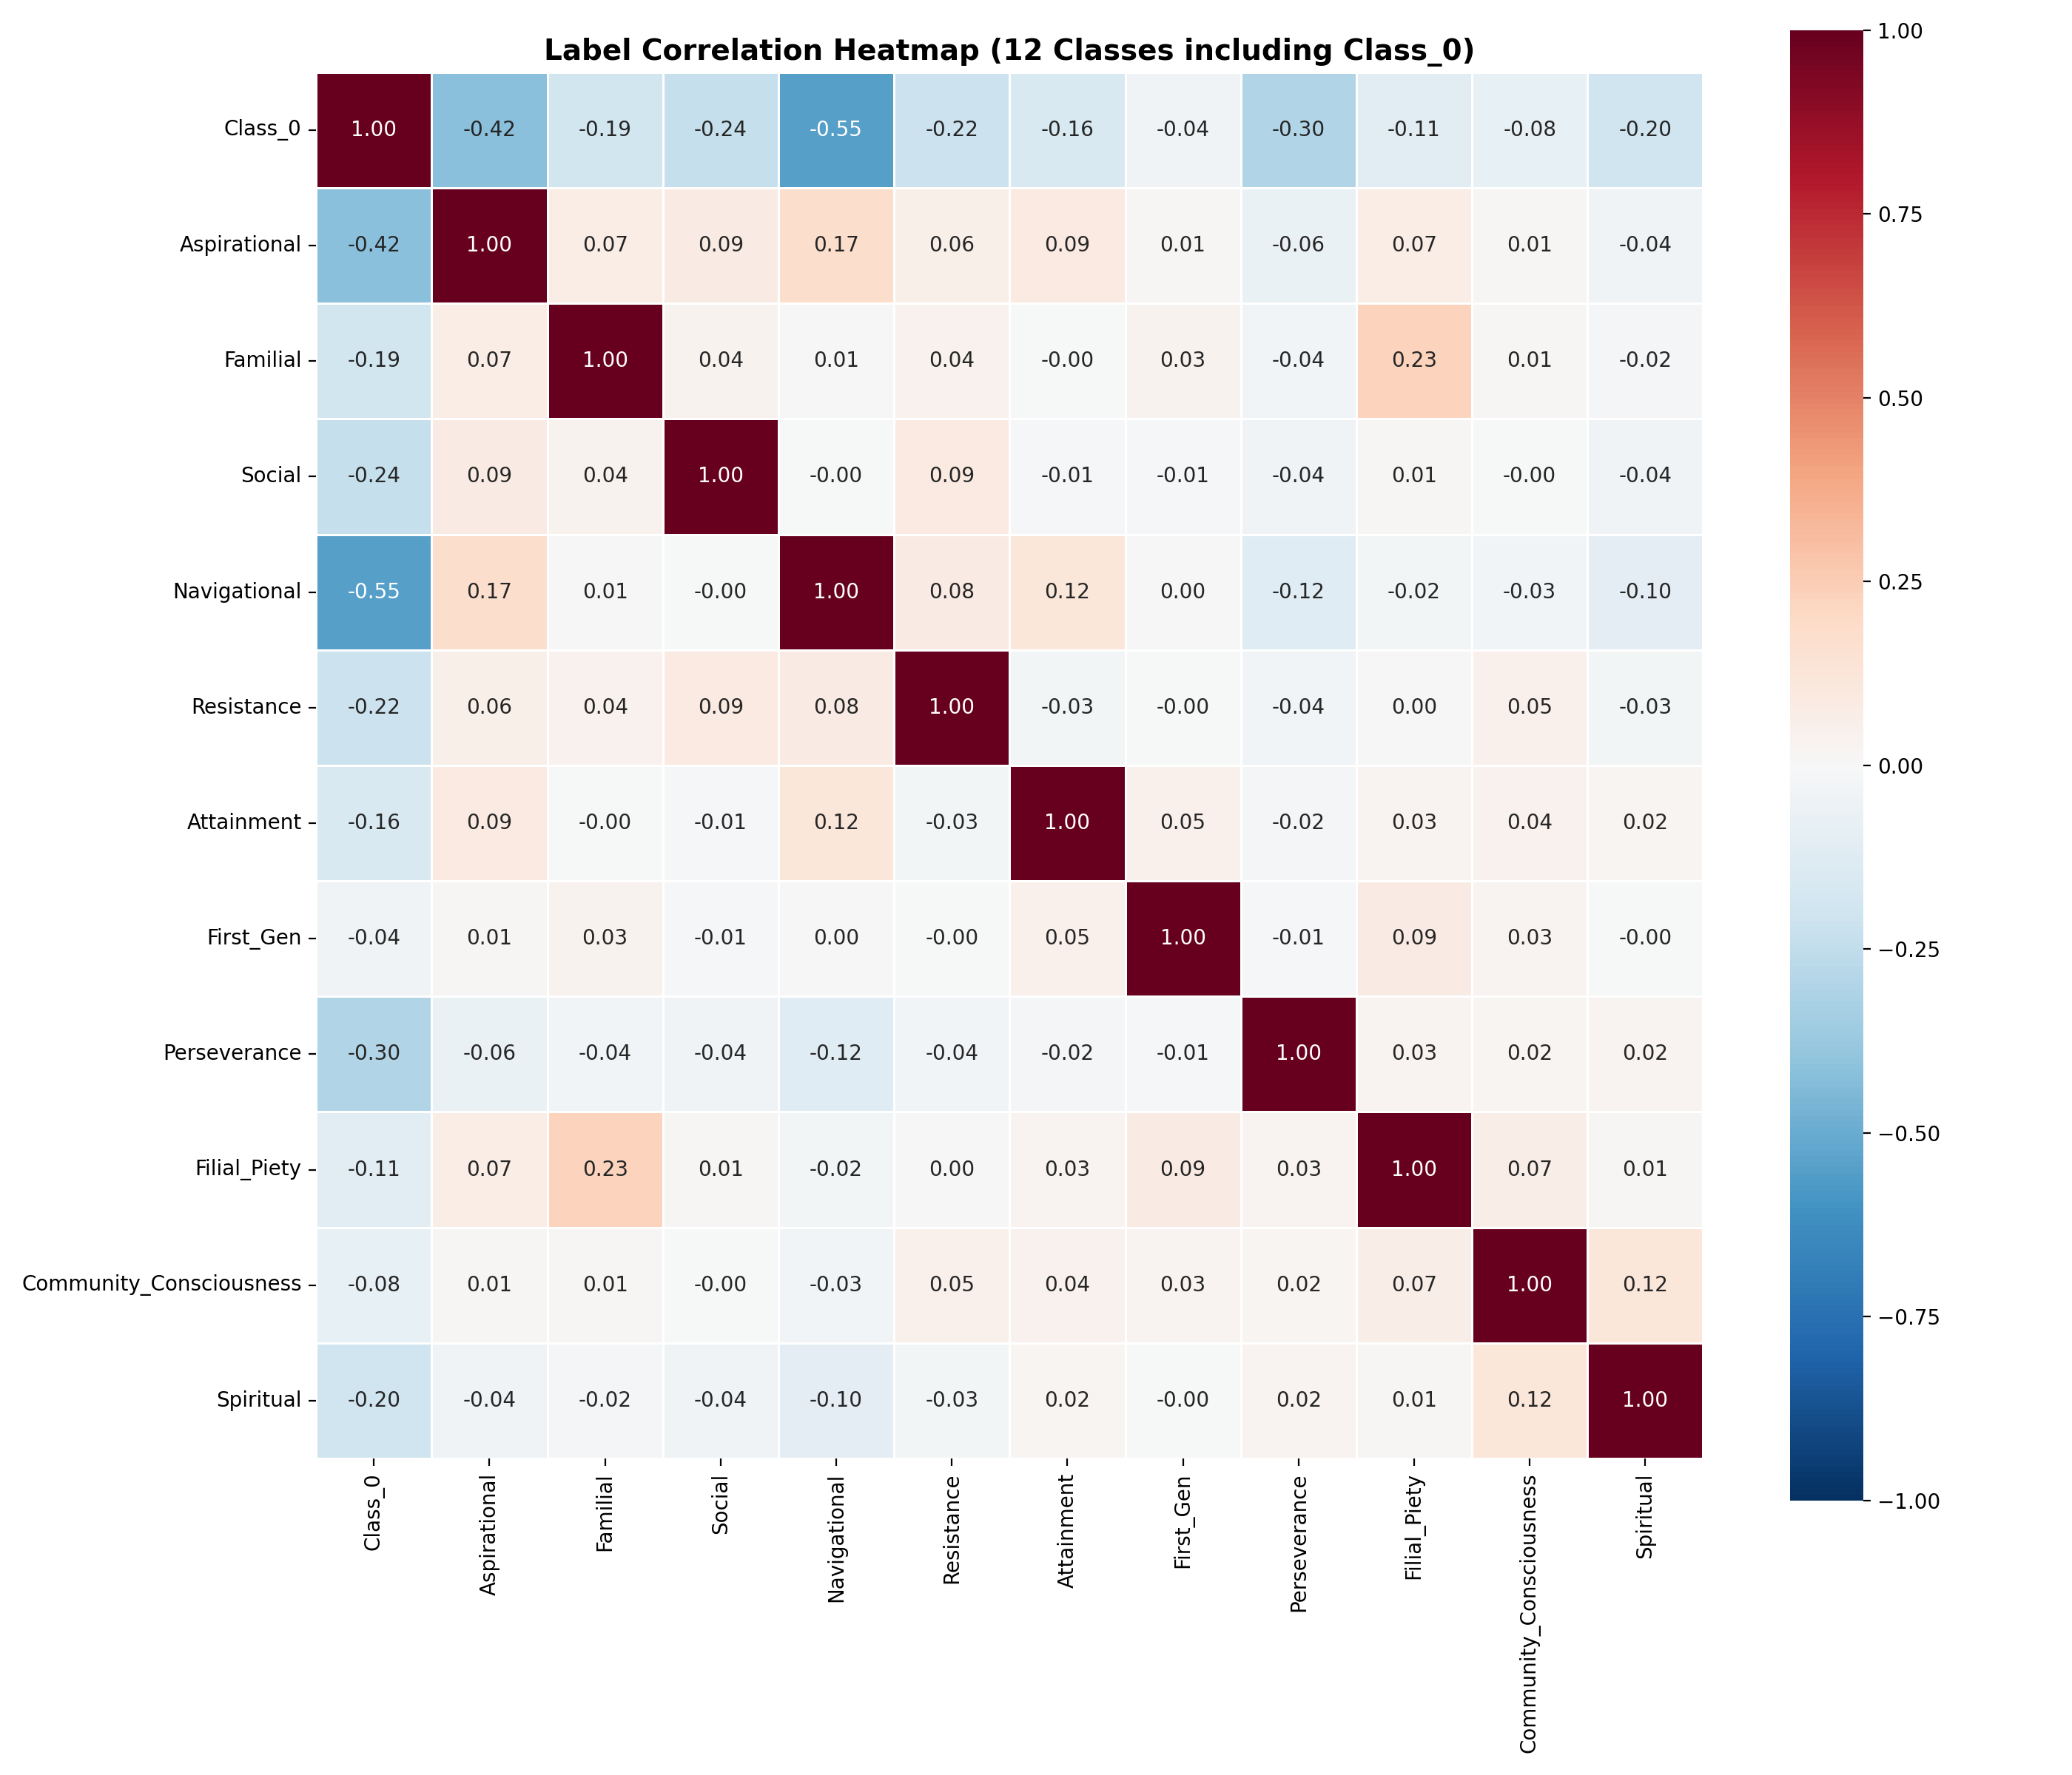
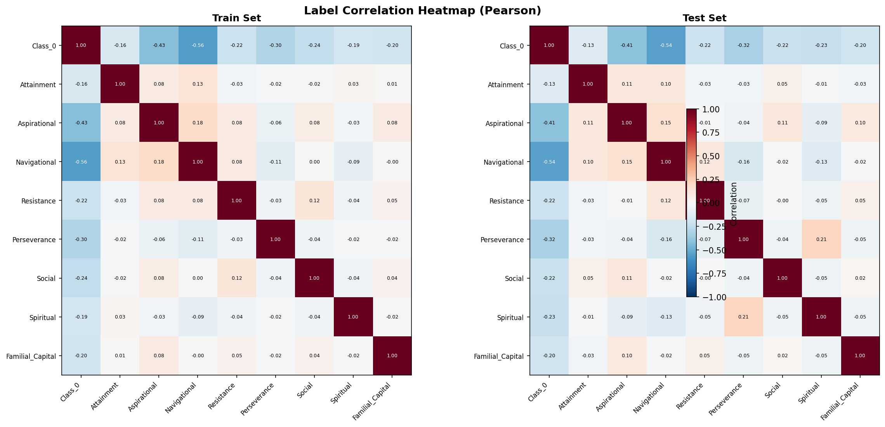
Observation 4: Theme Co-occurrence Is Not Random — It Is Structured

Slide 10
Data Processing Pipeline
4 Stages | Embedding-Based Semantic Cleaning | Principled Theme Consolidation

Slide 11
4-Stage Pipeline: Each Stage Responds to a Specific Data Problem
Stage 1: Assembly
Problem: 7 years of heterogeneous files, formats, naming
Unified 4,079 essays from multiple annotators into single format
Stage 2: Segmentation
Problem: Annotations at excerpt-level, not sentence-level
Split into 17,622 sentences; propagated labels from excerpts to sentences
Stage 3: Semantic Cleaning
Problem: Boundary noise — ambiguous sentences at theme edges
3 embedding-based rules removed 1,705 sentences (8.6%) using cosine similarity
Stage 4: Theme Consolidation
Problem: Some themes are indistinguishable or too rare
12 themes -> 8: merged (cosine=0.987), dropped (88% multi-label, N=33)

Slide 12
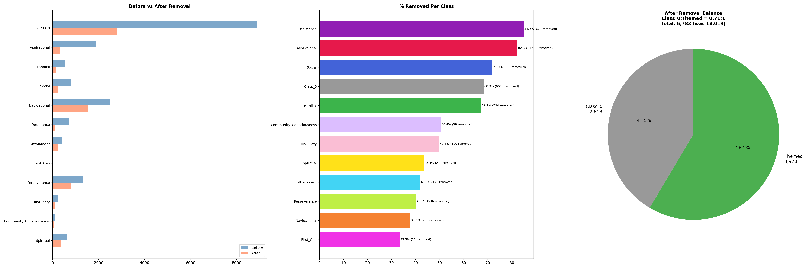
Semantic Cleaning: 3 Principled Rules (Embedding-Based, Not Keyword)
Rule 1: Class_0 inside theme clusters = ambiguous unthemed text
Evidence: These sentences sit closer to theme centroids than to Class_0 centroid
Removed: 589 sentences — reduces false negatives in training
Rule 2: Boundary violations = sentences at theme-theme edges
Evidence: Closer to a different theme's centroid than their own
Removed: 482 sentences — reduces label noise at decision boundaries
Rule 3: Low-density outliers from theme regions
Evidence: Sparse neighborhoods with few same-label neighbors
Removed: 634 sentences — removes annotation errors and edge cases
Total: 1,705 removed (8.6%). All decisions reproducible from embeddings.

Slide 13
AWARE Architecture
Every Component Responds to a Specific Data Attribute

Slide 14
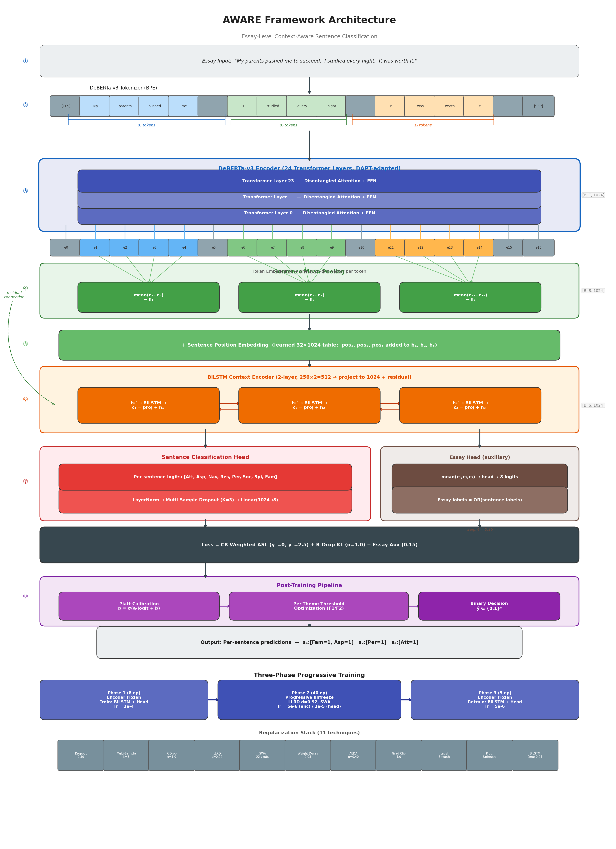
AWARE Framework: Full Architecture

Slide 15
Design Rationale: Each Component Addresses a Specific Problem
Problem Attribute | AWARE Component | Specific Evidence / Numbers
Domain Shift | DAPT (MLM on essays) | General-purpose DeBERTa: MLM loss=11.98. After DAPT: 2.71 (77% reduction)
Context Dependency | Essay-Level Encoding | Full essay as single input sequence — each sentence sees all others
Context Dependency | BiLSTM (2-layer, 256) | Models sentence-to-sentence narrative flow; +0.112 F1 on Social from context
Class Imbalance | ASL (gamma_neg=2.5) | Down-weights confident negatives; preserves ALL gradient from rare positives
Class Imbalance | CB Weights (up to 10.4x) | Attainment gets 10.4x weight vs Navigational to compensate 21.8:1 ratio
Small Data | 11-Technique Regularization | Dropout, R-Drop, weight decay, EMA, label smoothing, gradient clipping...
Small Data | 3-Phase Progressive Training | Frozen encoder -> progressive unfreeze -> SWA ensemble
Multi-Label | Per-Theme Thresholds | Replace default 0.5 with per-theme optimal thresholds (range: 0.05-0.35)
No component was added speculatively — each is a direct, evidence-based response.

Slide 16
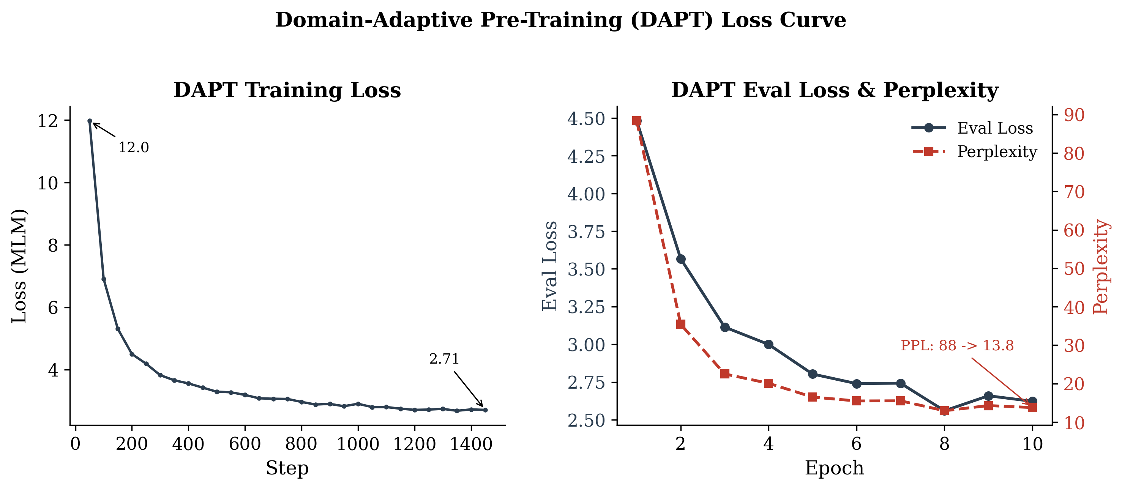
DAPT: Closing the Domain Gap — "navigate" Means Something Different Here
The domain gap is real:
MLM loss 11.98 on student essays (cold DeBERTa)
MLM loss 2.71 after 10 epochs DAPT (77% reduction)
What DAPT learns:
Code-switching in multilingual student writing
Informal register — slang, grammar errors, abbreviations
Domain-specific senses: 'navigate' = institutional navigation, not spatial movement
Why this matters:
Without DAPT: model starts cold on unfamiliar text
With DAPT: embeddings already aligned to student writing patterns before any classification training

Slide 17
Key Design Decisions: What We Tried and Why
Why BiLSTM, not Transformer?
Only 2-10 sentences/essay. BiLSTM adds 2M params vs 13M for Transformer layer. Sequential bias is right for short narrative sequences. Less overfitting risk.
Why ASL, not standard BCE?
With 1 positive + 7 negative themes per sentence, BCE gradient is dominated by negatives. ASL with gamma_neg=2.5 preserves ALL positive gradient (gamma_pos=0).
Why essay-level input, not sentence-level?
"They helped me figure it out" is unclassifiable alone. Essay context resolves ambiguity. Result: Social +0.112 F1, Spiritual +0.097, Resistance +118% vs TF-IDF.
Why per-theme thresholds?
Attainment at 1.7% prevalence: sigmoid output almost never > 0.5. Default threshold renders it nearly undetectable (F1=0.098). Optimized threshold=0.05 recovers F1=0.303.
Prototype head vs Linear head?
Tested cosine-similarity prototype head: F1=0.34 (29% worse). Themes share too much vocabulary for angular separation. Linear head learns arbitrary hyperplanes in full feature space.

Slide 18
Experiments
7 Experiments | Systematic Progression | Every Experiment Teaches Something

Slide 19
Model Comparison: From Random Baseline to AWARE-Large v4
Model | Params | Macro-F1 | 95% CI | PR-AUC | ROC-AUC | Key Learning
Majority Class | 0 | 0.000 | — | 0.085 | — | No theme > 50% prevalence
Random (prior) | 0 | 0.084 | ±0.007 | 0.085 | — | 6x worse than our best
Oracle Constant | 0 | 0.151 | — | 0.085 | — | Perfect freq knowledge still fails
TF-IDF + LogReg | ~10K | 0.378 | — | 0.350 | — | Keywords help, but not enough
AWARE-Base | 86M | 0.474 | [0.445, 0.497] | 0.473 | 0.893 | +25.4% over TF-IDF
AWARE-Large v3 | 438M | 0.461 | [0.431, 0.486] | 0.462 | 0.901 | WORSE than base (failed)
AWARE-Large v4 | 438M | 0.494 | [0.464, 0.520] | 0.484 | 0.888 | Best: 7 fixes recovered scaling
Key observation 1: Oracle baseline (cheats with test frequencies) still only F1=0.151 — task CANNOT be solved by frequency
Key observation 2: TF-IDF establishes what keywords can do; everything above 0.378 is the value of context + DAPT
Key observation 3: v3 failure is NOT about capacity — it's about optimization. Same architecture, different config = 0.461 vs 0.494

Slide 20
Per-Theme F1: Where Each Model Wins and Loses
Theme | TF-IDF | AWARE-Base | AWARE-v4 | v4 vs TF-IDF | v4 vs Base | What This Tells Us
Navigational | 0.631 | 0.685 | 0.707 | +12% | +3% | Already keyword-detectable; context adds little
Aspirational | 0.553 | 0.595 | 0.585 | +6% | -2% | Strong lexical markers (dream, goal, future)
Familial Cap. | 0.471 | 0.615 | 0.600 | +27% | -2% | Family vocab distinctive; base model sufficient
Social | 0.350 | 0.394 | 0.506 | +45% | +28% | Scale helps: large model wins biggest here
Perseverance | 0.364 | 0.477 | 0.480 | +32% | +1% | Context helps vs keywords; scale doesn't help
Resistance | 0.181 | 0.482 | 0.395 | +118% | -18% | BIGGEST context gain; but large model overfits
Spiritual | 0.288 | 0.278 | 0.375 | +30% | +35% | Scale recovers what base missed
Attainment | 0.183 | 0.264 | 0.303 | +66% | +15% | Fundamentally limited by 77.3% co-occurrence
Macro | 0.378 | 0.474 | 0.494 | +30.8% | +4.2%
Resistance: +118% over TF-IDF — context-dependent meaning needs essay-level encoding, not just keywords
Aspirational: only +6% — 'dream', 'goal', 'future' are strong enough that TF-IDF already captures most signal
Base beats v4 on 3 themes — 438M params overfit mid-frequency themes where 86M's implicit regularization helps

Slide 21
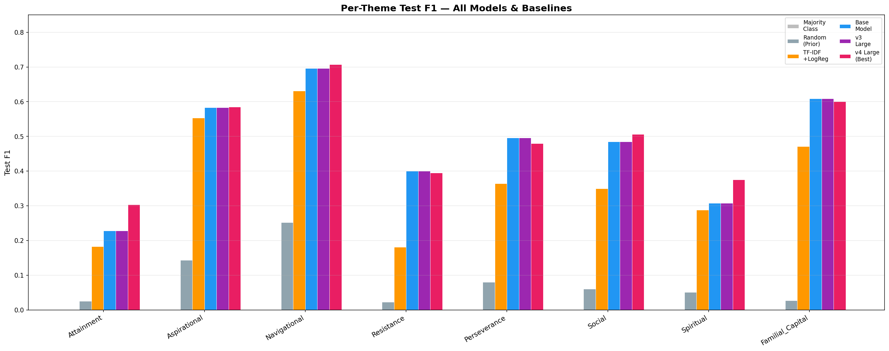
Per-Theme F1 Comparison (Visual)

Slide 22
The Scaling Failure: 4x More Parameters = WORSE (v3: 0.461 < Base: 0.474)
F1: Encoder memorized too fast — Train loss dropped 47% faster than base (0.072 vs 0.049/epoch)
F2: SWA never activated — Start ratio 0.50 + patience 5 = training stopped exactly when SWA should start. 0 checkpoints.
F3: LLRD froze bottom layers — 0.85^23 = 0.02x top LR. Bottom layers received updates of 3e-7 — effectively dead.
F4: R-Drop dominated the loss — KL divergence consumed 55-72% of gradient. Model learned CONSISTENCY, not CORRECTNESS.
F5: Phase 1 too short (4 ep) — Head PR-AUC = 0.144 at Phase 1 end — barely above random (0.085). Unstable gradient signal.
F6: Early stopping too eager — Patience=5 terminated at epoch 15. Late-peaking themes (Attainment) never got to converge.
F7: Phase 3 ineffective — Retraining 20.5K head params can't fix encoder-level representation problems.
These failures COMPOUND: fast encoder + short Phase 1 + dominant KL + eager stopping = cascading collapse.

Slide 23
v3 -> v4: 16 Targeted Fixes — Each Addresses a Specific Failure Mode
Parameter | v3 | v4 | Failure | Measured Impact
Encoder LR | 1.5e-5 | 5.0e-6 | F1 | Phase 2: 15 -> 31 productive epochs
LLRD Decay | 0.85 | 0.92 | F3 | Bottom layer LR: 3e-7 -> 8.5e-7
Phase 1 Epochs | 4 | 8 | F5 | Head PR-AUC: 0.144 -> 0.398 (2.8x)
R-Drop Alpha | 2.0 | 1.0 | F4 | KL share: 55-72% -> 11% of loss
Patience | 5 | 8 | F6 | Best checkpoint at epoch 31 (was 15)
SWA Start | 0.50 | 0.25 | F2 | 22 checkpoints collected (was 0)
Weight Decay | 0.06 | 0.08 | F1 | Stronger L2 for 438M params
Prog. Unfreeze | No | Yes | F1 | Top-12 first, all after epoch 14
Label Smoothing | 0.0 | 0.02 | — | Prevents logit explosion on negatives
ASL gamma_neg | 3.0 | 2.5 | — | Less overconfident on negatives
Single most impactful change: Encoder LR 1.5e-5 -> 5e-6. This cascaded: slower memorization -> longer training -> more SWA checkpoints -> better generalization.
This diagnostic framework is itself a contribution: a reference for practitioners fine-tuning large transformers on small data.

Slide 24
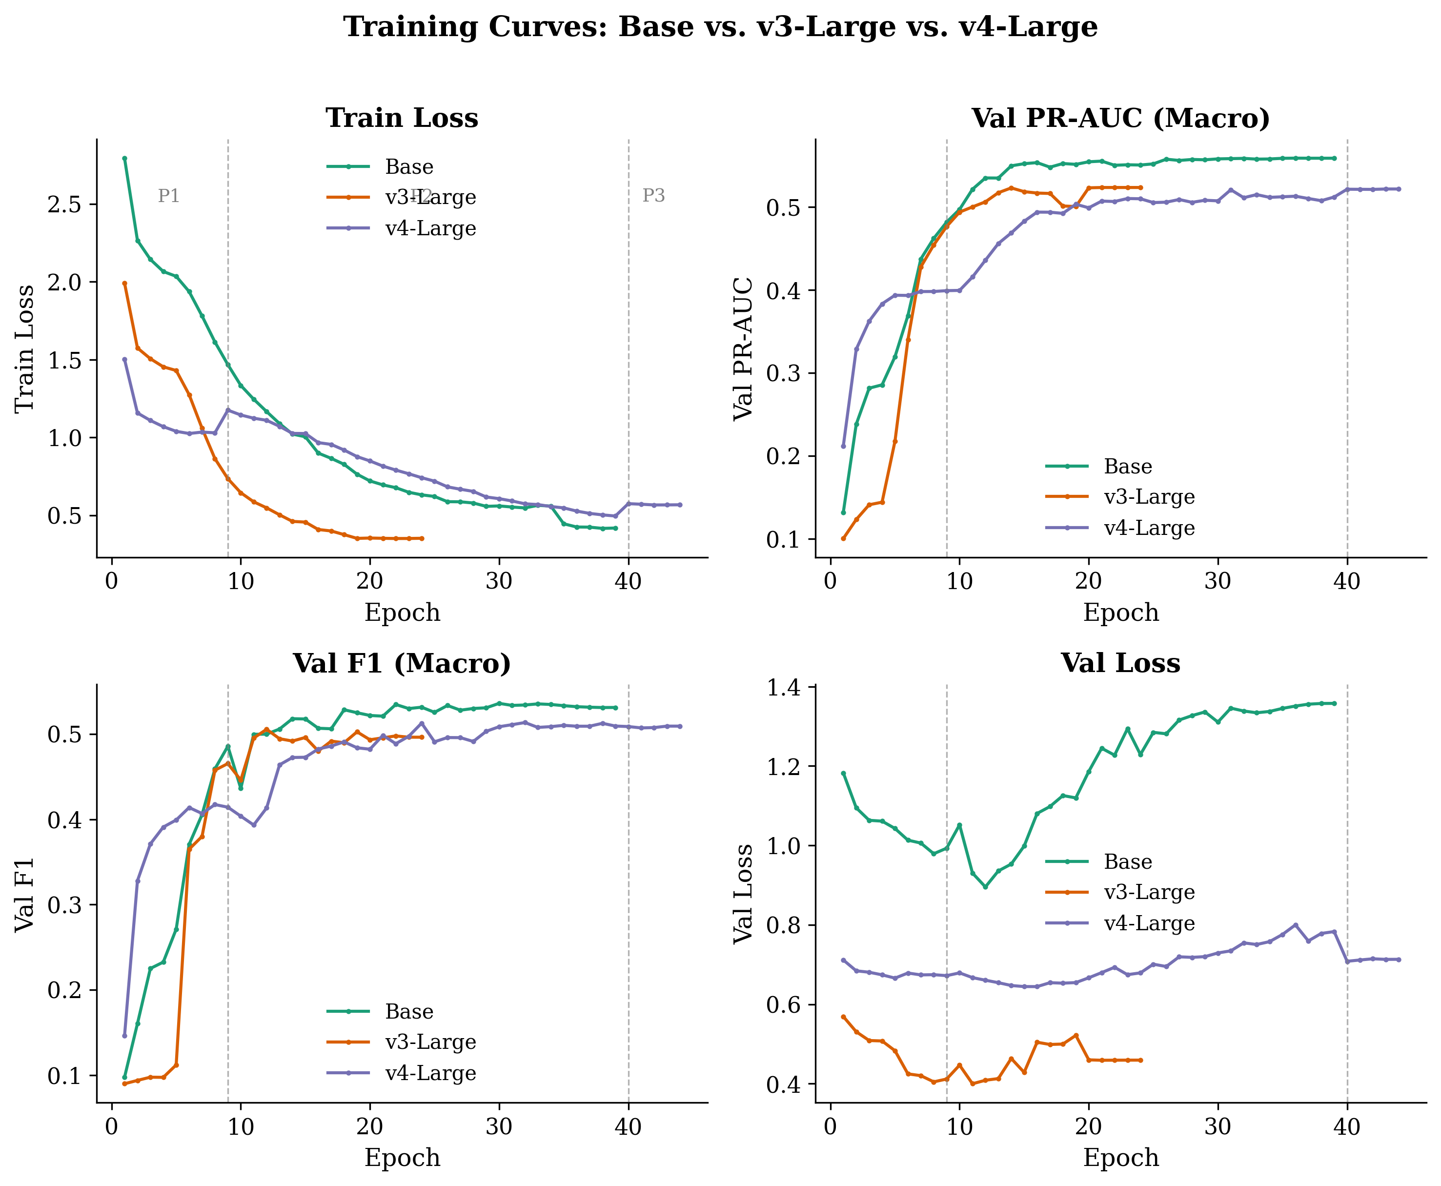
Training Dynamics: Base vs v3 Large vs v4 Large

Slide 25
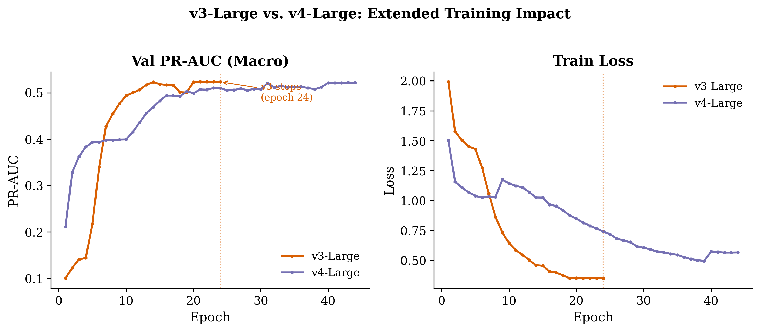
v3 vs v4: Validation PR-AUC Trajectory Shows the Fix
v3 plateaus at epoch ~20 and never improves; v4 sustains improvement through epoch 31
v3 train loss drops FASTER = faster memorization = WORSE generalization
v4 result: 31 productive epochs (vs 15), 22 SWA checkpoints (vs 0), KL at 11% (vs 55-72%)

Slide 26
Results & Analysis
Macro-F1 = 0.494 | Deep Per-Theme Analysis | Embedding Evidence

Slide 27
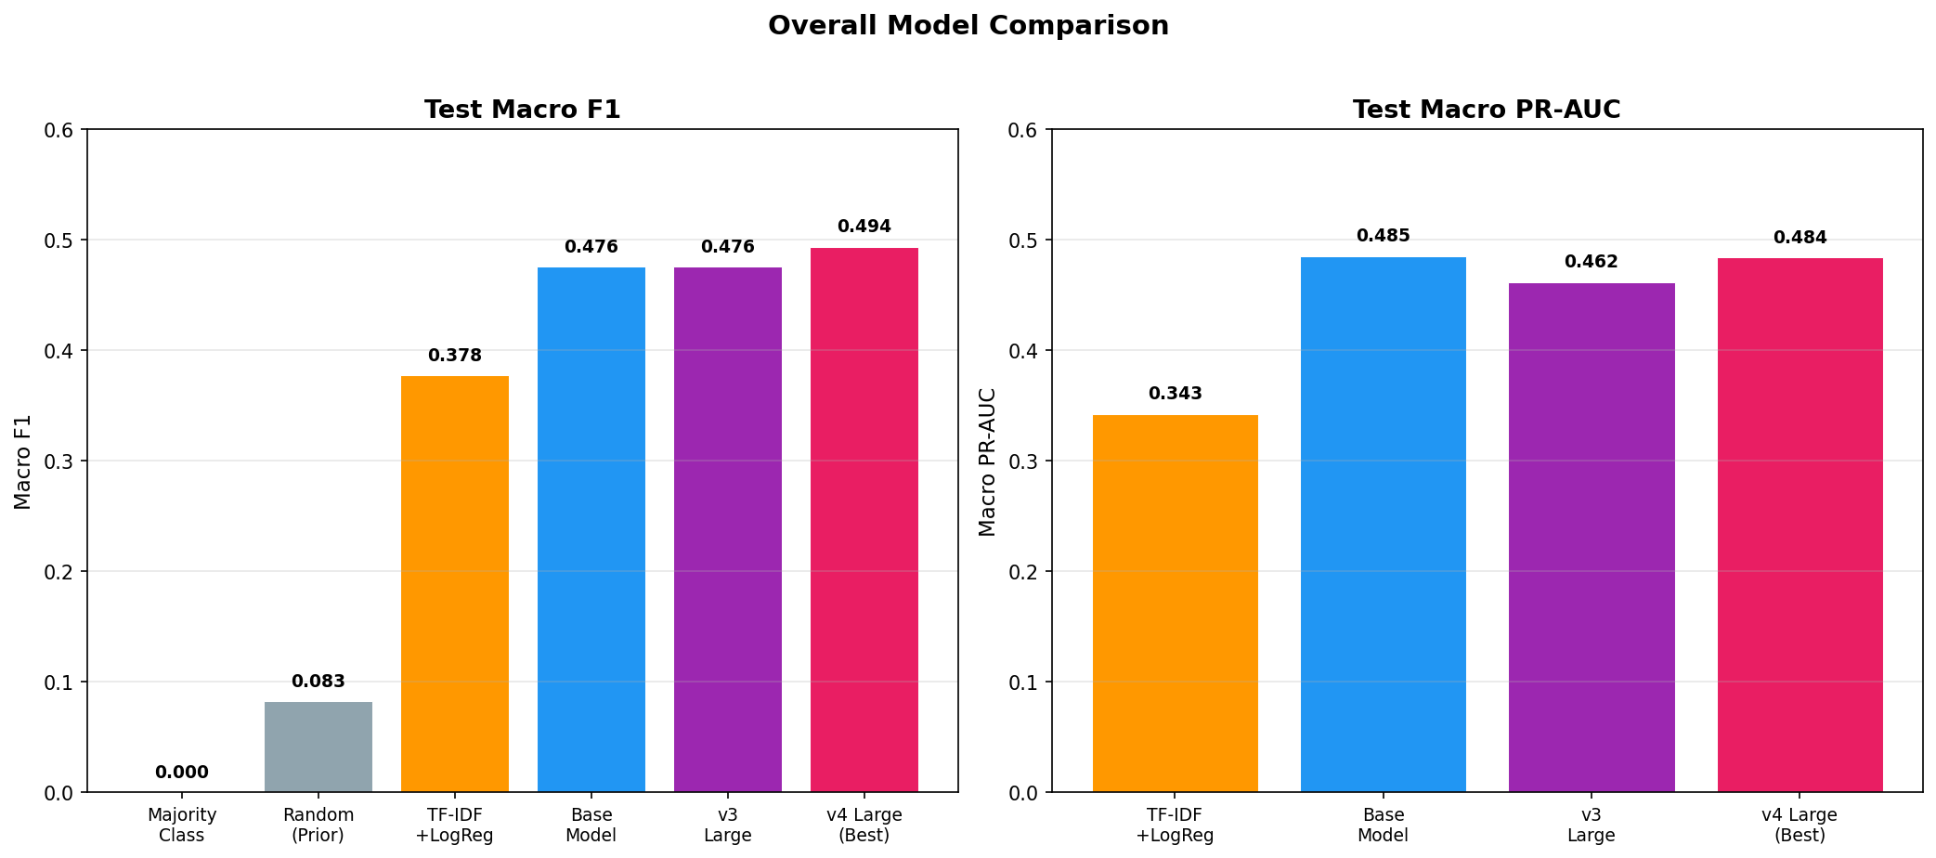
AWARE-Large v4: Overall Performance
0.494
0.484
0.888
+30.8%
6x
Macro-F1
PR-AUC
ROC-AUC
vs TF-IDF
vs Random
[0.464, 0.520]
Ranking quality
Discrimination
0.378 -> 0.494
0.084 -> 0.494

Slide 28
AWARE-Large v4: Complete Per-Theme Results (Optimized Thresholds)
Theme | Support | F1 | Prec | Recall | PR-AUC | ROC-AUC | Thresh | 95% CI
Navigational | 430 | 0.707 | 0.669 | 0.749 | 0.759 | 0.908 | 0.31 | [0.672, 0.740]
Familial Cap. | 70 | 0.600 | 0.533 | 0.686 | 0.586 | 0.941 | 0.14 | [0.500, 0.680]
Aspirational | 276 | 0.585 | 0.549 | 0.627 | 0.507 | 0.878 | 0.23 | [0.534, 0.631]
Social | 90 | 0.506 | 0.538 | 0.478 | 0.488 | 0.928 | 0.22 | [0.408, 0.591]
Perseverance | 176 | 0.480 | 0.570 | 0.415 | 0.536 | 0.874 | 0.35 | [0.406, 0.545]
Resistance | 86 | 0.395 | 0.303 | 0.570 | 0.377 | 0.893 | 0.09 | [0.319, 0.468]
Spiritual | 95 | 0.375 | 0.291 | 0.526 | 0.416 | 0.801 | 0.053 | [0.298, 0.446]
Attainment | 32 | 0.303 | 0.224 | 0.469 | 0.205 | 0.880 | 0.05 | [0.175, 0.414]
Familial Capital: Only 3.8% prevalence but F1=0.600 and HIGHEST ROC-AUC (0.941). Why? d-prime=1.62 (highest). Family vocab ('parents', 'mother', 'father') is unambiguous.
Attainment: Only 32 test examples, 77.3% multi-label. CI = [0.175, 0.414] — point estimate unreliable. PR-AUC=0.205 = barely above prior. A data scarcity limit, not a model failure.
All ROC-AUC > 0.80: Model has learned SOME signal for every theme — but PR-AUC reveals actual utility varies 0.205-0.759.

Slide 29
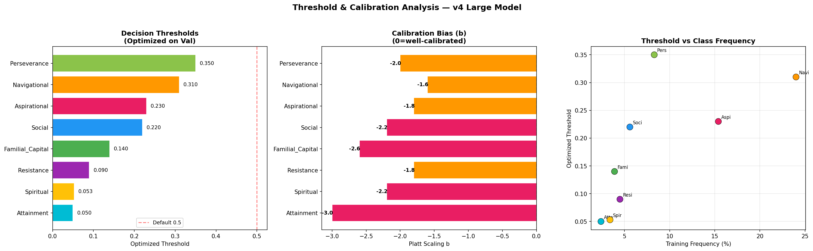
Threshold Optimization: +0.084 Macro-F1 — The Model 'Knows More Than It Shows'
Theme | Default (0.5) | Optimized | Thresh | Gain
Navigational | 0.639 | 0.707 | 0.31 | +0.068
Aspirational | 0.392 | 0.585 | 0.23 | +0.193
Familial Cap. | 0.587 | 0.600 | 0.14 | +0.013
Perseverance | 0.481 | 0.480 | 0.35 | -0.001
Social | 0.412 | 0.506 | 0.22 | +0.094
Resistance | 0.275 | 0.395 | 0.09 | +0.120
Spiritual | 0.394 | 0.375 | 0.053 | -0.019
Attainment | 0.098 | 0.303 | 0.05 | +0.205
Macro | 0.410 | 0.494 | — | +0.084
Attainment default F1=0.098 — at 1.7% prevalence, sigmoid output almost never exceeds 0.5. Optimized threshold=0.05 recovers F1=0.303 (+0.205).
Spiritual and Perseverance slightly hurt — default threshold was already near-optimal. Lower threshold trades precision for recall unfavorably.
Insight: The model has learned discriminative features (ROC-AUC > 0.80 everywhere) but the default 0.5 boundary hides this knowledge for rare themes.

Slide 30
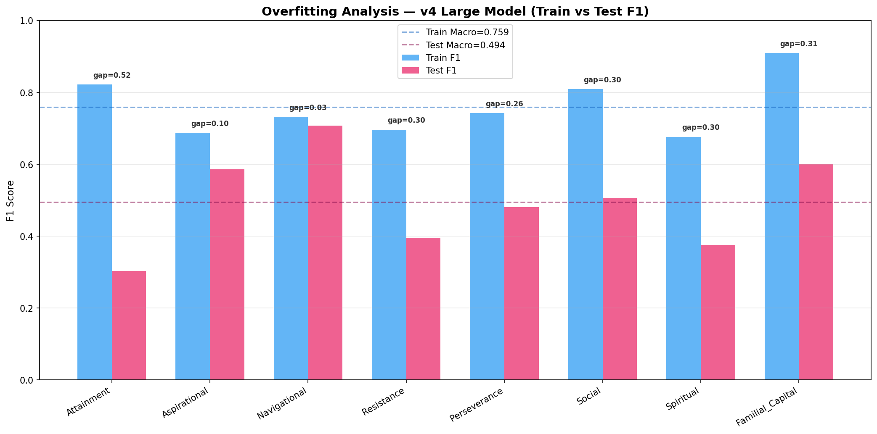
Overfitting: Train vs Test Gap Correlates with Data Properties
Theme | Train F1 | Test F1 | Gap | Train PR-AUC | Test PR-AUC | Gap
Navigational | 0.732 | 0.707 | 0.025 | 0.802 | 0.759 | 0.043
Aspirational | 0.687 | 0.585 | 0.102 | 0.758 | 0.507 | 0.251
Perseverance | 0.742 | 0.480 | 0.262 | 0.859 | 0.536 | 0.323
Social | 0.809 | 0.506 | 0.303 | 0.904 | 0.488 | 0.416
Resistance | 0.696 | 0.395 | 0.301 | 0.956 | 0.377 | 0.579
Spiritual | 0.676 | 0.375 | 0.301 | 0.992 | 0.416 | 0.576
Familial Cap. | 0.909 | 0.600 | 0.309 | 0.969 | 0.586 | 0.383
Attainment | 0.822 | 0.303 | 0.519 | 0.959 | 0.205 | 0.754
Macro | 0.759 | 0.494 | 0.265 | 0.900 | 0.484 | 0.416
Navigational (gap=0.025): 2,449 single-label examples + d-prime=1.07 = enough data to generalize
Attainment (gap=0.519): Train PR-AUC=0.959 means 438M params MEMORIZED the 339 examples. Does not transfer to 32 test examples.
Pattern: Gap correlates with (1) training set size, (2) d-prime, (3) multi-label rate. This is a DATA limitation, not model failure.

Slide 31
Embedding Space Analysis
What Did the Model Actually Learn? Visual Proof of Representation Restructuring

Slide 32
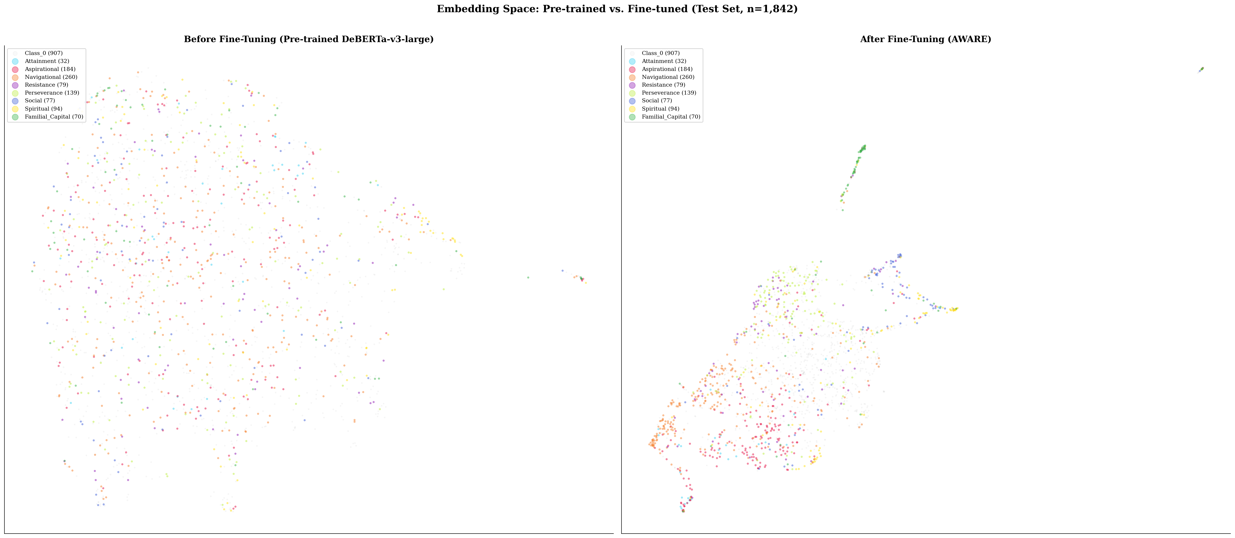
Before & After Fine-Tuning: Embedding Space Completely Reorganized

Slide 33
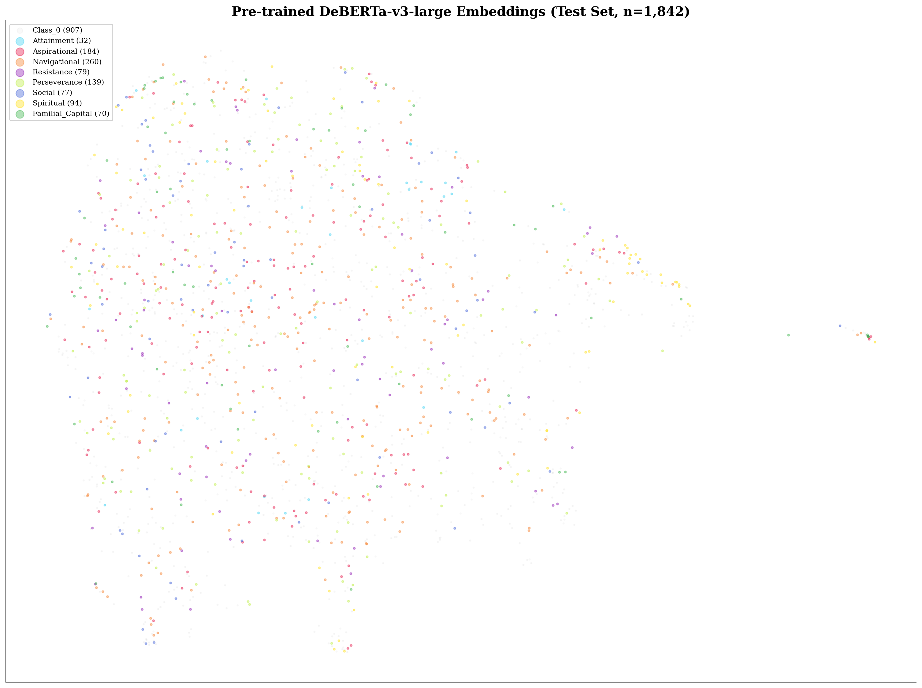
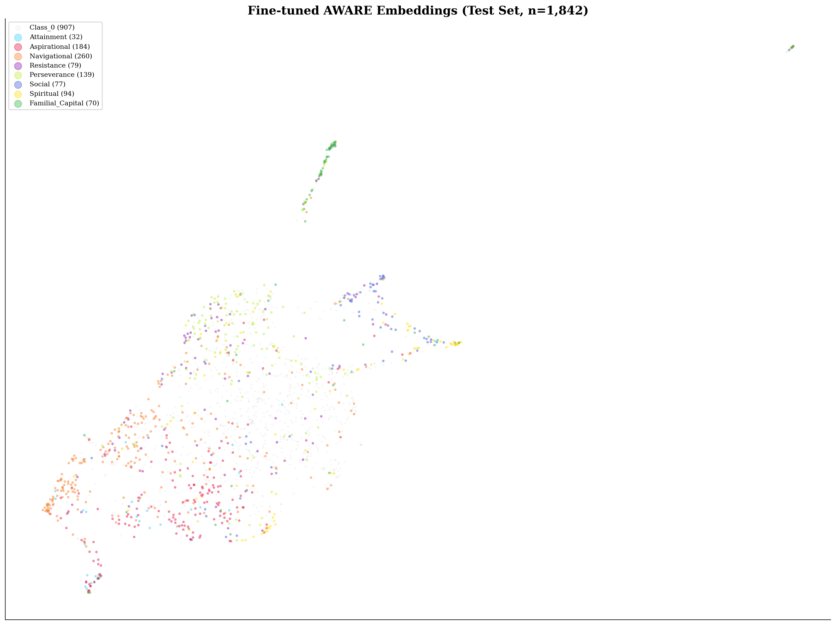
Before: Scattered, No Structure
After: Clustered, Theme-Organized

Slide 34
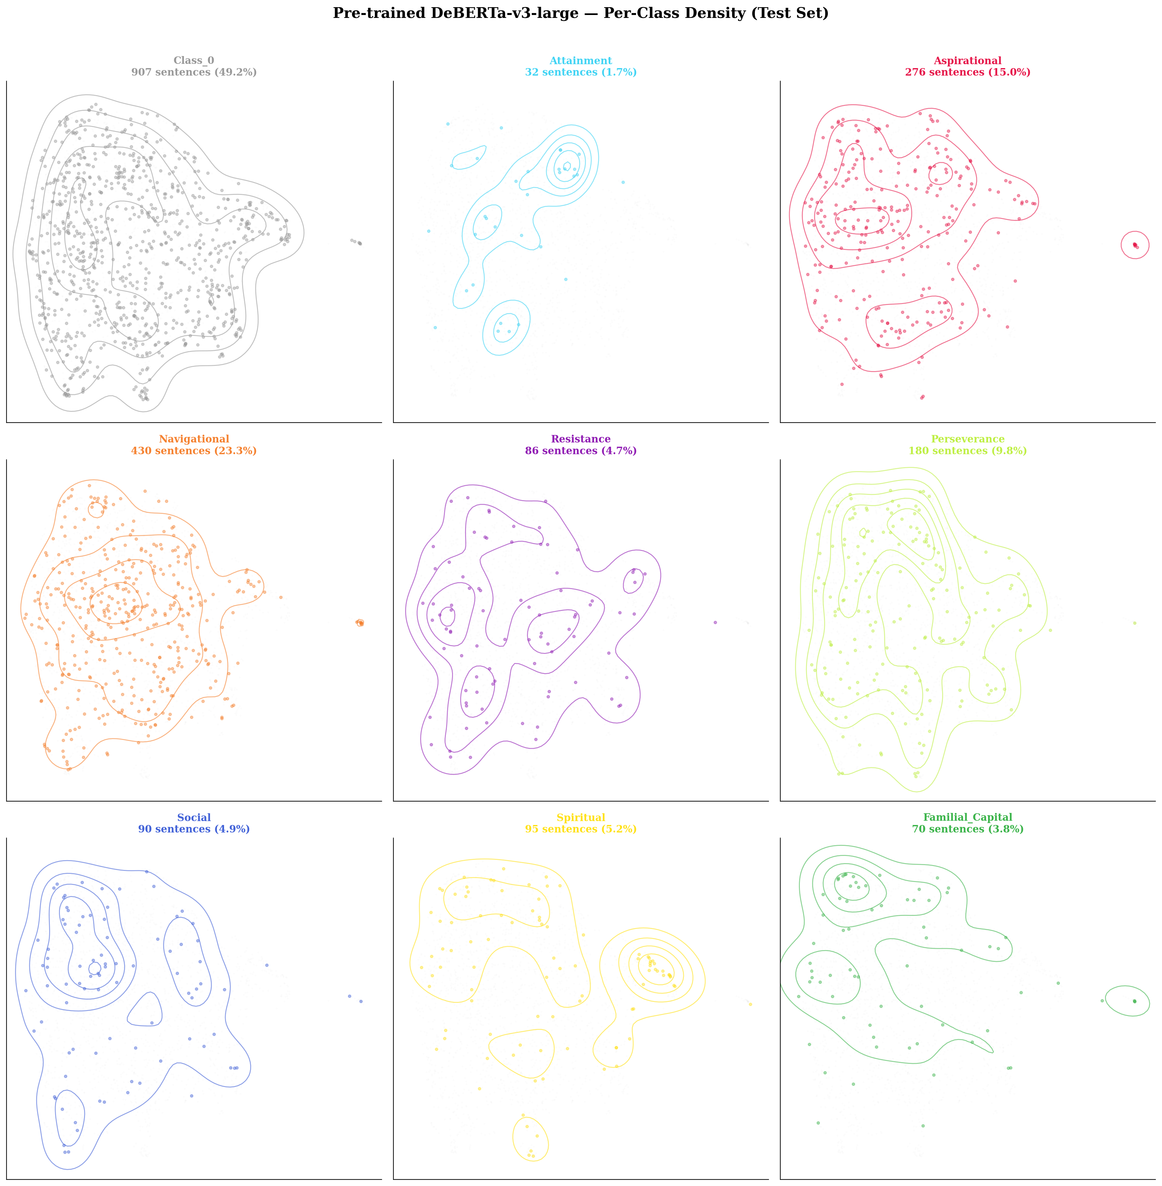
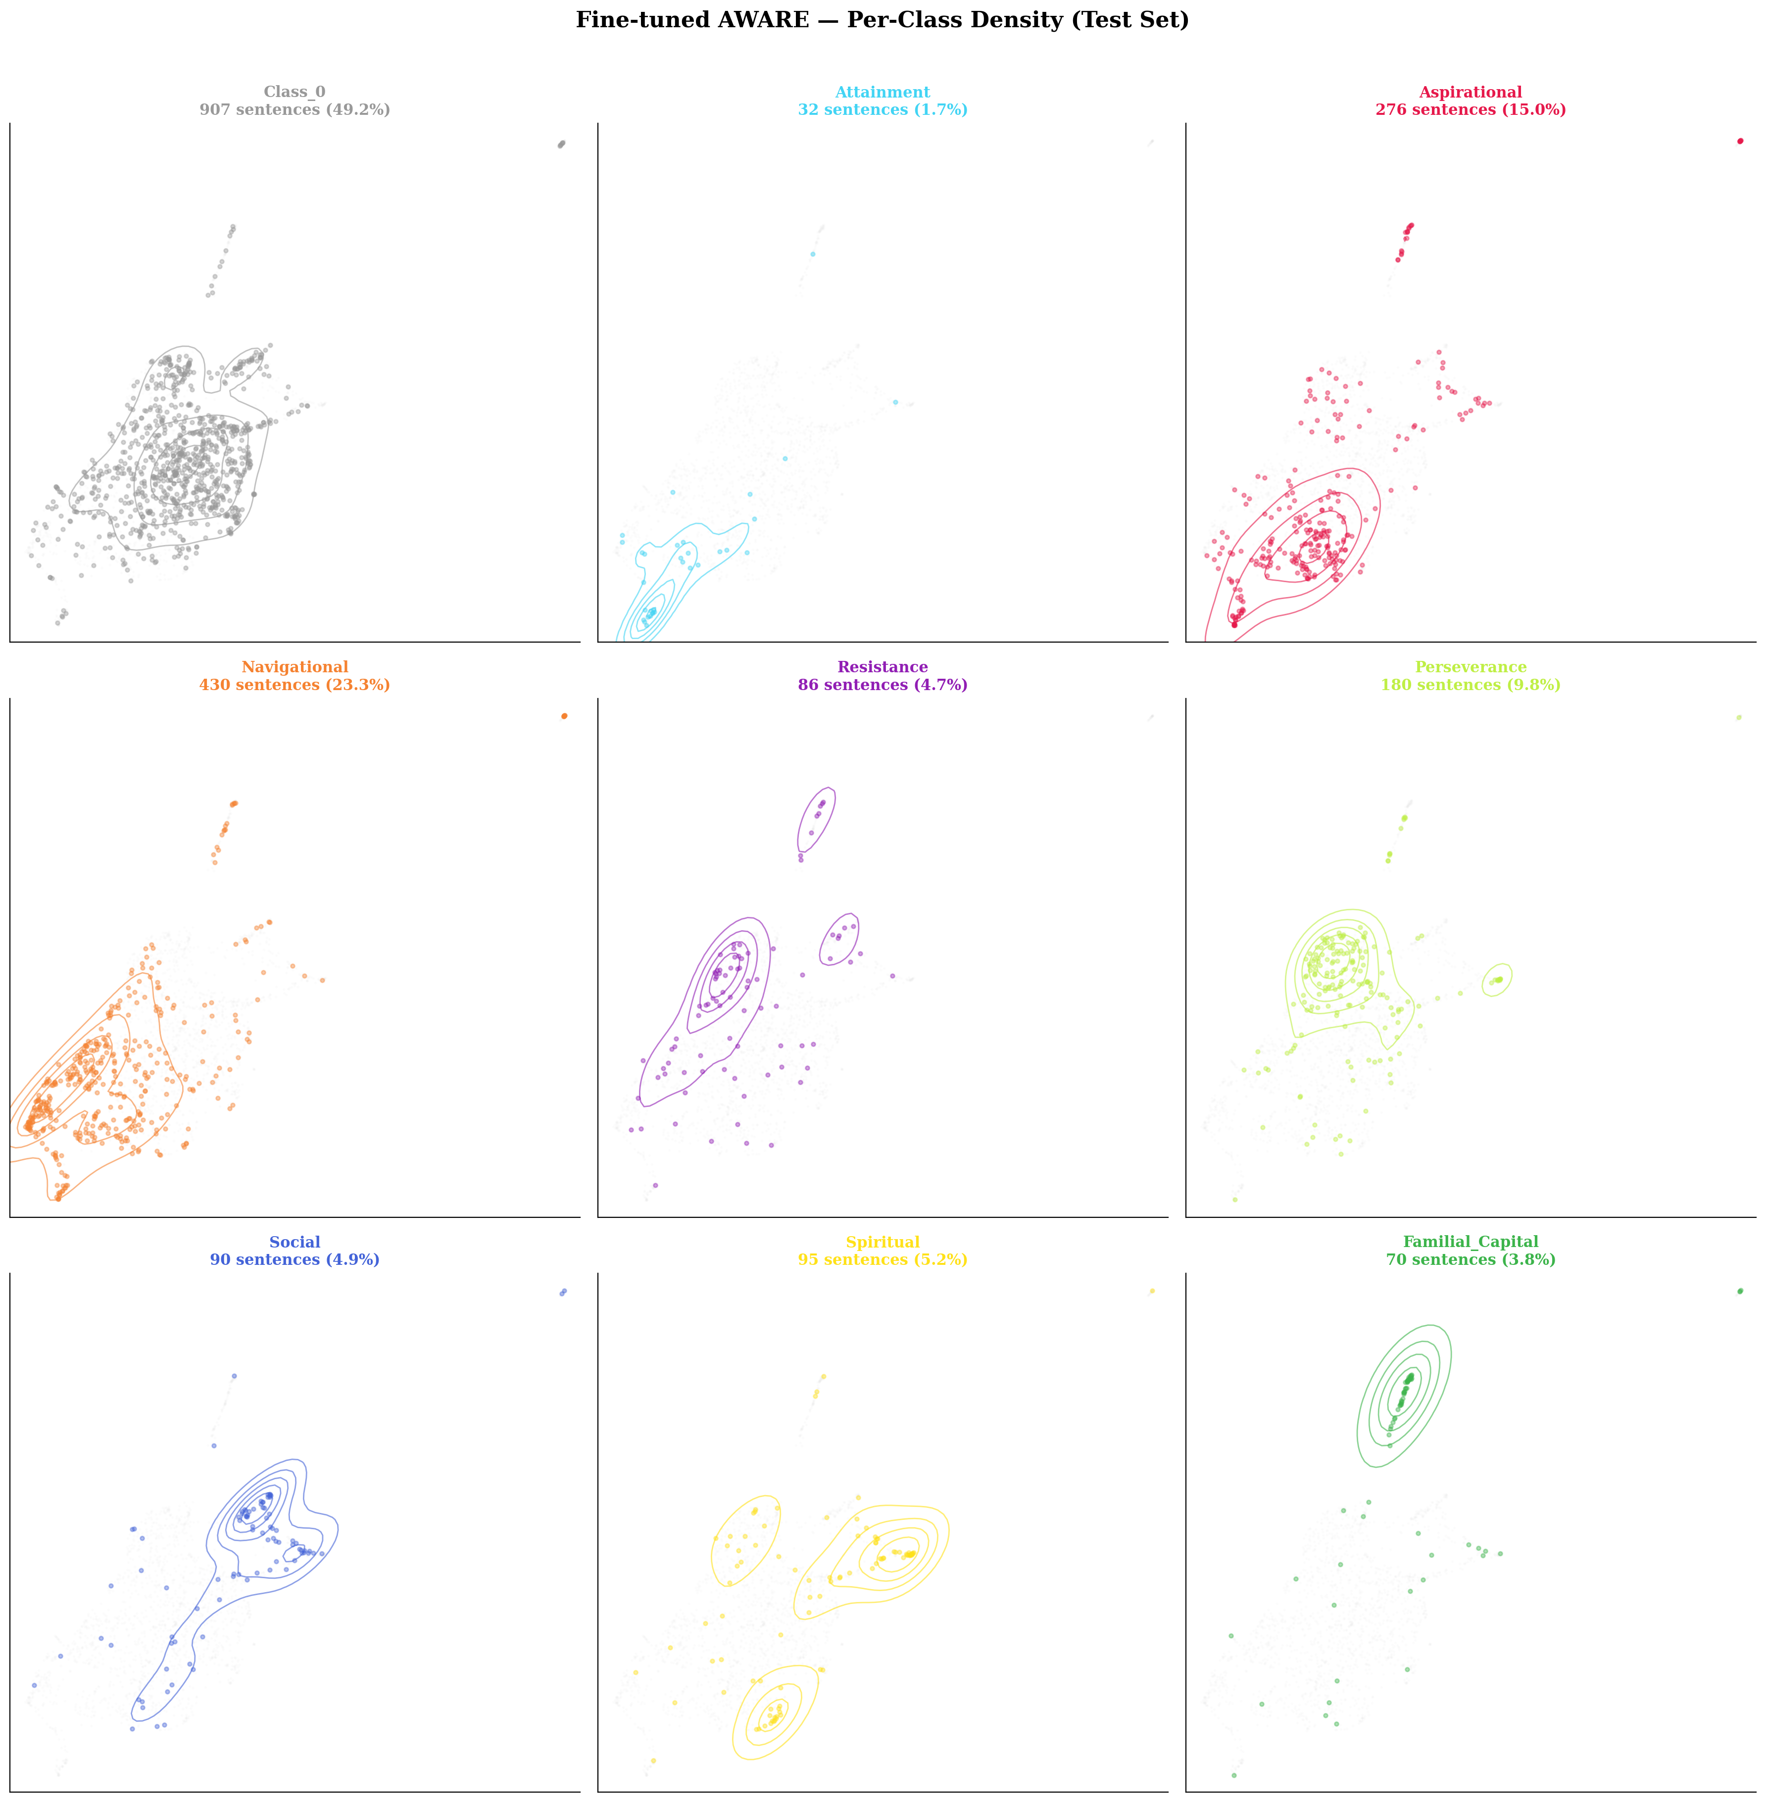
Before: Every Theme Spans Entire Space
After: Concentrated Clusters with Clear Peaks

Slide 35
What the Embedding Space Reveals About Each Theme
Navigational: Largest, most concentrated cluster. F1=0.707 — geometric dominance = classification dominance.
Familial Capital: TIGHTEST cluster despite 6x fewer examples than Nav. Family vocabulary creates sharp, unambiguous signal.
Aspirational: Broad cluster OVERLAPPING Navigational region. This overlap = the co-prediction pattern in results.
Attainment: NO distinct cluster. Points scattered across Nav + Asp regions. Visual proof of F1=0.303.
Class_0: Cleanly separated after fine-tuning (was completely intermixed). Enables 81% precision on unthemed text.
Resistance + Social: Small but distinct clusters. Social shows multi-modal sub-structure (peer groups vs mentorship).
Cluster tightness directly correlates with F1 score. The geometry IS the explanation.

Slide 36
Critical Discovery
The Model CAN Detect All 8 Themes — The Bottleneck Is Elsewhere

Slide 37
Single-Theme Sentences: The Model's TRUE Capability (Hidden by Macro-F1)
When a sentence carries only ONE theme — no co-occurrence — performance is dramatically higher:
Theme | Single-Theme F1 | Overall F1 | Delta | Single N | Precision
Navigational | 0.896 | 0.707 | +0.189 | 260 | 1.000
Familial Capital | 0.826 | 0.600 | +0.226 | 27 | 1.000
Aspirational | 0.800 | 0.585 | +0.215 | 102 | 1.000
Social | 0.794 | 0.506 | +0.288 | 38 | 1.000
Attainment | 0.727 | 0.303 | +0.424 | 7 | 1.000
Resistance | 0.706 | 0.395 | +0.311 | 33 | 1.000
Perseverance | 0.697 | 0.480 | +0.217 | 116 | 1.000
Spiritual | 0.568 | 0.375 | +0.194 | 58 | 1.000
PRECISION = 1.000 across ALL 8 themes. The model NEVER hallucinates themes.
Even Attainment (worst overall F1=0.303) reaches F1=0.727 on single-label sentences.
Macro-F1=0.494 measures DISENTANGLEMENT ability, not DETECTION ability.

Slide 38
Reframing: The Problem Is Not Detection — It Is Disentanglement
Single-Theme: Model CAN
Multi-Label: Model STRUGGLES
F1 = 0.568 - 0.896 across all 8 themes
Perfect precision (1.000) on every theme
6 of 8 themes exceed F1 = 0.69
Genuine theme understanding, not pattern matching
Suitable as screening tool for single-theme text
Detects dominant theme, misses secondary
Asp+Nav: Best pair — but only 31.7% exact match
Asp+Perseverance: 0% exact match (NEVER gets both)
Attainment: 77.3% multi-label = biggest gap (+0.424)
Multi-label disentanglement = the frontier
The delta between single-theme and overall F1 correlates directly with each theme's multi-label rate. Attainment (77.3% multi-label) has the largest gap (+0.424). Navigational (42.3% multi-label) has the smallest (+0.189).

Slide 39
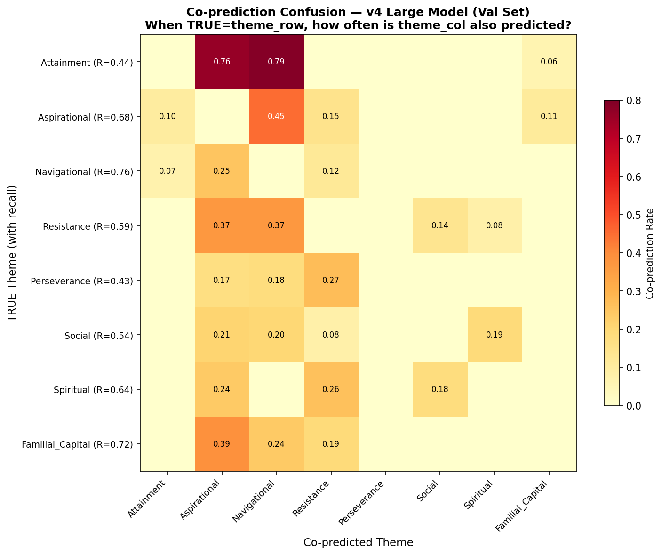
Co-Prediction Patterns: What Gets Confused With What, and Why
True Theme | Top Co-Predictions
Attainment | Nav 79%, Asp 76%
Familial Cap. | Asp 39%, Nav 24%
Resistance | Asp 37%, Nav 37%
Spiritual | Res 26%, Asp 24%
Social | Asp 21%, Nav 20%
Perseverance | Res 27%, Nav 18%
Navigational = 'default' prediction for any thematically rich text. At 24% prevalence, model learns a prior that themed text is likely Nav.
Attainment absorbed into Nav+Asp: model learned that Attainment-like text IS Nav+Asp text, but can't isolate the additional signal from only 92 single-label examples.

Slide 40
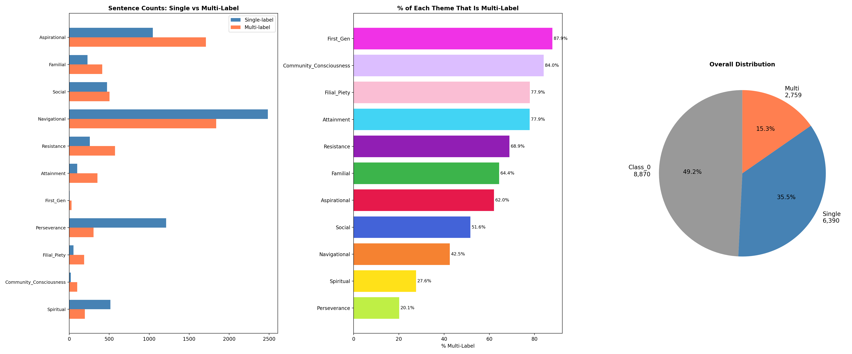
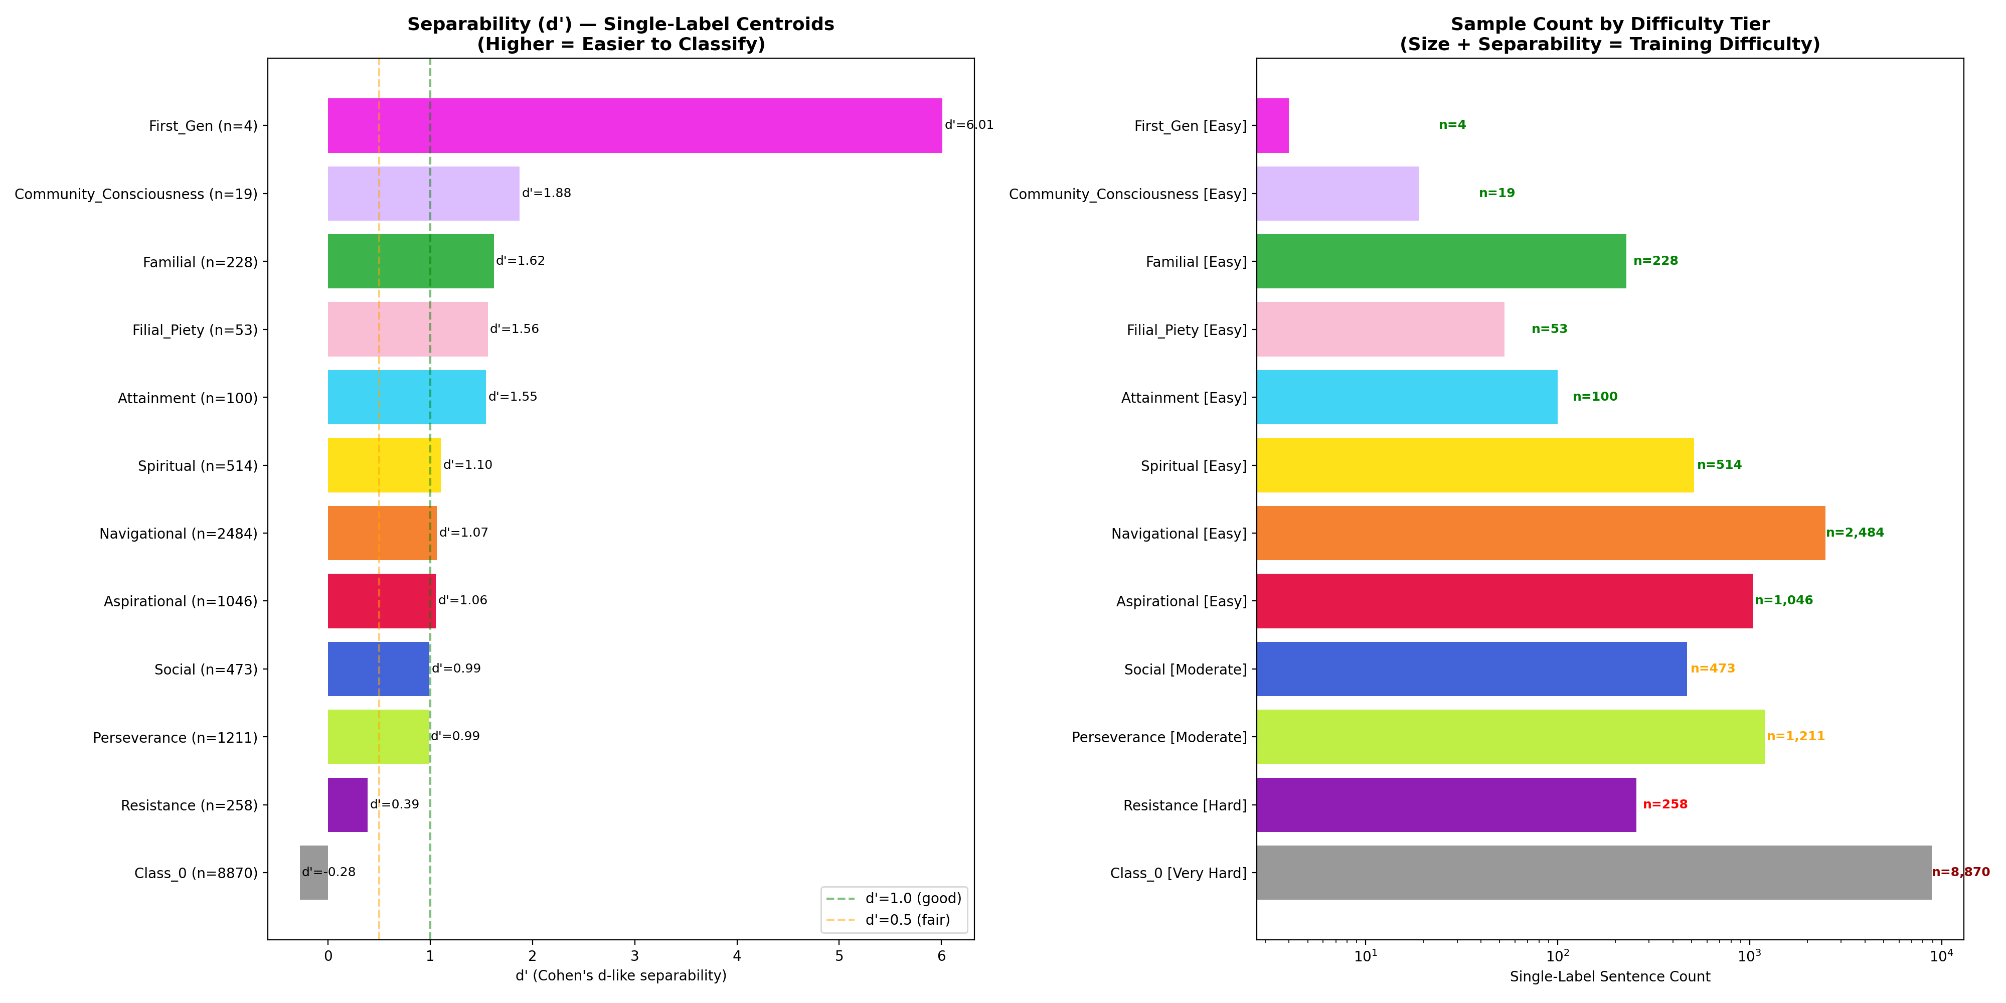
Data Evidence: Single-Label Sentences Are Much More Separable Than Multi-Label

Slide 41
Theme Amenability: Vocabulary Distinctiveness Matters More Than Prevalence
Tier | Themes | Overall F1 | Single F1 | Why
Tier 1: Strong | Navigational | 0.707 | 0.896 | High prevalence + distinctive context
Tier 2: Moderate | Familial, Asp, Social, Persev | 0.480-0.600 | 0.697-0.826 | Distinctive vocab OR moderate prevalence
Tier 3: Weak | Resistance, Spiritual, Attainment | 0.303-0.395 | 0.568-0.727 | Context-dependent + high co-occurrence
The anomaly that proves the rule:
Familial Capital (3.8% prevalence): F1=0.600, ROC-AUC=0.941 (highest of ANY theme)
Why? d-prime=1.62 (highest). Words like 'parents', 'mother', 'father', 'family' are unambiguous lexical markers.
Resistance (4.5% prevalence): F1=0.395, d-prime=0.39 (lowest)
Why? Resistance requires understanding whether 'overcoming difficulty' is about systemic barriers (Resistance) or personal grit (Perseverance). This depends on essay context, not keywords.
Conclusion: Themes with unique vocabulary succeed even at low prevalence. Themes requiring narrative context resist automation regardless of model capacity.

Slide 42
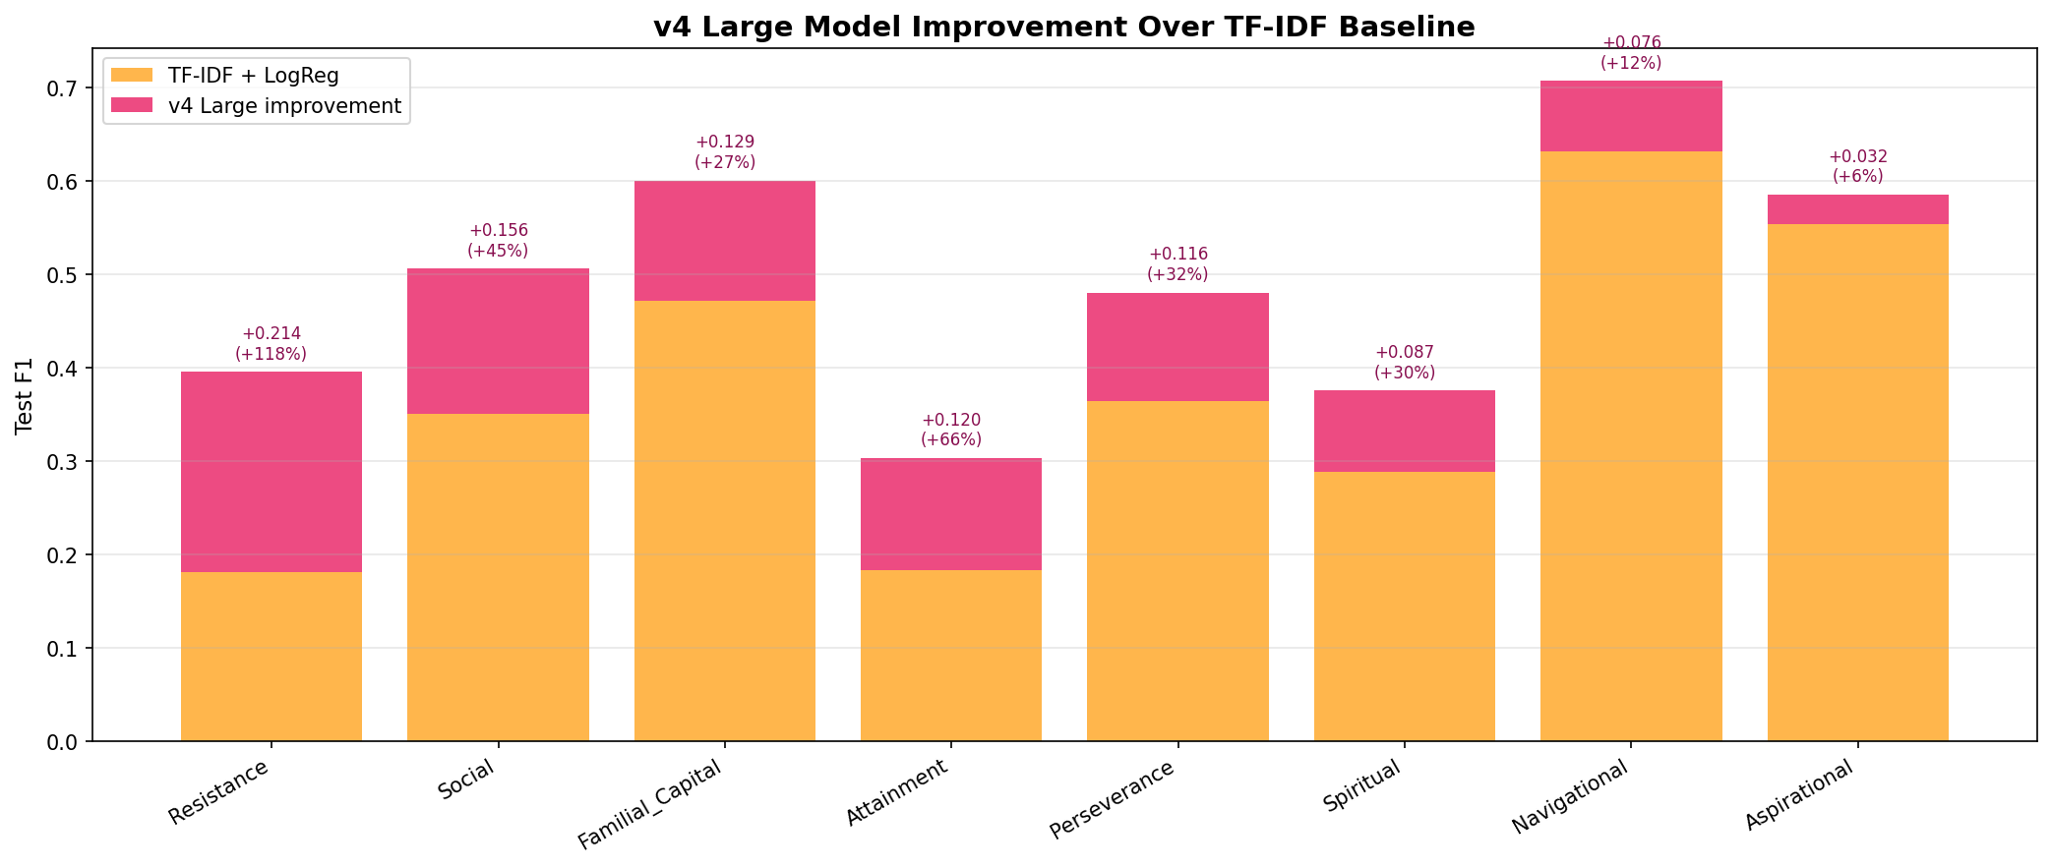
v3 to v4: Per-Theme Improvement Waterfall

Slide 43
When Does Model Scale Help? Per-Theme Base (86M) vs v4 Large (438M)
Theme | Base F1 | v4 F1 | Diff | Winner | Interpretation
Social | 0.394 | 0.506 | +0.112 | v4 Large | Most context-dependent; deeper encoder helps
Spiritual | 0.278 | 0.375 | +0.097 | v4 Large | Rare + context-dependent = needs capacity
Attainment | 0.264 | 0.303 | +0.039 | v4 Large | Marginal gain; still limited by data
Navigational | 0.685 | 0.707 | +0.022 | v4 Large | Already strong; minor improvement
Perseverance | 0.477 | 0.480 | +0.003 | Tie | Scale provides no benefit here
Aspirational | 0.595 | 0.585 | -0.010 | Base | Keyword-detectable; extra params unhelpful
Familial Cap. | 0.615 | 0.600 | -0.015 | Base | Distinctive vocab already captured by base
Resistance | 0.482 | 0.395 | -0.087 | Base | Large model overfits 629 training examples
Scale helps on rare, complex themes (Social +0.112, Spiritual +0.097) where deeper representations provide genuine signal.
Scale hurts on mid-frequency themes (Resistance -0.087) where 438M params memorize 629 examples. Base model's implicit regularization wins.
Practical implication: For small datasets, base-size model + strong regularization may be preferable unless rare-theme improvement is specifically needed.

Slide 44
5 Concrete Contributions
1. First Multi-Label CCW Classifier
Prior work classified 2 themes independently. AWARE classifies 8 themes simultaneously at sentence level.
2. Reproducible Data Pipeline
4-stage, embedding-based semantic cleaning. Every merge/drop decision justified by quantitative evidence.
3. AWARE Architecture
Essay-level context + sentence classification with DAPT, ASL, CB-weights, per-theme calibration.
4. Scaling Failure Diagnostic Framework
7 failure modes, 16 fixes, measured impact. A reference for practitioners on small-data fine-tuning.
5. Multi-Label Bottleneck Discovery
Single-theme F1 = 0.568-0.896 with PERFECT precision. The real challenge is disentanglement.

Slide 45
Future Directions
LoRA Fine-Tuning
Parameter-efficient: train only adapter layers. Fewer trainable params = less overfitting on rare themes.
LLM Data Augmentation
Generate synthetic single-label examples for Attainment (N=92), Spiritual, Resistance via GPT-4.
Active Learning
Human-in-the-loop: model flags uncertain multi-label predictions for annotator review.
Cross-Institutional Validation
Test on essays from other universities to validate generalization beyond SFSU.
ALMA Dashboard Deployment
Interactive platform for researchers: explore predictions, compare with human annotations, provide feedback.

Slide 46
Thank You
Questions?
AWARE | ALMA Project | San Francisco State University
Advisor: Dr. Anagha Kulkarni

