Slide 1
Context-Aware Perturbations for Data Augmentation
Khalid Mehtab Khan
SFSU ID: 923673423

Slide 2

Problem Description
Limited data availability often impacts the performance of machine learning models, especially in niche domains.
Random perturbations lack context and coherence, often leading to poor-quality data augmentation and unreliable insights.

Slide 3
Proposed Solution
Context-Aware Perturbations:
Generate data perturbations that maintain the structure and relationships in the dataset.
These perturbations can serve as high-quality data augmentation inputs and provide meaningful insights for model explanation.

Slide 4
Data and flow
Total Data: 12568 (NHANES Data)
Universal Train Data: 7540 (60%)
To create a situation of less data availability
Universal Test Data: 5028 (40%)
Total Data:
12568
Universal Train Data:
7540
(60%)
Universal Test Data:
5028 (40%)

Slide 5
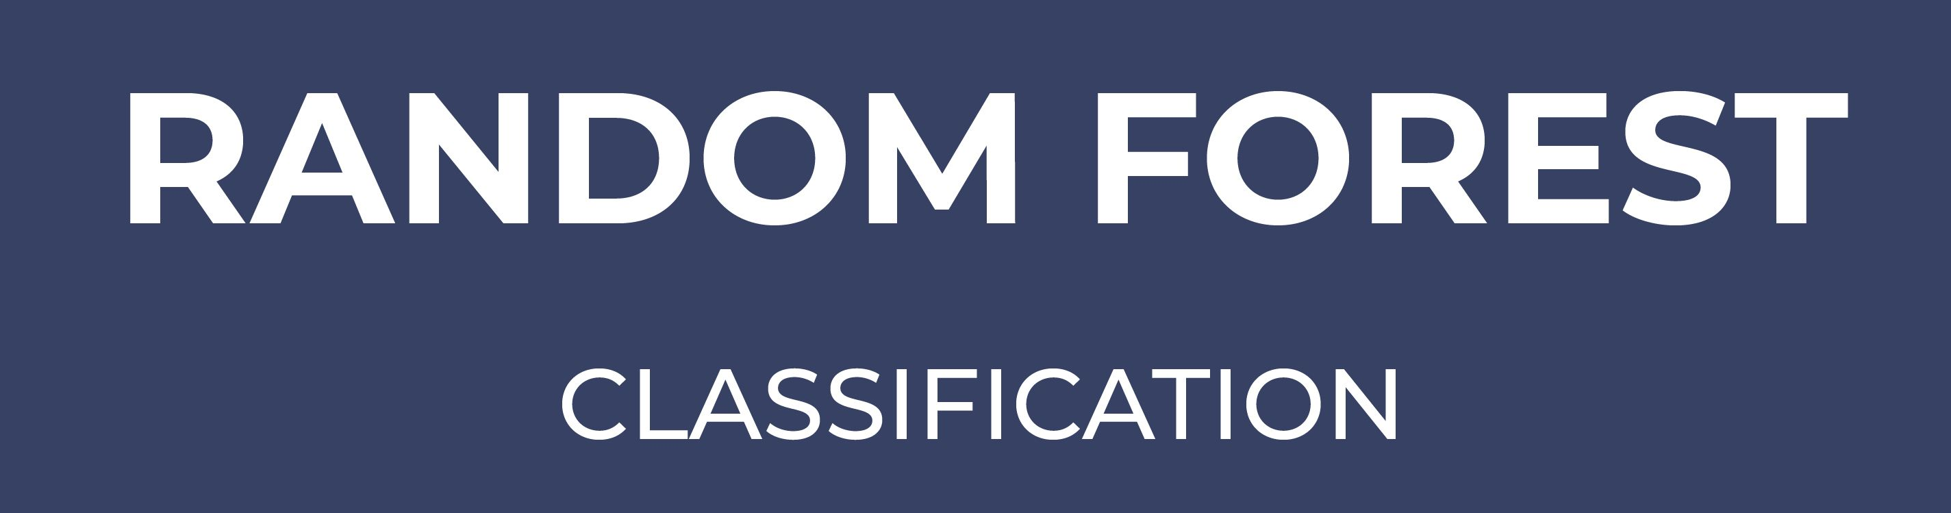

Classical ML Model: Random Forest (training)
Universal Train Data:
7540
(60%)

Slide 6
Class ML Model: Random Forest (evaluation)
 | precision | recall | f1-score | support
0 | 0.85 | 0.95 | 0.90 | 3977
1 | 0.65 | 0.39 | 0.49 | 1051
accuracy |  |  | 0.83 | 5028
macro avg | 0.75 | 0.67 | 0.69 | 5028
weighted avg | 0.81 | 0.83 | 0.81 | 5028
Random Forest Accuracy: 0.8294
Universal Test Data:
5028 (40%)

Slide 7
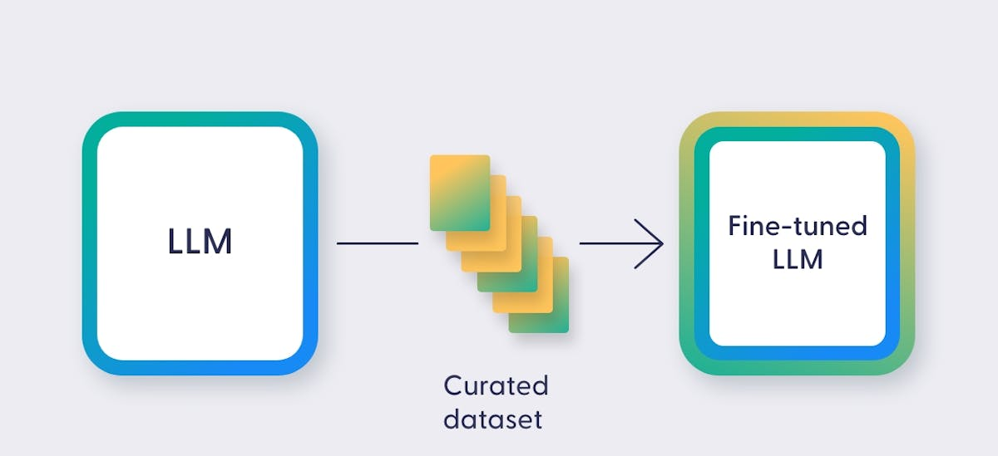
LLM Based Data Augmentation
Universal Train Data:
7540
(60%)

Slide 8
Perturbation Algorithm (Training)
Training Row:
{'Gender': 'Male’ | 'Age': 25 | ‘BMI’: 54.6 | ‘Smoking Status’: ‘Non-Smoker’ | ‘Restaurant Visits’: 3’}
Masked Prompt:
{'Gender': 'Male’ | 'Age': [MASK] | ‘BMI’: [MASK] | ‘Smoking Status’: ‘Non-Smoker’ | ‘Restaurant Visits’: 3'}

Slide 9
Perturbation Algorithm (single prediction)
Training Row:
{'Gender': 'Male’ | 'Age': 25 | ‘BMI’: 54.6 | ‘Smoking Status’: ‘Non-Smoker’ | ‘Restaurant Visits’: 3’}
↓
Masked Prompt:
{'Gender': 'Male’ | 'Age': [MASK] | ‘BMI’: [MASK] | ‘Smoking Status’: ‘Non-Smoker’ | ‘Restaurant Visits’: 3'}
↓
Completed Prompt:
{'Gender': 'Male’ | 'Age': 28 | ‘BMI’: 58.3 | ‘Smoking Status’: ‘Non-Smoker’ | ‘Restaurant Visits’: 3'}

Slide 10

Perturbation Algorithm (data-set)
The original training dataset is used as the base for generating new data.
Each row provides structured context for creating variations (perturbations).
For each row:
One or more fields are masked.
The model predicts the masked values.
This process adds diversity while maintaining the dataset’s structure and relationships.
By generating multiple perturbations for each row, we expand the dataset meaningfully, introducing variability while ensuring coherence.

Slide 11
Training The Classical ML Model with Perturbed Data (Random Forest)
Universal Train Data:
7540
(60%)
Perturbed Data:
7540

Slide 12
Testing The Classical ML Model with Perturbed Data (Random Forest)
First base model
 | precision | recall | f1-score | support
0 | 0.83 | 0.92 | 0.87 | 3977
1 | 0.60 | 0.36 | 0.45 | 1051
accuracy |  |  | 0.81 | 5028
macro avg | 0.72 | 0.64 | 0.66 | 5028
weighted avg | 0.79 | 0.81 | 0.79 | 5028
First base model: bert-base-uncased
Random Forest Accuracy: 0.811

Slide 13
Testing The Classical ML Model with Perturbed Data (Random Forest)
 | precision | recall | f1-score | support
0 | 0.85 | 0.94 | 0.89 | 3977
1 | 0.67 | 0.42 | 0.52 | 1051
accuracy |  |  | 0.83 | 5028
macro avg | 0.76 | 0.68 | 0.70 | 5028
weighted avg | 0.82 | 0.83 | 0.81 | 5028
better base model: deberta-v3-base. (better-model)
Random Forest Accuracy: 0.83

Slide 14
Testing The Classical ML Model with best Perturbed Data (Random Forest)
 | precision | recall | f1-score | support
0 | 0.85 | 0.94 | 0.89 | 3977
1 | 0.67 | 0.42 | 0.52 | 1051
accuracy |  |  | 0.83 | 5028
macro avg | 0.76 | 0.68 | 0.70 | 5028
weighted avg | 0.82 | 0.83 | 0.81 | 5028
better base model: deberta-v3-base
Random Forest Accuracy: 0.83

Slide 15
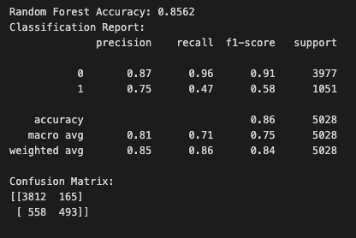
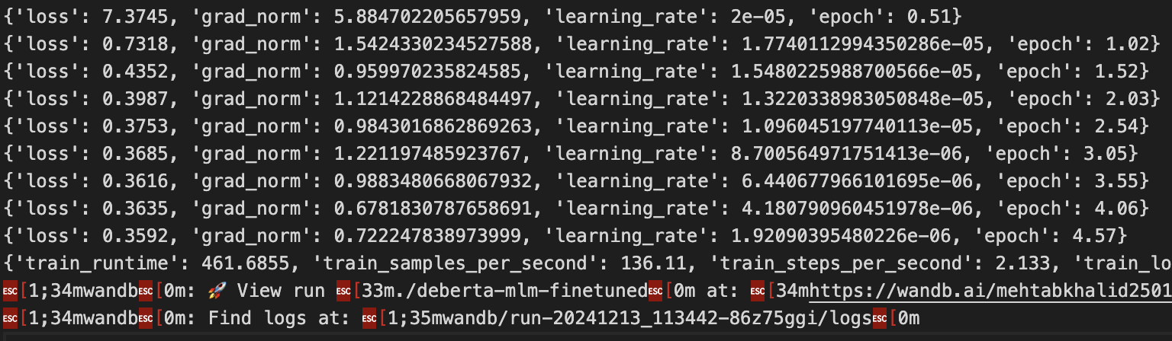
Results (best_model)

Slide 16
Efficiency of the Perturbation Algorithm
 | precision | recall | f1-score | support
0 | 0.87 | 0.96 | 0.91 | 3977
1 | 0.75 | 0.47 | 0.58 | 1051
accuracy |  |  | 0.86 | 5028
macro avg | 0.81 | 0.71 | 0.75 | 5028
weighted avg | 0.85 | 0.86 | 0.84 | 5028
best base model: deberta-v3-base (best hyperparameters)
Random Forest Accuracy: 0.856
We improved the performace of the original model on unseen test data by 3-3.5%

Slide 17

Direct Use Case
Practitioners can freeze specific features and easily generate targeted perturbations once the model is trained on the data.
Users can request specific scenarios, such as, “Generate variations by fixing ‘Smoking Status’ as ‘Non-Smoker’ and varying ‘Diet Question One’ and ‘Protein Intake.’”
This flexibility allows practitioners to create perturbations tailored to their requirements for deeper insights or scenario testing.

Slide 18
Stability of the Perturbation Algorithm
The final model is tested with different train-test split (of universal data_) seeds to confirm consistent performance.
Seed = 42
Seed = 456
 | precision | recall | f1-score | support
0 | 0.87 | 0.96 | 0.91 | 3977
1 | 0.75 | 0.46 | 0.57 | 1051
accuracy |  |  | 0.85 | 5028
macro avg | 0.81 | 0.71 | 0.74 | 5028
weighted avg | 0.85 | 0.86 | 0.84 | 5028
 | precision | recall | f1-score | support
0 | 0.86 | 0.96 | 0.90 | 3977
1 | 0.75 | 0.47 | 0.58 | 1051
accuracy |  |  | 0.85 | 5028
macro avg | 0.81 | 0.71 | 0.74 | 5028
weighted avg | 0.85 | 0.86 | 0.84 | 5028
Seed = 123
Seed = 999
 | precision | recall | f1-score | support
0 | 0.86 | 0.95 | 0.90 | 3977
1 | 0.76 | 0.48 | 0.59 | 1051
accuracy |  |  | 0.86 | 5028
macro avg | 0.81 | 0.72 | 0.75 | 5028
weighted avg | 0.85 | 0.86 | 0.84 | 5028
 | precision | recall | f1-score | support
0 | 0.86 | 0.95 | 0.91 | 3977
1 | 0.76 | 0.48 | 0.58 | 1051
accuracy |  |  | 0.86 | 5028
macro avg | 0.80 | 0.721 | 0.75 | 5028
weighted avg | 0.85 | 0.86 | 0.84 | 5028

Slide 19
Stability
Seed (test-train split) | Random Forest Mo
42 | 0.855
123 | 0.856
456 | 0.855
999 | 0.856
I tested the fine-tuned model’s performance using different train-test splits of the original data, and the results consistently demonstrated stability, validating the robustness of the fine-tuned model.

Slide 20

Fidelity (to show that our fine-tuned model truly understands the data)
The idea is simple:
if the model really captures the relationships in the data, it should be able to perform well on the same classification task we tested with a classical ML model.
By testing the fine-tuned model on this task, we’ll see if it can match or even outperform the classical approach.
This way, we’re not just saying the model works—we’re showing that it understands the overall data and can explain the task effectively.

Slide 21
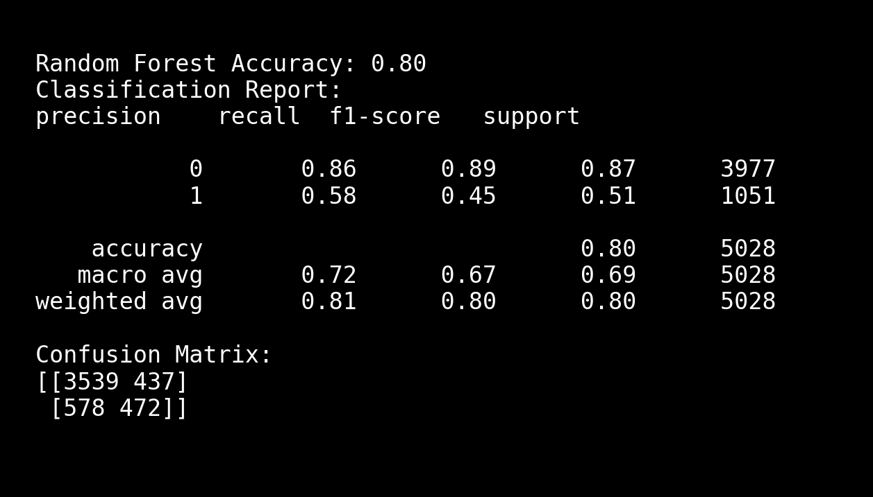
Fidelity (Any non context fine-tuned LLM)
bert-base

Slide 22
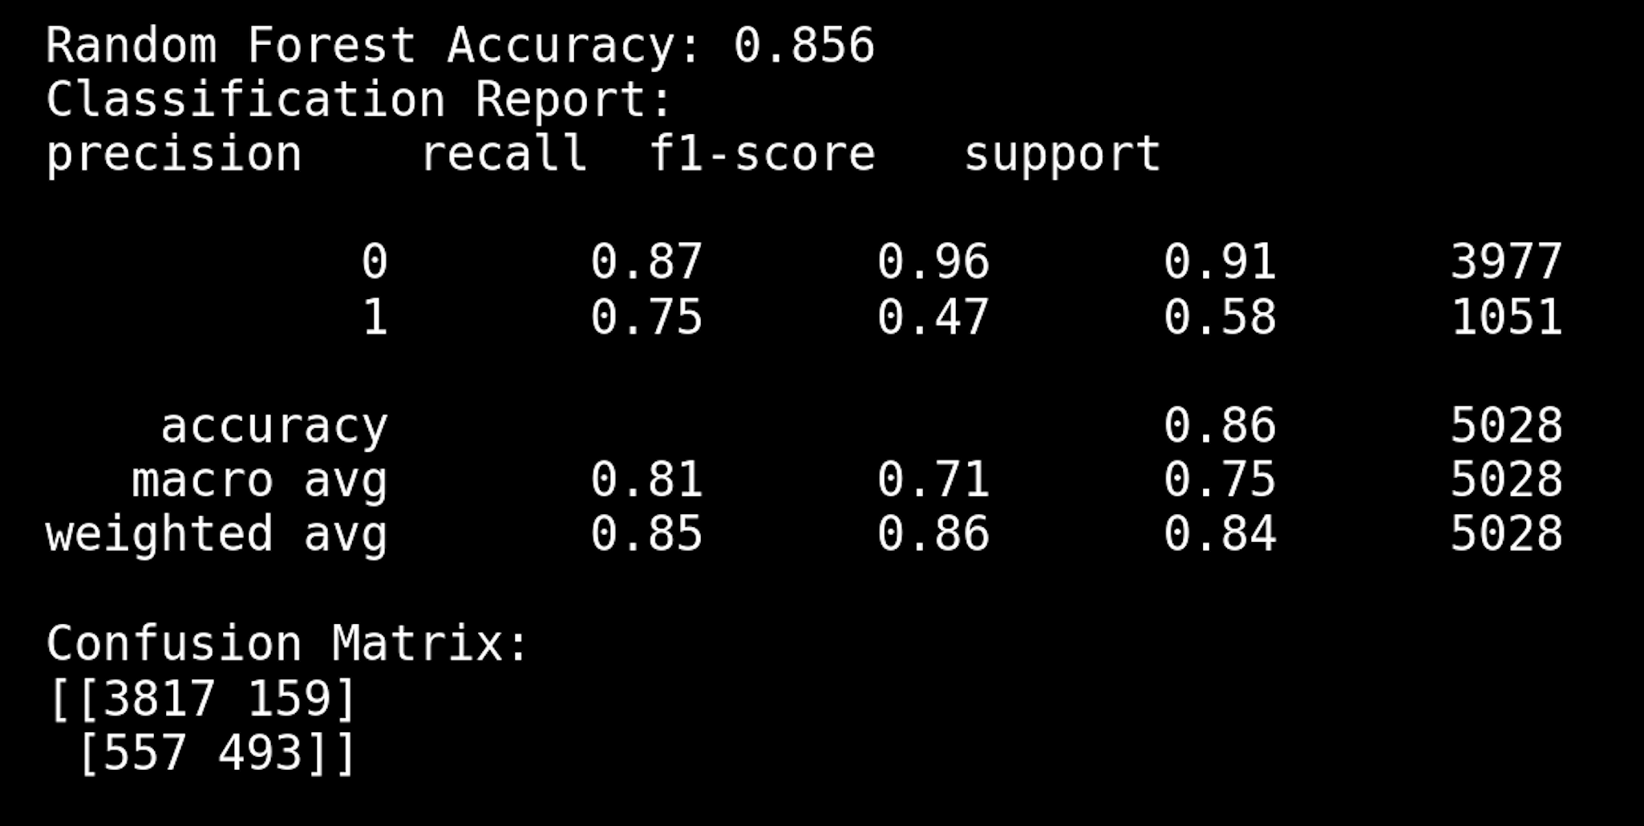
Fidelity (our perturbation model)

Slide 23
Future Possibilities
Scaling with Larger Models:
Integration with GPT or LLaMA models is currently limited because these models are better suited for generative tasks than predictive ones.
Integration with Techniques like LIME:
Future iterations will focus on embedding the perturbation algorithm into interpretability tools like LIME for broader applicability.

Slide 24

Thank you

