Slide 1
文章自动评分
任务和数据集介绍

Slide 2
文章自动评分 – 任务简介
输入：文章的文本
输出：根据文章质量的分数

Slide 3
文章自动评分 – 任务简介
文章质量差例子
Text: I do think that there are books that should be removed because some people take some things offensive. Some people may think that the book may be wrong because of the religion. And some people may not like what the book, movie, or music is teaching their child.
People that take the religion to be offensive because the book could say that religion that the person belives is not the right way to go.
Some parents may take the book offensive because it may contain bad things. These parents may not want their kids reading these types of books but if the library has them the kid could easily check out the book and keep it hidden from thier parents.
Some parents may not want there kids listenig, watchin, or reading anything that may teach or tell the kid to do things that htye shouldnt be doing.
I think that there are some books, movies, or music that is inapprpriate for smaller children but may be apprpriate for people that are older it all depends on the book.
Score: 2

Slide 4
文章自动评分 – 任务简介
文章质量好例子
Text: What is freedom of speech? It is the ability to speak out your mind without fear of prosecution – but is that all it is? Is it limited to verbal opinion? Or does every kind of speech count? Do books, music, movies, magazine, newspaper articles, and cartoons come under “speech”? Or are they the targets of the arrow called censorship? Author Katherine Paterson said, “if I have the right to remove that book from the shelf...then you also have exactly the same right and so does everyone else. And then we have no books left on the shelf for any of us.”
……
……
Paterson is right. One person may have a problem with a certain book – he raises people against it – the book is banned. Another woman may not like a song because of negative ideas – she rounds up other critics – the song is banned. A parent may find a certain movie inappropriate and offensive – he creates petitions banning it –
Score: 6

Slide 5
文章自动评分 – 数据集简介
数据集的来源：Kaggle的Automated Essay Scoring 大赛（2012年）[https://www.kaggle.com/c/asap-aes/overview]
数据集：总共有八个文章集，每一个文章集里的文章是回答同一个题目（prompt）的，每个文章集都有自己的特点（有不同题材、风格、评价要求、分数范围等等）。
文章长度：每篇从150到550英文单词
标签：每篇文章有两个人类给的分数，要预测的是两个人之间的平均分数（这个分数也是给定的）。
分数范围：文章集之间的分数范围不同，比如第一个文章集范围为2–12，第八个文章集为0–60。

Slide 6
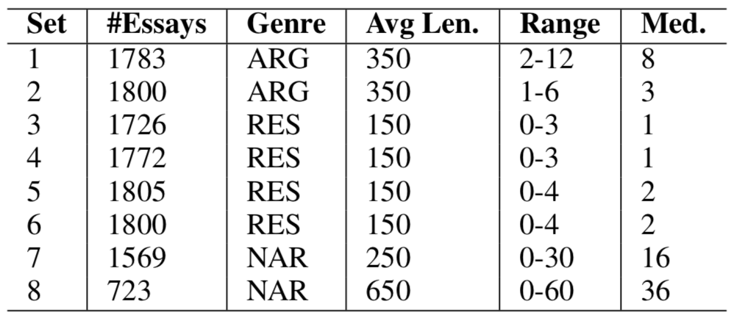
文章自动评分 – 数据集简介
数据集的总结：

Slide 7
文章自动评分 – 数据集简介
数据集的格式：
提供的文件:
TSV（tab-separated value）
train.tsv
dev.tsv
test.tsv

Slide 8
文章自动评分 – 数据集简介
数据集的格式：
数据集的文件有28个列:
essay_id: A unique identifier for each individual student essay
essay_set: 1-8, an id for each set of essays
essay: The ascii text of a student's response
rater1_domain1: Rater 1's domain 1 score; all essays have this
rater2_domain1: Rater 2's domain 1 score; all essays have this
rater3_domain1: Rater 3's domain 1 score; only some essays in set 8 have this.
domain1_score: Resolved score between the raters; all essays have this
rater1_domain2: Rater 1's domain 2 score; only essays in set 2 have this
rater2_domain2: Rater 2's domain 2 score; only essays in set 2 have this
domain2_score: Resolved score between the raters; only essays in set 2 have this
rater1_trait1 score - rater3_trait6 score: trait scores for sets 7-8
这些信息不用管了
这个是要预测的值
这些信息不用管了

Slide 9
文章自动评分 – 数据集简介
其他提供的信息：
Kaggle还提供一个Word 2010 Readme文档:
该文档有每个文章集的解释以及每个文章集的prompt。

Slide 10
文章自动评分 – 数据集简介
题目（prompts）：
Set 1 prompt: More and more people use computers, but not everyone agrees that this benefits society …
Write a letter to your local newspaper in which you state your opinion on the effects computers have on people. Persuade the readers to agree with you.
Set 2 prompt: All of us can think of a book that we hope none of our children or any other children have taken off the shelf. …
Do you believe that certain materials, such as books, music, movies, magazines, etc., should be removed from the shelves if they are found offensive? Support your position with convincing arguments from your own experience, observations, and/or reading.

Slide 11
文章自动评分 – 数据集简介
题目（prompts）：
Set 3 prompt: SOURCE TEXT: Do Not Exceed Posted Speed Limit–by Joe Kurmaskie | FORGET THAT OLD SAYING ABOUT NEVER taking candy from strangers. No, a better piece of advice for the solo cyclist would be, “Never accept travel advice from a collection of old-timers who haven’t left the confines of their porches since Carter was in office …
Write a response that explains how the features of the setting affect the cyclist. In your response, include examples from the essay that support your conclusion.
Set 4 prompt: SOURCE TEXT: Winter Hibiscus by Minfong Hon Saeng, a teenage girl, and her family have moved to the United States from Vietnam. As Saeng walks home after failing her driver’s test, she sees a familiar plant …
Write a response that explains why the author concludes the story with this paragraph. In your response, include details and examples from the story that support your ideas.

Slide 12
文章自动评分 – 数据集简介
题目（prompts）：
Set 5 prompt: SOURCE TEXT: Narciso Rodriguez, from Home: The Blueprints of Our Lives | My parents, originally from Cuba, arrived in the United States in 1956. After living for a year in …
Describe the mood created by the author in the memoir. Support your answer with relevant and specific information from the memoir.
Set 6 prompt: SOURCE TEXT: The Mooring Mast, by Marcia Amidon Lüsted | When the Empire State Building was conceived, it was planned as the world’s tallest building, taller even than the new Chrysler Building …
Based on the excerpt, describe the obstacles the builders of the Empire State Building faced in attempting to allow dirigibles to dock there. Support your answer with relevant and specific information from the excerpt.

Slide 13
文章自动评分 – 数据集简介
题目（prompts）：
Set 7 prompt: Write about patience. Being patient means that you are understanding and tolerant. A patient person experience difficulties without complaining. Do only one of the following: write a story about a time when you were patient OR write a story about a time when someone you know was patient OR write a story in your own way about patience.
Set 8 prompt: We all understand the benefits of laughter. For example, someone once said, “Laughter is the shortest distance between two people.” Many other people believe that laughter is an important part of any relationship. Tell a true story in which laughter was one element or part.

Slide 14

文章自动评分 – 指标
Quadratic Weighted Kappa (QWK):
QWK是一个计算两个判断者之间的认同度。
Weights matrix:
where i and j are the reference rating (assigned by a human rater) and the system rating (assigned by an AES system), respectively, and R is the number of possible ratings.

Slide 15

文章自动评分 – 指标
Quadratic Weighted Kappa (QWK):
An observed score matrix O is calculated such that Oi,j refers to the number of essays that receive a rating i by the human rater and a rating j by the AES system. An expected score matrix E is calculated as the outer product of histogram vectors of the two (reference and system) ratings. The matrix E needs to be normalized such that the sum of elements in E and the sum of elements in O keep the same. Finally, given the three matrices W , O and E, the QWK value is calculated according to Equation:

Slide 16
文章自动评分 – 作业要求
本次作业要求在该数据集上完成三个实验，并提交实验报告。
实验设置分为两种：
Prompt-dependent：模型在特定文章集上进行训练，并预测该文章集剩余的测试实例；
在该设置下，我们进行两个实验：
1.基于统计方法去预测分数，需要手动设计分类特征。
2. 基于神经网络去预测分数，可使用word2vec等预训练模型；
Prompt-independent：模型在排除目标文章集上进行训练，要求预测该目标文章集上的测试实例；
在该设置下，我们进行一个实验，可以使用统计方法，也可以使用神经网络的方法。该部分实验需要思考，不同的essay set之间的文章有什么通用的信息可以利用，可以去看知识迁移的论文。

Slide 17
文章自动评分—时间安排
第一次作业（基于统计学习的方法）
11月29日 23:59:59
第二次作业（基于神经网络的方法）
12月13日 23:59:59
第三次作业（prompt-independent设置）
12月30日 23:59:59
实验报告
1月12日 23:59:59

Slide 18
文章自动评分—提交方式
线上测评
测评系统网址为 47.110.235.226:12345
提交结果请以 “学号.tsv” 的方式进行提交，如MG1933025.tsv
提交结果应当包含8个文章集的所有预测结果
提交文件中的每一行依次为Essay-ID、Essay-Set和Prediction ，利用制表符（\t）进行分割
实验报告
通过FTP的方式提交，FTP地址待定。

