Slide 1
YouroQNet
Quantum Text Classification with Context Memory
Team: QwQ
Reporter: Armit
Notes:
Create Time: 2023/5/12

Slide 2
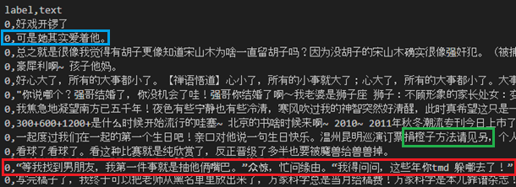
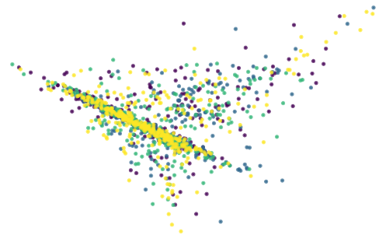
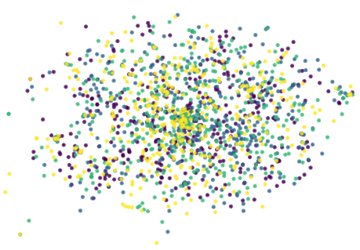
Text Classification in a Quantum Manner
what the problem is
NLP sentiment comprehension
the dataset just holy shit
how current methods work
TextCNN, TextRNN, BERT
QNLP , QSANN
nevertheless our contributions
heuristic k-gram tokenizer
YouroQNet
computational analysis
ambiguous example, wrong label and informal pragmatics
PCA & TSNE over word-level TF-IDF

Slide 3
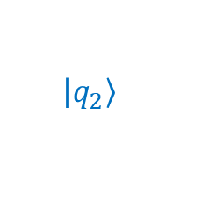

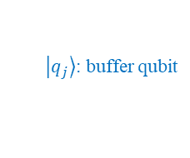

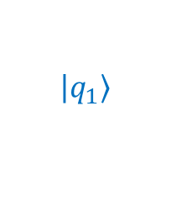

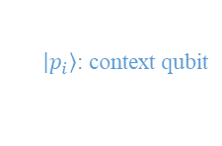

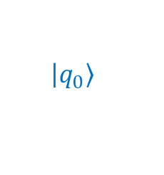
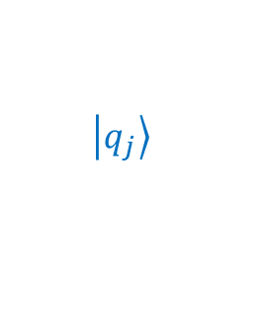
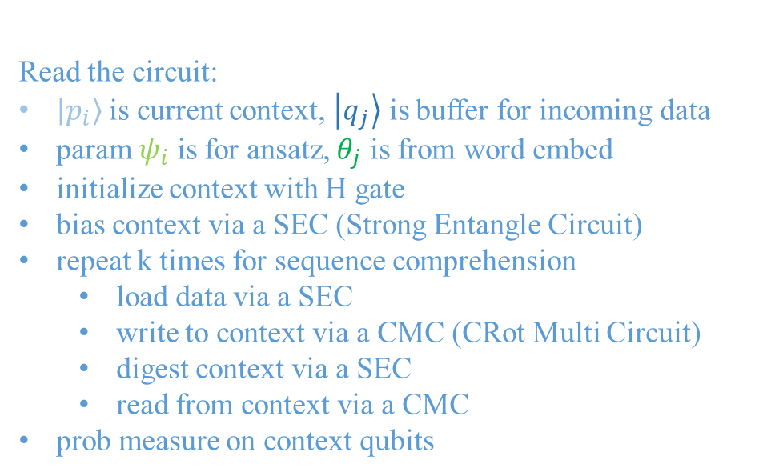






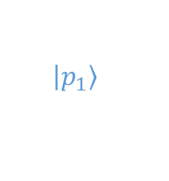

kgram tokenizer
ansatz
(YouroQNet)
Text Classification
n_qubit = model_length + n_class
这/是/一/个/例/子
这是/一个/例子
这是/一个/例/子
logp = -50.4
logp = -46.4
logp = -39.0
这是一个例子
H
......
$$ψ_{i}$$
$$ψ_{i}$$
......
PMeasure
$$\left|\left.p_{1}\right\rangle \right.$$
S.Entgl
S.Entgl
CRot
Multi
$$ψ_{i}$$
prob
distro
……
tokenize
$$\left|\left.p_{0}\right\rangle \right.$$
$$\left|\left.q_{0}\right\rangle \right.$$
$$θ_{j}$$
S.Entgl
CRot
Multi
word embedding
$$ψ_{i}$$
这是 / 一个 / 例 / 子
$$\left|\left.q_{1}\right\rangle \right.$$
$\left|\left.p_{i}\right\rangle \right.$: context qubit
PAD
我
是
一个
字典
embed
$$\left|\left.q_{2}\right\rangle \right.$$
$\left|\left.q_{j}\right\rangle \right.$: buffer qubit
…
……
$ψ_{i}$: ansatz param
learnable
[L=4, D]
$$\left|\left.q_{j}\right\rangle \right.$$
$θ_{j}$: embed param
$$θ_{j}$$
……
K=3000+
repeat $k$ times
……
align
Read the circuit:
$\left|\left.p_{i}\right\rangle \right.$ is current context, $\left|\left.q_{j}\right\rangle \right.$ is buffer for incoming data
param $ψ_{i}$ is for ansatz, $θ_{j}$ is from word embed
initialize context with H gate
bias context via a SEC (Strong Entangle Circuit)
repeat k times for sequence comprehension
load data via a SEC
write to context via a CMC (CRot Multi Circuit)
digest context via a SEC
read from context via a CMC
prob measure on context qubits
[mL=3, D]
D=16
ansatz
aligner
(split or pad to model length)
[${nq}^{2}$=16]
project
这 / 是 / 一个
是 / 一个 / 例子
[NC=4]
loss
loss
(binary cross entroy)
[0,1,0,0]
$$=y\log\left(x\right)+\left(1−y\right) log⁡(1−x)$$
(onehot label)
$$x∈\left[0,1\right], y∈\{0,1\}$$

Slide 4
Content Table
Entropy-based Heuristic k-gram Tokenizer
YouroQNet for Quantum Sequence Classification
Computational Analysis over Simple QCircuits

Slide 5
Entropy-based Heuristic k-gram Tokenizer
why tokenizing
not necessary, even not work on small datasets
reduce input length for limited qubits
from fixed n-gram to adaptive k-gram
build several n-gram vocabs from the corpus
word presence probability
tokenize corpus by longest match
bidirectional beam search
recollect all tokenized words as new vocab
can be iterative if needed
这是一个例子
这/是/一/个/例/子
这是/是一/一个/个例/例子
这是一/是一个/一个例/个例子
这是一个/是一个例/一个例子
……
(candidate n-gram words)
entropy
这/是/一/个/例/子
这是/是一/一个/个例/例子
这是一/是一个/一个例/个例子
这是一个/是一个例/一个例子
……
(recollected k-gram words)
Notes:
Q: why not a prior algorithm?
A: there are independent words, see 骆驼/葡萄 is frequent, however, any single char is not frequent

Slide 6
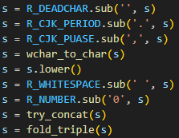
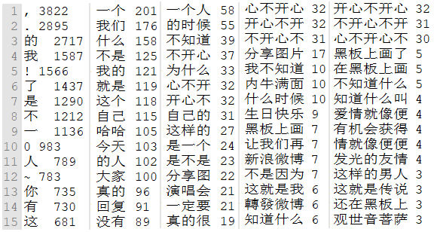
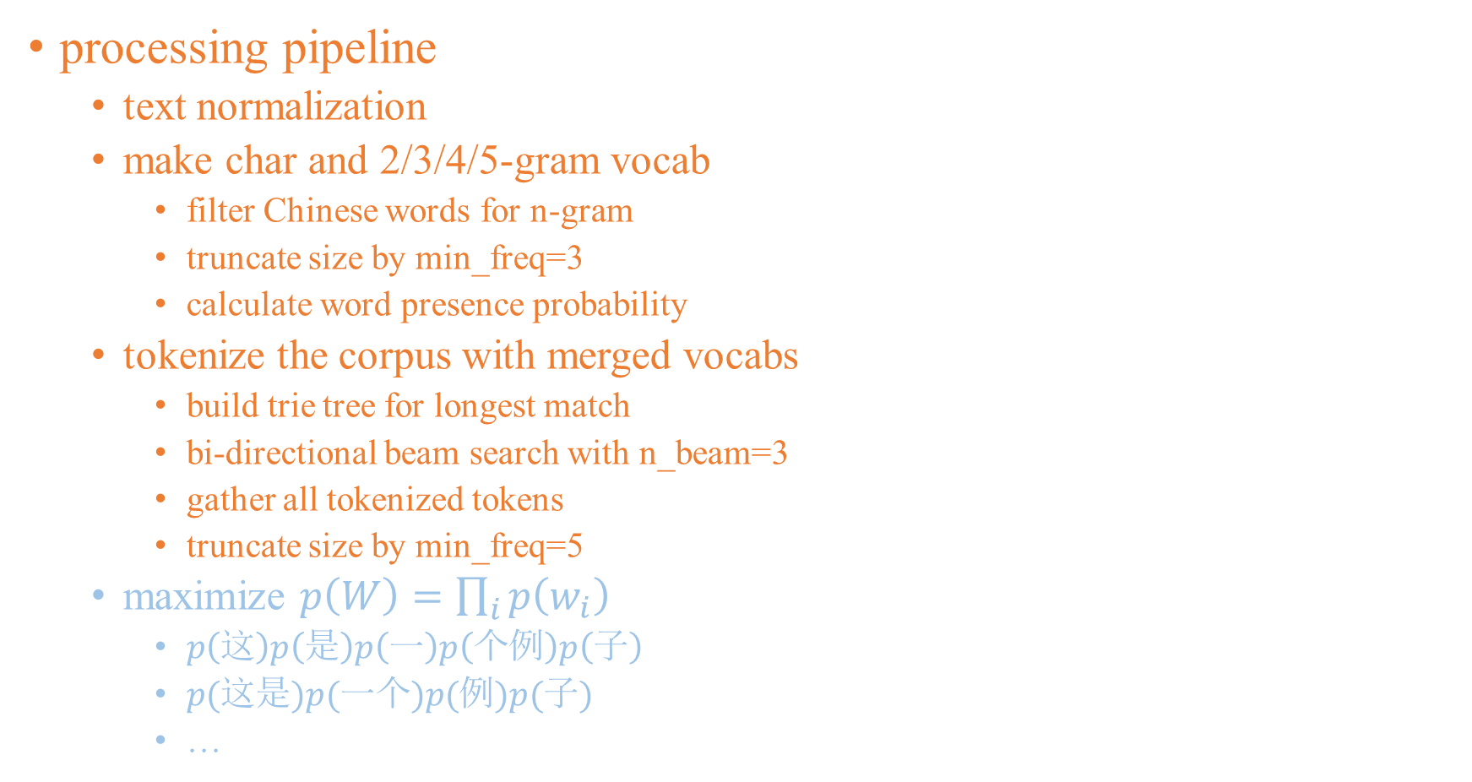
Tokenizer: concrete example
n-gram | n_vocab | n_vocab trunc.
char | 3345 | -
2-gram | 34363 | 4438
3-gram | 48720 | 1264
4-gram | 45478 | 238
5-gram | 38812 | 44
k-gram | 4934 | 2713
k-gram+ | 6376 | 2899
processing pipeline
text normalization
make char and 2/3/4/5-gram vocab
filter Chinese words for n-gram
truncate size by min_freq=3
calculate word presence probability
tokenize the corpus with merged vocabs
build trie tree for longest match
bi-directional beam search with n_beam=3
gather all tokenized tokens
truncate size by min_freq=5
maximize $p\left(W\right)=\prod_{i}{p\left(w_{i}\right) }$
$p\left(这\right)p\left(是\right)p\left(一\right)p\left(个例\right)p\left(子\right)$
$p(这是)p(一个)p(例)p(子)$
…
text norm
n/k-gram vocabs size
n-gram vocabs
Notes:
Init p for vocab char is forced to 1e-8, to encourage using n-gram rather than char (1-gram)
if the corpus is large enough, iterate this heuristic algorithm should yield a self-content convergence ☺

Slide 7
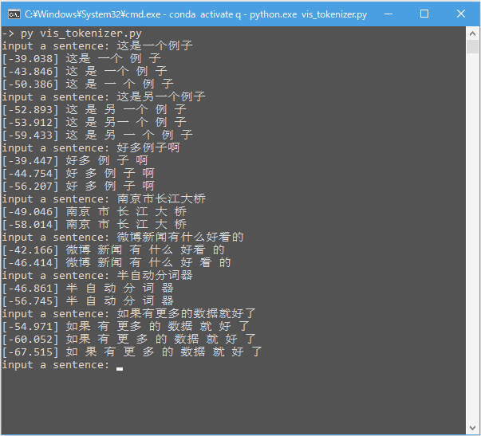
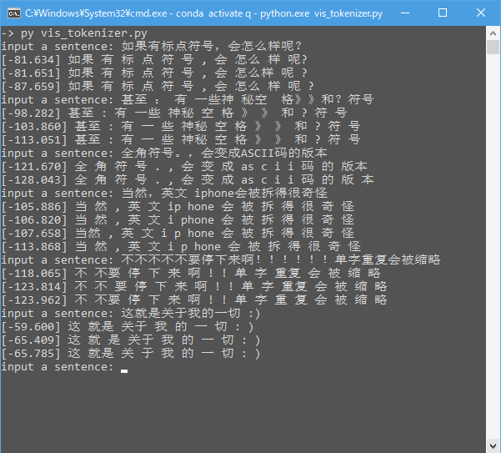
Tokenizer: interactive demo

Slide 8
Content Table
Entropy-based Heuristic k-gram Tokenizer
YouroQNet for Quantum Sequence Classification
Computational Analysis over Simple QCircuits

Slide 9
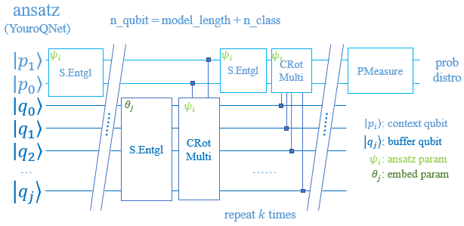
YouroQNet for Quantum Sequence Classification
YouroQNet :=
pure variational quantum circuit
representation learning
style-transfer scheme
what is for
sequence classification
feature abstraction
YouroQNet general architecture

Slide 10
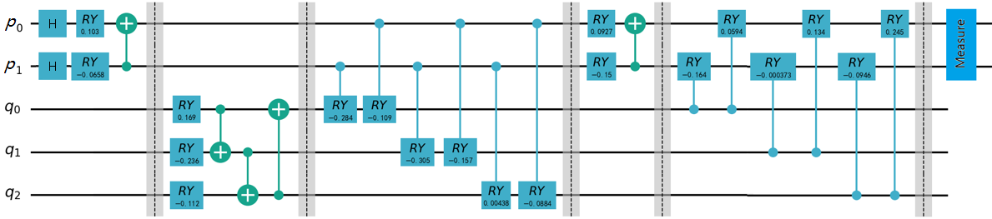
YouroQNet: minimal concrete example
pure variational quantum circuit
context init
data upload
context write
context transform
context read
measure
SEC
SEC
CMC
SEC
CMC
word embed
YouroQNet
(5qubit-1repeat)
SEC: Strong Entangle Circuit, here we set rots=[RY], entgl=CNOT
CMC: CRot Multi Circuit, here we set rots=[RY]
repeatable section

Slide 11
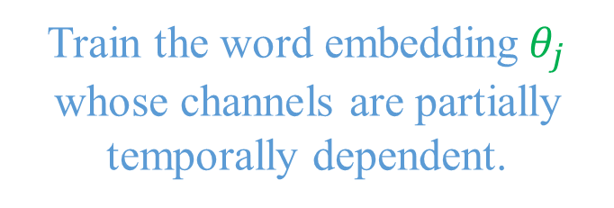
YouroQNet learns semantical word representation
YouroQNet :=
pure variational quantum circuit
representation learning
implicit convolutional
implicit recurrent
style-transfer scheme
Train the word embedding$θ_{j}$ whose channels are partially temporally dependent.

Slide 12

YouroQNet differs contextual invariants from variants
YouroQNet :=
pure variational quantum circuit
representation learning
implicit convolutional
implicit recurrent
style-transfer scheme
Train $ψ_{i}$ and $θ_{j}$ alternatively
alike the EM algorithm.
Note that $ψ_{i}$ is constant to all inputs, corresponding to contextual invariant (syntactical) transforms, while $θ_{j}$ builds up a (semantical) variant context.

Slide 13
YouroQNet is implicitly convolutional
YouroQNet :=
pure variational quantum circuit
representation learning
implicit convolutional
implicit recurrent
style-transfer scheme
Breaking down long sentences with the aligner, a YouroQNet is like a single Conv1d filter that slides along the sentence then applies an AvgPooling.

Slide 14
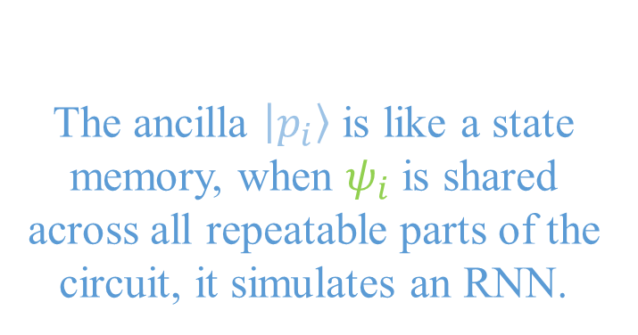
YouroQNet could be recurrent if needed
YouroQNet :=
pure variational quantum circuit
representation learning
implicit convolutional
implicit recurrent
style-transfer scheme
The ancilla $\left|\left.p_{i}\right\rangle \right.$ is like a state memory, when $ψ_{i}$ is shared across all repeatable parts of the circuit, it simulates an RNN.

Slide 15
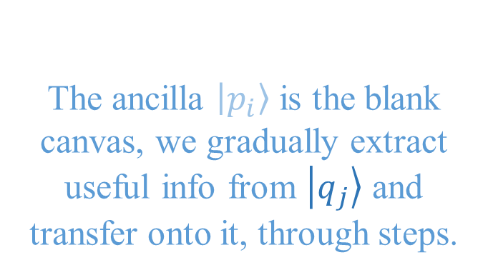
YouroQNet follows a style-transfer scheme
YouroQNet :=
pure variational quantum circuit
representation learning
implicit convolutional
implicit recurrent
style-transfer scheme
The ancilla $\left|\left.p_{i}\right\rangle \right.$ is the blank canvas, we gradually extract useful info from $\left|\left.q_{j}\right\rangle \right.$ and transfer onto it, through steps.

Slide 16
YouroQNet: metric evaluation & comparation
F1 score | Youro QNet | Text DNN | Text CNN | Text RNN | TF-IDF |  |  |  |  | FastText word2vec
 |  |  |  |  | kNN | GBDT | Bayes | SVM | MLP | kNN | GBDT | Bayes | SVM | MLP
Joy | 0.018 | 0.349 | 0.321 | 0.287 | 0.338 | 0.214 | 0.357 | 0.374 | 0.41 | 0.361 | 0.413 | 0.430 | 0.458 | 0.455
Angry | 0.342 | 0.294 | 0.175 | 0.32 | 0.327 | 0.356 | 0.300 | 0.336 | 0.291 | 0.347 | 0.333 | 0.375 | 0.393 | 0.370
Sad | 0.22 | 0.306 | 0.321 | 0.283 | 0.175 | 0.169 | 0.274 | 0.349 | 0.306 | 0.310 | 0.24 | 0.171 | 0.328 | 0.225
Hate | 0.273 | 0.187 | 0.275 | 0.318 | 0.271 | 0.259 | 0.308 | 0.24 | 0.313 | 0.179 | 0.289 | 0.306 | 0.314 | 0.290
Avg. | 0.213 | 0.284 | 0.273 | 0.302 | 0.278 | 0.25 | 0.31 | 0.325 | 0.33 | 0.3 | 0.319 | 0.321 | 0.373 | 0.335
Notes:
TextCNN impl in torch

Slide 17
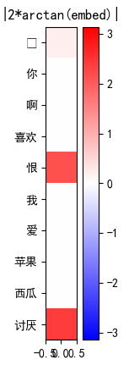
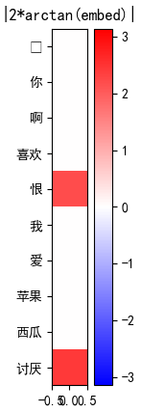
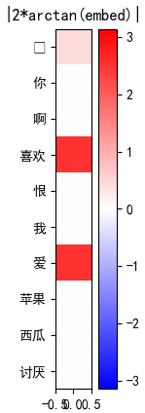
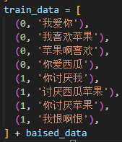
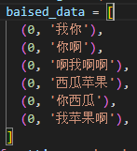
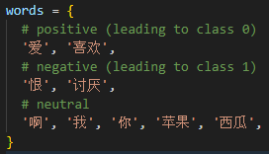
YouroQNet - mini: toy verification in details
toy model config
3+1 qubits, 1 repeat, [RY]-CNOT-[RY]
embedding analysis
manually bias the dataset
embed highlights the minority
👉 it learns TF-IDF successfully !!
vocab
pos = 0
neg = 1
neutral
bias pos
bias neg
train data

Slide 18
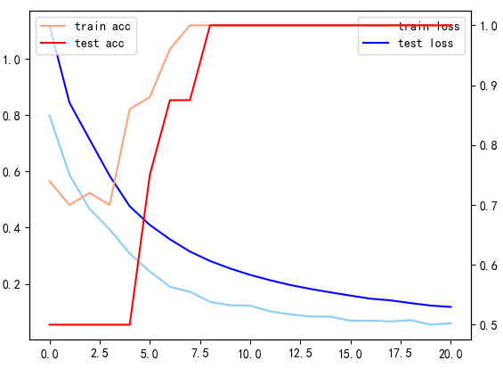
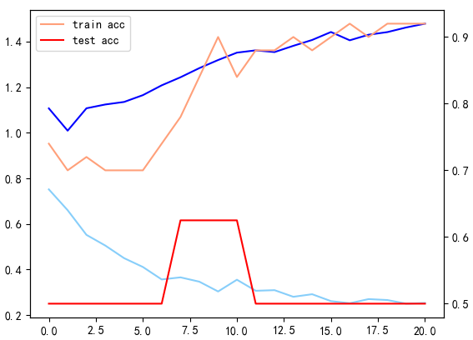
YouroQNet: QNN is fragile | symmetric, periodical, finite-valued
parameter initialization
uniform ❌
normal ✔️
embedding normalization
±pi/2 ❌
±pi ✔️
gradient method
param_shift ❌
finite_diff ✔️
loss not decay or quickly overfit
tune rand seed
kill & retry 😅
✔️
❌
good & bad loss curves

Slide 19
Content Table
Entropy-based Heuristic k-gram Tokenizer
YouroQNet for Quantum Sequence Classification
Computational Analysis over Common QCircuits

Slide 20
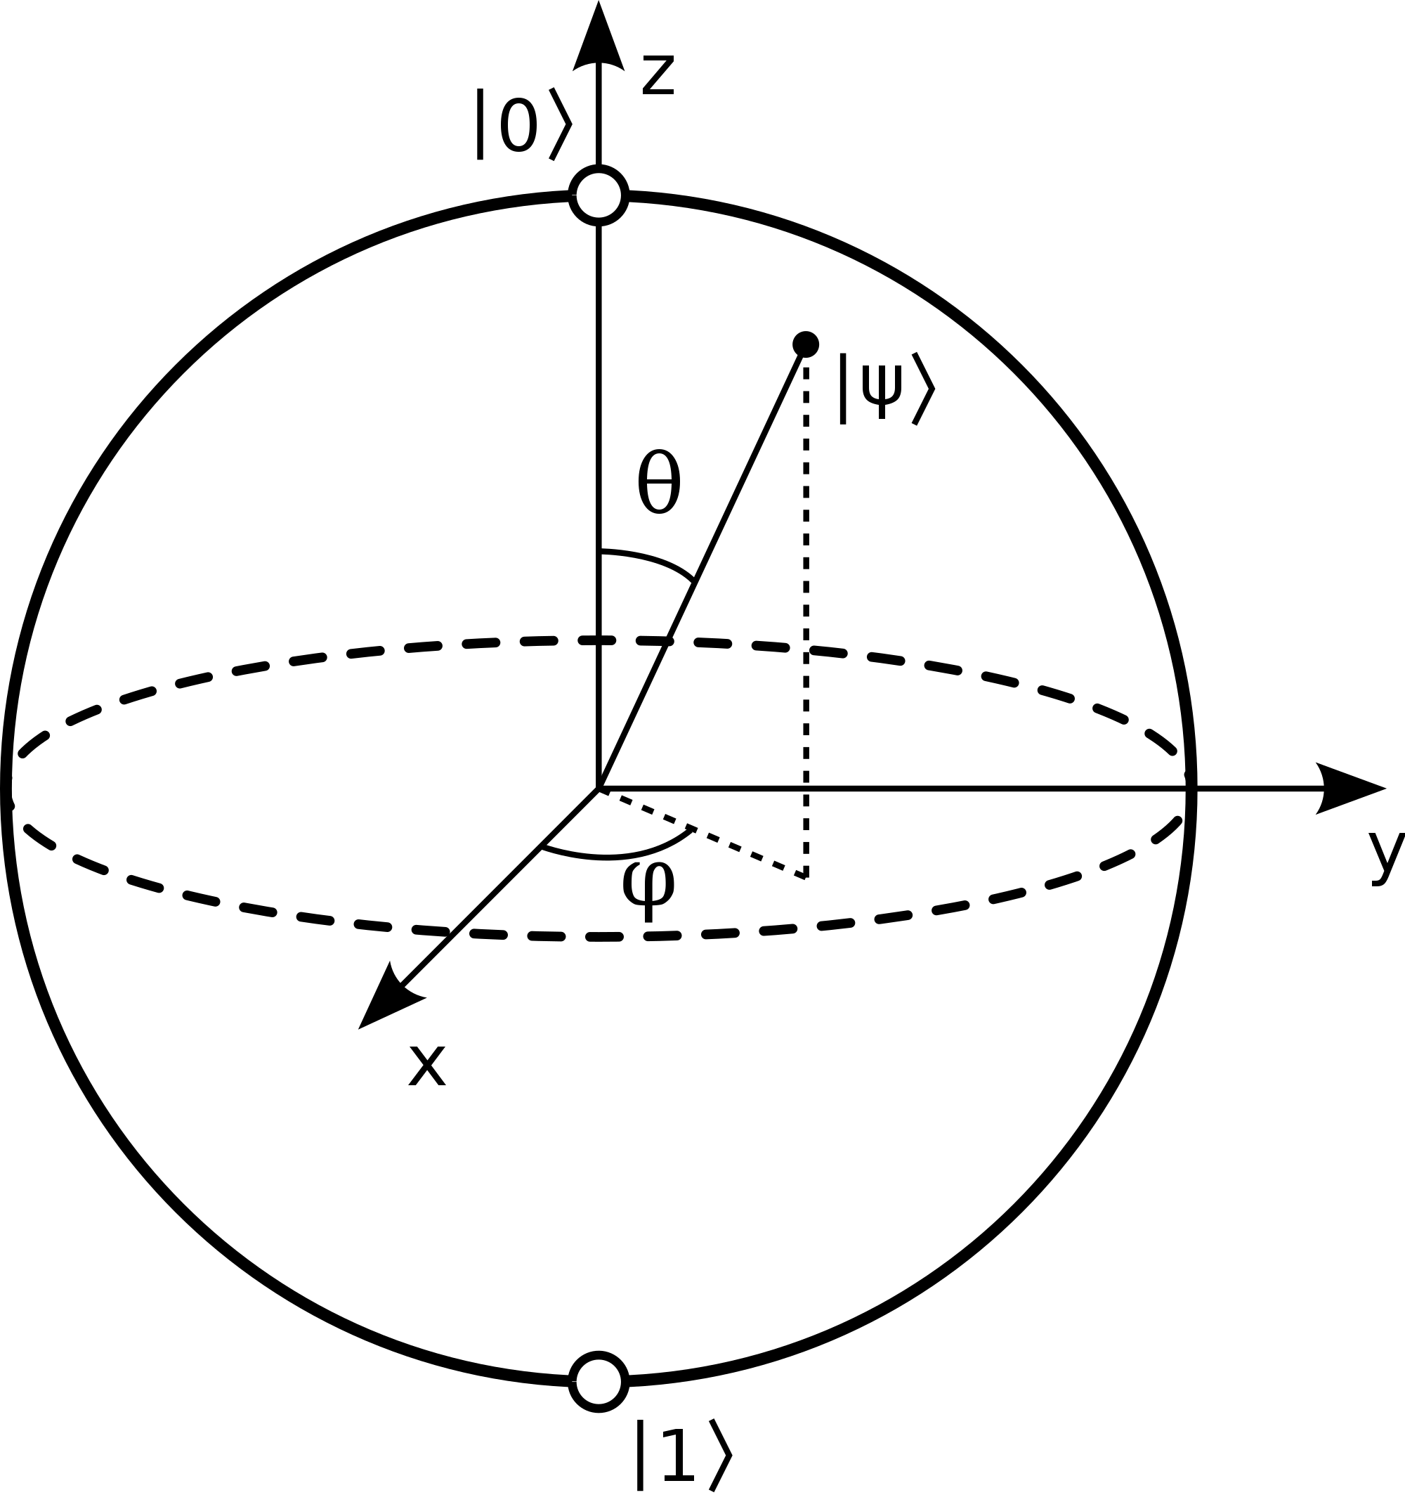
Rethink on QCricuit
Conceptual model in meme
Balancer / 3D Clock
Map-Reduce
But what’s the mathematical model?
Single qubit rotation (superposition)
Multi-qubit entanglement
https://leimao.github.io/blog/Qubit-Bloch-Sphere/

Slide 21
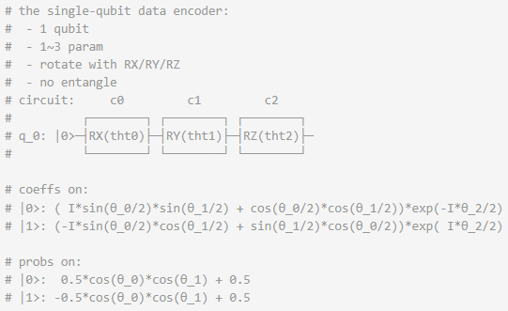
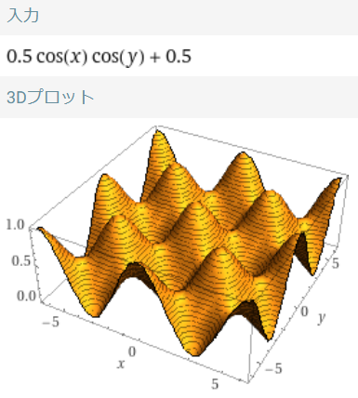
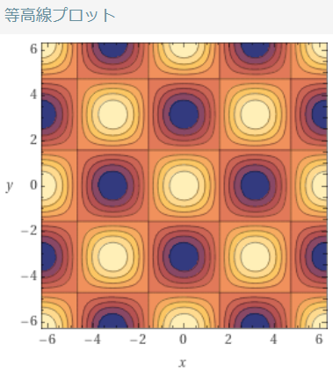
XYZ - RotCiruit
numerical XOR!!
Notes:
这种结构意义上，QNN的深度和宽度的方向，是否与经典MLP的恰恰相反？
QNN：数据串行化给出，网络层并行化计算
NN：数据并行化给出，网络层串行化计算

Slide 22
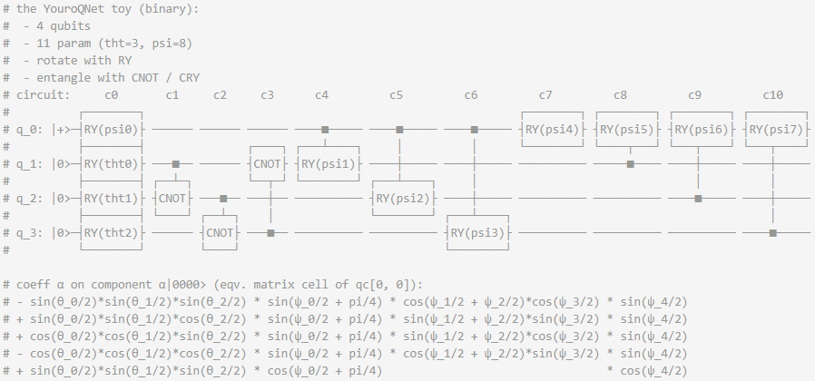

YouroQNet - mini
combinational sum with trigonometric activation!!
$$+ψ_5/2+…$$

Slide 23
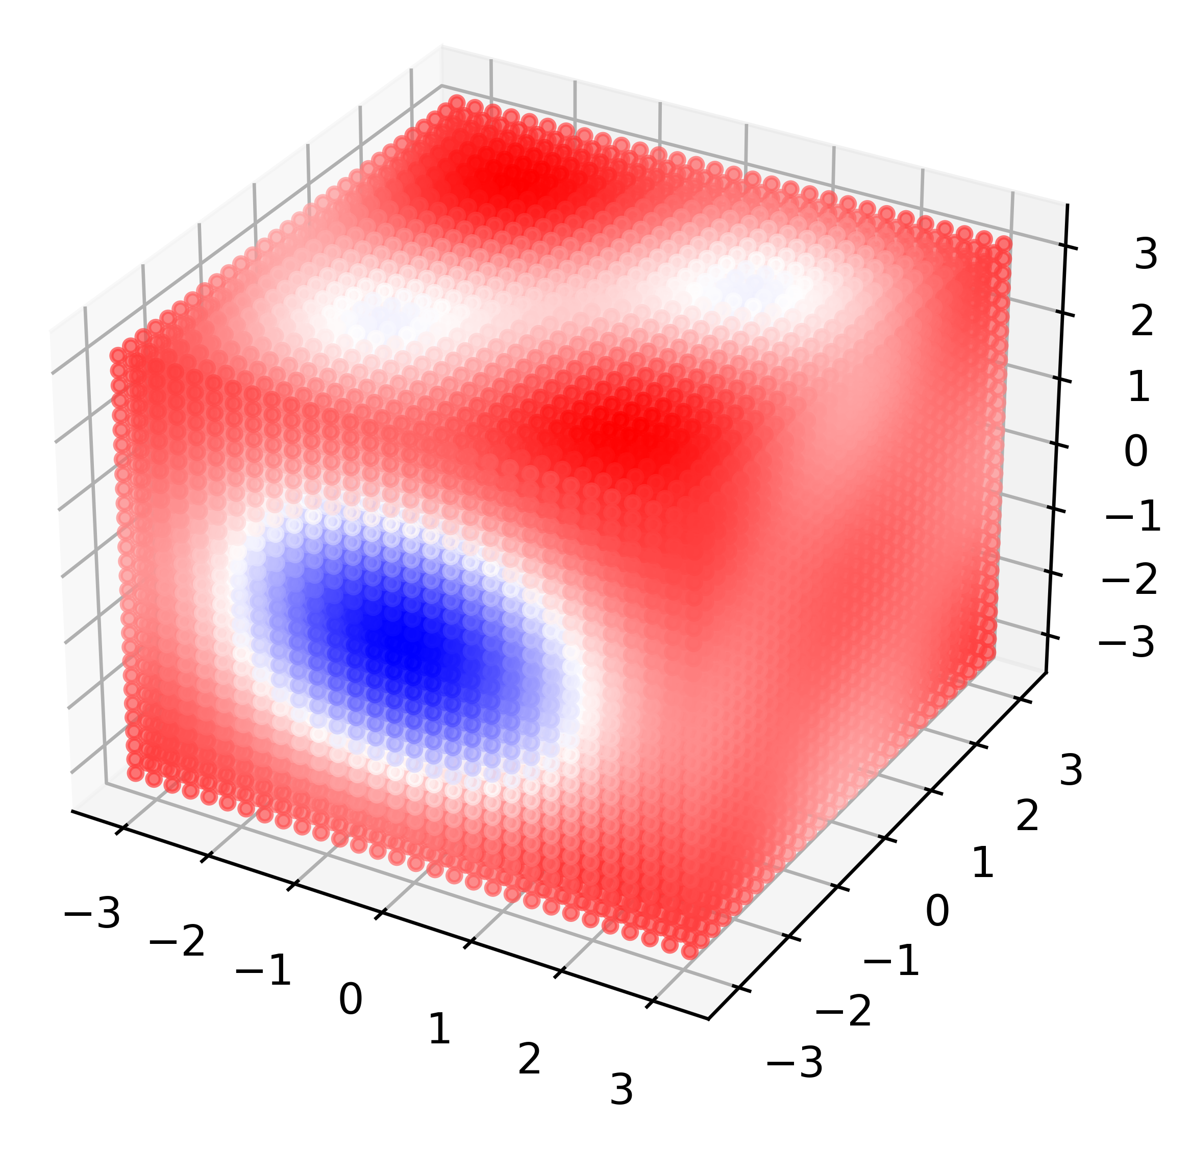
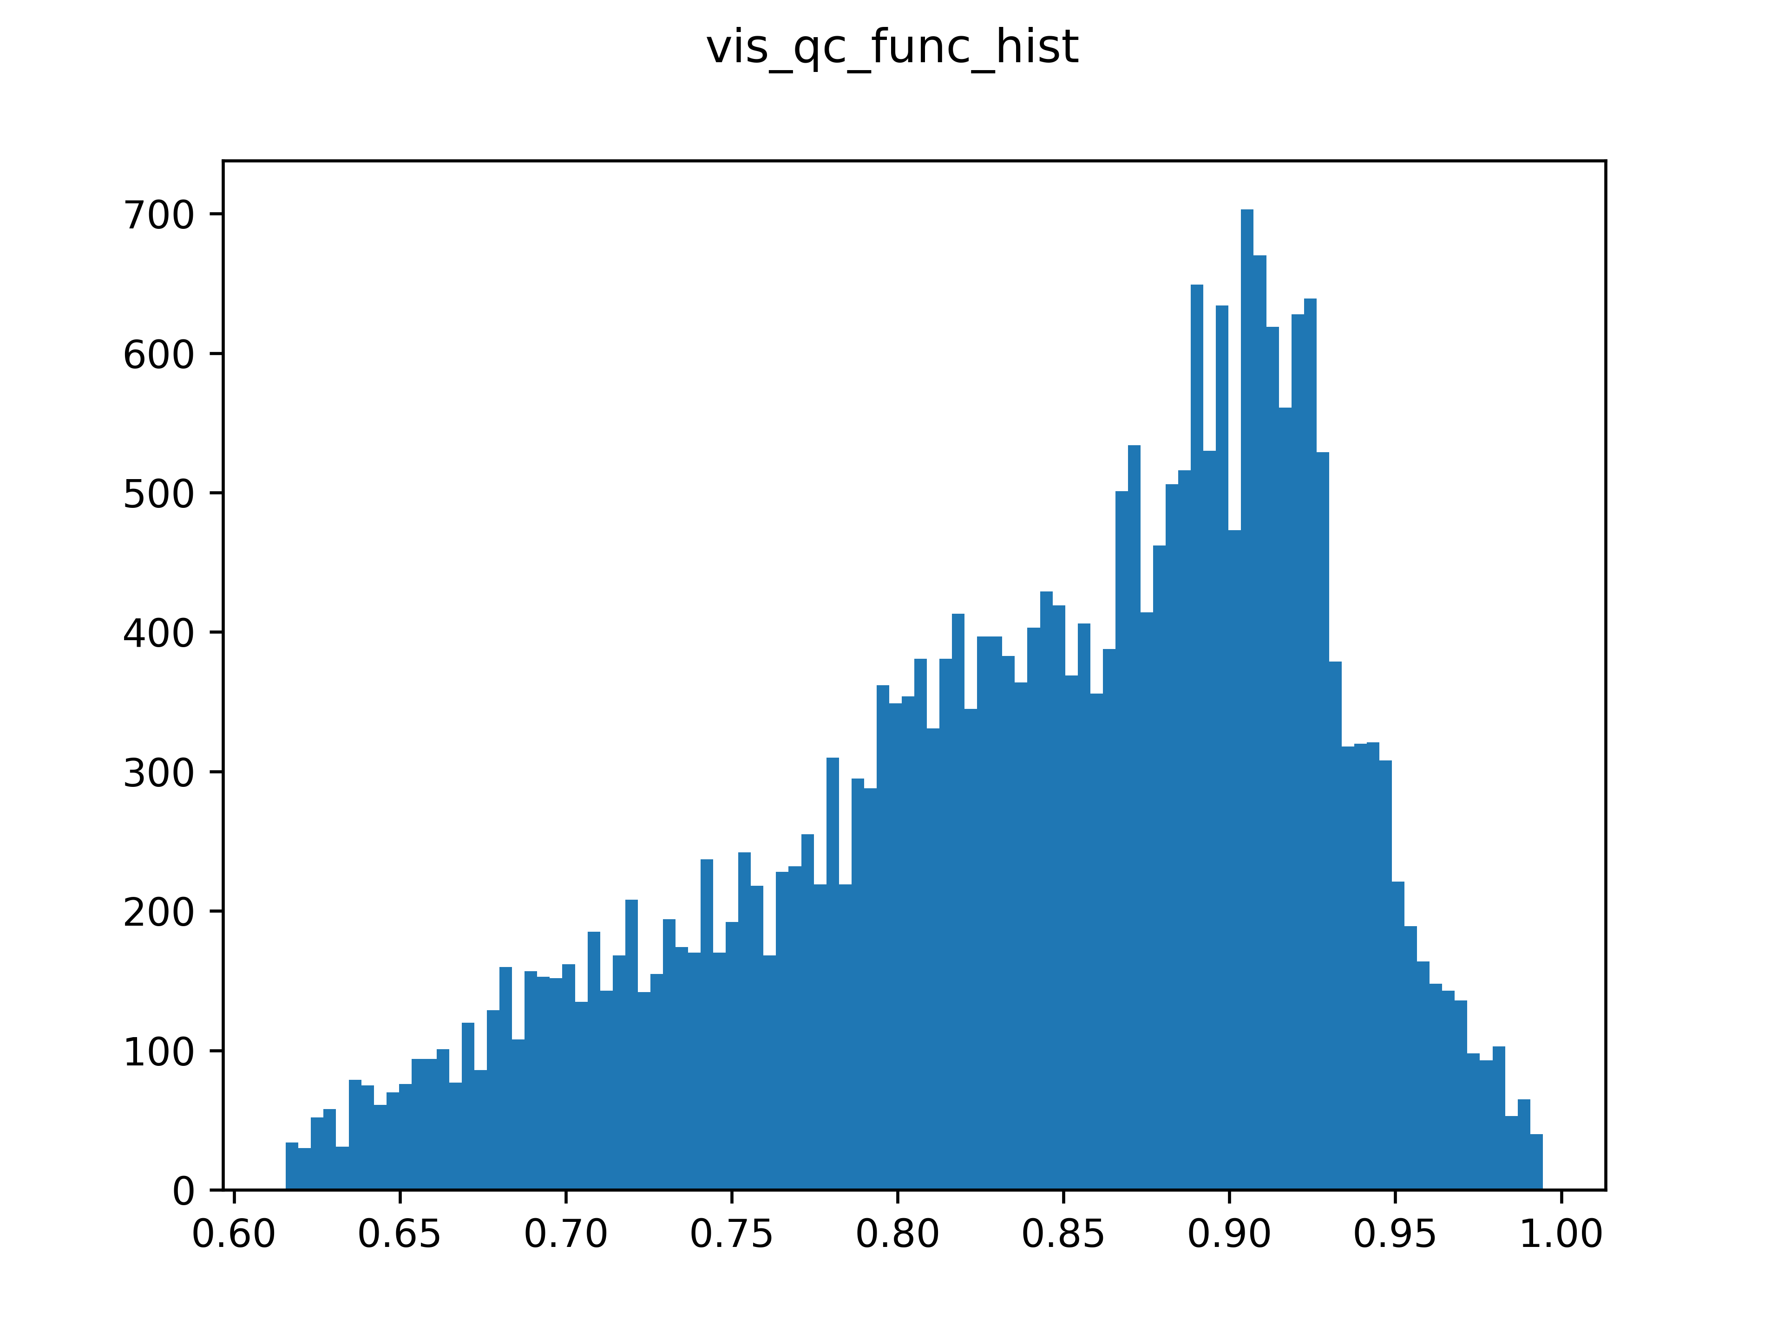
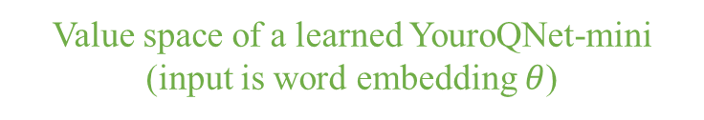
YouroQNet - mini: learned function value space
weird generalization…
Value space of a learned YouroQNet-mini
(input is word embedding $θ$)

Slide 24
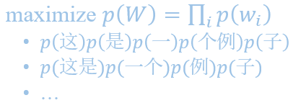
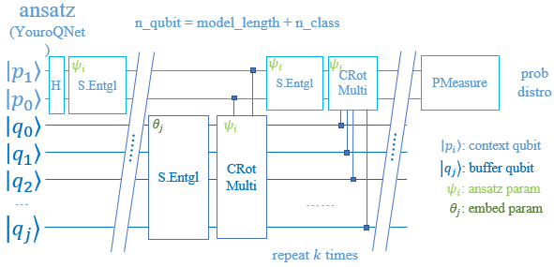
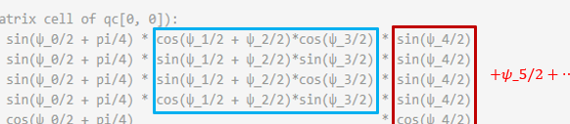
Content Table
Entropy-based Heuristic k-gram Tokenizer
YouroQNet for Quantum Sequence Classification
Computational Analysis over Simple QCircuits

Slide 25
Thanks for your watching~ YouroQNet
熔炉ネットと言うのは、虚仮威し全て裏技を繋ぐもん
Team: QwQ
Reporter: Armit

