Slide 1
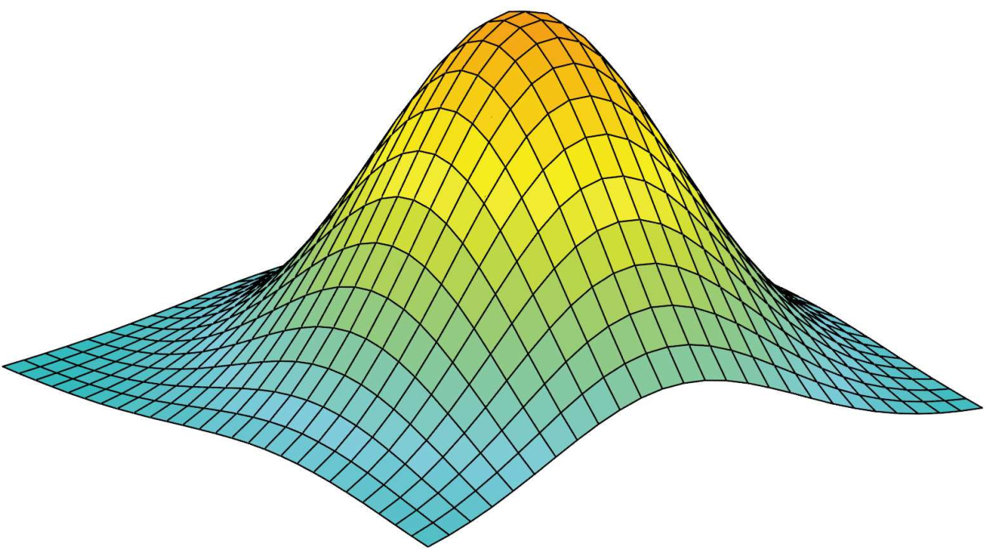
i-th pixel
Conventional Covariance
Computation
...
Compose two sets of discrete variables
Covariance computation
...
j-th pixel
Image set
Each set consisting of grayscale intensity values of n pixels at same location.
(a)
(b)
(c)
Riemannian Covariance
Computation
i-th region
…
…
…
...
...
Extract feature
of regions
Compose two sets of Gaussians
Covariance computation
…
…
…
...
j-th region
...
Image set
Pixel-wise feature vectors consisting of intensity, derivatives, etc.
Model feature vectors of regions by Gaussian model.
Covariance computation on the Gaussian manifold
(â)
(d)
(e)
(f)

