Slide 1
Investigating Patients with Rare Diseases Using Graph-Based Models
MLMI Praktikum – Final Presentation
Büşra Nur Zeybek, Tuna Karacan, Kai-Ze Deng
Supervisor: Kamilia Zaripova

Slide 2
Table of Contents
Project Outline
  Problem Statement
  Motivation
  Milestones
Project Progress & Outlook
  Model Overview
  Key Characteristics
  Data Preprocessing
  Overview of the Patient Graph
  Overview of the GiG Model
  Results & Milestones
  Discussions
Conclusion
IV. Take Home Messages & Feedback
V. Q&A

Slide 3
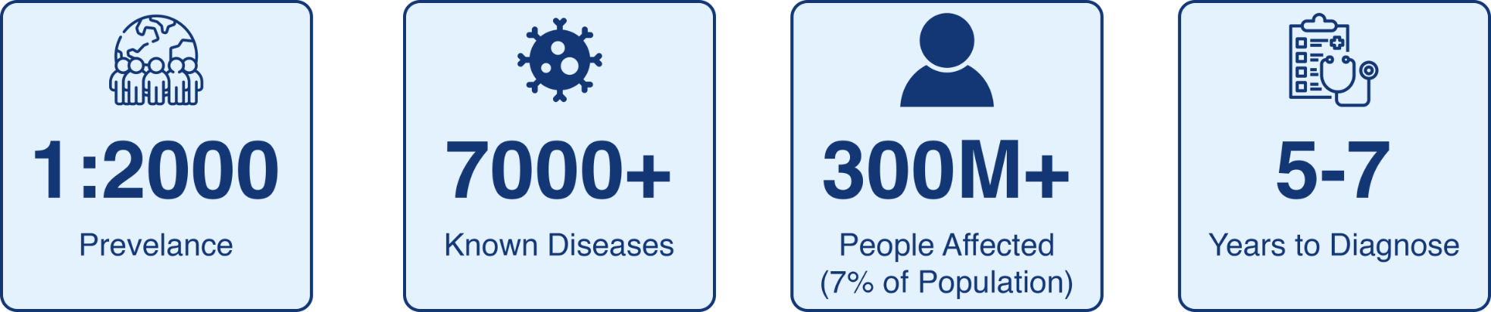
Project Outline
Problem Statement

Slide 4
Project Outline
Motivation
Why the Project Matters:
Discovering unknown disease and gene patterns based on patient similarity
Combining the known knowledge to guide the learning process
Reducing time to diagnose
Provide insight for the future

Slide 5
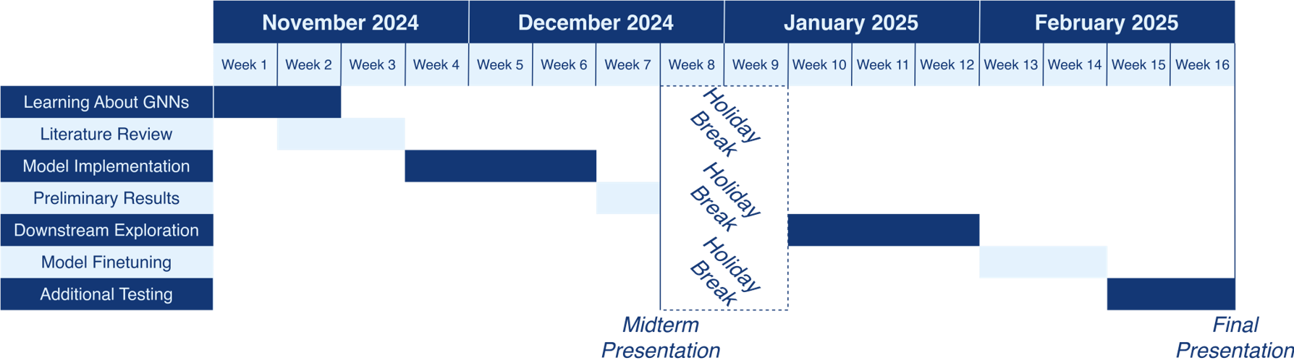
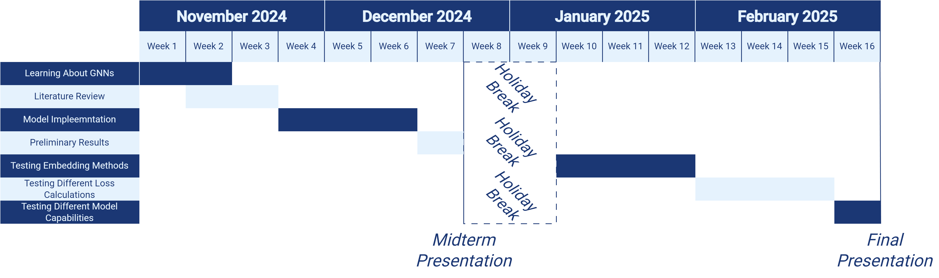
Project Outline
Milestones

Slide 6
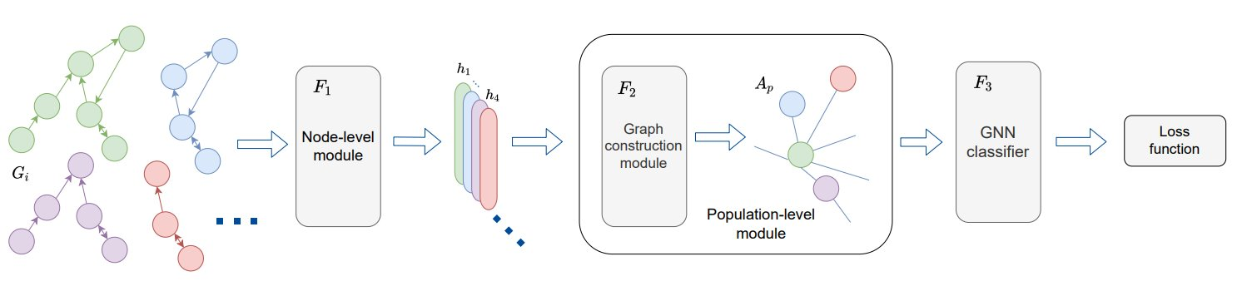
Project Progress & Outlook
Model Overview
Node-Level Module
Population-Level Module
Classifier Module
Mullakaeva, K., Navab, N., & Bronstein, M.M (2023). Graph-in-Graph (GiG): Learning interpretable latent graphs in non-Euclidean domain for biological and healthcare applications

Slide 7
Shepherd Dataset Overview
Key Characteristics
40,000+ Simulated Patient Profiles
Each Patient Data Contains:
  One True Gene Id:
    Ground truth label
  List of Positive Phenotypes Ids:
    Representation of patient
  Additional Information
Notes:
Now We are going to introduce the dataset we use, we use Shepherd Dataset, it contains more than 40K simulated Patient profiles.
Each patient data has one true gene id, which is the ground truth label for supervised learning, the a list of positive phenotypes ids, which is a comprehensive description of patients
For our task, we use only these two informations.

Slide 8
Methodology
Data Preprocessing
Patient Graph Construction:
Patient dataset contains:
  True-gene id
  Positive phenotypes
Knowledge graph for connection information
Transform patient data into patient-specific graphs
Knowledge Graph
Patient Dataset
Patient Specific Graph
Mapping Dictionary
Edges Information
Notes:
Next, we will introduce our methodology, starting with data preprocessing.
First task is to construct patient graph. Our dataset provides only list of phenotypes without relationships between them.
So we use knowledge graph, knowledge graph includess established known relationships between phenotypes.
We use it to build the connections between phenotypes,
in the end we will get patient specific graph.

Slide 9
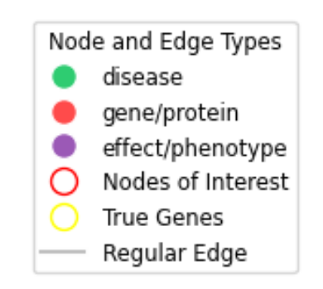
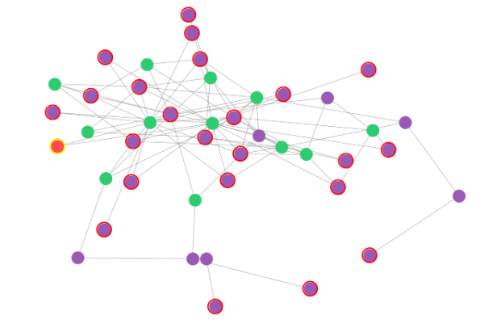
Methodology
Patient Graph Overview
Notes:
(in the patient specific graph, each node represents a phenotype and edges are connections between nodes, each graph represents one patient.)

Slide 10
Methodology
Data Preprocessing
True Gene ID to Classes Mapping:
  Convert true gene Ids to sequential class labels
Data Extraction for Downstream Tasks:
  Critical Information:
    True-gene id: ground truth label
    Positive phenotypes ids: representation of patient
    Edge index: connections between phenotypes
Convert Phenotype id into Vector Representation
  Each phenotype id is mapped to a unique vector representation
Notes:
Our downstream task is to classify patients based on their true gene id, therefore, in our approach we have to transform the discrete true gene id into sequential labels.
Then we extract only the useful information for our later GNN processing, which means ( True gene id, pos.....)
Then we use Embedding approach to convert discrete Phenotypes ids into vector representations.
Each phenotype id will be mapped into a unique vector representation

Slide 11
Methodology
Overview of the GiG Model
F1 Node Level Module:
  Graph Convolution
  Global pooling layer -> graph embedding
F2 Population Level Module:
  Cosine Similarity
  Temperature and threshold to control connection
  KL divergence-loss to regularize degree of connections.
F3 Classifier Level Module:
  Integrates learned representations from F1 and F2 modules
  Classify patients based on their true gene ids
Notes:
Next, we are going to introduce our model architecture and the implementation.
There are three main modules, first is the node level module:
In the node Level Module, we employ graph convolution to transform intrinsic node features (nodes, edge, edge attributes ) and its connected neighboring nodes information into more meaningful representations.
Since each patient has a different graph structure (the numbers of nodes and edges are ), global pooling is used to create a fixed-size representation
In the F2 Module calculate the cos similarity between graph embedding to find out the similarity of each patient.
To build meaningful connection between patients, we need to use two key parameters: temperature and threshold."
Temperature
Temperature is the scaling factor of the similarity value.
High temeprature means we allows more connections
Threshold:
Is the boundary of connection.
Only the similarity higher than threshold will be connected
These parameters are both set as learnable parameters
KL divergence is used to compared the distribution node connection degree and target distribution. And we set our target distribution as Gaussian.
In the F3 Classifier Module, we integrates the learned Parameters from F1 And F2, Integrates them using a specialized embedding layer

Slide 12
Methodology
Overview of the GiG Model
Input Data
Feature representation
Graph Representation
Integration of F1 and F2
Classification
End
Latent Space Transformation
Population Graphs
Building Connection
Cos Sim
Graph Conv​
Pooling
KL Div
Notes:
This is the overview of our working flow

Slide 13
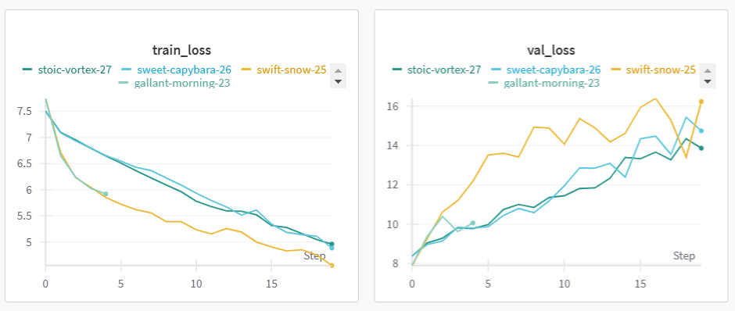
Project Progress & Outlook
Results & Milestones
-Initial Trials: No Global NodeID
Used raw node features (data.x) without global node IDs.
The model did not learn at all
Failed to generalize node representations across different graphs
No transfer of information across similar nodes in different graphs
-Introducing Global Node Embeddings
Replaced data.x with original_node_id embeddings
The model overfitted
Memorizing node patterns rather than learning meaningful representations

Slide 14
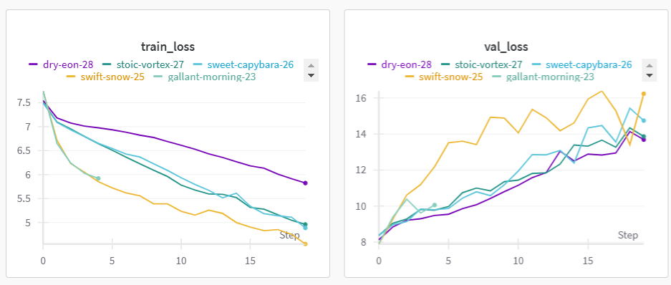
Project Progress & Outlook
Results & Milestones
-Activation Function Changes
Changed ReLU to Leaky ReLU in all layers
Still overfitting
Leaky ReLU helps with dying neurons, but it did not fix overfitting
-Additional Projection Layers Before Graph Convolution
Added extra linear layers before GraphConv in F1
Still overfitting
More parameters increased model capacity but did not address generalization.

Slide 15
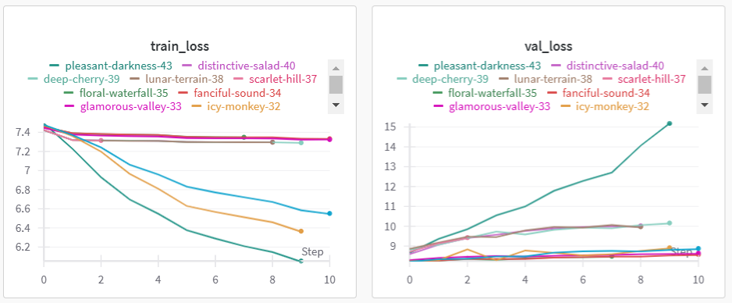
Project Progress & Outlook
Results & Milestones
-Adding Layer Norm & Dropout
Introduced Layer Normalization and Dropout.
Still overfitting, but slightly better.
Dropout prevents some overfitting but is not enough when the model is still learning correlations.
- Introducing GATConv
Added GATConv (Graph Attention) instead of basic GraphConv layers.
Overfitting decreased, but training loss stabilized.
Attention mechanisms selectively weight node neighbours
Helped reduce overfitting but did not improve training loss
The model still has poor regularization.

Slide 16
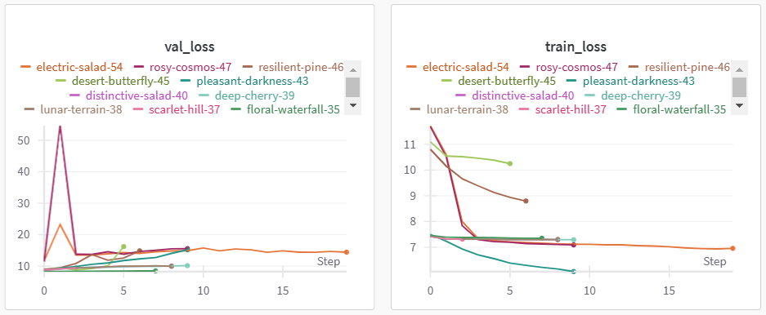
Project Progress & Outlook
Results & Milestones
-Contrastive Learning with CLIP Loss
Implemented contrastive CLIP loss. Total loss = CLIP loss+CE loss
Validation loss stabilized, training became very slow
Forced similar nodes closer and dissimilar ones apart
Helped regularize embeddings, but it needs tuning for better optimization
-Key issues and future improvements
Too many parameters
Insufficient regularization
Graph structure complexity
Graph augmentation – edge dropout and node masking
Applying contrastive learning in the first projection layers
Optimal loss scheduling

Slide 17
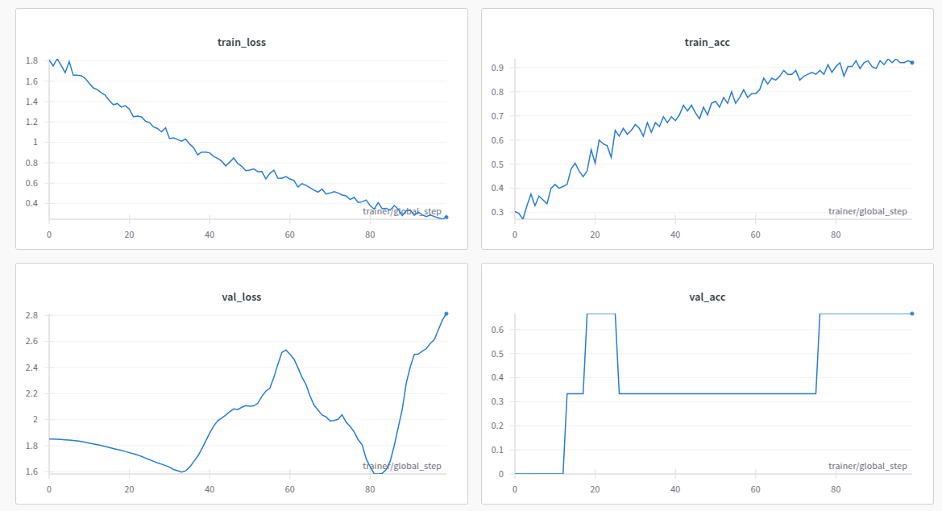
Project Progress & Outlook
Results & Milestones
Model Capacity Test
  100 training data, single layer projection, latent dim = 64

Slide 18
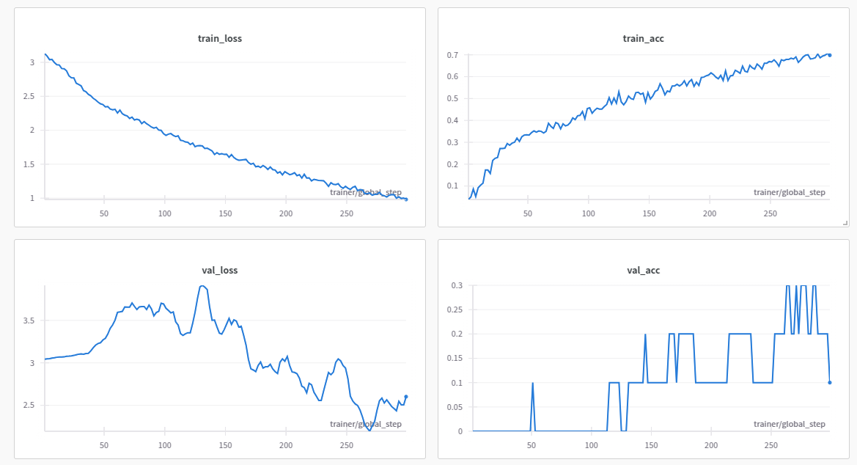
Project Progress & Outlook
Results & Milestones
Model Capacity Test
  500 training data, single layer projection, latent dim = 64

Slide 19
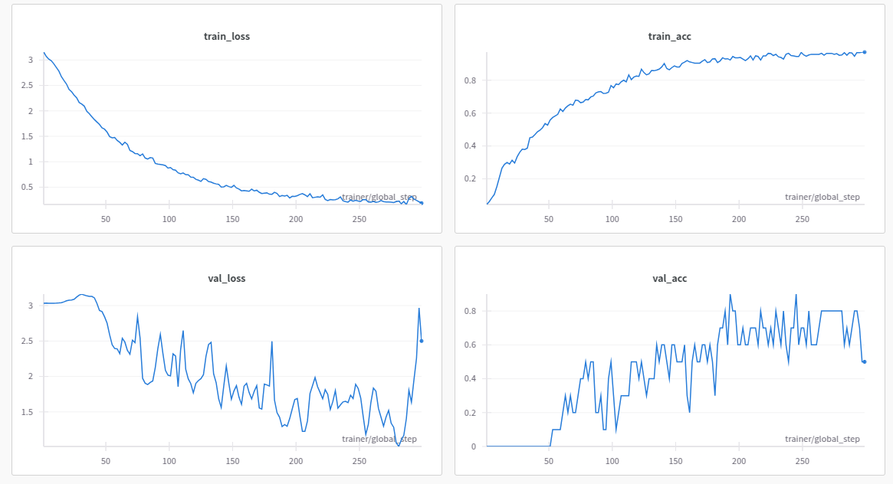
Project Progress & Outlook
Results & Milestones
Model Capacity Test
  500 training data, single layer projection, latent dim = 128

Slide 20
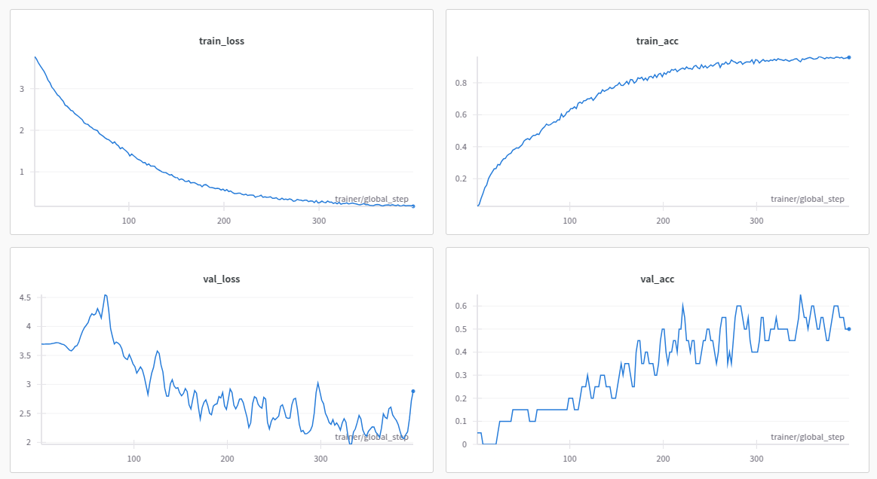
Project Progress & Outlook
Results & Milestones
Model Capacity Test
  1000 training data, single layer projection, latent dim = 128

Slide 21
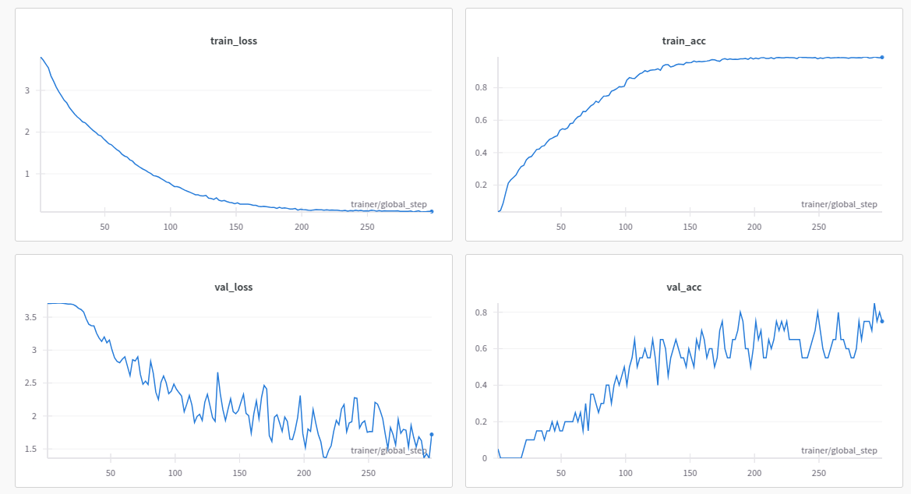
Project Progress & Outlook
Results & Milestones
Model Capacity Test
  1000 training data, three layers projection, latent dim = 128

Slide 22
Take-Home Messages & Feedback
Working with a complex dataset requires careful design
  More than 40k graphs and 2405 classes
Choice of the loss function is critical
  Loss function tailored to the dataset
More Face-to-Face meetings
  To improve better communication among team members
Ask questions at the right time
  To prevent delays and roadblockings

Slide 23
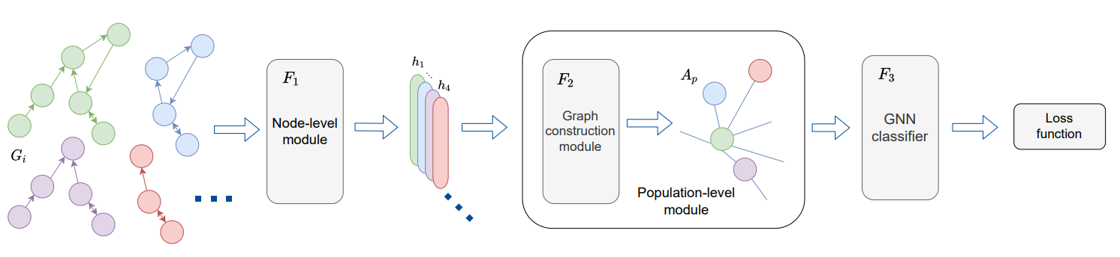
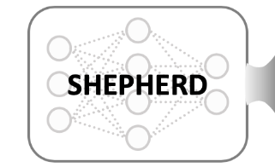
Conclusion
GiG architecture for true gene classification with 2405 classes
Main issues are overfitting, loss function selection and architecture configuration
Our work lays a foundation for unknown disease and gene patterns
Graph-based learning is challenging but it teaches a lot
Always start with small model with few dataset samples

Slide 24
Q&A
Thank you for your attention,
do you have any questions?

