Slide 2
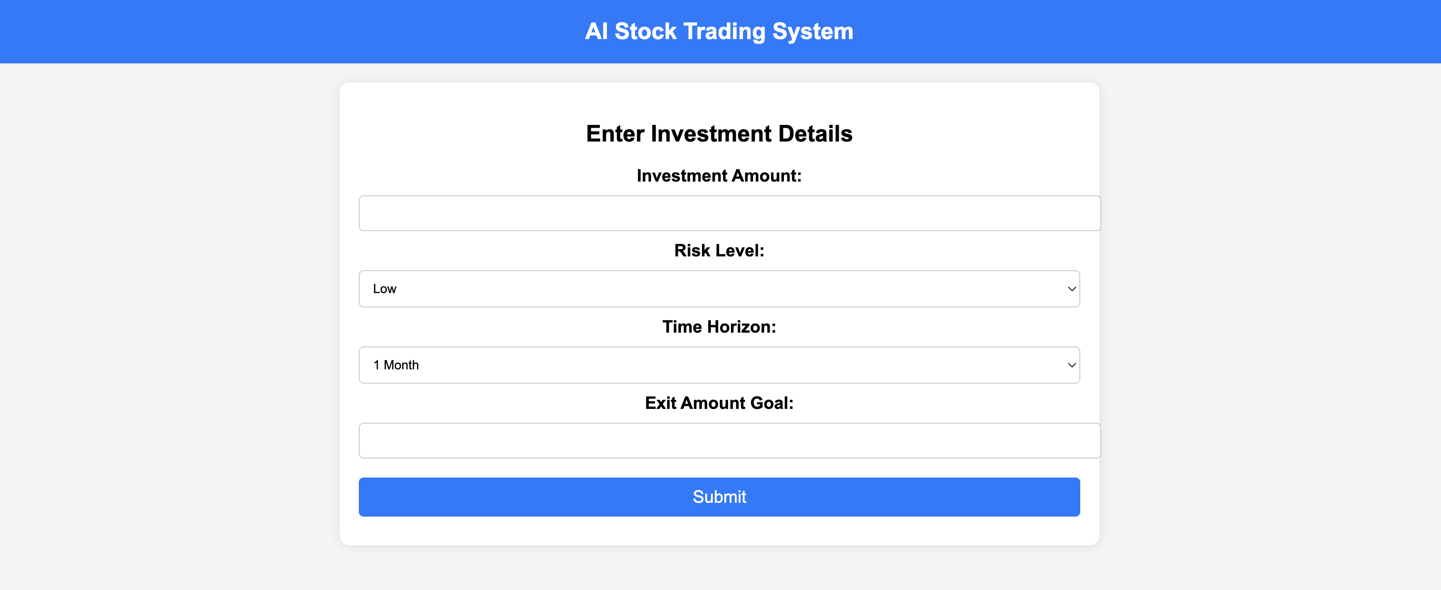
›
By Kaushik naidu
Graph of the stock chosen
Output detills of the stock and other relevant details

