Slide 1
Java期末專題--個人聯絡簿
ACS109151楊竣凱

Slide 2
Control
+verify:String +accouts:HashMap<String,String> +config:Config +dataManager:DataManager
+Control() :void +loadverify() :void +loadAllData() :void +doMainMenu:void +SetConfigMap():HashMap<String,String> +doMainMenu(boolean):void +doShowAll() :void +doShowByCatalog() :void +doShowPerPage() :void +ShowPerPage(int, int, String, int, boolean, boolean, boolean, boolean, boolean) +doSearch() :void +doModify() :void +doDelete() :void +doAddContact() :void +doAddCatalog() :void +doShowAllCatalog() :void +doSetDisplayField() :void +doSetViewPerpage() :void +doSetOrder() :void +doSetOrderByField() :void +doShowRawData() :void +doDataOptimize() :void +formatString(String, int):String +formatNumber(int, int):String +doLogin() :void +login(String, String):boolean +getLoginInfo() :void +getVerify() :String
DataManager
+peoples : ArrayList<People> +catalogs : ArrayList<Catalog> +config : Config
+load() :void +printAllPeople() :void +setorder() :void +getUnSortedList():ArrayList +getSortedList():ArrayList +getPeopleTitle(boolean, boolean, boolean, boolean, boolean) :String +loadCatalogs() :void +loadPeoples() :void +selectCatalog(boolean, boolean) :String +inputPeople(boolean) :String +getInput(String[], String[], String) :String +inputPeople() :String +checkName() :String +checkName(String) :String +checkPhone() :String +checkPhone(String) :String +checkCatalog() :String +checkCatalog(String) :String +checkEmail() :String +checkEmail(String) :String +checkBirth() :String +checkBirth(String) :String +getInput(String[]) :String +savePeople() :void +AddCat(String):boolean +checkDate(String):Boolean
Catalog
+name : String
Catalog(String)
Main
+scanner:Scanner +control:Control
Call Control function .
People
+id : int +name : String +birthday : String +phone : String +catalog : String +email : String
+People(String) +People(int, String, String, String, String, String) +People() +print(boolean, boolean, boolean, boolean, boolean):void +getRaw() :String

Slide 3
功能介紹

Slide 4
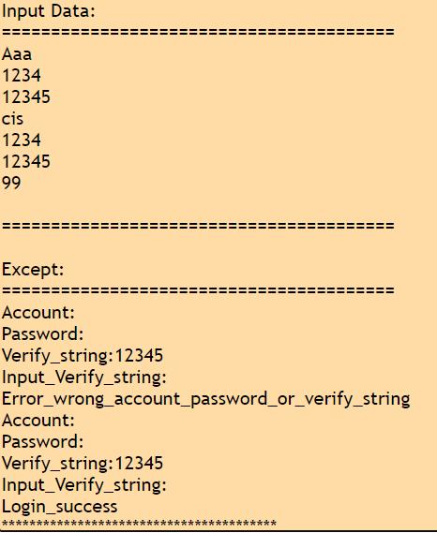
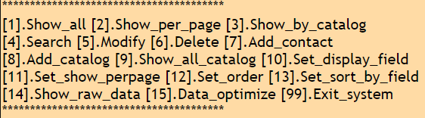
Login and MainMenu

Slide 5
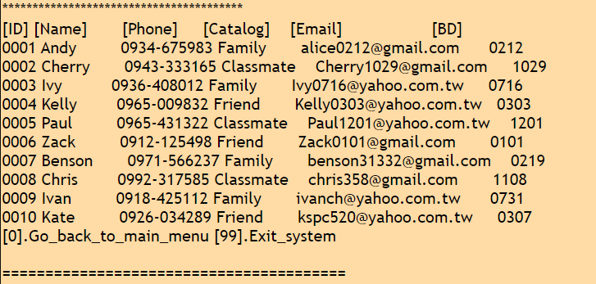
1.Show_All

Slide 6
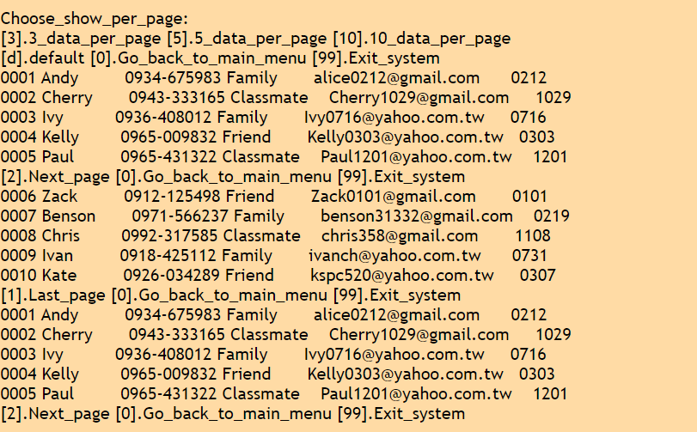
2. Show_per_page

Slide 7
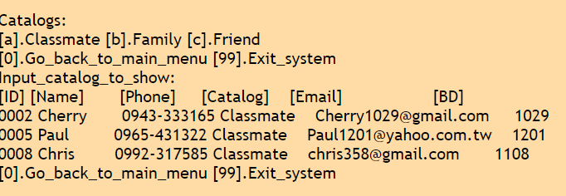
3. Show_by_catalog

Slide 8
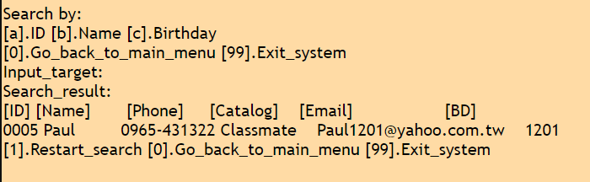
4. Search

Slide 9
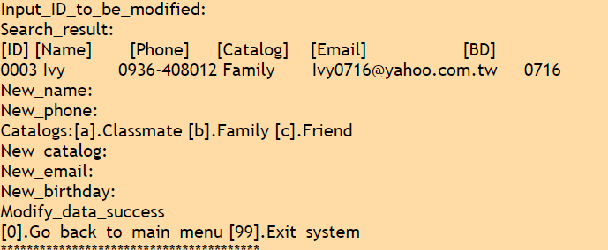
5. Modify

Slide 10
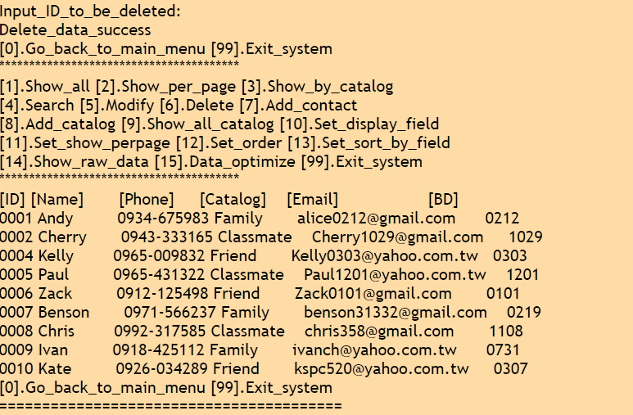
6. Delete

Slide 11
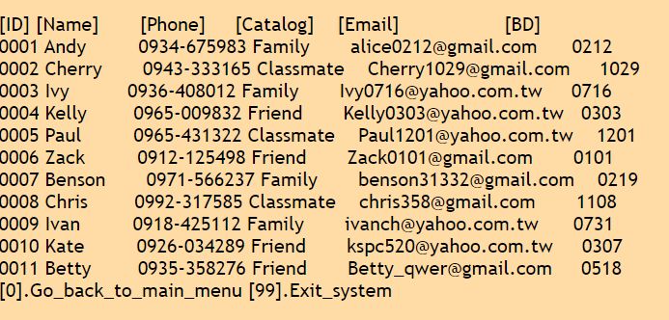
7. Add_contact and Check

Slide 12
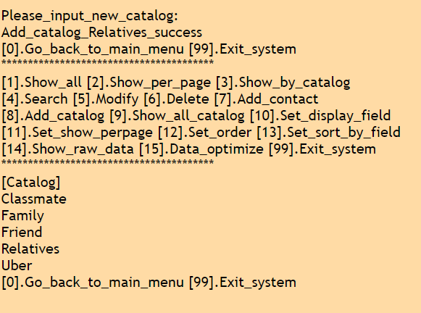
8. Add_catalog

Slide 13
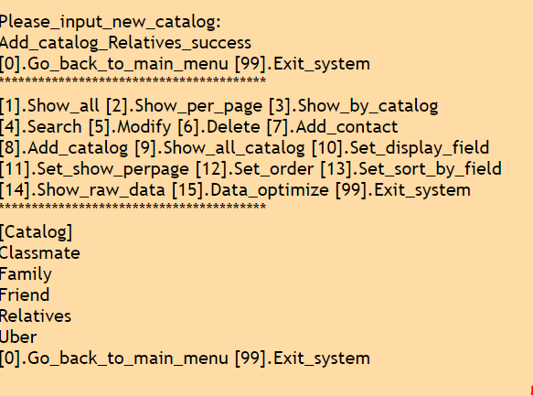
9. Show_all_catalog

Slide 14
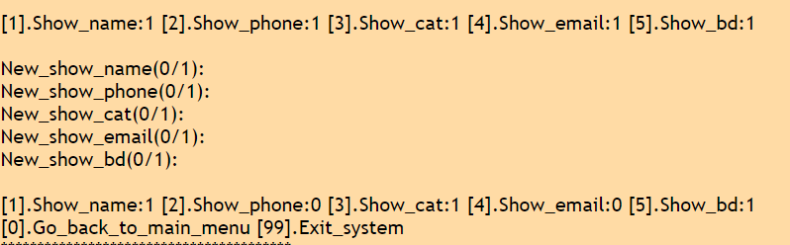
10. Set_display_field

Slide 15
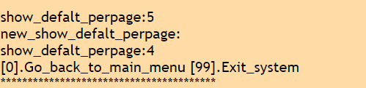
11. Set_show_perpage

Slide 16
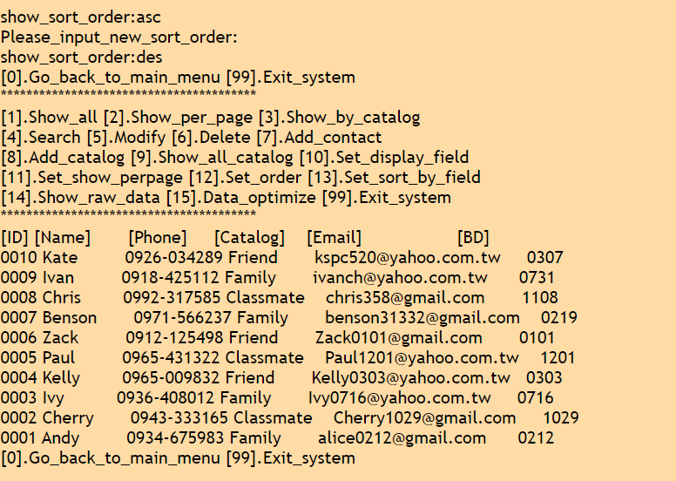
12. Set_order

Slide 17
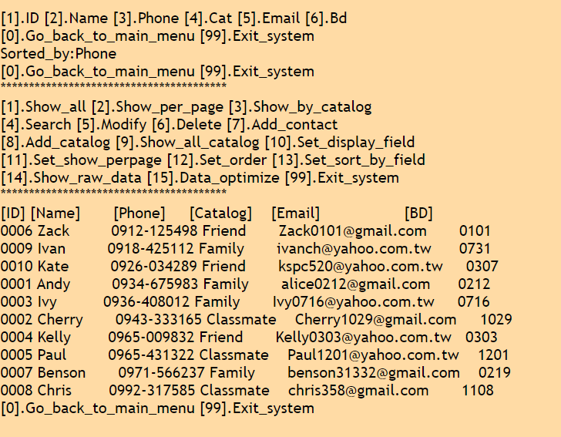
13. Set_sort_by_field

Slide 18
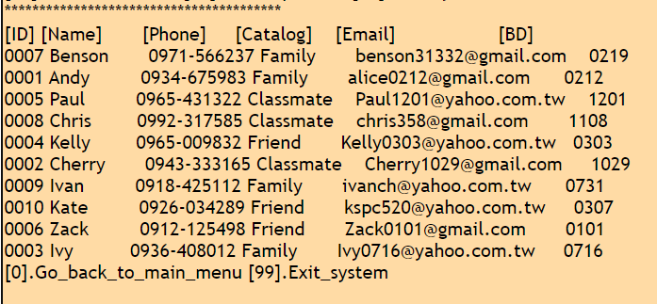
14. Show_raw_data

Slide 19
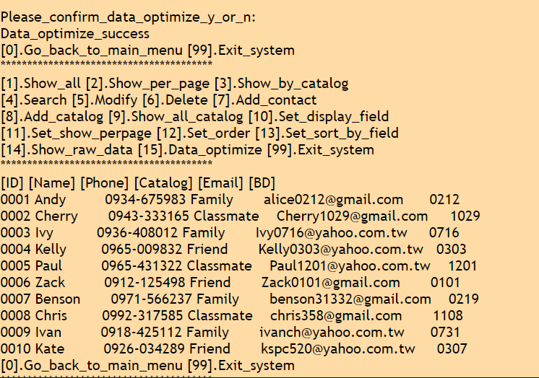
15. Data_optimize

