Slide 1
Rendez
vous
Replacing hours of fragmented research with your perfect shortlist — in minutes.
Plan the day you've imagined.
AI Wedding Concierge · Vancouver, BC · Build-A-Thon 2026

Slide 2
Wedding planning is broken.
⏱
💰
📋
🌍
Hours wasted
Opaque pricing
Fragmented tools
Zero personalization
Couples spend weekends browsing vendors only to find they're over budget or wrong for their needs.
88% of vendors hide real pricing. Couples spend $3,000 on venue tours before getting a single honest quote.
Planning lives across 6+ apps — Google Sheets, Pinterest, Instagram, email. Nothing connects.
Platforms assume a generic Western wedding. Cultural traditions, guest counts, and budgets are afterthoughts.
"78% of couples say pricing is the #1 factor when deciding which vendors to contact — yet 88% of vendors still hide their real prices."
— WeddingPro 2025 Real Weddings Vendor Report

Slide 3
A massive, underserved market.
$70B+
$8.5B
2.5M
$33K
Global wedding industry (2025)
North American market
US + Canadian weddings per year
Average Canadian wedding spend
Why now?
🤖
😤
📍
AI is ready
Couples are frustrated
Local first
LLMs now deliver genuinely useful planning guidance. The Knot just launched ChatGPT integration (Feb 2026) — validation the category is moving.
Reddit r/weddingplanning has 1M+ members — couples actively fleeing The Knot because of fake reviews and vendor-paid results.
A tightly scoped Vancouver launch (38 curated vendors) lets us prove the model before scaling — the exact opposite of what incumbents do.

Slide 4
Rendezvous: a concierge, not a directory.
Instead of browsing thousands of vendors, couples answer 4 questions. Rendezvous does the rest — matching vendors by budget, guest count, style, and cultural requirements, then generating a photorealistic vision of their ceremony.
1
2
3
4-Question Intake
→
AI Matching Engine
→
Vision Board + Dashboard
Date, location, guests, budget, style, cultural requirements
Scores 38 Vancouver vendors across budget, capacity, style, setting & culture
AI-generated ceremony scene + ranked vendor shortlist + budget planner
The result: your personalized wedding shortlist in under 5 minutes — instead of 5 weekends.

Slide 5
Live Demo
— or pre-recorded walkthrough —
① Couple fills in 4-step intake (date, location, guests, budget, style)
② AI generates a photorealistic vision board of their ceremony in real-time
③ Per-category budget sliders — adjust spending → scene regenerates
④ Ranked vendor shortlist: 38 Vancouver vendors scored to their profile
⑤ Each card shows: price range · capacity · setting · catering · LGBTQ+ friendly · Google rating
rendezvous.vercel.app

Slide 6
Why Rendezvous wins.
The Knot / WeddingWire
Zola / Joy
Rendezvous
Pricing shown upfront
✗ Vendors opt-in only
✗ Not applicable
✓ Core feature
Intake-driven recommendations
✗ Browse-and-filter
✗ No matching engine
✓ Budget + guests + culture
Multicultural vendor tags
✗ Not supported
✗ Not supported
✓ Cultural matching
Vendor-pays conflict
✗ Reviews suppressed
— (no marketplace)
✓ No vendor advertising
AI vision board
✗ No
✗ No
✓ gpt-image-1 scene
Incumbents are vendor marketplaces with planning tools bolted on. Rendezvous is a couple-first concierge.

Slide 7
Business model.
Charge couples. Earn vendor trust first.
Phase 1 Now
Phase 2 6–12 months
Phase 3 12 months+
Couples — one-time unlock
Vendor referral (gated intro)
Planner white-label (B2B)
~$49
$50–200 per lead
$200–500 /month
Free: intake + shortlist + 1 vision board Paid: AI chat, unlimited regenerations, PDF export, full comparison view
Vendors pay per qualified introduction. Ranking stays purely by match score — not by who paid more.
Wedding planners embed Rendezvous intake + matching on their own sites. Low CAC, recurring SaaS revenue.
Key principle: vendor ranking is NEVER for sale. Couples trust Rendezvous because their interests always come first.

Slide 8
What we built. What's next.
Built in 6 weeks
Go-to-market: Vancouver first
✓ Full SPA — landing, intake wizard, dashboard
Now
Launch MVP · 38 vendors · organic SEO
✓ 38 curated Vancouver vendors, fully enriched
Month 1–3
Vancouver bridal expos + Reddit communities
✓ AI scoring engine (budget × capacity × style × setting × culture)
✓ Real-time AI vision board via OpenAI gpt-image-1
Month 3–6
SEO content ("best outdoor venues Vancouver under $30k")
✓ Interactive budget planner — sliders regenerate the scene
Month 6–12
Paid unlock · first revenue · expand vendor count
✓ Deployed live on Vercel
Year 2
Add cities (Toronto, Calgary) · vendor referral program

Slide 9
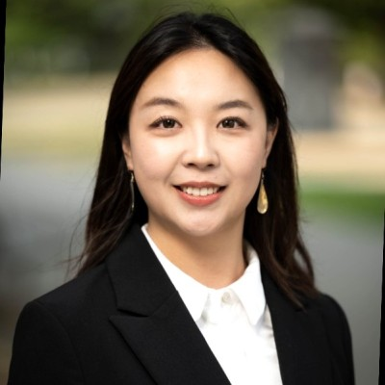

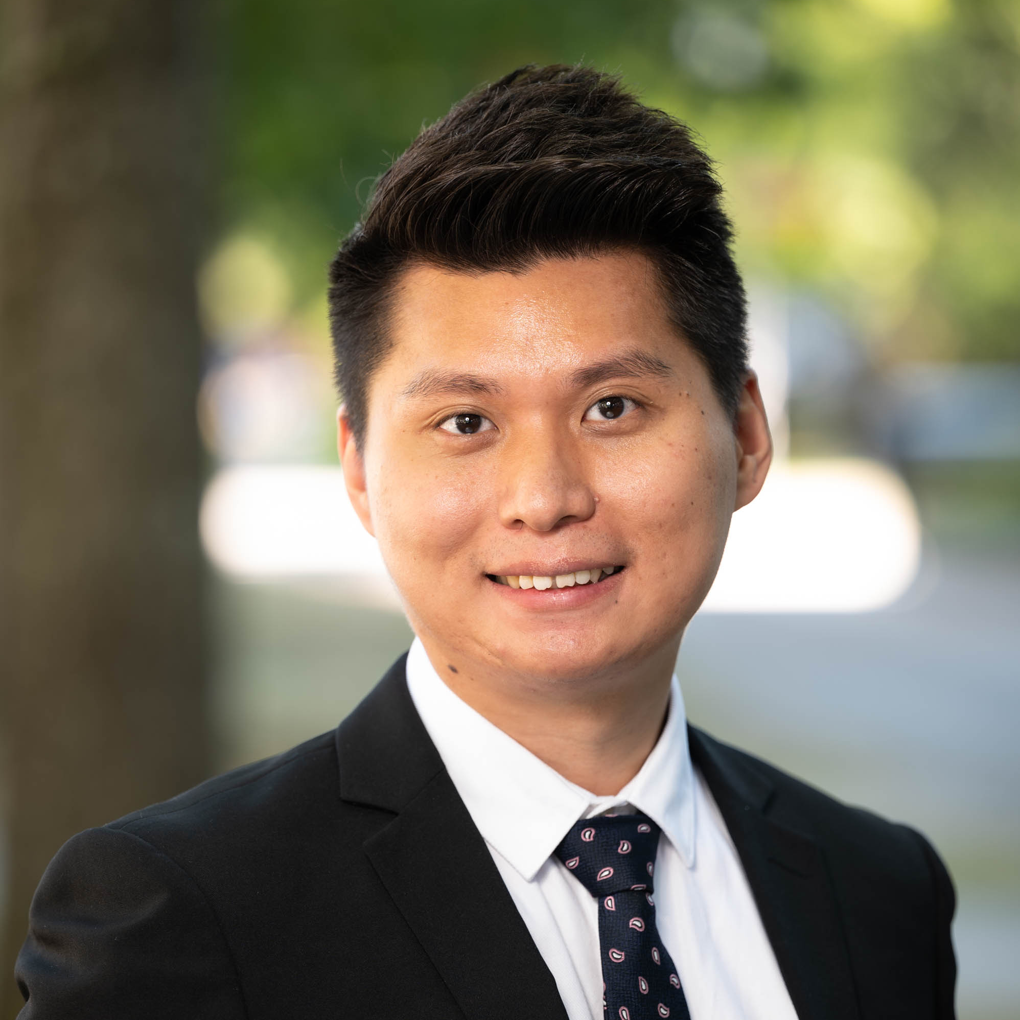
The team.
👤
👤
Maggie Yang
Yelin Fan
Kai Li
CEO & Product
Developer
Developer & Business Development
Former AI Product Manager at Huawei, where she owned search and analytics platforms across international markets — driving +47% DAU and +107% CTR. MBA from UBC Sauder and Master's from Columbia. Recently planned two 150-guest weddings and lived every pain point this product solves.
Data scientist and engineer with expertise in machine learning, analytics, and full-stack development. Master of Business Analytics from UBC Sauder, B.Sc. from McGill. 4+ years as Senior Analyst at PHSA and former Senior Business Analyst at TELUS Health, building data-driven systems at scale.
Business analyst with a background in event management and large-scale event operations. Master of Business Analytics from UBC Sauder and Master's from Columbia. Strong in Python, BI, and rapid prototyping. Co-planned two 150-guest weddings — and decided no couple should have to do it without better tools.

Slide 10
When you get engaged, open Rendezvous first.
We're building the default starting point for wedding planning — putting couples first from the very first search.
5 min
38
$0
to a personalized shortlist
Vancouver vendors — ready now
vendor advertising — ever
Rendezvous · Build-A-Thon 2026

