Slide 1
Version Control and Git/Hub
May 23, 2024

Slide 2

Andy: You know, we should really put our code on GitHub
Steph: Git what?
Andy: GitHub, largest code sharing platform on the web?
Steph: So like Facebook?
## Andy shows Steph website
Steph: I like the octocat…

Slide 3





Slide 4
Outline
Why version control?
Setting up our first repository
Sharing through GitHub
The BCGov GitHub Organization
Course notes can be found at: https://bcgov.github.io/ds-intro-to-git

Slide 5
Workshop Code of Conduct
We aim to make this a welcoming and supportive environment for everyone, regardless of background
We encourage respectful discussion and questions throughout the course
Be fully present and engaged during the session (that email can wait!)
Notes:
Sw carpentry url coc
Include talk about how teaching virtual is hard – never taught this one before virtually (have taught variants before) – stick with us!

Slide 6
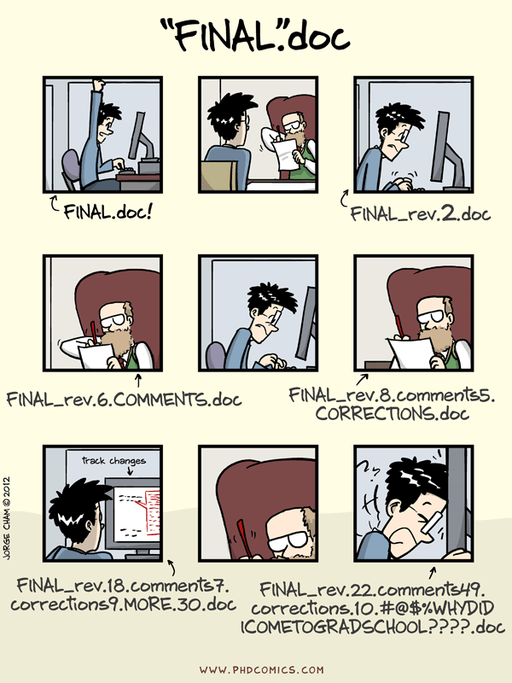
Notes:
We’ve all been in this situation before: it seems ridiculous to have multiple nearly-identical versions of the same document – either by yourself, or spread around among colleagues.
It’s difficult to tell the difference between files, and what was changed when, by whom, and why?

Slide 7
Why Should BC Stats adopt this?

Slide 8

Notes:
Enter version control. A version control system is a tool that keeps track of changes for us. There are several options; we are going to talk about git. It keeps track of snapshots in time - You decide which changes make up the each snapshot, and git stores those changes and keeps useful metadata about them.
You store all of your project files in a folder.
All of the files, plus the complete history for all the files in a that folder make up a repository (repo).
Repositories can be kept in sync across different computers facilitating collaboration among different people.

Slide 9

Repository
|── wes-analysis
| |── data
| │ |── wes-results
| │ │ |── wes-results-2019.csv <-- DON'T WORRY, THESE WON'T BECOME PUBLIC!
| │ │ |── wes-results-2020.csv
| │ │ |── wes-results-2021.csv
| │ | |── wes-results-2022.csv
| |── doc
| |── ref
| │ |── references
| │ |── images
| |── plots
| |── code
| |── .git <------------------------ THIS MAKES IT A GIT REPOSITORY!
Notes:
Git keeps track of snapshots in time – each document or file starts with a base version and then git saves just the changes you made at each step of the way.
You decide which changes make up the each snapshot, and git stores those changes and keeps useful metadata about them.
Each snapshot is called a ‘commit’.
You store all of your project files in a folder.
All of the files, plus the complete history for all the files in a that folder make up a repository (repo).
You can revisit (rewind to) any of those stages, or commits, along the way.

Slide 10

Changes saved sequentially
Commit
Commit
Base Version
Notes:
Git keeps track of snapshots in time – each document or file starts with a base version and then git saves just the changes you made at each step of the way.
You decide which changes make up the each snapshot, and git stores those changes and keeps useful metadata about them.
Each snapshot is called a ‘commit’.
You store all of your project files in a folder.
All of the files, plus the complete history for all the files in a that folder make up a repository (repo).
You can revisit (rewind to) any of those stages, or commits, along the way.

Slide 11
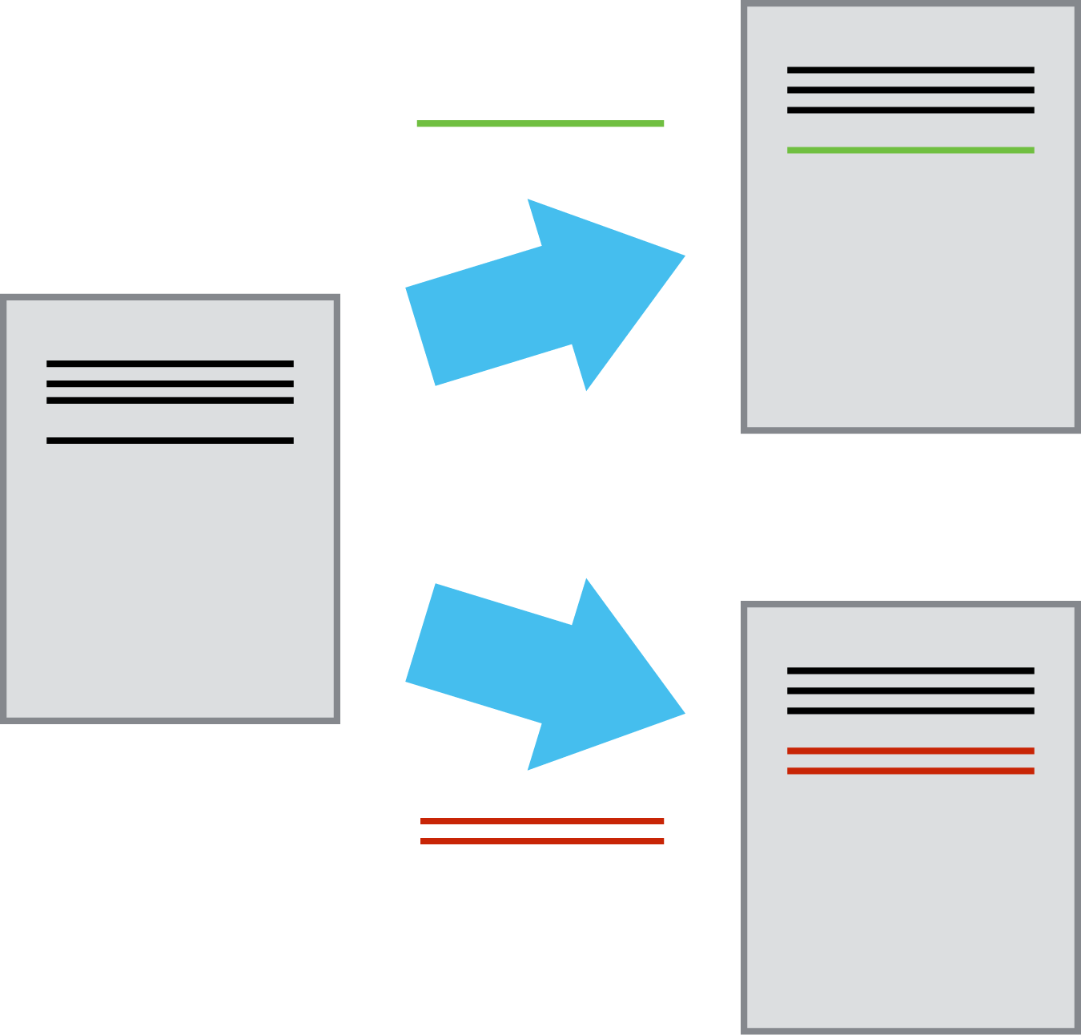
Branching
Notes:
Go off on a different track and work on it independently while keeping the master copy intact.
When it's working you can merge that work back into the original. If not, throw it out.

Slide 12
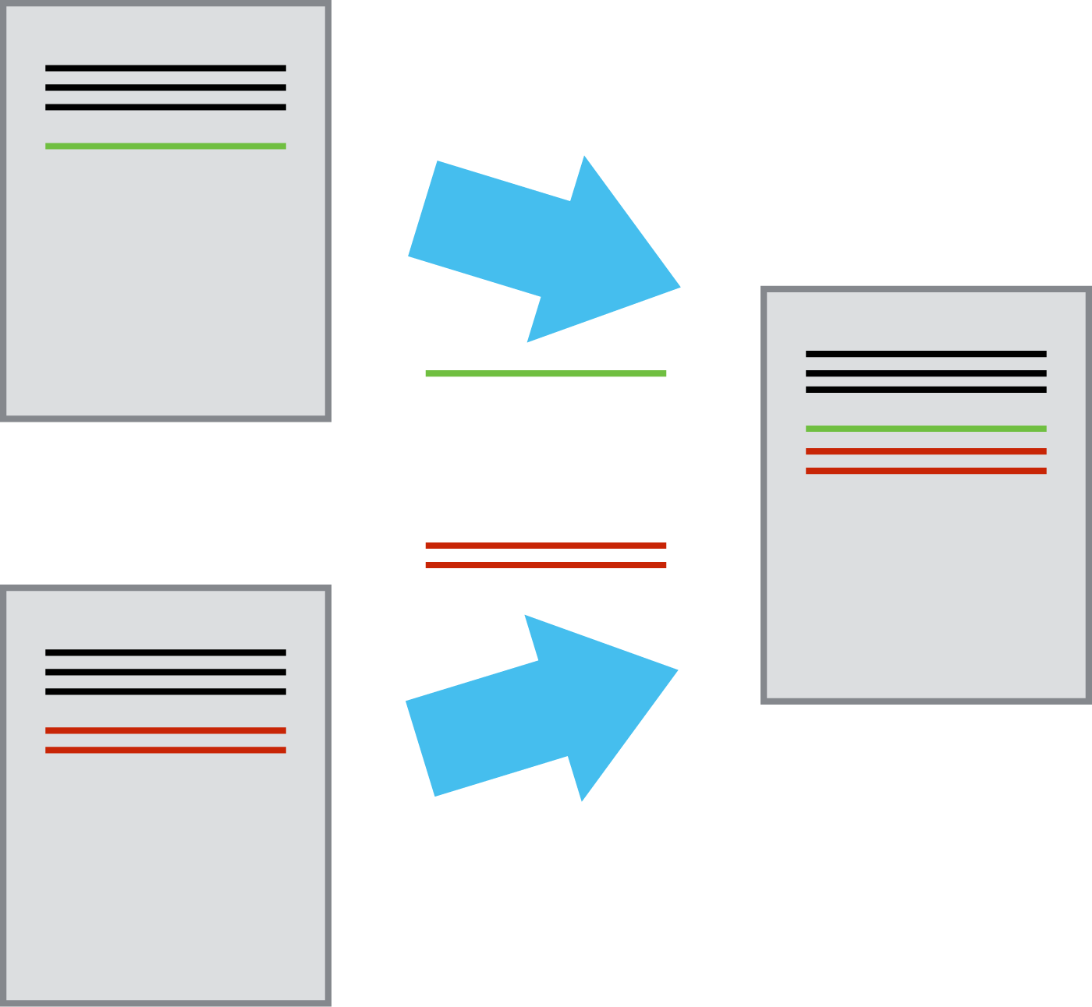
Collaborating
Multiple users: different people work on their own copy
Compare and merge contributions from multiple people
“Remote Copy”
Notes:
Introduce concept of remote
Documents/Repositories can be kept in sync across different computers facilitating collaboration among different people.

Slide 13
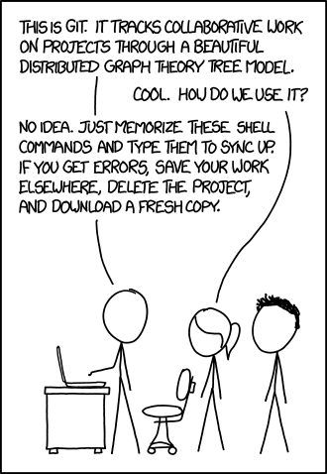
Burn It Down
“This is a highly inelegant, but effective technique for disaster recovery”
- Jenny Bryan (RStudio, UBC)
Notes:
Allows fearless experimentation without worrying about breaking your code

Slide 14

Jargon
Repository (repo)
Stage/Add
Commit
Push
Pull
Clone
Branch
Fork
Notes:
Read definition – necessary evil to use the tools

Slide 15
Create our first repository!
Notes:
Let’s make our first repository

Slide 16
bash jargon
$ cd path/to/directory # Go to specified directory - "quotes" are needed if there are spaces
$ cd .. # Go up one directory level
$ mkdir new_directory # Create specified directory
$ ls # List directories and files
$ ls -a # List directories and files, including hidden

Slide 17
git jargon
$ git init # initiate a repository in the current directory
$ git status # indicate if there are any changes to files
$ git add <filename> # add a new file/change to the staging area
$ git commit –m “commit message” # commit all changes to the repository
$ git log # view commit history

Slide 18
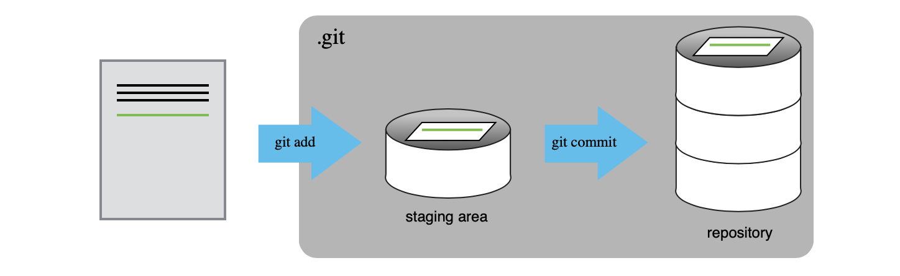
The Staging Area

Slide 19

GitHub
Hosting service for git repositories
Greatly facilitates collaboration
Git: Version Control
+
Hub: Centralized repos &
networking/collaborating
Notes:
GitHub is a platform that hosts Git repositories in the web and provides a web interface to interact with repos.
Main Function is to host the ‘remote’ or main copy of a git repository (project)

Slide 20

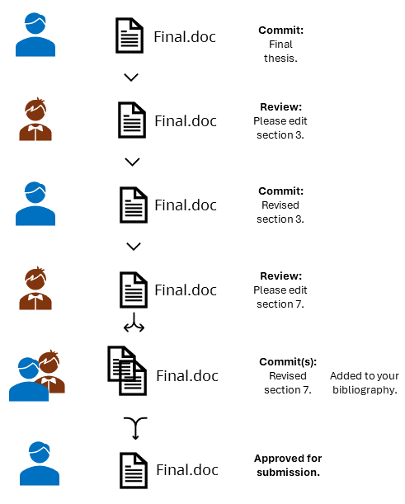
Notes:
Version control really comes into its own when we begin to collaborate with other people. We already have most of the machinery we need to do this; the only thing missing is to copy changes from one repository to another.

Slide 21
Create a remote repository
Notes:
Let’s make our first repository

Slide 22
A Collaborative Workflow
git init
git add mars.txt
git commit –m “first commit”
Original Repository
|── planets
| |── mars.txt
| |── .git
Initial repository set up

Slide 23
A Collaborative Workflow
done on GitHub
Original Repository
|── planets
| |── mars.txt
| |── .git
GitHub Repository
|── planets
| |── .git
Initial repository set up
Remote repository created

Slide 24
A Collaborative Workflow
git push –u origin main
Original Repository
|── planets
| |── mars.txt
| |── .git
GitHub Repository
|── planets
| |── mars.txt
| |── .git
Initial repository set up
Remote repository created
Local changes pushed to remote

Slide 25
A Collaborative Workflow
git clone <repo-url>
Original Repository
|── planets
| |── mars.txt
| |── .git
GitHub Repository
|── planets
| |── mars.txt
| |── .git
Cloned Repository
|── planets
| |── mars.txt
| |── .git
Initial repository set up
Remote repository created
Local changes pushed to remote
Remote repository cloned by collaborator

Slide 26
A Collaborative Workflow
git add pluto.txt
git commit –m “add pluto”
Original Repository
|── planets
| |── mars.txt
| |── .git
GitHub Repository
|── planets
| |── mars.txt
| |── .git
Cloned Repository
|── planets
| |── mars.txt
| |── pluto.txt
| |── .git
Initial repository set up
Remote repository created
Initial repository set up
Remote repository created
Local changes pushed to remote
Remote repository cloned by collaborator
Collaborator makes additions

Slide 27
A Collaborative Workflow
git push
Original Repository
|── planets
| |── mars.txt
| |── .git
GitHub Repository
|── planets
| |── mars.txt
| |── pluto.txt
| |── .git
Cloned Repository
|── planets
| |── mars.txt
| |── pluto.txt
| |── .git
Initial repository set up
Remote repository created
Initial repository set up
Remote repository created
Local changes pushed to remote
Remote repository cloned by collaborator
Collaborator makes additions
Collaborator updates remote with changes

Slide 28
A Collaborative Workflow
git pull origin main
Original Repository
|── planets
| |── mars.txt
| |── pluto.txt
| |── .git
GitHub Repository
|── planets
| |── mars.txt
| |── pluto.txt
| |── .git
Cloned Repository
|── planets
| |── mars.txt
| |── pluto.txt
| |── .git
Initial repository set up
Remote repository created
Initial repository set up
Remote repository created
Local changes pushed to remote
Remote repository cloned by collaborator
Collaborator makes additions
Collaborator updates remote with changes
Collaborator changes pulled back to original

Slide 29
Ignore data files! .gitignore
Notes:
Also not the artifacts (.Renviron, .ipynb, html/ppt/docx)

Slide 30
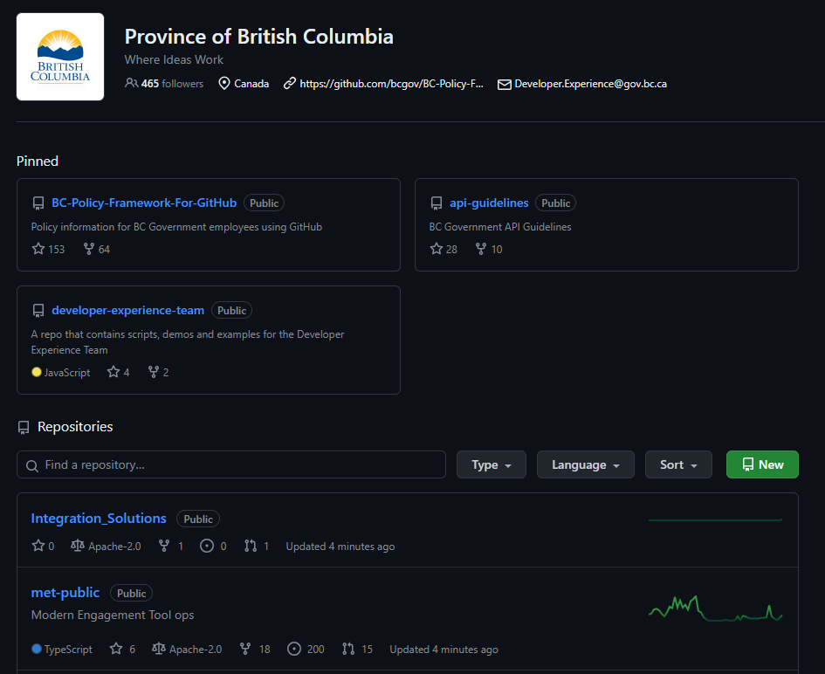
https://github.com/bcgov
Notes:
Efforts and leadership from the OCIO and the BCDevExchange team resulted in a BCGov Org in GitHub, established in early 2014.

Slide 31
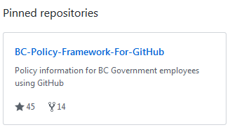
BC-Policy-Framework-For-GitHub
Joining
Opening & Contents of Repositories
Licensing
Privacy, Security, Copyright
Appropriate Use
How to’sC
Notes:
(SLH)

Slide 32
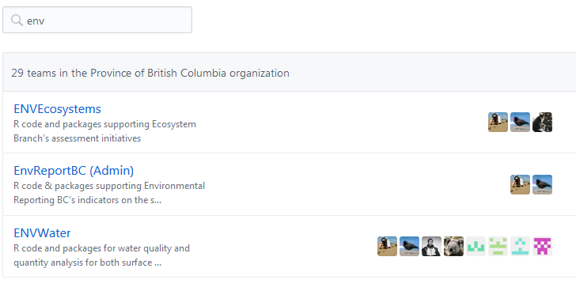
Joining
GitHub account with bcgov email address
Enable 2-Factor Authentication
Join the BCGov Organization & appropriate team(s)
Notes:
(SLH)

Slide 33
OPEN CODE CHECKLIST
Your Code & GitHub?
New code
Existing code (you, contractor?)
Contributing to other’s code
Privacy
Copyright
Intellectual Property
Security
Notes:
(SLH)
Can my code go into GitHub? Things to consider -- why we have a checklist.
Less steps to start new, but fine to publish too.

Slide 34
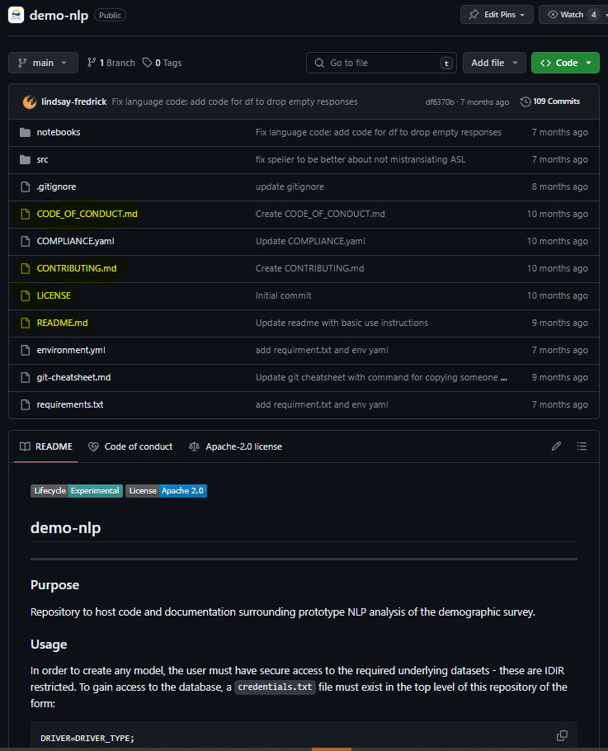
Repo Content
Notes:
(SLH)
3 Mandatory files:
LICENSE
README – what is in this project
Contributing – encourage government employees, public and members of the private sector are encouraged to contribute to the repository and how to do that
To foster a kind, inclusive, cooperative, and harassment-free open source BCGov community -> Optional Code-of-Conduct.
Open Source space in general has had its struggles with conduct and one approach to improving this is establishing clear code of conduct for open source projects. Most often this is a statement around fostering an open, safe, welcoming, and respectful inclusive community for all.

Slide 35

Licensing 1-2-3
BCGov default for code == Apache License 2.0
LICENSE file directly in the repository
2.0 LICENSE boiler-plate to the bottom of your README.md
LICENSE boiler-plate to the comments header of every source code file
Notes:
(SLH)

Slide 36
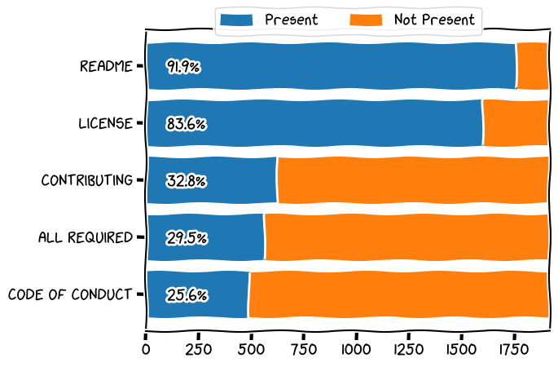
BCGov Org Stats
Notes:
(SLH)

Slide 37

Appropriate Use
e.g. standards of conduct, social media guidelines
Avoid any conflicts of interest
Notes:
(SLH)

Slide 38
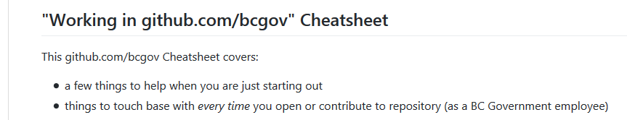

"Working in github.com/bcgov" Cheatsheet
https://github.com/bcgov/BC-Policy-Framework-For-GitHub/blob/master/BC-Gov-Org-HowTo/Cheatsheet.md
Notes:
(SLH)
Most of the content in this talk is summarized in a new “Working in BCGov GitHub” cheatsheet
Includes a list of learning resources for Git & GitHub

