Slide 1
Sentiment Analysis of Tweets Directed at Apple & Google Products
Harnessing customer insights from social media
Group 3-Phase 4 Project
Members: Irene, Luciana, Erastus, Benson, Akwabi, Sydney

Slide 2
Contents
Executive Summary
High-level overview of the project, key results, and business value.
Business Objectives
Define the problem &project Objectives
Data Understanding
Explore dataset size, structure, missing values, and sentiment class distribution..
Exploratory Data Analysis
Visualize tweet lengths, class imbalance, word frequencies, and brand-level sentiment trends.
Modelling & Evaluation
Models: Logistic Regression, Naïve Bayes, Random Forest, XGBoost.
Conclusion & Recommendations
Key findings and actionable insights.
3
4
5
6
8
13

Slide 3
Executive Summary
Built a sentiment analysis model for Apple & Google tweets.
Regression delivered the best performance (~84% accuracy).
Strong on Positive detection, weaker on Negative due to imbalance.
Provides a foundation for real-time brand monitoring and insights.
Next: improve Negative detection, deploy as dashboard/API, expand scope.

Slide 4

Business Context & Objectives
Project Objectives
Automate Sentiment Detection – Classify tweets as positive, negative, or neutral in real time.
Problem Statement
Customers constantly share opinions on Twitter, but the volume and noise make manual monitoring impossible. Without automation, businesses risk missing early warnings of negative sentiment, overlooking positive advocacy, and losing actionable insights. A sentiment analysis model enables real-time classification of tweets, empowering proactive reputation management and data-driven decisions.
Enhance Brand Monitoring – Track how customers perceive Apple & Google products across Twitter.
Identify Actionable Insights – Highlight negative feedback for rapid response and improvement.
Support Strategic Decisions – Provide data-driven insights to inform marketing and product strategy.

Slide 5
Data Understanding and Preparation
Data Set Overview
9,000+ labeled tweets from CrowdFlower dataset.
Sentiment classes: Positive, Negative, Neutral/Unclear.
Imbalance: Neutral dominates (~60%).
Tweets are short, noisy, and contain slang/hashtags.
Data Cleaning
Dropped 1 null tweet
Ignored brand metadata (~5,800 missing)
Label Consolidation
4 classes → 3 classes (Positive, Negative, Neutral)
Neutral = No emotion + I can’t tell
Text Preprocessing
Lowercasing
Remove URLs, hashtags, mentions
Remove punctuation, numbers, stopwords
Lemmatization
Modeling Readiness
Labels encoded numerically
80/20 train-test split (stratified)
Methodology
Preprocessing: clean tweets (remove URLs, mentions, stopwords).
Feature Extraction.
Models: Logistic Regression, Naïve Bayes, Random Forest, XGBoost.
Class balancing: Oversampling of minority classes.

Slide 6
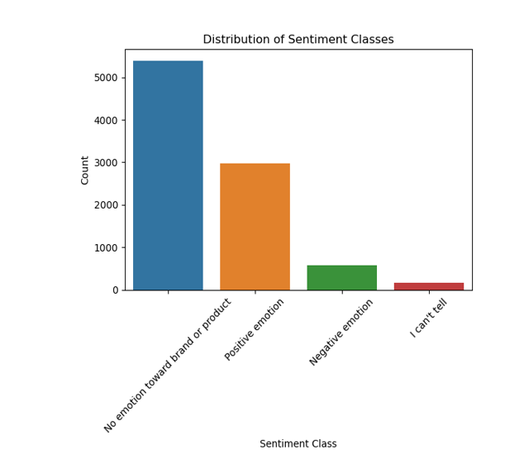
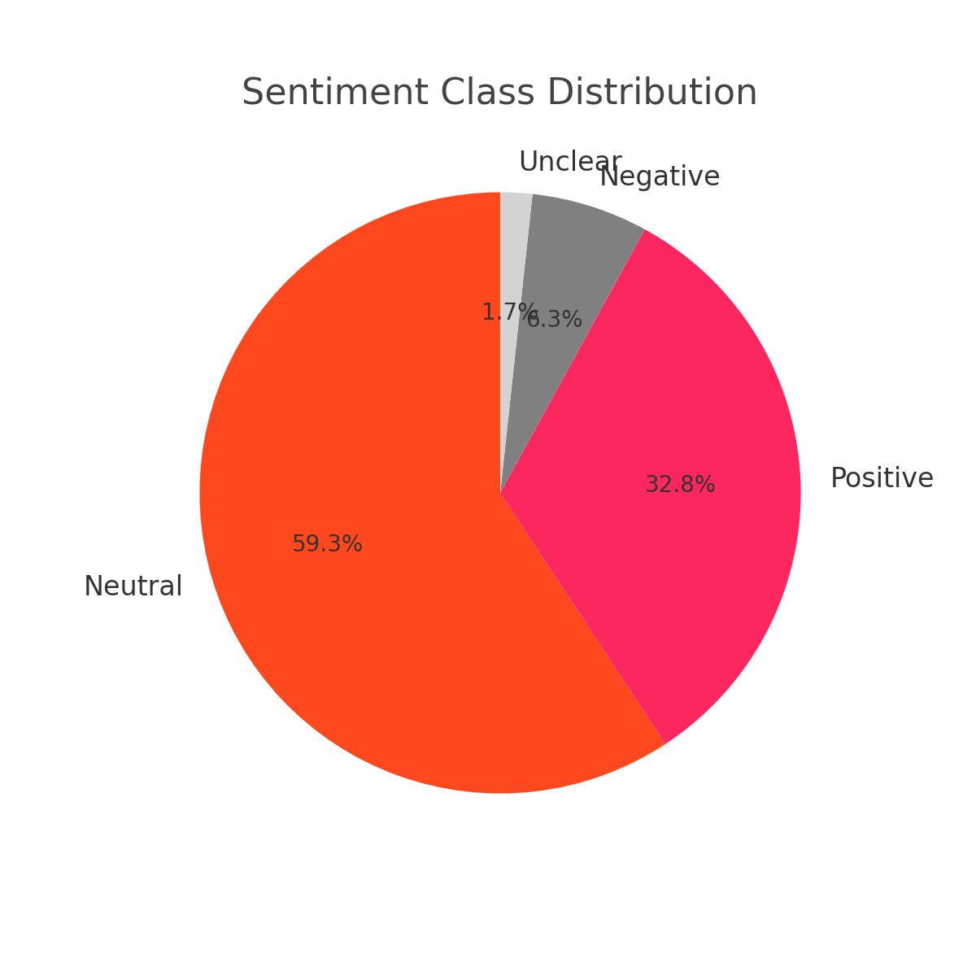
Exploratory Data Analysis -EDA
Overview
Neutral dominates (~60%), Positive ~33%, Negative ~6%.
Negative underrepresented → detection harder.

Slide 7
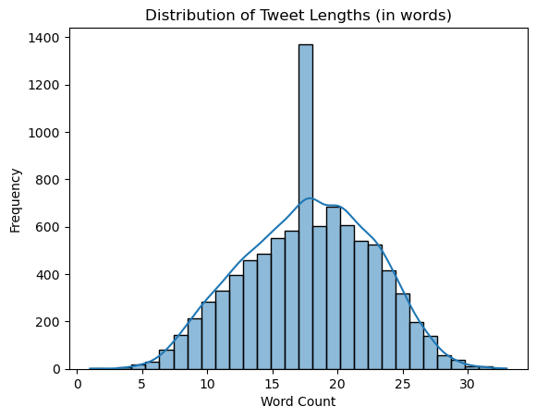
Exploratory Data Analysis -EDA
Data Set Overview
Most tweets fall between 5–25 words.
Reflects short, noisy nature of Twitter data.

Slide 8
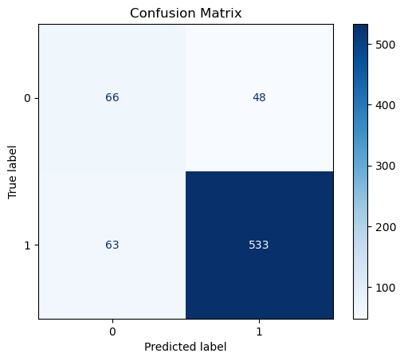
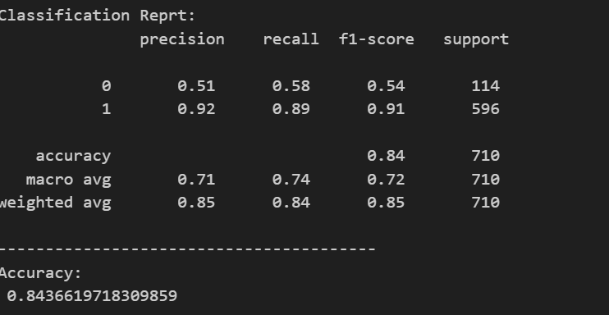
Modelling For Binary Data
Overall accuracy: 84%
Strong on Positive detection (92% precision, 89% recall).
Weak on Negative detection (51% precision, 58% recall).
Risk: Some negative tweets are missed improvement needed

Slide 9
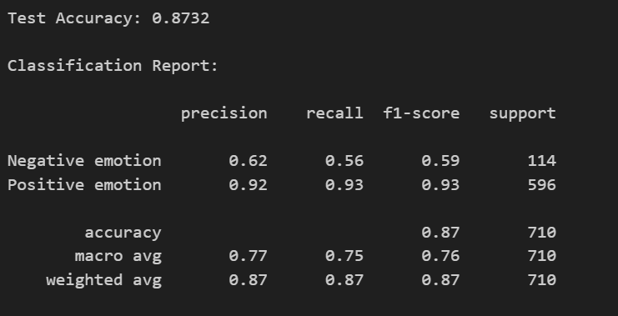
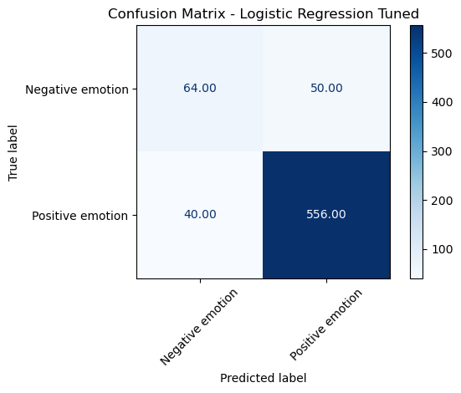
Modelling For Multiclass Data
Accuracy = 68%
Per-Class Metrics
Negative: F1 = 0.43 → weakest, poor precision/recall due to low support (114).
Positive: F1 = 0.61 → moderate, fair balance of precision/recall (596 examples).
Neutral: F1 = 0.74 → strongest, benefits from majority class size (1109 examples).

Slide 10
Model Comparison
Model Benchmarking for the Binary Data
Cross-validation performed across models.
Logistic Regression performed best (Baseline F1 ~0.71).
Tuned model achieved ~87% accuracy.
Visualization: Logistic Regression outperformed others
Cross-validation performed across models.
Best model achieved ~68% accuracy.
Neutral class showed strongest performance (F1 ~0.74).
Model struggled with minority classes, especially Negative (F1 ~0.43).
Visualization: performance skewed toward Neutral due to class imbalance.
Model Benchmarking for the Multiclass Data

Slide 11
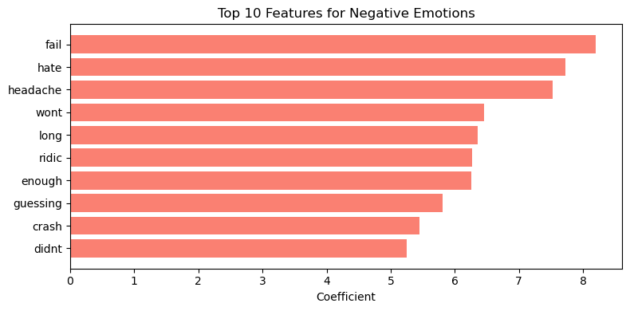
Features Driving Negative Emotions
'fail','hate’,’headache' drive negative classification.

Slide 12
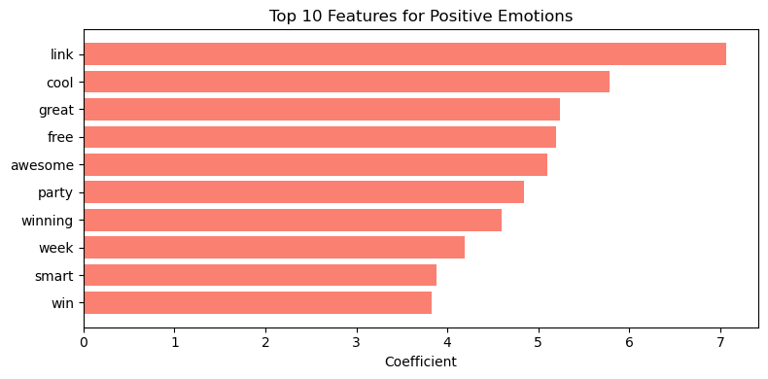
Feature Driving Positive Emotions
'link',’cool’,’great' drive positive classification.

Slide 13
Real-Time Dashboard: Logistic Regression (~87% accuracy) can power a live dashboard for Marketing/Comms with trend alerts and CRM integration.
Product Feedback: Negatives = crashes & usability; Positives = features & freebies. Fix recurring issues, build on positives.
Customer Engagement: Track negative keywords (fail, hate, crash) and trigger alerts for proactive support.
Marketing Leverage: Amplify positive tweets (cool, great, awesome) via retweets, testimonials, influencer/hashtag campaigns.
Class Imbalance: Neutral dominates (~60%), Negative underrepresented (~16%). Add more labeled data and diversify sources (forums, app reviews).
Model: TF-IDF + Logistic Regression, Accuracy ~84%, F1 = 0.87.Strong on Positive sentiment, weak on Negative due to imbalance.Next: Improve Negative detection (SMOTE, deep learning), deploy dashboard/API, expand to other brands, integrate CRM alerts.
Conclusion
Key Insights & Recommendations
Key Insights
Negative emotion signals: fail, hate, headache.
Positive emotion signals: link, cool, great.
Model strong on Positive and weaker on Negative class
Recommendations

Slide 14
Model Deployment
Link to the model: https://group-3-project-app-46ae69b19de0.herokuapp.com/

Slide 15
Thank You!
erastus@gmail.com lucianandanu9@gmail.com
irenekibengo@gmail.com
bensonmwihia@gmail.com
danakwabi@gmail.com
sydneywere563@gmail.com

