Slide 1
Sentiment Analysis of Tweets Directed at Apple & Google Products
Harnessing customer insights from social media
Group 3-Phase 4 Project
Members: Irene, Luciana, Erastus, Benson, Akwabi, Sydney

Slide 2
Contents
Executive Summary
High-level overview of the project, key results, and business value.
Business Objectives
Define the problem &project Objectives
Data Understanding
Explore dataset size, structure, missing values, and sentiment class distribution..
Exploratory Data Analysis
Visualize tweet lengths, class imbalance, word frequencies, and brand-level sentiment trends.
Modelling & Evaluation
Models: Logistic Regression, Naïve Bayes, Random Forest, XGBoost.
Conclusion & Recommendations
Key findings and actionable insights.
3
4
5
6
8
13

Slide 3
Executive Summary
Built a sentiment analysis model for Apple & Google tweets.
Regression delivered the best performance (~84% accuracy).
Strong on Positive detection, weaker on Negative due to imbalance.
Provides a foundation for real-time brand monitoring and insights.
Next: improve Negative detection, deploy as dashboard/API, expand scope.

Slide 4

Business Context & Objectives
Project Objectives
Automate Sentiment Detection – Classify tweets as positive, negative, or neutral in real time.
Problem Statement
Customers constantly share opinions on Twitter, but the volume and noise make manual monitoring impossible. Without automation, businesses risk missing early warnings of negative sentiment, overlooking positive advocacy, and losing actionable insights. A sentiment analysis model enables real-time classification of tweets, empowering proactive reputation management and data-driven decisions.
Enhance Brand Monitoring – Track how customers perceive Apple & Google products across Twitter.
Identify Actionable Insights – Highlight negative feedback for rapid response and improvement.
Support Strategic Decisions – Provide data-driven insights to inform marketing and product strategy.

Slide 5
Data Understanding and Preparation
Data Set Overview
9,000+ labeled tweets from CrowdFlower dataset.
Sentiment classes: Positive, Negative, Neutral/Unclear.
Imbalance: Neutral dominates (~60%).
Tweets are short, noisy, and contain slang/hashtags.
Data Cleaning
Dropped 1 null tweet
Ignored brand metadata (~5,800 missing)
Label Consolidation
4 classes → 3 classes (Positive, Negative, Neutral)
Neutral = No emotion + I can’t tell
Text Preprocessing
Lowercasing
Remove URLs, hashtags, mentions
Remove punctuation, numbers, stopwords
Lemmatization
Modeling Readiness
Labels encoded numerically
80/20 train-test split (stratified)
Methodology
Preprocessing: clean tweets (remove URLs, mentions, stopwords).
Feature Extraction: TF-IDF with up to 5,000 n-grams.
Models: Logistic Regression, Naïve Bayes, Random Forest, XGBoost.
Class balancing: Oversampling of minority classes.

Slide 6
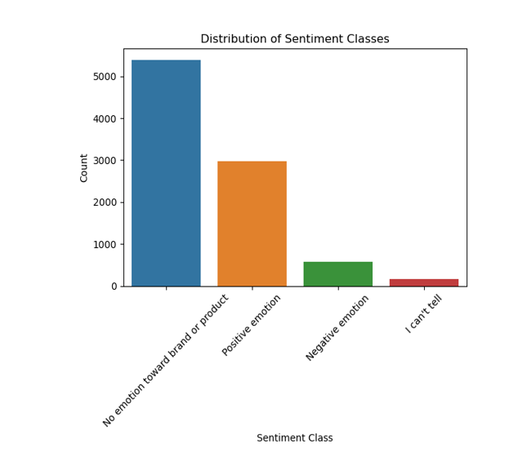
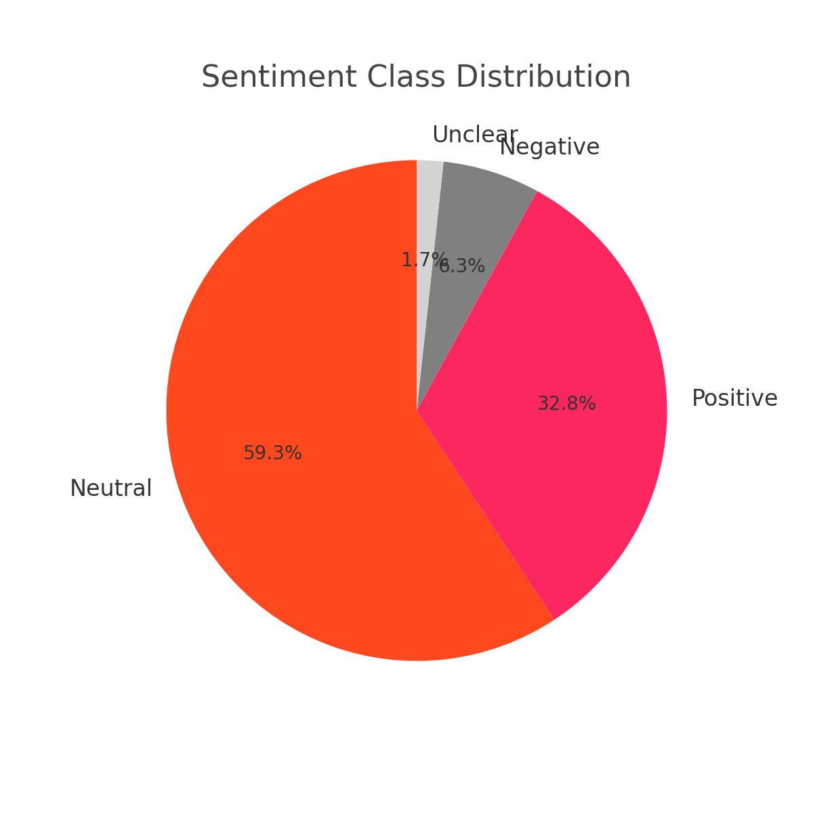
Exploratory Data Analysis -EDA
Overview
Neutral dominates (~60%), Positive ~33%, Negative ~6%.
Negative underrepresented → detection harder.
Business Value: real-time monitoring, risk detection, marketing insights.
Recommendations: improve Negative detection, deploy dashboard/API, extend scope.

Slide 7
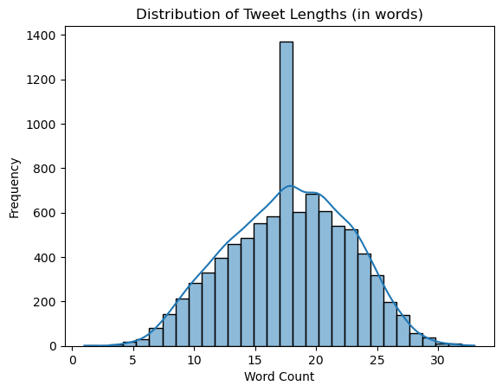
Exploratory Data Analysis -EDA
Data Set Overview
Most tweets fall between 5–25 words.
Reflects short, noisy nature of Twitter data.

Slide 8
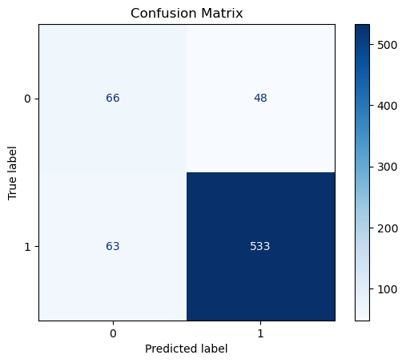
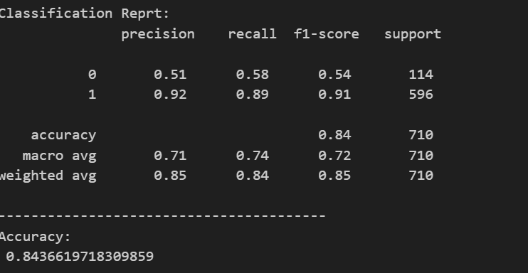
Modelling
Overall accuracy: 84%
Strong on Positive detection (92% precision, 89% recall).
Weak on Negative detection (51% precision, 58% recall).
Risk: Some negative tweets are missed improvement needed

Slide 9
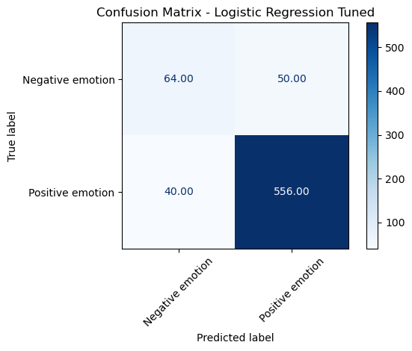
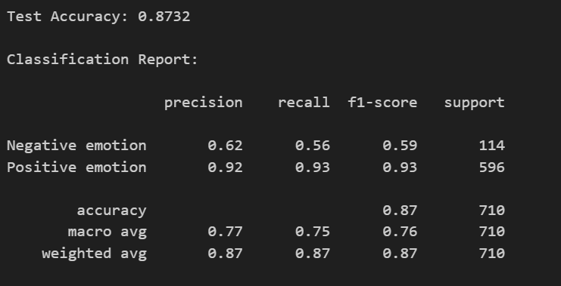

Slide 10
Model Comparison
Model Benchmarking
Cross-validation performed across models.
Logistic Regression performed best (Baseline F1 ~0.71).
Tuned model achieved ~87% accuracy.
Visualization: Logistic Regression outperformed others

Slide 11
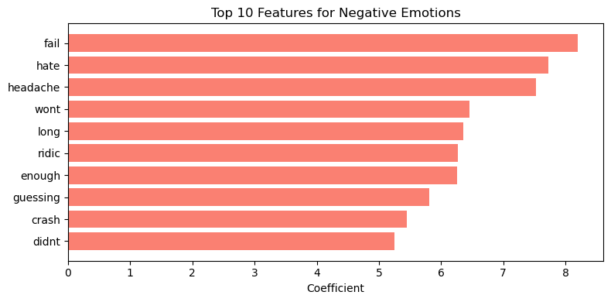
Feature Selection
'fail','hate’,’headache' drive negative classification.

Slide 12
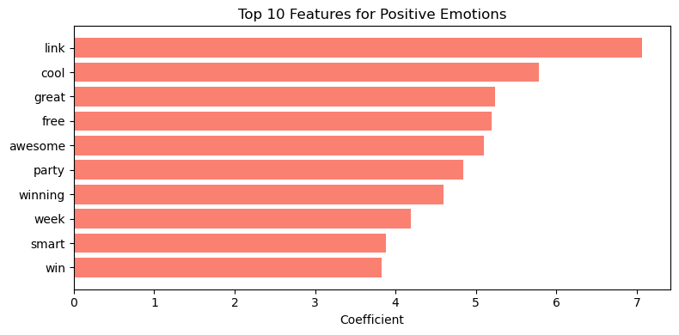
Feature Selection
'link',’cool’,’great' drive positive classification.

Slide 13
Key Insights & Recommendations
successfully built a sentiment analysis model to classify tweets about Apple and Google products.
Using TF-IDF + Logistic Regression (with oversampling), the model achieved an accuracy of ~84% and a tuned F1-score of ~0.87.
The model performs very well on Positive tweets, but struggles with Negative sentiment detection due to class imbalance.
This highlights the importance of balancing datasets and focusing on underrepresented but critical signals.
Improve classification of Negative tweets (SMOTE, deep learning).
Deploy as real-time dashboard or API.
Expand to other brands/industries.
Integrate with CRM for automated alerts.
Conclusion
Key Insights
Negative emotion signals: fail, hate, headache.
Positive emotion signals: link, cool, great.
Neutral signals: link, cool, update.
Model strong on Neutral & Positive; weaker on Negative class
Recommendations

Slide 14
Thank You!

