Slide 1


FAKE NEWS DETECTION
Determine the authenticity of an article.
R&D : Kai

Slide 2

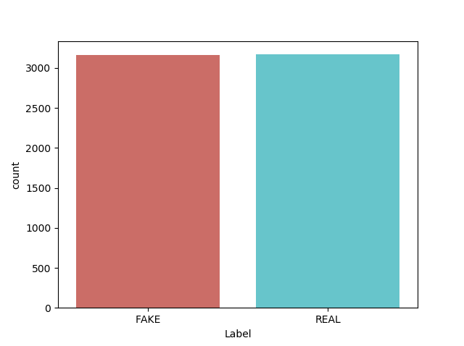
DATA SET
6335 articles – Title – Content – Label
Fake news – from Kaggle
Real news – from reality source NYT, WSJ, The Guardian, …
News – publish in 2016 around 45th U.S President Election
Notes:
New York Times ,Wall Street Journal

Slide 3
PURPOSE
Predict : the article is REAL / FAKE
Compare the of models using distinct feature sets performance
find what model is “work” with Fake/Real News classification
understand what factors are most predictive of fake news

Slide 4
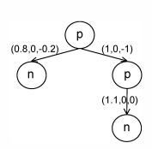
PURPOSE
Output : values for the nodes of Propagation Structures

Slide 5

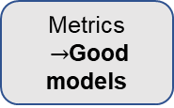
OVERVIEW
CSV file
Corpus1 : Content
Clean the text
(title, content)
Corpus2 :
Title
Feature Extracting (Test)
- Ngrams
- Word Count Feature
- TF-IDF Vector
- Sentiment Feature
Feature Extracting
- Embedding Matrix : GloVe
Predict2
Split / Train data
Deep models :
RNN using lstm
Split / Train data
Classification models :
Naïve Bayes
Logistic Regression
SVM
Decision Tree
Passive Aggressive
Gradient Boosting
…
Metrics $→$Good models
Predict1
Output

Slide 6

MODEL
Clean the text
Restore shorted words
Remove punctuation, short words
Remove Stopwords
Stemming : SnowballStemer
Set words to lower
‘ Trump doesn’t have a national campaign,
So the “GOP” is trying to run one for him \n.'
' trump not nation campaign gop tri run one ‘
Notes:
New York Times ,Wall Street Journal

Slide 7
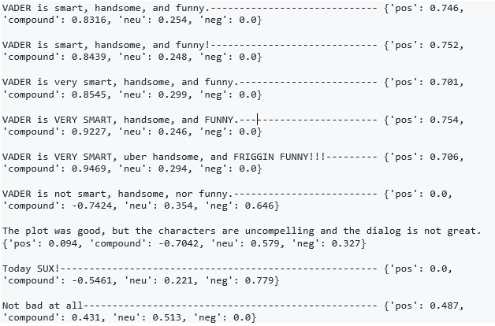
MODEL
Feature Extraction ( corpus 1 : content )
Ngrams, Word Count Feature, TF-IDF Vector
Sentiment Feature :
- Vader sentiment analyzer
Notes:
New York Times ,Wall Street Journal Valence Aware Dictionary and Sentiment Reasoner)

Slide 8
MODEL
Feature Selection ( corpus 1 : content )
Feature + Sentiment/ Accuracy | Word Count | TF-IDF | TF-IDF ngrams (bigrams) | TF-IDF ngrams (trigrams)
Logistic Reg | 90.77 | 91.56 | 90.21 | 89.18
Decision Tree | 81.69 | 81.72 | 80.98 | 81.68
K - NNs | 79.00 | 77.98 | 77.82 | 76.63
Passive Agressive | 89.67 | 92.42 | 92.82 | 93.05
Gradient Boosting | 87.77 | 89.42 | 88.87 | 83.40
92.58
Sentiment Feature + TF-IDF ngrams
Notes:
New York Times ,Wall Street Journal

Slide 9
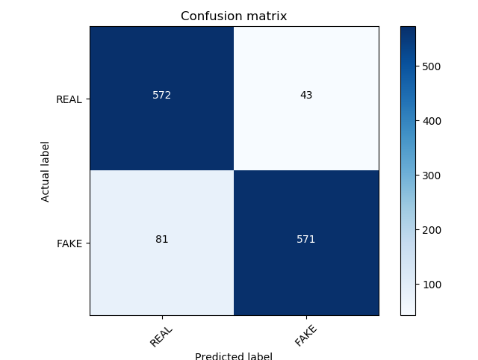
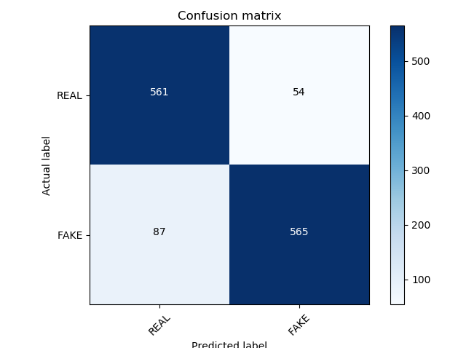
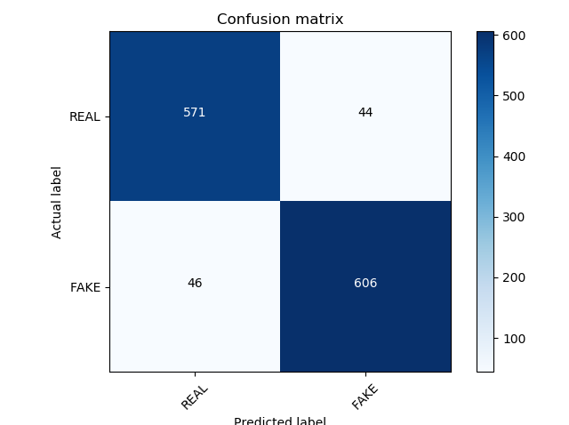

MODEL
Model Selection ( corpus 1 : content )
Logistic Regression
XGBoost
Passive Agressive
Based on
“False Alarm Rate” (FPR)
Passive Agressive
Notes:
New York Times ,Wall Street Journal

Slide 10
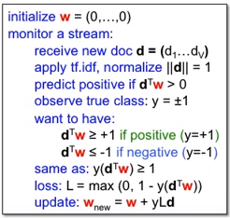
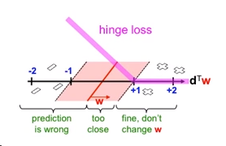
MODEL
PASSIVE AGGRESSIVE CLASSIFIER (PAC)
is an on-line algorithm : learn from massive streams of data
Notes:
New York Times ,Wall Street Journal

Slide 11
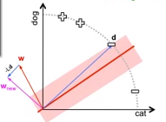
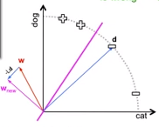
MODEL
PASSIVE AGGRESSIVE CLASSIFIER (PAC)
PASSIVE
AGGRESSIVE
Notes:
New York Times ,Wall Street Journal

Slide 12
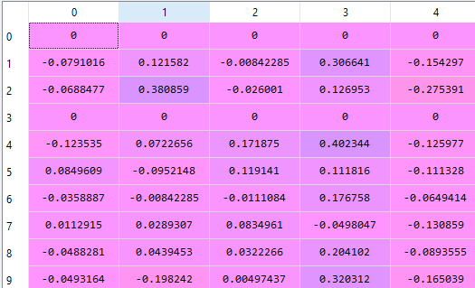
MODEL
Feature Extraction ( corpus 2) :
Create embedding matrix :
Tokenizer (TensorFlow) - 6875 tokens
Word2vec (GoogleNews – 300d) - 3000000 {word : vec}
Embedding matrix - 2138 vectors : [zeros]
Notes:
New York Times ,Wall Street Journal

Slide 13
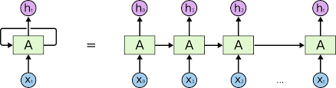
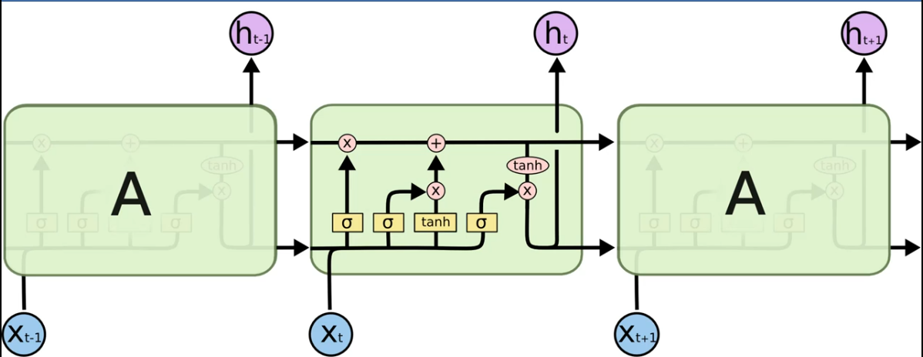
MODEL
Deep model ( corpus 2 )
Recurrent Neural Networks – LSTM
RNNs
LSTM cell
Notes:
New York Times ,Wall Street Journal

Slide 14
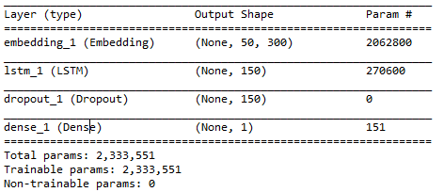
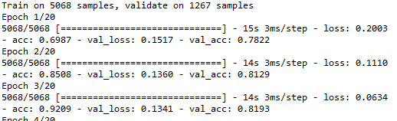
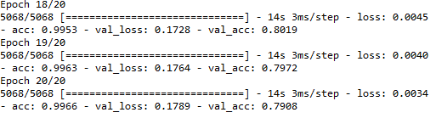
MODEL
Deep model ( corpus 2 )
Recurrent Neural Networks – LSTM
model_summary :
model_result :
After 20 epochs, batch size = 128
Mean of validation accuracies : 0.8041041836413042
Notes:
New York Times ,Wall Street Journal

Slide 15
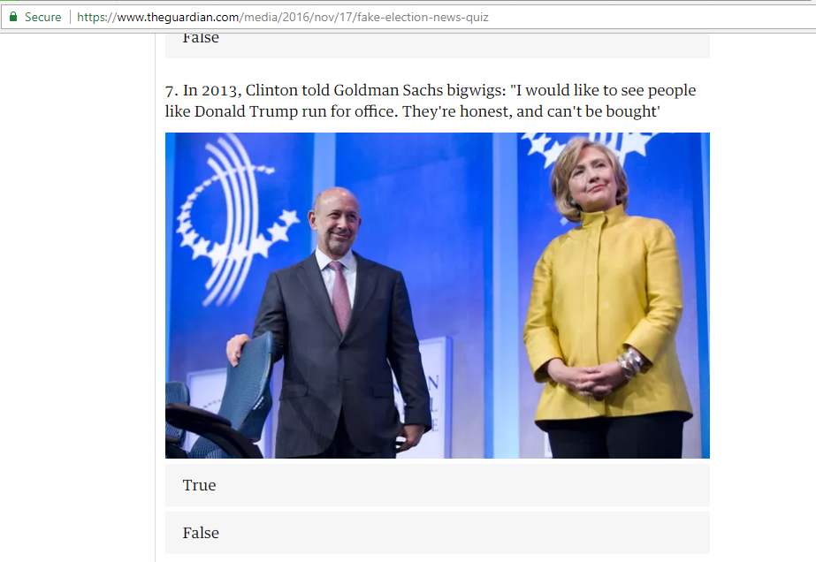
PREDICTING
Can you spot the fake US election news stories?
Notes:
New York Times ,Wall Street Journal

Slide 16




PREDICTING
Let ‘s try !
Notes:
New York Times ,Wall Street Journal

Slide 17
CONCLUSION
Result :
On this dataset : Overall,
PAC is the best performance, with sparse matrix feature ~ 94% acc (with Grid – search)
RNN – LSTM is quite good , with short articles ~ 80% acc
TF-IDF shows promising potential predictive power
Improvement :
Feature
Add RNN layer, adjust epochs, batch_sizes
Data set
Language (Vietnamese)
Notes:
New York Times ,Wall Street Journal

Slide 18
REFERENCES
https://github.com/cjhutto/vaderSentiment
https://github.com/kushnagpal/FakeNewsDetection/blob/master/CMSC389AFinalProject.ipynb
https://github.com/docketrun/Detecting-Fake-News-with-Scikit-Learn
https://www.datacamp.com/community/tutorials/scikit-learn-fake-news
https://www.kaggle.com/lystdo/lstm-with-word2vec-embeddings
https://www.kaggle.com/mrisdal/fake-news
https://www.ijcai.org/Proceedings/16/Papers/408.pdf - Recurrent Neural Network for Text Classification with Multi-Task Learning - Xipeng Qiu et al.
https://www.youtube.com/user/victorlavrenko/channels - TC 3 : Passive aggressive algorithm - Victor Lavrenko
https://arxiv.org/ftp/arxiv/papers/1806/1806.11316.pdf - Fake News Identification on Twitter with Hybrid CNN and RNN Models - Oluwaseun Ajao et al.
Exploring the Application of NLP Methods to Machine Identification of Misleading News Sources - Lauren Dyson & Alden Golab - 2017
Notes:
New York Times ,Wall Street Journal

Slide 19
Notes:
New York Times ,Wall Street Journal

