Slide 1
Exploration of Global CO2 Emissions
A brief analysis of developed, underdeveloped and developing countries

Slide 2
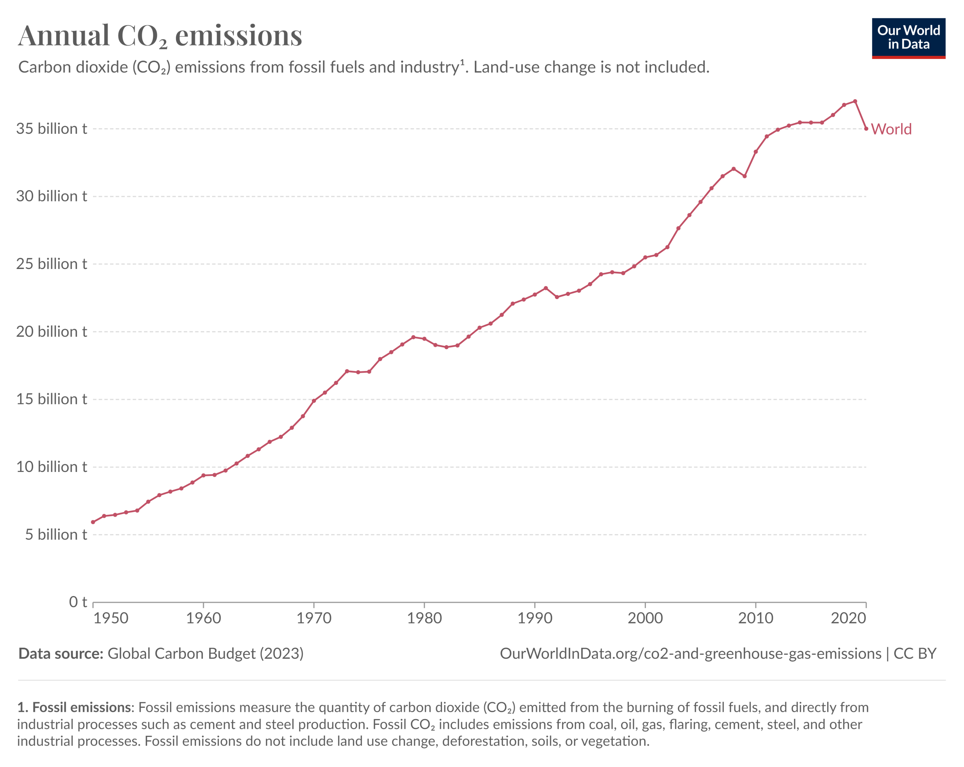
Cause & Effect
Emission Causes
Generating Power | Manufacturing Goods
Using Transportation | Powering Buildings
Producing Food | Consumption
CO2 emissions growth
1950’s – 42.15% | 1960’s – 16.33% | 1970’s – 8.28% | 1980’s – 4.39%
1990’s – 4.95% | 2000’s - 5.26% | 2010’s - 2.92%

Slide 3
Country Classifications:
Economic & Emission Markers:
Developed | Developing | Underdeveloped
Australia | India | Bangladesh
Sweden | Greece | Afghanistan
Japan | Egypt | Senegal
Switzerland | Brazil | Ethiopia
USA | South Africa | Cambodia
Annual GDP ($USD)
Population Size
Average Daily Income ($USD)
Total CO2 Emissions (millions of tonnes)
Annual CO2 Emissions Per Capita (tonnes)

Slide 4

Investigate Trends In Emission Data
Trends
Population vs Total emissions
Major Contributors
Economic conditions
GDP vs Total emissions
GDP vs Total Emissions ratio
Emissions Per Person vs Daily Income
Change over time
Average income
GDP vs Population
Country categorisation
Does the overall development classification of the country impact it’s CO2 emissions?

Slide 5
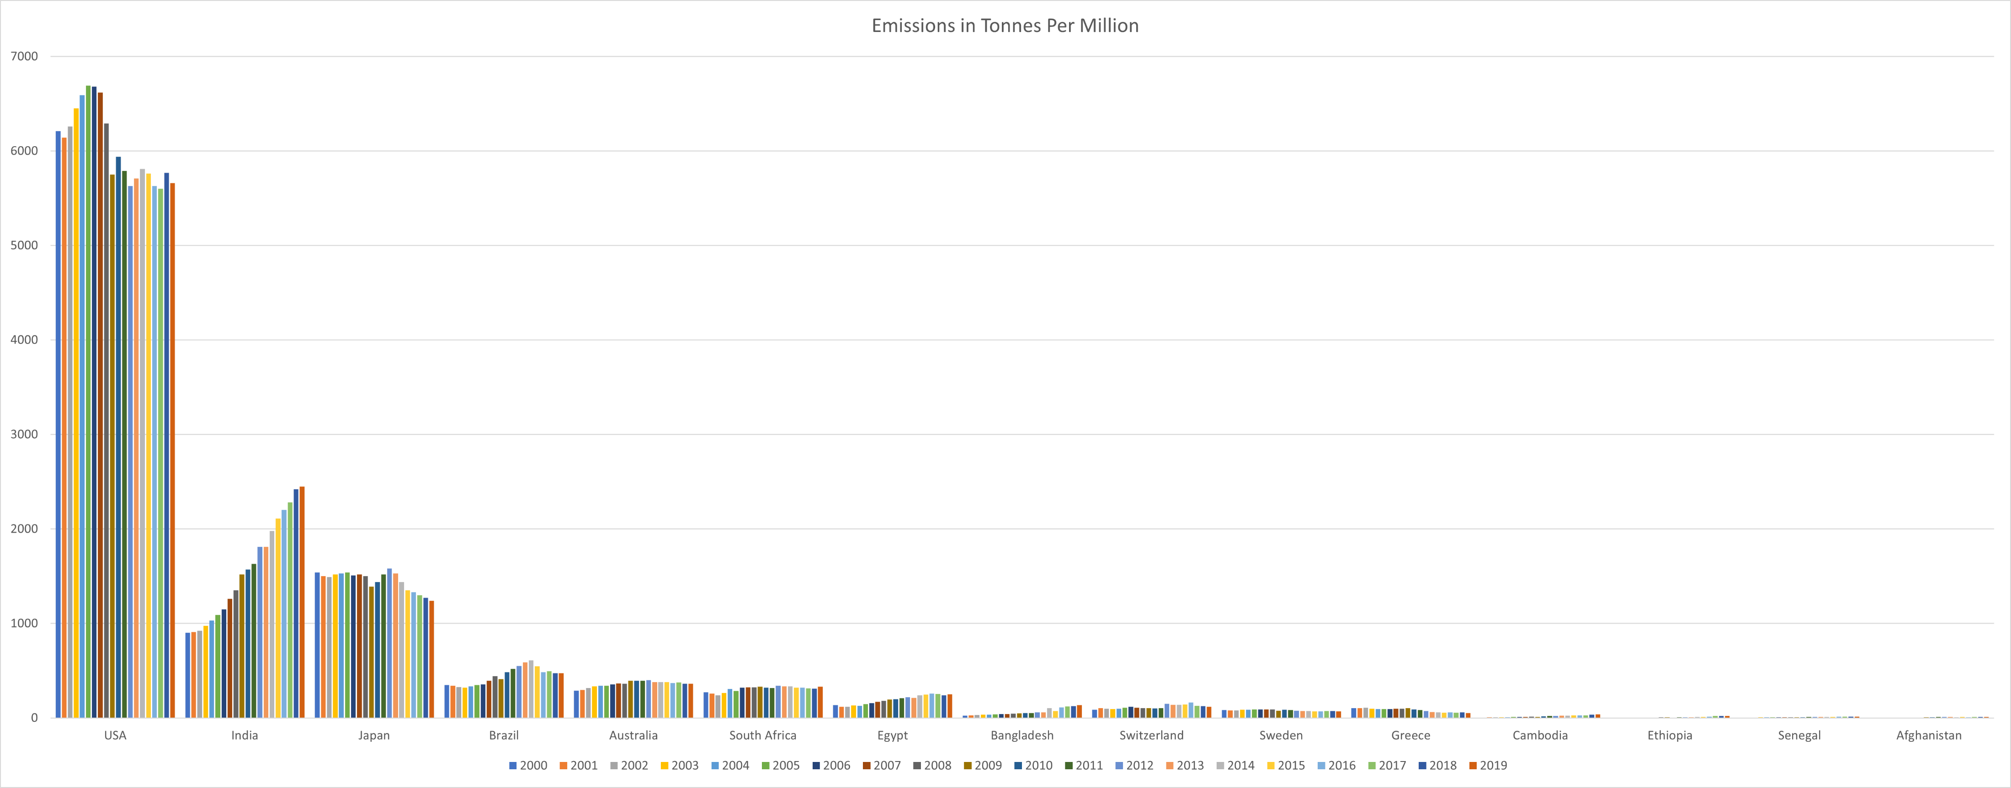

Slide 6
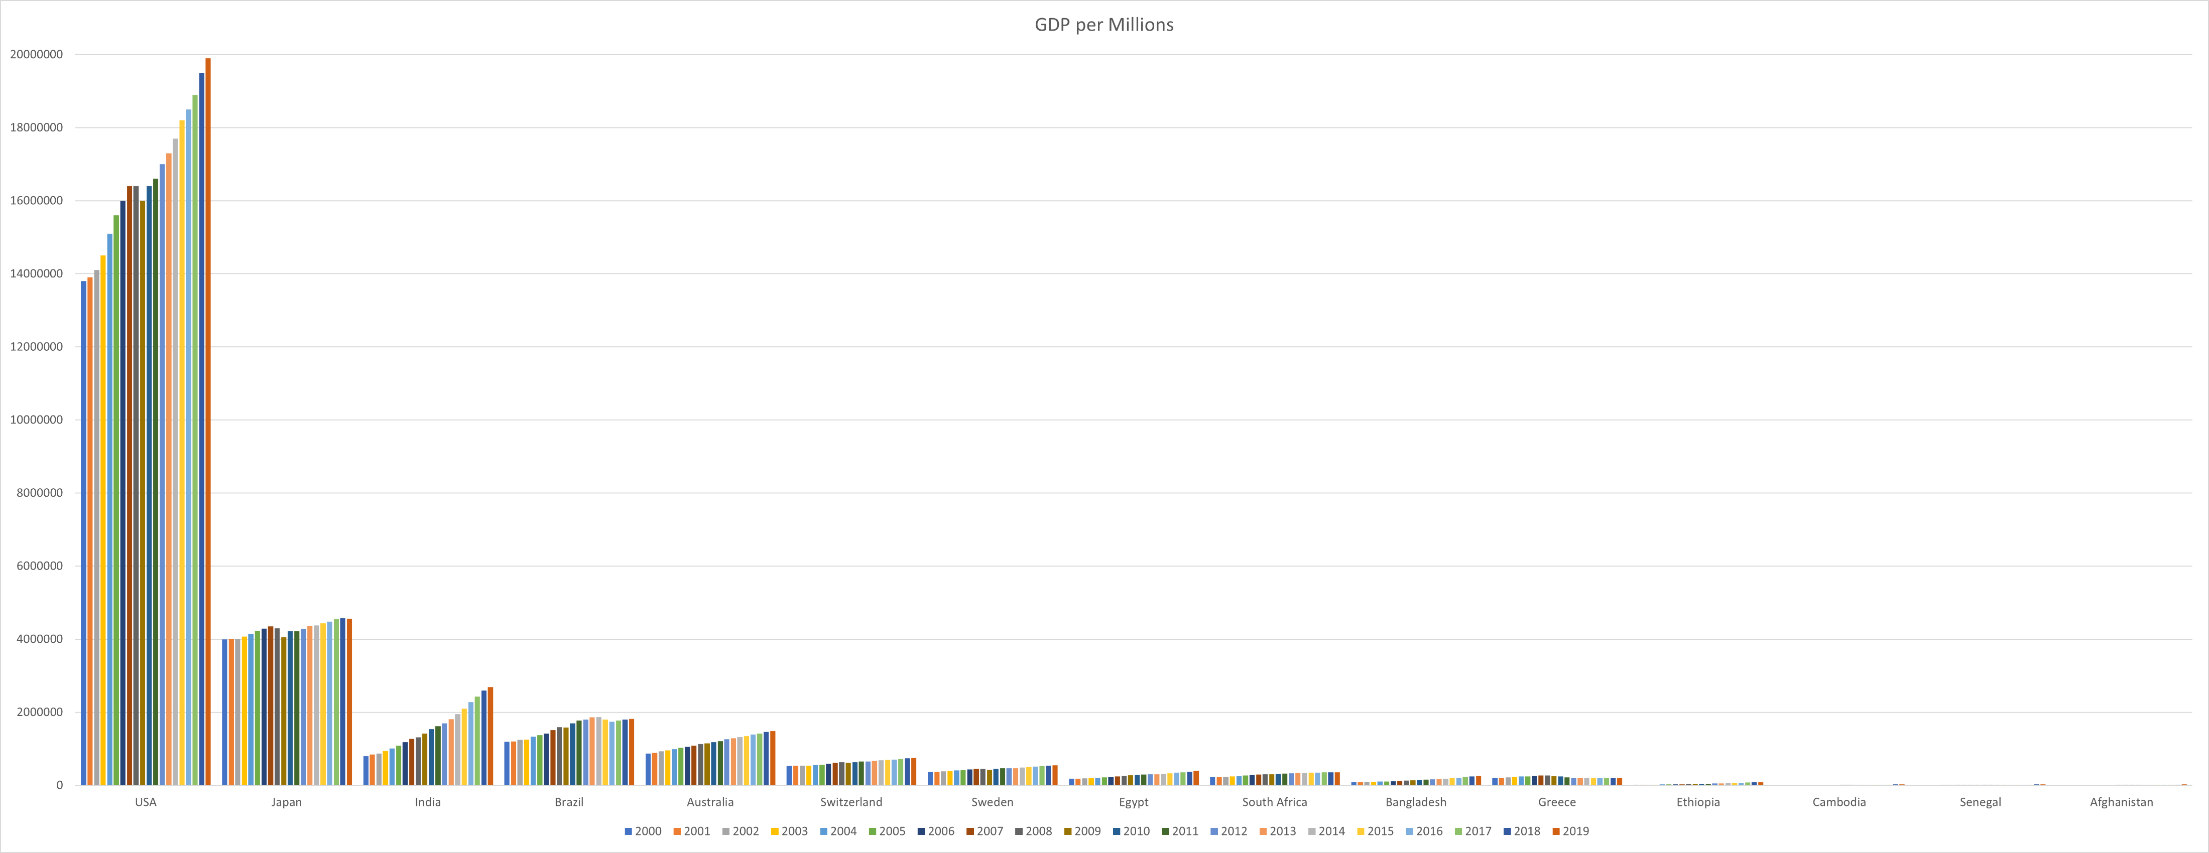

Slide 7
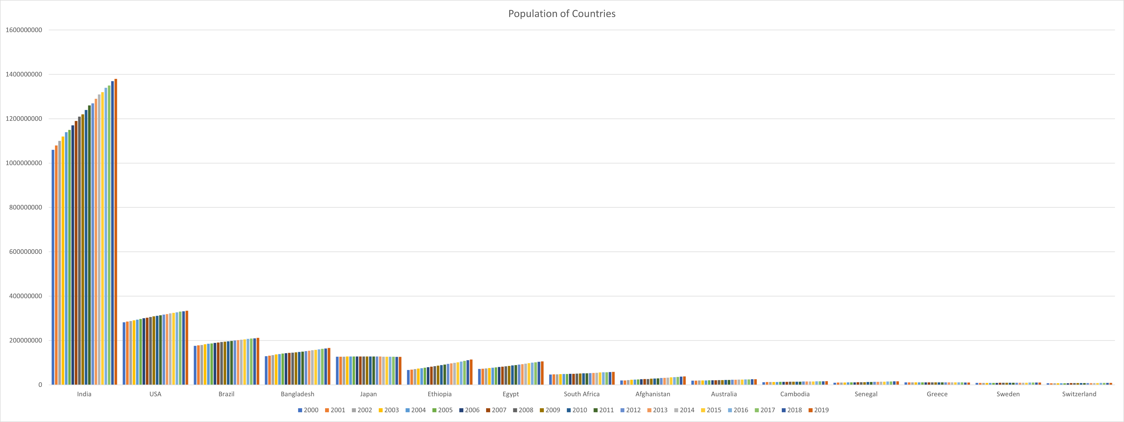

Slide 8
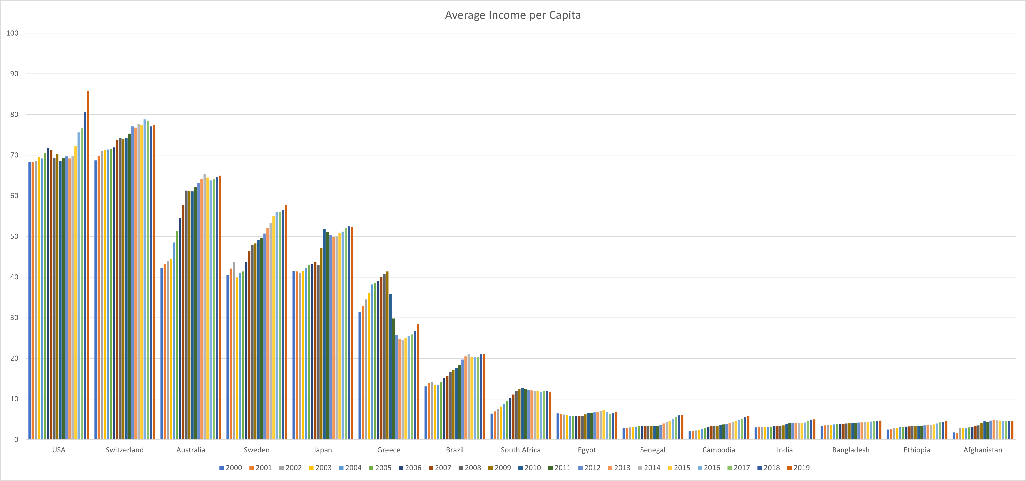

Slide 9


Slide 10
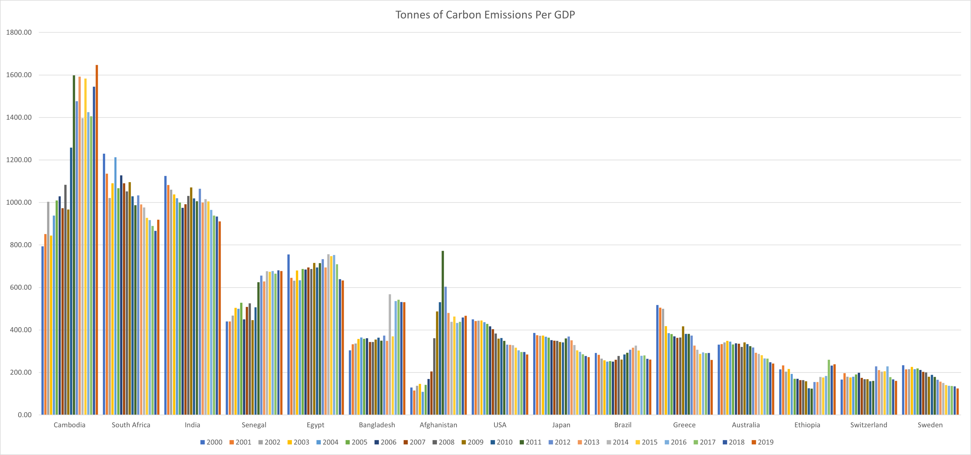

Slide 11
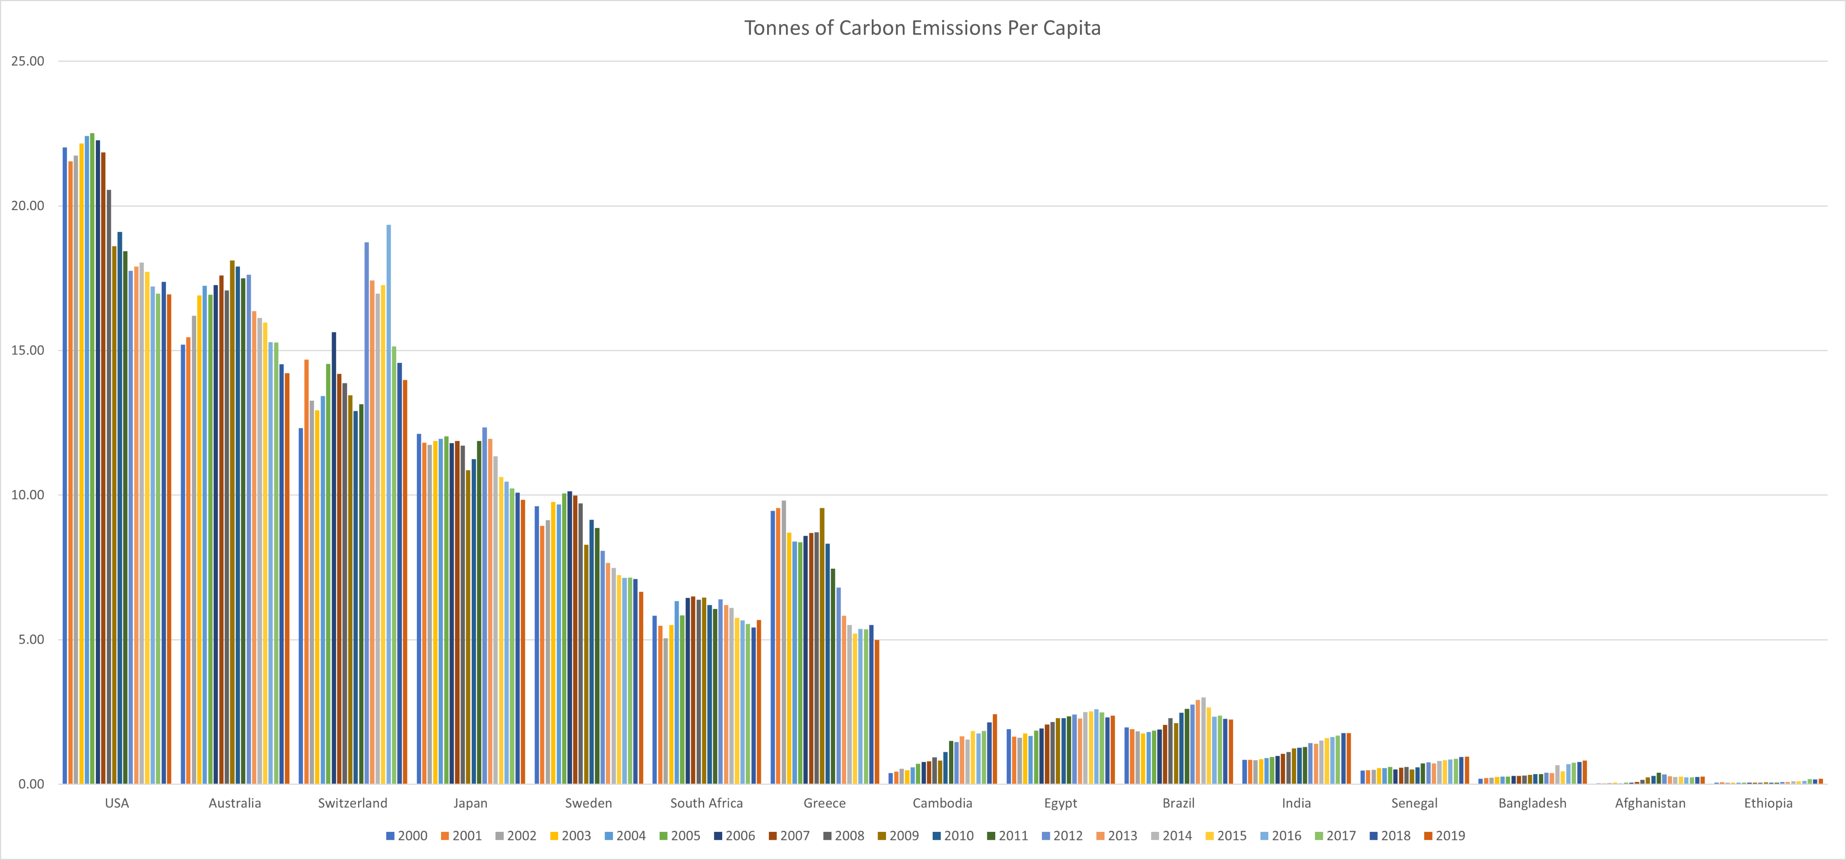

Slide 12
Ethical Considerations
Privacy
Identifying information
Authority
Authority to access
Use permissions
Misrepresentation
Data cleaning
Purpose of use
Data Sourcing
Analysis/Visualisation
Decisions/Outcomes

Slide 13
Thank You

