Slide 1



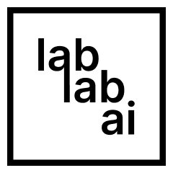
Google Cloud Vertex AI Hackathon
ChatBot for Autism Kids
Enhance communication abilities in children with autism.

Slide 2
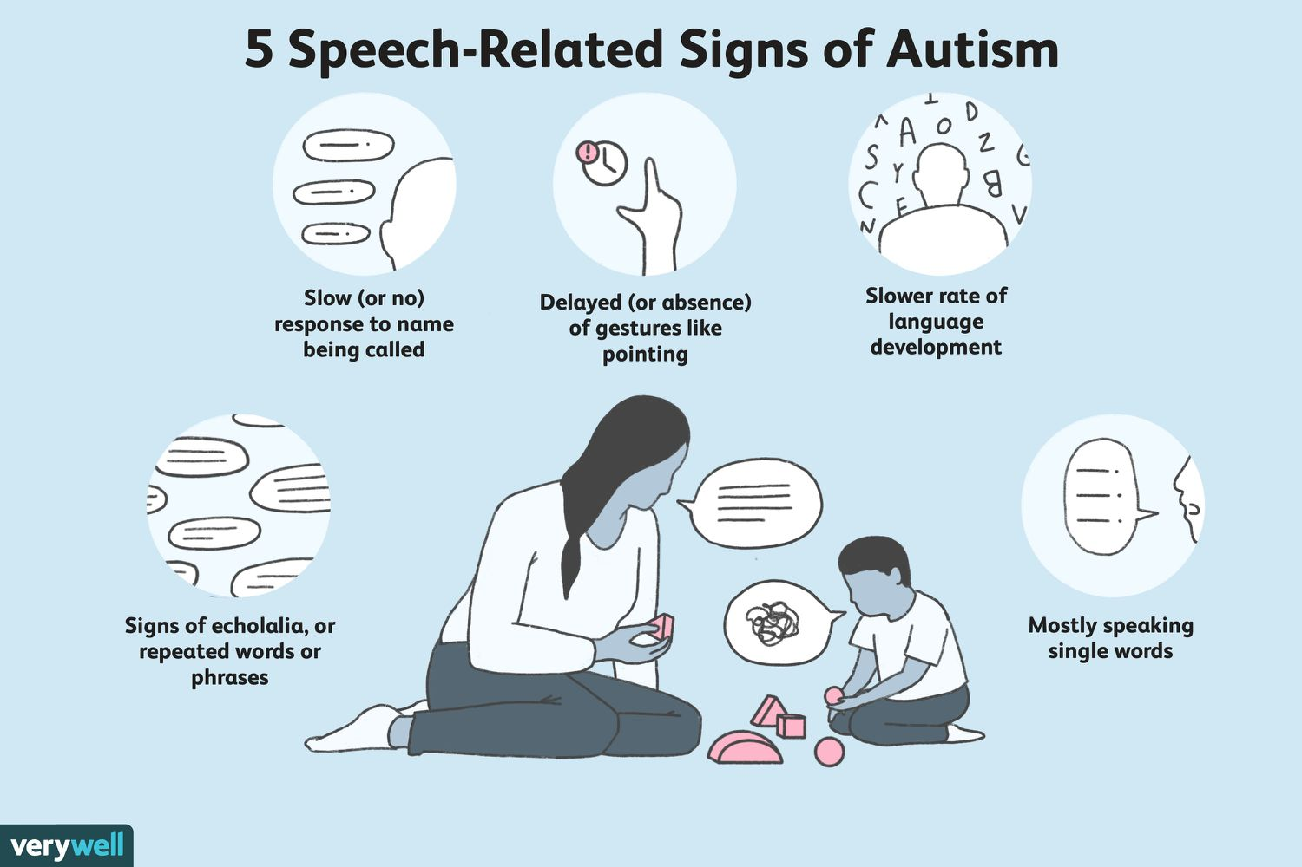
Source: https://www.verywellhealth.com/is-late-speech-a-sign-of-autism-259888

Slide 3
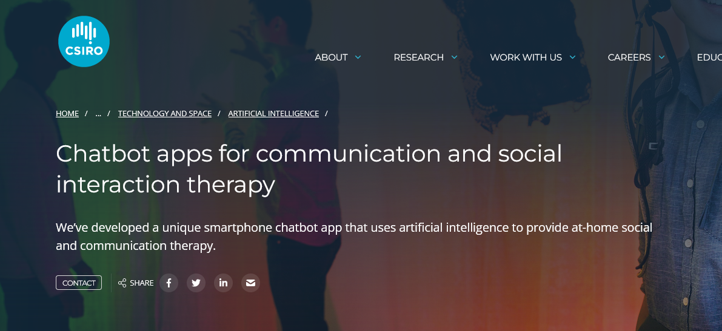
Source: https://www.csiro.au/en/research/technology-space/ai/chatbots-for-therapy

Slide 4
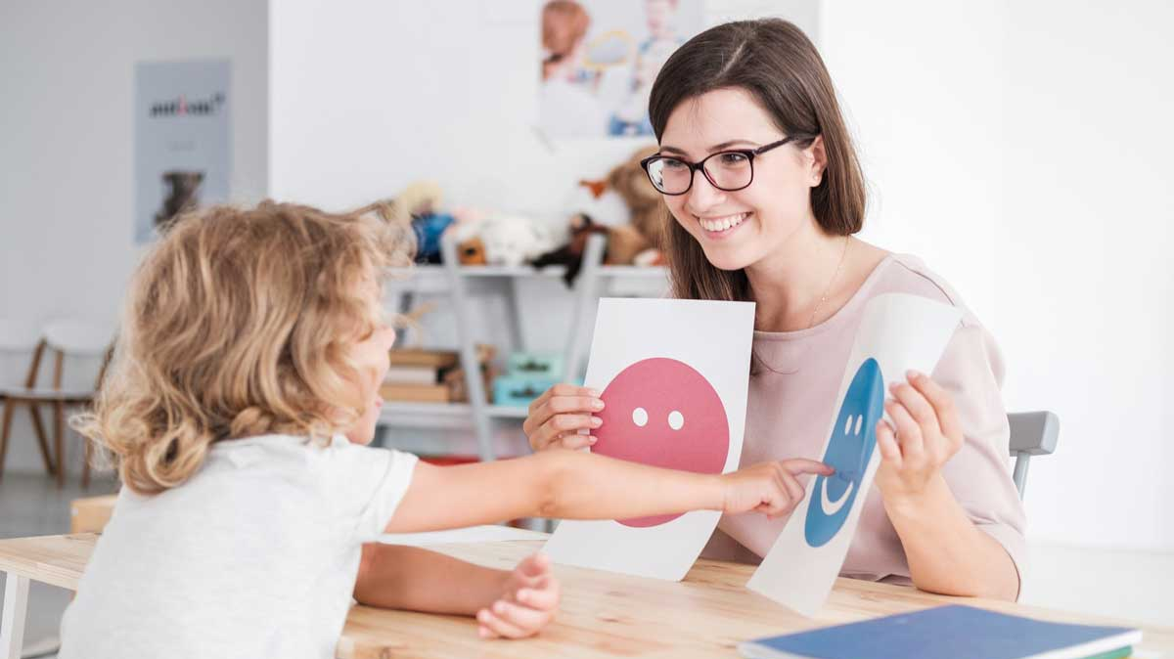
The Solution:
Speech and Communication Training Using Google Cloud Vertex AI model

Slide 5
Support children with autism throughout their communication journey
Build Essential Communication Skills
Improve Social Interactions
Develop a Sense of Autonomy

Slide 6
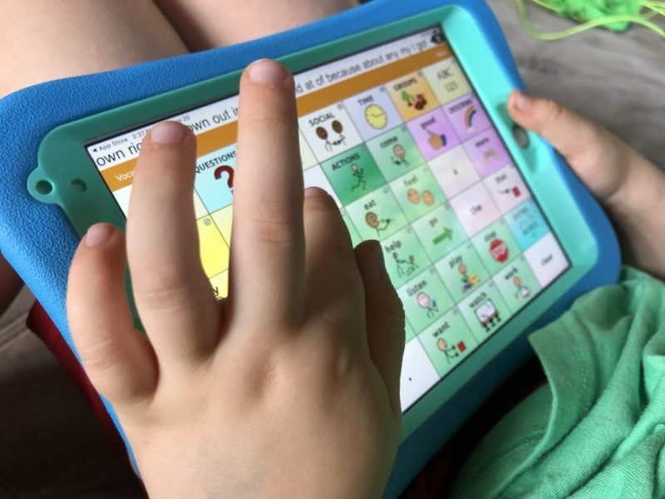
Mode 1: Augmentative and Alternative Communication (AAC)
Provides visual aids to facilitate understanding and expression.
Effectively convey their needs, wants, and thoughts visually,
Fostering independence
Reducing frustration.
Technologies: PaLM 2 (Chat) +
Stable Diffusion (Visual Aids)

Slide 7
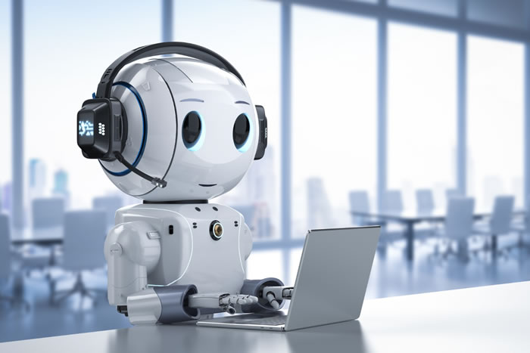
Mode 2: Text Communication
Allows children who are more comfortable with written language to engage in meaningful conversations
Technologies: PaLM 2 (Chat)

Slide 8
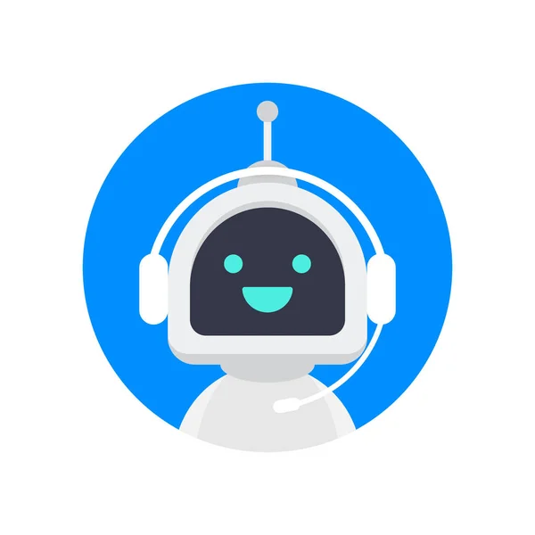
Mode 3: Speech Communication
Children can use their own voice to communicate, with the ChatBot understanding and responding accordingly.
Technologies: PaLM 2 (Chat) + Chirp (Speech Recognition)

Slide 9
How can it help autism kids ?
This application provide:
A safe and controlled environment for communication and social interaction.
Consistent and predictable responses, reducing anxiety and stress for the child.
Engaging and educational content, helping to improve cognitive and social skills.

Slide 10

Key Features: Simplicity and Ease of Use
Can be easily programmed by speech and occupational therapists, as well as other key stakeholders involved in the child's development

Slide 11
The Competitor
Proloquo2Go
Speech Blubs
Ours
AAC
✅
✅
✅
Text
✅
✅
Speech
✅
✅
Customize
✅
✅
Stakeholders
✅
✅

Slide 12
Thank You

