Slide 1
Saltend vibration data review
09.11.2023

Slide 2
Content
Plot

Slide 3
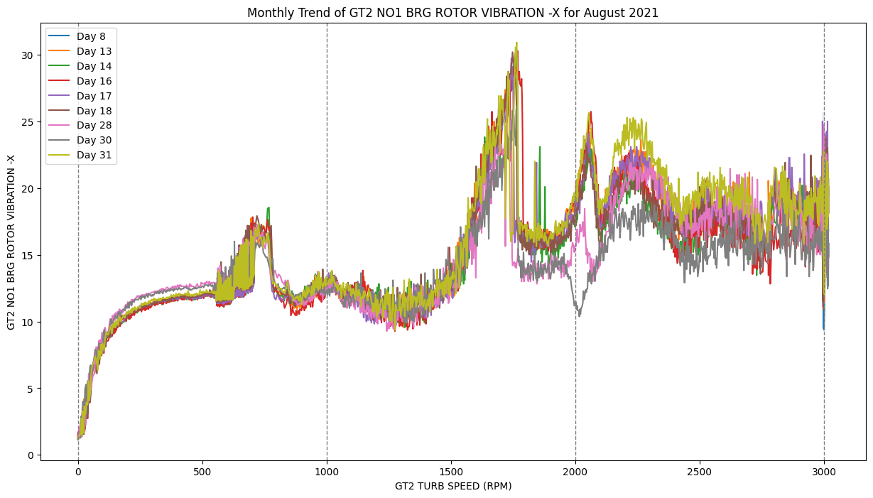
August 2021 – GT2 NO1 BRG ROTOR VIBRATION-X
At different starting stages, the spike values around the speed of 2000 rpm are different

Slide 4
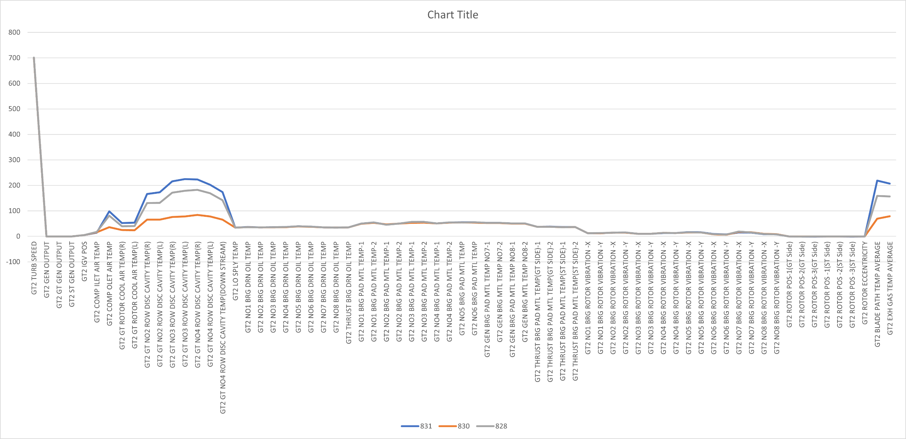
28/08/2021 VS 30/08/2021 VS 31/08/2021

Slide 5
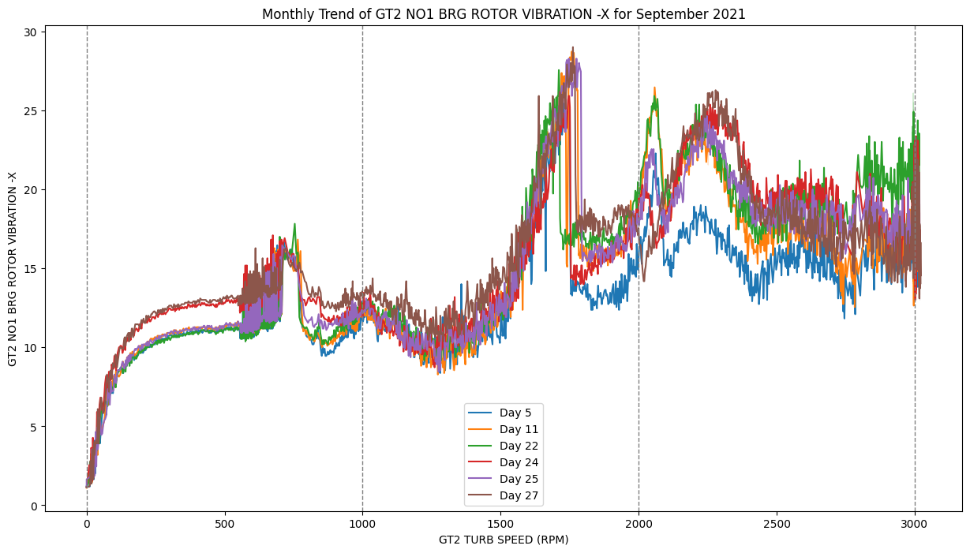
September 2021 – GT2 NO1 BRG ROTOR VIBRATION-X

Slide 6
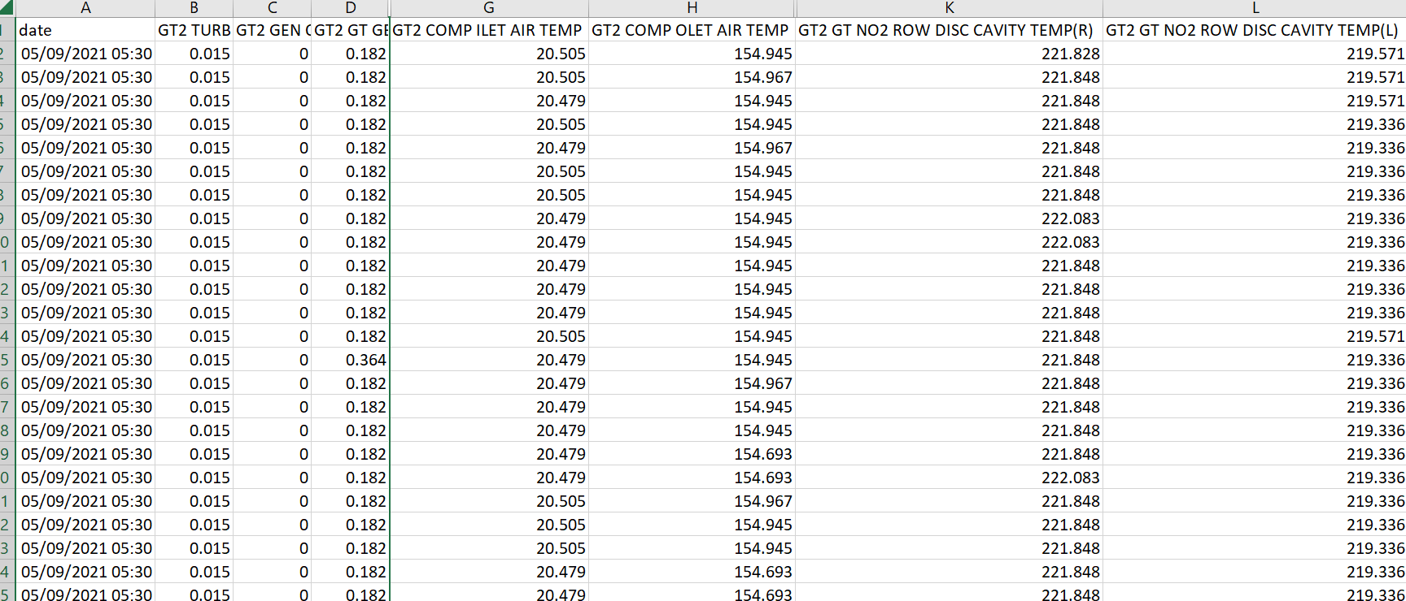
05/09/2021-Hot Start

Slide 7
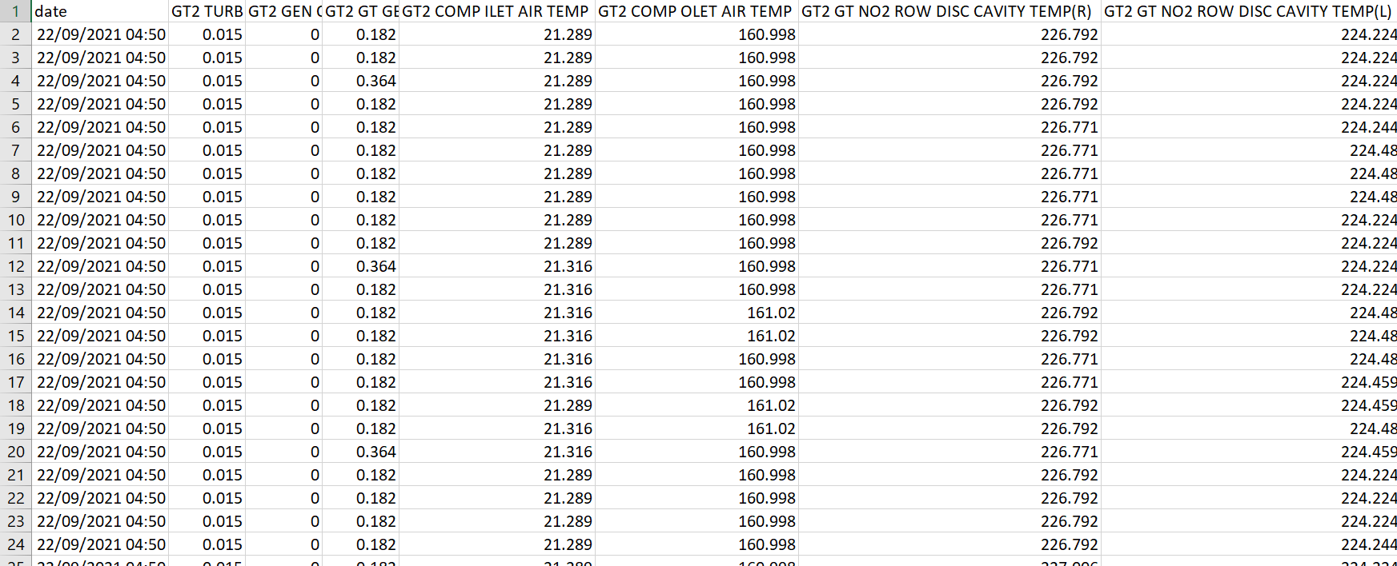
22/09/21-Hot Start

Slide 8
05/09/2021-Hot Start VS 22/09/2021-Hot Start
At the same starting stage, there is a difference in the spike values around the speed of 2000 rpm

Slide 9
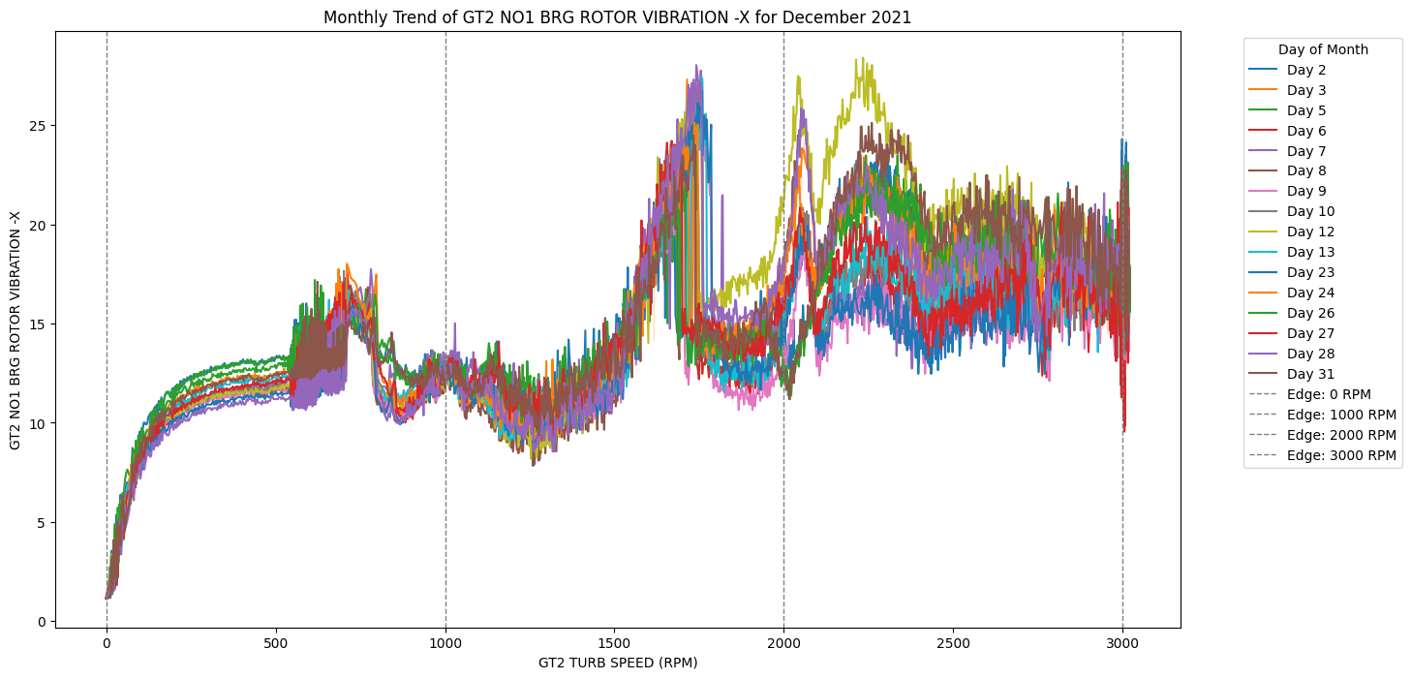
December 2021 – GT2 NO1 BRG ROTOR VIBRATION-X

Slide 10
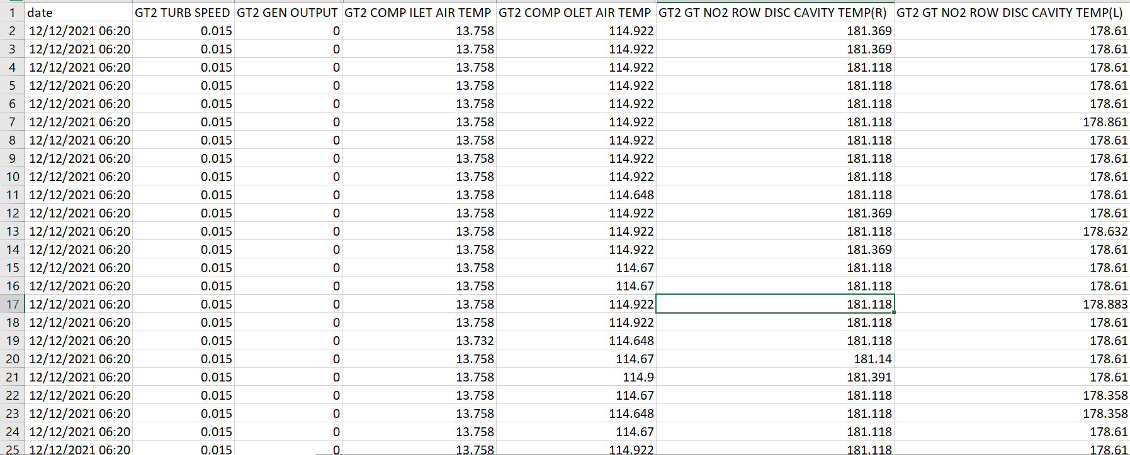
12/12/2021-Warm Start

Slide 11
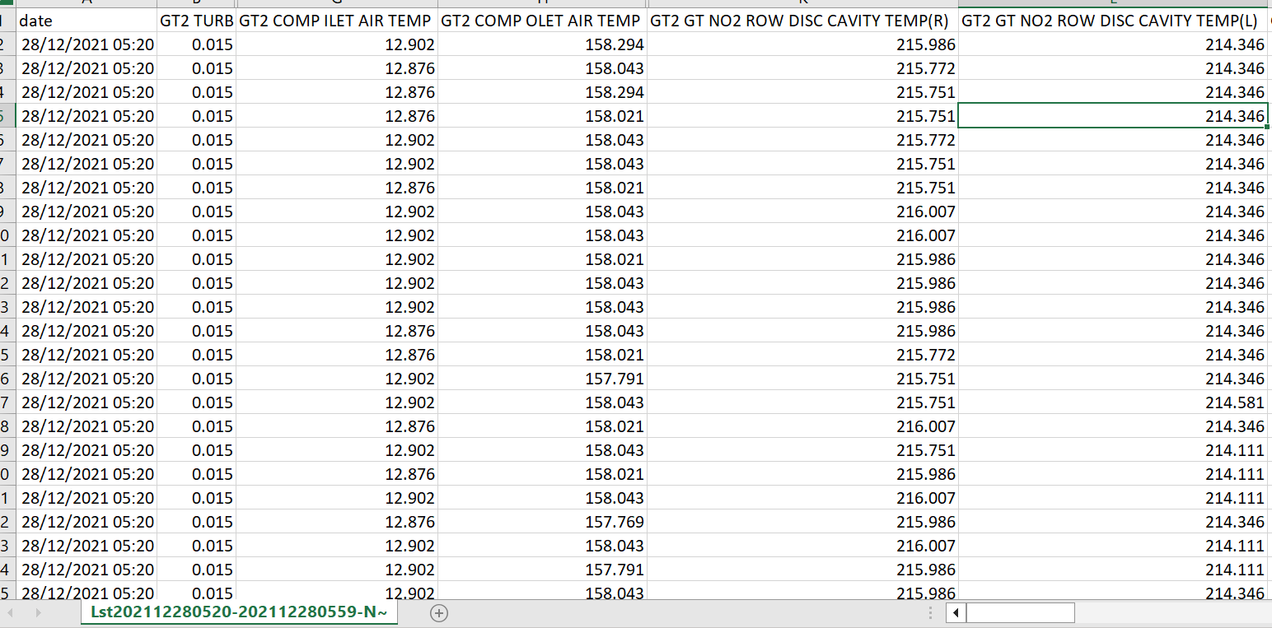
28/09/21-Hot Start

Slide 12
12/12/2021-Warm Start VS 28/12/2021-Hot Start
At different starting stages, the spike values around the speed of 2000 rpm are similar

