Slide 1
Preliminary trial of anomaly classification
06.10.2023

Slide 2
Text page with list
Anomaly Detection Performance with CSO
Build Binaray classification model
CNN_Transfer
FCN (from script)

Slide 3
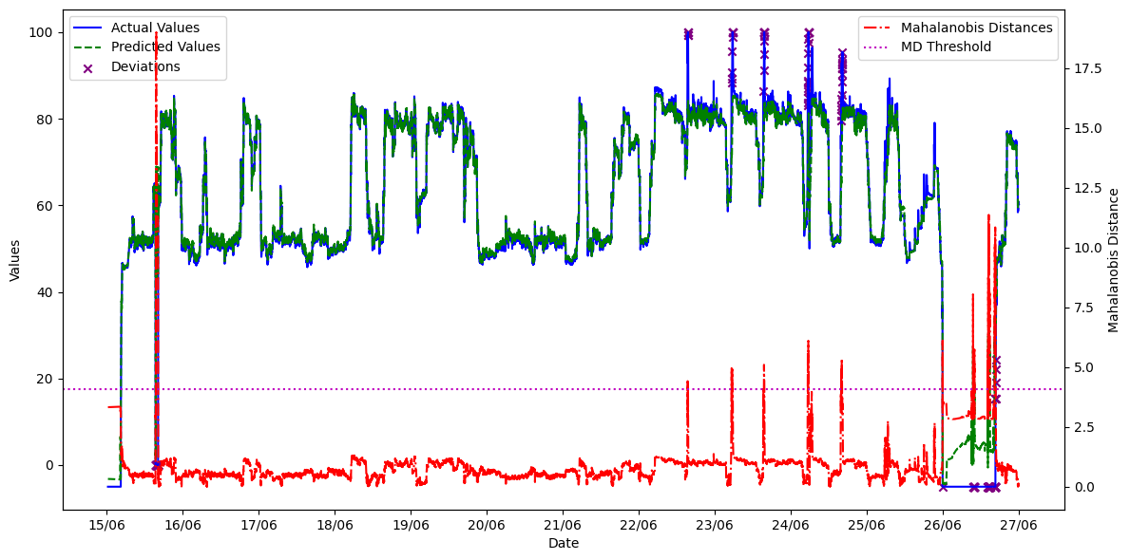
Anomaly Detection Performance with CSO
Total inference data amount : 17281
Time interval : 15/06/2018 00:00:00 to 26/06/2018 23:59:00
Model : CNN
Deviation detection method : Mahalanobis distance

Slide 4
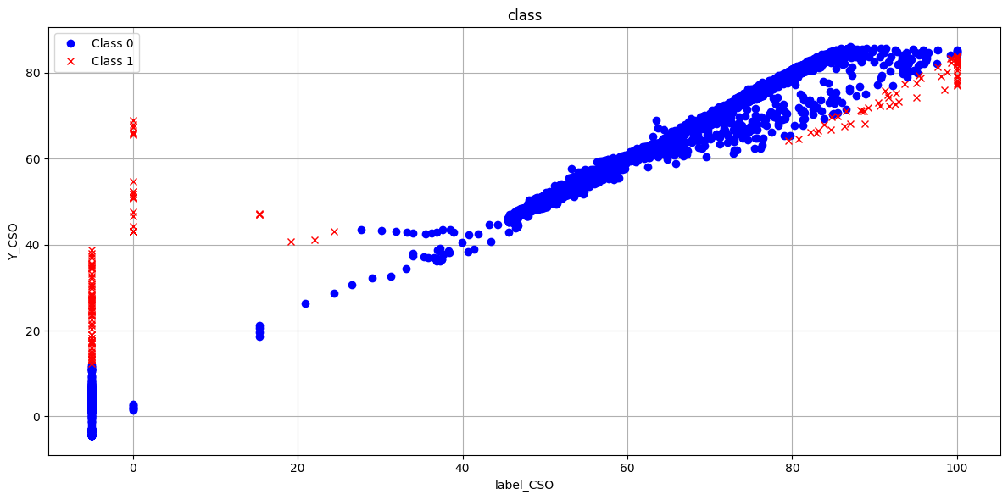
Binary Classification : AUC metric
Why use AUC as an Evaluation Metric:
Imbalanced Datasets: Accuracy can be misleading in imbalanced datasets due to the dominance of the majority class.
False Positive and False Negative Rates : Beyond accuracy, the rates of False Positives (Miss) and False Negatives (Overkill) are important indicators of model performance.
Summarizes Trade-off: AUC provides a summary of the trade-off between false positives and true positives across different decision thresholds.
The AUC, or Area Under the Curve, value lies between 0 and 1. (Higher AUC values are better)
1: Indicates perfect distinction between positive and negative classes.
0.5 to 1: A model predicting randomly will have an AUC of 0.5..
Below 0.5: A model is doing worse than random prediction.
Performance Indicator: A higher AUC indicates the classifier's capability to distinguish positive from negative samples with fewer errors, resulting in lower False Positive Rates and higher True Positive Rates.
Class 0(normal),Class1(Anomaly)
E,g
 | Predicted Class 0 | Predicted Class 1
True Class 0 | 20000(TP) | 13(FN)
True Class 1 | 6(FP) | 300(TN)
Accuracy = 20300/20319 ≈ 99.9%

Slide 5
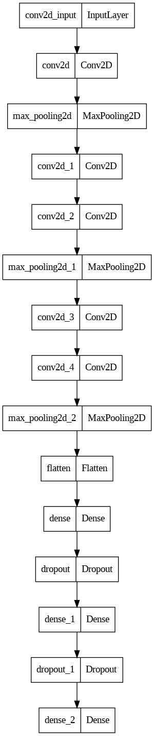
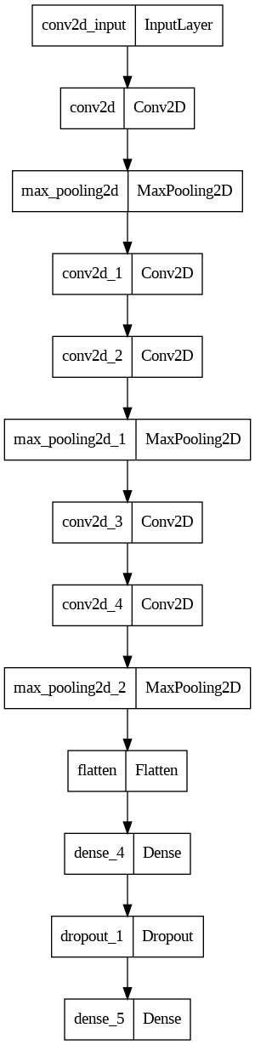
Binary Classification : CNN_Transfer
Freeze
model_transfer.add(Dense(128, activation='relu'))
model_transfer.add(Dropout(0.05))
model_transfer.add(Dense(1, activation='sigmoid')) # Single neuron with sigmoid for binary classification
# Compile the transfer model
model_transfer.compile(optimizer='adam', loss='binary_crossentropy', metrics=[AUC(name='auc')])
Train

Slide 6
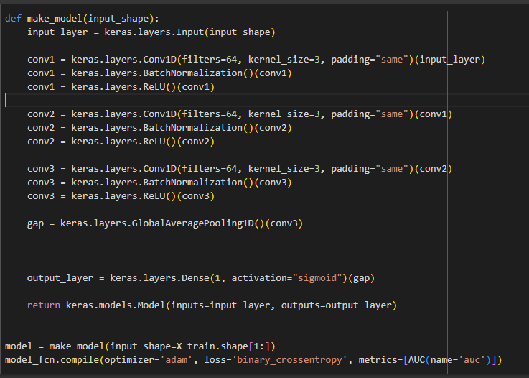
Binary Classification : FCN (From Script)
Data amount : 17281
(70% for training ,30% for testing)
Time interval : 15/06/2018 00:00:00 to 26/06/2018 23:59:00

Slide 7
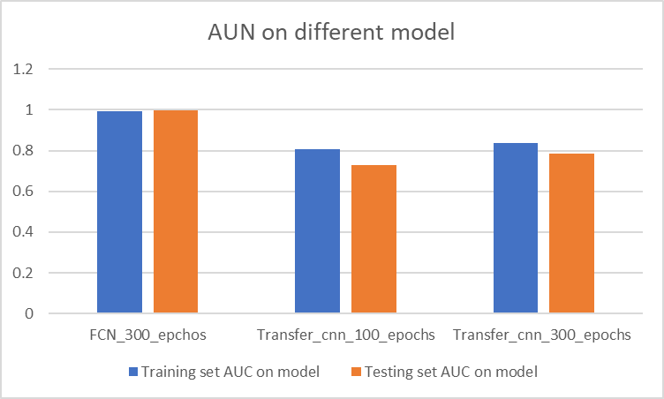
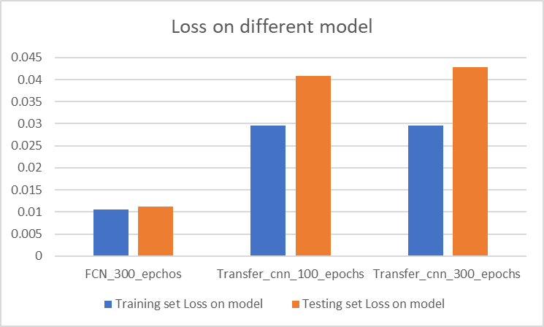
Binary Classification : Model Comparison
 |  | FCN_300_epchos | Transfer_cnn_100_epochs | Transfer_cnn_300_epochs
Loss | Training set | 0.010622 | 0.029547 | 0.029594
 | Testing set | 0.011174 | 0.040745 | 0.042756
AUC | Training set | 0.995616 | 0.805636 | 0.835424
 | Testing set | 0.999263 | 0.72954 | 0.7842

Slide 8
Binary Classification : Model Comparison
Transfer_CNN_300 |  | Predicted
 |  | Class0 | Class1
Actual | Class0 | 5121 | 3
 | Class1 | 31 | 21
FCN_300_epochs |  | Predicted
 |  | Class0 | Class1
Actual | Class0 | 5110 | 14
 | Class1 | 5 | 47
 | FCN | Transfer_CNN
FPR | 9.62% | 59.62%
FNR | 0.27% | 0.059%
False Positive Rate (FPR) : the ratio of the number of false positives to the total number of actual negatives. FPR ={FP}/{FP + TN}
False Negative Rate (FNR) : the ratio of the number of false negatives to the total number of actual positives. FNR = {FN}\{FN + TP}

Slide 9
Binary Classification : Model Comparison
AUC
Confusion Matrix
 | FCN | Transfer_CNN
FPR | 9.62% | 59.62%
FNR | 0.27% | 0.059%

