Slide 1
Trial of anomaly classification
13.10.2023

Slide 2
Content
Training process Summary
Data pre-process for binary classification
Build Binary Classification

Slide 3
Training process Summary
Anomaly
Classification
Binary
Model
Training
UC2-1
Anomaly
Detection
Model
UC2-4
Result
UC2-4
UC2-2
Inference
UC2-3
Label Class
Data Cleaning
Normalization
Split data for training and testing (7:3)
Inference
Testing
Testing
Result

Slide 4
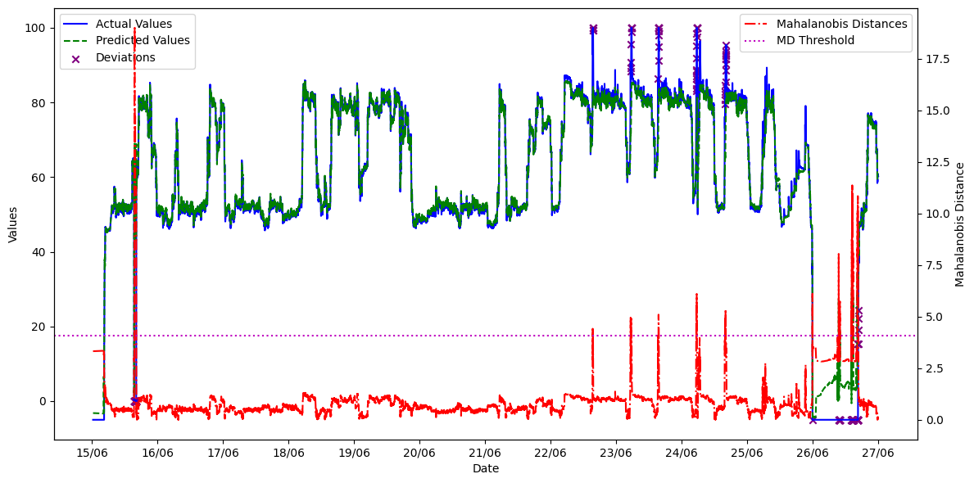
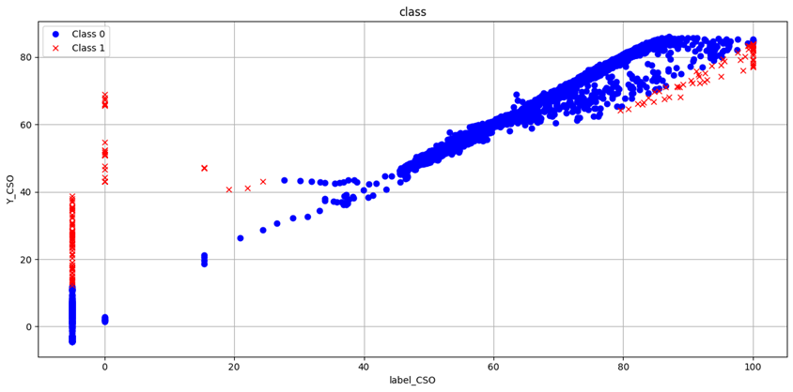
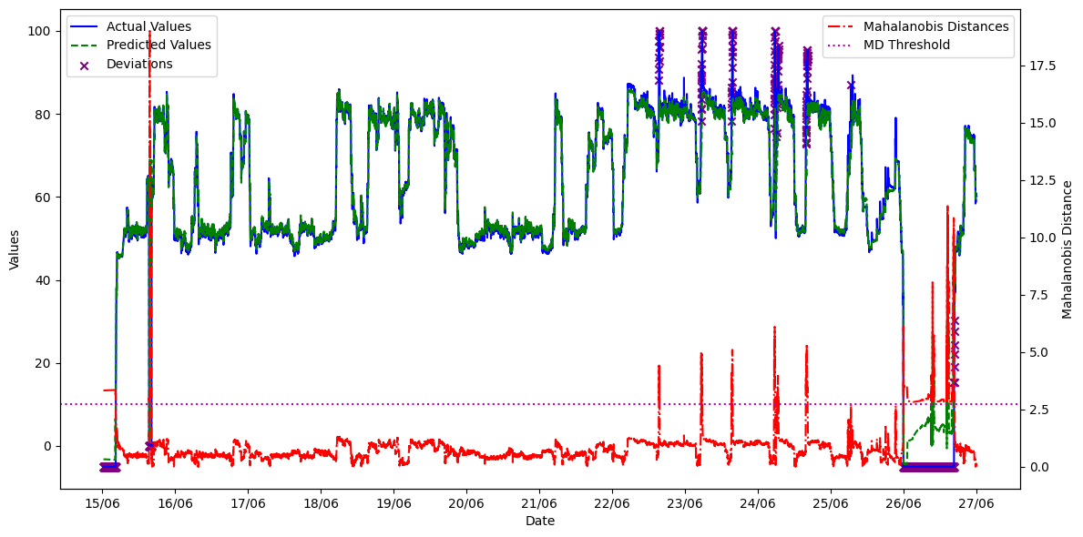
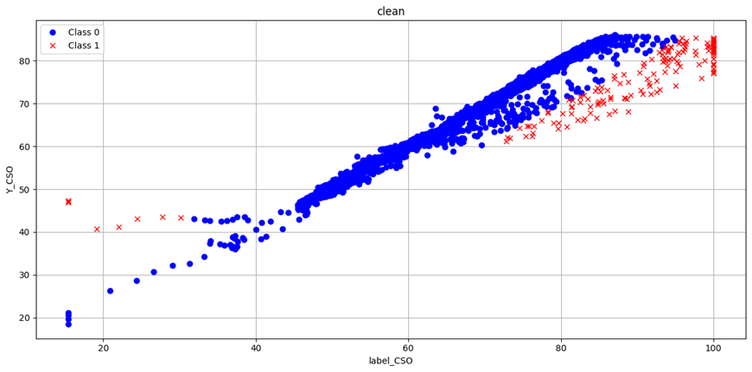
Data pre-process for binary classification
Recalculate mahalanobis distance
Remove noisy data point
Noisy point
Before
Before
After
After

Slide 5
Binary Classification
How to choose algorithm and implement:
Each algorithm will build own baseline model
Each algorithm will implement a different enhancement method combination
Compare each model performance

Slide 6
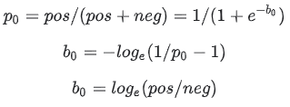
Binary Classification
picture 1
Enhancement methods:
To find optimal parameters
Hyperparameters tuner ( Keras-Tuner API)
Imbalance class issue (normal is majority)
Initialize the final layer weights
Idea: If we have an imbalanced dataset of a ratio 1:10 of positives:negatives, set the bias on logits such that the network predicts probability of 0.1 at initialization.
How :The correct bias to set can be derived from formula on picture 1. By setting this value as a parameter in the model, the model will give much more reasonable initial guesses.
Effect: Setting these correctly will speed up convergence and eliminate “hockey stick” loss curves where in the first few iteration your network is basically just learning the bias.
Calculate class weights
Idea : since we would want to have the classifier heavily weight the few examples that are available.
How : Passing Keras weights for each class through a parameter.
Effect: These will cause the model to "pay more attention" to examples from an under-represented class.

Slide 7
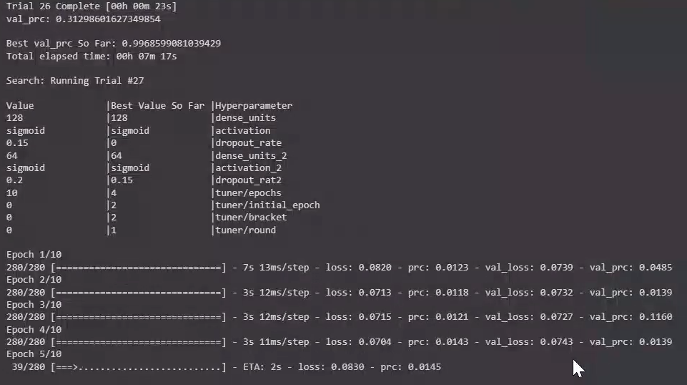
KerasTuner
KerasTuner is a hyperparameter tuner, it help us to learned hyperparameter from the training data, such as the number of neurons in a layer, learning rate, batch size, and so on.
Step:
As we implement our model architecture, we define what ranges we want to search over for a given parameter (e.g., # of filters in our first CONV layer, # of filters in the second CONV layer, etc.)
Then define an instance of either Hyperband, RandomSearch, or BayesianOptimization
The keras tuner package takes care of the rest, running multiple trials until we converge on the best set of hyperparameters

Slide 8
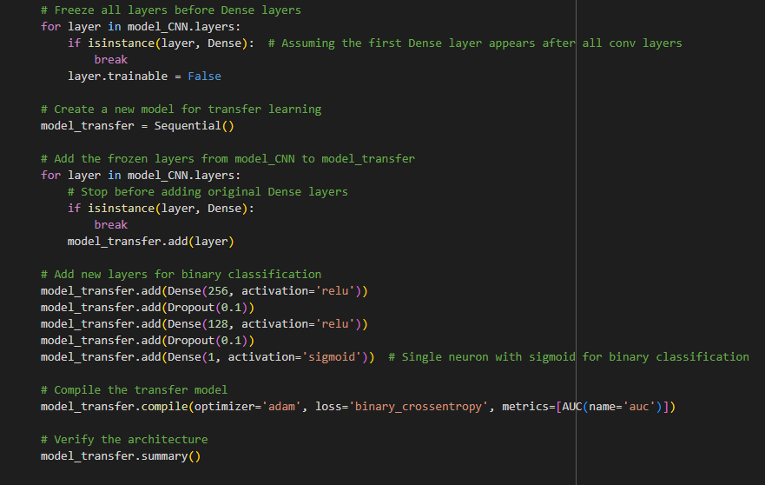
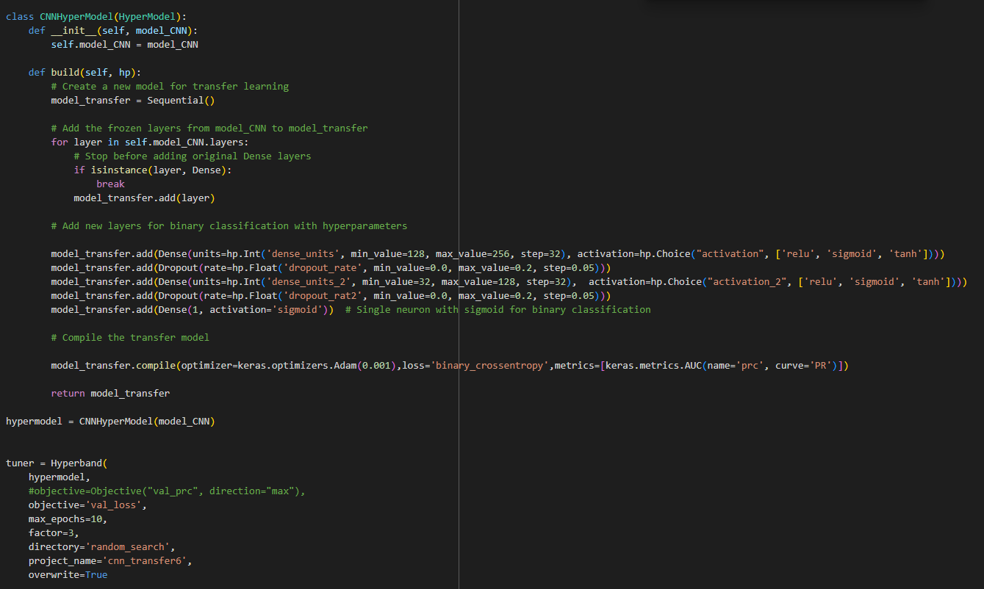
KerasTuner
Based on the baseline structure, defined what kind of choice of parameter we want
Baseline

Slide 9
Binary Classification
Enhancements over Two Primary Algorithms vs. Baseline Model:
CNN Transform_Learning
CNN_TL without initial weight and tuner(Baseline model)
CNN_TL with tuner(using hypermeters tuner)
CNN_TL with initial weight
FCN(From script)
FCN without initial weight(Baseline model)
FCN with initial weight

Slide 10
Binary Classification : CNN_Transfer_Learning

Slide 11
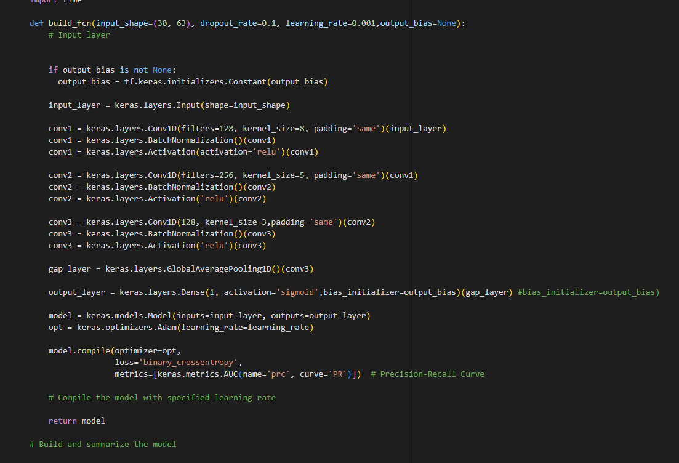
Binary Classification : FCN (From Script)

Slide 12
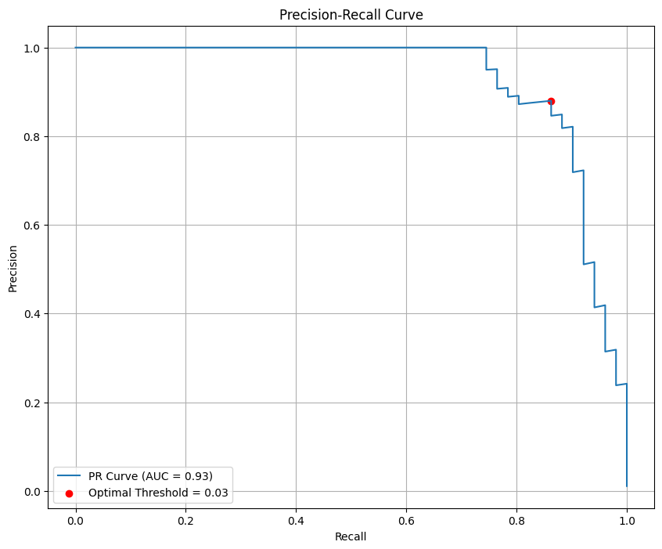
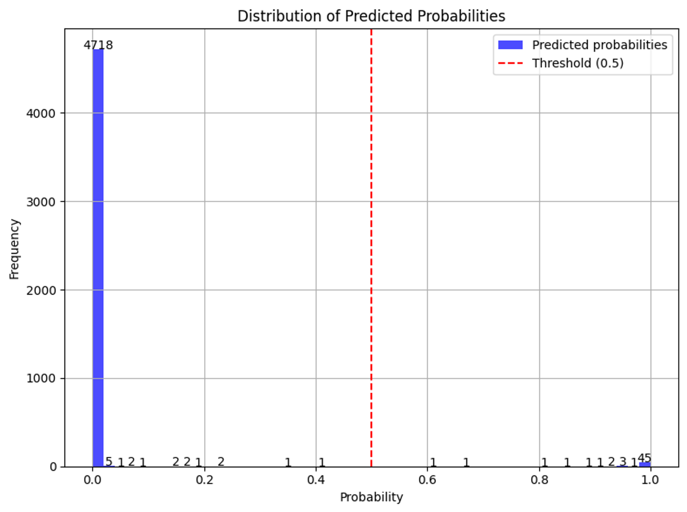
Binary Classification : Evaluation
Evaluation methods:
(1,1) is the best
Since our data is imbalance
Using Precision-Recall Curve to evaluate binary classification model
The PR curve illustrates the trade-off between precision and recall for different threshold values. This makes it particularly useful for imbalanced datasets because it focuses only on the positive class
Find the optimal threshold base on maximum Precision-Recall Curve value
Bias Towards the Majority Class : setting a threshold of 0.5 might not capture the true distribution and characteristics of the data.

Slide 13
Binary Classification : Model Comparison
Cnn_TL_100_baseline | Predicted
Actual | 4738 | 4
 | 0 | 51
Optimal threshold: 0.57196665
Model Name | F1_Score | Overkill Rate | Miss Rate
Cnn_TL_100_baseline | 0.9996 | 0.0008 | 0
Cnn_TL_100_with_tuner | 0.9995 | 0.0004 | 0.0588
Cnn_TL_100_initial_weight | 0.9993 | 0.0013 | 0.0196
FCN_100_baseline | 0.9995 | 0.0006 | 0.0392
FCN_100_initial_weight | 0.9994 | 0.0006 | 0.0588
Cnn_TL_100_with_tuner | Predicted
Actual | 4740 | 2
 | 3 | 48
Optimal threshold: 0.03
Cnn_TL_100_initial_weight | Predicted
Actual | 4736 | 6
 | 1 | 50
Optimal threshold: 0.13
Analysis: (Depends on primary concern )
Minimizing False Negatives: Cnn_TL_100_with_tuner is the best model as it has the lowest miss rate.
Minimizing False Positives: Cnn_TL_100_baseline is the best model as it has a perfect score with an overkill rate of 0.
Balance between the two rates is desired: FCN_100_baseline offers a middle ground, with relatively low values for both rates.
FCN_100_baseline | Predicted
Actual | 4739 | 3
 | 2 | 49
Optimal threshold: 0.9003032
FCN_100_initial_weight | Predicted
Actual | 4739 | 3
 | 3 | 48
Optimal threshold: 0.15639941
Miss Rate (False Negative Rate):It's the proportion of actual positive cases which are incorrectly .FN/(TP+FN)
Overkill Rate (False Positive Rate):It's the proportion of actual negative cases which are incorrectly predicted as positive. FP/(TN+FP)

