Slide 1
Cracked Rotor Prediction
27.10.2023

Slide 2
Content
Build Binary Classification with class weight
Sampling Trial

Slide 3
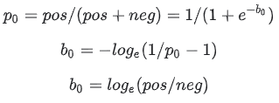
Binary Classification
picture 1
Enhancement methods:
To find optimal parameters
Hyperparameters tuner ( Keras-Tuner API)
Imbalance class issue (normal is majority)
Initialize the final layer weights
Idea: If we have an imbalanced dataset of a ratio 1:10 of positives:negatives, set the bias on logits such that the network predicts probability of 0.1 at initialization.
How :The correct bias to set can be derived from formula on picture 1. By setting this value as a parameter in the model, the model will give much more reasonable initial guesses.
Effect: Setting these correctly will speed up convergence and eliminate “hockey stick” loss curves where in the first few iteration your network is basically just learning the bias.
Calculate class weights
Idea : since we would want to have the classifier heavily weight the few examples that are available.
How : Passing Keras weights for each class through a parameter.
Effect: These will cause the model to "pay more attention" to examples from an under-represented class.

Slide 4
Binary Classification
GT Operation & Maintenance
Moni

Slide 5
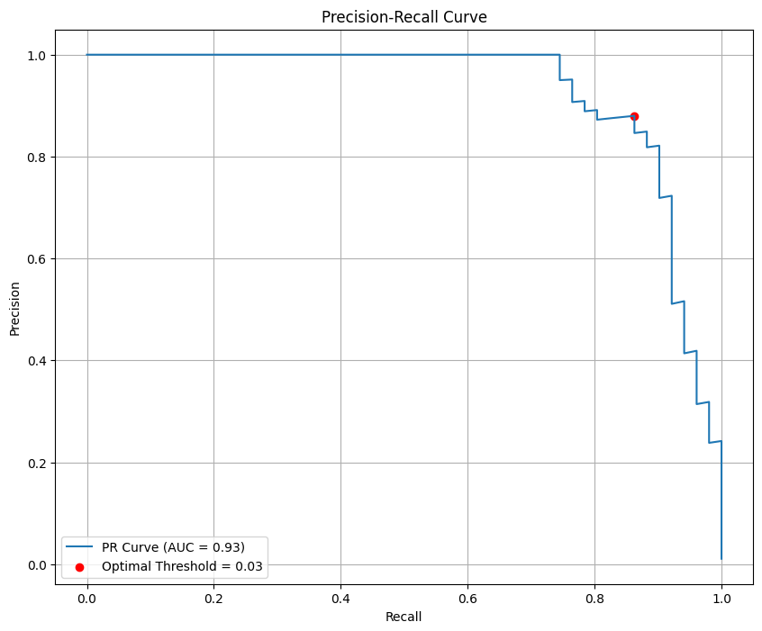
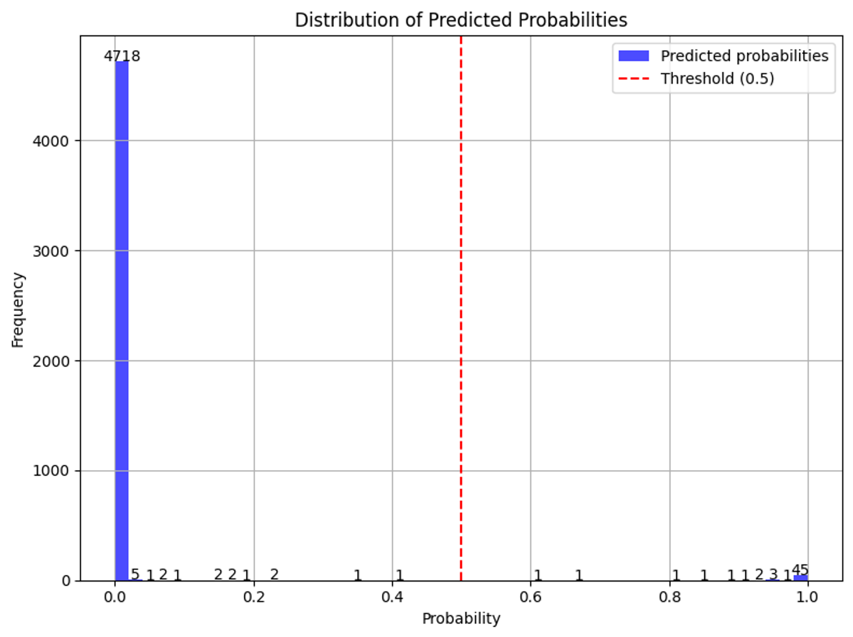
Binary Classification : Evaluation
Evaluation methods:
(1,1) is the best
Since our data is imbalance
Using Precision-Recall Curve to evaluate binary classification model
The PR curve illustrates the trade-off between precision and recall for different threshold values. This makes it particularly useful for imbalanced datasets because it focuses only on the positive class
Find the optimal threshold base on maximum Precision-Recall Curve value
Bias Towards the Majority Class : setting a threshold of 0.5 might not capture the true distribution and characteristics of the data.

Slide 6
Binary Classification : Model Comparison
Cnn_TL_baseline | Predicted
Actual | 4738 | 3
 | 1 | 50
Optimal threshold: 0.24912743
Model Name | F1_Score | False Positives Rate | False Negatives Rate
Cnn_TL_baseline | 0.9996 | 0.0196 | 0.0006
Cnn_TL_Class_Weight | 0.9995 | 0.0392 | 0.0006
FCN_baseline | 0.9991 | 0.0784 | 0.0011
FCN_Class_Weight | 0.9995 | 0.0392 | 0.0006
Cnn_TL_Class_Weight | Predicted
Actual | 4739 | 3
 | 2 | 49
Optimal threshold: 0.8662481
Analysis: (Depends on primary concern )
Minimizing False Negatives: Models with class weights perform slightly better, particularly `Fcn_class_weight` and `Cnn_class_weight`.
Minimizing False Positives: Cnn_TL_baseline is the best model as it as the lowest FPR of 0.0196
Balance between the two rates is desired: `Cnn_baseline` offers the best balance with the highest F1 score and low FPR.
While using class weights tends to improve the performance in the case of false negatives .the `Cnn_baseline` model (without class weight) still emerges as the most balanced and best-performing model across the board.
FCN_baseline | Predicted
Actual | 4737 | 5
 | 4 | 47
Optimal threshold:0.3874237
FCN_Class_Weight | Predicted
Actual | 4739 | 3
 | 2 | 49
Optimal threshold: 0.97072464
Notes:
In conclusion, class weights appear to be effective in this situation, especially when our priority is to reduce false negatives.
However, it's essential to adjust our approach based on the specific requirements of our application.for example, As discussed this morning, false positives require greater attention in rotor craker detection.

Slide 7
Sampling trial
Using different sampling method to solving imbalance class issue
Oversampling — Duplicating or Generate samples from the minority class
Method 1: SMOTE- Base on KNN to generate the minority class data point (from imblearn.over_sampling import SMOTE)
Method 2 : Interpolate
Set the 'Timestamps' column as the index.
Filter rows where 'predicted' is 1.
Check differences between consecutive timestamps that satisfy step 2. If the difference is one minute, insert rows at 10-second intervals and interpolate.
Undersampling — Deleting samples from the majority class
Method: Base on K-means clustering result ,then processing proportional sampling.
Goal is to sample representative data points from the majority class.
Apply k-means clustering to the majority class.
Sample proportionally from each cluster. For instance, if one cluster is bigger (has more data points) than others, take more samples from it#
Benefits :Representative Sampling and Preservation of Information , decrease training time
Notes:
- **Representative Sampling**: By clustering first and then sampling, you ensure that the samples you retain are representative of the overall distribution of the majority class.
- **Preservation of Information**: Even though you're reducing the number of samples, by selecting from clusters you're ensuring that the "essence" or "major patterns" of the majority class are retained.

Slide 8
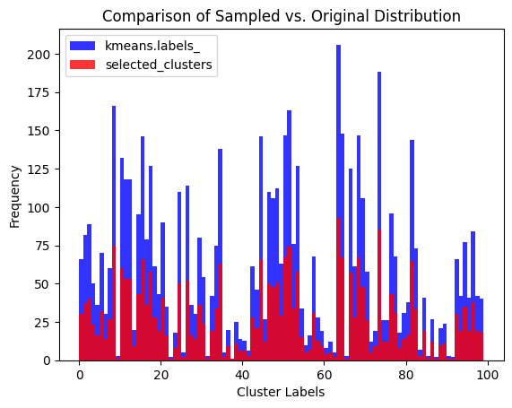
Sampling trial – Undersampling(Kmeans + proportional sample)
Raw Data
Normalization & Windows sliding
Clean Data
Training Data
Testing Data
Undersampling will only be applied to the positive class in the training data
Original positive class in train data : 11036
Undersampling positive class in train data : 5000

Slide 9
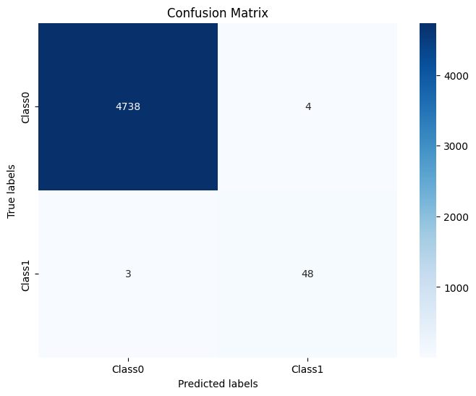
Sampling trial - Undersampling

