Slide 1
Prior to the session
1. Azure subscription
2. Start Bash or PowerShell as admin [Can be Bash in Windows]
3. Install Git
4. Install (or update) Azure CLI
3. Install Conda. Be sure Conda is on the PATH
4. Install AzCopy
5. [optional] Install Azure Machine Learning CLI
6. Set up Azure Machine Learning SDK for Python
conda create -n azureml -y Python=3.6 ipywidgets nb_conda
conda activate azureml
pip install --upgrade azureml-sdk[notebooks,contrib] \ scikit-image tensorflow tensorboardX --user
jupyter nbextension install --py --user azureml.widgets
jupyter nbextension enable azureml.widgets --user –py

Slide 2
Admin to provide users
Admins follow set up as described in https://github.com/msraidli/dogbreeds/lab/admin
Then provide the following information to the users
The storage account and key vault name for the dogbreeds data
DATA_STORAGE_ACCOUNT
DATA_STORAGE_CONTAINER
DATA_KEYVAULT_NAME
Workspace information
SUBSCRIPTION_ID
RESOURCEGROUP_NAME
WORKSPACE_NAME
WORKSPACE_STORAGE_ACCOUNT
WORKSPACE_KEYVAULT
Name of a default compute target

Slide 3
Getting started on Azure ML
For MSRLABS

Slide 4
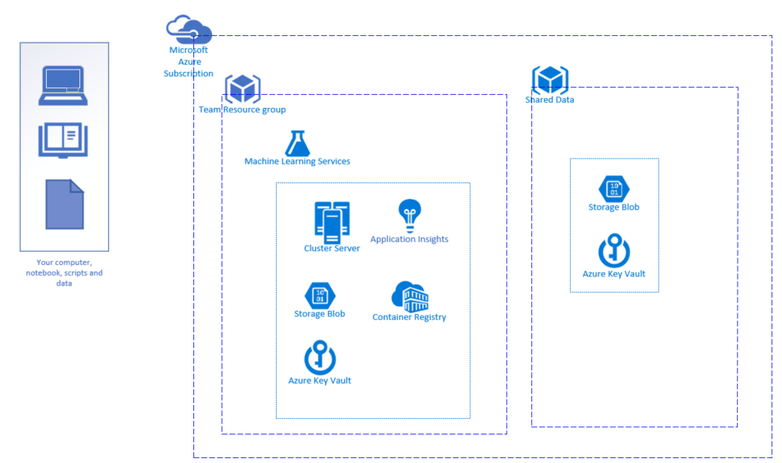
Overview

Slide 5
Agenda
Set up development system
Use Azure ML Python SDK from Jupyter Notebook
Understand Azure ML basics

Slide 6
Get set up

Slide 7
Getting started
We provide:
Workspace
Compute
Storage
Container registry
Key vault
Specifically to get started we provide:
Subscription ID
Resource group name
Your storage account name
Key vault name
Compute target(s) aka compute cluster name(s)
To run the demo:
Dogbreeds storage account name and container name
Dogbreeds key vault name
You provide
Set up your dev system
Provide your code
Provide your data or use ours
Request access to the security group for the common data from your admin

Slide 8
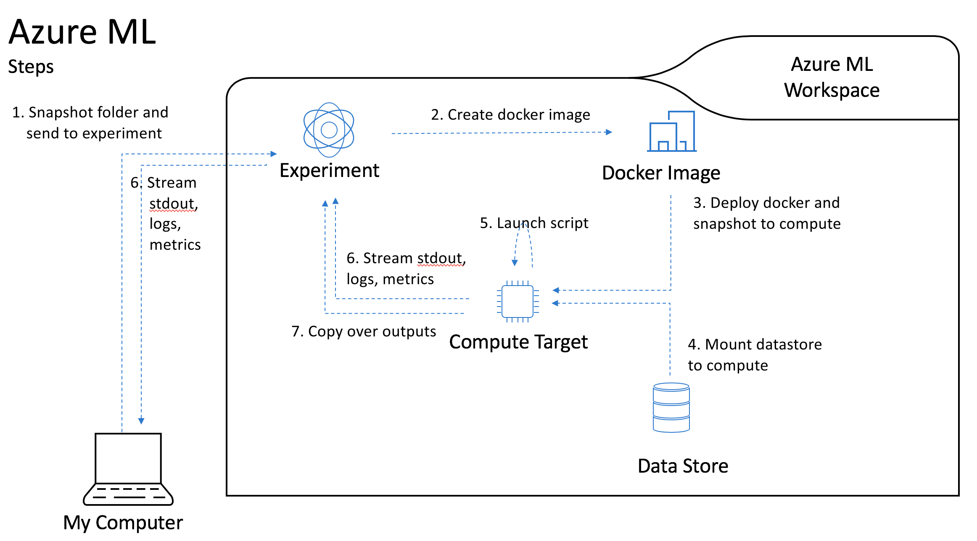
Steps to submitting your job
In Bash or PowerShell
Set up environment
In Python
Set workspace
Create experiment
Attach storage (input)
Set and run estimator
See results

Slide 9
Set up
Install tools
Set up Python environment
Azure CLI
Conda
AzCopy
[optional] Azure ML CLI
Demo code:
git clone https://github.com/danielsc/dogbreeds
git clone https://github.com/Azure/MachineLearningNotebooks/
conda create -n azureml -y Python=3.6 ipywidgets nb_conda
conda activate azureml
pip install --upgrade azureml-sdk[notebooks,contrib] \ scikit-image tensorflow tensorboardX --user
jupyter nbextension install --py --user azureml.widgets
jupyter nbextension enable azureml.widgets --user –py

Slide 10
Set environment variables and start Jupyter
Linux
PowerShell
export DATA_STORAGE_ACCOUNT=<data_account_name>
export DATA_STORAGE_CONTAINER=<demo_data_storage_container>
DATA_KEYVAULT_NAME=<demo_data_keyvault_name>
export RESOURCEGROUP_NAME=<resourcegroup_name>
export SUBSCRIPTION_ID=<subscription_id>
export WORKSPACE_NAME=<yourworkspacename>
az login
az account set –-subscription $SUBSCRIPTION_ID
az account show
# by convention the admin used the storage account as the name # of the key stored key vault
KEY=az keyvault secret show --name $DATA_STORAGE_ACCOUNT \
--vault-name $DATA_KEYVAULT_NAME | \
python -c 'import sys, json; \ sys.stdout.write(json.load(sys.stdin)[0][\" value\"])')
export AZURE_STORAGE_KEY=$KEY
## COPY DATA TO AZURE STORAGE IF NEEDED
jupyter notebook
$env:DATA_STORAGE_ACCOUNT=<data_account_name>
$env:DATA_STORAGE_CONTAINER=<demo_data_storage_container>
$DATA_KEYVAULT_NAME=<demo_data_keyvault_name>
$env:RESOURCEGROUP_NAME=<resourcegroup_name>
$env:SUBSCRIPTION_ID=<subscription_id>
$env:WORKSPACE_NAME=<yourworkspacename>
az login
az account set –-subscription $env:SUBSCRIPTION_ID
az account show
$keys_in_json = az keyvault secret show `
--name $env:AZURE_STORAGE_ACCOUNT `
--vault-name $KEYVAULT_NAME
$keys = $keys_in_json | ConvertFrom-Json
$key_value = $keys[0].value
$env:AZURE_STORAGE_KEY=$key_value
## COPY DATA TO AZURE STORAGE IF NEEDED
jupyter notebook

Slide 11
Copy data to Azure storage
PowerShell
$retrievedPassword = az keyvault secret show --vault-name $KEYVAULT_NAME ` --name $env:WORKSPACE_STORAGE_ACCOUNT
$env:WORKSPACE_STORAGE_KEY = $retrievedPassword.SecretValueText
$YOUR_STORAGE_CONTAINER = "mycontainer"
cd 'C:\Program Files (x86)\Microsoft SDKs\Azure\AzCopy'
./AzCopy `
/Source:C:\mydatafolder ` /Dest:https://$storageAccountName.blob.core.windows.net/$STORAGE_CONTAINER_NAME ` /DestKey:$env:WORKSPACE_STORAGE_KEY ` /S
Bash
export WORKSPACE_STORAGE_KEY=az keyvault secret show --vault-name $KEYVAULT_NAME \ --name $AZURE_STORAGE_ACCOUNT | \ python -c 'import sys, json; \ sys.stdout.write(json.load(sys.stdin)[\" value\"])')
azcopy \ --source /mnt/myfiles/ \ --destination https://$storageAccountName.blob.core.windows.net/$STORAGE_CONTAINER_NAME \ --dest-key $WORKSPACE_STORAGE_KEY \ --recursive
NOTE: AzCopy will create the storage container

Slide 12
Azure ML Basics

Slide 13
Understand Azure ML Basics
Parts of Azure ML
How to submit your run
How to get results

Slide 14
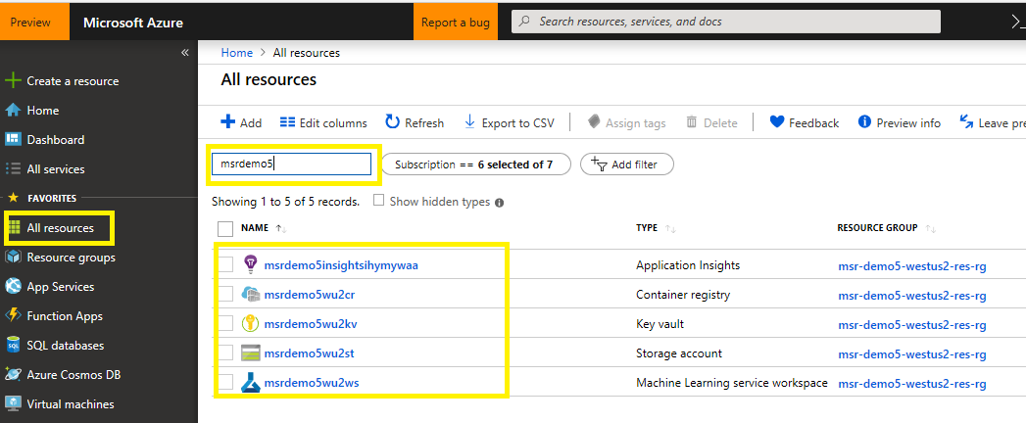
Parts of Azure ML Resources
Workspace
Storage
Container registry
Key vault
Application insights

Slide 15
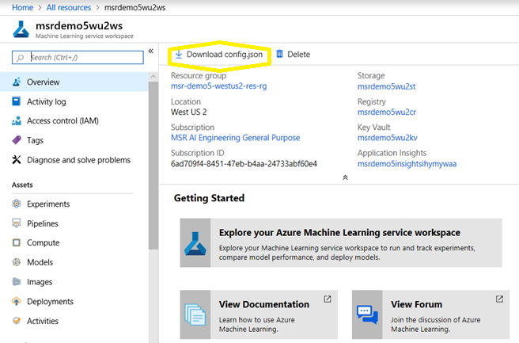
Parts of Azure ML Workspace
Workspace
Experiments
Pipelines
Compute
And more…
Download config.json

Slide 16
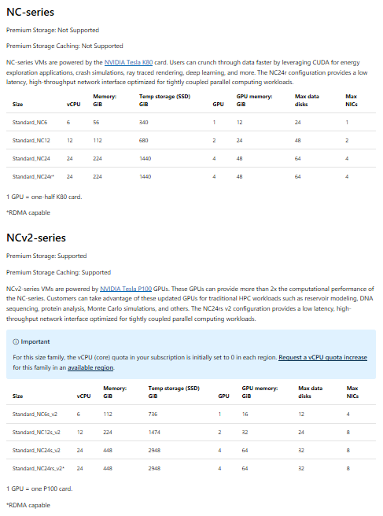
Parts of Azure ML Compute Cluster
Uses CUDA
Dedicated vs Low priority
VM type
K80 – NC series
P100 - NCv2 series
Automatic scaling
Supports Ethernet between nodes [for now]
https://docs.microsoft.com/en-us/azure/virtual-machines/windows/sizes-gpu

Slide 17
Submit run

Slide 18
Submit run
Create Workspace object
Create AMLCompute object
Set datastore
Name experiment
Build estimator
Run

Slide 19
Create Workspace
From Config file
from azureml.core import Workspace
ws = Workspace.from_config(path=<wherever-you-put-the-config-file>) print('https://ms.portal.azure.com/#@microsoft.onmicrosoft.com/resource' + ws.get_details()['id'])
From subscription id, resource group name and workspace name
from azureml.core import Workspace import os
subscription_id = os.environ['SUBSCRIPTION_ID']
resource_group = os.environ['RESOURCEGROUP_NAME']
workspace_name = os.environ['WORKSPACE_NAME']
try:
ws = Workspace(subscription_id = subscription_id, resource_group = resource_group, workspace_name = workspace_name)
ws.write_config()
print('Library configuration succeeded')
except:
print('Workspace not found')

Slide 20
Create AmlCompute
from azureml.core.compute import AmlCompute, ComputeTarget
# use the name for your cluster
cluster_name = 'p100-1gpus-ded'
try: compute_target = ws.compute_targets[cluster_name]
print('Found existing compute target.')
except KeyError:
print('Error with compute target...')

Slide 21
Set datastore
First, register data
from azureml.core import Datastore
import os
Datastore.register_azure_blob_container(workspace=ws,
datastore_name='thebreeds', # just a name to refer the Datastore
container_name=os.environ['AZURE_STORAGE_CONTAINER'],
account_name=os.environ['AZURE_STORAGE_ACCOUNT'],
account_key=os.environ['AZURE_STORAGE_KEY'])
Then, set the datastore
from azureml.core import Datastore
ds = Datastore(ws, 'thebreeds’)
path_on_datastore = 'breeds-10’
ds_data = ds.path(path_on_datastore)
print(ds_data)

Slide 22
Name the experiment
from azureml.core import Experiment
experiment_name = ‘<yourname>-pytorch-dogs’
experiment = Experiment(ws, name=experiment_name)

Slide 23
Build the estimator
You provide the estimator with:
The container (can be the default PyTorch, TensorFlow, or Chainer)
A pointer to your data
A pointer to your code
The name of the file to run
The parameters of the file you want to run
You can add pip or conda packages
You may specify a custom container
from azureml.train.dnn import PyTorch
script_params = { '--data_dir': ds_data.as_mount(), '--num_epochs': 10, '--output_dir': './outputs’., '--log_dir': './logs’, '--mode': 'fine_tune’ }
estimator10 = PyTorch(source_directory=‘.’, script_params=script_params, compute_target=compute_target, entry_script='pytorch_train.py’, pip_packages=['tensorboardX’], use_gpu=True)
https://github.com/Azure/MachineLearningNotebooks/blob/master/how-to-use-azureml/training-with-deep-learning/how-to-use-estimator/how-to-use-estimator.ipynb

Slide 24
Run
Run the estimator to
Build the container
Copy the entire folder to the container
Attach your data to the container
Start the run
RunDetails
Updates the widget in the notebook
After completion, copies the results to your storage location
run10 = experiment.submit(estimator10)
# in Jupyter Notebook
from azureml.widgets import RunDetails
RunDetails(run10).show()

Slide 25
(Option 1) Estimator using custom container
from azureml.train.estimator import Estimator
script_params = { '--num_epochs': 20, '--data_dir': ds_data.as_mount(), '--output_dir': './outputs’ }
estimator = Estimator(source_directory=project_folder, compute_target=compute_target, entry_script='cntk_distr_mnist.py’, script_params=script_params, node_count=2, process_count_per_node=1, distributed_backend='mpi’, pip_packages=['cntk-gpu==2.6’], custom_docker_image='microsoft/mmlspark:gpu-0.12’, use_gpu=True)
https://github.com/Azure/MachineLearningNotebooks/blob/master/how-to-use-azureml/training-with-deep-learning/distributed-cntk-with-custom-docker/distributed-cntk-with-custom-docker.ipynb

Slide 26
Demos

Slide 27
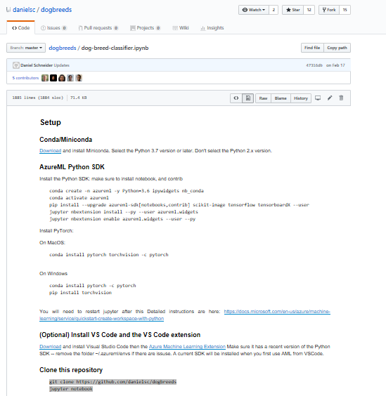
Demo Using Jupyter Notebook
Set workspace
Set compute target
Set datastore
Upload data
Create experiment
Create estimator
Run estimator
See results
Find results in storage

Slide 28
Demo Using Python script
Set workspace
Set compute target
Set datastore
Upload data
Create experiment
Create estimator
Run estimator
See results
Find results in storage

Slide 29
Get results

Slide 30
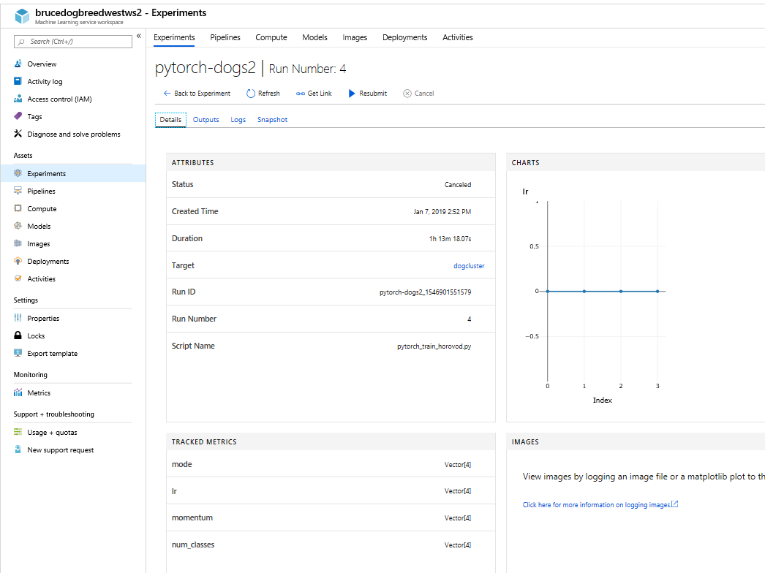
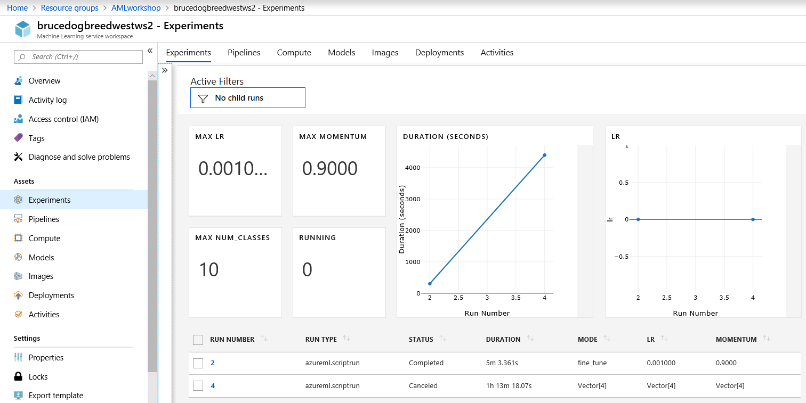
Find results - portal
View in Azure portal

Slide 31
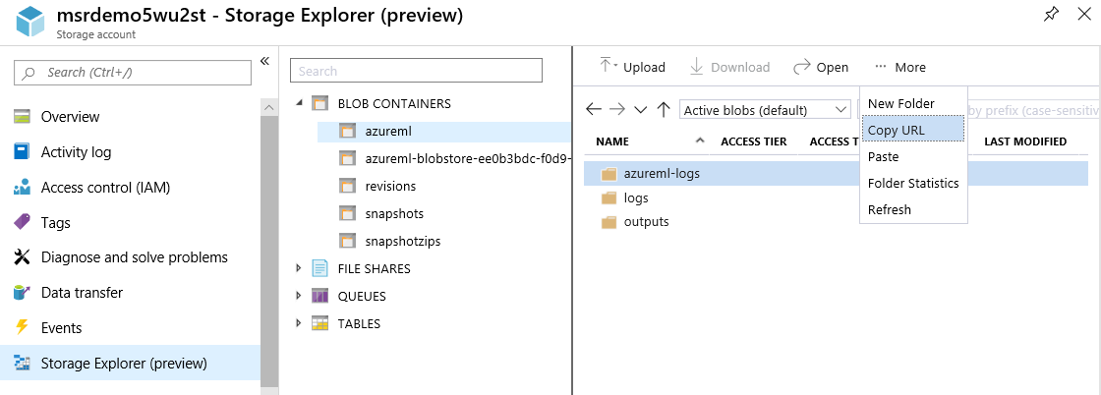
Find results
Open storage account
Results are in a folder in the azureml container
Can copy results from storage account to your development machine using portal or using AzCopy
Can sync results using azcopy sync (AzCopy v10)

Slide 32
Next steps
Distributed application
Hyperparameter tuning
Inferencing
Deploy model
Automated Machine learning

Slide 33
References
Dog breeds demo
Azure ML GitHub
Azure ML Documentation

Slide 34
Appendix

Slide 35
(Option 1a) Estimator using custom container in registry
[Before you start your Python script]
Set the CUSTOM_DOCKER_PWD environment variable to the registry password
from azureml.core.runconfig import EnvironmentDefinition
environment_definition = EnvironmentDefinition()
environment_definition.docker.enabled = True
environment_definition.docker.base_image = "amltraining/gpumpi:gpu-tag"
environment_definition.docker.base_image_registry.username ="CustomDockerE2E"
environment_definition.docker.base_image_registry.password = os.environ.get("CUSTOM_DOCKER_PWD")
environment_definition.docker.base_image_registry.address= "customdockere2e.azurecr.io"
environment_definition.python.user_managed_dependencies=True
estimator = PyTorch(project = project, script_params = script_params, compute_target = compute_target, entry_script = training_script, node_count = 1, environment_definition = environment_definition)
https://github.com/Azure/MachineLearningNotebooks/

Slide 36
(Option 2) Run locally
from azureml.core.runconfig import RunConfiguration
# Editing a run configuration property on-fly.
run_config_user_managed = RunConfiguration() run_config_user_managed.environment.python.user_managed_dependencies = True
# You can choose a specific Python environment by pointing to a Python path
#run_config.environment.python.interpreter_path = '/home/johndoe/miniconda3/envs/myenv/bin/python'
from azureml.core import ScriptRunConfig
src = ScriptRunConfig(source_directory='./’,
script='train.py’,
run_config=run_config_user_managed)
run = exp.submit(src)
run
# on Jupyter Notebook
run.wait_for_completion(show_output=True)
https://github.com/Azure/MachineLearningNotebooks/blob/master/how-to-use-azureml/training/train-on-local/train-on-local.ipynb

Slide 37
Notes on storage
Can connect to:
Blob
Azure File
Azure Data Lake Store
SQL Database
Access ADLS using Pipelines

Slide 38
Get key in your Python code
1. Using your current login credentials
from azure.common.client_factory import get_client_from_cli_profile
from azure.mgmt.compute import ComputeManagementClient
client = get_client_from_cli_profile(ComputeManagementClient)
2. Get key
vault_url = https://<yourvaultresourcename>.vault.azure.net/
secret_id = <name of your storage account>
secret_version = ''
secret_bundle = client.get_secret(vault_url, secret_id , secret_verion)
key = secret_bundle.value
https://docs.microsoft.com/en-us/python/api/azure-common/azure.common.client_factory?view=azure-python

Slide 39
Common Storage
Dog breeds
West US 2
West Europe
Imagenet
West US 2
West Europe

Slide 40
Log into container using SSH (temp solution to be updated by AML team)
Start run
Get SSH log in information from Node tab of run in workspace portal
Log in using user name and password
User name is teamlead alias and password is workspace name
Get container images
sudo container image ps
Guess which one
sudo container exec

Slide 41

Thanks
Azure CAT Team
AML Program Managers
MSR Machine Learning at Scale team

