Slide 1

BEA14 @ ACL
August 02, 2019
14th Workshop on Innovative Use of NLP for Building Educational Applications
Organisers:
Ekaterina Kochmar
Claudia Leacock
Nitin Madnani
Ildikó Pilán
Helen Yannakoudakis
Torsten Zesch
Notes:
1

Slide 2
BEA
14 years of history... (first BEA in 2003)
Workshop Focus: NLP innovation in the context of educational applications
BEA14
Record registrants this year (120+)
Many thanks to 137 reviewers!
7th BEA with sponsorship (6 sponsors)
6th BEA with a shared task (Grammatical Error Correction)
Notes:
2

Slide 3
BEA numbers
Year | Total Submissions | Total Accepted | Oral | Poster | Acceptance Rate
2011 | 36 | 22 | 8 | 14 | 61%
2012 | 42 | 24 | 8 | 16 | 57%
2013 | 25 | 15 | 9 | 6 | 60%
2014 | 35 | 21 | 7 | 14 | 60%
2015 | 44 | 29 | 10 | 19 | 66%
2016 | 46 | 28 | 8 | 20 | 61%
2017 | 62 | 34 | 9 | 25 | 55%
2018 | 41 | 26 | 8 | 18 | 63%
2019 | 86 | 36 | 8 | 28 | 42%
2012, 2013, 2016, 2017, 2019 numbers do not include shared tasks.
Notes:
3
This year we received a record 62 submissions, and accepted 9 papers as oral presentations and 25 as
poster presentation and/or demos, for an overall acceptance rate of 55 percent.
3

Slide 4
Grammatical Error Correction (GEC)
Shared Task
GEC: task of automatically correcting grammatical errors in text.
Organisers:
Christopher Bryant, University of Cambridge
Mariano Felice, University of Cambridge
Øistein Andersen, University of Cambridge
Ted Briscoe, University of Cambridge
1 overview paper (oral presentation) and 15 submitted systems (posters).
Notes:
4
This year, the workshop is hosting a Shared Task on Native Language Identification2 (NLI). NLI is the
process of automatically identifying the native language (L1) of a non-native speaker based solely on
language that he or she produces in another language. Two previous shared tasks on NLI have been
organized in which the task was to identify the native language of non-native speakers of English based
on essays and spoken responses to a standardized assessment of academic English proficiency. The first
shared task3 was based on the essays only and was also held with the BEA workshop in 2013. Three
years later, Computational Paralinguistics Challenge4 at Interspeech 2016 hosted a sub-challenge on
identifying the native language based solely on the spoken responses. This year’s shared task combines
the inputs from the two previous tasks. There are three tracks: NLI on the essay only, NLI on the speech
response only, and NLI using both responses from a test taker. 19 teams competed in the NLI shared
task, with 17 presenting their systems during the poster session. A summary report of the shared task
(Malmasi et al.) will be presented orally.
4

Slide 5
BEA14 news
We’re now a Special Interest Group (ACL SIGEDU)!
President: Jill Burstein (Educational Testing Service)
Secretary: Ekaterina Kochmar (Cambridge University)
Treasurer: Helen Yannakoudakis (King’s College London, Cambridge University)
Media Chair: Nitin Madnani (Educational Testing Service)
Publications Chair: Torsten Zesch (University of Duisburg-Essen)
Board members:
Claudia Leacock (Grammarly)
Ildiko Pilan (Develop Diverse)
164 members (register online: sig-edu.org/members)
Members added to BEA mailing list, receive updates, can run for positions on the SIG, vote in elections.
Notes:
5

Slide 6
BEA14 news
Brand new website for SIGEDU and BEA: sig-edu.org
SIGEDU blog features newsletters and blog posts.
Website designed and populated with the BEA community in mind: code is open-source and hosted on GitHub.
Anyone can suggest changes, submit content (links to resources, events, papers, job openings), write blog posts...
Twitter account: @aclsigedu
BEA14 student sponsorship thanks to our amazing sponsors
Congratulations to Klára Klimčíková (LMU Munich)!
BEA14 ambassador paper award (more from Torsten...)
Notes:
6

Slide 7

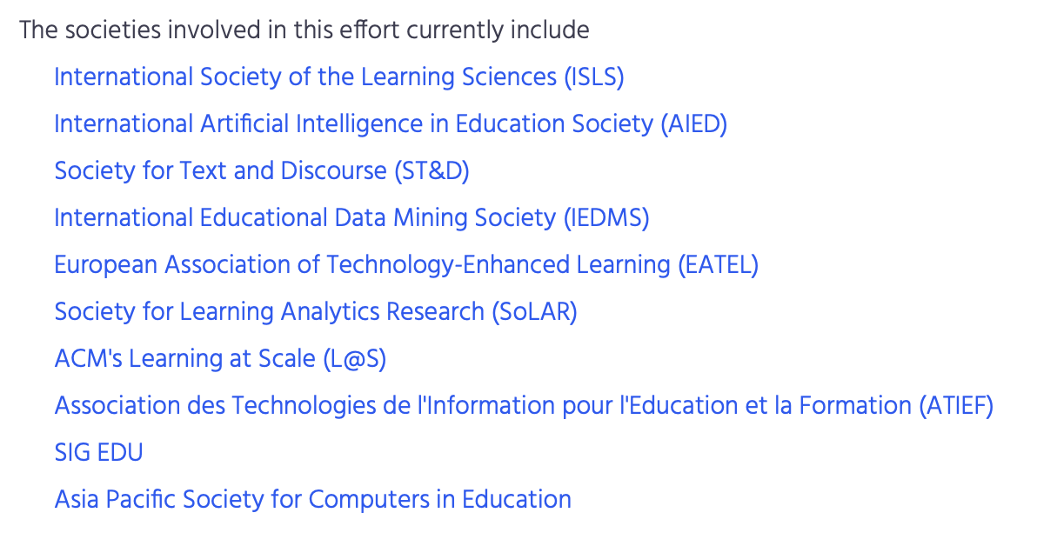
Ambassador Paper

Slide 8
Ambassador Paper – Incoming
Shelley Feuer
Effects of the self-view window during video-mediated survey interviews: An eye-tracking study.
Best Paper from ST&D (Society for Text and Discourse)
Notes:
8

Slide 9
Ambassador Paper – Outgoing
Ambassador paper != best paper
Select another organization and present paper at their venue
Financial support from SIGEDU
Voting: http://bit.ly/bea14-ambassador
Notes:
9

Slide 10




Gold Sponsors
Notes:
10
10

Slide 11


Silver Sponsors
Bronze Sponsors
Notes:
11
11

Slide 12
Poster Session Notes
28 BEA posters + 15 GEC shared task papers
Spread over two poster sessions:
Group A: 2:00 – 2:45
Group B: 2:45 – 3:30
Presenters: set up at 1:45
BEA14 schedule:
https://sig-edu.org/bea/current
Notes:
12
This year, the workshop is hosting a Shared Task on Native Language Identification2 (NLI). NLI is the
process of automatically identifying the native language (L1) of a non-native speaker based solely on
language that he or she produces in another language. Two previous shared tasks on NLI have been
organized in which the task was to identify the native language of non-native speakers of English based
on essays and spoken responses to a standardized assessment of academic English proficiency. The first
shared task3 was based on the essays only and was also held with the BEA workshop in 2013. Three
years later, Computational Paralinguistics Challenge4 at Interspeech 2016 hosted a sub-challenge on
identifying the native language based solely on the spoken responses. This year’s shared task combines
the inputs from the two previous tasks. There are three tracks: NLI on the essay only, NLI on the speech
response only, and NLI using both responses from a test taker. 19 teams competed in the NLI shared
task, with 17 presenting their systems during the poster session. A summary report of the shared task
(Malmasi et al.) will be presented orally.
12

Slide 13
Coffee breaks & Poster sessions
Coffee breaks:
Snack bar area, ground floor Spadolini Pavilion
Poster sessions:
Outside Hall 2
Notes:
13
This year, the workshop is hosting a Shared Task on Native Language Identification2 (NLI). NLI is the
process of automatically identifying the native language (L1) of a non-native speaker based solely on
language that he or she produces in another language. Two previous shared tasks on NLI have been
organized in which the task was to identify the native language of non-native speakers of English based
on essays and spoken responses to a standardized assessment of academic English proficiency. The first
shared task3 was based on the essays only and was also held with the BEA workshop in 2013. Three
years later, Computational Paralinguistics Challenge4 at Interspeech 2016 hosted a sub-challenge on
identifying the native language based solely on the spoken responses. This year’s shared task combines
the inputs from the two previous tasks. There are three tracks: NLI on the essay only, NLI on the speech
response only, and NLI using both responses from a test taker. 19 teams competed in the NLI shared
task, with 17 presenting their systems during the poster session. A summary report of the shared task
(Malmasi et al.) will be presented orally.
13

Slide 14
Post-workshop dinner
We will be hosting our "world famous" post-workshop dinner immediately following the closing remarks of the workshop!
Students will have their dinner subsidized
Please sign up! http://bit.ly/bea14-dinner
Venue:
Trattoria Coco Lezzone
Via del Parioncino, 26/r – 50100 Firenze
Time: 7pm
If you’d like to walk with us, we’ll be leaving the conference venue at 6.30pm sharp.
Notes:
14

Slide 15
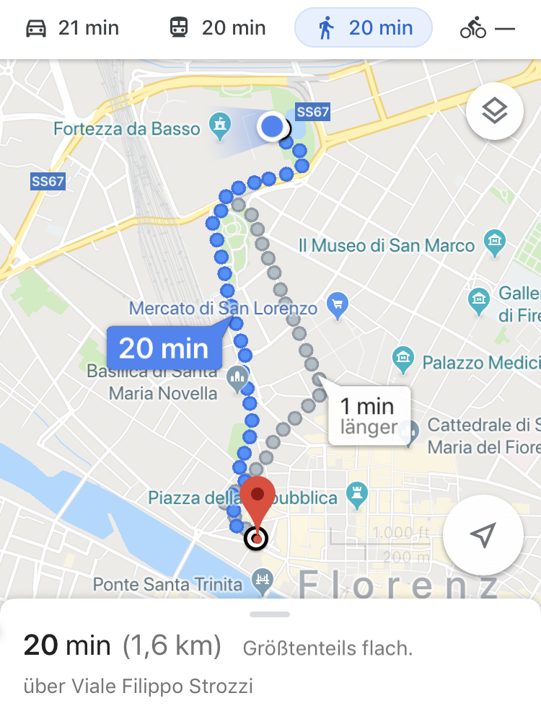
Let’s Go!
Notes:
15

