Slide 1
Lab 1 - Backpropagation
Department of Computer Science, NCTU
TA Yu-Chuan Chuang

Slide 2
Important Rules
Important Date :
Report Submission Deadline: 3/28 (Thu) 12:00 p.m.(中午12點)
Demo date: 3/28 (Thu)
Turn in :
Experiment Report (.pdf)
Source code (.py)
Notice: zip all files in one file and name it like「DLP_LAB1_your studentID_name.zip」, ex: 「DLP_LAB1_0656608_莊祐銓.zip」

Slide 3
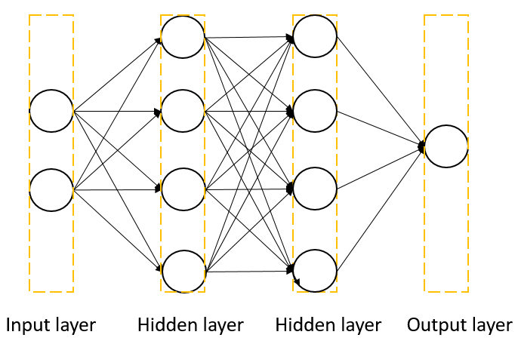
Lab Objective
In this lab, you will need to understand and write a simple neural networks with forward pass and backpropagation using two hidden layers.
Fully connected就好ㄌ

Slide 4
Requirements
Implement a simple neural networks with two hidden layers
You must use backpropagation in this neural network and only can use Numpy and other python standard library to implement
Plot your comparison figure showing the predictions and ground truth

Slide 5


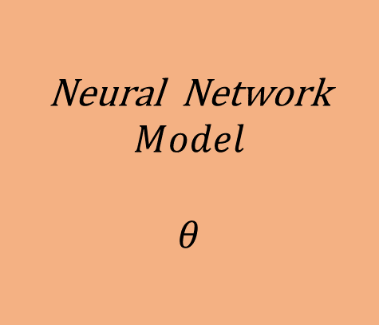









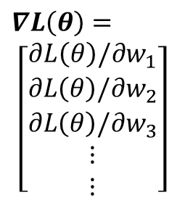

Gradient Descent
$${ x}^{n}$$
Neural Network
$$Model$$
$$θ$$
$${ y}^{n}$$
$${ \hat{y}}^{n}$$
Loss Function
$$L(θ)$$
Input
Model
Output
Ground
truth
$$∇L\left(θ\right)=$$
$$\left[\begin{aligned}∂L\left(θ\right)/∂w_{1} \\ ∂L\left(θ\right)/∂w_{2} \\ ∂L\left(θ\right)/∂w_{3} \\ ⋮ \\ ⋮\end{aligned}\right]$$
$${Compute ∇L(θ}^{0})$$
$$θ^{1}={θ^{0} − ρ ∇L(θ}^{0})$$
Network Parameters
$$θ=\{w_{1},w_{2},w_{3},w_{4},⋯\}$$
$$θ^{2}={θ^{0} − ρ ∇L(θ}^{1})$$
$${Compute ∇L(θ}^{1})$$
$${Compute ∇L(θ}^{2})$$
$$θ^{3}={θ^{0} − ρ ∇L(θ}^{2})$$
$$ρ :Learning rate$$

Slide 6
Flow Chart
Prepare data
Create model
Forward pass
Repeat n times or until convergence
Training
Backward pass
Update weights
Notes:
這邊則是大家實作時可以參考的流程 我們等等就會按照這個流程來一步一步觀察
首先是準備你的資料
在來是設計你的模型
之後就可以決定你的訓練方法
那訓練方法又可在拆分為三個階段
Forward backward以及update weights
一直重複training這個步驟 直到網路收斂或是你認為ok就可以停下來

Slide 7
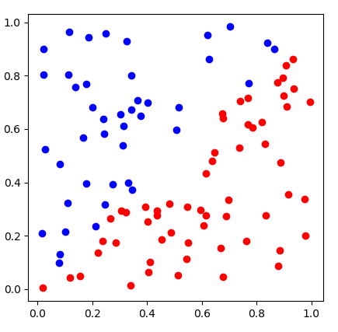
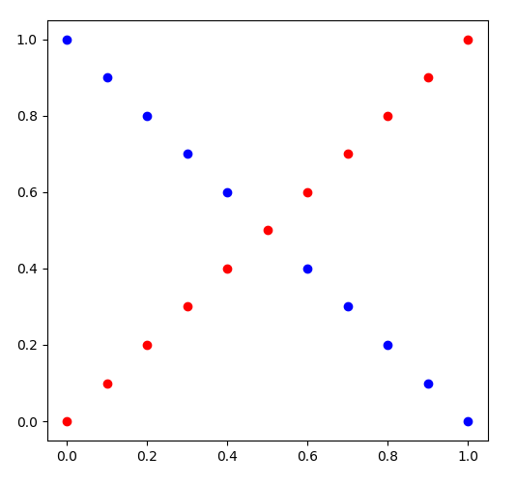
Prepare Data
線性可分資料，採100個點就好
線性不可分版本
generate_linear()
generate_XOR_easy()

Slide 8
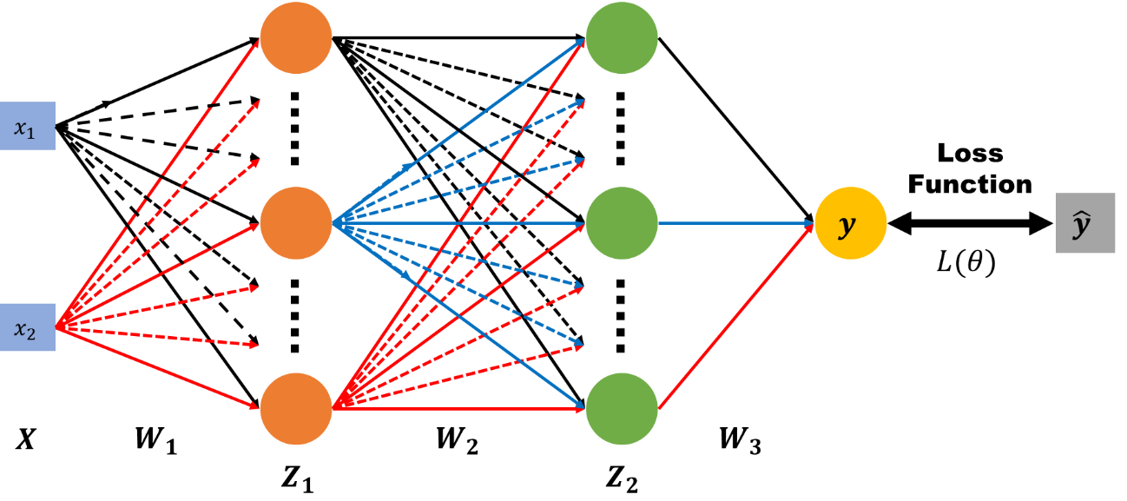
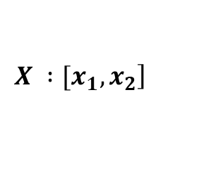


Create Model
4個neuron就差不多ㄌ
$$\left.X :[x_{1}, x_{2}\right]$$
$$y : outputs$$
$$\hat{y} : ground truth$$
$W_{1}, W_{2}, W_{3}$ $: weight matrix of network layers$

Slide 9
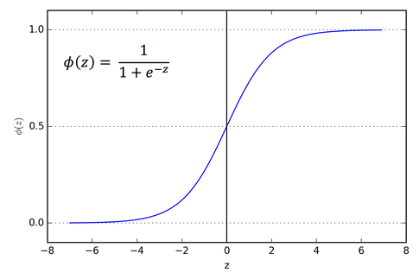
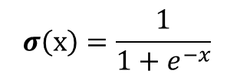
Forward
要經過non-linear的轉換
$Z_{1}=σ(XW_{1})$ $Z_{2}=σ(Z_{1}W_{2})$ $y=σ(Z_{2}W_{3})$
$$σ\left(x\right)=\frac{1}{1+e^{−x}}$$

Slide 10



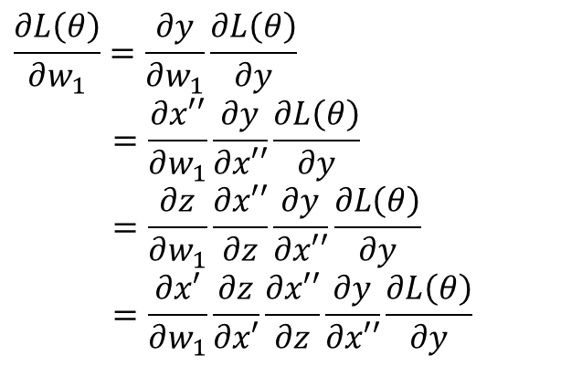




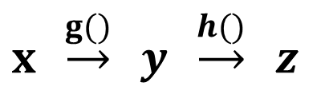




Backward
$$x′$$
$$z$$
$$x′′$$
$$x$$
$$y$$
$$\hat{y}$$
$$w_{1}$$
$${w′}_{1}$$
$$L(θ)$$
$x′=xw_{1}$ $z=σ(x′)$ $x′′=z{w′}_{1}$ $y=σ(x′′)$
$$\frac{∂L\left(θ\right)}{∂w_{1}}=\frac{∂y}{∂w_{1}}\frac{∂L\left(θ\right)}{∂y}$$
$$=\frac{∂x′′}{∂w_{1}}\frac{∂y}{∂x′′}\frac{∂L\left(θ\right)}{∂y}$$
$$=\frac{∂z}{∂w_{1}}\frac{∂x′′}{∂z}\frac{∂y}{∂x′′}\frac{∂L\left(θ\right)}{∂y}$$
$$=\frac{∂x′}{∂w_{1}}\frac{∂z}{∂x′}\frac{∂x′′}{∂z}\frac{∂y}{∂x′′}\frac{∂L\left(θ\right)}{∂y}$$
Chain rule
$y=g\left(x\right) z=h(y)$
$x \underset{→}{g()} y \underset{→}{h()} z$
$$\frac{dz}{dx}=\frac{dz}{dy} \frac{dy}{dx}$$

Slide 11
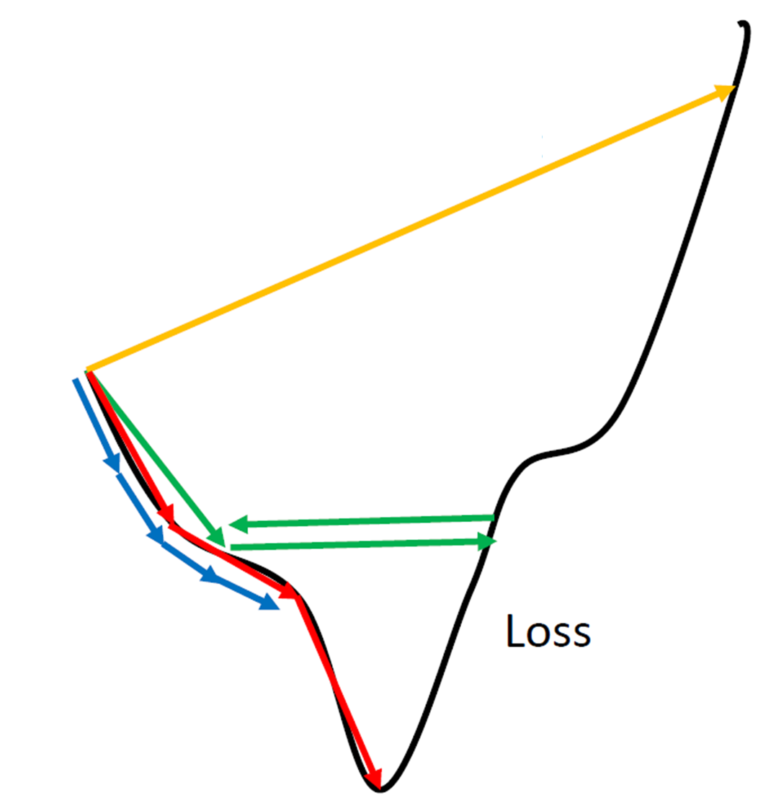










Update Weight
Network Parameters
$$θ=\{w_{1},w_{2},w_{3},w_{4},⋯\}$$
$$∇L\left(θ\right)=$$
$$\left[\begin{aligned}∂L\left(θ\right)/∂w_{1} \\ ∂L\left(θ\right)/∂w_{2} \\ ∂L\left(θ\right)/∂w_{3} \\ ⋮ \\ ⋮\end{aligned}\right]$$
$${Compute ∇L(θ}^{0})$$
$$θ^{1}={θ^{0} − ρ ∇L(θ}^{0})$$
$$ρ :Learning rate$$
$${Compute ∇L(θ}^{1})$$
$$θ^{2}={θ^{0} − ρ ∇L(θ}^{1})$$
設可以小一點但不要太小
$${Compute ∇L(θ}^{2})$$
$$θ^{3}={θ^{0} − ρ ∇L(θ}^{2})$$
$$⋮$$
http://www.denizyuret.com/2015/03/alec-radfords-animations-for.html

Slide 12
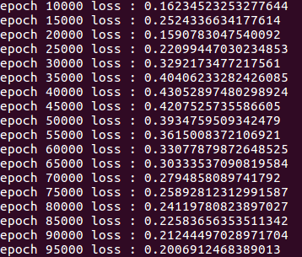
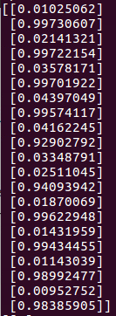
In the training, you need to print loss
In the testing, you need to show your predictions
觀察neuron有沒有再好好training
就直接拿training data下去test就好ㄌ

Slide 13
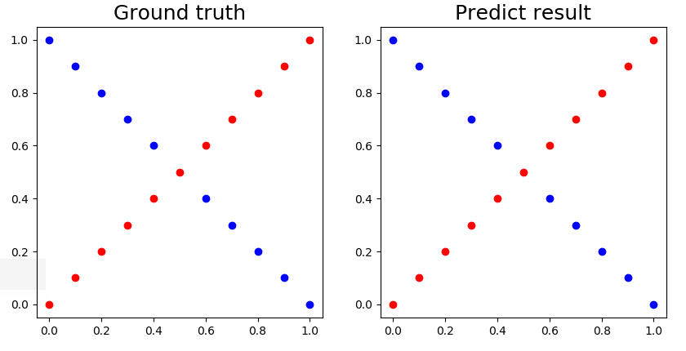
Visualize the predictions and ground truth at the end of the training process

Slide 14
Reference
http://www.denizyuret.com/2015/03/alec-radfords-animations-for.html
http://speech.ee.ntu.edu.tw/~tlkagk/courses_ML17_2.html

