Slide 1
Neural Network Accelerator
Team 11
Kai Segimoto, Shang Wang
ESE 5730 Spring 2026

Slide 2
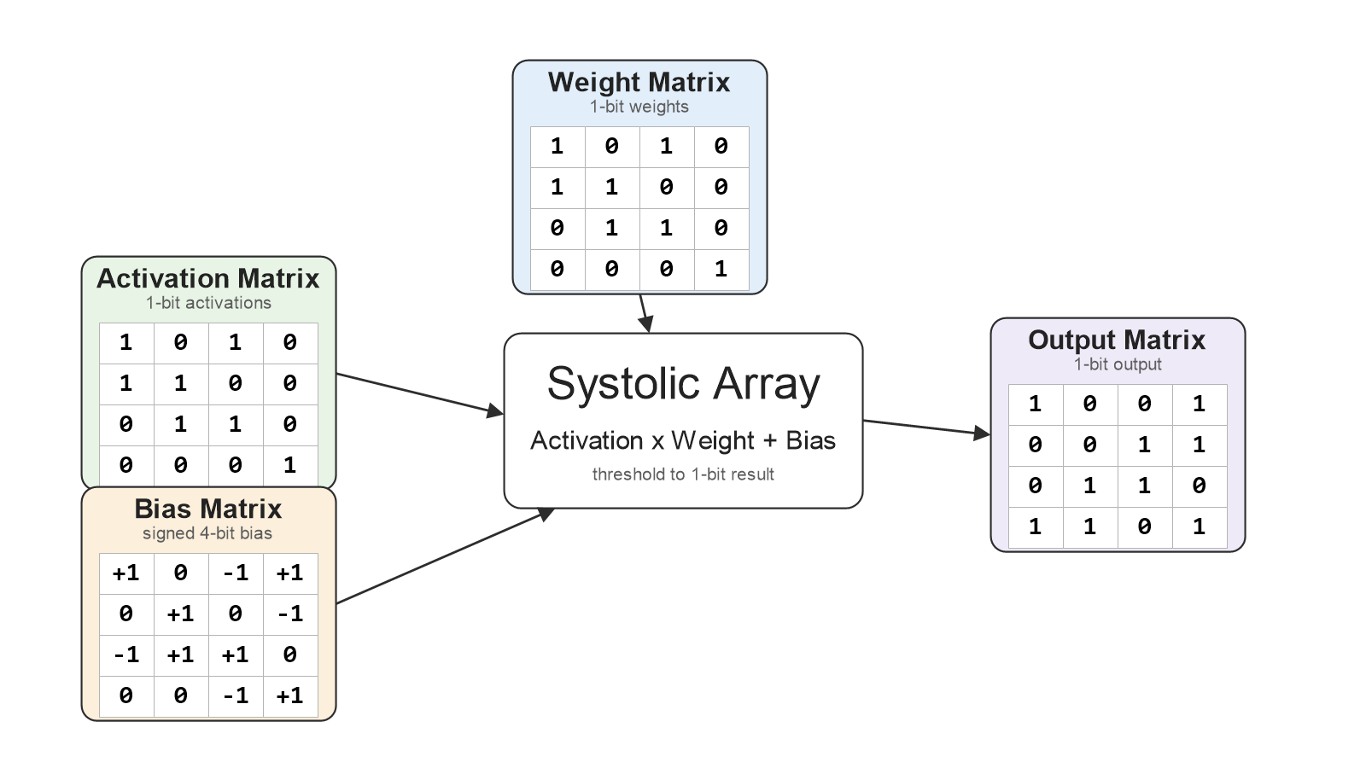


Importance & Design Goals
Matrix Multiplication
Our chip is a small hardware accelerator for matrix multiplication, which is the core operation used in many neural network and AI workloads
The chip takes an activation matrix, a weight matrix, and a bias matrix, then computes the output matrix using a compact binary systolic array and binary quantization.
This type of accelerator can be used in low-power edge AI applications such as edge inference, image classification, sensor processing, and embedded neural network systems.
Implement Matrix multiplication using a systolic array architecture, which uses parallelism for highly increased throughput
Add an activation stage (ReLU) + quantization, then store results in an output memory with serial I/O interface support.

Slide 3
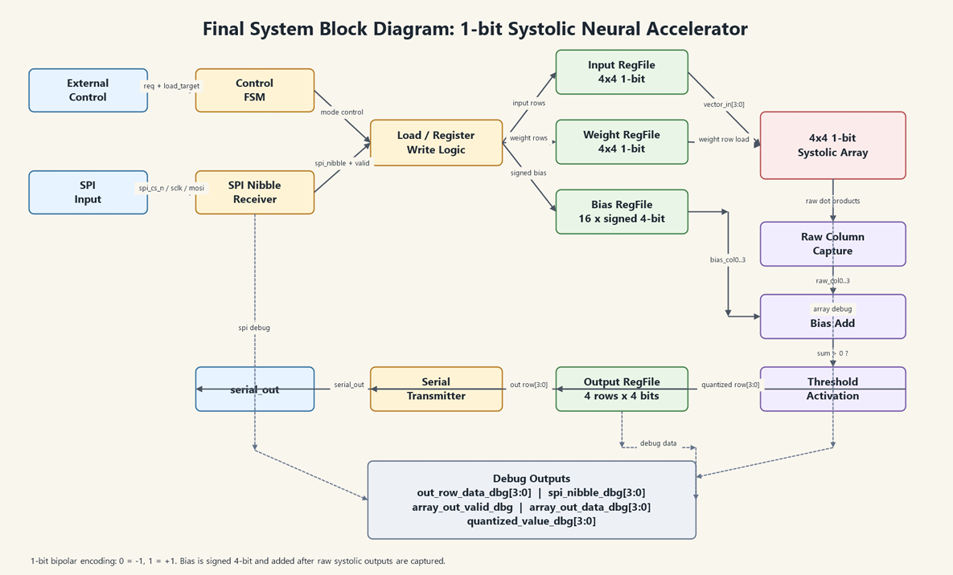
Block Diagram

Slide 4
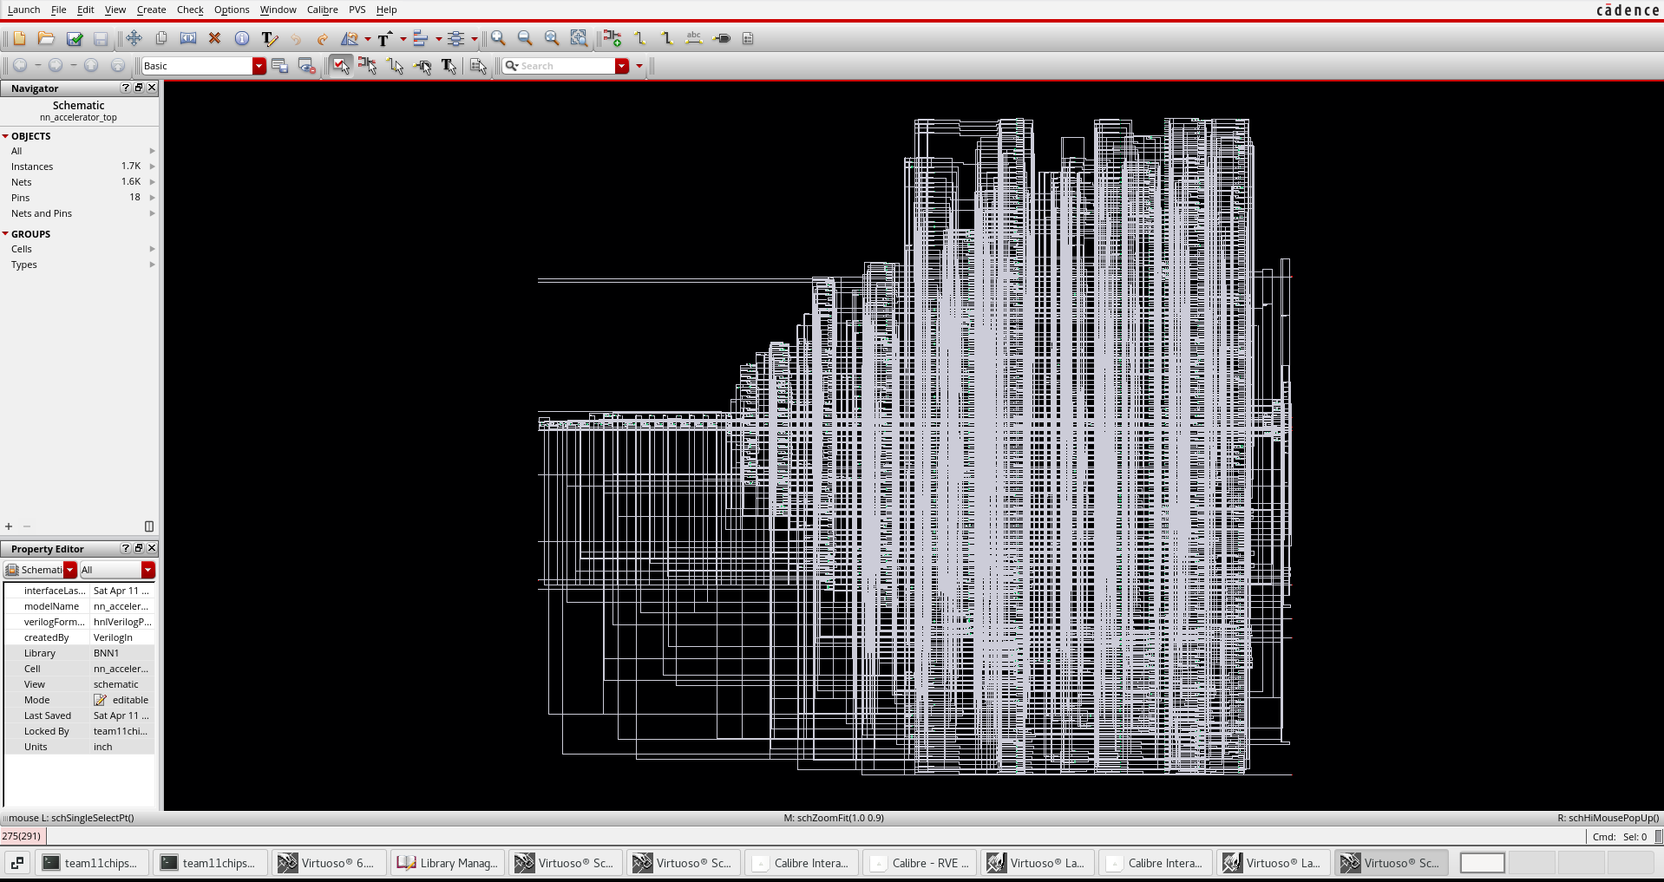
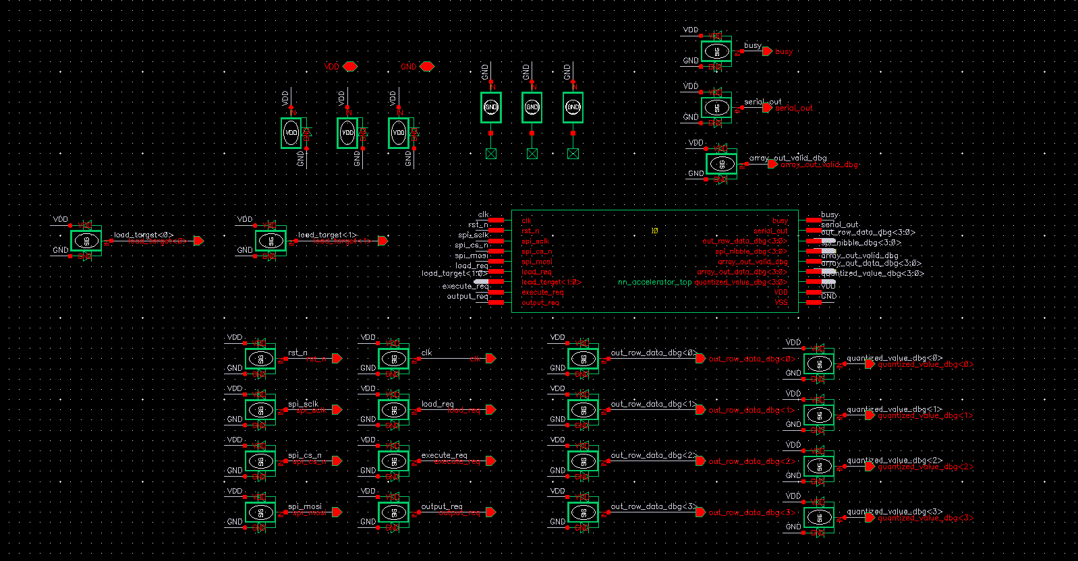
Top Level Schematics
Import gate level .v netlist and .def physical layout files into virtuoso
Schematic generated by Genus
Top-level schematic

Slide 5
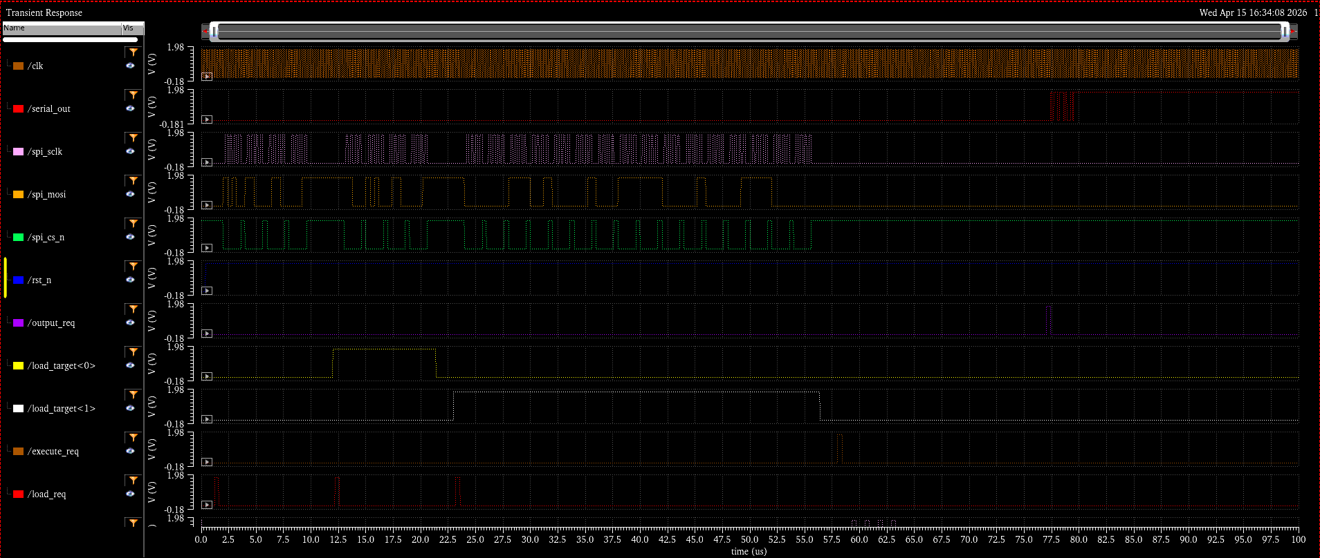
Functional Simulation

Slide 6
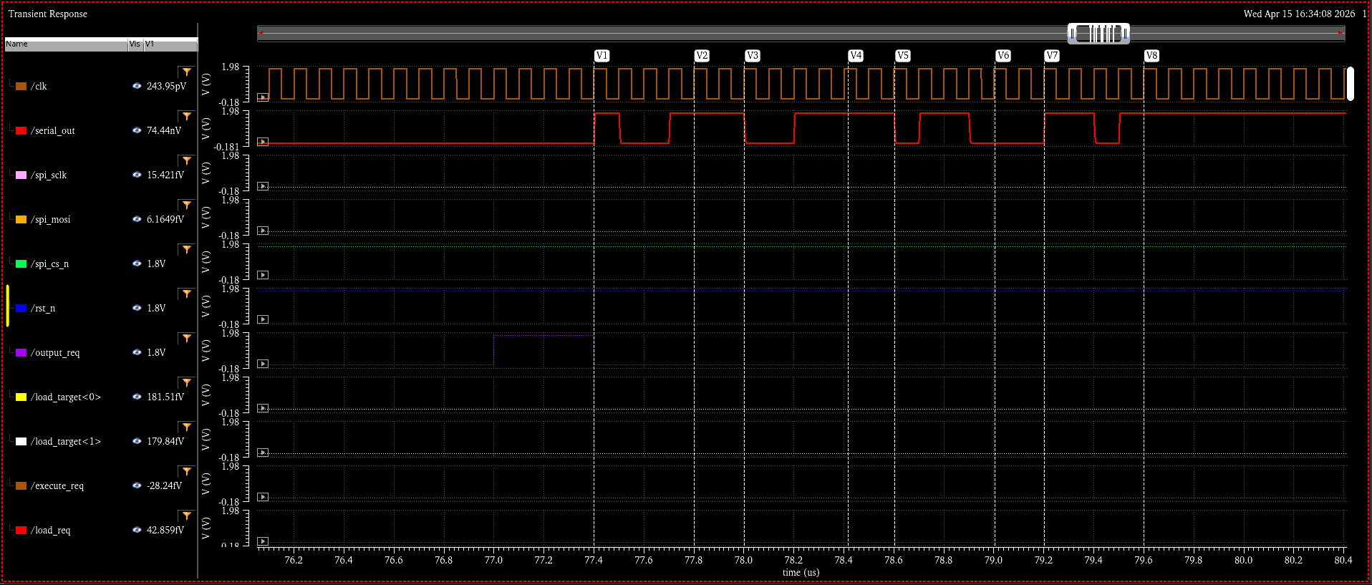
Functional Simulation

Slide 7
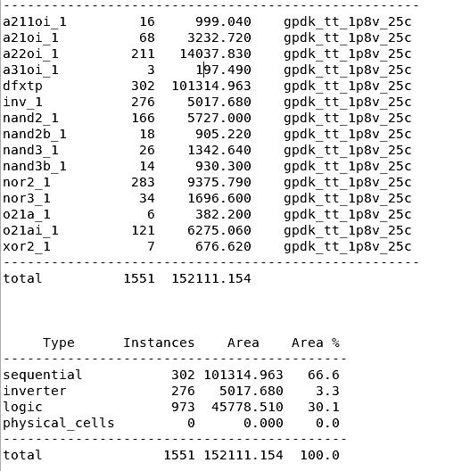
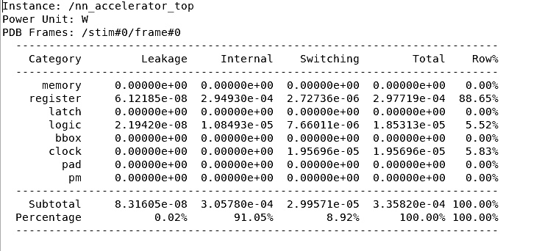
Power/Area Reports
~.336 mW power consumption

Slide 8
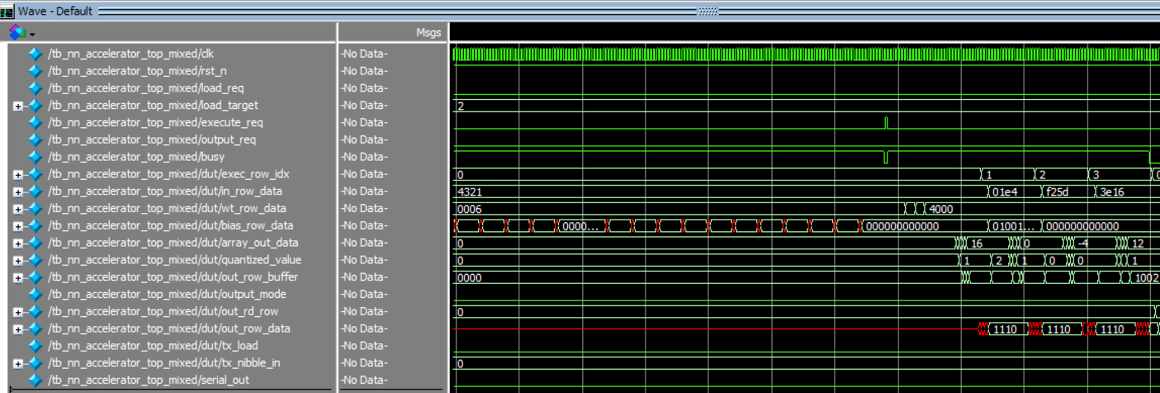
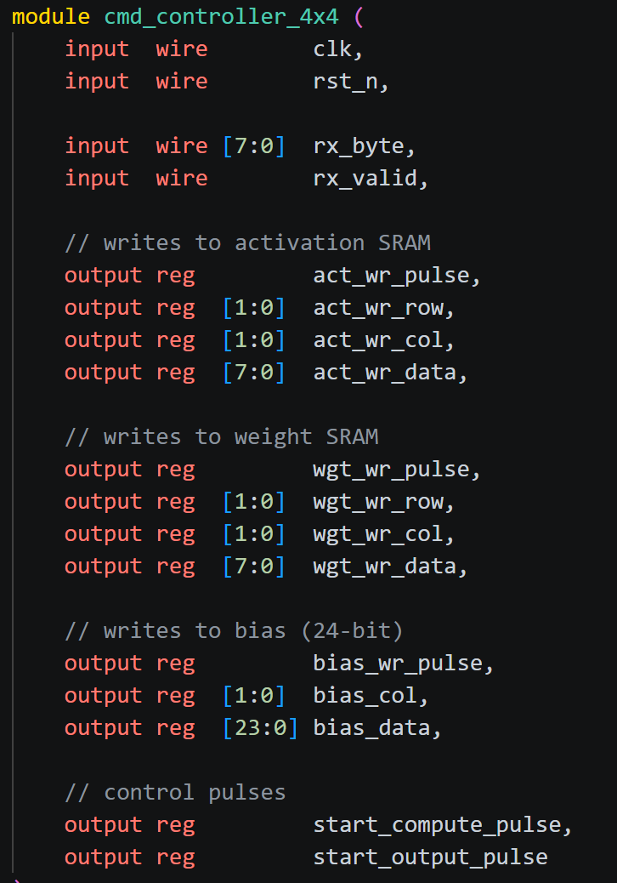
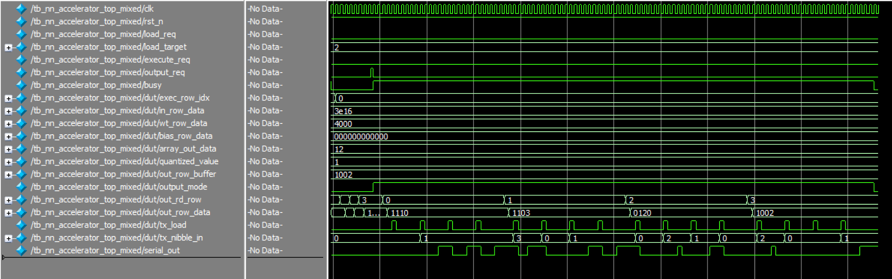
Chip finalization
Verilog code
Top level RTL simulation

Slide 9
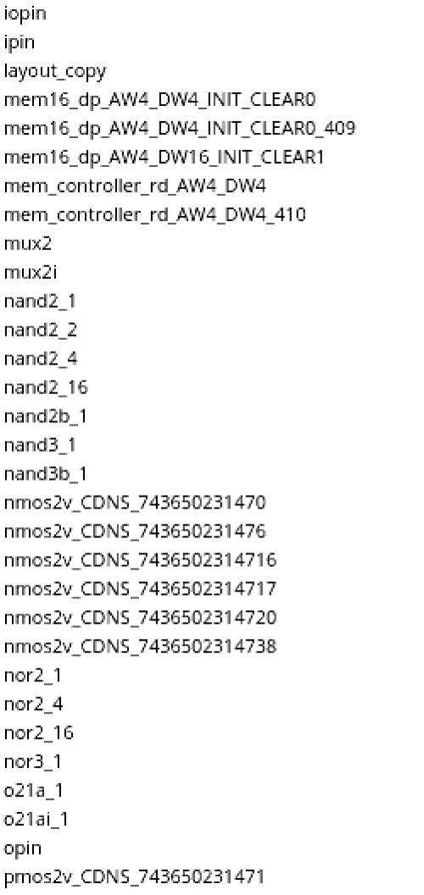
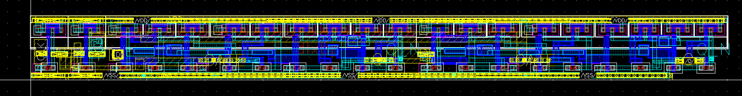
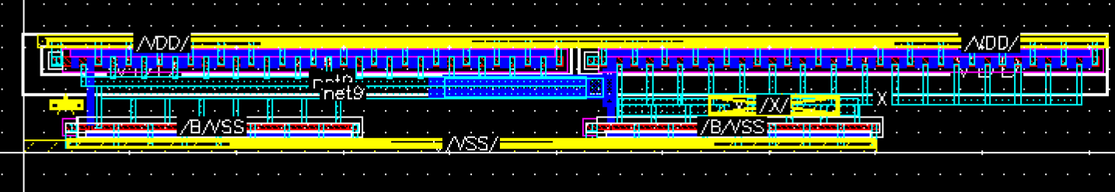
Chip finalization
Characterize standard cell library .lib (cadence liberate)
Abstract .lef generation (cadence abstract)
layout of dfxtp (register) standard cell
layout of buffer_16 standard cell

Slide 10
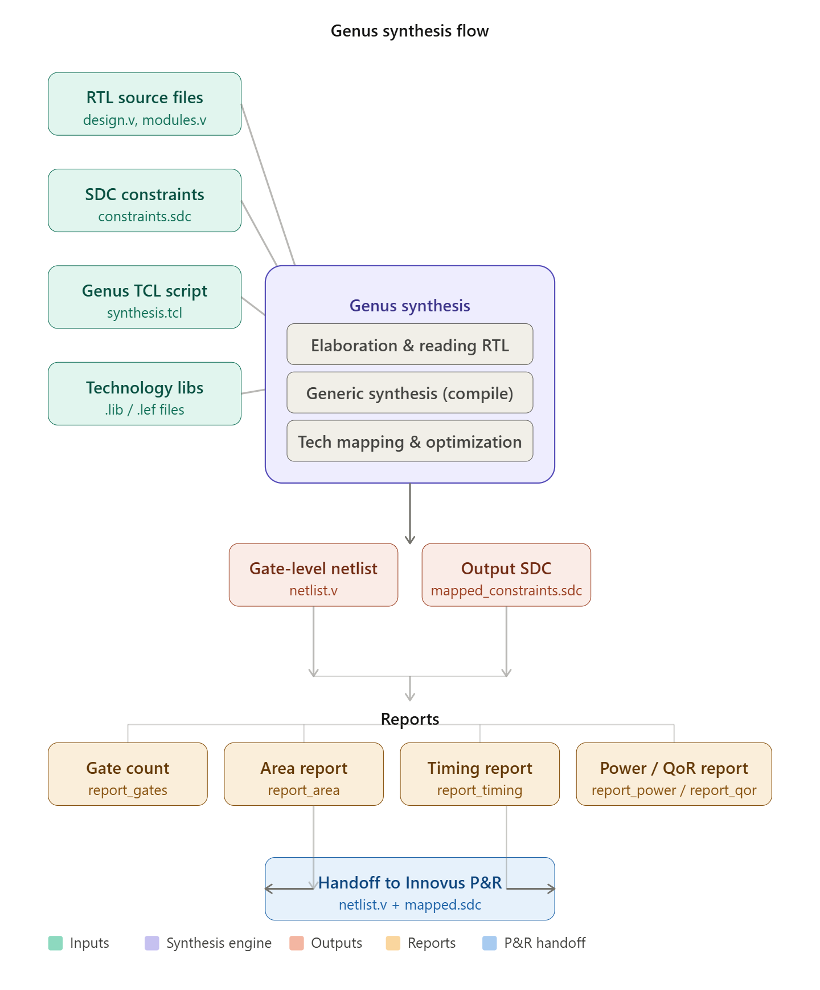
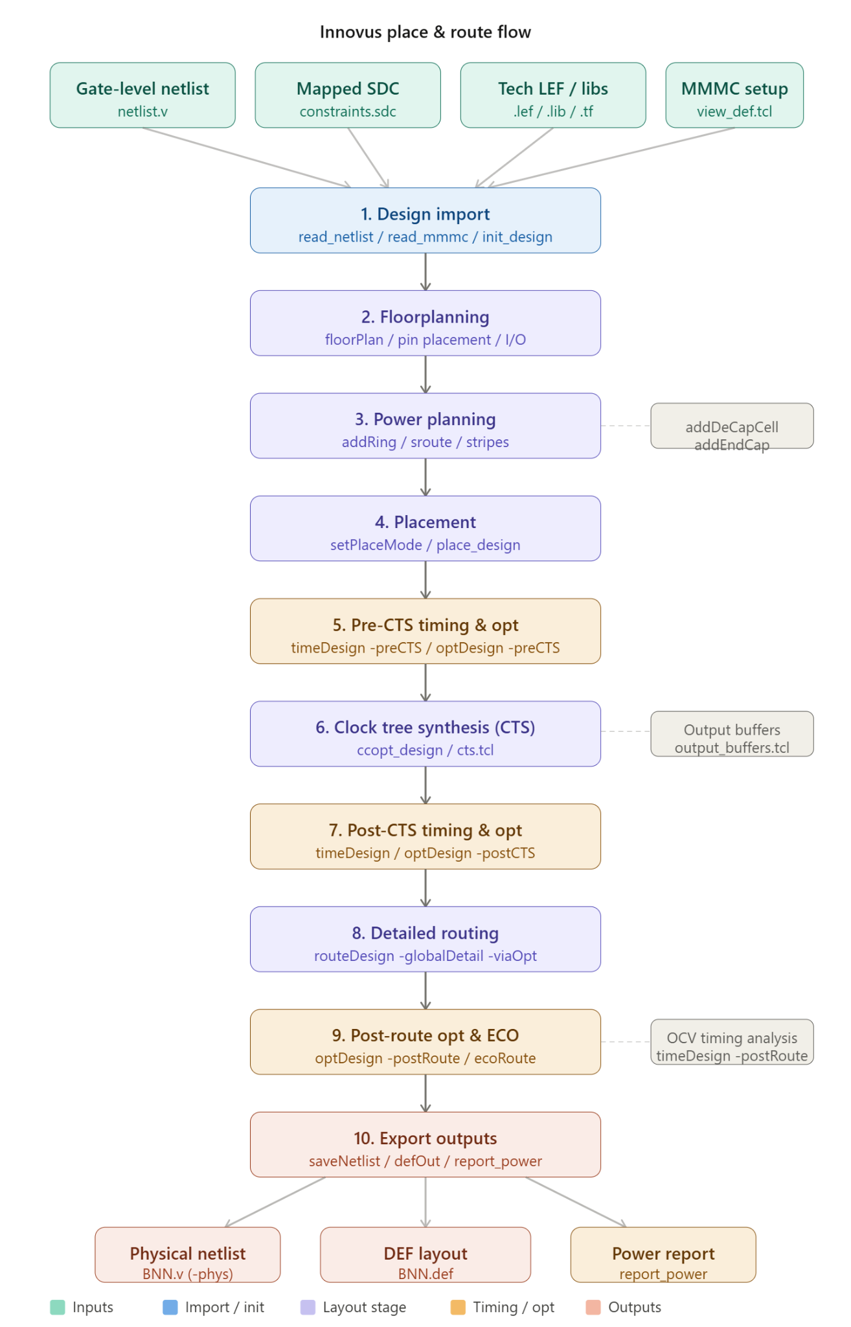
Genus and Innovus Flow

Slide 11
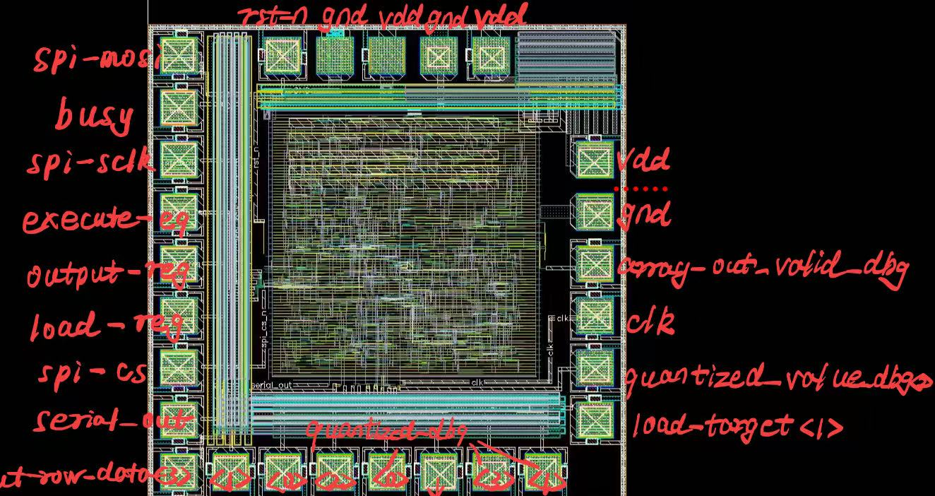
Top Level Layout

