Slide 1

Hurricanes
Group 311C:
Kai Tsuyoshi
Jason Fu
William Fan
Fei Qin
Nihar Simhadri

Slide 2
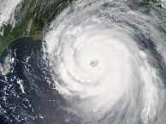
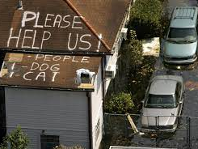
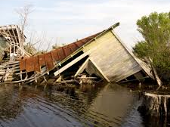
Do Hurricanes and Global Warming Correlate?
Causes of Hurricanes:
time
Hypothesis:
Warm waters
Uniform wind
A moist atmosphere
Deadlier, costlier hurricanes more frequently
Green-house gases
Factors become met more often with increased global warming

Slide 3
Data & Question
Six variables:
Name
Date formed (mm/dd/yy)
Date dissipated (mm/dd/yy)
Speed (mph)
Damage ($)
deaths
Questions of Interest
What are the average lengths (in days) of hurricanes by years (bars split by season)
Which year had the most monetarily damaging hurricanes (on average)?
Which year had the most hurricane related deaths?

Slide 4
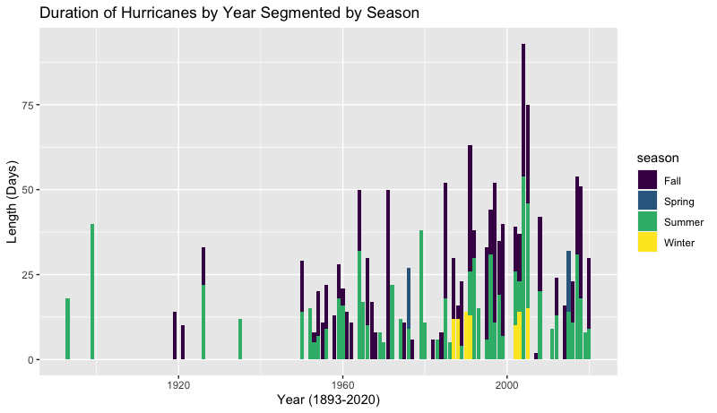
What are the average lengths (in days) of hurricanes by year?

Slide 5
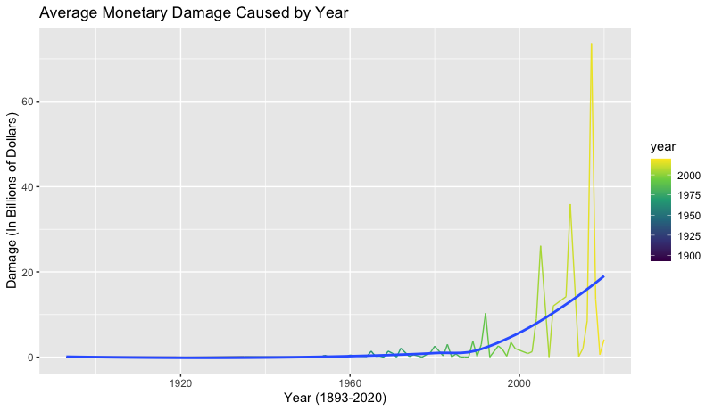
Which year has the most monetarily damaging hurricanes?
The hurricanes are becoming costlier, and could be inferred that they are stronger
Year Damage
1 2017 73.6 B
2 2012 35.9 B
3 2005 26.1 B
4 2011 14.2 B
5 2018 13.5 B
6 2008 11.9 B

Slide 6
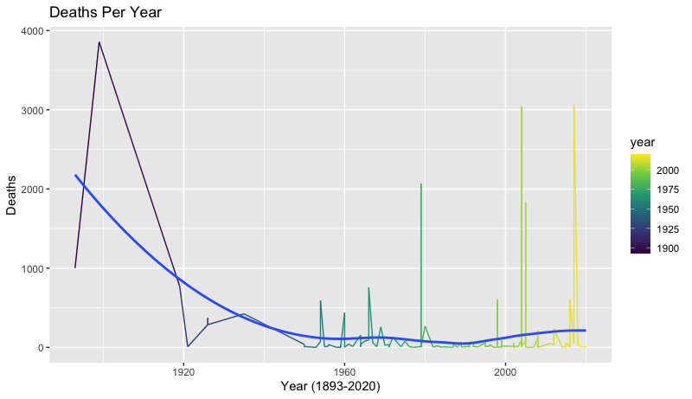
Which year had the most hurricane related deaths?
Why???

Slide 7
Conclusion
Do hurricanes and global warming correlate based on our observations?
---Yes. We can see a trend of increasing frequency, length, and damage
Will the increased damage of hurricanes lead to more deaths?
---No!! Because the level of science and technology is also constantly developing, the death rate (although inevitable) will be minimized

Slide 8

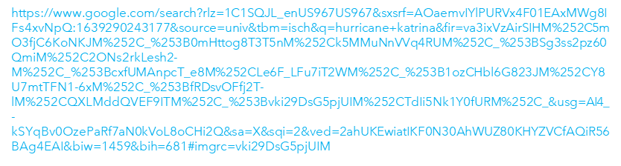

Thank you

