Slide 1


疑似洗錢交易預測 (Anti-Money Laundering)
Group member: 張凱東、陳丕中、劉洮語

Slide 2
Introduction

Slide 3
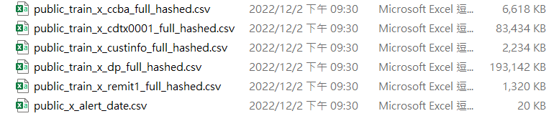
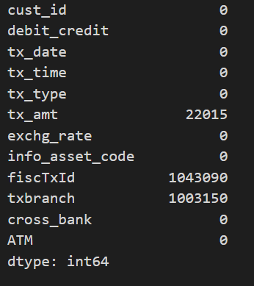
Data preprocessing – raw data
We have six csv file is training data, and one csv file is answer
dp.csv have two columns full with Nan(Null), so we drop this two columns

Slide 4
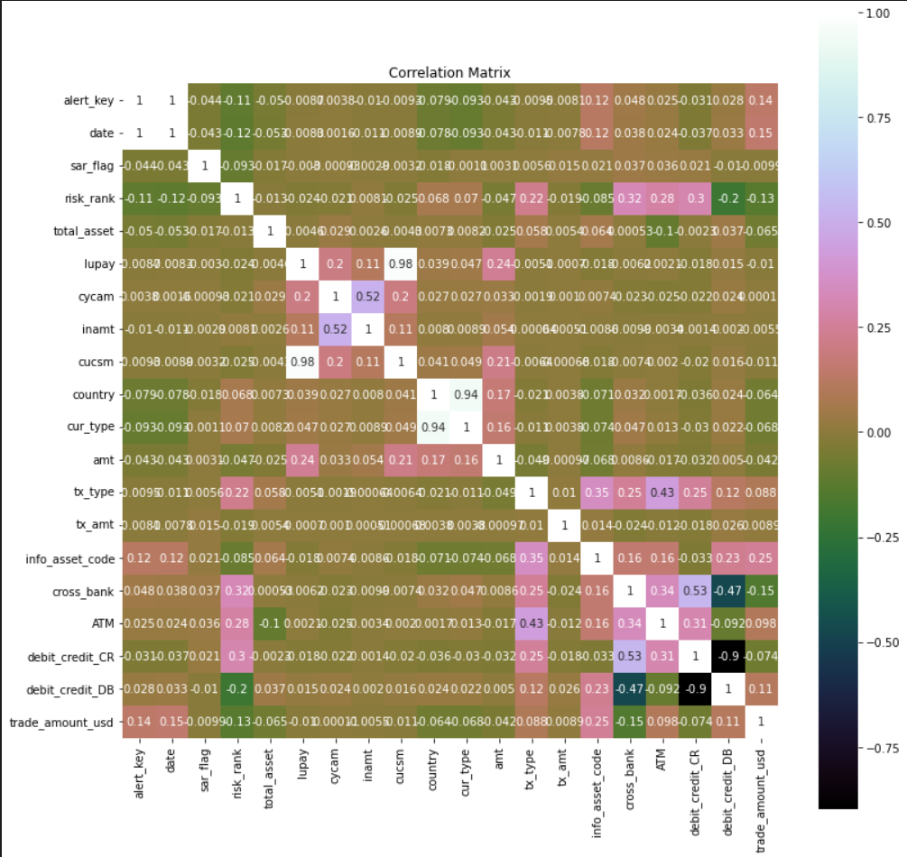
Data preprocessing - correlation
We try to find the key feature that correlate most to the answer.
We can’t ☹.

Slide 5

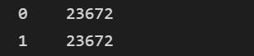


Data preprocessing – unbalance data
Our training data is unbalance, there two ways to deal with this problem, oversampling and undersampling
we tried oversampling and undersampling and sample 10000
In the end we choose sample half data off class ‘0’ to balanced.

Slide 6

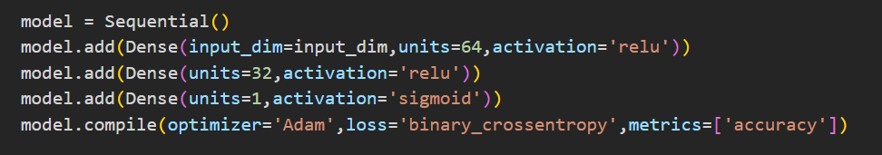
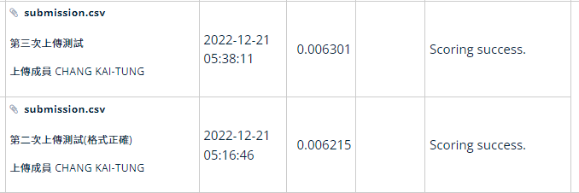
Model1 – first try
Epoch: 100
Batch = 500

Slide 7
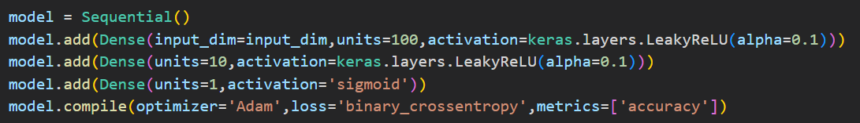
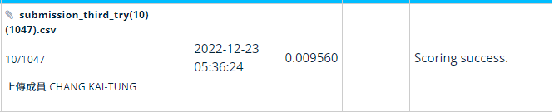
Model2 – after hard working
Epoch: 100
Batch = 500

Slide 8
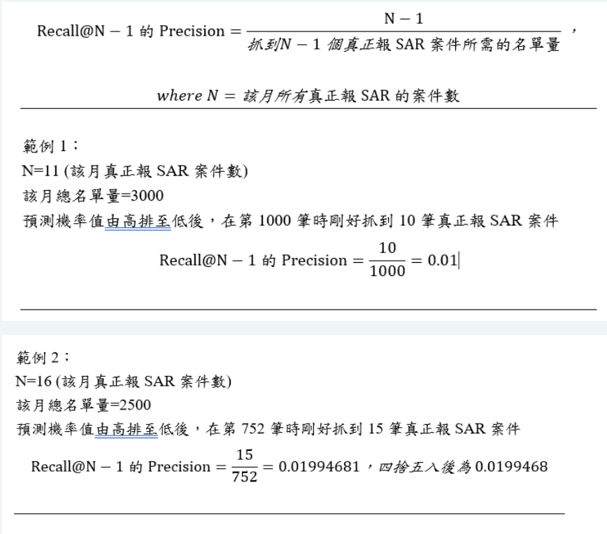
Scoring
scoring rule for this competition.
Find all of the people who laundering the money to increase the numerator.
Find all of those people use least data to decrease the denominator.

Slide 9
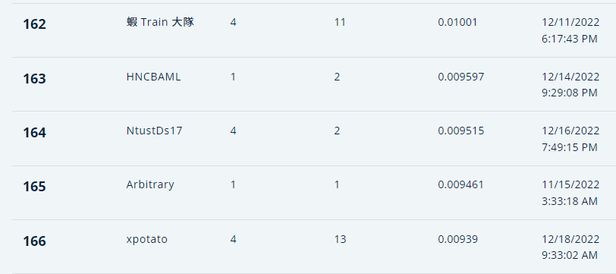
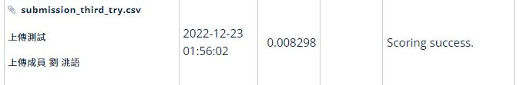
Submission History
Before oversampling
After oversampling
Our rank is about 164th

Slide 10
What we think about this competition
Out model with LeakyRelu have better performance than Relu.
Unbalanced data is hard to handle.
Money laundering have many feature need to be considered.
Our group have very little domain knowledge about money laundering, and google can’t find any result about “How to do money Laundering”.

Slide 11
Feature work
Find the key feature to detect which transaction is money laundering
Find a better way to preprocessing our data
Improve our model architecture

