Slide 1


疑似洗錢交易預測 (Anti-Money Laundering)
Group member: 張凱東、陳丕中、劉洮語

Slide 2
Introduction

Slide 3
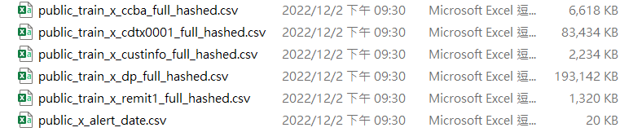
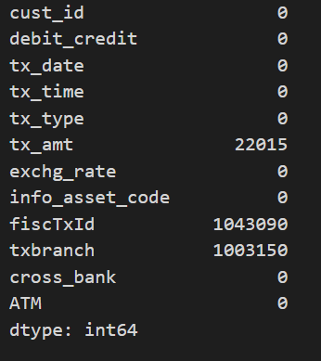
Data preprocessing
We have six csv file is training data, and one csv file is answer
dp.csv have two columns full with Nan(Null), so we drop this two columns

Slide 4


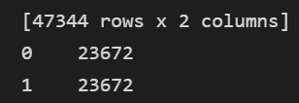
Data preprocessing – unbalance data
Our training data is unbalance
So we use oversampling to increase the data of class ‘1’

Slide 5
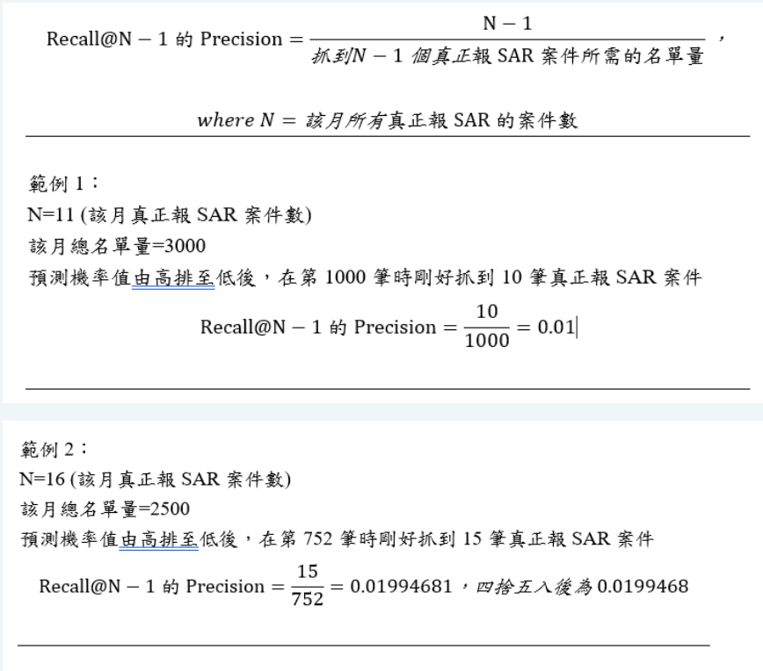
Scoring
This picture is scoring rule for this competition

Slide 6
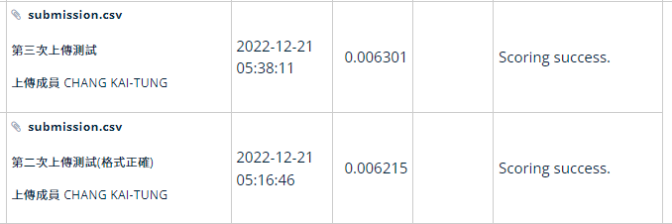
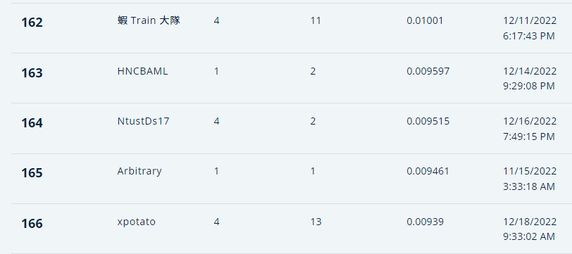
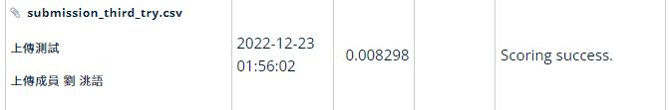
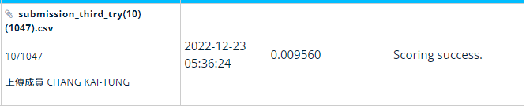
Submission History
Before oversampling
After oversampling
Our rank is about 164th

Slide 7
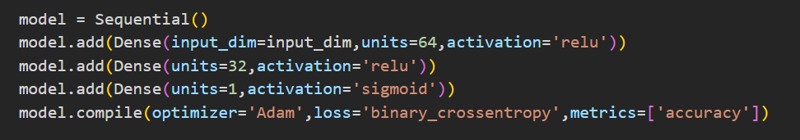
Model

Slide 8
Feature work
Find the key feature to detect which transaction is money laundering
Find a better way to preprocessing our data
Improve our model architecture

