Slide 1
Fox Fox Foo The program for project groups
Lizzy Jamie
Jay Shoumaker
Joseph Tate

Slide 2



Project analysis slide 2
The Engineering Design Process
Identify Problem
Refine
Test
Identify Constraints
PROJECT
Build Prototype ..
Generate Solutions
Plan & Schedule
Evaluate Solutions

Slide 3
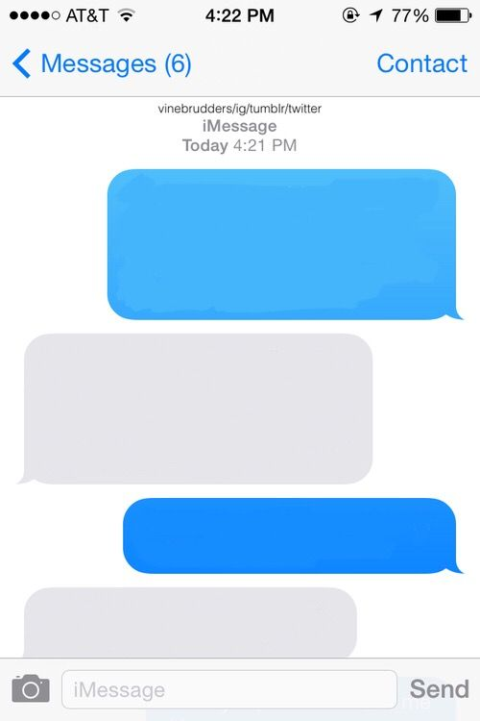
Project analysis slide 3
Identify Problem
Where should we meet to work on our project?
Idk. I don’t want to walk too far
How about Bizzell?
No, I’m in Sarkey’s
Notes:
Imessage citation:
Sample, Faythe. “Blank Image.” PicsArt, 29 July 2017, cdn140.picsart.com/239043789057202.jpg?r1024x1024.

Slide 4

Project analysis slide 3
Identify Constraints
Deadline: December 2, 2019
Resolve all errors
Program runtime efficiency
Limited presentation space
Notes:
Deadline cite:
“Deadline.” 10 Essential Tips To Meeting Deadlines, 7 May 2017, thepitcher.org/10-essential-tips-to-meeting-deadlines/.

Slide 5
Project analysis slide 3
Generate Solutions
Java code
Maps API – Google Maps API, HERE Maps API
JavaX – GUI applications
Variables – number of group members, method of travel, current locations, preferred places to meet, carpooling
Outputs picture of map

Slide 6
Project analysis slide 3
Evaluate Solutions
GitHub
Free Maps API – N/A
Time does not allow for:
Input method of travel
Input list of preferred places to meet
Carpooling
Output picture of map

Slide 7
Project analysis slide 3
Plan & Scheduling
Mondays during Freshman Engineering Experience class
Thursdays at 7:00pm in Bizzell
GitHub – online collaboration
Notes:
https://github.com/KaiTuyt/ENGR-1411-Project

Slide 8
Project analysis slide 3
Build Prototype
3 classes and a ReadMe file
ReadMe – detailing steps of the engineering design process
Map.java – Create campus locations and brainstorm center point calculator
MapDisplay.java – Creating the initial menu box
Main.java – Create map object

Slide 9
Project analysis slide 3
Build Prototype
Map.java – Finish coordinate locations of major buildings and complete center point functionality
MapDisplay.java – Finish menu box
Main.java – No changes since

Slide 10

Project analysis slide 3
Test
Open Eclipse and run the program!

Slide 11

Project analysis slide 3
Cited Sources
Sample, Faythe. “Blank Image.” PicsArt, 29 July 2017, cdn140.picsart.com/239043789057202.jpg?r1024x1024.
“Deadline.” 10 Essential Tips To Meeting Deadlines, 7 May 2017, thepitcher.org/10-essential-tips-to-meeting-deadlines/.
“Yay Gif.” Giphy, giphy.com/gifs/rainbow-colorful-pinwheel- f7GDJs0SXg1WFXNSNQ.

Slide 12
Project analysis slide 3
Fox Fox Foo
Lizzy Jamie – elizabeth.l.jamie-1@ou.edu
Jay Shoumaker – jay.w.shoumaker-1@ou.edu
Joseph Tate – joseph.a.tate-1@ou.edu
Table Space – enough to fit two laptops
Floor Space – none required
Electrical Outlet – yes (preferably two)
Each member should* be able to attend the Freshman Showcase
Notes:
Lizzy – 100% free
Jay – Free after 1:20pm
Joseph - unknown

Slide 13
Thank You Any Questions?

