Slide 1
A general framework for Causal Learning algorithms
Kai Teh
Supervised by Kayvan Sadeghi & Terry Soo (University College London)

Slide 2

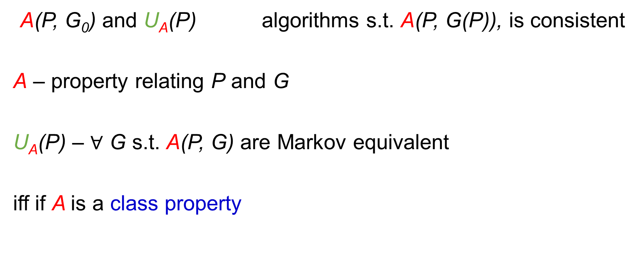
The framework
A(P, G₀) and U_{A}(P) algorithms s.t. A(P, G(P)), is consistent
A – property relating P and G
U_{A}(P) – $∀$ G s.t. A(P, G) are Markov equivalent
iff if A is a class property

Slide 3

Examples of A(P, G₀)
A(P, G₀) B(P, G₀), does not imply
A(P, G₀) | A(P, G₀) and U_{A}(P)
G₀ is the Markov graph to P with the fewest edges | Sparsest Markov Representation (SMR) assumption
G₀ is faithful to P | G₀ is faithful to P
G₀ is the Markov graph to P | G₀ is the complete DAG and P is not Markov to any subgraph
A(P, G₀) + U_{A}(P) B(P, G₀) + U_{B}(P)
or

Slide 4
SMR is ‘best’ amongst minimality
Forster (2018) et al. : Fixing P, G₀, for the following A :
Minimal Markovian
+ U_{minimal} _{Markovian}
Sparsest Markov (Frugality)
P-minimality
Causal minimality
+
U_{P-minimality}
+
U_{sparsest Markov}
+
U_{causal minimality}

Slide 5
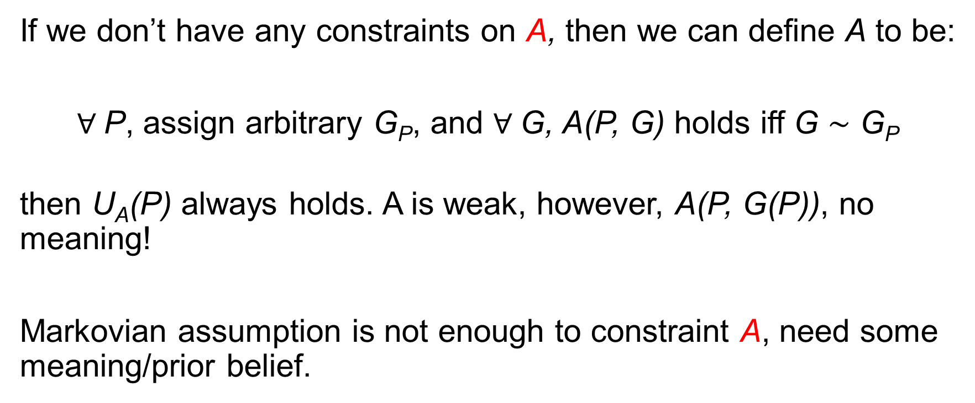
A can be degenerate
If we don’t have any constraints on A, then we can define A to be:
$∀$P, assign arbitrary G_{P}, and $∀$G, A(P, G) holds iff G $\sim$ G_{P}
then U_{A}(P) always holds. A is weak, however, A(P, G(P)), no meaning!
Markovian assumption is not enough to constraint A, need some meaning/prior belief.

Slide 6
An algorithm with an example of A
(Modified from Sadeghi et al.), A(P, G₀) be:
P is adjacency faithful to G₀
P satisfies v-ordered upward stability
P satisfies v-ordered downward stability
Gives SGS/PC like algorithm
Simpson’s paradox doesn’t happen on a non-collider
implied by Markov property

Slide 7
Conclusions and future work
By subbing different A, we have different conditions for causal learning by + U_{A}.
A can be very degenerate, needs prior belief about G₀
Different ways of constructing A s.t. U_{A} holds, by submodular optimisation formulation etc

